Slide 1
AI-Powered Job Scam Detection System
HAKIKI HIRE
Notes:
Emphasize that this is a deployed capstone decision-support system with a real benchmark evaluation. The frontend and API are live; the model is still a benchmark-validated tool and Kenyan-market generalization remains unverified. Team roles reflect division of labor across data, modelling, and product/deployment work.

Slide 2


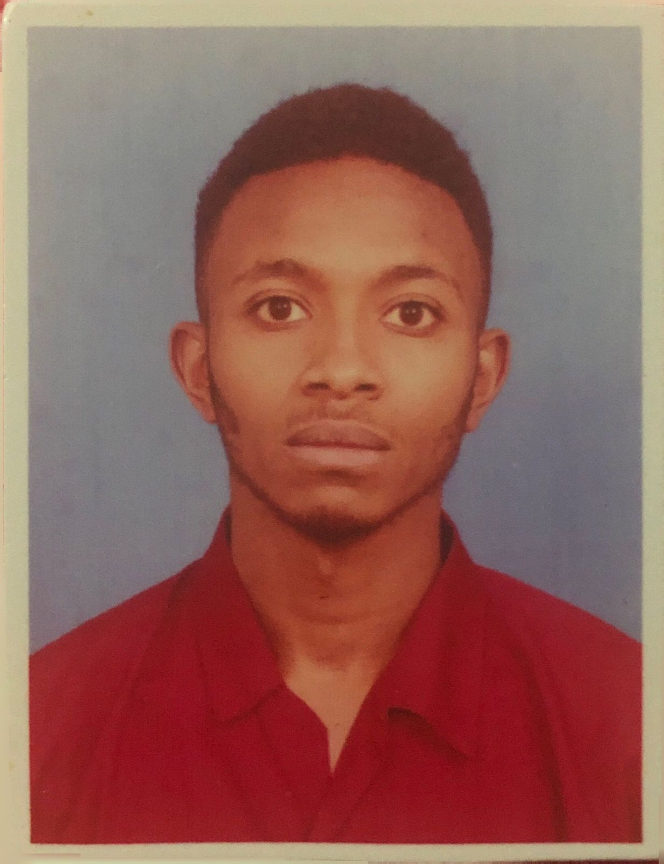
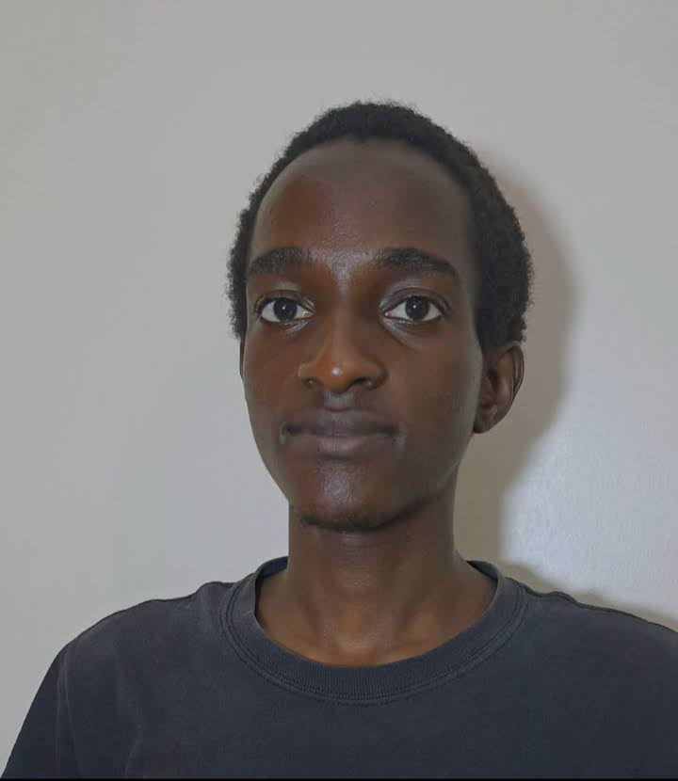

Project Participants & Roles
Christopher Kariuki
Melisa Achieng
Briannah Chelangat
Data Cleaning & Data Collection.
EDA, Data & PowerPoint Deck collection, Project Documentation creation
Backend, Government Dashboard UI, Deployment & Data collection.
Cleopas Karanja
Alex Kinyua
Modelling & Data collection.
Data collection, Backend, Repository Admin & Deployment, Job seeker UI.
AI-Powered Job Scam Detection System | HAKIKI HIRE

Slide 3

Problem Statement
Traditionally, job seekers often searched for opportunities through newspapers, notice boards, recruitment offices, and personal networks. As internet access became easier, job searching moved increasingly online, making it faster and easier for people to find and apply for jobs from anywhere. However, this wider and easier access has also created new opportunities for scammers to advertise fraudulent jobs and target job seekers online.
Job seekers may encounter upfront-fee requests, vague job descriptions, urgency language, impersonated employers, or suspicious contact channels
External evidence: FTC-reported US job-scam losses rose from ~$90M (2020) to ~$501M (2024)
External evidence: a 2024 Kenyan DCI case reportedly affected ~1,000 job seekers
The practical gap: job seekers need a way to prioritize verification before engaging with a posting
A prioritization tool
Helping job seekers know what to verify first — not a substitute for official investigation or human judgment
External statistics: Commission, F.T. (2024), Federal Trade Commission; DCI (2025), Ministry of Interior and National Administration.
Notes:
Keep the framing careful: this is a decision-support / prioritization tool, not an enforcement or investigation system. The FTC figure is US-wide, not Kenya-specific — presented as external context, not a Kenyan statistic.

Slide 4




Proposed Solution
→
→
→
Posting Text + Metadata
Fraud-Risk Score
Explanation
Human Verification
Title, description, requirements, structured fields
Model-generated probability estimate
Influential words & structured signals
Job seeker / reviewer decides next step
The system supports human verification and official reporting channels — it does not replace them
Output is a fraud-risk score and classification (Legitimate / Fraud-risk) at a chosen operating threshold, not a certainty
Notes:
Emphasize the human-in-the-loop framing throughout: score → explanation → human verification, not score → automatic action.

Slide 5
Objectives
1
Objective 1: Detect Fraudulent Job Advertisements
2
Objective 2: Identify Scam Patterns
Develop a machine learning model that classifies job advertisements as Genuine (0) or Fraudulent (1) using textual and structured job-posting information.
Use NLP techniques to identify common scam indicators such as urgent hiring language, upfront payment requests, poorly written descriptions, unrealistic salaries, and suspicious contact information.
3
Objective 3: Integrate Kenyan Government Verification
4
Objective 4: Explain Predictions
Verify whether a recruitment agency is licensed, whether the agency appears on government blacklists, and whether the company exists in government records.
Explain why a posting was flagged with reasons such as an agency not found in the NEA registry, visa-processing fee requests, unrealistic overseas salaries, or urgency phrases such as “Apply Immediately.”
The system supports verification and human review; the model output is a decision-support signal, not a final determination.
Notes:
The 'future accessibility' objective is intentionally phrased as future work — no USSD or WhatsApp integration has been built or tested.

Slide 6
Stakeholders & Intended Workflow
Primary Users
Kenyan job seekers, especially young adults
Beneficiaries
Distribution & Data Partners
Legitimate employers and agencies
Job boards and recruiters
Fraud-Risk
Screening System
Community Channels
Public-Sector Partners
County governments and TVET career services
NEA, Ministry of Labour, DCI, and related agencies
Notes:
Public-sector partners are grouped together (NEA, Ministry of Labour, DCI) — none of these integrations are implemented; they represent the intended long-term ecosystem.

Slide 7
Data Sources & Labeling Strategy
Source group | Approx. original size | Label status
Fake Job Postings / EMSCAD | 17,880 | Real benchmark labels
Fuzu Kenya | 666 | Unlabeled scraped postings
PigiaMe Kenya | 1,500 | Unlabeled scraped postings
Corporate Staffing Kenya | 3,988 | Unlabeled scraped postings
BrighterMonday Kenya | 1,964 | Unlabeled scraped postings
JobWeb Kenya | 5,323 | Unlabeled scraped postings
Synthetic Kenya-market augmentation | 40,000 (39,733 after cleaning) | Generated labels
71,321
−1,019
70,302
57,150 / 13,152
Initial combined records
Duplicates removed
Final integrated records
Labeled / Unlabeled records
Scraped Kenyan postings were not automatically labeled legitimate — they remain a separate, unlabeled contextual set.
Notes:
Row-count reconciliation, verified against the notebook: 71,321 raw → 1,019 duplicates removed (matched on title+company+location+description) → 70,302 final → split into 57,150 labeled and 13,152 unlabeled.

Slide 8
Dataset Structure & Target Definition
0 — Legitimate
0 = Legitimate
1 — Suspicious
1 = Fraud-risk
(Suspicious + Fraudulent)
2 — Fraudulent / Scam
Binary modeling target: Suspicious and Fraudulent/Scam are combined into a single Fraud-risk positive class.
Feature group | Examples
Text | title + description + requirements → TF-IDF, 1–2 n-grams, 50K-word vocabulary
Structured | company, location, industry, work type, salary range, experience level, qualification
Engineered | text lengths, word counts, URL/email/phone counts, uppercase-word count, missing-field flags
Label | is_fraud (0/1/2 source scheme) → binary Fraud-risk target for modeling
Notes:
The three-class-to-binary mapping was applied consistently across EMSCAD (harmonized from its native binary label) and the synthetic dataset (native 3-class).

Slide 9
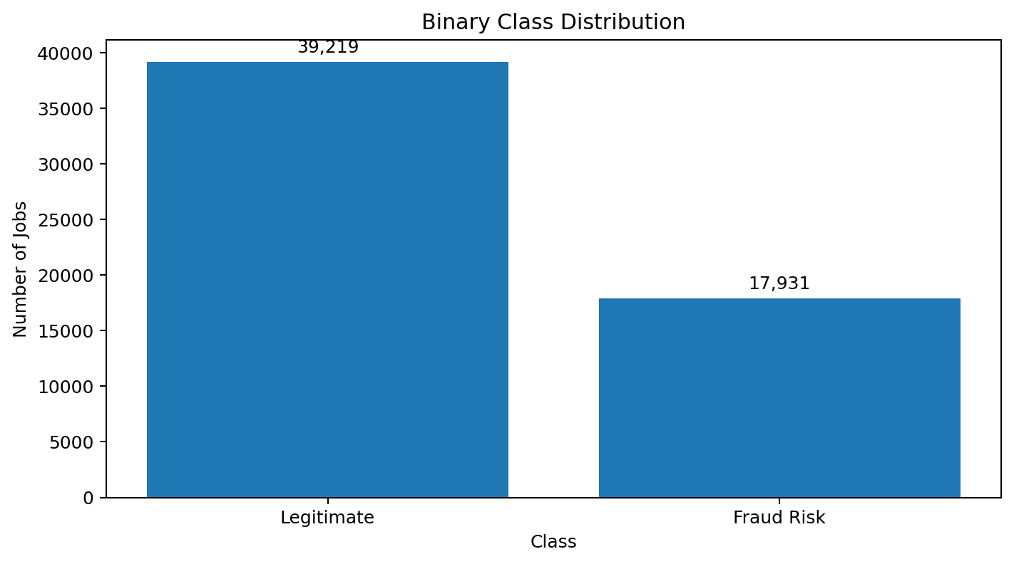
What it shows
• Legitimate: 39,219
• Fraud Risk: 17,931
• Fraud Risk combines Suspicious + Fraudulent
• The labeled data remains imbalanced

Slide 10
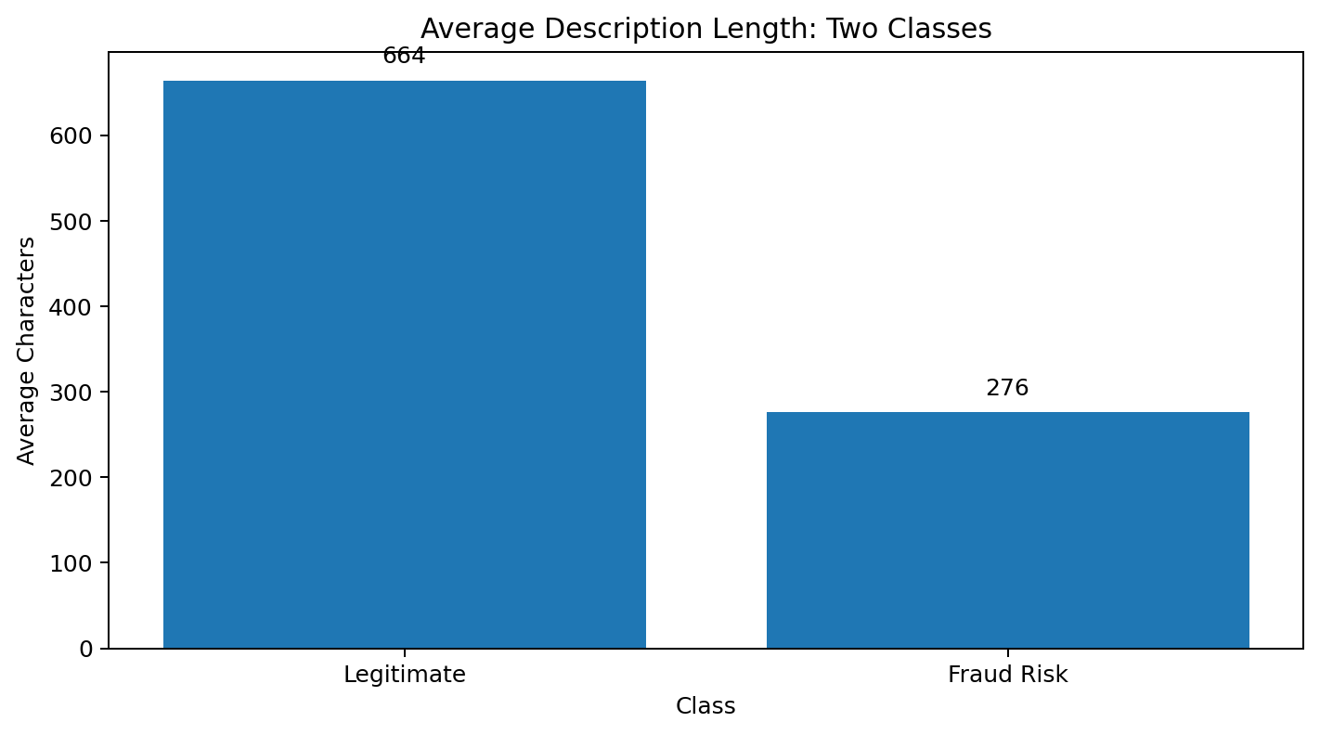
What it shows
• Legitimate postings had a longer average description
• Fraud Risk postings had shorter average descriptions
• This is a dataset pattern, not a universal fraud rule
• Description length was retained as an engineered feature

Slide 11


Methodology & Evaluation Design
→
→
→
Isolate Holdout
Train/Validation Pool
Tune Models
Threshold & Holdout Eval
20% of real EMSCAD records set aside untouched
Remaining EMSCAD + synthetic labels: 53,666 records
TF-IDF + engineered features; GridSearchCV, 5-fold, average precision
Validation threshold selection, then one-time holdout evaluation
Baseline: Logistic Regression on TF-IDF text only • Hybrid candidates: Logistic Regression and LinearSVC on TF-IDF + structured features
Class imbalance handled with class_weight="balanced"; tuning optimizes average precision (PR-AUC) via 5-fold GridSearchCV
Training split: 42,932 records • Validation split: 10,734 records • Real holdout: 3,484 records (kept fully separate)
Notes:
The real EMSCAD holdout (3,484 records: 3,314 Legitimate, 170 Fraud-risk) is the primary final estimate of performance — it is never used for fitting, tuning, or threshold selection.

Slide 12
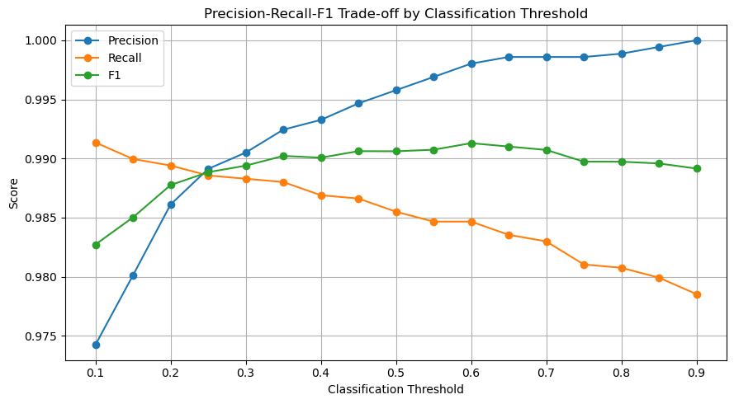
Modeling Insight — Threshold Selection
What it shows
Threshold candidates were evaluated on validation data only
0.6047 maximized validation F1 (0.9913)
The real holdout was not used to choose this threshold
Not claimed to be a universal or permanently optimal threshold
Source/data note: notebook threshold-sweep output (validation set).

Slide 13
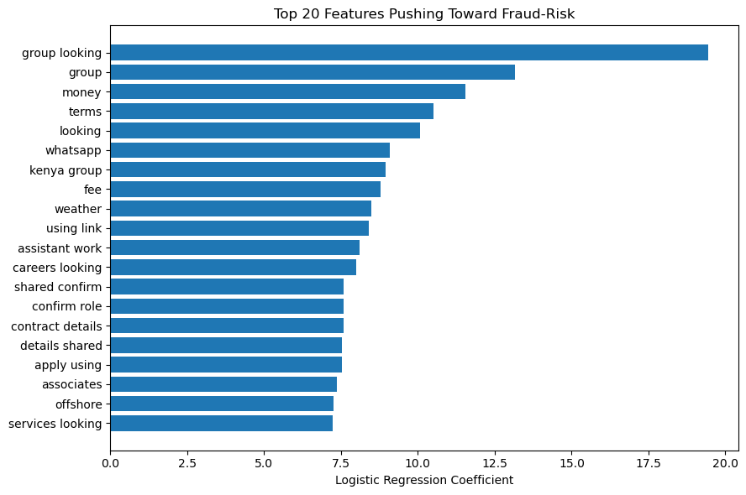
Modeling Insight — Explainable Fraud-Risk Signals
What it shows
Strongest positive coefficients include meaningful terms such as "fee", "money", "whatsapp", and "confirm role"
Some other high-weight terms are synthetic generator fragments (e.g. "group looking", "weather", and "shared confirm") rather than validated scam language
These are dataset-specific associations, not universal or causal fraud rules; they support human review, not replace it
The real EMSCAD holdout is the primary reference for reported model performance
Source/data note: notebook Logistic Regression coefficient output.

Slide 14
Final Evaluation, Deployment & Limitations
Real EMSCAD holdout — measured results (left) vs. current deployment status and remaining limitations (right)
Measured Results
Deployment Status & Limitations
Fraud-risk precision
99%
Deployment is live: Vercel frontend + Render FastAPI backend
Registry verification, blacklist checks, and fuzzy impersonation matching are implemented
Training data is synthetic-heavy
Kenyan scraped postings lack ground-truth fraud labels
Real Kenyan-market generalization has not yet been fully established
Fraud-risk recall
92%
Fraud-risk F1
96%
ROC-AUC
0.9947
PR-AUC
0.9768
False positives
1 legitimate posting flagged
False negatives
13 fraud-risk postings missed
Notes:
Results come from the real EMSCAD benchmark holdout, not confirmed Kenyan job-board scam cases. The system is now deployed with a Vercel frontend and Render FastAPI backend. Registry verification, blacklist checks, and fuzzy impersonation matching are implemented. Kenyan-market generalization remains unverified because the scraped Kenyan postings have no ground-truth fraud labels.

Slide 15

Thank You
Questions welcome
“The goal is not to replace human verification—it is to help people know what to verify first.”
AI-Powered Job Scam Detection System | Moringa School Data Science Capstone

