Slide 1
AI-Powered Job Scam Detection System
HAKIKI HIRE
Notes:
Emphasize that this is a deployed capstone decision-support system with a real benchmark evaluation. The frontend and API are live; the model is still a benchmark-validated tool and Kenyan-market generalization remains unverified. Team roles reflect division of labor across data, modelling, and product/deployment work.

Slide 2



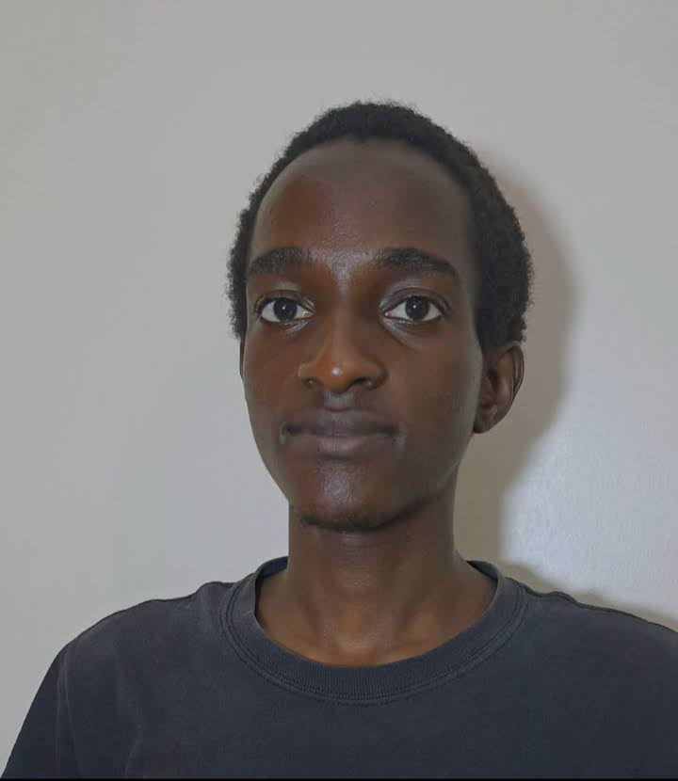

Project Participants & Roles
Melisa Achieng
Briannah Chelangat
Christopher Kariuki
Data Cleaning & Data Collection.
Backend, Government Dashboard UI, Deployment & Data collection.
EDA, Data & PowerPoint Deck collection, Project Documentation creation
Cleopas Karanja
Alex Kinyua
Modelling & Data collection.
Data collection, Backend, Repository Admin & Deployment, Job seeker UI.
AI-Powered Job Scam Detection System | HAKIKI HIRE

Slide 3

Problem Statement
Traditionally, job seekers often searched for opportunities through newspapers, notice boards, recruitment offices, and personal networks. As internet access became easier, job searching moved increasingly online, making it faster and easier for people to find and apply for jobs from anywhere. However, this wider and easier access has also created new opportunities for scammers to advertise fraudulent jobs and target job seekers online.
Job seekers may encounter upfront-fee requests, vague job descriptions, urgency language, impersonated employers, or suspicious contact channels
External evidence: FTC-reported US job-scam losses rose from ~$90M (2020) to ~$501M (2024)
External evidence: a 2024 Kenyan DCI case reportedly affected ~1,000 job seekers
The practical gap: job seekers need a way to prioritize verification before engaging with a posting
A prioritization tool
Helping job seekers know what to verify first — not a substitute for official investigation or human judgment
External statistics: Commission, F.T. (2024), Federal Trade Commission; DCI (2025), Ministry of Interior and National Administration.
Notes:
Keep the framing careful: this is a decision-support / prioritization tool, not an enforcement or investigation system. The FTC figure is US-wide, not Kenya-specific — presented as external context, not a Kenyan statistic.

Slide 4




Proposed Solution
→
→
→
Posting Text
Fraud-Risk Score
Explanation
Human Verification
Title, description and requirements
A score from 0 to 1 from the model
Key words and rule signals behind the score
Job seeker / reviewer decides next step
The system supports human verification and official reporting channels. It does not replace them.
The result is a score and a risk level: low, suspicious (0.25 or higher) or high-risk (0.70 or higher). It is a warning, not a certainty.
Notes:
Emphasize the human-in-the-loop framing throughout: score → explanation → human verification, not score → automatic action.

Slide 5
Objectives
1
Objective 1: Detect Fraudulent Job Advertisements
2
Objective 2: Identify Scam Patterns
Build a machine learning model that tells genuine job ads (0) from fraud-risk ads (1) using the text of the posting.
Use NLP techniques to identify common scam indicators such as urgent hiring language, upfront payment requests, poorly written descriptions, unrealistic salaries, and suspicious contact information.
3
Objective 3: Integrate Kenyan Government Verification
4
Objective 4: Explain Predictions
Verify whether a recruitment agency is licensed, whether the agency appears on government blacklists, and whether the company exists in government records.
Explain why a posting was flagged with reasons such as an agency not found in the NEA registry, visa-processing fee requests, unrealistic overseas salaries, or urgency phrases such as “Apply Immediately.”
The system supports verification and human review; the model output is a decision-support signal, not a final determination.
Notes:
The 'future accessibility' objective is intentionally phrased as future work — no USSD or WhatsApp integration has been built or tested.

Slide 6
Stakeholders & Intended Workflow
Primary Users
Kenyan job seekers, especially young adults
Beneficiaries
Distribution & Data Partners
Legitimate employers and agencies
Job boards and recruiters
Fraud-Risk
Screening System
Community Channels
Public-Sector Partners
County governments and TVET career services
NEA, Ministry of Labour, DCI, and related agencies
Notes:
Public-sector partners are grouped together (NEA, Ministry of Labour, DCI) — none of these integrations are implemented; they represent the intended long-term ecosystem.

Slide 7
Data Sources & Labeling Strategy
Source group | Approx. original size | Label status
Fake Job Postings / EMSCAD | 17,880 | Real fraud labels
Fuzu Kenya | 666 | Unlabeled scraped postings
PigiaMe Kenya | 1,500 | Unlabeled scraped postings
Corporate Staffing Kenya | 3,988 | Unlabeled scraped postings
BrighterMonday Kenya | 1,964 | Unlabeled scraped postings
JobWeb Kenya | 5,323 | Unlabeled scraped postings
Synthetic Kenya-market data (two files) | 44,990 (40,000 + 4,990) | Generated labels (0/1/2)
76,311
−5,031
71,280
58,225 / 13,055
Records after merging
Duplicate rows removed
Final records
Labelled / Unlabelled
Scraped Kenyan posts were not treated as legitimate. They stay unlabelled. Of the 58,225 labelled rows, 15,537 are real (EMSCAD) and 42,688 are synthetic.
Notes:
Row counts checked against the notebook: 76,311 rows after merging, 75,223 after removing 1,088 exact duplicates, then 71,280 after removing near-duplicate and empty-text rows (5,031 removed in total). Of these, 58,225 are labelled and 13,055 (the Kenyan job-board posts) are unlabelled. The labelled rows are 15,537 real EMSCAD posts (667 fraud) and 42,688 synthetic posts.

Slide 8
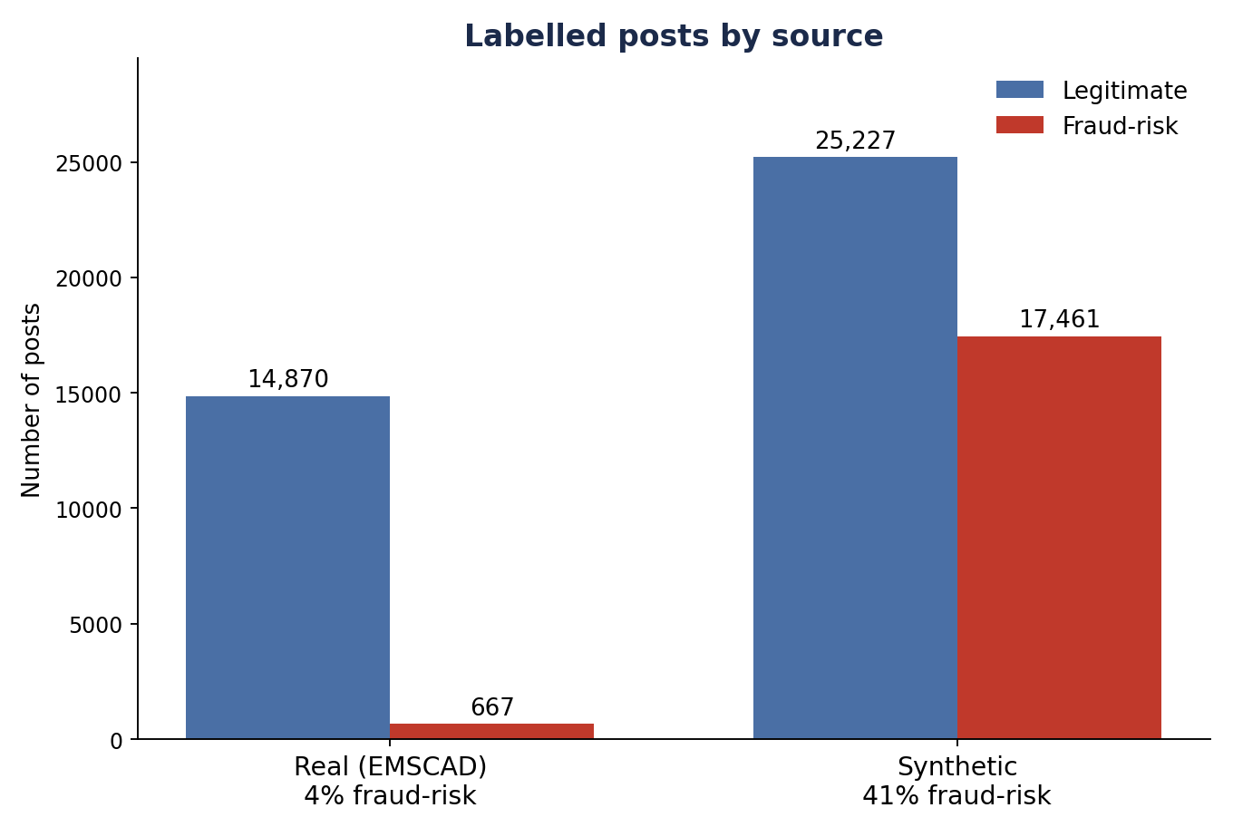
Class Balance by Source
What it shows
• Legitimate: 40,097
• Fraud-risk: 18,128 (Suspicious + Fraudulent)
• Real data (EMSCAD): only 4% is fraud-risk
• Synthetic data: 41% is fraud-risk
• The two sources are very different, so the model learns from real data only

Slide 9
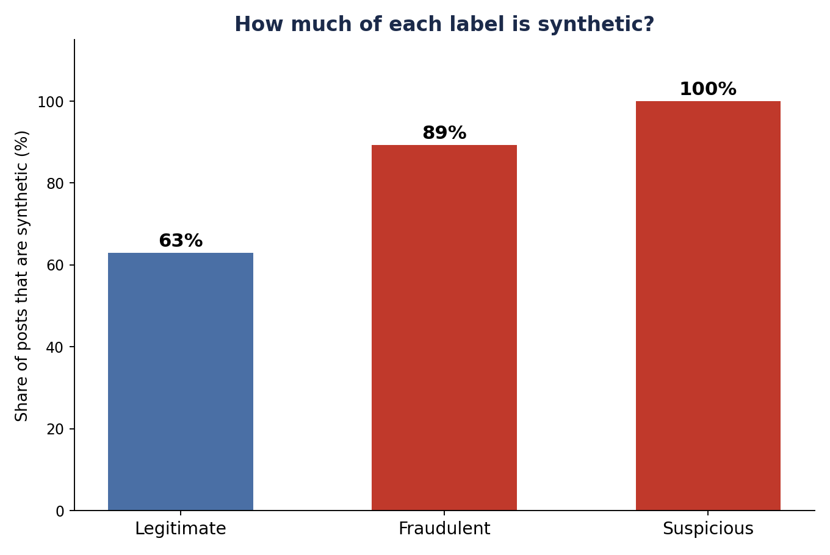
Source Leakage Check
What the EDA found
• company_profile: 69.32% Legitimate • 100% Suspicious • 96.61% Fraudulent missing. This field is specific to EMSCAD.
• salary_range: 37.34% Legitimate • 4.00% Suspicious • 11.02% Fraudulent missing.
• requirements: 11.51% Legitimate • 4.00% Suspicious • 5.32% Fraudulent missing.
• description length: Average: 631 chars Legitimate, 259 Suspicious, 284 Fraudulent — mainly a source difference.
• other source clues: Company, work type, experience level, location and industry also vary by source.
Decision: exclude these provenance signals from predictive modelling.

Slide 10
Synthetic Text Patterns & Vocabulary
344
unique words in all synthetic text
339 / 344
98.55% of synthetic words also occur in original data
5
synthetic-only words
Repeated template signals
• work / preferred
11,426 occurrences each — exactly matching the 11,426 Synthetic Suspicious rows.
• certificate / certificate required
5,757 occurrences each — indicating repeated template wording.
• repeated scam phrases
processing fee; registration fee; refundable registration; via m-pesa; pay processing; needed anyone; must willing.
• interpretation
The main concern is vocabulary concentration and repeated templates, not a completely different vocabulary.
Modelling implication: test EMSCAD-only vs EMSCAD + synthetic on the same real holdout, and keep synthetic data only if real-data performance improves.

Slide 11
Dataset Structure & Target Definition
0 — Legitimate
0 = Legitimate
1 — Suspicious
1 = Fraud-risk
(Suspicious + Fraudulent)
2 — Fraudulent / Scam
Binary target: Suspicious and Fraudulent are joined into one Fraud-risk class. The Suspicious class exists only in synthetic data.
Feature group | Examples
Text | title + description + requirements → TF-IDF word counts (1–2 word phrases, full vocabulary)
Engineered | 6 numbers from the text: links, emails and phone numbers per 100 words; share of capital letters; share of digits; average word length
Left out | company, location, industry, work type, salary, experience, qualification, post length and missing-field flags (they show the data source, not fraud)
Label | is_fraud (0/1/2) → Legitimate (0) or Fraud-risk (1)
Notes:
The three-class-to-binary mapping was applied consistently across EMSCAD (harmonized from its native binary label) and the synthetic dataset (native 3-class).

Slide 12


Methodology & Evaluation Design
→
→
→
Isolate Holdout
Train & Validate
Tune Models
Threshold & Holdout
15% of real EMSCAD posts (2,331) locked away until the end
Real EMSCAD only: 10,875 to train, 2,331 to validate
Compare model types with 5-fold cross-validation (PR-AUC)
Pick the threshold on validation data, then score the holdout
Posts are split in groups of near-duplicate text, so copies of one post never sit in both training and test sets (70% / 15% / 15%). An earlier version scored 0.99 because copies were on both sides.
Test: adding synthetic data lowered PR-AUC on real data by about 0.11 on all 5 splits, so training uses real data only.
Validation PR-AUC: tuned logistic regression 0.79 (best), calibrated SVM 0.79, DistilBERT 0.69, gradient boosting 0.63, rules only 0.05.
The holdout was scored twice: after the first model and again after a feature fix. No setting was chosen with it.
Notes:
The real EMSCAD holdout has 2,331 posts (2,217 Legitimate, 114 Fraud-risk) and is the main estimate of real performance. It was never used for fitting, tuning or choosing the threshold. It was scored twice, once in Part 26 and again in Part 27 after a feature change. The second use is declared in the notebook. Synthetic data is excluded from training because the A/B test showed it made real-data results worse.

Slide 13
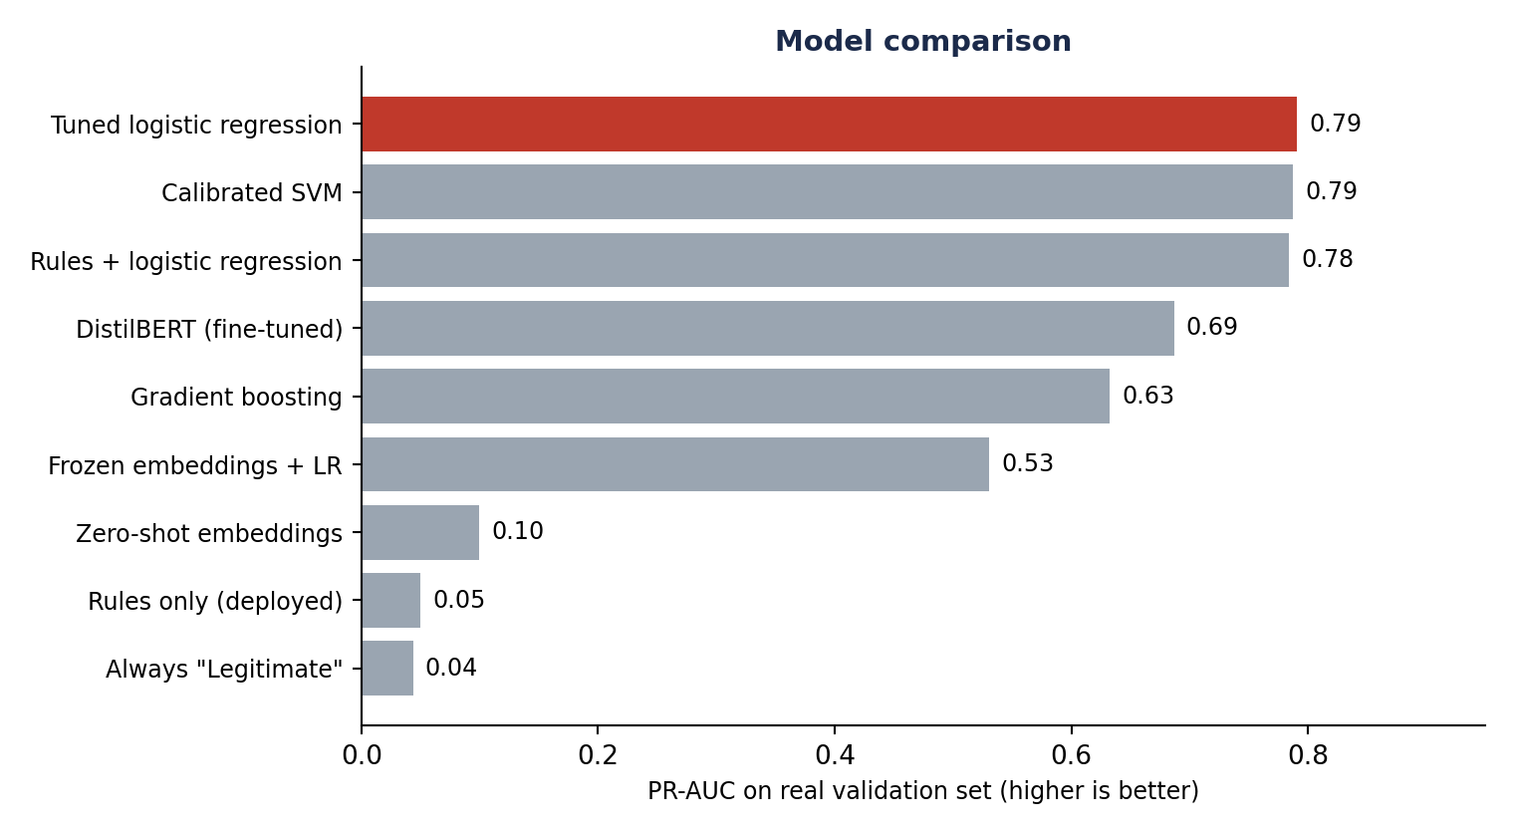
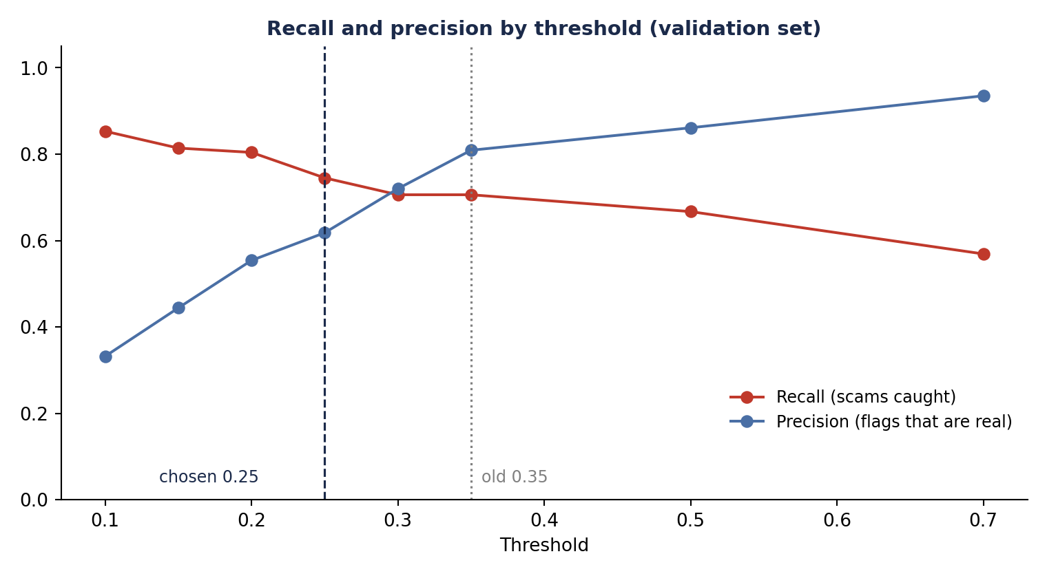
Modeling Insight — Model Comparison
What it shows
All models were scored on the same real validation set (2,331 posts)
A tuned logistic regression won (0.79). The calibrated SVM was almost the same
Rules alone scored 0.05, about the same as guessing, because EMSCAD has few Kenyan scam words
DistilBERT scored lower on EMSCAD (0.69) but did better on a few Kenyan test scams. It needs Kenyan training data first
We kept the simple model behind the rule layer. Synthetic data and calibration were tried and dropped
Source: notebook model comparison (validation set, PR-AUC).
Notes:
All models were scored on the same real EMSCAD validation set (2,331 posts, 4.4% fraud-risk). The tuned logistic regression (0.7906 PR-AUC) and the calibrated SVM (0.7874) were close. Gradient boosting on reduced text, frozen sentence embeddings and zero-shot similarity all did worse. The rule engine alone scores about the same as guessing on EMSCAD because the dataset has few Kenyan scam patterns, but the rules are kept because they cover patterns the model has never seen. Fine-tuned DistilBERT scored 0.69 on EMSCAD, but on a few hand-written Kenyan test scams it scored 0.72 to 0.99, while the logistic regression scored the fee and Dubai scams below 0.35. Those test posts are only a handful, so treat them as a hint, not a measurement. The notebook recommends not deploying a transformer for now and revisiting it once labelled Kenyan data exists.

Slide 14
Modeling Insight — Threshold Selection
What it shows
Thresholds were tested on validation data only
Chosen threshold: 0.25 (it was 0.35)
At 0.25 the model catches more scams (75% vs 71% on validation) but gives more false alarms (47 vs 17)
A missed scam costs a job seeker far more than a false alarm, so recall was favoured
The high-risk level stays at 0.70. This is not a permanent best threshold
Source: notebook threshold sweep (validation set).

Slide 15
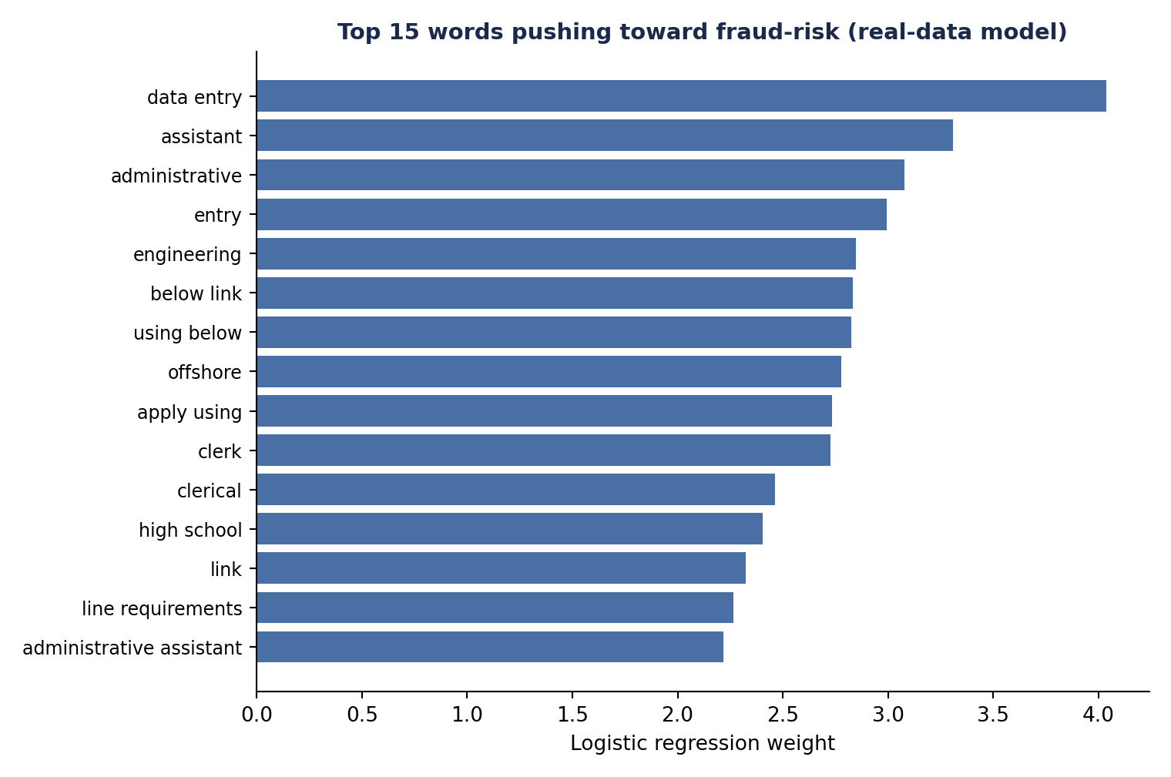
Modeling Insight — Explainable Fraud-Risk Signals
What it shows
The strongest words come from real US job posts, such as "data entry", "assistant", "administrative" and "offshore"
Kenyan scam words such as "M-Pesa" or till numbers do not show up, because the training data has no Kenyan scams
An earlier model that used synthetic data ranked "whatsapp" and "fee" highly, but also template words like "group" and "looking". We dropped it
These are patterns in this data, not rules for all scams. They support human review
Source: notebook, logistic regression trained on real EMSCAD data.

Slide 16
Final Evaluation, Deployment & Limitations
Real EMSCAD holdout (2,331 posts, 114 fraud-risk) at threshold 0.25: results (left) and limits (right)
Measured Results
Deployment Status & Limitations
Fraud-risk precision
63%
Deployment is live: Vercel frontend + Render FastAPI backend
Registry verification, blacklist checks, and fuzzy impersonation matching are implemented
Trained on US job posts from 2012–14. No labelled Kenyan scams exist yet
About 1 in 5 scams is missed (21 of 114)
A Kenyan fee-scam test scored only 0.31, just over the 0.25 warning level
Padding a scam with normal text lowers its score (7 of 93 caught scams slipped under the line)
Real Kenyan performance is still unproven
Fraud-risk recall
82%
Fraud-risk F1
71%
ROC-AUC
0.969
PR-AUC
0.807
False positives
54 legitimate posts flagged
False negatives
21 fraud-risk posts missed
Notes:
These results come from the real EMSCAD holdout (2,331 posts, 114 fraud-risk) at threshold 0.25: 93 scams caught, 21 missed, 54 false alarms; PR-AUC about 0.81 and ROC-AUC about 0.97. They are not confirmed Kenyan scam cases. The model is trained only on US posts from 2012–14 and there are no labelled Kenyan fraud posts, so Kenyan performance is unproven. The notebook notes that adding filler text to a scam lowers its score; in a test, 7 of 93 caught scams fell below the threshold.

Slide 17
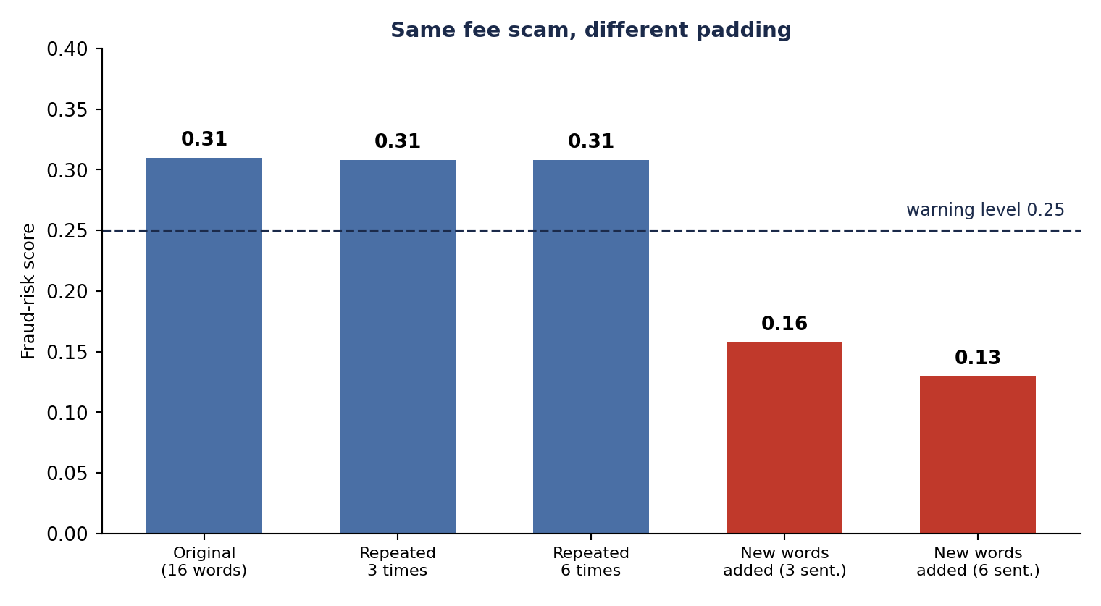
Stress Test — Padding a Scam Post
What it shows
We took one M-Pesa fee scam and changed only the padding around it
Repeating the scam 3 or 6 times left its score at 0.31
Adding normal-sounding new words cut it to 0.13
So the cause is word mix, not length. Our first guess (length) was wrong
On the holdout, padding pushed 7 of 93 caught scams under the line. The rule layer won back 1
Source: notebook Part 27 padding tests.
Notes:
The notebook first suspected post length: the same legitimate advert scored 0.575 when cut to 28 characters and 0.196 at 462. Replacing length counts with length-independent features did not fix it, and neither did changing the TF-IDF scaling. A cleaner test showed that repeating the scam text 3 or 6 times leaves the score at about 0.31, while adding new normal-sounding words drops it to 0.13. So the weakness is vocabulary dilution: new ordinary words water down the scam words. On the 114 fraud posts in the holdout, adding neutral filler reduced the number caught from 93 to 86 (87 with the rule layer). This matters because a scammer could pad a post on purpose. The defence is to keep the rule layer and employer checks, and to keep a human in the loop.

Slide 18
Limits & Next Steps
Label Kenyan Posts
Check the Employer
Test on Kenyan Data
Revisit DistilBERT
Review the 13,055 scraped Kenyan posts by hand. Biggest gain available
Some scams read like normal ads. Only employer and blacklist checks catch them
Rules changed nothing on EMSCAD. Re-check them and the threshold on Kenyan posts
Best on Kenyan test scams. Retry once labelled Kenyan data exists
Thresholds were tuned on EMSCAD only. They are not yet checked on Kenyan traffic.
Some "false alarms" may be wrong EMSCAD labels: two different models scored them above 0.98. So precision is probably understated.
Tried and dropped: synthetic training data, calibration, gradient boosting, frozen embeddings and zero-shot scoring. Each lost on real data.
Notes:
The notebook calls a labelled corpus of Kenyan job posts the single highest-value addition: it would settle the synthetic-data question, let the rules be validated instead of assumed, allow the thresholds to be tuned on real traffic, and let the transformer route be reconsidered on evidence. The 13,055 scraped Kenyan posts are unlabelled, so they are the natural starting point for manual review. Employer checks matter because some fraud posts read like ordinary adverts, and no text model can catch those. The thresholds (0.25 and 0.70) were tuned on EMSCAD, where the rule layer changes no decisions, so they must be re-checked on Kenyan traffic. Several posts labelled legitimate in EMSCAD scored above 0.98 from two very different models, which points to label errors rather than model failure, so reported precision is probably pessimistic.

Slide 19

Thank You
Questions welcome
“The goal is not to replace human verification—it is to help people know what to verify first.”
AI-Powered Job Scam Detection System | Moringa School Data Science Capstone

