Slide 1
Oil and Natural Gas Production
Group 9:
Shubham Kumar Verma
Rajesh Singh Negi
Ashish Kumar
Sumit Gangwar
Md. Shahriar Tasjid
Mondira Ghosh
Supervisor:
Dr. Durga Toshniwal

Slide 2
INTRODUCTION
In the oil and gas industry, data and process mining would enable the following:
Discover previously unknown and possibly useful relationships in data, thus improving the understanding of the plant equipment, systems, operations, people, etc.
Forecast usage patterns and determine sustainable modes of operations at a granular level. This helps with accurate modeling, estimating and calculating plant throughput.
Track and predict oil and gas demand by using macro indicators, such as weather and production units/volume at a given time period.

Slide 3
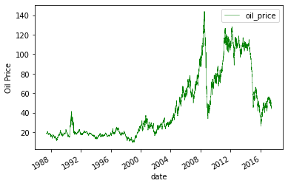
Data Collection
The data for this study is a primary oil dataset from the U.S Energy Information administration.
It lists the oil prices (in dollars) from 1987-2017 in a daily frequency fashion.

Slide 4
Data Extraction and Cleaning
All these datasets are publicly available in Kaggle. Thus, we have two different datasets:
The first contains the oil prices in time series format and the second contains share prices information of top oil companies in a similar time series fashion.
For a meaningful analysis, the data from these two sources is extracted and merged and transformed into a new single dataset.

Slide 5
Data Transformation
For our analysis purpose we will create a master data frame that will contain the information of oil price and share price of each company for the daily frequency series.
We will merge the Oil Prices dataset with the Share price dataset for each company based on a joining condition which is ‘Date’ in our case.
Additionally, we will drop the rows for which there is no merging possible i.e., the rows which yield NAN after merging.

Slide 6
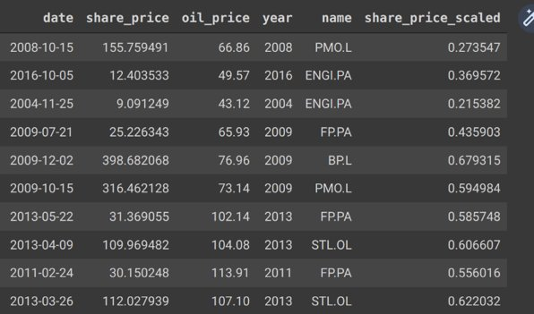
Data Transformation
A Random sample drawn from the final master data frame

Slide 7
Exploratory Data Analysis
To begin with analysis, we plot the scatter plot between Oil Price and Share Price for each of the companies for the last two years of data.
Only last two years data was used to check for patterns in recent past and for lowering down the scale of analysis.
From the scatter plot we check for correlations if any between the oil prices and share prices.
It is a prior knowledge that share price of a company increase with the rise in Oil prices.

Slide 8
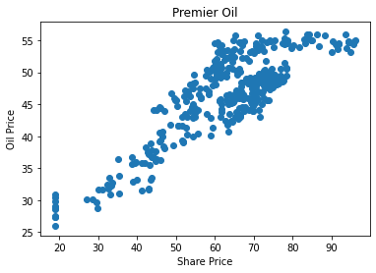
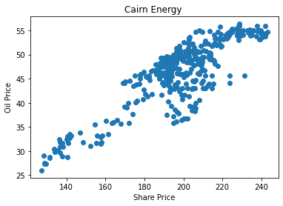
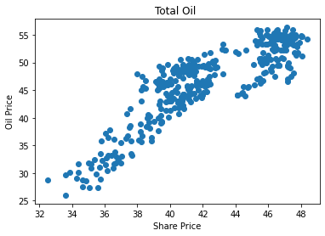
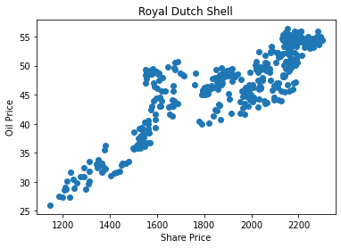
Scatter Plot for various Oil companies

Slide 9
Linear Regression Model
We will construct a simple linear regression model using supervised learning.
The objective is to evaluate the prediction of data from the last 100 days using data trained from years 2016/17 (excluding test data).
Train data is the data used to construct the model and test data is the data we are trying to predict.
Figure on next slide shows the model trying to predict Share Price from the Oil Price for the Royal Dutch Shell Company.

Slide 10
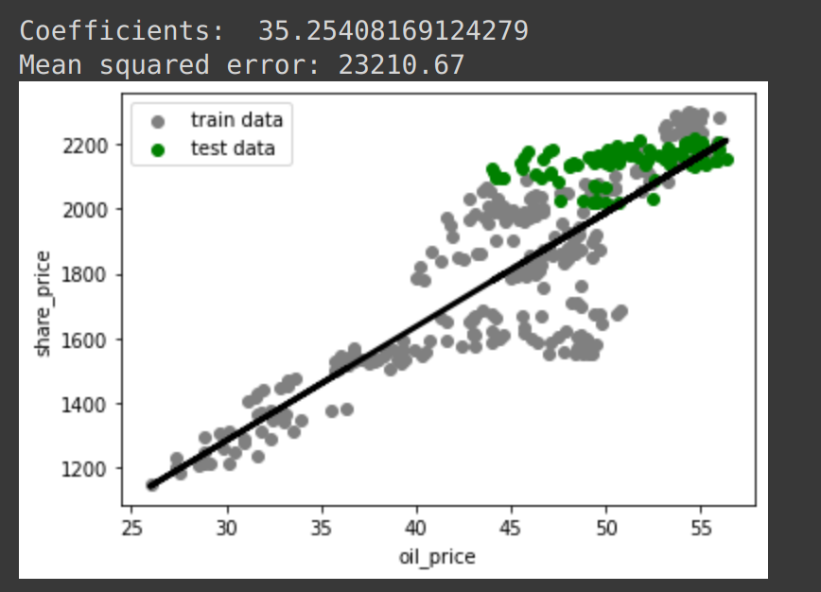
Linear Regression Model

Slide 11
Random Forest Model
Random forest is an ensemble tool which takes a subset of observations and a subset of variables to build a decision trees.
It builds multiple such decision tree and amalgamate them together to get a more accurate and stable prediction.
We use more than one variables to predict the share price of Shell using a Random Forest.
Specifically the prices of 'Premier Oil', 'Cairn Energy', 'TOTAL', 'ENGIE' and 'STATS Oil' companies along with the 'Oil price' was used as input features.

Slide 12
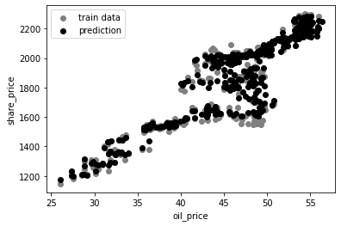
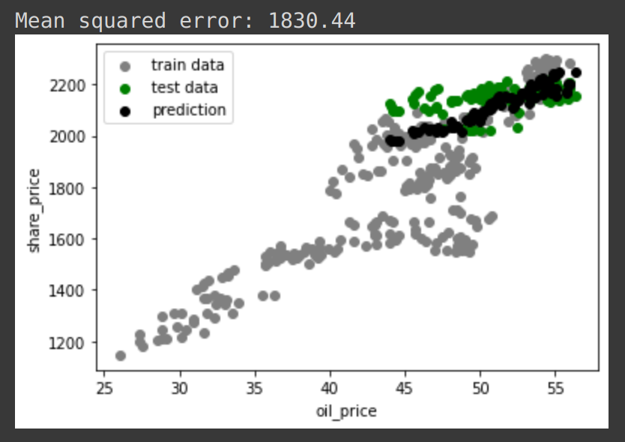
Model Predictions with Random Forest

Slide 13
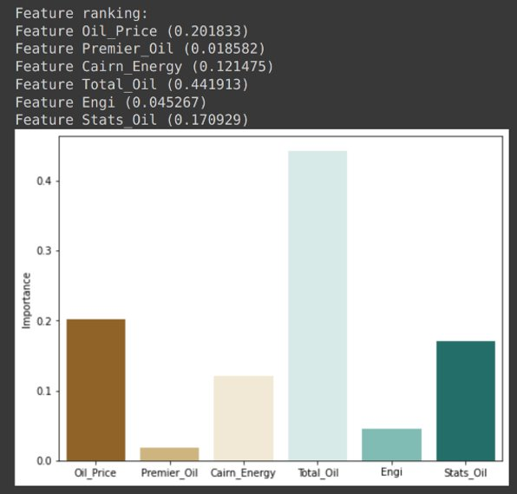
Feature Ranking according to Random Forest

