Slide 1

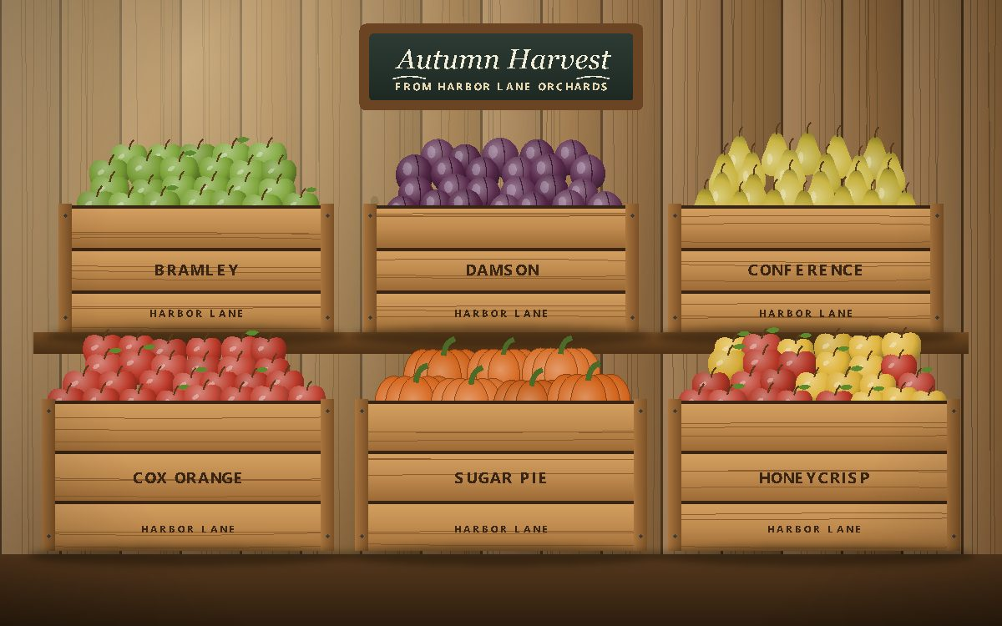
Autumn Harvest 2025
Seasonal lines from Harbor Lane Provisions for grocers, cafes and restaurants.
Notes:
Open with the sell-out story: the range sold out twice before November.

Slide 2
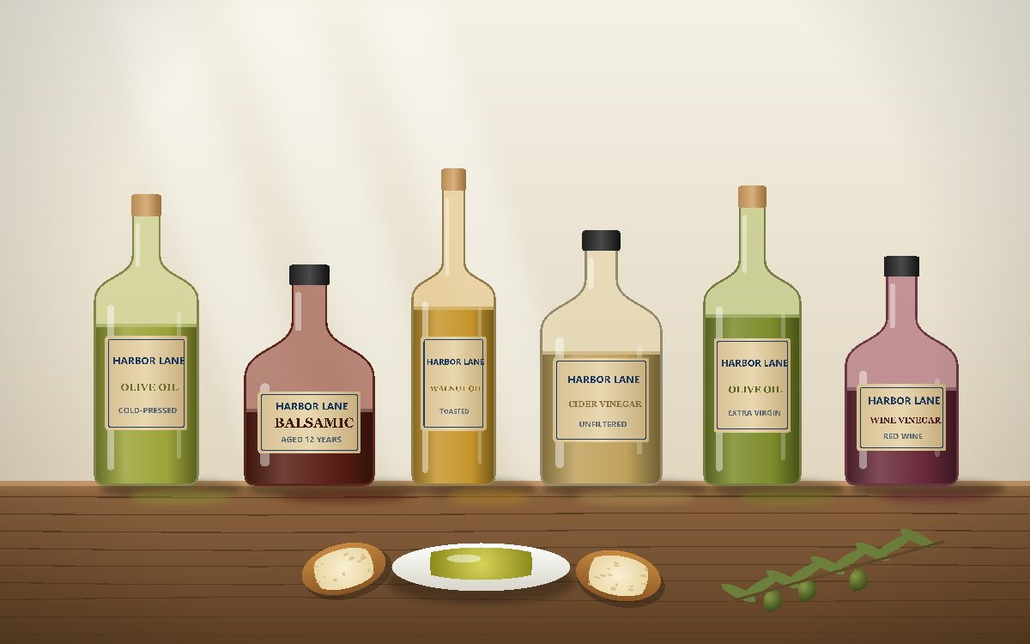
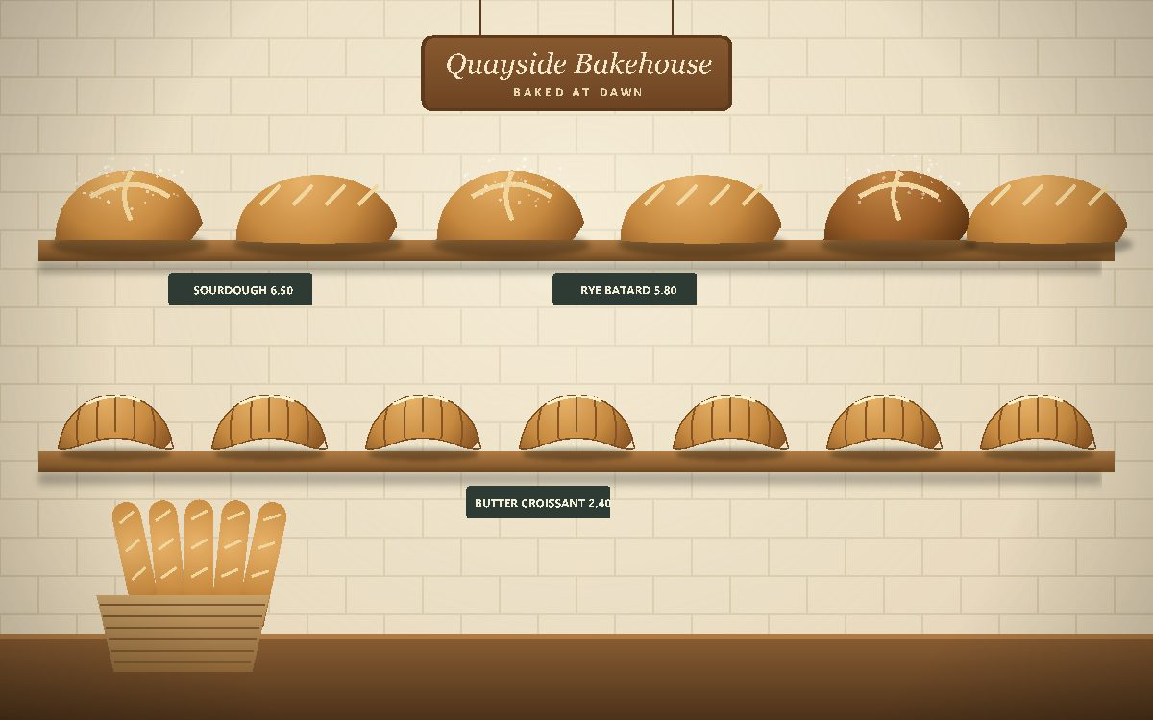
What is in the range
Autumn Harvest spiced roast from Northwind Coffee Roasters
Apple butter, cranberry relish and fig preserve
Squash soup, muesli and a fruit loaf from local producers
Notes:
Mention that the spiced roast is blended for us by Northwind.

Slide 3
Wholesale prices
SKU | Product | Unit | Price
HLP-CF-105 | Autumn Harvest spiced roast | 500 g bag | $11.20
HLP-HN-305 | Autumn Harvest apple butter | 300 g jar | $4.60
HLP-GR-405 | Autumn Harvest muesli | 750 g bag | $5.90
HLP-BK-704 | Autumn Harvest fruit loaf | 500 g loaf | $4.75
HLP-CN-905 | Autumn Harvest squash soup | 600 ml jar | $3.70
Prices per unit, delivered, excluding sales tax. Order by 15 October.
Notes:
Prices hold until 31 December 2025.

