Slide 1
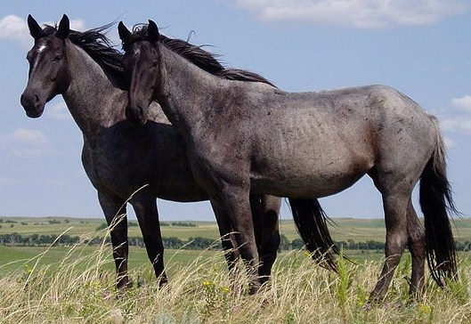
Presentation with JPG image in background

