Slide 1


Brand Pitch
A refreshed visual identity for Northwind Coffee Roasters
Photography · Brand Design · Motion · 2026

Slide 2
Who we are
A senior-led studio for photography, brand design, and motion.
One team from brief to delivery — no hand-offs.
Watermark-protected delivery keeps your assets controlled.
Average 12-day turnaround on a full campaign.
AURORA VISUALS · Brand Pitch

Slide 3

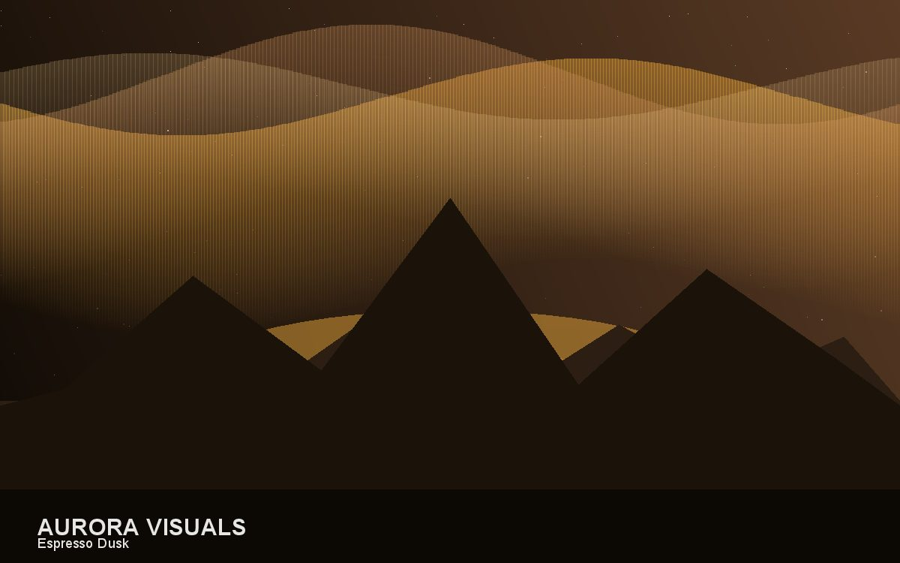
Selected work
Espresso Dusk — on-location photography
AURORA VISUALS · Brand Pitch

Slide 4
Campaign results
AURORA VISUALS · Brand Pitch

Slide 5
Engagement & next steps
Phase 1 — Discovery workshop and creative brief.
Phase 2 — Photography and brand system design.
Phase 3 — Motion pack and brand film.
Fixed project fee: $29,700. Start within two weeks of sign-off.
AURORA VISUALS · Brand Pitch

