Slide 1

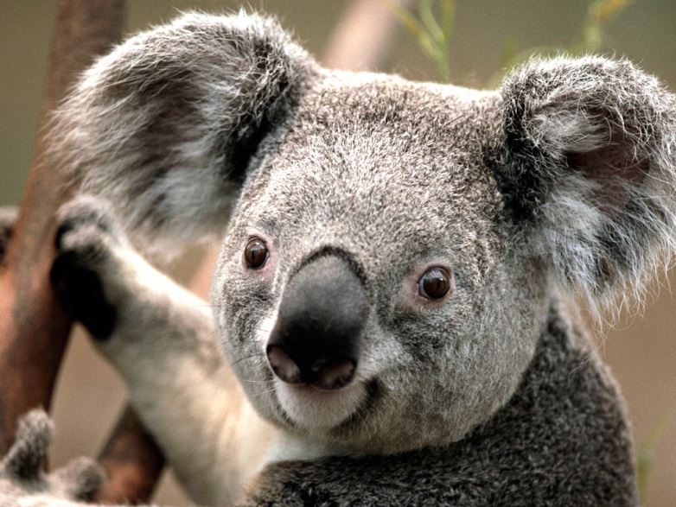
Hello there

Slide 2
Hello from second slide
This is second slide with a koala’s picture.
This is a hyperlink.

