Slide 1
RESEARCH METHODOLOGY
A short note

Slide 2
SEARCH TOOLS
https://scholar.google.com/
https://www.scopus.com/search/form.uri?display=basic
www.webofknowledge.com

Slide 3
Tips & tricks for researching
Use Google Scholar instead of Google.
Use the Hash for truncation ie. Organi# could give you: organisation, organization, organisational, organise, organises – all alternate endings
Searching for a phrase? Use quotation marks ie “port authority”
Start with singular term ie “port authority” rather than “port authorities”
Brainstorm for Keywords (to find synonyms use a thesaurus or synonym.com)
Think about your choice of terminology – Geographical influences ie. Mobile phone or cell / cellular phone (synonyms)
Be flexible with your searching – if one combination of keywords doesn’t work in one databases try another combination or database.
Follow the research. Trace back and Trace forward. Once you find a great article, use the hyperlinks in the article while it’s in the databases to find other articles by the same author, make a note of the keywords attached to the article, use the reference list (or bibliography) to find other articles on the same topics, use the cited by option to find articles that have cited your article.
Check the journal rank/# citations/publication year before read it. It really helps to save your time!

Slide 4
Criteria when selecting the readings
Time: Empirical studies should be within 3-5 years. Theoretical studies has no limitation in publication time (the older ones normally are better).
Journal ranking: Please take your time to read articles published in top journals (Q1, higher IF, higher h-index, journals in a shortlist, A* and A).
Number of citations: a signal for the impact of the article. It can be few if the article has been published very recently.

Slide 5
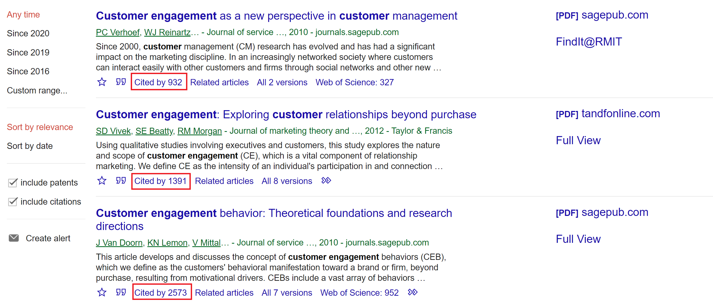
Research impact
Research impact is increasingly important in assessing research quality.
  Article Citation Count
  Journal Impact Factor
  Journal Ranking Lists
  Article Citation Count

Slide 6
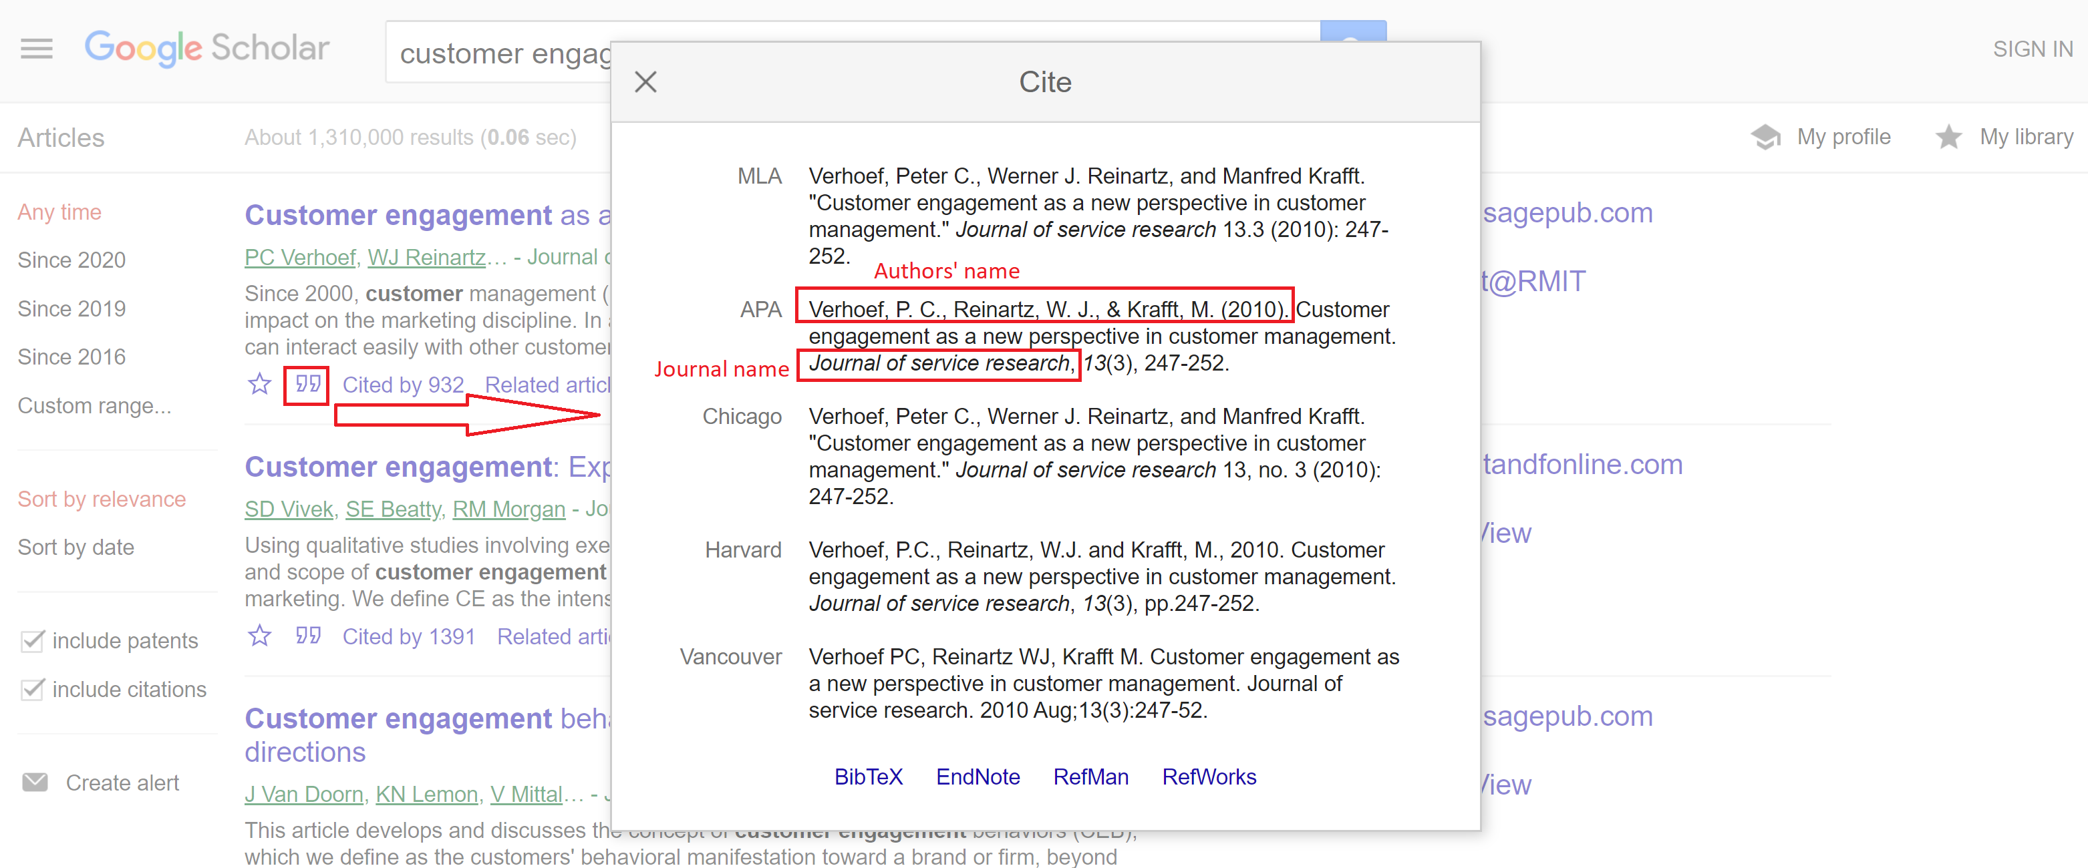
Research impact
  Journal Impact Factor
  Check the Journal Impact Factor:
  Google Journal name + “impact factor”
  Go to journal website, see the journal information

Slide 7
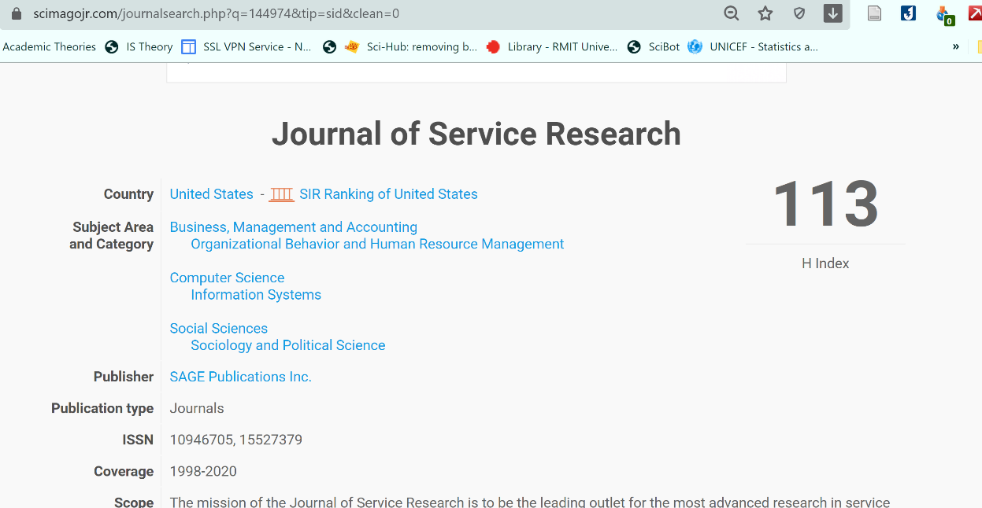
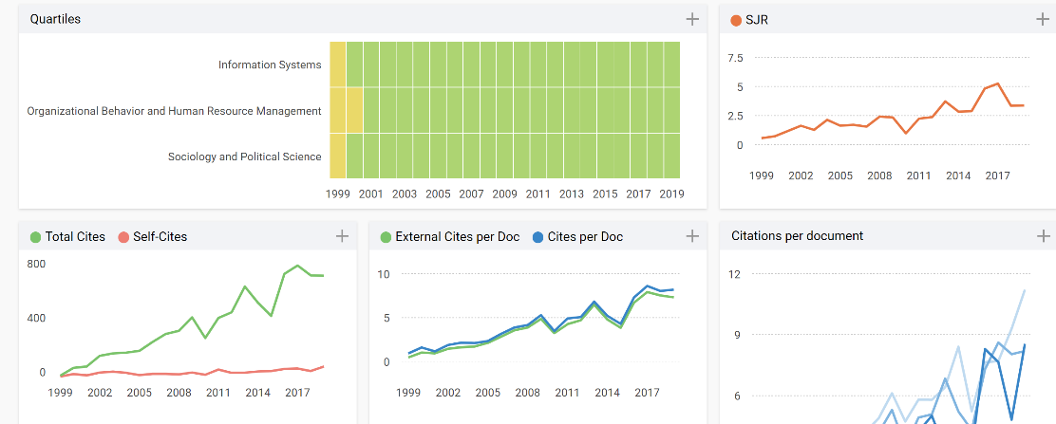
Research impact
  Journal Ranking Lists:
  - Scopus database: https://www.scimagojr.com/
  - Search journal name (be careful because there are several journals with similarity in parts of the name
Check h-index (depends on the discipline)
Check the Quartile: Q1 with green color is better

Slide 8
How to access to the publications
  - Via official gateway from your university
  - https://sci-hub.tw/ Search for the name of articles
  - http://gen.lib.rus.ec/ Search for the keyworks of books

Slide 9
