Slide 1
PowerPoint Example
Greg Rousell

Slide 2
R Markdown
This is an R Markdown document that knits to a PowerPoint template. Using this feature you can control the appearance of your documents.

Slide 3
Slide with Bullets
Bullet 1
Bullet 2
Bullet 3

Slide 4
Slide with Table
Species | Sepal Length | Sepal Width
setosa | 5.0 | 3.4
versicolor | 5.9 | 2.8
virginica | 6.6 | 3.0
The flextable package will format R data frames into tables. For more information on flextable see: https://ardata-fr.github.io/flextable-book/index.html

Slide 5
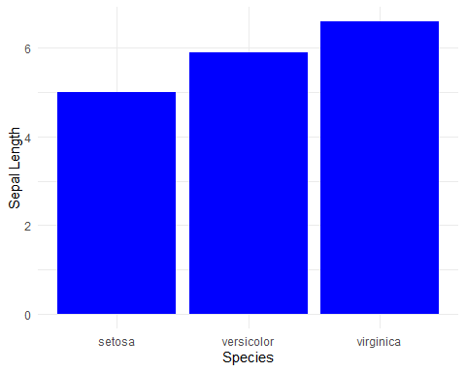
Slide with Plot

Slide 6
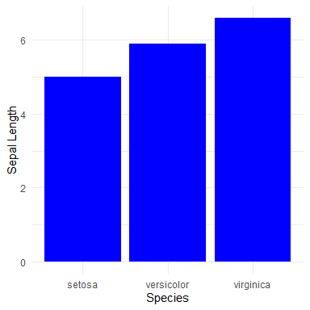
Columns
Species | Sepal Length | Sepal Width
setosa | 5.0 | 3.4
versicolor | 5.9 | 2.8
virginica | 6.6 | 3.0

