Slide 1

RevShop
Ariesh Grover’s Foundation Project

Slide 2
Agenda
1
Project Introduction
A look at the project requirements
2
Technologies
What technologies were harnessed?
3
Features
What can RevShop do for you?
4
ERD Diagram
A look at how it is all stored

Slide 3
Introduction
What is RevShop
An ecommerce platform that is an all-in-one solution for shoppers
Supports The Basics
Login
Registration
Product Display
Cart and Checkout
Some Extra Sprinkles
Email Notifications
Order History
Reviewing Products
Notes:
RevShop is an ecommerce platform for shoppers to shop without hinderance.
It covers the basics: Login registration, product display(filtering) features, and cart/checkout
Advanced features include an email notification service built in ability to view order history and reviewing products

Slide 4
Technologies
BACK END
FRONT END
HTML & CSS: The Basics
JavaScript: To add dynamic functions
Bootstrap Icons
Java spring framework
MySQL Database

Slide 5
Features
Login/Register
Order History
Product Page
Login and register
Error handling for all scenarios
View any Historical Orders
View the products for each order
Show specific details of a product
Leave a review
Dashboard
Cart
Checkout
View all products
Filter by Keyword or Category
View any specific item in detail
Remove any item from the cart
Change the Quantity of any item
Form Validation all throughout
Shows Final Summary before checking out
Can edit any information before continuing

Slide 6
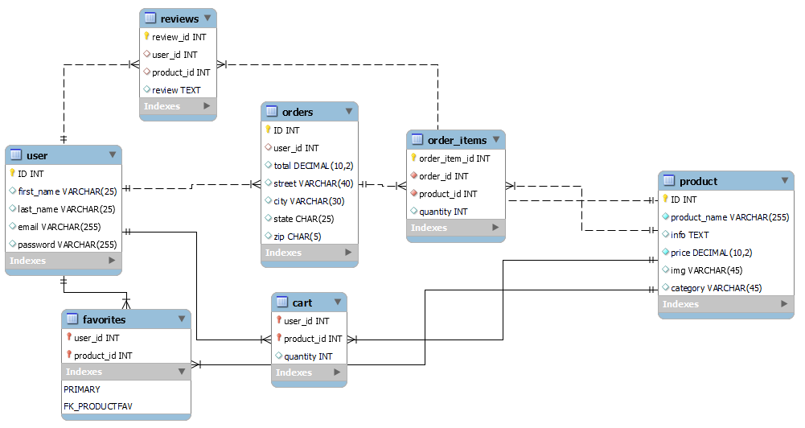

Slide 7

Demo

Slide 8

Challenges
Joins in Spring
Searching by ID
Email Service

