Slide 1
The checked hilltop result was correct
VIPER site maps, Oct 27 2027

Slide 2
The reported result
The map shows a hilltop in shadow.
The side of the same hill is lit.
This result required a terrain check.

Slide 3
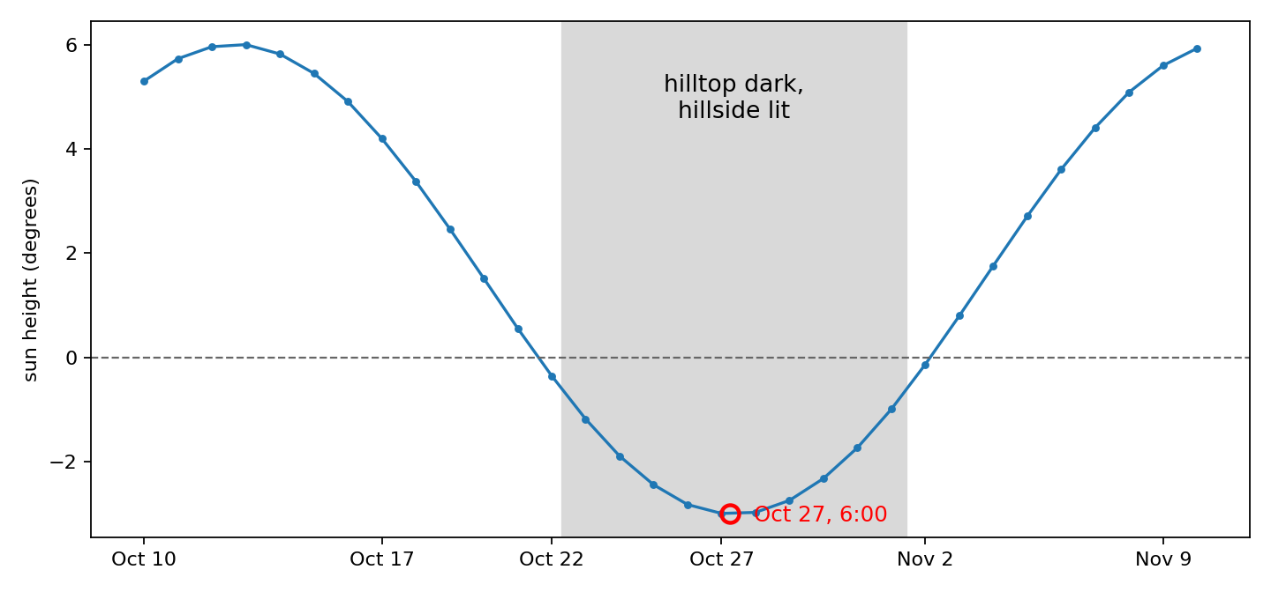
The Sun was below the local horizontal plane
The Sun was 3 degrees below the local horizontal plane. The shaded band shows the relevant part of the cycle.

Slide 4
Terrain can block the Sun at the hilltop
Sunlight reaches the site from below the local horizontal plane.
Terrain receives direct light where the Sun is above its terrain horizon.
A slope can receive light while nearby terrain blocks light at the hilltop.

Slide 5
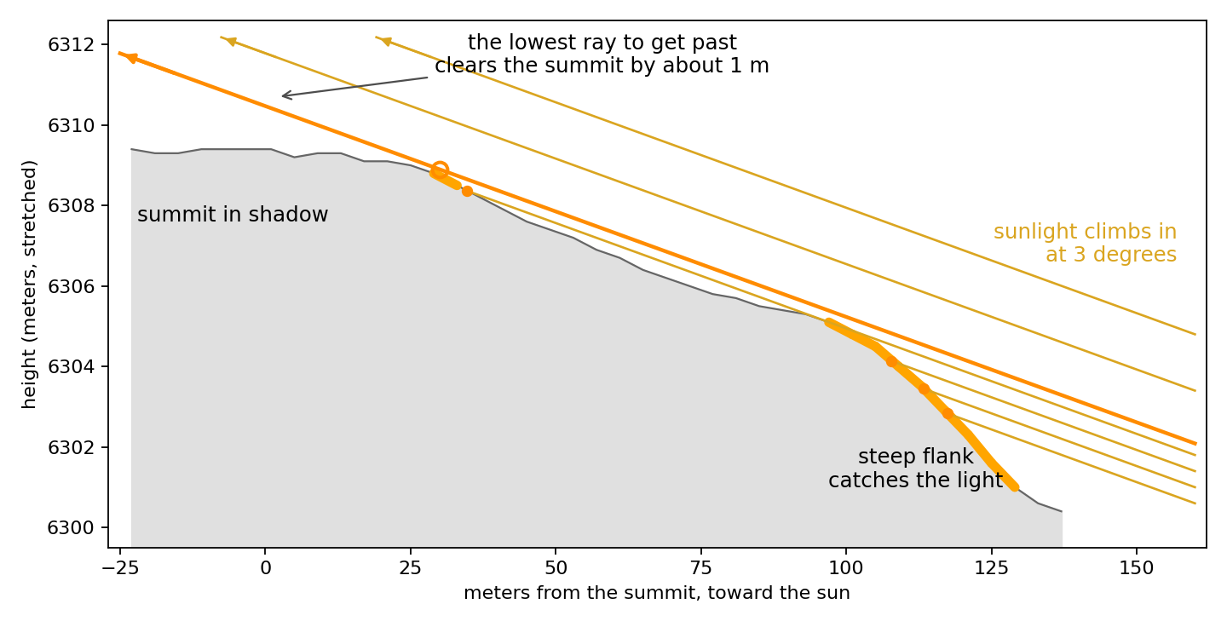
Cross section of the measured hill
Light reaches the steep flank. A limiting ray passes approximately 1 meter above the hilltop.

Slide 6
Observer height changes the result
At 1 meter observer height, the hilltop pixel receives part of the solar disk. At ground level, it remains in shadow.
For a fixed blocker 13 meters away, a 1 meter height change gives an angular change of approximately 4 degrees.
The map values agree with the independent terrain calculation.

Slide 7
Investigation result
The checks found no renderer defect in this case.
The checks used the renderer, independent terrain geometry, and Sun-position calculations.
Use tools/debug/probe_pixel.jl to examine a site pixel.

