Slide 1








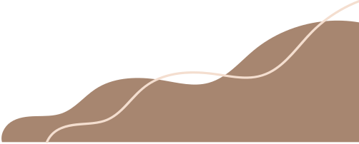
catchup
We lose our sleep so you don’t lose your friends and connections

Slide 2

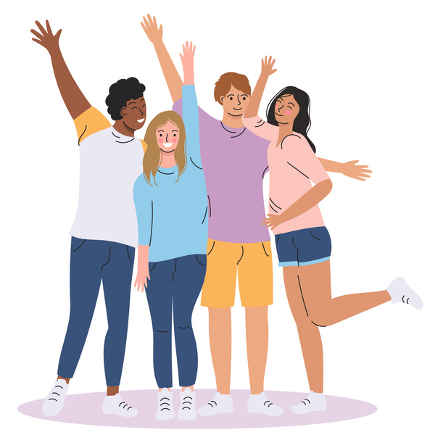

Problem Statement
As we move to different cities, we lose touch with our friends and connections whom we can rarely afford losing. Here, we the CatchUp come in for the rescue of you and your buds.

Slide 3



Our solution
A social media application designed for bringing together friends and community members who are separated by distance . After the the user sign up they can see the location of the friends who are in their area .

Slide 4

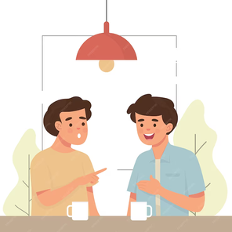



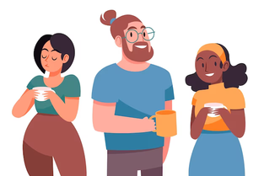


Objectives
Make it easy for you to catch up with your far away friends
make your communities meet ups more easy and arranagble
Encourages physical interaction and social bonding

Slide 5
what makes us unique
Where most social media apps in the market focus on virtual interaction, our site promotes real world interactions by notifying users about their old friends thereby fostering genuine connections.

Slide 6




HOW IT WORKS
01
Sign up on our site , make your profile and add your friends.
02
When visiting any place select whether you are available for meeting or not.
03
When you and your friends are in same location and available for meet up our site will send notification to both.
04
You can create your own community or join other communities. Also community members can arrange meet ups when visiting same location.

Slide 7





TECH STACK USED
Taipy
Django
MySQL

Slide 8
conclusion
In summary, your web app enhances the social networking experience by fostering physical meetings, building deeper connections, and bringing back the charm of reconnecting with old friends and communities in person.

Slide 9
Thank You

