Slide 1
Realizing Value Through Our
Business and Technology Partnership

Slide 2
Agenda
Executive Summary
Introduce IBM Business Consulting Services
Share Our Perspective on the Retail Industry
Discuss How We Can Partner to Address Your Needs
Determine Next Steps

Slide 3
IBM Business Consulting Services is a new model for helping clients realize value through business insight and technology
> Executive Summary
The combination of IBM Business Innovation Services and PwC Consulting provides not only unparalleled breadth and depth of consulting capabilities on a global basis, but also access to the broad technology resources of IBM
Our deep business and technology expertise combined with our extensive industry experience will help you meet your shorter-term objectives and position you for future success
We help you with innovative thinking, rapid execution, and reduction of risk resulting in enhanced value realization
IBM Business Consulting Services is your collaborative business and technology partner, with the ability to help you conceive, develop, implement and operate critical aspects of your business
Please note that IBM recently completed its acquisition of PricewaterhouseCoopers’ global management consulting and information technology services business, PwC Consulting. As a result, PwC Consulting is no longer a part of the PricewaterhouseCoopers network of firms, and is now a part of the IBM Global Services unit. IBM (including IBM Global Services) and PricewaterhouseCoopers are not the same firm, and neither governs or is affiliated with the other, or any affiliate, subsidiary or division of the other.
Notes:
IBM Business Consulting Services is a new model for helping clients realize value through business insight and technology

Slide 4
Agenda
Executive Summary
Introduce IBM Business Consulting Services
Share Our Perspective on the Retail Industry
Discuss How We Can Partner to Address Your Needs
Determine Next Steps

Slide 5
The combination of IBM and PwC Consulting creates a business-services partner of unmatched breadth and depth
> Introduce IBM Business Consulting Services
IBM Business Consulting Services
The world’s largest consulting organization
85,000 professionals in 160 countries
Deep experience and expertise in over 20 industries
Broad set of solutions spanning strategic change, customer relationship management, supply-chain operations, financial management, human capital, IT, and business-process outsourcing
Access to the global capabilities of IBM, including integrated technology services, application management services, strategic outsourcing, learning services, and global financing
$5 billion annual investment in technology and business research
Our focus is to become your partner in helping realize business value
As of October 1, 2002 PwC Consulting (PwCC) is no longer a part of the PricewaterhouseCoopers network of firms and is now part of the IBM Global Services business unit.
Notes:
The combination of IBM and PwC Consulting creates a business-services partner of unmatched breadth and depth

Slide 6


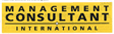

IBM and PwC Consulting were already recognized leaders in many areas prior to our combination
> Introduce IBM Business Consulting Services
Representative Recognition
Consulting Monitor | #1 in understanding client’s industry #1 in building relationships
 | #1 business & IT strategy consulting #1 for enterprise resource planning Leader in supply-chain services
 | #1 professional and management services provider #1 IT services industry Leader in customer-relationship management
 | #1 global consultant
 | #1 consulting in e-business worldwide
As of October 1, 2002 PwC Consulting (PwCC) is no longer a part of the PricewaterhouseCoopers network of firms and is now part of the IBM Global Services business unit.
Notes:
IBM and PwC Consulting were already recognized leaders in many areas prior to our combination

Slide 7



The marketplace has recognized that IBM Business Consulting Services creates a new model for client-centric service
> Introduce IBM Business Consulting Services
What People Are Saying About IBM Business Consulting Services
“PwCC and IBM clients will benefit tremendously."
— Giga Research
“The client is the driving force behind today’s announcement …”
— The Financial Times
“PwC allows IBM to benefit
from the growing trend towards
selling ‘solutions’ to clients…”
— Goldman Sachs
“This changes everything”
— Gartner
As of October 1, 2002 PwC Consulting (PwCC) is no longer a part of the PricewaterhouseCoopers network of firms and is now part of the IBM Global Services business unit.
Notes:
The marketplace has recognized that IBM Business Consulting Services creates a new model for client-centric service

Slide 8
The combination of IBM and PwC Consulting creates the market leader in the Retail Industry
> Introduce IBM Business Consulting Services
IBM Business Consulting Services
Leader in store solutions
Dominance in grocery sector
Strategic outsourcing
Applications support
Integrated solutions across broad retail segments
Multi-channel solutions
Focus on food, mass and fashion sectors
Strategic consulting
Human Capital Solutions
Supply Chain Transformation
Leader- Consumer Packaged Goods Industry
Strong thought leadership
Our depth and breadth of experience makes us an ideal partner to work with retailers from “ideas to benefits” across the entire value chain

Slide 9
Our centers of excellence for retailing span the globe
> Introduce IBM Business Consulting Services
Our global reach is unsurpassed. We have the resources to meet retailer’s needs throughout the world. Together we serve most of the global 100 retailers

Slide 10
The new IBM Business Consulting Services provides an opportunity for a partnership to enhance your business value
> Introduce IBM Business Consulting Services
IBM Business Consulting Services
The trusted business partner, unmatched in our ability to fuse business insight with technology to drive lasting economic advantage for our clients.
Providing solutions integrating business insight with technology to accelerate our clients’ business performance
Trusted to operate entire portions of our clients’ value chains
Accountable for delivering measurable results
Enabling clients to turn fixed cost into variable cost
Collaborating with clients to ensure sustainable business results
More than just a consulting firm — Business Consulting Services is your value realization partner
Notes:
The new IBM Business Consulting Services provides an opportunity for a partnership to enhance your business value

Slide 11
Agenda
Executive Summary
Introduce IBM Business Consulting Services
Share Our Perspective on the Retail Industry
Discuss How We Can Partner to Address Your Needs
Determine Next Steps

Slide 12
Through our combined capabilities, we will help you capture and ride the next wave of value creation
> Share our perspective on key trends and strategic imperatives
The value-creation approaches of the past two decades have largely been exploited
Future value realization will increasingly involve networked transformation
  Collaborating across enterprises
  Focusing on strategic capabilities
  Outsourcing non-core activities
Early ’00s
Networked Transformation
Early ’90s
Process Improvement/
Re-engineering
Aligning Competencies
Late ’90s
Enterprise & CRM Technologies
Web Solutions
’80s
Cost Reduction
Competitive Positioning
Going forward, companies need to refine
their definition of core customers, products/services, and operations
Notes:
Through our combined capabilities, we will help you capture and ride the next wave of value creation

Slide 13


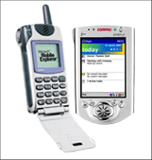

The competitive landscape is mandating change for retailers globally …
>Share our perspective on the retail industry
Consumer complexity
Population growth, age wars
Global teenager, local tastes
Time/money trade-off too simple
Shift from products to services
‘You don’t understand my needs’
Consumer spending defies gravity – for how long?
Pensions time bomb
Competitive battleground
Oversupply in mature markets
Increasing global competition
Sameness, lack of innovation
Retail sectors blurring
Share of wallet
Leaders and laggards to winners and losers
Technology underpins everything
Real-time networks create a “connected store “
CRM enables a “connected customer”
Mobile, wireless and AutoID change the supply chain
Analytics and decision support across the enterprise
Challenge of legacy replacement becomes critical
Suppliers fight for relevance
CPG companies fighting for consumer relevance and control of distribution
Global powerplay
China opening up massive capacity to supply
Emergence of supplier backlash
… the next 5 years will see big winners and spectacular losers as Wal*Mart doubles in size along with other global mass merchants

Slide 14











Tomorrow’s big winners will be very focused on where to compete …
>Share our perspective on the retail industry
Opportunitist
  Basis of Competition:
    Fashion, product, newness, in-store experience
  The shopper says:
    ‘It’s fun to shop’
    ‘Great product’
    ‘It’s me’
Lifestylist
  Basis of Competition:
    Enthusiasm, customer intimacy flexibility
  The shopper says:
    ‘They know what I want’
    ‘They help me to be me’
SELF EXPRESSION
PRODUCTS
SOLUTIONS
Mass Value
  Basis of Competition:
    Price, selection, convenience
  The shopper says:
    ‘I can get everything I need here’
    ‘I’m getting a good deal’
    ‘It’s quick and convenient
Solver
  Basis of Competition:
    Superior service, solution offer, meeting needs
  The shopper says:
    ‘I trust them’
    ‘They solve my problems’
    ‘I couldn’t have done that anywhere else’
BASIC NEEDS
… and shape their business to be the best at what they do

Slide 15

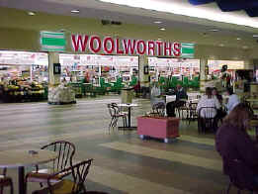
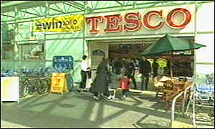
Mass Value — buy for less, operate for less…
>Share our perspective on the retail industry
Process excellence is a differentiator
  Customer facing – tailored propositions to local markets – range, customer service, multi-channel
  Buy for less – global sourcing, play big with suppliers
  New product development – own label used to drive down cost
  Supply chain – efficiency and reliability are key
  Support services – shared service centres, global process standardisation
Exploit technology to drive down cost
  Standard applications
  Optimised to support global business needs
Low cost culture
  Focus on creating value for customer
  Focus on routines, get it right every time
Performance measures
  Lifetime customer value/share of wallet
  Comparative price and cost
  Process measures
… aligning business DNA with Customer Value Proposition

Slide 16

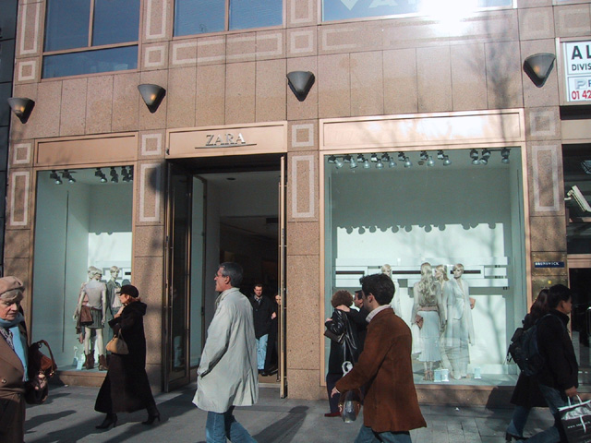
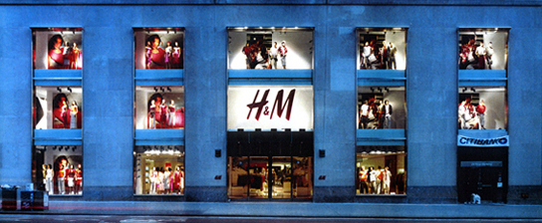
Opportunist — flexible, responsive, agile…
>Share our perspective on the retail industry
Process agility is critical
  Customer facing – in touch with lifestyles, global trends
  Buy to thrill – product innovation, supplier collaboration
  New product development – time compression, rapid churn
  Supply chain – flexible, agile; focus on product life cycle management
  Support Services – not a driver of value – outsource?
Exploit technology to drive out time
  Focus investment on time compression
  Tools for supplier collaboration/innovation
Innovative, exciting culture
  Focus on creating excitement for customer
  Product knowledge and passion
  Thirst for what is new
Performance measures
  Speed to market
  Product churn
  Sell-through percentage
… aligning business DNA with Customer Value Proposition

Slide 17
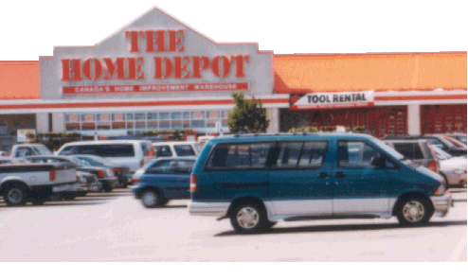
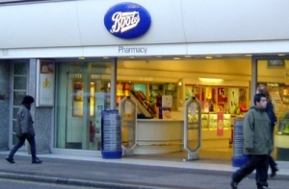
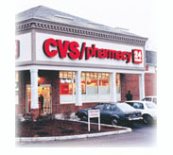
Solver — integrating solutions…
>Share our perspective on the retail industry
People focused processes to the fore
  Customer facing – focus on relationship, customer intimacy, multiple touch points
  Buying / sourcing – products and people to formulate solutions
  Supply chain – focus on reliability: component assembly and project life-cycle management
  Support services – HR, training, staff development are critical - outsource others as non-core
Make technology add value to service delivery
  Accessibility at point of service delivery
  Mobile / wireless
  Knowledge bases, information sharing
Deep routed service culture
  Knowledgeable, credible, trustworthy
  Ability to network with other organisations
Performance measures
  Customer satisfaction/retention
  Cost to serve
  Capacity utilisation
… aligning business DNA with Customer Value Proposition

Slide 18







Lifestyle — serving the individual…
>Share our perspective on the retail industry
Processes tailored to the individual
  Customer facing – key differentiator, flexible/tailored, few routines
  Buy for me – focused, low volume, buy to order, specialist suppliers
  Supply chain – flexible, responsive, one-off
  Support services – HR, recruiting, motivation are critical
Exploit technology to know your customer
  Individual profiles / preferences
  Tailored range & services
Enthusiast culture
  Passionate, empowered to serve
  Personal coach
Performance measures
  Share of lifestyle spend
  Customer retention
… aligning business DNA with Customer Value Proposition

Slide 19
The Retail Imperative
>Share our perspective on the retail industry
SELF EXPRESSION
PRODUCTS
BASIC NEEDS
SOLUTIONS
Determine how and where to compete..
.. align business DNA with Customer Value Proposition ..
Enterprise collaboration
Future Store
Dynamic Workplace
Merchant Reach
Efficient Infrastructure
… accelerate implementation through pre-configured solutions

Slide 20
Our Retail Industry solutions accelerate the pace of change …
>Share our perspective on the retail industry
Where to compete ..
Reinventing your business takes time, management attention and investment … scarce commodities for any retailer.
We have developed industry solutions supporting each of the four retail business models required to compete in today’s retail environment. They combine people, processes and systems.
We have the people to work with your teams to deploy these solutions rapidly to drive up business performance. And, because the solutions are modular, we will help you focus on the area of greatest gain first.
And we can help finance the investment so you pay as the benefits are realised.
SELF EXPRESSION
PRODUCTS
BASIC NEEDS
how to compete ..
SOLUTIONS
Enterprise collaboration
Future Store
Dynamic Workplace
Merchant Reach
Efficient Infrastructure
.. to achieve superior results
… and are modular to focus on biggest benefit first

Slide 21




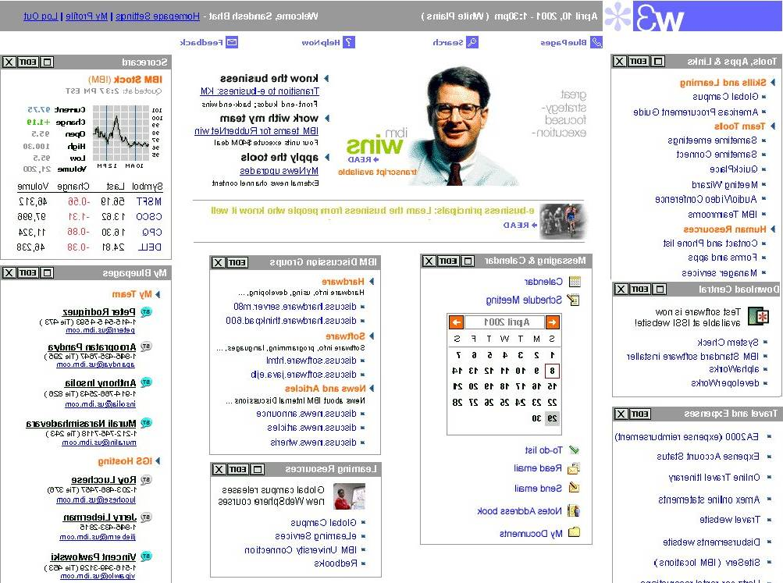
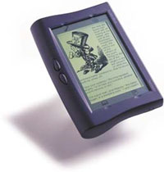


21st Century retailers will develop and exploit five new store competencies
>Share our perspective on the retail industry
Future Store Competencies
The Expert Store Manager
Management reports and alerts
Training and Development
People Management
Task management and communication
The Empowered Team
Clienteling
Automated Inventory visibility
Assisted checkout
e-HR, e-learning
The Satisfied Customer
Customer Services
Cross-channel transactions: buying, fulfillment, returns
Personal device touch points, Self checkout
Advanced payment techniques
Streamlined Store Logistics
Computer-Aided Ordering/Continuous Replenishment
Stock Management
Shrink management
Transforming Store Operations
"Desire to Demand" Conversion
Advertising / Marketing Effectiveness
Cross-channel marketing and promotions
Leveraging Customer Insight
Dynamic digital merchandising and messaging
Future Store

Slide 22



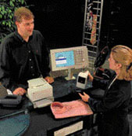
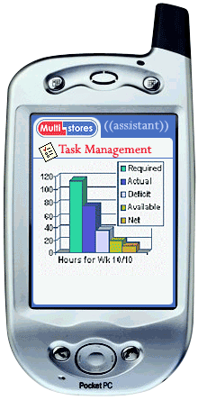
21st Century retailers will exploit Human Capital competencies to their most important assets
>Share our perspective on the retail industry
Strategic Employee Competencies
Employees
Human Capital Transformation
People Strategy
Shared services strategy
HR Transformation for Point solutions, thin or enterprise-wide
HR Delivery, Self-service and Process
HR Management Systems
Portal for key Corporate Processes
Empowered Managers
  Management alerts
  Workflow management
  Staff management / scheduling
  Collaboration – instant messaging, e-meeting
  Manager Information Portal- KPI
  *Store Mgr included in Store Competencies
Self-Service Employee
  E-HR self service – benefits, payroll, recruitment, expense reporting, expertise locator
  Mobile Employee Workforce management – Regional Mgrs, Buyers, etc.
  Business to Employee Portals
Workforce Analytics
  Performance Leadership
  Employee Relationship Management
  Best Practice Workforce analytics
  Workforce management rapid mart and delivery system
  Workforce Role Based Portal
Dynamic Workplaces
Learning Solutions
Self Service Learning
Skills Database
Competency Assessments
Career Roadmaps
Performance Based Modularized training and content

Slide 23
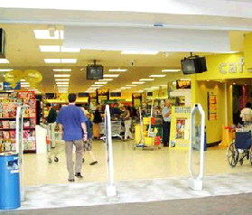




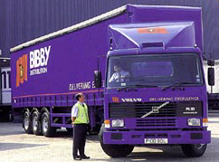


21st Century retailers will need to collaborate with suppliers in 6 main areas to bring value to their customers
>Share our perspective on the retail industry
Enterprise Collaboration Competencies
Product Collaboration
  Plan new assortments & ranges
  Shelf Allocation, Gondola ends
  Price optimization through collaboration
  Collaborative Promotions Planning
  Performance Analysis
  Funds Allocation
Product Innovation
  Concept Development
  Joint Product Design
  Product Development
  Product Launches
Data Synchronization
  Content Management
  Item Synchronization
  Price Synchronization
  Data Pool Connectivity
  Global Registry
Buying Better
  Auctions
  Strategic Sourcing
  GNFR e-Procurement
Managing Supplier Relations
  Supply Portals
  Supplier Metrics & KPI’s
  Simple data publishing
  Event Tracking
  Knowledge Management
Supply Collaboration
  Forecasting
  Replenishment
  Warehouse Management
  Transportation
  CP/CF/CR
  VMI
  Visibility
Enterprise
Collaboration

Slide 24
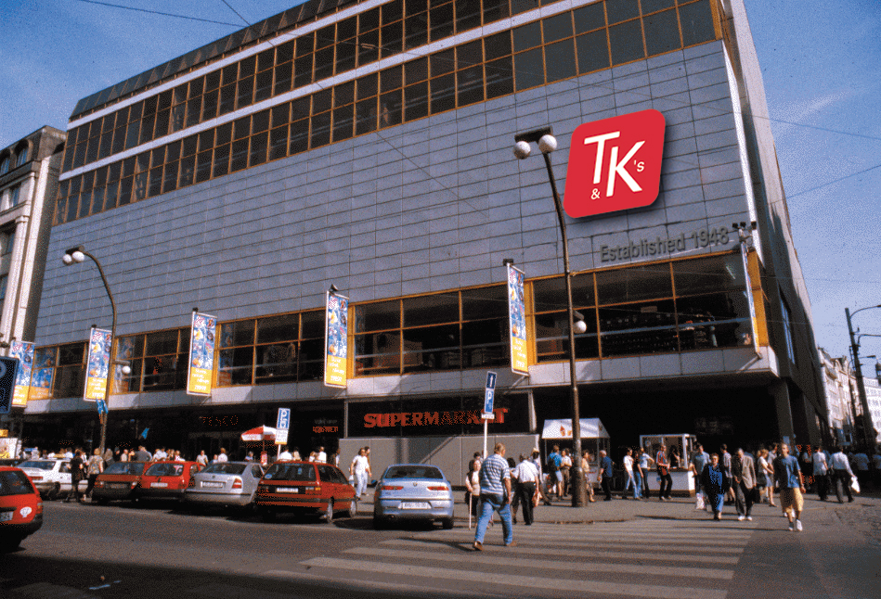
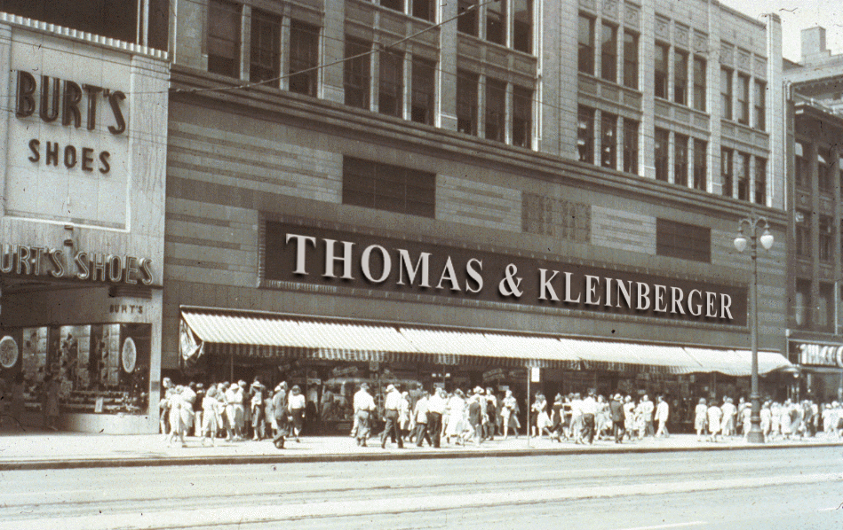
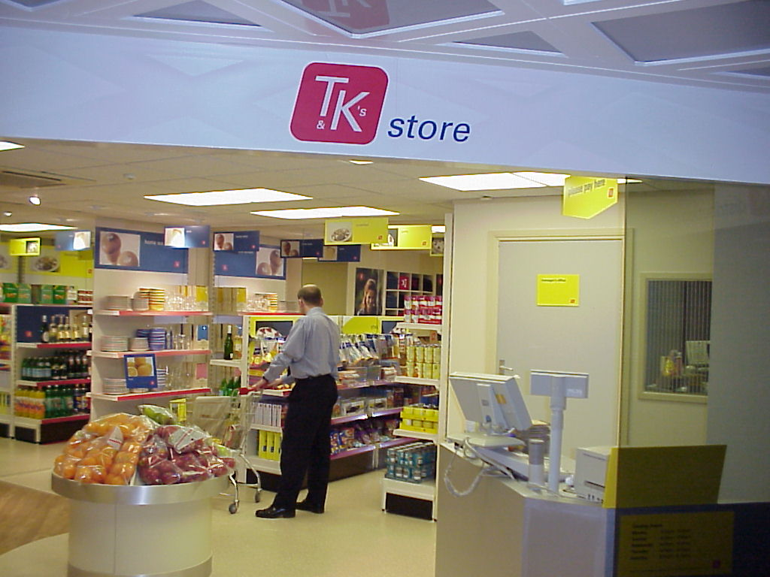

Winning 21st Century retailers will align the DNA of their business with their customer value proposition…
>Share our perspective on the retail industry
Efficient Business Infrastructure Competencies
Strategic Asset Management
  Property management as a basis of competition
  Cost/service optimization
  Capital program management
The Virtual Head Office
  Head office functions and a window into each store, anytime and anywhere
  Truly mobile collaborative working with suppliers
  Employee Self Service
ERPworks
  Retek / SAP designer DNA & rapid deployment
  Idea to execution accountability
  Supply-web connectivity
  Real-time retail
Global IT Model
Global Sourcing
Global NPD
Optimised Supply Chain at Regional Level with Key Suppliers
Shared Services
Best Practices Disseminated Globally
Rapid Deployment to New Markets
Reduced IT Costs
Efficient Business Infrastructure
Finance in a box
International Financial Shared Service Centres
iAnalytics – in your hand
Financial Benchmarking
Performance Improvement

Slide 25
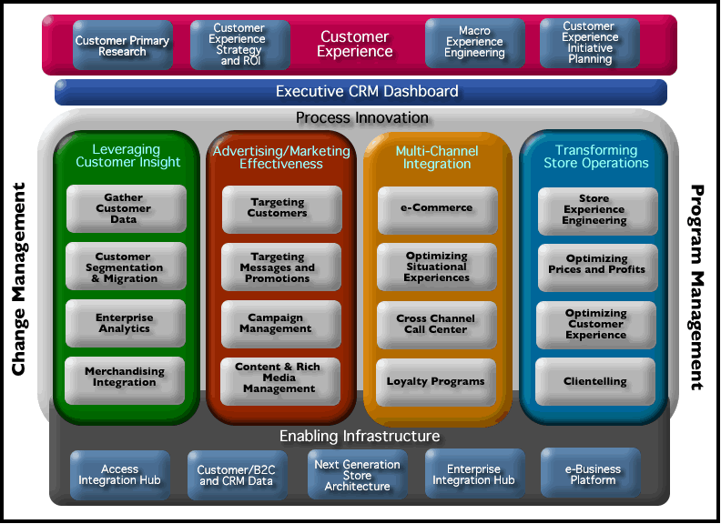
>Share our perspective on the retail industry
Our MerchantReach industry solution accelerates
the transformation process

Slide 26

Our industry solutions are supported by capabilities which span the entire Retail Value Chain…
>Share our perspective on the retail industry
Business Transformation
Strategy
Positioning / Go-To-Market Strategy
Growth / Innovation Strategy
Global Business Model
Merger Integration
Shareholder Value Management
Operational Diagnostic
Store and HQ cost reduction and performance improvement
Business Intelligence
Finance Benchmarking
Performance Management
CRM
Campaign Management
Mutli-channel Customer Interaction
Customer Loyalty
iAnalytics
IT Transformation
IT
Enterprise IT Strategy
Merchant Reach
Application Development
Store Systems Data Warehousing
Operate
Application Management / Support
Business process outsourcing
Supply Chain Transformation
Merchandise Management
Price / Markdown Optimization
Merchandise Management (Planning,
Allocation, Replenishment)
SKU Rationalisation / Category Management
Global Sourcing
New Product Development
Supply Chain
Supply Chain Strategy
Supply Chain Optimisation
Factory Gate Pricing
Warehouse Mgmt
Auto ID/RFID
DC Network Design
Collaborative Value Chain(e.g. CP/CF/CR)
Exchange strategy/participation
Data Synch
Store Operations
Store Systems
Store Ops and Logistics
Labor Management
HR Transformation
HR Service Delivery Models
Manager/Employee Self Service Portals
HR ERP’s – Payroll and HRIS
eLearning
Workforce Analytics
Dynamic Workplace

Slide 27






…and are supported by strong alliances with leading software companies serving the industry
>Share our perspective on the retail industry
Strategy
Supplier
Consumer
We have invested in pre-configured solutions to accelerate the process of change and minimise disruption to your business
We have the breadth and depth of business and technical skills to support all aspects of retail change
Our capabilities and experience covers the major retail package solutions, SAP, Retek, PeopleSoft, i2, Blue Martini, DemandTek, Manugistics, and Siebel.
We can give objective advice and be held accountable for implementation.
Operate
Enterprise collaboration
Future Store
Dynamic Workplace
Merchant Reach
Efficient Infrastructure

Slide 28
Our service offer lines up well with the positioning choices retailers are facing
>Share our perspective on the retail industry
Opportunitist
Enterprise Collaboration
MerchantReach
Future Store
  Efficient Infrastructure
  Enterprise Collaboration
  Dynamic Workplace
Lifestylist
Future Store
MerchantReach
SELF EXPRESSION
PRODUCTS
SOLUTIONS
Mass Value
Solver
Future Store
Dynamic Workplace
MerchantReach
Efficient Workplace
Enterprise Collaboration
BASIC NEEDS

Slide 29












Our value has been demonstrated with leading retailers In all major segments and geographies
>Share our perspective on the retail industry

Slide 30
Agenda
Executive Summary
Introduce IBM Business Consulting Services
Share Our Perspective on the Retail Industry
Discuss How We Can Partner to Address Your Needs
Determine Next Steps

Slide 31
To address your strategic imperatives, you need to innovate, execute, and reduce risk to create sustainable value
> Discuss how we can partner to address your needs >> Your Requirements
Short-term creative solutions
Strategic transformational thinking
Industry- and company-specific insights
Rapid results and payback
Effective implementation
of organization, process and technology change
Conversion of fixed to variable costs
Integrated, full-service providers
Incentives for all parties to win
Focus on shareholder value
Positioning for the long term
Sustainable competitive advantage
Collaboration with Trusted Partners
Trusted collaborators who are focused on integrity
Accountable business partners who achieve results
Professionals who understand your business
Innovative Thinking
Rapid, Effective Execution
Reduced Risk
Enhanced Value Realization
+
+
=
Notes:
To address your strategic imperatives, you need to innovate, execute, and reduce risk to create sustainable value

Slide 32
With our global breadth and depth of service, we have capabilities to be your full-service value realization partner
> Discuss how we can partner to address your needs >> Our Capabilities
Capabilities
Collaboration with Trusted Partners
Long-term relationships
Focus on creating value
Integrity in everything we do
Innovative Thinking
Rapid, Effective Execution
Reduced Risk
Enhanced Value Realization
+
+
=
Fusion of business insight and technology
World’s second largest strategy-consulting firm
Deep industry points-of-view
Academic partnerships
Integrated industry solutions
In-depth set of methodologies and capabilities
Global set of professionals
Third-party relationships
Ability to integrate execution into design
World’s largest IT financing entity
Ability to share financial risk
Seamless delivery from strategy through execution
Rich heritage of repeated success
Quantifiable results, to optimize your ROI
Success defined in terms of value delivered
Ability to conceive, execute, and operate business and technology solutions
Notes:
With our global breadth and depth of service, we have capabilities to be your full-service value-realization partner

Slide 33
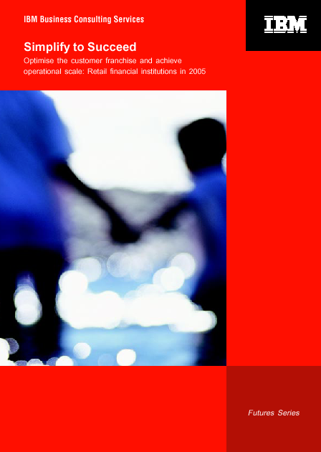
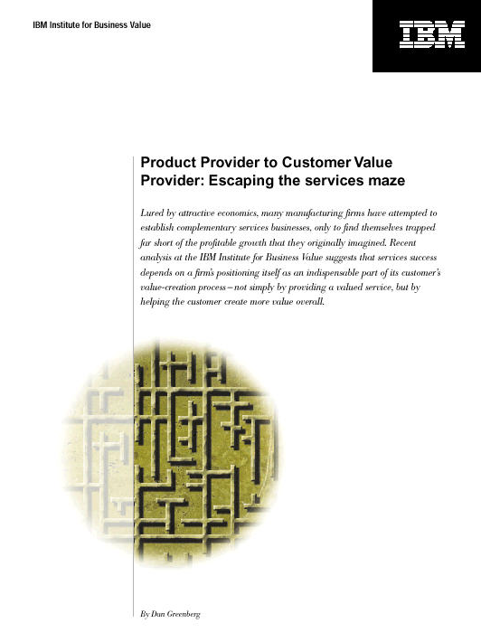
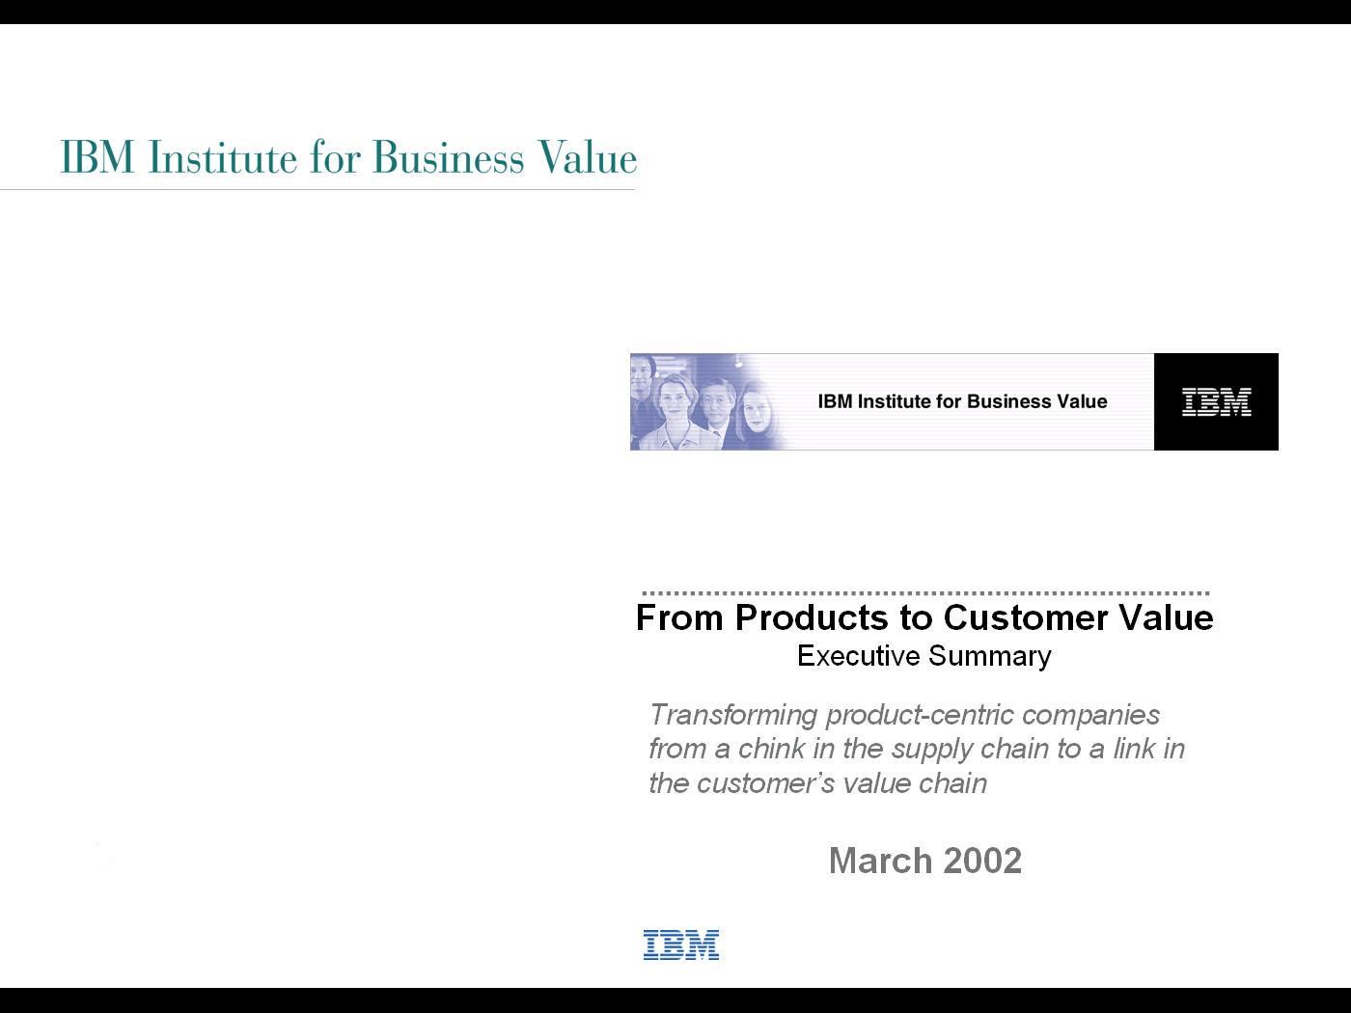
We make significant investments in order to bring you new and innovative thinking
> Discuss how we can partner to address your needs
Innovative
Thinking
Strategic Insights
The world’s second-largest strategic change practice, with over 3,000 professionals globally
Institute for Business Value, staffed by 50 full-time professionals in North America, Europe, and Asia
Over 100 in-depth strategy studies and related publications annually
Focused client membership programs, including up to 20 client events per year
Technology Innovation
World’s largest industrial research group
Eight labs and 3,000+ employees worldwide
$5 billion annual budget and five Nobel prizes
More than 3,400 patents in 2001 (over 75% more than next closest company)
Academic Partnerships
Collaborative research with leading institutions, around the world
Professional staff with teaching positions at key institutions
Joint publications and industry forums
Retail Industry Points-of-View
Wake Up and Shake Up: The Retail Industry Imperative, Oct 2002
Auto ID Impact on Retail Shelf Availability, September 2002
Auto ID Impact on Warehouse and Distribution, September 2002
Retail Technology Forecast July 2002
Providing a fusion of business insight
and technology specifically for the Retail Industry
Notes:
We make significant investments in order to bring you new and innovative thinking

Slide 34
Our solutions and capabilities have been developed to ensure that you realize value quickly and effectively
> Discuss how we can partner to address your needs
Rapid, Effective
Execution
Integrated and Flexible Solutions
Integrated end-to-end solution sets
Built on deep experience and expertise in our core sectors
Expanded and refined through the combination of IBM and PwC Consulting
Proven methodologies with flexible, customisable modules
Industry Solutions
MerchantReach
Dynamic Workplace
Enterprise Collaboration
FutureStore
Efficient Infrastructure
Process Capabilities
Ascendant, the top-ranked project-management tool
Standardised delivery mechanisms
Consistency and rapidity of results
Alliances
SAP
Retek
Manugistics
PeopleSoft
Siebel
DemandTek
I2
BlueMartini
Suppliers
Enterprise
Customers
IBM
Business
Consulting
Services
Strategic Change
Customer Relationship Management
Supply Chain and Operations
Financial Management
Human Capital
Information Technology
Operate
IBM
Global
Services
Integrated Technology Services
Application Mgt. Services
Strategic Outsourcing
e-Business Hosting Svcs.
Learning Services
We are a single provider with people working together orchestrating parallel sequences of strategy, process, and technology
Notes:
Our solutions and capabilities have been developed to ensure that you realize value quickly and effectively

Slide 35
With our unique capabilities, we can help you mitigate financial and strategic risk
> Discuss how we can partner to address your needs
Reduced
Risk
Financing
Risk Sharing
Seamless
Execution
World’s largest IT financing entity, with over $40 billion in assets
In 2000, more than
$18 billion in IT financing, and $28 billion in working-capital financing
Explicit linkage to results during engagement
Creative contracting/
risk-sharing arrangements
Ability to share financial risk
Eliminates need to validate multiple service providers
Reduced hand-offs and improved communication
Predicated on global breadth of experience
IBM BCS reduces uncertainty, increases financial returns and ensures operational success
Notes:
With our unique capabilities, we can help you
mitigate financial and strategic risk

Slide 36
We utilize our proven approach to conceive, execute, and operate business and technology solutions
> Discuss how we can partner to address your needs
Enhanced
Value Realization
Quantifiable Results
Comprehensive value-driver frameworks
Economic value analysis tools and ROI calculators
Ability to identify and capture long-term competitive advantage
Ability to link business benefits to shareholder value creation
Proven Approach
Methodology integrated with industry-focused solution sets
Global deployment and consistent execution
Customized benchmarking analysis by operational/process area
Industry Examples
Driver of GCI Global Scorecard
Lead Integrator Auto ID Technology
Sponsor CIES Glosup Retailer Survey and Benchmarking service
Driver of WWRE, Transora and GNX
Active Member of ECR Committees including UCCNet Standards Group
We respond to any business-service need with measurable results
Notes:
We utilize our proven approach to conceive, execute, and operate business and technology solutions

Slide 37
We recognize your need to collaborate with accountable partners
> Discuss how we can partner to address your needs
Collaboration
Client
Commitment
Long-term relationships
Focus on ensuring sustainable results over time
True business partner
Business and
Technology Insights
Deep understanding of client situation and needs
Leading research capabilities
Account
Focus
Integrated, collaborative solutions across the value chain
Engagements developed within context of overall company needs
Reduce the risk of your projects
Integrity
Ethical approach
Dedication to creating value
Focus on most appropriate solutions
IBM BCS is building a new kind of business relationship, we are your Value Realization Partner
Notes:
We recognize your need to collaborate with accountable partners — and we base your entire client experience on it

Slide 38
In summary, IBM Business Consulting Services brings together the unique set of capabilities required to realize business value
> Discuss how we can partner to address your needs
Our Vision
The world’s leading business partner trusted
to unlock economic advantages by
delivering innovative business and technology solutions
We Provide
Innovative thinking, built on focused business and technology research
Integrated solutions that lead to rapid, effective execution
Reduced risk throughout our partnership
Commitment to developing substantive, sustainable value
Collaborative approach to meeting your business objectives

Slide 39
Agenda
Executive Summary
Introduce IBM Business Consulting Services
Share Our Perspective on the Retail Industry
Discuss How We Can Partner to Address Your Needs
Determine Next Steps

Slide 40
We look forward to continuing to partner with you to enhance your value realization
> Discuss how we can partner to address your needs
For More Information, Please Contact:
[Insert Name Here]
[Title, or Area of Focus]
[Address]
[Telephone]
[E-mail Address]
Notes:
We look forward to continuing to partner with you to enhance your value realization

