Slide 1
Customer Relationship Management
Statement of Qualifications
February 2003

Slide 2
Table of Contents
I. Executive Summary: The Power of Big Blue
II. Marketplace: CRM Trends and Statistics
III. CRM Done Right: The BCS CRM Value Proposition
IV. Solutions: Innovative CRM Service Offerings and Case Studies
V. Accelerators: Implementation Tools and Methods
VI. Alliances: Strong Relationships with Leading ISVs
VIII. Infrastructure: Valuable IBM Resources
VIII. Credentials: Accolades from Analysts and Clients
IX. Contacts: Our CRM Leadership Team

Slide 3
I. Executive Summary
The Power of Big Blue

Slide 4
The IBM Advantage
The world’s largest information technology company and business and information technology services provider
The 8th largest corporation in the world
Year end 2001, IBM reported:
  $85.9 billion in revenue
  $7.7 billion in net income
  More than 320,000 employees worldwide
  More than 670,000 stockholders of record
IBM 2001 Revenue
15%
4%
1%
Sales & Distribution
41%
39%
Global Financing
Global
Services
Hardware
Software
Services
Financing
Hardware
Enterprise
Research & Development
Software
Investments/Other

Slide 5
IBM is organized to address the realities of today’s business and IT marketplace
Innovation Value
Business Value
IBM Business Consulting Services
IBM Global Financing
Infrastructure Value
IBM Global Services
Server Group
Software Group
Storage Systems Group
Personal and Printing Systems Group
IBM
Research
Component Value
Technology Group
Notes:
_{<number>}
_{<footer>}
_{<header>}
_{<date/time>}
Together these business operations create a powerful combination of capabilities, assets and resources that is currently unmatched in the industry.

Slide 6
IBM Global Services Group – Spanning Business through Technology
TELL ME
HELP ME DO IT
MANAGE IT
WHAT TO DO
FOR ME
BUSINESS
Business Consulting Services
Strategic
Strategic Change
Financial Management
Outsourcing
Customer Relationship
Human Capital
Services
Management
e-business Integration
Transformational
Supply Chain and
Business Transformation
Outsourcing
Operations
Outsourcing
Application
Management
Integrated Technology Services
e-business Hosting
e-business
Business Continuity
Infrastructure
Infrastructure
& Recovery
Outsourcing
Networking &
Technical Support
Data Center
Connectivity
Desktop
Infrastructure &
Network
TECHNOLOGY
Systems Management
Managed Storage
Learning Services
Notes:
World’s largest business and technology services provider
$35 billion in revenue
More than 175,000 employees
Helps customers:
Capitalize on IT to improve business performance
Manage IT operations and resources
Principal lines of business:
Business Consulting Services
Integrated Technology Services
Strategic Outsourcing Services
Learning Services

Slide 7
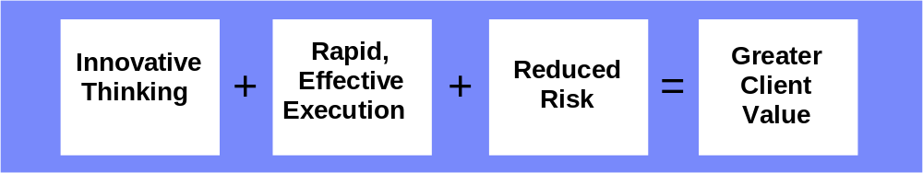
Business Consulting Services is the “tip of the arrow” for IBM solutions
Ideas to benefits -- a single, trusted partner accountable for results
Unmatched capabilities and process skills to lead clients to On Demand
Industry’s leading ISV practices and alliances
The “tip of the arrow” for IBM solutions:
  Global Services
  Servers and Storage
  Software
  Research
  Global Financing

Slide 8
The BCS Business Model
Within each geo/region:
Sectors/Industries
Comm.
Dist.
Financial
Services
Industrial
Public
SMB
GRP
GRP
GRP
GRP
GRP
SMB GTM
Strategic
Change
CRM
Solution Areas
Supply Chain
and Operations
Financial
Management
Human Capital
e-BI
BTO

Slide 9


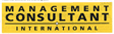


IBM BCS is recognized leader in many areas
Representative Recognition
Consulting
Monitor
#1 in understanding client’s industry
#1 in building relationships
#1 business & IT strategy consulting
#1 for enterprise resource planning
Leader in supply-chain services
#1 professional and management services provider
#1 IT services industry
Leader in customer-relationship management
#1 global consultant
#1 consulting in e-business worldwide
#1 in Business Transformation Outsourcing
Notes:
_{<number>}
_{<footer>}
_{<header>}
_{<date/time>}
IBM and PwC Consulting were already recognized leaders in many areas prior to our combination

Slide 10
The IBM BCS CRM Organization
Delivering world-class, strategy through implementation services across the entire CRM spectrum.
Industries
Service Offerings
Geographies
Financial Services
Communications
Distribution
Industrial
Public
CRM Vision
Contact Center and Channel Integration
Sales Productivity
Field Service Effectiveness
Marketing and Customer Analytics
Asia/Pac
EMEA
North America
South America
BCS World-Class
CRM Capabilities
Skills
Tools & Technologies
Analytics
CTI/Telephony
Content Management
Data Warehousing
EAI
Mobile
Portals
Web
Applications
Change Management
Business Case Realization
Communications
Customer Strategies
End-user Training
Program Management
Processes
Sales
  Field
  Inside
  Partner
  On-line
  Pricing
Marketing
Service
  Field
  Self
Avaya
BEA
Chordiant
Cisco
E.Piphany
Kana
Genesys
Onyx
Oracle CRM
PeopleSoft CRM
SAP CRM
SAS
Siebel
Unica
Notes:
What This Means to the Marketplace & Our Clients
PwC is organized to better serve clients and support our offerings
Strengthened those elements of our operating model which support execution of our vision
Removed the potential roadblocks.
Combined technology and process skills and core competencies for collaborative go-to-market.

Slide 11
IBM BCS CRM Global Support Network
When clients hire the IBM BCS team for CRM, the receive the support of our entire practice.
CRM Global Leadership
CRM Professional
Development
Methods & Tools
Operations
Alliance Program
World-Class
Global CRM Support
Quality Control Program
Knowledge Management
Marketing & Comms
Solution Delivery Centers
Analyst Relations
Top Tier ISVs
Siebel Oracle SAP PeopleSoft
Notes:
What This Means to the Marketplace & Our Clients
PwC is organized to better serve clients and support our offerings
Strengthened those elements of our operating model which support execution of our vision
Removed the potential roadblocks.
Combined technology and process skills and core competencies for collaborative go-to-market.

Slide 12
II. Marketplace
CRM Trends and Statistics

Slide 13






CRM Priorities have shifted over the years…
Historical Focus
Today’s Focus
Revenue Enhancement
Focus primarily on top-line marketing, sales and service activities
Enterprise
Integration
Link back and front office operations
ROI
Oriented
Provide measurable proof and a compelling ROI
Transformation Management
Drive incremental advantages within the context of a blueprint
Broad, Multi-channel Solutions
Integration of multiple channels across sales, service and marketing
Focused Solutions
Deliver solutions that can deliver value individually and integrate with enterprise infrastructure

Slide 14
The Merits of CRM today are being challenged
Current State of the CRM Marketplace
There is tremendous hype in the marketplace, and a proliferation of CRM opportunities that companies are trying to prioritize.
Leading organizations are recovering from the scars of failed implementations.
Ideas like “improving customer service” or “one-to-one marketing” which will improve the bottom line are being challenged in the face of spending without adequate ROI
Notes:
There is tremendous hype in the marketplace, and a proliferation of CRM opportunities that companies are trying to prioritize.
“CRM” has been referenced 30,000 times in the past 12 months in business publications, representing a 10-fold increase since 1999
Leading organizations are recovering from the scars of failed implementations.
“But the real news about CRM is its decidedly mixed reputation in the tech world. Some studies show that half of all CRM projects never work out, despite the hundreds of millions of dollars companies sometimes spend on them.” (Wall Street Journal)
“Prediction: Through 2006, more than 50 percent of all CRM implementations will be viewed as failures from a customer’s point of view because of a combination of the inability to link channels, lack of process redesign or failure to provide any real customer benefits (0.8 probability).” - Gartner Group
Ideas like “improving customer service” or “one-to-one marketing” will improve the bottom line are being challenged in the face of spending without adequate ROI
Customer Satisfaction has actually declined since 1995 relative to S&P 500 Earnings
“Strategic Planning Assumption: Through 2006, 55 percent of CRM initiatives will fail to meet measurable benefit objectives and will fail to positively affect ROI, due to lack of business processes for conducting ongoing measurements (0.7 probability).” - Gartner Group

Slide 15
But CRM is still vital to business success – the market is a large one
Worldwide CRM Services Forecast by Service Line, 2000-2006 (Millions of U.S. Dollars)
CAGR
2000 2001 2002 2003 2004 2005 2006 2001-2006
✓ Hardware Maintenance and Support 1,027 1,102 1,203 1,306 1,410 1,522 1,629 8.1%
✓ Software Maintenance and Support 945 1,095 1,224 1,454 1,719 1,982 2,257 15.6%
✓ Consulting 2,026 2,188 2,433 2,737 3,157 3,636 4,113 13.5%
✓ Development and Integration 7,470 8,126 9,175 10,528 12,179 14,201 16,208 14.8%
✓ Education and Training 333 358 401 441 516 607 669 13.4%
✓ Management Services 2,870 3,258 3,820 4,500 5,258 6,154 7,163 17.1%
✓ Business Process and Transaction Management 5,228 5,895 7,070 8,502 10,371 12,711 15,057 20.6%
Total 19,900 22,022 25,325 29,469 34,610 40,813 47,096 16.4%
Note: Columns may not add up to total shown because of rounding. Source: Gartner Dataquest (March 2002)
Growth Rates by Service Line, 2000-2006
2000 2001 2002 2003 2004 2005 2006
Hardware Maintenance and Support 12% 7% 9% 9% 8% 8% 7%
Software Maintenance and Support 32% 16% 12% 19% 18% 15% 14%
Consulting 30% 8% 11% 13% 15% 15% 13%
Development and Integration 31% 9% 13% 15% 16% 17% 14%
Education and Training 29% 7% 12% 10% 17% 17% 16%
Management Services 21% 14% 17% 18% 17% 17% 16%
Business Process and Transaction Management 29% 13% 20% 20% 22% 23% 18%
Total 28% 11% 15% 16% 17% 18% 15%
Source: Gartner Dataquest (March 2002)
Notes:
_{<number>}
_{<footer>}
_{<header>}
_{<date/time>}

Slide 16
Every industry considers CRM important
Worldwide CRM Services Forecast by Service Line, 2000-2006 (Millions of U.S. Dollars)
CAGR
2000 2001 2002 2003 2004 2005 2006 2001-2006
Financial Services 5,731 5,858 6,281 7,220 8,261 9,509 10,832 13,1%
Manufacturing 3,941 4,473 5,179 6,094 7,234 8,734 10,126 17.8%
Communications 3,685 4,008 4,938 5,982 7,026 8,571 10,031 20.1%
Services 1,664 1,861 2,140 2,387 2,803 3,306 3,815 15.4%
Government 1,262 1,762 2,026 2,328 2,769 3,232 3,730 16.2%
Utilities 1,102 1,145 1,264 1,359 1,596 1,881 2,171 13.6%
Transportation 971 1,079 1,231 1,444 1,772 2,000 2,308 16.4%
Retail 681 769 917 1,126 1,350 1,428 1,648 16.5%
Healthcare 569 742 934 1,058 1,246 1,498 1,681 17.8%
Education 247 271 342 398 467 551 636 18.6%
Agriculture, Mining and Construction 46 55 63 74 87 102 118 16.4%
Total 19,900 22,022 25,325 29,469 34,610 40,813 47,096 16.4%
Note: Columns may not add up to total shown because of rounding. Source: Gartner Dataquest (March 2002)
Notes:
_{<number>}
_{<footer>}
_{<header>}
_{<date/time>}
Reinforce Objective:

Slide 17
The combination of IBM and PwC Consulting makes IBM Business Consulting Services the leading CRM provider
Worldwide CRM Services Revenue by Top 10 Vendors, 2001
Company Revenue ($M) Share (%) Notes
Accenture 2,287 11.8 IDC estimate.
Accenture added Customer Billing to its CRM practice during FY01. Revenue figure based on FY01.
IBM Global Services 2,151 11.1 IDC estimate.
IBM Global Services has transitioned Pervasive Computing out of its
Sell and Support business unit.
Does not include contact center outsourcing.
PwC Consulting 1.100 5.7 Revenue figure based on FY01.
Does not include outsourcing.
Cap Gemini Ernst & Young 1,000 5.2 IDC estimate.
Fujitsu 960 5.0 IDC estimate.
Includes consolidated CRM services revenues for Fujitsu,
DMR Consulting, and ICL.
EDS 870 4.5 IDC estimate.
Does not include contact center outsourcing.
Deloitte Consulting 854 4.4 -
KPMG Consulting 580 3.0 IDC estimate.
Revenue figure based on FY01.
Computer Sciences Corp. 565 2.9 IDC estimate.
Does not include contact center outsourcing.
Acxiom 440 2.3 IDC estimate.
Revenue figure based on FY01.
Total top 10 10,806.9 55.8
Total CRM services market 19,353.9 100.0
Note: Revenue figures are for CY01 unless otherwise noted. Source: IDC, 2002
Notes:
_{<number>}
_{<footer>}
_{<header>}
_{<date/time>}
The combination of IBM and PwCC’s CRM practices makes us the biggest integrator in the market with almost a 20% marketshare ($3,251 combined revenue)

Slide 18
III. CRM Done Right
The BCS CRM Value Proposition

Slide 19

You’ve already cut the obvious fat
You’ve asked more from everybody
You’ve been open to any new idea
You’ve heard plenty of advice
But it’s not enough
Not enough to compete, much less thrive
Clearly not enough to get ahead
So you’re stuck
And when you’re stuck, there’s only one place to go

Slide 20
IBM BCS: Deeper in CRM
Our Definition of CRM
Our CRM Point-of-View
A business strategy comprised
of process, organizational, and technical change whereby a company seeks to better
manage its own enterprise around customer behaviors.
It entails acquiring and
deploying knowledge about
one’s customers and using this information across the various touch points resulting in increased revenue and operational efficiencies.
A focus on value and ROI is paramount to ensuring successful implementations
The movement from CRM as a buzzword, to CRM as a business discipline will alter the landscape and place more emphasis on integrating the business with the technology components, rather than simply integrating the technology
Innovative, practical solutions that address real business issues – focused around core industry dynamics – will enable leading organizations to truly transform themselves to a “customer-centric” business model

Slide 21
IBM BCS is a Leader in the CRM ESP Market
The IBM Advantage
A focus on value realization, rather than simply revenue enhancement and enterprise integration
Vision
Strategy through Operations: Global solution provider: hardware, software, & services
Deep industry expertise: World-class global sales force with deep client relationships and industry knowledge
Innovative Thinking: $5+ billion investment in research & development annually
Risk Mitigation: IBM Global Financing enables us to underwrite our client’s CRM investments.
Innovative, practical, end-to-end services from strategy through outsourcing; spanning the complete customer experience
Solutions
Cross-industry leadership in developing ground breaking, innovative solutions for world-class organizations across sales, service and marketing
Clients
Knowledge
Global knowledge repositories supporting over 5,700 practitioners; a comprehensive CRM training program; formal methods providing delivery support
Innovation
Leveraging resources across the IBM organization to bring value and new opportunities to client
Multi-tiered alliance program providing insight and competitive advantage when bringing alliance partners to our clients
Alliances

Slide 22
IBM BCS Provides An Unbeatable CRM Value Proposition
Business Impact
Value We Bring
Increase Revenue
Improved revenue and organizational performance through the creation of an enhanced customer experience
Reduce Costs
Reduce the cost of doing business and lower the cost associated with CRM implementation expenses
Mitigate Risk
Avoid the usual risk associated with CRM implementation through reliable, tested solutions
Speed Time to Market
Leverage our CRM Accelerators to fast track your implementation and get to market quickly for a lasting competitive advantage
Realize the Rewards
Take advantage of IBM’s financing arrangements which lower total cost of ownership and ensure mutual rewards are realized upon solution delivery
Notes:
_{<number>}
_{<footer>}
_{<header>}
_{<date/time>}
Reinforce Objective: Articulate our CRM value proposition

Slide 23
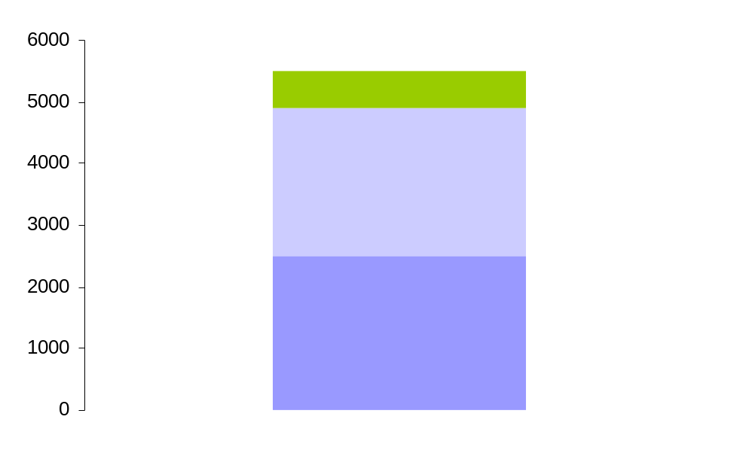
IBM BCS Global CRM Practitioners
5,700 CRM consultants globally, aligned to both industry and CRM solution competencies; spanning strategy, business process, and technology skills
Global CRM Consultants: ~5700
Other IBM CRM Staff (BTO, SO, SWG-GBIS, and S&D): ~5000
CRM Consultants: Breakdown by Geo
AsiaPac 800
EMEA 2400
Americas 2500
Notes:
_{<number>}
_{<footer>}
_{<header>}
_{<date/time>}
The combination of IBM and PwC Consulting creates a business-services partner of unmatched breadth and depth

Slide 24
IV. Solutions
Innovative CRM Service Offerings and Case Studies

Slide 25

IBM BCS CRM Offering Portfolio – Ideas to Outsourcing
What do I do ?
Strategy, Business Case, Roadmaps, ROI
Value Optimizers
CRM Vision
Help me Do it ?
Contact Center
&
Channel Integration
Change & Program Management
Process, Organization,
Performance Metrics
Package Implementation
System Integration
Sales
Productivity
Field Service Effectiveness
Marketing & Customer Analytics
Do it for me ?
CRM Management Services
Outsourcing (IT, Application, CRM Process)
business on demand
Notes:
_{<number>}
_{<footer>}
_{<header>}
_{<date/time>}
Reinforce Objective: Articulate our CRM value proposition

Slide 26
CRM Vision
CRM Vision focuses on helping our clients:
  Achieve consensus around their CRM strategy and identify the capabilities required to meet business goals
  Create a view of the end state, from a customer and company perspective, and a benefits-driven blueprint of what it looks like
  Establish the transformation program, an integrated set of projects required to deliver new business capabilities using a value-based, staged approach
Key to our approach is a focus on value realization and identifying core CRM capabilities through our industry- recognized Maturity Model framework.
Our Offerings
CRM Value Proposition
Blueprint and Roadmap
Transformation Program
Client Facing Benefits
Ensures management buy-in on CRM vision and business objectives and acts as a rallying point for executive sponsorship
Align the vision with shareholder and customer value
Aligns the strategy with the operations (marketing, sales, and service) by linking the value proposition with customer facing process or channels
Notes:
_{<number>}
_{<footer>}
_{<header>}
_{<date/time>}
Reinforce Objective: Articulate our CRM value proposition
Client Examples
Aventis (klaber – follow-up to last year’s reference)
Sprint (dan)
Dell (dan)
AT&T Wireless (klaber)

Slide 27
CRM Vision Case Study: US insurer
Introduction
This company had a declining brand and was organized and driven by distribution channels and product units. They wanted to transform its organization into a customer centric business model.
Business Problem
The company, traditionally resistant to change, was experiencing declines in market share, erosion of its traditional distribution channel, high expense ratios, poor data quality, low household penetration and customer defections, making the Company less competitive in the marketplace. The Company wanted to increase revenues, improve marketing and sales effectiveness, improve household product density and reduce unit costs
Our Solution
Build a vision of the future state customer centric environment and perform a gap analysis
Develop a strategic roadmap and timeline to transform the organization to a customer centric model
Our Solution, cont.
Perform marketing proofs of concept through data mining and customer segmentation and use to build a business case for the transformation of the organization to the customer centric model
Develop Infrastructure to support the customer centric model
  Adopt Industry standard data model (IAA) and perform data quality assessment
  Develop middle-ware to support data integration
  Build operational data store to support customer centric environment
  Build data warehouse and data marts to support customer centric marketing efforts
  Build a common front end for customer facing interactions
Business Benefits
Improved access to high quality data, improved marketing efforts, and improved sales effectiveness
Reduced marketing unit costs and reduced service unit costs

Slide 28
Sales Productivity
The Sales Productivity solution focuses on strategies and solutions to improve sales performance Key principles of our solution are a focus on:
  Driving effectiveness and efficiency through all stages of the sales process, and
  Transforming sales operations to drive revenue and create customer value in the selling process based on an appropriate cost of sale.
Our solutions include direct (field), indirect (distributor) and partner (alliance) channels.
Our Offerings
Sales and Channel Strategy
Sales Diagnostics
Sales Force Automation & Integration
Partner Relationship Management Integration
Client Facing Benefits
Optimize selling resources to drive sales growth and reduce cost of sales
Provide more accurate forecasting and pipeline management
Increase the delivery and use of critical information to sales representatives
Shorten the sales cycle and time-to-market
Notes:
_{<number>}
_{<footer>}
_{<header>}
_{<date/time>}
Reinforce Objective: Articulate our CRM value proposition
Client Examples
Aventis (klaber)
Warner Bros (klaber)
Verizon (klaber)
Caterpillar (IBM)
JP Morgan Chase (IBM)

Slide 29
Sales Productivity Case Study: Communications Manufacturer
Introduction
The client started a CRM initiate to improve customer satisfaction, increase market share/revenue/margins and consolidate its cross-sector sales tools on to one platform. BU’s include – Custom Computing, Telecom Batteries, Automotive Telephony and Automotive Controls.
Business Problem
Consolidate multiple SFA tools
(4) Product based sales teams
Disparate sales processes, materials
Distribute customer information
Our Solution
Single instance, Siebel Multi-Org
Account, Global Account teams
Global sales processes, shared tools
Rolled up CRM Customer Master D&B
Business Benefits
14 month, 2-Phase implementation
Sector wide roll up reporting
GAM – Global Account Management tools
Consistent sales processes/tools

Slide 30
Contact Center and Channel Integration
The Contact Center and Channel Integration solution helps our clients:
  Improve efficiency and effectiveness of contact center operations
  Design and implement a contact center model that delivers a superior customer experience
  Achieve reasonable cost-to-serve, through consistent approaches to dealing with customers across all channels within the contact center (phone, web, IDTV/kiosk, mobile access. etc).
The solution spans inbound and outbound sales and service.
Our Offerings
Contact Center Strategy
Contact Center Consolidation Strategy
Contact Center Diagnostic
Contact Center Integration
Telephony Integration
Client Facing Benefits
Rationalize and optimize your customer care assets to reduce cost of care
Migrate lower value customers and transactions to lower cost media/channels (IVR, web, email)
Consolidate and standardize care processes and infrastructure
Notes:
_{<number>}
_{<footer>}
_{<header>}
_{<date/time>}
Reinforce Objective: Articulate our CRM value proposition
Client Examples
Thomson Learning
Aventis (klaber)
AT&T Wireless (klaber)
PG&E (IBM)
BC/BS of Tenn (IBM)
Abbott Labs

Slide 31
Contact Center Case Study: A US commercial airline
Introduction
A leading US commercial airline with global operations serving in excess of 200,000 passengers per day. Client operated six contact center locations fielding 4,500 agent positions, and staffed by 7,000 customer service representatives.
Business Problem
The client needed to Design, development and implementation of a contact center solution for customer service organization.
  Implement the capability to serve low-value customers in a cost-efficient manner
  Reduce operating costs
  Establish a 360º view of the customer
  Enhance its ability to share information across touchpoints
Our Solution
IBM Business Consulting Services conducted a contact analysis to establish a baseline performance level and identify process reengineering opportunities. The project team developed a working desktop prototype integrated with the existing legacy application that clearly demonstrated business benefits. Redesigned call flows and technical architecture.
Business Benefits
Fifteen percent reduction in AHT
Reduced cost of direct selling and ticketing
Established an infrastructure to allow information sharing across customer service organizations
Notes:
_{<number>}
_{<footer>}
_{<header>}
_{<date/time>}

Slide 32
Field Service Effectiveness
Our Field Service Solution focuses around four market segments:
  Product Service
  Utility Emergency Repair
  Medical Device support
  Sales support, Insurance claims processing
The solution helps our clients to improve customer and employee satisfaction, and dramatically drive down the “cost to serve,” often resulting in improved revenue.
Looking across the entire Field Service lifecycle, We help to set competitive metrics, simplify/standardize processes and leverage technology aggressively but prudently.
Our Offerings
Field Service Strategy
Field Service Diagnostic
Field Service Integration
Client Facing Benefits
Improved customer satisfaction at a lower cost of service
Improved revenue through enhanced cost competitiveness
An integrated view on field service and customer care activities
A more responsive and knowledgeable field service organization
Notes:
_{<number>}
_{<footer>}
_{<header>}
_{<date/time>}
Reinforce Objective: Articulate our CRM value proposition
Client Examples
PDI
Sprint (strategy – dan)
Abbott
PG&E (IBM)

Slide 33
Field Service Effectiveness Case Study: Health Care
Introduction:
  A Multi-billion dollar diversified health care company with over 1,000 Field Service Techs that repair diagnostic equipment.
Business Problem
  Reduce cycle repair time
  Improve quality of first-time repair
  Improve reagent sales due to faster repair
  Simplify tracking of data
Our Solution
  Maturity Model and Project Roadmap
  Siebel Field Services, improved processes
  Potentially Axeda remote diagnostic
Business Benefits
  Strategy, project plan and Siebel implementation completed
  Anticipated cycle time reduction, improved information and processes, added revenue

Slide 34
Marketing and Customer Analytics
The Marketing and Customer Analytics solution focuses the use of customer data to provide differentiated responses to an organization’s existing or proposed customer base.
Our solution provides:
  Analytics and analytical models that enable the appropriate actions to be identified
  Business processes-- and the technology required to support them--that make use of the analytics
  Organization and training required to operate the new business processes
  Data required to deliver the analytics and business processes
Our Offerings
Analytics Vision
Campaign Management Strategy
Analytics Integration
Campaign Management Integration
Customer Data Warehousing & Data Mining
Client Facing Benefits
Increase effectiveness of targeting and customer segmentation to optimize “marketing spend”
Drive a tighter ROI and provide a measurable payback on marketing campaigns
Adopt new processes and technologies to reduce campaign cycle times and costs
Increased level of understanding and tracking customer profitability and customer behaviors
Notes:
_{<number>}
_{<footer>}
_{<header>}
_{<date/time>}
Reinforce Objective: Articulate our CRM value proposition
Client Examples
GM (can anyone talk to it?)
CTBC Telecom (JJ – South Americas)
Telemig Cellular (JJ – South America)
Canadian Medical (Philip – canada)

Slide 35
CRM Business Transformation Outsourcing (BTO)
The CRM Business Transformation Outsourcing (CRM BTO) solution, provides and end-to-end solution to our customer CRM needs, assisting in the transformation of their business around an enterprise-wide CRM strategy. The solution provides
  A Business Transformation Roadmap to define the customer CRM needs, identify required change
  Implementation of best of breed, industry-specific CRM tools, processes and practices
  An on-demand solution to support the enterprise CRM strategy through a scalable, secure, reliable infrastructure
  A one-stop shop for CRM solutions, through selected global alliances with selected SW and Call Center vendors
Our Offerings
CRM Vision and Transformation Consulting
Implementation Services for Sales, Support, Billing and Marketing operations
e-Business on Demand (CRM Operate)
Call Center Operations
Client Facing Benefits
Increased Revenue through the creation and delivery of an enhanced customer experience
Reduced costs by leveraging best practices, on-demand solutions and alliances to reduce the cost and increase the effectiveness of customer interactions
Improved Customers Satisfaction, through an optimized, value-focused, customer interaction experience
Immediate financial impact, through financing and IT solutions that reduce the customers upfront investment
Notes:
_{<number>}
_{<footer>}
_{<header>}
_{<date/time>}

Slide 36
V. Accelerators
Implementation Tools and Methods

Slide 37
Our Solution Delivery Framework
CRM Accelerators
Industry-specific value
propositions (PoVs)
Integrated demonstration
environments
Service Offerings, Methods, and Tools
Business
Process models
Data models
Software templates, code
Architectures

Slide 38
Industry Specific Value Propositions
Industry-specific
Value propositions
Communications
Distribution
Financial Services
Industrial
Public Sector
CRM Solution for Publishers and Broadcasters
Mobile Work Force Utilities
Retail Strategies for EMEA utilities
Siebel / SAP ISU Integration
Merchant Reach Solution
Retail Perspectives on CRM & Customer Loyalty
World Class Key Account Management
Superior Economic Engagement with General Customers
Trade Funds and Trade Promotion Management
Consumer Insight & Innovation
Customer Centricity
Base II Value Proposition
Closed Loop Marketing
Simplify to Succeed
iAnalytics for Global Banking & Financial Institutions
Multichannel Customer Management in Retail Banking
Automotive PoV
e-S+P21 Sales and e-Service
Oil Industry CRM PoV
Automotive aftermarket / retail portal solution
CRM in the Oil and Gas Industry
eGovernment Solution
Pharma Sales & Marketing Effectiveness
Multichannel Strategies
Note: These materials include re-useable Sector Specific CRM Solutions and
Business Insights

Slide 39
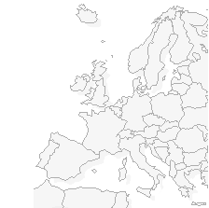

EMEA Wide Demonstration Capabilities
Integrated Demonstration
Environments
Stockholm
Our Innovation Centers around EMEA are interactive design and development studios that help our customers strategise, design, develop, and manage their e-businesses
London /
Heathrow
Hamburg
Walldorf
Paris
La Gaude /
Montpellier
Milan
Madrid
Notes:
The Solution Delivery Centers:
Provide live demonstrations and scenarios to help our clients visualize their solution
Provide customized solutions and comparison capabilities of IBM BCS CRM strategic and technical offerings to executives with specific applications
Create an environment where envisioning workshops can take place to allow for more rapid buy-in to solution alternatives
Provide a facility where new or enhanced solutions can be incubated (prototyped), as well as developed and hosted if desired
Are central locations for our clients to gain knowledge and information about what is happening in their industry and how we can help them achieve their business objectives

Slide 40
Service Offerings Methods and Tools
Methods:
Full lifecycle complementary methods providing detailed, customizable
routes maps, deliverables and formats, across:
  Strategy, vision, design, implementation, through post-implementation
  Process, organization, operations, change management, project management
  Package implementation, system integration, data warehouse
Tools:
A range of strategy and implementation tools linked to the methods, including:
  Industry-specific Maturity Models providing clients with a view of core capabilities required to achieve key business objectives
  ROI Toolbench
  Assessment Toolkits
  Project management tools
Service Offerings Methods
and Tools

Slide 41
Models, Software and Architectures
Models, Software Templates
and Architecture
Business
Process models
Data models
Software templates, code
Architectures
By Functional Area
By Industry
Customer Data Model
Customer Interaction Model
Pricing Model
Product Model
Data Standards
Industry Specific Application Templates
EJBs
Application Connectors
Pre-configured Software
Functional Architecture
Application Architecture
Physical Architecture

Slide 42
VI. Alliances
Strong Alliances with Leading ISVs

Slide 43












Our CRM Alliances
Integrated Alliances
Managed Alliances
Marketing Alliances
Notes:
_{<number>}
_{<footer>}
_{<header>}
_{<date/time>}
Tier 1 also includes: ($150M+)
SAP
PeopleSoft
Siebel
Oracle
JD
i2
Dassault
Tier 2 also includes: ($25M+)
Documentum
Vignette
Great Plains (MS)
Lawson
Hyperion
Informatica
Congos
SA
Sas
Arib
Manugistic
Matrix One
MR
Retek

Slide 44
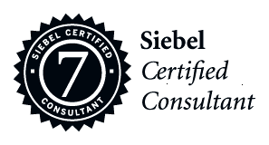
Siebel
IBM has been a Siebel Global Strategic Alliance Partner for 5+ years. Rated by Siebel at the highest level in Integrator Customer Service – Gold Star Distinction.
Strategic Global Alliance
Extensive Experience
More than 700 clients and 1000+ projects, on every continent and within every industry
Customer Satisfaction
Winner of 7 Siebel partner excellence awards. One of only 3 other firms ever to win these prestigious awards.
Skilled SAP Consultants
1,500 Siebel-skilled resources worldwide with over 890 Siebel 7.0 Certified Consultants – more than all other Siebel Global Strategic Consulting Partners combined
Joint Development
Siebel has selected IBM platforms and is running its applications on DB2 for development & production. IBM partners with Siebel from development through testing and deployment
Firsthand Experience
IBM is Siebel’s largest customer
First to Market
IBM has delivered many Siebel firsts with Siebel 7 ePharma, Siebel WAP Solution, Siebel 2000, Siebel ‘99, Siebel Marketing and various vertical solutions
Key CRM clients: The Hartford, Abbott Labs, AT&T Wireless, General Motors

Slide 45
SAP CRM
IBM BCS has been an SAP Global Strategic Alliance Partner since 1989.
IBM BCS was SAP’s first global alliance partner. CRM alliance agreement
was signed in 2001
Strategic Global Alliance
Extensive Experience
More than 1,500 joint SAP client projects around the world, on every continent and within every industry. Approximately 25 SAP CRM projects.
  IBM BCS has won the SAP Award of Excellence everywhere it has been offered, winning more awards around the world than any other SAP implementation partner. In 2002 a perfect score in CRM was required to win the Award of Excellence.
Customer Satisfaction
Skilled SAP Consultants
8,200 SAP-certified consultants worldwide and 300 experienced and trained SAP CRM consultants
Joint Development
Jointly developed HT SAP CRM solution, input into Trade Promotion Management, Pharma and Key Account Management solutions
SAP Tools & Resources
  Implementation tools, techniques, accelerators, knowledge management systems and a global support network to jump-start projects
First to Market
Delivered SAP first Global Mobile Sales implementation; first to implement Mobile Workplace; first to implement 3.0 capabilities. Implementing 3.1
Key CRM clients: Nestle, SAP, Cadbury, Symbol, US Customs, Perkin Elmer

Slide 46
PeopleSoft CRM
Longest Standing and Strongest Alliance
IBM has been a PeopleSoft global alliance partner since 1987
Largest PeopleSoft Practice
Over 2,000 fully experienced staff globally with an average of 5+ years of PeopleSoft experience making IBM the largest PSoft SI Partner in the world
PeopleSoft’s Most Valued Partner
Only Partner to win PeopleSoft Award of Excellence.
Largest Base of Successful Engagements
Over 800 successful implementations across PeopleSoft’s full suite of applications, in over 50 countries around the world.
IBM’s Depth and Breadth in the Market
With over 1,600 PeopleSoft customers using IBM technology, IBM has unique insights invaluable to new customers.
First to Market
Market leader in PeopleSoft v8 implementations. With regards to CRM, IBM developed, with PeopleSoft, the Vantive to PS 8 CRM upgrade methodology and a white paper on the PS CRM 8.4 Data Model.
Project Accelerators
Implementation tools, techniques, accelerators, knowledge management systems and a global support network to jump-start projects.
Unparalleled Industry, Product and Process Skills
Our strong industry, product and process skills are relevant from early strategy through live operation, and we know how to leverage those skills to our customers’ advantage.
Key CRM clients: ABN Amro, Lufthansa, Nextel, Thomson Financial, Compensation Insurance Fund (CA), TPSA (Polish Telecom)

Slide 47
Oracle CRM
Strategic Global Alliance
More than a decade of successful teaming with Oracle; Global practice structure with dedicated global partner leadership; Monthly CEO meetings to ensure successful partnering an customer success.
Extensive Experience &
Customer Satisfaction
Over the last ten years, more successful Oracle projects to the Fortune 500 than any other service provider and has developed the largest independent global Oracle consultancy. Voted by Oracle executives, received the 2000 Global Partner Award.
Skilled Oracle Consultants
Largest independent Oracle consultancy — 1,400+ consultants world-wide.
Dedicated Global Oracle Training Center providing ongoing applications and methods training to consultants
Vertical Focus
Extensive vertical implementation experience and Oracle-specific industry approaches & solutions
  Implementation tools, techniques, accelerators, knowledge management systems and a global support network to jump-start projects. These include Oracle Center of Excellence, Oracle Global Training Center, Oracle RapidPath Method, and Oracle Advance Software Engineering Centers.
Oracle Tools & Resources
Key CRM clients: AT&T Business Services, Tyco, Imaginistics

Slide 48
VII. Infrastructure
Valuable IBM Resources

Slide 49
IBM’s Global Financing (IGF) can eliminate initial investment hurdle
Contact Center Engagement Example
Illustrative
Cost-savings only
An IBM-delivered solution can deliver measurable cost reduction
  Facilities & asset consolidation
  Improved customer service
  AHT and operations improvements
There are also revenue enhancement opportunities available to the
  Personalized offers
  Maximize existing relationships through business intelligence
Lastly, the opportunity cost associated with a
-managed solution will have a huge impact on investment alternatives for years to come
Baseline Cost Case - Business as Usual
Dollars
Typical Contact Center Implementation
IBM’s financing program enables typical up-front project investment to be avoided
Benefits are realized sooner through deferment of project costs
IBM CCT Implementation
Time
* Space between baseline and solution alternative represents savings to the client
Notes:
_{<number>}
_{<footer>}
_{<header>}
_{<date/time>}
Depending on the client’s financial objectives, we make the investment hump go away – but that requires an end-to-end solution (i.e., Design, Build and Run solution)
This graph is based on ACTUAL customer data – However, since there are no specific numbers on the graph, it is by definition illustrative.
The "red" line is based on what it would cost the customer to do the program themselves. The "blue" line is the customer's TOTAL cost line (which includes both the IBM price and the customer retained expenses). As you can imagine, IBM has an internal cost line that has a "hump" like the red line, but we find ways to finance that hump throughout the life of the deal. Now the tricky part is the end-state costs. Customers may ask, why can you do it cheaper that I can? Here some reasons (not an inclusive list):
1. We have tools and methodologies to do the work (vs. an internal IT shop)
2. We can run equipment cheaper than they can (example is we get deeper discounts on Sun maintenance costs than customer)
3. We can design a shared services solution that would run at an IBM site (requiring fewer FTEs and facilities costs to support)
4. Our technical design can save them money (especially with technology refresh)
5. We can buy software cheaper (with our extensive purchasing power)
6. We will commit to price and delivery date (many companies have poor internal history on IT delivery and cost estimates – thus the businesses (LOBs) often put a burden on top of IT estimates – which we won't have because we will contract for it)
Note that we are not saying that we can always get to a cheaper end-state (even after financing up front costs), but it is possible. We have very detailed business cases that support curves like this. They are specific for each customer.

Slide 50
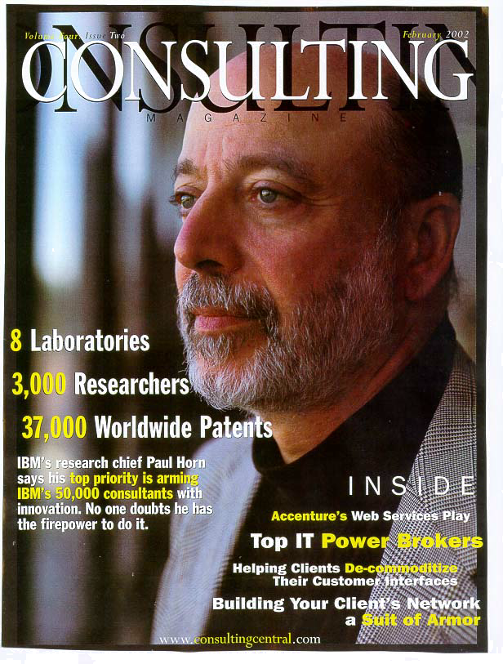
IBM Research
IBM Research is the world’s largest information technology research organization, with more than 3,000 scientists and engineers at eight laboratories in six countries. In addition, IBM maintains more than two dozen development labs around the world
"This idea of a services organization realizing assets is something we're paying close attention to — it's The Big Idea.“
— Paul Horn, IBM Research
"... if the largest producer of intellectual property was also the largest supplier of professional IT services, traditional consultancies would have a lot to fear. It is, and they do.”
— Consulting Magazine February, 2002

Slide 51
IBM Research – The Client Benefits
Clients:
A Global Automobile Manufacturer – Early Warning System using Advanced Analytics
Large Insurance Company – Federated Data Warehouse for Agents using Advanced Security & Privacy components
Leading Catalog Retailer – Mail Stream Optimization / Multi-Channel Horizontal Marketing
Innovations:
Advanced Natural Language Voice Recognition & Translation – Contact Centers, Cell Phone, Websites
Real-Time, Self-Tuning, & Fully Automated Segmentation Models – Marketing Campaigns, Websites
Text Mining – Customer Analysis, Competitive Intelligence
Advanced Mobile/Wireless/RF Technologies – Real-Time, Self-Sensing, & Highly Personalized Offers over Cell Phones, PDAs, or Kiosks

Slide 52
Institute for Business Value
IBV Capabilities
Thought Leadership Deliverables
In-depth industry landscapes
Issue-based consulting studies and value realization stories
White papers
Client Member Programs
IBV’s member programs (Business Value Alliance and Institute for Knowledge-Based Organizations) provide strategic deliverables, dialogue, and community to clients
Deployment and Community
Foster development of industry-based communities
Educate selling partners
Trained practitioners globally
The Institute for Business Value runs two retainer membership programs for senior executives:
Business Value Alliance
Institute for Knowledge-Based
Organizations
The Business Value Alliance is a sector-based global community of member organizations committed to driving business value from understanding the key drivers of competitive advantage in their industry.
The Institute for Knowledge-Based Organizations is a global community of member organizations committed to understanding and deriving tangible business value from knowledge management and the leverage of knowledge-based assets throughout their companies.

Slide 53
Institute for Business Value – CRM Insights
The Customer Dynamics track within the member programs focus on issues of changing customer behavior
IBV Studies
Type of Content
Date Completed
The Dismal State of Customer Satisfaction: How Can You Delight Them?
Value Realization Study
February 2002
Collaborating with Your Customers to Create Innovative New Products and Services
Value Realization Study
June 2002
How Do You Drive Customer Adoption and Affect Customer Loyalty Through Indirect Channels
Value Realization Study
White Paper in production
October 2002
Next Generation Consumer Advertising
Value Realization Study
February 2002
Innovative Market Research Techniques and Technologies
Value Realization Study
June 2002
Marketing of Alliances
Value Realization Study
White Paper in production
October 2002
Sales Force Management
Value Realization Study
October 2002
Go Ahead. Ask Them. Unlocking Actionable Consumer Insights
Business Value Directions Journal Article
September 2002
Customer Satisfaction: Do You Know the Score?
White Paper
April 2002
Countdown to product launch: are you confident your customers will buy?
White Paper
October 2002

Slide 54
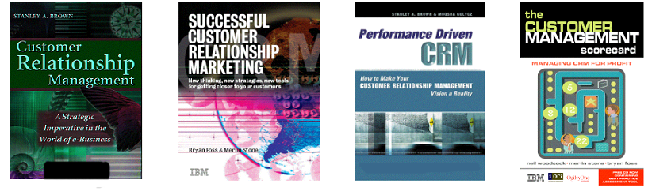
CRM thought leadership – cross sector
CRM: A Strategic Imperative in the World of E-Business
Multi-channel Value Quantification: An IBM BCS Consulting Research Initiative
Performance Driven Change: How to Make your CRM Vision a Reality
Achieving Success Through Performance Driven CRM: IDEAS 2001 Survey
Optimizing Multi-Channel Performance
Successful Customer Relationship Marketing
The Customer Management Scorecard
Multichannel Customer Management: The Benefits and Challenges (Journal of Database Marketing 2002)

Slide 55
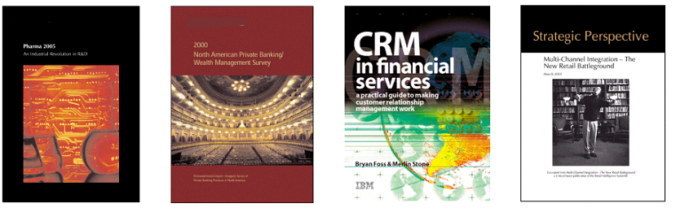
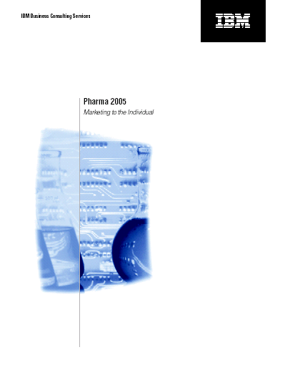

CRM thought leadership – industry specific
Pharma 2005 (Pharma 2010 to be released Nov. 2002)
2002 North American Private Banking/Wealth Management Survey
Global Energy Retailing Revolution
Multichannel Integration — The New Retail Battleground
Hitting Your Target Customer Segments Through Interactive Television (iTV)
Optimizing Distribution Channels: The Next Generation of Value Creation
The implications of e-commerce for strategy: UK case studies (Journal of Financial Services Marketing February 2002)
CRM in Investment Banks (JFSM 2002)
Financial Services Markets (JFSM 2002)
CRM in Financial Services

Slide 56
VIII. Credentials
Accolades from Analysts and Clients

Slide 57
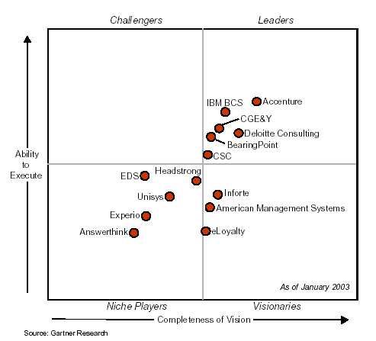
IBM BCS CRM practice has been listed as a CRM external service providers Leader by Gartner, Inc. for the past five years.
CRM Service Provider Magic Quadrant for the Americas Region in 2003
Source: Gartner “Management Update: CRM Service Providers 2003 Americas Magic Quadrant” B.Eisenfeld, January 2003
The Magic Quadrant is copyrighted January 2003 by Gartner, Inc. and is reused with permission. Gartner permission to reprint its Magic Quadrant should not be deemed to be an endorsement of any company or product depicted in the quadrant. The Magic Quadrant is Gartner’s opinion and is an analytical representation of a marketplace at and for a specific time period. It measures vendors against Gartner-defined criteria for a marketplace. The positioning of vendors within a Magic Quadrant is based on the complex interplay of many factors. Well-informed vendor selection decisions should rely on more than a Magic Quadrant. Gartner research is intended to be one of the many information sources and the reader should not rely solely on the Magic Quadrant for decision-making. Gartner expressly disclaims all warranties, express or implied of fitness of the research for a particular purpose.

Slide 58
Sol Melia on the IBM BCS CRM Practice
“Overall, Sol Melia is a very satisfied client of IBM Business consulting Services. It describes its implementation ‘as a miracle’ in terms of scheduling and the performances of the different parts involved in the project. IBM Business Consulting Services provided Sol Melia with the right people and has shown flexibility and willingness to adapt.”
“The performance of IBM Business Consulting Services in this successful project must be commended, as the many constraints of time and integration complexity, led to this being a very challenging project.”
A Case Study: IBM Business Consulting Services Builds and Integrates Multi-channel Strategy for Sol Melia, February 2002

Slide 59
Gartner on the IBM BCS CRM Practice
“CRM initiatives are successful when companies identify measurable CRM objectives and craft a business case to explicitly justify investments in CRM capabilities that are increasingly becoming milestone-driven. Understanding the maturity level of existing CRM capabilities and cost/benefits of improvements focuses clients on achieving their phased objectives while minimizing risk of over/under-investment. PwC Consulting's* value-based CRM methodology, is one such approach.”
-- Scott Nelson, Gartner January 2002
“The key differentiator for Pharma companies in today's market is articulating a multi-channel CRM strategy that provides real benefits. PwC Consulting* is one firm that understands CRM in this industry from a strategic level -- especially as it relates to the compliance issues facing this regulated market.”
--Dale Hagemeyer, Gartner January 2002
* NOTE THAT IBM recently completed its acquisition of PricewaterhouseCoopers' global management consulting and information technology services business, PwC Consulting. As a result, PwC Consulting is no longer a part of the PricewaterhouseCoopers network of firms, and is now a part of the IBM Global Services business unit. Accordingly, all references to PwC Consulting or PwCC in this document should be deemed to be references to IBM Global Services. IBM (including IBM Global Services) and PricewaterhouseCoopers are not the same organisation, and neither governs or is affiliated with the other, or any affiliate, subsidiary or division of the other.

Slide 60
First Services Networks on the IBM BCS CRM Practice
“According to Eric Glerum, First Service Networks' Vice President of Sales and Marketing, IBM Business Consulting Services was chosen because of their excellent reputation as a consulting firm, as well as their proven experience in information technology and Internet related initiatives.
In choosing a partner to design and implement the solution, First Service Networks had good fortune. IBM Business Consulting Services brought competencies to the table in all of the disciplines needed to complete the project. Furthermore, IBM Business Consulting Services has significant relationships with both Siebel and JD Edwards that helped facilitate a strong working relationship.”
— Brian Bingham, IDC, A CRM Case Study: Field Service Meet WAP as IBM Business Consulting Services Deploys Siebel 2000 to Empower First Service Networks’ Field Service Representatives January 2001

Slide 61
First Services Networks on the IBM BCS CRM Practice
“There were several factors that contributed to the success of this project. In short, these factors were attributes effused by IBM Business Consulting Services practice. Specifically, the global presence, expertise (particularly in consulting and implementation) of technology, and breadth of solutions by vertical industry are competencies that all but guaranteed the favorable outcome witnessed in this case study.”
-- Brian Bingham, IDC, A CRM Case Study: Field Service Meet WAP as IBM Business Consulting Services Deploys Siebel 2000 to Empower First Service Networks’ Field Service Representatives January 2001

Slide 62
IDC on the IBM BCS CRM Practice
“The range of client experiences for IBM [BCS] in the Asia/Pacific region is also strong. They have developed CRM solutions for a number of regionally significant telecommunication organizations, financial service companies, IT hardware suppliers, airlines and government bodies.
IBM BCS’s Asia/Pacific CRM business has been particularly successful… IBM [BCS] must continue its excellent track record to date...”
— Phil Hassey, IDC Asia/Pacific IT Services Newsletter, January 2001

Slide 63
IDC on the IBM BCS CRM Practice
“Change management is considered one of the most critical elements when an organization is considering any business solution initiative. Murphy's believes that IBM Business Consulting Services role in providing ongoing coaching throughout the project and transferring knowledge to the team has contributed to the success of the initial phases of the CRM project and has mapped out a path for the management of future change initiatives.”
— Rasika Versleijen-Pradhan, IDC, Measuring Customer Loyalty in the eBusiness Era: Five Real-Life Case Studies December 2000

Slide 64
IX. Contacts
The IBM BCS CRM Leadership Team

Slide 65
BCS Global CRM Sector and Solutions Leadership Team
North America
EMEA
AsiaPac
Theater Leads
Adam Klaber*
Ralph Schuler
Stuart McGregor
SECTORS
Communications
Dan Nellius
Glynn McConnell
Distribution
Lori Steele
Peter Monk
Financial Services
David Campbell
Tage Domela Niewenhuis
John Armstrong
Industrial
Dan Hirschbuehler
Peter Monk
Public
Mike Plymack
Henrik Bodskov
Sara Cheng
SMB
Julie Johnson
BTO
Pat Howard*
Hammou Messatfa
TBD
SOLUTIONS
CRM Vision
Steve Lavalle
Christian Petross
John Armstrong
Sales Productivity
Tony Steel
Phil Walker
Peter Monk
Contact Center & Channel Integration
Andy Pritchard
Adolfo Arana Herencia
Glynn McConnell
Marketing and Customer Analytics
Mark Ramsey
Gavin Potter
Rod Bryan
Field Service Effectiveness
Tim Thompson
Sam Anahory
Peter Monk
ALLIANCES
Peoplesoft CRM
Guy Heiser
TBD
SAP CRM
Lori Mingo
Wolfgang Ries
Richard Arkell
Siebel
Jeff Jordan*
Tage Domela Niewenhuis
Damian Coburn
Other CRM Alliances
Ricardo Lobo
*Denotes Primus Global Leaders

Slide 66


Slide 67
Appendix

Slide 68
Other IBM Global Services Leadership Highlights
Ranked #1 in On-Demand Services by IDC. “IBM is the first company to make public a comprehensive strategy to pursue business by adopting the (e-business on demand) model,” said IDC analyst David Tapper. “Given IBM’s dominance as an IT outsourcer ... If successful, IBM could establish itself as ‘the Dell’ of the services industry, creating a market in which competitors lose the ability to compete, or find themselves playing constant catch-up to IBM.” IBM’s On-Demand Services: Customers Say Big Blue Can Supply the IT Utility, but Challenges Remain (Dec. 2002)
Leading provider of business solutions for industry-specific business needs. According to Summit Strategies. “The transformation from product-led to services-led selling is already leading to more business-responsive solutions ... No single vendor or provider can hope to match IBM acorss the full span of disciplines required to power a true services-based business model,” said Tom Kucharvy. Succeeding in the New Services-Based IT Industry (Nov. 2002)
Positive Reaction to IBM’s new e-business on demand strategy unveiled on Oct. 30:
Forrester Research: “"Today, IBM's CEO, Sam Palmisano announced IBM's new strategy to support customers with "on-demand infrastructure ... Forrester applauds IBM's commitment to transform infrastructure pricing to help companies better match IT investment to business returns." IBM Charts A Course To On-Demand Infrastructure (Oct. 30, 2002)
Amy Wohl Associates: "The Palmisano vision looks to a new On Demand era of business and technology that will create enormous opportunities for IBM, the computer industry, and its customers." IBM’s Palmisano Has A Vision (Nov. 2, 2002)

Slide 69
Other IBM Global Services Leadership Highlights (cont.)
Giga: “Giga expects IBM to be a leading player in the market for these more flexible, modular, self-managing service-oriented platforms. Long-term, IBM has the massive intellectual property assets and cross-platform and industry coverage that Sun does not (have).” IBM Announces On Demand Operating Environment (Nov. 5)
Tier 1 Research: IBM adds Chairman role to CEO; holds the Sam Palmisano Event about $10 billion on-demand strategy. “Our opinion is that this was a flawless start to his reign and one that, as he stated in his opening comments, is one of the most challenging economic environments in most people’s business history,” said Andrew Schroepfer. (Nov. 1, 2002)
Ranked #1 in Brand and Reputation Management for the e-business on demand marketing campaign. ITSMA, the global adviser to companies that market and sell technologies, in awarding IBM a Diamond Services Excellence Award, said: “IBM developed ‘e-business on demand’ to respond to key points of pain for business executives.” (Oct. 15, 2000)
Ranked as the leader in high-availability services. Gartner says, “IBM's leadership position reflects strong results in many aspects of its vision and ability to execute. IBM has the world's largest services organization and the widest array of services dedicated to high availability, from business and IT consulting services through to directly delivered business-continuity services.” Server Vendors’ High-Availability Services: Magic Quadrant (Sept. 30, 2002)

Slide 70
Other IBM Global Services Leadership Highlights (cont.)
Ranked #1 in worldwide storage services market in Gartner Dataquest’s debut survey, which said IGS had 15 percent of the market. “Largely as a result of its outsourcing services, IBM is by far the market share leader among hardware and software vendors ... IBM maintains its leadership across all geographies ... In 2003, Gartner Dataquest believes that IBM will maintain storage services revenue leadership because of the increasing importance of storage services to its strong outsourcing and managed hosting businesses.” Leaders Emerge in Storage Services Market (Sept. 11, 2002)
Ranked #1 provider of networking services worldwide. IDC says, "Once again, IBM claimed the market share leadership position, owning 17.7 percent of the $19.2 billion global market” for network consulting and integration services worldwide. In the U.S., IDS says: “IGS once again led the competition, having generated $1.4 billion from U.S.-based engagements. In terms of U.S. market share, IGS captured 12.5 percent of the $11.2 billion market. Network Consulting and Integration Services: Year 2001 U.S. and Worldwide Top 10 Market Share Leaders. (August 2002)
Ranked #1 in the inaugural Peerstone ERP & CRM Integrator Scorecard. The Peerstone ERP & CRM Integrator Scorecard report was based upon an extensive questionnaire administered to 163 Fortune 1,000 and mid-market organizations using ERP or CRM from SAP, Oracle, Peoplesoft, Siebel, JD Edwards or their competitors. (August 2002)
IBM and Thomson Alliance will be “a major force,” according to the Lifelong Learning Market Report, which quoted James Lundy of Gartner Group, who said the IBM and Thomson are “two large, established players in a tactical relationship that’s beneficial to both. -- Volume 7, Number 15 (Aug. 9, 2002)

Slide 71
Other IBM Global Services Leadership Highlights (cont.)
Leadership in e-learning: “IBM has moved more aggressively in e-learning than most IT vendors,” Gartner says. News that IBM and Thomson will resell each other’s e-learning offerings “marks the second major step IBM has made in 2002 to build a complete portfolio offerings.” IBM Takes Another Big Step in e-learning with Thomson Deal. (July 31, 2002)
Ranked #1 in IT services companies: “IBM Global Services maintains the leading position among its peers with a huge backlog ... More and more, IBM is a services company that happens to sell hardware and software.” Technology Business Research’s Professional Services Business Quarterly Competitive Benchmark. (July 16, 2002)
Ranked #1 professional services provider, for the second year in a row, according to InfoWorld 2002 Readers” Choice awards. IBM won top honors in eight categories, including Vendor of the Year. InfoWorld magazine. (July 15, 2002)
Industry leader in Life Sciences market, IDC says. “Few IT vendors have the wherewithal to undertake and thrive in an industry as intrinsically complex as the lift sciences industry. Perhaps more so than most, IBM has positioned itself well to engage the industry and to become a leading force in the IT market that adjoins it.” Vendor Profile: IBM Life Sciences. (July 2002)
Ranked #1 in services in Europe according to France’s Mensuel magazine “Logiciels et Services Survey.” (July 12, 2002)

Slide 72
Other IBM Global Services Leadership Highlights (cont.)
Ranked #1 as the leading services firm by consumer goods companies. An IDC survey of 60 U.S.-based consumer goods producers ranked IGS first in five areas: CRM services, ERP services, knowledge management services and outsourcing. “IGS has a very strong perception advantage, leading the second-place firm by 15 percent or more.” The Value of Brand: The Consumer Goods Industry’s Perception of Leading IT Services Firms. (July 2002)
Ranked #1 wireless services provider. IDC called IGS “by far the leading provider of mobile and wireless professional services.” Worldwide Mobile and Wireless Professional Services Forecast and Analysis, 2001-2006. (June 2002)
Leading provider of full-service IT outsourcing services, according to Meta Group. IGS finished first in six categories that measured market presence and performance. Full-Service IT Outsourcing: North America, a MetaSpectrum Evaluation, Meta Group. (June 28, 2002)
Ranked #1 in the VAR Business 500. For the seventh consecutive year, IGS was ranked as the number one solution provider in North America. VARBusiness (June 24, 2002)
IBM classified as a Software and Services company by the FTSE All World Index. In 2001, IBM’s services and software divisions contributed 55 percent of IBM’s total revenue and nearly 65 percent of gross profit. The FTSE (Financial Times Stock Exchange) Global Classification System is used by Euronext and stock exchanges in London, Hang Seng, Portugal and Johannesburg. (June 24, 2001)

Slide 73
Other IBM Global Services Leadership Highlights (cont.)
Ranked #1 as the largest consultancy in the world. “IBM is by far the largest firm in the world -- generating $1.3 billion more than any consultancy.” Consultants News (June 2002)
Ranked #1 as the largest consultancy in the world. “IBM is by far the largest firm in the world -- generating $1.3 billion more than any consultancy.” Consultants News (June 2002)
Best practices in establishing alliance partners. According to Gartner Dataquest, the IGS ITS alliance program “is a case study in excellence because of the organizational maturity it exemplifies .... IBM’s capability to embrace the partnership model, create a centralized program office and make it so successful in just over two years makes it truly best in class.” IBM Alliance Strategy: Don’t Divide and Conquer, Unite and Rule. (May 8, 2002)
Ranked #1 for business and technology consulting in the banking sector. A survey by IDC of more than 40 U.S.-based executives in the banking and securities industry resulted in IBM ranked first in all services, including customer relationship management (CRM), supply chain management, enterprise resource planning (ERP), and e-commerce solutions. The Value of Brand: The Banking Industry’s Perception of Leading IT Services Firms. (May 2002)
Ranked #1 in brand perception and customer awareness among services providers, according to a survey of 235 U.S.-based companies by IDC. "IGS is the leader in brand perception across the board ... IBM is the perceived best-in-class leader for business strategy consulting ... IBM Global Services is the company to catch in terms of reputation." Also: “The acquisition of PwC Consulting will (help it) make progress among C-level executives. The Value of Brand: Market Perception of Leading IT Services Firms. (April 2002)

Slide 74
Other IBM Global Services Leadership Highlights (cont.)
Ranked #1 in Brand Perception in the Banking, Energy, Communications, Consumer Goods and Life Sciences vertical industries. IDC’s Stephanie Torto said, “IBM Global Services ...has undertaken extensive marketing campaigns over the past 10 years to promote its reputation as a services company.” Brand Perception of IT Services Firms in Select Vertical Industries (April 2002)
Ranked as the leading managed hosting services provider in the U.S. "In a year where dot-com churn drove significant changes in the market, most notably a flight toward quality and reliability, IBM Global Services extended its leadership in the U.S. Managed Hosting market during 2001,'' said Andrew Schroepfer, President of Tier One. "Overall, IBM is the biggest market share gainer in the industry and is clearly reaping substantial benefits from its investments in e-business infrastructure." IBM's overall share of the Managed Web Hosting market rose to 31.3 percent in 2001, up 157 percent from 2000. The Web Hosting Bible, 1999-2002 Market Size and Share (April 2002)
Ranked #1 in worldwide IT services industry: “IBM Global Services continues to lead the (IT Services) market with $35 billion in IT Services revenue in 2001, which represents 5.4 percent growth from $33.2 billion in revenue in 2000.” Gartner-Dataquest’s Preliminary 2001 Worldwide IT Services Market Share. (March 2002)
Leadership in utility-based computing: “Utility concepts are making their way into IT outsourcing relationships ... One primary example is the recent $4 billion transaction between IGS and American Express ... Utility-based pricing and the ability for American Express to access IBM infrastructure capacity ... represent significant innovations in IT outsourcing.” The Hurwitz Group: Emerging Avenues for Commercial Application of Utility Computing. (March 18, 2002)

Slide 75
Other IBM Global Services Leadership Highlights (cont.)
Leadership in developing e-business on demand as the “next utility.” According to Gartner-Dataquest, “IBM has taken a leadership role in the utility concept of IT services on demand by developing and rolling out its e-sourcing concept. ... The IBM-American Express relationship may define how traditional IT outsourcing deals evolve to preserve (and retire) the old, while paving the way for the new on-demand computing paradigm.” IBM Global Services and American Express Sign Mega ‘On Demand’ Contract. (March 1, 2002)
Ranked #1 in Web-hosting by IDC. “IGS once again held the top spot in the rankings, with 19.3 percent of total market revenue, up from 15.9 percent at the end of 2000,” according to IDC analyst Melanie Posey: The Web Hosting Top 20: Revised 2001 Market Share Analysis. (May 2002)
Canada’s leading Web-hosting provider -- Convergence Consulting Group Ltd. (June 24, 2002)
Leadership in European Web-hosting: “IBM has been a reliable and financially stable name during the downturn in the Web-hosting market.” -- E. Paulak, Gartner: Magic Quadrant: European Web-hosting Market Develops. (Aug. 2, 2002)
IBM is the leading provider utility services in the Asia-Pacific region, according to a survey of 280 IT managers in Australia, China, India, Japan, Singapore and South Korea. Asia Pacific Survey of Telecommunications and Financial Services Businesses, Gartner Consulting. (June 2002)

Slide 76
Other IBM Global Services Leadership Highlights (cont.)
Services leadership: “IGS is the golden child, generating an astounding 40 percent of IBM’s total revenue. IGS’ systems-integration capabilities are strong; and its outsourcing, hosting and applications management groups, in particular, position IBM at the forefront of what we believe will represent the next revolution in corporate services: ‘multi-sourcing,’ ” says Tom Kucharvy, Summit Strategies. Is IBM Invincible, or Does it Have an Achilles’ Heel? (May 2002)
Leadership in utility-based computing in Europe. “Big Blue goes to market with its e-business on demand offering, which moves IT as a utility one step closer ... e-business on demand is new and still evolving; at the moment it is currently being implemented for several IBM customers in Europe, Middle East and Africa. Sooner or later, IT is simply going to become a utility, and at the moment, e-business on demand looks the best bet for making it happen.” Bloor Research: IT as a Utility -- IBM’s e-business on demand. (April 12, 2002)
Ranked #1 as worldwide services vendor, according to Gartner Dataquest. “IBM Global Services continues to lead the market with $35 billion in IT services revenue in 2001, which represents 5.4 percent growth from its $33.2 billion revenue in 2000. Preliminary 2001 Worldwide IT Services Market Shares. (April 11, 2002)
Services leadership: “IBM, with its 150,000 IBM Global Services staffers, is considered the 800-pound gorilla to beat in this arena.” Microsoft Going Shopping/Software Giant Seen Ready to Buy Up Other Companies. (New York Daily News, April 11, 2002)

Slide 77
Other IBM Global Services Leadership Highlights (cont.)
Ranked #1 in the AMS market in Europe. IDC says, “IGS is ahead of the others due in part to the clarity with which it approaches the Application Management Services market ... As the largest IT services company in the world, (IBM has) a relatively mature and comprehensive Application Management capability.” Application Management Services in Europe, Competitive Overview. (March 2002)
Ranked #1 as Top Systems Integration/Consulting Company by readers of Intelligent Enterprise magazine. IBM won in six categories: consulting, one-to-one customer interaction, application servers, B2B integration, enterprise integration and specialized data management. Editor David Stobbe said, “IBM has a vision ... It is IBM’s ability to design, build and manage the parts into whole solutions that positions it as the IT industry’s most formidable and influential player.” (Jan. 14, 2002)

