Slide 1



E-Business Discussion
June 24, 1999

Slide 2

E-Business : Definitions
“e-Business is using electronic information to improve performance, create value and enable new relationships between businesses, their suppliers and customers”
Timberland
Plan Categories
& Assortments
Replenish &
Allocate Products
Supplier network
Develop Products
Distribute
Products
Customer network
- Stores
- Consumers
Source & Buy
Products
Sell to & Serve
Customers
Communicate
Information
“e-Commerce is using e-business to market, sell, and buy products and services”

Slide 3
Our Vision : Five phases of E-business evolution
New industry sectors entering the business of retailing and retailers entering new industry sectors
4 - Industry
Transformation
Restructuring the value chain to create “many-to-many” relationships, new value propositions & new business models
3 - Convergence
2 - Value Chain
Integration
Connections with trading partners & process changes across the value chain (buy side)
Degree of change to business model
1 - Channel Enhancement
Enhancing current channels and adding new channels to market (sell side)
0 - Intra-Enterprise Connectivity
Internet technology enabled process, systems & organisational change & getting the organisation connected
Role of E-Business
Notes:
Our landscape for e-business evolution:
E-business initially enables selling and buying activities, with firms doing the same type of activities more efficiently (box one and two)
Second stage is equivalent of the railway and telegraph revolution: complete restructuring of value chains, creation of new virtual firms and cybersourcers (box three)
Finally, process specialists take their expertise to new markets - a virtual version of the convergence on attractive markets familiar from the physical world

Slide 4

Traditional Value Chain … the beginning
Distributors
Demand Information
Suppliers
Manufacturer
Retailers
Products
Other Service
Providers
Logistics
Thinking about e-business …

Slide 5
Intra-Enterprise Connectivity … stage zero
Distributors
Investors
Stores
Demand Information
Manufacturer
Suppliers
Retailers
Products
Potential
Recruits
Other Service
Providers
Logistics
Getting connected within the organization

Slide 6
Why E-Business? … The Case for Intra-Enterprise Connectivity
Cost savings
  reduction of physical infrastructure & labor costs (90% cost savings in using Internet over traditional WANs & VANs)
  lower cost connectivity for a global business
Leveraging assets & expertise internally
  make data & information widely available in the organization
  share knowledge & expertise
Improve effectiveness of business operations
  simplification of tasks
  Implement information and business processes more quickly & effectively
  create greater visibility & control
Instantly connect geographically dispersed businesses
  facilitate communication & collaboration
Ubiquitous technology platform
  lower cost technology platform
  upgrades easier, fewer
  single platform for both intra- and inter-enterprise connectivity

Slide 7

Intra-Enterprise Connectivity - Requirements
Intranet Deployment
Internet Based Wide Area Networks
Knowledge Management Processes & Technology
HR Services (e.g. recruiting, benefits)
Process Management Technology (for Promotions, New Product Introduction
Collaborative Working Technology
  Internally, among different divisions / locations
Web-Enabled enterprise systems
Virtual Head Offices
Business
Advisors
Factories
Stores
Timberland
Develop Strategy & Proposition
Manage Brand
Manage the Business
Manage
Customer Relationships
Manage Business Performance
Plan
Categories / Assortment
Develop Products
Source & Buy Products
Replenish & Allocate Products
Distribute Products
Sell to & Serve Customers
Manage People
Manage Operations
Manage Information & Systems
Support the Business
Manage Property
Manage Legal & Regulatory Affairs
Provide Financial Services
Investors
Outsourced Services
Potential Recruits
Internet technology enabled process, systems & organizational change

Slide 8












Intra-Enterprise Connectivity - Retail Example
Kingfisher DIY
Kingfisher Electric Retailing
WERGERT VENWALTUNG & CO.
PROMARKT
ELECTRIC CITY
Global business - Europe & Asia,
3,000+ stores
Over 16 separate retail businesses
3 sector divisions and Corporate HQ

Slide 9
Channel Enhancement … stage one
Distributors
Investors
Stores
Demand Information
Manufacturer
Suppliers
Retailers
Other
Service
Providers
Products
Potential
Recruits
On-line
Enhancing and Expanding Channels to Market

Slide 10
Why E-Business ? …. The Case for Channel Enhancement
Expanding revenue streams by opening new products / services and markets / customers (both consumers & other businesses)
  Product Testing / Development
  Mass Customization
  Close-out / Inventory Management
Enhancing and personalizing their offer
  Customer Service
  Merchandise
  Marketing
Enhancing and customising the shopping experience
  Expanded merchandise information
  New merchandising techniques
  Personalization
Extending marketing, advertising, and brand reach
  Cross-channel marketing
  Customer relationship management

Slide 11
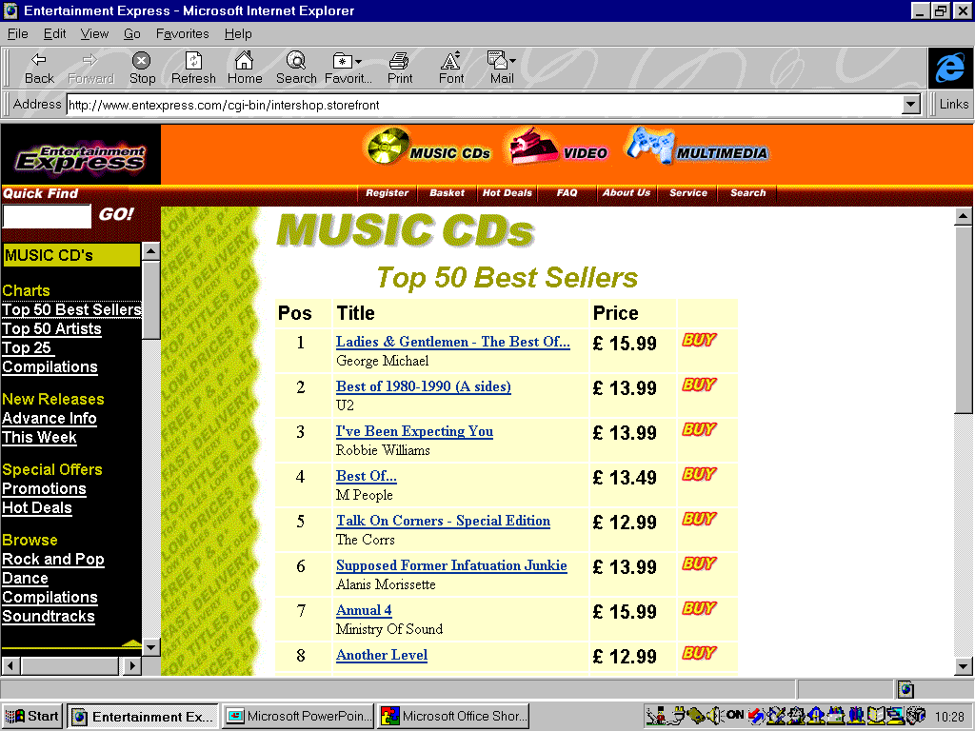

Channel Enhancement - Requirements
Timberland
Corporate Intranets
Retailers and Other Businesses
Catalogues
Stores
Manage the Business
Develop Strategy
Develop Propositions
Manage Categories
Source Products & Services
Buy Products & Services
Replenish & Distribute
Sell Products & Services
Manage Customer Relationships
Manage Operations
Manage Infrastructure
Support the Business
Manage Information & Systems
Manage Legal & Regulatory Affairs
Provide Financial Services
Kiosks
Manage People
Websites
PDAs, Mobile Phones, etc.
Interactive TV
Multiple channels, fully integrated with business process, enterprise systems and organization

Slide 12
Value Chain Integration … stage 2
Distributors
Investors
Stores
Demand Information
Manufacturer
Suppliers
Retailers
Other
Service
Providers
Products
Potential
Recruits
On-line
Buy-side and Sell-side connections with trading partners & process changes across the value chain

Slide 13
Why E-Business ? …. The Case for Value Chain Integration
Cost Reduction (e.g. Procurement)
Increase Speed of Doing Business
Optimize Entire Value Chain
Respond to Increasingly Complex Consumer Demand
Increase Margin and Profit

Slide 14

Value Chain Integration - More Than Just Commerce
Soft, Unstructured ...
Manufacturer
Develop
Strategy &
Propositions
Retailer
Develop Strategy
Future Strategy, Product Portfolio Development, Consumer Insights
Strategic Capacity Management
Collaborative relationship management
New Product Development
Plan Categories
& Assortments
Plan Categories
Develop Products
& Services
Joint Category Management
Category Structure, Policies, etc.
Assortment Planning
Space Planning
New Product Introduction
Promotions Management
Product Catalogues, Specifications, Prices
Develop Products
Perform
Marketing
&Sales
Source & Buy
Products
Plan Supply
Chain
Joint Supply Management
Collaborative Planning, Forecasting & Replenishment
Shared production, inventory & sales data
Vendor managed inventory
Replenish &
Allocate Products
Procure &
Manage Materials
Manufacture
Products
Distribute
Product
Distribute
Products
Orders
Advanced Shipping Notifications
Deliveries
Goods Receipt Notes
Invoices
Payments
Perform
Customer
Service
Sell to & Serve
Customers
Manage
Customer
Relationships
… Hard, Structured !

Slide 15

Value Chain Integration - Three Trading Models
Trading Partner A
Develop Strategy
Develop Propositions
Manage Categories
Source Products & Services
Buy Products & Services
Point-to-Point Connection via Private Extranet or 3rd Party Hosted Service
Enterprise Systems
Web Server
Timberland
Trading Partner B
Manage the Business
Develop Strategy
Develop Propositions
Manage Categories
Source Products & Services
Buy Products & Services
Replenish & Distribute
Sell Products & Services
Manage Customer Relationships
Develop Strategy
Develop Propositions
Manage Categories
Source Products & Services
Buy Products & Services
Manage Operations
Manage Infrastructure
Support the Business
Manage Information & Systems
Manage Legal & Regulatory Affairs
Provide Financial Services
Manage People
Enterprise Systems
Web Server
Web Server
Internet (Public)
Enterprise Systems
Web EDI / Other Connection via public Internet
EDI Gateway
Trading Partner C
Develop Strategy
Develop Propositions
Manage Categories
Source Products & Services
Buy Products & Services
Enterprise Systems
EDI Gateway
EDI Connection

Slide 16
Convergence … stage 3
E-tailers
Private Brands /
Direct Sourcing
Info-
mediaries
Distributors
Investors
Stores
Demand Information
Manufacturer
Suppliers
Inter-
mediaries
Retailers
Other
Service
Providers
Products
Inter-
mediaries
Potential
Recruits
On-line
New entrants selling to consumers, new services linking businesses, increase in vertical integration

Slide 17
Convergence is already happening in the physical world
What industry is GE in?
What about Virgin?
Electricity companies
look at Internet access via wall sockets
Electricity
Travel
Information
Technology
Psion + Nokia, Ericsson
Citigroup,
many others
Insurance
Enter- tainment
Telecomms
Banking
Retail
Broad- casting
Consumer Goods
British Telecom
+BSkyB=BIB
Sainsbury,
Barclay Square
Loblaw
Cablevision
Disney Stores, Warner Bros
Nike, Levi, Nine West, Bose
Notes:
Value enhancing opportunities based on figures calculated by AC.
Revenue side obviously based on small number of examples and depends on your product. Best ones are
B2C - computer related, digital, non-experience goods (i.e. do not have to touch or hear) e.g. books - Leading examples would be Cisco & Dell
B2B - MRO
First mover advantage are around setting standards and establishing e-brands e.g. power of portals: 18 months ago most observers thought AOL would go under - now buying Netscape: NetCenter plus AOL will have 44m visitors combined vs 29M for Microsoft Network - plus 70m on Netscape’s browser
Is a real threat of commiditisation e.g. talk about threat to suppliers using CommerceOne type solutions.
New entrants are always worth thinking about - talk about disintermediation and reintermediation
Be careful not to screw up your legacy business model before new one has taken shape
Industry attractiveness is important i.e. in the Porter sense of does a firm want to be a player in an unattractive industry - Value chain integration can make industries less attractive because
Economies of scale less important - part. If product is digital
Lower switching costs (generally)
Lower capital requirements (generally but IT expensive)
Easier for competitors to enter

Slide 18















The internet is speeding convergence as new and existing companies enter the “direct selling” model
Infomediaries
Multi-channel Retailers
Electronic markets
Business & retail customers
Manufacturer Retailers
Communities
Direct-only retailers
Combinations
Notes:
Model of “going direct” to consumers was the original concept. Best exponents are manufacturers (Dell, recently Compaq, Office Depot) “virtual stores” (Amazon, CDNow, Peapod), and sex sites. Players with existing infrastructure (large banks, supermarkets) have not been energetic.
Customers may get better convenience or value from new “intermediary” sites:
Electronic markets - back to the old idea of a farm market i.e. supply and demand come together at a single point
Communities - Motley Fool very successful in the US re: individual investment - not ‘owned’ in the traditional sense - interestingly they now also publish books
Portals - way into Web - flurry of recent mergers & deals (AOL/ Netscape, Excite / @Home, Disney / Infoseek for GO) and prospective bids. Also TV portals (British Interactive Broadcasting’s “Open” and portal/ISP plays (Dixons’ Freeserve)
[Note: Distinction explained later between portals (AOL, MSN and search engines: and even inside search engines - Yahoo for example is not a full search engine, but pre-categorises a limited data set]
Tel-Save Inc: A US discount long distance phone company ran a 24-hour online marketing test to America Online’s entire customer base of 9 million. As the final phase of online testing prior to an offline media blitz upcoming in January, AOL sent a pop-up advertisement to its entire base and used banner ads and a position in the welcome area to attract customers to the 9-cents-a-minute long distance service offering. Throughout the day, the AOL Long Distance Web site had over 500,000 hits as AOL members checked sample bills, reviewed pricing, and signed up for service. The company reported that the 24-hour test will generate approximately 27,000 new lines for its long distance service. Tel-Save Chairman and CEO Dan Borislow stated, "This test clearly demonstrates the strength and marketing power of the AOL advertising medium. What we've produced in a 24-hour period online with AOL is equal to the product of 6,000 direct sales."

Slide 19
Industry Transformation … stage 4
What is a Retailer?
?
Other
Industry
e-tailer
Manufacturer
Retailer
Distributor
Broker / Market
Exchange
Infomediary
Many-to-many relationships, new entrants, new types of businesses, new business models

Slide 20
Industry Transformation … stage 4
What is a Fashion Company?
Speed
Service
Quality
Type
Attribute
“Executors” (Mast Industries)
“Owners” (Gap)
Owner
Strong in most areas
Requires strong mgmt.
Image Maker
Emphasizes intangible asset efficiency
Price
“Image Makers”
(Calvin Klein)
Style
Executor
Emphasizes tangible asset efficiency
“Opportunists”
(Tie Rack)
Opportunist
Least sustainable (especially on-line)
Location
Brand
Selection
Core competencies and overall business direction will help determine on-line opportunities

Slide 21






Industry Transformations often take time as standards are set and consumer behavior changes
Notes:
American Airlines have implemented a set of customer-care databases that centralise all of the company's content. The personalization project, aimed at ultimately generating new revenue streams from the 31 million members of American's frequent flyer program, will be used to create custom Web experiences. As for American, it will roll out what appears to be one of the most complex of the current efforts. Using an architecture that rides on top of its Web services, personalization will be extended to 56 interactive applications, invoking more than 200 separate business rules.
American plans to use the site as a way to extend affinity marketing programs to its advertising partners. Citibank, Hertz and Hilton Hotels Corp. are among pilot advertisers in the Web program. Beyond new marketing revenue, American plans to extend the database for use at call centers before the end of the year.

Slide 22

That’s nice Karl … but what does it mean to us?

Slide 23
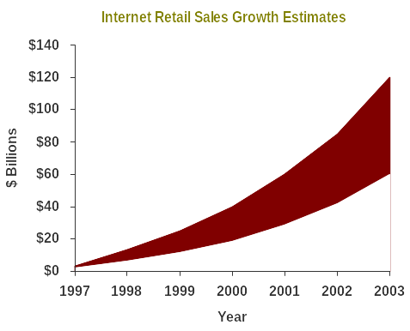
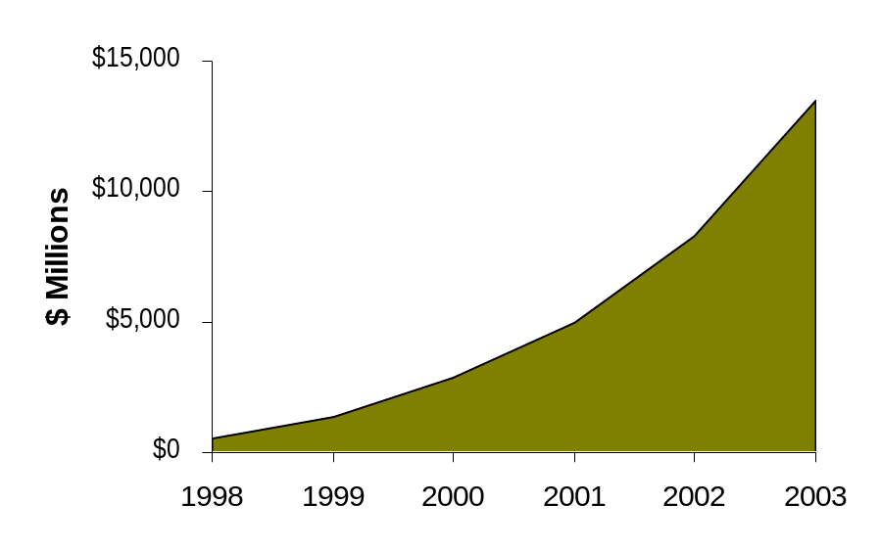
On-line retail sales are forecasted to hit $100B+ by 2003; Apparel / Footwear / Accy’s are estimated to be $14B
Analysts estimate the on-line opportunity for Apparel, Footwear, and Accessories to be nearly $14 billion by 2003. Factors contributing to this growth include:
  An expanding marketplace (on-line audience size)
  An increase in the number of companies selling on-line
  Advancements in customization, personalization, and customer service
Estimated On-line Sales of Apparel /
Footwear / Accessories
Source: Jupiter Communications, Morgan Stanley, Yankee Group, IDC, Forrester Research, shop.org, and PwC.

Slide 24
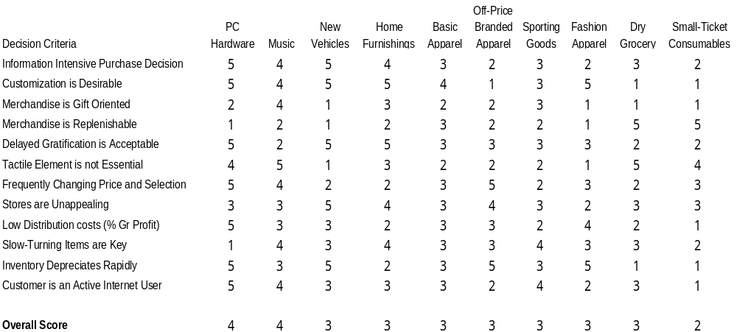
Goldman Sachs suggests moderate on-line (B2C) opportunities exist for Timberland’s core categories
Source: Goldman Sachs

Slide 25
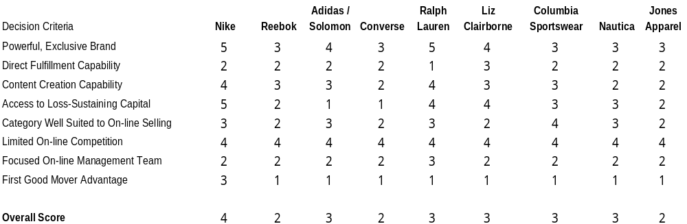
As the category ranking would suggest, the B2C opportunity for many Apparel / Footwear companies is also moderate
Source: Goldman Sachs

Slide 26
Timberland’s on-line presence is relatively limited, as is much of the competition
Timberland Online
Timberland.com
  product information
  company description
  investor relations
  the environment
  HR/Recruiting
Some other sites selling Timberland merchandise
  REI
  Macy’s
  Nordstrom
  Just for feet
  DonQs.com
  National-Shoes.com
  shoesontheweb.com
  Shop.theglobe.com
Footwear / Apparel On-Line Presence
Company Website E-Commerce
Ralph Lauren No No
Columbia Sportswear Yes No
Jones Apparel Yes No
Nautica Yes No
Philips-Van Heusen Yes Yes
Adidas Yes No
Reebok Yes No
Rockport Yes No
Ecco Yes No
New Balance Yes Yes
Nine West Yes Yes
Steve Madden Yes Yes
Nike Yes Yes
Patagonia Yes Yes
Sketchers Yes Yes
Teva Yes Yes

Slide 27
Some initial thoughts about Timberland’s e-Business opportunities …
We believe Timberland has near term opportunities across stages 1-3
Intra-Enterprise Connectivity
  Timberland appears to have made some moves in this area
  Additional opportunities may exist to connect corporate, stores, plants, licensees, licensors, and overseas offices / agents
Channel Enhancement
  With an established brand name and in-store presence, Timberland is well positioned to expand it’s retail business on-line
    Merchandise assortments (expanded assortments, exclusive goods, special services, product tests)
    Cross-promotion / marketing opportunities (to own stores and retail customers)
    “Go to where the customers are”
Value Chain Integration
  Linking suppliers, retail customers, and other business partners (e.g. on-line ordering, virtual showrooms)
  Collaborative planning, forecasting, and replenishment (CPFR)
… to help Timberland learn more about its consumers and meet their needs

Slide 28
… And some potential challenges
Strategic Decisions
Business objectives and level of investment required / available
  Footwear has an established catalog business, but primarily in special sizes
  Most consumers will want to try on before buying
  B2C websites cost upwards of $5M; total e-Business costs can resemble ERPs
Sales Cannibalization / Channel Conflict w/ wholesale accounts
  Should be a non-issue over time
Channel Synchronization (with wholesale and own retail business)
  Merchandise, Pricing
Organizational Requirements
  Dotcom spin-off vs. integrated
Operational Hurdles
Direct-to-Consumer Fulfillment
  In-source / Outsource options
Content Management
  Generally requires new operations, systems, and skills
Customer (consumer) Relationship Management
  Call Center, email Management,
Systems Development / Integration

