Slide 1
High Level Requirements Assessment For The Implementation Of Merchandise Planning And Allocation
Project Scope and Objectives
April 10th, 2002

Slide 2
Contents
Section Page
Our Understanding . . . . . . . . . . . . . . . . . . . . . . . . . . . . . . . . . . . . . . . . . . . 3
Objectives and Scope . . . . . . . . . . . . . . . . . . . . . . . . . . . . . . . . . . . . . . . . 4
Key Principals . . . . . . . . . . . . . . . . . . . . . . . . . . . . . . . . . . . . . . . . . . . . . . . 5
Our Methodology . . . . . . . . . . . . . . . . . . . . . . . . . . . . . . . . . . . . . . . . . . . . 6
Project Organization and Staffing . . . . . . . . . . . . . . . . . . . . . . . . . . . . . . . . 14
Project Timing . . . . . . . . . . . . . . . . . . . . . . . . . . . . . . . . . . . . . . . . . . . . . . . 15
Appendix – Assumptions, Representative Resumes, Standard Terms and Conditions

Slide 3
Our Understanding

Slide 4
Objectives and Scope

Slide 5
Project Approach - Key Principles
Drive to Consensus
  We identify your “unique and strategic requirements” based on the corporate vision and direction; these are used as the gage when decisions about vendors must be made. In our experience most software applications can meet most of the detailed requirements, but only one or two will have the ability to support your ultimate vision.
Speed
  The objective of each project is to assist you in making an educated decision in the least amount of time. Throughout the project there are what we call “elimination checkpoints”, which give the you the opportunity to narrow the selection or select the package based on the knowledge gained thus far.
Transition to Implementation
  We know that the selection is only the “tip-of-the-iceberg” and the real risks are taken during the integration of the software to your business. We involve the PwC Consulting implementation practitioners throughout the project, to give you confidence that you are receiving the best information from the source, not just the vendor’s sales force. We also employ a “transition” process that is followed during each engagement from the selection team to the implementation team.

Slide 6
Project Approach – Package Selection Methodology
Our methodology has the following key aspects
  Route Maps – used very early in the process, are “client specific” and designed to meet the unique goals of each client. Eliminates scope creep, clearly defines deliverables and responsibilities.
  Functionality and Process – user evaluation criteria include both functionality and process flow.
  Definition of Key Selection Criteria – serves as the guidance throughout the project
  Vendor Q&A session – to provide the vendor and client an opportunity for one-on-one discussions prior to the demos.
  PwC Consulting Q&A Session – provides the client an opportunity to meet, ask questions and become educated by the implementers of the specific software products
  Transition Document – an automated spreadsheet that calculates potential implementation risk and considerations that is completed by the Selection Project Team as a transition document for the implementation team.

Slide 7
Our Methodology – Route Maps
Our methodology is based on configurable“Route Maps” that can be tailored to each clients specific requirements
Supports Existing Selection Process
Adds Focus & Dicipline
Highlevel Requirements
Detailed Requirements
Documented Processes
RFP or RFI
Implementation Strategy
Business Case
Selection Support
Facilitation & oversight of the selection process
Proof of
Concept
Seeks to Prove one applications’ viability based on your strategic & business requirements
Methodology Approach
Selection is driven by your strategic & unique business & process requirements
Vision & Strategic
Requirements
Detailed
Requirements
Selection is based on a thorough understanding of your detailed business processes & requirements
Detailed
Requirements &
Business Case
Selection is driven by your strategic & unique business & process requirements & supported by a Business Case

Slide 8

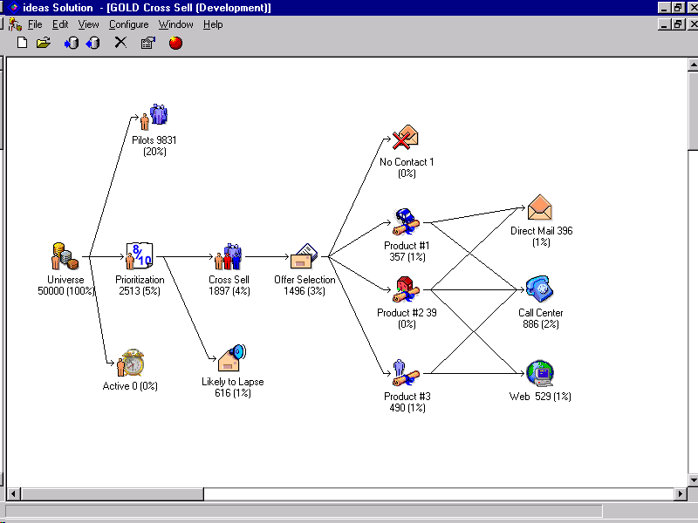




Our Methodology - Phases and Tasks
Key Metrics
& Vision
Requirements
& Data
Collection
Create
RFI/P
Vendor
Demos
Select
Application
Develop
Detailed
Project Plan
Collect &
Document
System
Requirements
& Metrics
Create &
Issue
RFI/P
Create Demo
Scripts &
Evaluation
Process
Compare Findings
to Key Selection
Requirements
Facilitate
Demos
Define
Key Selection
Requirements
Research
Vendor
Viability
Facilitate
PwC
Consulting
SME Q&A
Facilitate
Recommendation
Worksession
Receive
Responses
& Compile
Data
Develop
Implementation
Strategy
Perform
Vendor
Reference
Checks
Conduct
Executive
Interviews
Document
Technical
Architecture
Facilitate
Vendor
Q&A
Develop Business
Case
Possible Vendors
Short List
3-5 Vendors
Short List
2-4 Vendors
Short List
1-2 Vendors
Present Final
Recommendation
Possible
Vendors
Business
goals
drive
process
requirements
Business process requirements drive information requirements
. . . Which is rooted in the identification of business goals to drive the selection of the new application.
Information requirements drive application solutions
Information, application and technology requirements drive organization structure
Information strategy drives implementation plans
Application solutions drive technology requirements
Business Goals
Information Technology Strategy
Implementation Planning

Slide 9
Our Methodology – Key Metrics and Vision
Based on our understanding of your situation, our approach is based on the Vision & Strategic Requirements route map and tailored to CVS’s specific requirements
Key Metrics
& Vision
Key Metrics
& Vision
Requirements
& Data
Collection
Requirements
& Data
Collection
Create
RFI/P
Create
RFI/P
Vendor
Demos
Vendor
Demos
Select
Application
Select
Application
Project Activities
Collect CVS strategic requirements and corporate vision through interviews with executive staff
Create detailed project workplan
Key Issues to be Addressed
Can any one vendor be chosen based on the strategic requirements?
Can any particular vendor(s) be eliminated based on the strategic requirements?
Staff availability to meet dates in project workplan
Work Products
PwC Consulting Role
CVS Role
Vision and Strategic Requirements Document
List of Viable Vendors
Project Workplan
Interview Senior Mgmt and document vision
Recommend List of Vendors
Develop Project plan and schedule
Communicate strategies and participate in interviews
Review and approve vendor list
Review and approve Project Plan

Slide 10
Our Methodology – Requirements & Data Collection
Key Metrics
& Vision
Key Metrics
& Vision
Requirements
& Data
Collection
Requirements
& Data
Collection
Create
RFI/P
Create
RFI/P
Vendor
Demos
Vendor
Demos
Select
Application
Select
Application
Project Activities
Hold worksessions to collect detailed system requirements from users
Research viability of each of the selected vendors
Document current technical architecture and metrics
Key Issues to be Addressed
Client staff being able to provide timely information and still fulfill their corporate responsibilities
Identifying the Client specialists who know how complex, unique or intricate processes are performed
Identification of a “short list” of 3 - 5 vendors
Buy-in from staff to support project and provide information
Work Products
PwC Consulting Role
CVS Role
Requirements Document
Process Flows & Narratives
Identify “short list” of 3 - 5 vendors
Compile requirements data and document requirements
Create process flows and document narratives
Support client in clarifying issues
Review & approve requirements
Review and approve process flows and narratives
Recommend “short list” of vendors

Slide 11
Our Methodology – Create RFI / P
Key Metrics
& Vision
Key Metrics
& Vision
Requirements
& Data
Collection
Requirements
& Data
Collection
Create
RFI/P
Create
RFI/P
Vendor
Demos
Vendor
Demos
Select
Application
Select
Application
Project Activities
Create the RFI/RFP
Issue the RFI/RFP
Notify vendors to anticipate RFI/RFP
Receive and compile response data
Key Issues to be Addressed
Managing vendor questions and desire to circumvent the process to help secure their package is selected
Understanding and compiling response data that may be provided in inconsistent format
Eliminating vendor list to one or two candidates
Quick approval of RFI/RFP
Vendors responding in a timely manner
Work Products
PwC Consulting Role
CVS Role
RFI /RFP
Identify “short list” of 2 - 4 vendors
Develop RFI/RFP
Support client in clarifying issues
Review & approve RFI/RFP
Recommend “short list” of vendors

Slide 12
Our Methodology – Vendor Demos
Key Metrics
& Vision
Key Metrics
& Vision
Requirements
& Data
Collection
Requirements
& Data
Collection
Create
RFI/P
Create
RFI/P
Vendor
Demos
Vendor
Demos
Select
Application
Select
Application
Project Activities
Schedule demos with Client and vendors
Create evaluation schedule and process
Develop Demo scripts and evaluation forms
Facilitate vendor demos
Client to perform vendor reference checks
Collect and document business metrics
Hold PricewaterhouseCoopers Product Specialist Q&A
Key Issues to be Addressed
Coordination of schedules between vendors and Client for demos
Consistent evaluation of vendors during demos
Quick elimination of one of the two vendors based on demo or information uncovered during reference checks
Compilation of questions for Vendors & PwC Consulting Product Specialists
Following the Vendor Q&A identify 2 vendors to demo
Work Products
PwC Consulting Role
CSV Role
Demo Scripts
Evaluation Forms
Vendor Q&A Session
Short list of 2 Vendors
PricewaterhouseCoopers Product Specialist Q&A Session
Create scripts
Create evaluation forms
Prepare and facilitate session
Facilitate decision process
Review and approve scripts and evaluation forms
Define 2 vendors to demo
Provide questions and participate in sessions

Slide 13
Our Methodology – Select Application
Key Metrics
& Vision
Key Metrics
& Vision
Requirements
& Data
Collection
Requirements
& Data
Collection
Create
RFI/P
Create
RFI/P
Vendor
Demos
Vendor
Demos
Select
Application
Select
Application
Project Activities
Compare all data collected to Strategic Requirements
Facilitate a worksession with project team to recommend one vendor
Develop the implementation strategy & milestone plan
Develop business case
Present final recommendation
Key Issues to be Addressed
Ability of Client staff to see past all distractions and issues and select one vendor
Work Products
PwC Consulting Role
CVS Role
Final Recommendation Document and Highlevel Imp. Strategy and Milestone Plan
Select Vendor
Create Document
Support client in clarifying issues
Review and approve final deliverable
Recommend vendor

Slide 14
Project Organization and Staffing

Slide 15
Project Timing
May
June
July
August
ID
Task Name
05/06
05/13
05/20
05/27
06/03
06/10
06/17
06/24
07/01
07/08
07/15
07/22
07/29
08/05
08/12
08/19
08/26
1
CVS – Allocation Package Selection Engagement
2
Key Metrics & Vision
3
Mobilize Project
4
Interview Key Sponsors/Process Owners
5
Document Strategic Requirements
6
Identify Vendor Long List
7
Prepare/Present Vision
05/29
8
Requirements & Data Collection
9
Schedule Site Level Visits/Interviews/Workshops
10
Develop "logical" systems architecture
11
Complete Site Level Data Collection
12
Summarize/Reconcile Requirements
13
Map detailed requirements to application capabilities
14
Identify "short list" for RFI/RFP submission
15
Validate requirements and "short list"
06/19
16
Create RFI/RFP
17
Develop RFI/RFP
18
Notify vendors, bidders conference etc.
19
Receive Responses
20
Evaluate Responses
21
Identify demonstration candidates
07/02
22
Vendor Demonstrations
23
Prepare demonstration "scripts", agenda, rules of the road
24
Prepare evaluation criteria and process
25
Hold SME Q&A as needed
26
Conduct Demonstrations
27
Check references and demo "punch list" information
28
Select Application(s)
29
Build Business Case (BR detail in separate plan)
30
Collate demonstration findings
31
Map findings to Business Case
32
Develop selection recommendations
33
Prepare/Present Recommendations/Justification/Benefits
07/09

