Slide 1

DRAFT
FOR DISCUSSION ONLY
BroadVision B2C Demonstration Project - January 4, 2000
© 1999, PricewaterhouseCoopers L.L.P.

Slide 2
PwC’s BroadVision Demonstration Overview

Slide 3
Customer Segments and Community Development
T&K communities are based on behavioral segmentation. Full-range shoppers represent the most important “community”, and can be considered the “default” community for unknown users:
Sale/coupon driven
Other
visitors
1%
High-end,
7%
luxury/brand-focused
customers
12%
(Scenario 2)
People who shop for
basics regularly
15%
(Scenario 3)
Full-range value shoppers /
Unknown Customer
65%
(Scenario 1)
Note: All data are hypothetical

Slide 4
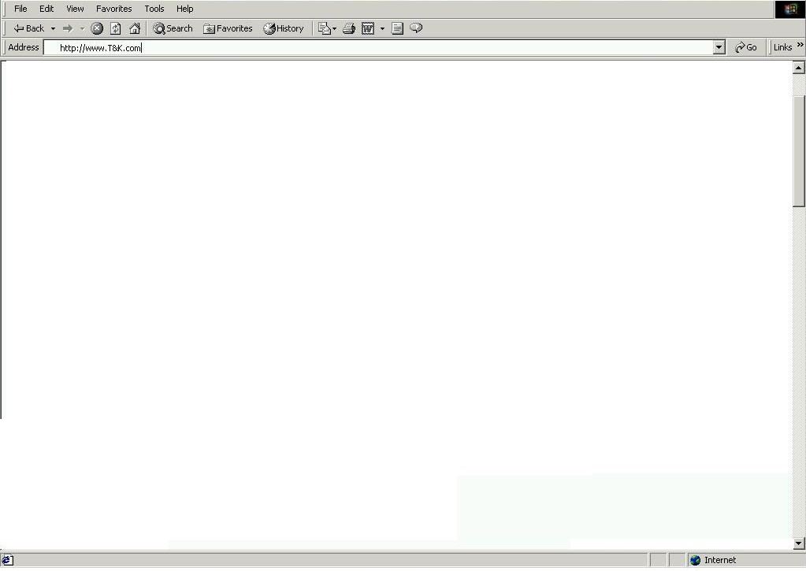

BroadVision Rules and Templates
Personalization Template Samples
Homepage
Category / Sub-category Page
Specialty Shop Page
Product Detail Page
Shopping Cart
Homepage Rule Set Samples
Banner Ad Ruleset (BA_A)
Featured Product Rule sets
(FP_A, FP_B, FP_C, FP_D)
Ad Rule Sets (AD_A, AD_B, AD_C)
Incentive rule set (IN_A)
Matching Techniques for each Rule Set
Community rules
Purchasing History rules
Observation / in-session rules
Taxonomy matched rules
Sample Homepage Template and Content Zones
BA_A
FP_A
FP_B
AD_A
AD_B
FP_C
FP_D
AD_C
IN_A

Slide 5
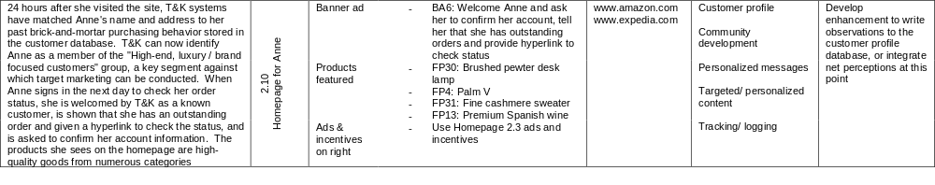
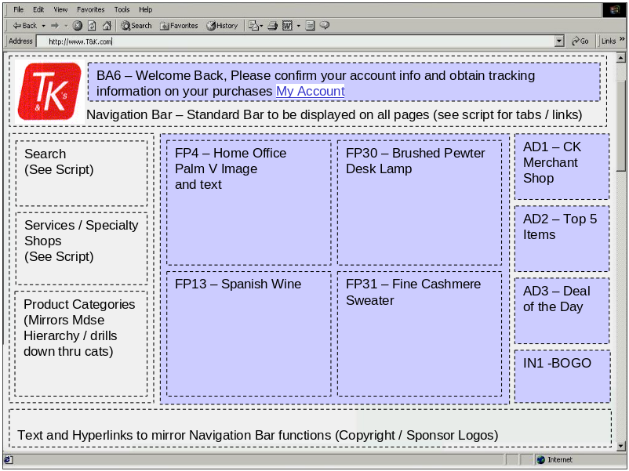
BroadVision Storyboard Documentation Example
Storyboard Script
Customer Storyboard Slide Slide Elements Example Website BroadVision Features Custom / Enhancement
Webpage Example Slide 2.10

Slide 6
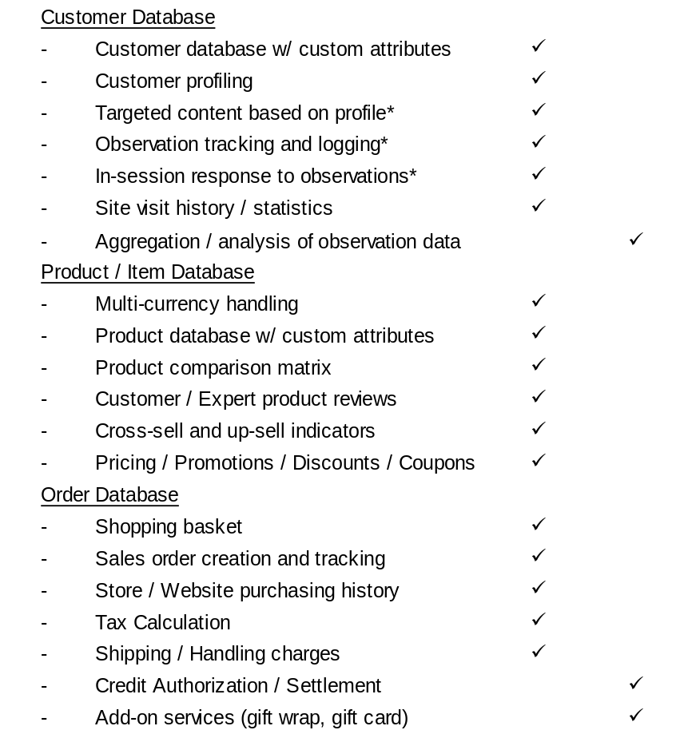
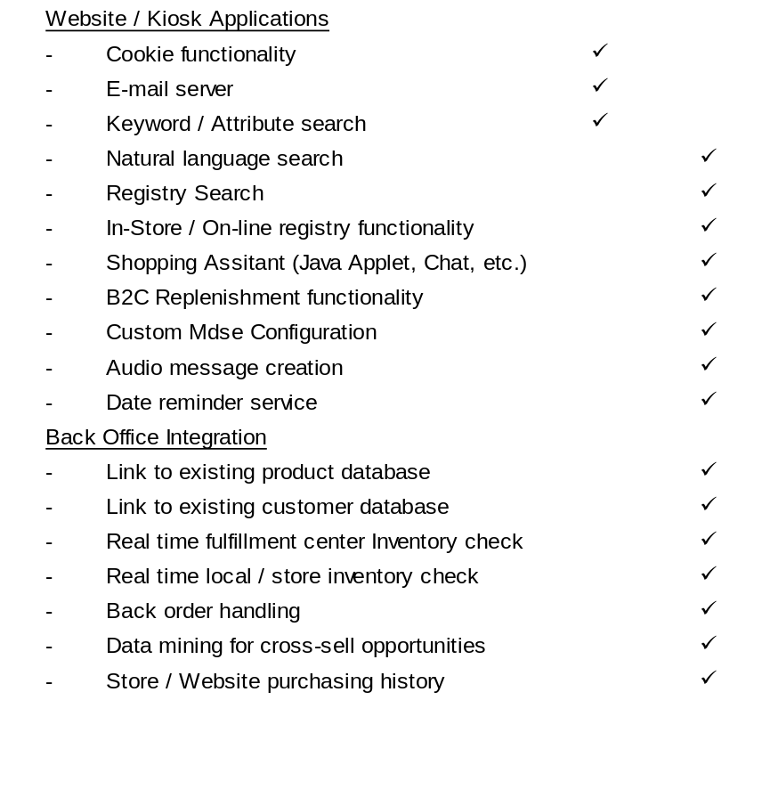
Demonstration System and Website Features
BV
Feature
Custom
Feature
BV
Feature
Custom
Feature
System / Website Functionality
System / Website Functionality
* Net Perceptions functionality for these features to be determined

Slide 7
T&K Site Map
Splash Page
Home Page
Shopping
Search
Registry/
Order status
My Account
Corp info/
Product
Specialty
Service
Cart
wish list
contact us
categories
shop
Shopping
Search
Order
Personal
General
Apparel
Fashion
Martha
Replenish
Assistant
Results
Search
Tracking
Info/ID &
Contact Info.
Accsry.
Stewart
Program
Form
Password
Women
Women
Men
Men
Infants
Children
Checkout
Instructions/
Order Detail
Job Info.
Boys
Groceries
info.
Girls
Calvin Klein
Inventory
Houseware
Cheese
Check
Coffee
Annual
Bedding
Cookbooks
Customer
Registry
Report/10K/
Bath
Desserts
Invoice
Listing Page
Investor Info
Kitchen
Fruits & Nuts
Hewlett
Specials
Dining
Health Food
Packard
Home Decor
Meats
Tea
Purchase
Policies
Electronics
Wine & Accsry.
Camcorders
Home
Wine Club
Gift Ideas
Cameras
Office
DVD Players
Answering Machines
Modify
FAQs
Home Audio
Calculators
PIMs
Organizers
Store
Telephones
Toner, Ribbon, etc.
Locator
Portable Audio
Labels & Tags
TVs
Fax Machines
VCRs
Notebooks
Answer. Machine
Telephones
T&K Credit
Accessories
Printers
Card
Music / video
Office furniture
Accessories
Product
Details

Slide 8
T&K Demonstration Scenario Overviews
Scenario 1: Unregistered user makes a registry purchase
An unregistered customer searches the T&K registry database to find a registry originally created in the UK. Selects an item from the registry, checks DC and local inventory, has his purchase gift wrapped and indicates that the gift will be picked up locally by the gift recipient. During checkout, he provides his purchasing information, creates an electronic gift card including a recorded voice message, and receives an e-mail confirmation of his purchase.
Scenario 2: Registered high end, brand-focused user builds profile and shopping history
A new user creates a T&K on-line profile, and shops for a printer using the product comparison matrix. She is offered complementary items and up-sell opportunities for more feature rich printers. After completing her first on-line purchase, the system recognizes her as an in-store customer by cross referencing her in the existing customer database and is able to develop a more complete picture of her shopping behavior. On return visits she is given increasingly personalized content based on her profile.
Scenario 3: Frequent basics customer responds to replenishment and cross selling
A T&K value card shopper enters his membership number, is recognized in the legacy customer database, and based on the web profile and purchasing history that is built is offered the opportunity to receive in home replenishment of items purchased most often. The customer also responds to cross sell advertisements and orders a custom configured CD compilation from T&K online.
Scenario 4: The T&K Product Manager / Merchant
The Product Manager utilizes reporting and analysis tools to better merchandise the website and respond to customer preferences

