Slide 1
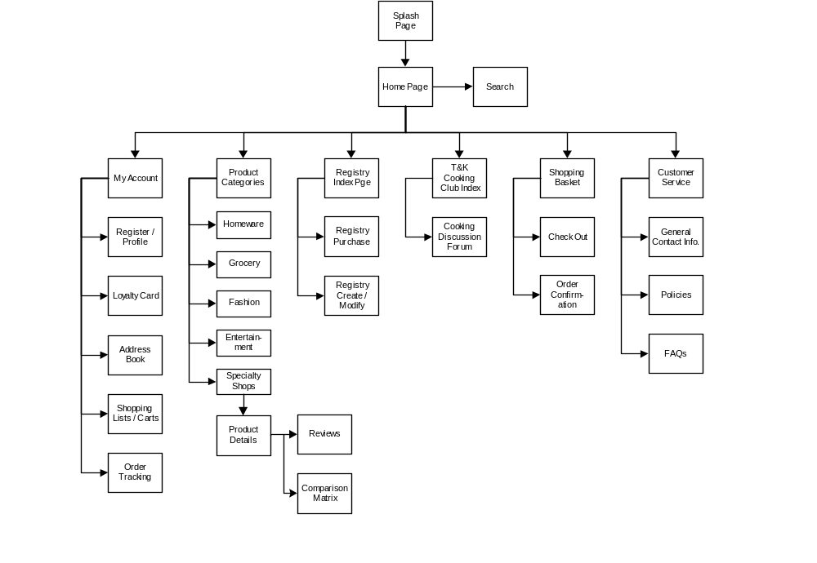
Site Map

Slide 2
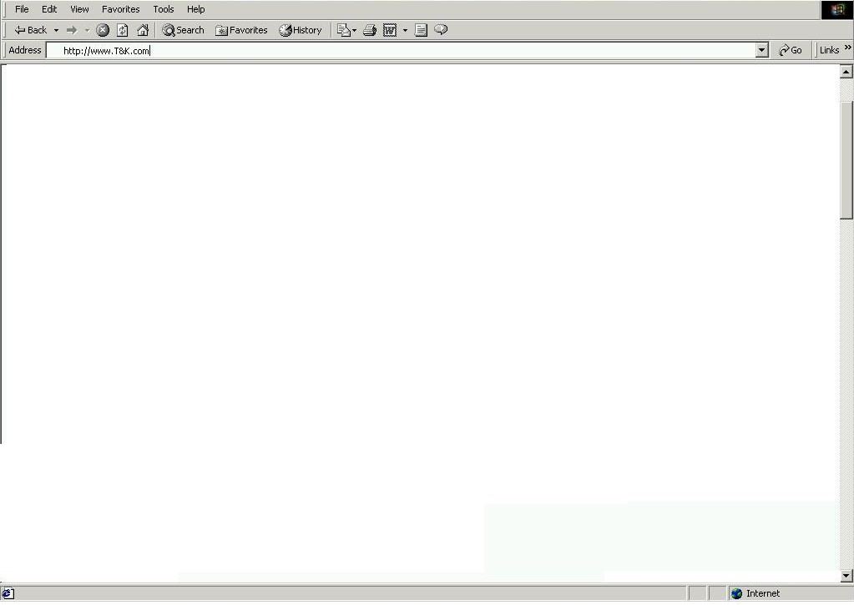

Splash Page
Editorial - Welcome to T&K.com, General Description of product offering and services available
Select the country your are shopping from:
United States
GO
Store / Product Images
T&K Map Logo with 2 active regional hyperlinks
T&K Member Sign In
User ID
Region 1 (US)
Region 2 (UK)
Password
Enter your T&K Value card number:
New Customer
Registration

Slide 3
Home Page
Navigation Bar – Standard Bar to be displayed on all pages (see script for tabs / links)
Search Box
Food & Drink
Rule set:
Homepage_ed
Rule Set:
hp_ad1
Favorite Links
Home Wares
Rule Set:
hp_ad2
Fashion
Product Category Menu
Entertainment
Rule Set:
hp_inc
Text and Hyperlinks to mirror Navigation Bar functions (Copyright / Sponsor Logos)

Slide 4
My Account Index Page
Navigation Bar – Standard Bar to be displayed on all pages (see script for tabs / links)
BA – Banner Ad Space
Search Box
Profile
Loyalty
Lists
Address
Tracking
Text Space with links to the following areas:
Register / Update Profile
Loyalty Program
Shopping Lists
Address Book
Order Tracking / Purchasing History
T&K Member Sign In
Editorial –
Are you a member?
Benefits of Registration:
1.
2.
3.
Favorite Links
User ID
Password
Product Category Menu
Text and Hyperlinks to mirror Navigation Bar functions (Copyright / Sponsor Logos)

Slide 5
My Account – Register / Profile Page
Navigation Bar – Standard Bar to be displayed on all pages (see script for tabs / links)
BA – Banner Ad Space
Search Box
Basic User Account – User ID / Password / E-mail Address
Favorite Links
Personalize my T&K Shopping experience
Home
Personalized Profile – Personal Information (Interests / Preferences / Needs)
Product Category Menu
Home
Text and Hyperlinks to mirror Navigation Bar functions (Copyright / Sponsor Logos)

Slide 6
My Account – Loyalty Program Account Search
Navigation Bar – Standard Bar to be displayed on all pages (see script for tabs / links)
Search Box
Rule set:
Editorial – Loyalty Card Program Information by card level
Rule set:
loyalty_ad1
Favorite Links
Rule set:
loyalty_ad2
Product Category Menu
Dynamic Index of rewards available to the user based on point account balance.
Text and Hyperlinks to mirror Navigation Bar functions (Copyright / Sponsor Logos)

Slide 7
My Account – Loyalty Program Account Review
Navigation Bar – Standard Bar to be displayed on all pages (see script for tabs / links)
BA – Banner Ad Space
Search Box
Message – Welcome, You Have X Total Points
Monthly Summary of Activity
Favorite Links
Date | Description | Total $ | Points
Total
Product Category Menu
Editorial – Loyalty Card Program Offers and links to previous period summaries
Text and Hyperlinks to mirror Navigation Bar functions (Copyright / Sponsor Logos)

Slide 8
My Account – Address Book
Navigation Bar – Standard Bar to be displayed on all pages (see script for tabs / links)
BA – Banner Ad Space
Search Box
Editorial – Address Book Info / list of stored addresses to chose from
Favorite Links
Form – Create Shipping Address
Form – Create Personal Address Book entry
Product Category Menu
Add
Update
Delete
Form – Create Date reminder event
Add
Update
Delete
Add
Update
Delete
Text and Hyperlinks to mirror Navigation Bar functions (Copyright / Sponsor Logos)

Slide 9
My Account – Shopping Lists
Navigation Bar – Standard Bar to be displayed on all pages (see script for tabs / links)
BA – Banner Ad Space
Search Box
Form – Saved Shopping List
QTY | DESCRIPTION | $
Favorite Links
Remove
Details
New List
Buy
Shop
Product Category Menu
Editorial – Saved shopping list editorial
Text and Hyperlinks to mirror Navigation Bar functions (Copyright / Sponsor Logos)

Slide 10
Order Tracking Page
Navigation Bar – Standard Bar to be displayed on all pages (see script for tabs / links)
BA – Banner Ad Space
Search Box
FM – Order Tracking Form
User ID
Password
Timeframe
Order #
AD_C
Favorite Links
Form Results: List valid orders in Order Database
Order 1 - Tracking Number link to shipping company
Order 2 - Tracking Number link to shipping company
Order 3 - Tracking Number link to shipping company
Order 4 - Tracking Number link to shipping company
IN_B
Product Category Menu
Text and Hyperlinks to mirror Navigation Bar functions (Copyright / Sponsor Logos)

Slide 11
Order Detail
Navigation Bar – Standard Bar to be displayed on all pages (see script for tabs / links)
BA – Banner Ad Space
Order number, date placed, Loyalty Points earned
ORDER CONFIRMATION / RECAP
QTY | DESCRIPTION | $
Shipping
Tax
Total | $
Return
Home
Text and Hyperlinks to mirror Navigation Bar functions (Copyright / Sponsor Logos)

Slide 12
Category / Sub-Category Page
Navigation Bar – Standard Bar to be displayed on all pages (see script for tabs / links)
Search Box
Category.gif
Ruleset:
Cat_ad1
Favorite Links
Dynamicly generated subcategory index from DCC.
Subcat 1
Subcat 2
Ruleset:
Cat_ad2
Product Category Menu
TBD open sapce
Text and Hyperlinks to mirror Navigation Bar functions (Copyright / Sponsor Logos)

Slide 13
Product Detail Page
Navigation Bar – Standard Bar to be displayed on all pages (see script for tabs / links)
Search Box
Product Detail
(Enlarged Graphic / Extended Text, Web Inv Level, Price, Tell a Friend, Product Comparison, Place in Basket, Add to Registry, Add to shopping list,
Review product, streaming content)
Ruleset:
PD_ad1
Favorite Links
Ruleset:
PD_ad2
Product Category Menu
Discussion Group / Static Review/ Configurator
Text and Hyperlinks to mirror Navigation Bar functions (Copyright / Sponsor Logos)

Slide 14
Customer Reviews
Navigation Bar – Standard Bar to be displayed on all pages (see script for tabs / links)
BA – Banner Ad Space
Search Box
Graphic
DG_A - Review
Buy Now
Details
Favorite Links
Graphic
DG_B - Review
Buy Now
Details
Graphic
DG_C - Review
Buy Now
Product Category Menu
Details
Graphic
DG_D - Review
Buy Now
Details
Text and Hyperlinks to mirror Navigation Bar functions (Copyright / Sponsor Logos)

Slide 15
Product Comparison Matrix
Navigation Bar – Standard Bar to be displayed on all pages (see script for tabs / links)
BA – Banner Ad Space
Search Box
CM – Product Comparison Matrix
 | Product 1 | Product 2 | Product 3 | Product 4
Feature 1 | X |  | X | x
Feature 2 | X | X |  | X
Feature 3 | X | X |  | X
Feature 4 |  | X |  | X
Feature 5 |  | X |  | X
Price | $ | $ | $ | $
Favorite Links
Product Category Menu
Buy Now
Buy Now
Buy Now
Buy Now
Text and Hyperlinks to mirror Navigation Bar functions (Copyright / Sponsor Logos)

Slide 16
Registry Search
Navigation Bar – Standard Bar to be displayed on all pages (see script for tabs / links)
BA – Banner Ad Space
Search Box
Form - Registry Search
First name
Last Name
Event
Date
Editorial – Registry / Wish List instructions and info
Favorite Links
Product Category Menu
Purchase
User ID
Modify
Password
Text and Hyperlinks to mirror Navigation Bar functions (Copyright / Sponsor Logos)

Slide 17
Registry Search Results
Navigation Bar – Standard Bar to be displayed on all pages (see script for tabs / links)
BA – Banner Ad Space
Search Box
Form - Registry Search
First name
Last Name
Event
Date
Registry Search Results
Match 1
Match 2
Match 3
Favorite Links
Product Category Menu
Purchase
User ID
Modify
Password
Text and Hyperlinks to mirror Navigation Bar functions (Copyright / Sponsor Logos)

Slide 18
Registry Purchasing Page
Navigation Bar – Standard Bar to be displayed on all pages (see script for tabs / links)
BA – Banner Ad Space
Search Box
Form – Registry Listing
ID | Description | Wants | Needs | Price | Web Inv | Local Inv | Buy
1 | Hyperlink to Detail Page
2
3
4
5
Favorite Links
Product Category Menu
Continue Shopping
Clear Order
Add to Cart
Text and Hyperlinks to mirror Navigation Bar functions (Copyright / Sponsor Logos)

Slide 19
Registry Modify Page
Navigation Bar – Standard Bar to be displayed on all pages (see script for tabs / links)
BA – Banner Ad Space
Search Box
Form – Start with a saved list and then look at adding QTY, date, needed, other registry specific info.
Favorite Links
Product Category Menu
Text and Hyperlinks to mirror Navigation Bar functions (Copyright / Sponsor Logos)

Slide 20
T&K Cooking Club
Navigation Bar – Standard Bar to be displayed on all pages (see script for tabs / links)
BA – Banner Ad Space
Search Box
Recipe Configurator
Editorial – Cooking Club
Info about the club, links to discussion forum.
Prompts to assist profile development
Ruleset:
Cook_ad1
Favorite Links
Ruleset:
Cook_ad2
Product Category Menu
Text and Hyperlinks to mirror Navigation Bar functions (Copyright / Sponsor Logos)

Slide 21
T&K Cooking Club Discussion Forum
Navigation Bar – Standard Bar to be displayed on all pages (see script for tabs / links)
BA – Banner Ad Space
Search Box
Chat about Recipes Forum
Messages List
AD_J
Favorite Links
Chat about Wine Forum
Messages List
AD_K
Product Category Menu
Text and Hyperlinks to mirror Navigation Bar functions (Copyright / Sponsor Logos)

Slide 22
Shopping Cart
Navigation Bar – Standard Bar to be displayed on all pages (see script for tabs / links)
BA – Banner Ad Space
Search Box
QTY | DESCRIPTION | $
Remove
Details
Favorite Links
CS1 – Two complementary products
CS2 – Two also bought items not listed above
Product Category Menu
IN_D – Progressive Discount
(Buy X $ get Y% off)
Continue Shopping
Recalculate Order
Checkout
Text and Hyperlinks to mirror Navigation Bar functions (Copyright / Sponsor Logos)

Slide 23
Check Out
Navigation Bar – Standard Bar to be displayed on all pages (see script for tabs / links)
BA – Banner Ad Space
Search Box
Form – Customer Name / Billing Address
Form – Payment Information
Form – Order Shipping Address, Delivery Scheduler, Gift wrap, Card
Favorite Links
ORDER CONFIRMATION / RECAP
QTY | DESCRIPTION | $
Product Category Menu
Shipping
Tax
Total
Continue Shopping
Confirm Order
Adjust Order
Text and Hyperlinks to mirror Navigation Bar functions (Copyright / Sponsor Logos)

Slide 24
Customer Invoice
Navigation Bar – Standard Bar to be displayed on all pages (see script for tabs / links)
BA – Banner Ad Space
Message – Thank you for your order, an e-mail has been sent. Please print this page for your records
ORDER CONFIRMATION / RECAP
QTY | DESCRIPTION | $
Shipping
Tax
Total | $
Home
Text and Hyperlinks to mirror Navigation Bar functions (Copyright / Sponsor Logos)

Slide 25
Customer Service Index Page
Navigation Bar – Standard Bar to be displayed on all pages (see script for tabs / links)
BA – Banner Ad Space
Search Box
E-mail Us
Jobs
FAQ
Policies
Stores
Editorial – General T&K information, contact numbers, addresses, and inks to the following areas:
  E-mail Customer Service
  Store Locator
  Employment Opportunities
  FAQ
  Policies:
    Web returns
    In-store returns
    Store pick-up
    Pricing Issues
Favorite Links
Product Category Menu
Text and Hyperlinks to mirror Navigation Bar functions (Copyright / Sponsor Logos)

Slide 26
T&K Web Store Policies
Navigation Bar – Standard Bar to be displayed on all pages (see script for tabs / links)
BA – Banner Ad Space
Search Box
Editorial – T&K Web store policies
Favorite Links
Product Category Menu
Text and Hyperlinks to mirror Navigation Bar functions (Copyright / Sponsor Logos)

Slide 27
T&K Frequently Asked Questions (FAQ)
Navigation Bar – Standard Bar to be displayed on all pages (see script for tabs / links)
BA – Banner Ad Space
Search Box
Editorial – T&K FAQ – Text based with expanding drop down sections or in page links
Favorite Links
Product Category Menu
Text and Hyperlinks to mirror Navigation Bar functions (Copyright / Sponsor Logos)

Slide 28
Search Results Page
Navigation Bar – Standard Bar to be displayed on all pages (see script for tabs / links)
BA – Banner Ad Space
Search Box
Search Results
Match 1
Match 2
Match 3
AD_L
Favorite Links
AD_M
IN_E
Product Category Menu
Text and Hyperlinks to mirror Navigation Bar functions (Copyright / Sponsor Logos)

