Slide 1

DRAFT
FOR DISCUSSION ONLY
BroadVision B2C Demonstration Project - December 28, 1999
  Site Map
  Data Elements
  Storyboard Scripts
  Webpage Templates
  Merchandise Hierarchy
© 1999, PricewaterhouseCoopers L.L.P.

Slide 2
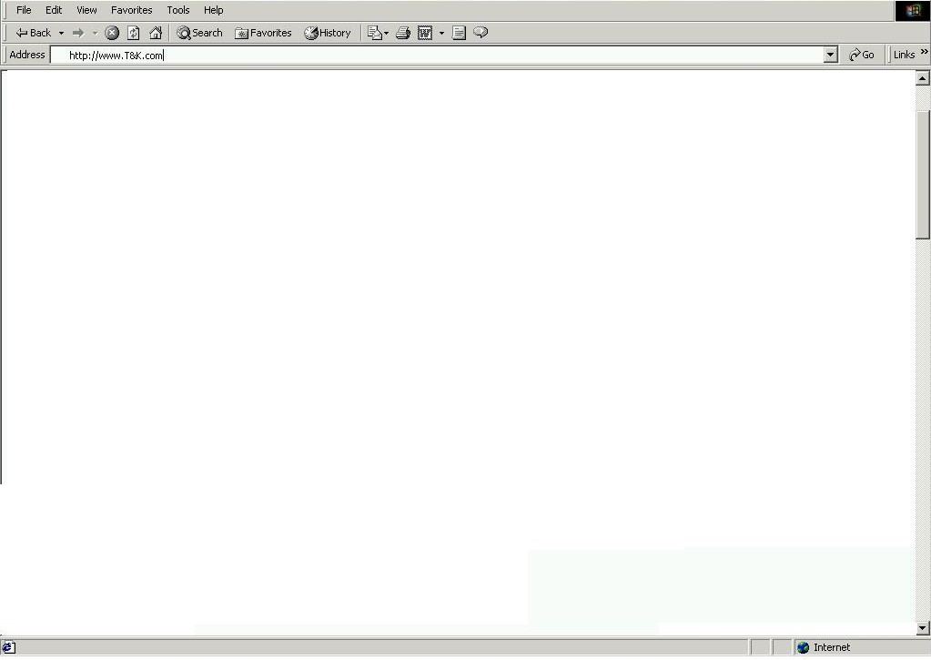

1.1 - Splash Page
Welcome to T&K.com - Editorial and General Description of product offering and services available
Select the country your are shopping from:
United States
Store / Product Images
T&K Map Logo with 2 active regional hyperlinks
T&K Member Sign In
User ID
Region 1 (US)
Region 2 (UK)
Password
Enter your T&K Value card number:
New Customer
Registration

Slide 3
1.2 - U.S. Regional Home Page
Navigation Bar – Standard Bar to be displayed on all pages (see script for tabs / links)
BA1 – T&K Branded Visa Card Signup
Search
(See Script)
FP1 – Food & Wine
Bottle of image
and text
FP2 – App & Acc
20% off Women’s
Sweaters
AD1 – CK Merchant Shop
Services / Specialty Shops
(See Script)
AD2 – Top 5 Items
FP3 – Housewares
New Martha Stewart
Stoneware
FP4 – Home Office
Palm V Image
and text
AD3 – Deal of the Day
Product Categories
(Mirrors Mdse Hierarchy / drills down thru cats)
IN1 -BOGO
Text and Hyperlinks to mirror Navigation Bar functions (Copyright / Sponsor Logos)

Slide 4
1.3 – Registry Search
Navigation Bar – Standard Bar to be displayed on all pages (see script for tabs / links)
BA13 – Check out our gift picks
Search
(See Script)
FM6 – Registry Search
First name
Last Name
Event
Date
ED1 – Registry / Wish List instructions and info
Services / Specialty Shops
(See Script)
Product Categories
(Mirrors Mdse Hierarchy / drills down thru cats)
Purchase
Modify
User ID
Password
Text and Hyperlinks to mirror Navigation Bar functions (Copyright / Sponsor Logos)

Slide 5
1.4 – Registry Search Results
Navigation Bar – Standard Bar to be displayed on all pages (see script for tabs / links)
BA13 – Check out our gift picks
Search
(See Script)
FM6 – Registry Search
First name
Last Name
Event
Date
FM14 - Search Results
Match 1
Match 2
Match 3
Services / Specialty Shops
(See Script)
Product Categories
(Mirrors Mdse Hierarchy / drills down thru cats)
Purchase
Modify
User ID
Password
Text and Hyperlinks to mirror Navigation Bar functions (Copyright / Sponsor Logos)

Slide 6
1.5 – Registry Listing Page
Navigation Bar – Standard Bar to be displayed on all pages (see script for tabs / links)
MS3 – Announcement (Bob & Cindy’s Registry / Date, etc.)
AP1 – Shopping Assistant for registry Purchases (Local Inventory, Gift Wrap, Gift Cards & Multiple Ship tos)
FM7 – Registry Listing
ID | Description | Wants | Needs | Price | Web Inv | Local Inv | Buy
1 | Hyperlink to Detail Page
2
3
4
5
Continue Shopping
Clear Order
Check Out
Text and Hyperlinks to mirror Navigation Bar functions (Copyright / Sponsor Logos)

Slide 7
1.6 – Shopping Cart
Navigation Bar – Standard Bar to be displayed on all pages (see script for tabs / links)
BA5 – Secure Web Pages thru Better Web
Search
(See Script)
QTY | DESCRIPTION | $
Remove
Details
Services / Specialty Shops
(See Script)
AP1 – Shopping Assistant for registry Purchases (Local Inventory, Gift Wrap, Gift Cards & Multiple Ship tos)
Continue Shopping
Recalculate Order
Checkout
Shipping
Handling
Total
Product Categories
(Mirrors Mdse Hierarchy / drills down thru cats)
Text and Hyperlinks to mirror Navigation Bar functions (Copyright / Sponsor Logos)

Slide 8
1.7 – Shopping Assistant
Navigation Bar – Standard Bar to be displayed on all pages (see script for tabs / links)
BA17 – Shopping Assistant Banner
Search
(See Script)
AP1 – Shopping Assistant for registry Purchases (Local Inventory, Gift Wrap, Gift Cards & Multiple Ship tos)
FM8 – Gift Card / Personalized Message
Would you like to send a personalized gift card with your purchase?
Type the note as you would like it to appear:
Would you like to e-mail a text or voice message or to the gift recipient?
Would you like a reminder emailed to you on a specified date regarding this gift in the future?
Services / Specialty Shops
(See Script)
Product Categories
(Mirrors Mdse Hierarchy / drills down thru cats)
Continue Shopping
Checkout
Text and Hyperlinks to mirror Navigation Bar functions (Copyright / Sponsor Logos)

Slide 9
1.8 – Check Out
Navigation Bar – Standard Bar to be displayed on all pages (see script for tabs / links)
BA1 – T&K Branded Visa Card Signup
Search
(See Script)
FM2 – Customer Name / Billing Address
FM15 – Order Shipping Address / s
FM4 – Payment Information
Services / Specialty Shops
(See Script)
ORDER CONFIRMATION / RECAP
QTY | DESCRIPTION | $
Product Categories
(Mirrors Mdse Hierarchy / drills down thru cats)
Shipping
Handling
Total
Continue Shopping
Confirm Order
Adjust Order
Text and Hyperlinks to mirror Navigation Bar functions (Copyright / Sponsor Logos)

