Slide 1
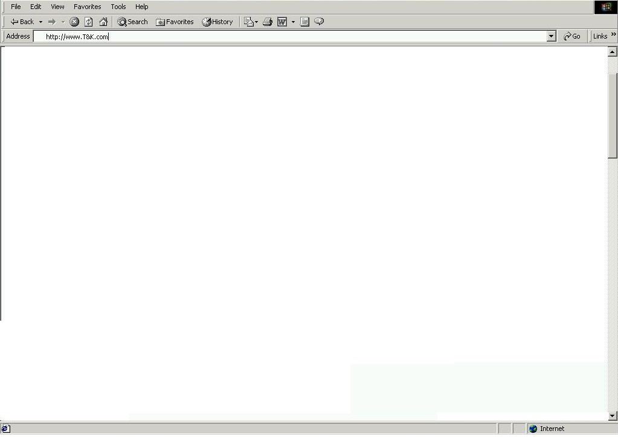

2.1 - Splash Page
Welcome to T&K.com - Editorial and General Description of product offering and services available
Select the country your are shopping from:
United States
Store / Product Images
T&K Map Logo with 2 active regional hyperlinks
T&K Member Sign In
User ID
Region 1 (US)
Region 2 (UK)
Password
Enter your T&K Value card number:
New Customer
Registration

Slide 2
2.2 – My Account (Required Info)
Navigation Bar – Standard Bar to be displayed on all pages (see script for tabs / links)
BA7 – Replenishment Program
ED2 – Benefits of registration / with link to registration FAQ, Track your orders and view
purchasing history
FM1 – User ID / Password / E-mail Address
Personalize my T&K Shopping experience
Home
FM2 – Customer Name / Billing Address
FM15 – Shipping Address
FM3 – Personal Information (Interests / Preferences / Needs)
Home
Text and Hyperlinks to mirror Navigation Bar functions (Copyright / Sponsor Logos)

Slide 3
2.3 - U.S. Regional Home Page
Navigation Bar – Standard Bar to be displayed on all pages (see script for tabs / links)
BA1 – T&K Branded Visa Card Signup
Search
(See Script)
FP1 – Food & Wine
Bottle of image
and text
FP2 – App & Acc
20% off Women’s
Sweaters
AD1 – CK Merchant Shop
Services / Specialty Shops
(See Script)
AD2 – Top 5 Items
FP3 – Housewares
New Martha Stewart
Stoneware
FP4 – Home Office
Palm V Image
and text
AD3 – Deal of the Day
Product Categories
(Mirrors Mdse Hierarchy / drills down thru cats)
IN1 -BOGO
Text and Hyperlinks to mirror Navigation Bar functions (Copyright / Sponsor Logos)

Slide 4
2.4 – Printer Sub-Category Page
Navigation Bar – Standard Bar to be displayed on all pages (see script for tabs / links)
BA2 – 20 % off Printer Accessories
Search
(See Script)
FP5 – Home Office
HP Printer 1 Image
and text
FP8 - Home Office
HP Printer 2 Image
and text
AD7 – Register and win Toner
Services / Specialty Shops
(See Script)
AD8 – Visit the HP Shop
FP9 - Home Office
HP Printer 3 Image
and text
FP10 - Home Office
HP Printer 4 Image
and text
AD9 – Craft Ideas for Printers
Product Categories
(Mirrors Mdse Hierarchy / drills down thru cats)
IN3 – Free Shipping for orders > 500
Text and Hyperlinks to mirror Navigation Bar functions (Copyright / Sponsor Logos)

Slide 5
2.5 – HP Printer 1 Detail Page
Navigation Bar – Standard Bar to be displayed on all pages (see script for tabs / links)
BA3 – Subscribe to PC Magazine
Search
(See Script)
FM13 – Product Detail for HP Printer 1
(Enlarged Graphic / Extended Text, Web Inv Level, Local Inventory Level, Price, Tel a Friend, Product Comparison, Place in Cart)
AD10 – Customer who bought X also bought Y & Z
Services / Specialty Shops
(See Script)
AD11 – Extended Warranty Service
Product Categories
(Mirrors Mdse Hierarchy / drills down thru cats)
DG1 – Expert Printer Review from PC Magazine
Text and Hyperlinks to mirror Navigation Bar functions (Copyright / Sponsor Logos)

Slide 6
2.6 – Printer Product Comparison Matrix
Navigation Bar – Standard Bar to be displayed on all pages (see script for tabs / links)
BA4 – Contact a Personal Shopper for Assistance
Search
(See Script)
CM1 – Printer Comparison Matrix
 | Printer 1 | Printer 2 | Printer 3 | Printer 4
Feature 1 | X |  | X | x
Feature 2 | X | X |  | X
Feature 3 | X | X |  | X
Feature 4 |  | X |  | X
Feature 5 |  | X |  | X
Price | $100 | $120 | $95 | $150
Services / Specialty Shops
(See Script)
Product Categories
(Mirrors Mdse Hierarchy / drills down thru cats)
Buy Now
Buy Now
Buy Now
Buy Now
Text and Hyperlinks to mirror Navigation Bar functions (Copyright / Sponsor Logos)

Slide 7
2.7 – Shopping Cart
Navigation Bar – Standard Bar to be displayed on all pages (see script for tabs / links)
BA5 – Secure Web Pages thru Better Web
Search
(See Script)
QTY | DESCRIPTION | $
Remove
Details
Services / Specialty Shops
(See Script)
CS1 – Two complementary products
CS2 – Two also bought items not listed above
Product Categories
(Mirrors Mdse Hierarchy / drills down thru cats)
IN4 – Progressive Discount
(Buy X $ get X% off)
Continue Shopping
Recalculate Order
Checkout
Shipping
Handling
Total
Text and Hyperlinks to mirror Navigation Bar functions (Copyright / Sponsor Logos)

Slide 8
2.8 – Check Out
Navigation Bar – Standard Bar to be displayed on all pages (see script for tabs / links)
BA1 – T&K Branded Visa Card Signup
Search
(See Script)
FM2 – Customer Name / Billing Address
FM15 – Order Shipping Address / s
FM4 – Payment Information
Services / Specialty Shops
(See Script)
ORDER CONFIRMATION / RECAP
QTY | DESCRIPTION | $
Product Categories
(Mirrors Mdse Hierarchy / drills down thru cats)
Shipping
Handling
Total
Continue Shopping
Confirm Order
Adjust Order
Text and Hyperlinks to mirror Navigation Bar functions (Copyright / Sponsor Logos)

Slide 9
2.9 – Customer Invoice
Navigation Bar – Standard Bar to be displayed on all pages (see script for tabs / links)
BA10 – Food and Accessories Ad
MS1 – Thank you for your order, an e-mail has been sent. Please print this page for your records
ORDER CONFIRMATION / RECAP
QTY | DESCRIPTION | $
Shipping
Handling
Total | $
Home
Text and Hyperlinks to mirror Navigation Bar functions (Copyright / Sponsor Logos)

Slide 10
2.10 - U.S. Regional Home Page (Personalized)
Navigation Bar – Standard Bar to be displayed on all pages (see script for tabs / links)
BA6 – Welcome Back, Please confirm your account info and obtain tracking information on your purchases My Account
Search
(See Script)
FP4 – Home Office
Palm V Image
and text
FP30 – Brushed Pewter
Desk Lamp
AD1 – CK Merchant Shop
Services / Specialty Shops
(See Script)
AD2 – Top 5 Items
FP13 – Spanish Wine
FP31 – Fine Cashmere
Sweater
AD3 – Deal of the Day
Product Categories
(Mirrors Mdse Hierarchy / drills down thru cats)
IN1 -BOGO
Text and Hyperlinks to mirror Navigation Bar functions (Copyright / Sponsor Logos)

Slide 11
2.11 – Order Tracking Page
Navigation Bar – Standard Bar to be displayed on all pages (see script for tabs / links)
BA6 – Welcome Back, Please confirm your account info and obtain tracking information on your purchases My Account
Search
(See Script)
FM5 – Order Tracking Form
User ID
Password
Timeframe
Order #
AD1 – CK Merchant Shop
Services / Specialty Shops
(See Script)
AD2 – Top 5 Items
FM11 - Form Results: List valid orders in Order Database
Order 1 - Tracking Number link to shipping company
Order 2 - Tracking Number link to shipping company
Order 3 - Tracking Number link to shipping company
Order 4 - Tracking Number link to shipping company
AD3 – Deal of the Day
Product Categories
(Mirrors Mdse Hierarchy / drills down thru cats)
IN1 -BOGO
Text and Hyperlinks to mirror Navigation Bar functions (Copyright / Sponsor Logos)

Slide 12
2.12 – Customer Order Detail Screen
Navigation Bar – Standard Bar to be displayed on all pages (see script for tabs / links)
BA6 – Welcome Back, Please confirm your account info and obtain tracking information on your purchases My Account
MS2 – Order Status “Your order has been Shipped” Tracking Number link to shipping company
ORDER CONFIRMATION / RECAP
QTY | DESCRIPTION | $
Shipping
Handling
Total | $
Return
Home
Text and Hyperlinks to mirror Navigation Bar functions (Copyright / Sponsor Logos)

Slide 13
2.13 – My Account
Navigation Bar – Standard Bar to be displayed on all pages (see script for tabs / links)
BA7 – Welcome please fill out missing info, etc.
FM2 – Customer Name / Billing Address
FM15 – Shipping Address
FM3 – Personal Information (Interests / Preferences / Needs)
Home
Text and Hyperlinks to mirror Navigation Bar functions (Copyright / Sponsor Logos)

Slide 14
2.14 - U.S. Regional Home Page (Personalized)
Navigation Bar – Standard Bar to be displayed on all pages (see script for tabs / links)
BA8 – Welcome Back, Ask us for Assistance Contact Us
Search
(See Script)
FP4 – Home Office
Palm V Image
and text
FP30 – Brushed Pewter
Desk Lamp
AD1 – CK Merchant Shop
Services / Specialty Shops
(See Script)
AD2 – Top 5 Items
FP13 – Spanish Wine
FP31 – Fine Cashmere
Sweater
AD3 – Deal of the Day
Product Categories
(Mirrors Mdse Hierarchy / drills down thru cats)
IN1 -BOGO
Text and Hyperlinks to mirror Navigation Bar functions (Copyright / Sponsor Logos)

Slide 15
2.15 – Wine Category Page
Navigation Bar – Standard Bar to be displayed on all pages (see script for tabs / links)
BA9 – Napa Valley Contest (Enter to win w/ purchase)
Search
(See Script)
FP12 – Food & Wine
California Wine Ad
FP13 – Food & Wine
Spanish Wine Ad
AD12 – Party Ideas
Services / Specialty Shops
(See Script)
AD13 – What do the experts think
FP14 – Food & Wine
French Wine Ad
FP15– Food & Wine
Australian Wine Ad
AD14 – Top 10 Selling Wines
Product Categories
(Mirrors Mdse Hierarchy / drills down thru cats)
IN5 – 10% off Spanish Wine
Text and Hyperlinks to mirror Navigation Bar functions (Copyright / Sponsor Logos)

Slide 16
2.16 – Wine Expert Reviews
Navigation Bar – Standard Bar to be displayed on all pages (see script for tabs / links)
BA10 – Food and Accessories Ad
Search
(See Script)
FP12
Graphic
DG2 – California Wine Expert Review
Buy Now
Details
Services / Specialty Shops
(See Script)
FP13
Graphic
DG3 – French Wine Expert Review
Buy Now
Details
FP14
Graphic
DG4 – Spanish Wine Expert Review
Buy Now
Product Categories
(Mirrors Mdse Hierarchy / drills down thru cats)
Details
FP15
Graphic
DG5 – Australian Wine Expert Review
Buy Now
Details
Text and Hyperlinks to mirror Navigation Bar functions (Copyright / Sponsor Logos)

Slide 17
2.17 – Shopping Cart
Navigation Bar – Standard Bar to be displayed on all pages (see script for tabs / links)
BA5 – Secure Web Pages thru Better Web
Search
(See Script)
QTY | DESCRIPTION | $
Remove
Details
Services / Specialty Shops
(See Script)
IN6 – 10% off Spanish Brand
CS2 – Also bought items
Product Categories
(Mirrors Mdse Hierarchy / drills down thru cats)
IN4 – Progressive Discount
(Buy X $ get Y% off)
Continue Shopping
Recalculate Order
Checkout
Shipping
Handling
Total
Text and Hyperlinks to mirror Navigation Bar functions (Copyright / Sponsor Logos)

Slide 18
2.18 - U.S. Regional Home Page (Wine Buyer)
Navigation Bar – Standard Bar to be displayed on all pages (see script for tabs / links)
BA11 – Ad for serving Arrangement
Search
(See Script)
FP16 – Food & Wine
Brie Cheese Ad
FP17 – Housewares
Wine Glasses Ad
AD12 – Party Ideas
Services / Specialty Shops
(See Script)
AD13 – What do the experts think
FP18 – Housewares
Candle Arrangement Ad
FP19 – Housewares
Serving Platter Ad
AD14 – Wine Accessories and food
Product Categories
(Mirrors Mdse Hierarchy / drills down thru cats)
IN6 – 10% off Spanish Brand
Text and Hyperlinks to mirror Navigation Bar functions (Copyright / Sponsor Logos)

Slide 19
2.19 – Search Results Page
Navigation Bar – Standard Bar to be displayed on all pages (see script for tabs / links)
BA10 – Food and Accessories Ad
Search
(See Script)
FM12 - Search Results
Match 1
Match 2
Match 3
Services / Specialty Shops
(See Script)
Product Categories
(Mirrors Mdse Hierarchy / drills down thru cats)
Text and Hyperlinks to mirror Navigation Bar functions (Copyright / Sponsor Logos)

Slide 20
2.20 – Martha Stewart Specialty Shop Page
Navigation Bar – Standard Bar to be displayed on all pages (see script for tabs / links)
BA12 – Subscribe to the Martha’s Living Magazine
Search
(See Script)
FP20 – Books
MS Home meals
Cookbook
FP21 – Books
MS Dessert
Cookbook
AD15 – Join the recipe exchange club
Services / Specialty Shops
(See Script)
AD16 – Buy Martha’s xmas video
FP22 - Housewares
MS Bed Linens
FP23 - Housewares
Measuring Cups
AD17 – Check Martha’s TV Schedule
Product Categories
(Mirrors Mdse Hierarchy / drills down thru cats)
IN7 – Earn value points
Text and Hyperlinks to mirror Navigation Bar functions (Copyright / Sponsor Logos)

