Slide 1
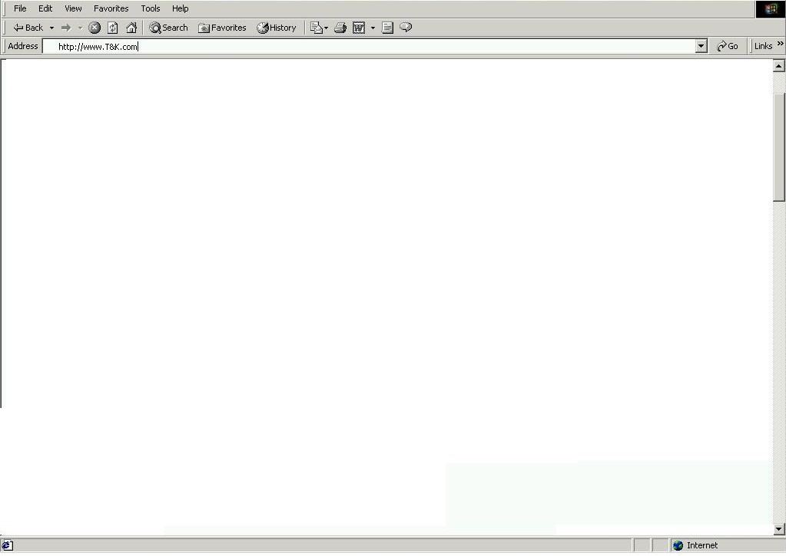

3.1 - Splash Page
Welcome to T&K.com - Editorial and General Description of product offering and services available
Select the country your are shopping from:
United States
Store / Product Images
T&K Map Logo with 2 active regional hyperlinks
T&K Member Sign In
User ID
Region 1 (US)
Region 2 (UK)
Password
Enter your T&K Value card number:
New Customer
Registration

Slide 2
3.2 – My Account (Required Info)
Navigation Bar – Standard Bar to be displayed on all pages (see script for tabs / links)
BA7 – Welcome Davis , Please verify your account info
ED2 – Benefits of registration / with link to registration FAQ
FM1 – User ID / Password / E-mail Address
Personalize my T&K Shopping experience
Home
FM2 – Customer Name / Billing Address
FM15 – Shipping Address
FM3 – Personal Information (Interests / Preferences / Needs)
Home
Text and Hyperlinks to mirror Navigation Bar functions (Copyright / Sponsor Logos)

Slide 3
3.3 - Personalized Home Page
Navigation Bar – Standard Bar to be displayed on all pages (see script for tabs / links)
BA14 – T&K Replenishment Program
Search
(See Script)
FP24 – Mens’ Footwear
Running Shoes Ad
FP25 – Consumer Elec
Bose Speaker System
AD1 – CK Merchant Shop
Services / Specialty Shops
(See Script)
AD2 – Top 5 Items
FP3 – Housewares
New Martha Stewart
Stoneware
FP11 – Home Office
Desk Lamp Image
and text
AD3 – Deal of the Day
Product Categories
(Mirrors Mdse Hierarchy / drills down thru cats)
IN1 -BOGO
Text and Hyperlinks to mirror Navigation Bar functions (Copyright / Sponsor Logos)

Slide 4
3.4 – Replenishment Page
Navigation Bar – Standard Bar to be displayed on all pages (see script for tabs / links)
BA4 – Contact a Personal Shopper for Assistance
AP2 – Shopping Assistant for Replenishment Items
FM9 – Maintain Replenishment Items
Catalog ID | Description | Price | QTY | Frequency | Add to Shopping List
1 | Product Detail Page
2
3
4
Total
Clear Selections
Continue Shopping
Shopping Cart
Text and Hyperlinks to mirror Navigation Bar functions (Copyright / Sponsor Logos)

Slide 5
3.5 - Personalized Home Page
Navigation Bar – Standard Bar to be displayed on all pages (see script for tabs / links)
BA15 – Create your own CD from this week’s Rolling Stone Top 50
Search
(See Script)
FP24 – Mens’ Footwear
Running Shoes Ad
FP25 – Consumer Elec
Bose Speaker System
AD1 – CK Merchant Shop
Services / Specialty Shops
(See Script)
AD2 – Top 5 Items
FP3 – Housewares
New Martha Stewart
Stoneware
FP11 – Home Office
Desk Lamp Image
and text
AD3 – Deal of the Day
Product Categories
(Mirrors Mdse Hierarchy / drills down thru cats)
IN1 -BOGO
Text and Hyperlinks to mirror Navigation Bar functions (Copyright / Sponsor Logos)

Slide 6
3.6 – Music and Video Page
Navigation Bar – Standard Bar to be displayed on all pages (see script for tabs / links)
BA16 – Join the T&K CD Club
Search
(See Script)
FP27 – Consumer Elec
Disc Cleaner
FP6 – Electronics
DVD Player Image
and text
AD18 – This weeks’ top5 CD’s
Services / Specialty Shops
(See Script)
AD19 – Create a custom CD
FP28 – Consumer Elec
Speaker Wire
FP29 – Music & Video
CD Ad
AD20 – Visit the DVD Store
Product Categories
(Mirrors Mdse Hierarchy / drills down thru cats)
IN8 – 15% off DVD / Receivers
Text and Hyperlinks to mirror Navigation Bar functions (Copyright / Sponsor Logos)

Slide 7
3.7 – Custom CD Configurator
Navigation Bar – Standard Bar to be displayed on all pages (see script for tabs / links)
BA16 – Join the T&K CD Club
AP3 – Shopping Assistant for CD Configuration
FM10 – CD Configurator
Sort Songs by:
Rank
Price
Length
Artist
Rank | Song Title | Artist | Album | Length | Price | Add to CD
1
2
3
Total
Clear Order
Add to Cart
Continue Shopping
Text and Hyperlinks to mirror Navigation Bar functions (Copyright / Sponsor Logos)

Slide 8
3.8 – Shopping Cart
Navigation Bar – Standard Bar to be displayed on all pages (see script for tabs / links)
BA5 – Secure Web Pages thru Better Web
Search
(See Script)
QTY | DESCRIPTION | $
Remove
Details
Services / Specialty Shops
(See Script)
CS1 – Two complimentary products
CS2 – Two also bought items not listed above
Product Categories
(Mirrors Mdse Hierarchy / drills down thru cats)
IN4 – Progressive Discount
(Buy X $ get X% off)
Continue Shopping
Recalculate Order
Checkout
Shipping
Handling
Total
Text and Hyperlinks to mirror Navigation Bar functions (Copyright / Sponsor Logos)

Slide 9
3.9 – Check Out
Navigation Bar – Standard Bar to be displayed on all pages (see script for tabs / links)
BA1 – T&K Branded Visa Card Signup
Search
(See Script)
FM2 – Customer Name / Billing Address
FM15 – Order Shipping Address / s
FM4 – Payment Information
Services / Specialty Shops
(See Script)
ORDER CONFIRMATION / RECAP
QTY | DESCRIPTION | $
Product Categories
(Mirrors Mdse Hierarchy / drills down thru cats)
Shipping
Handling
Total
Continue Shopping
Confirm Order
Adjust Order
Text and Hyperlinks to mirror Navigation Bar functions (Copyright / Sponsor Logos)

Slide 10
3.10 – Customer Invoice
Navigation Bar – Standard Bar to be displayed on all pages (see script for tabs / links)
BA10 – Food and Accessories Ad
MS1 – Thank you for your order, an e-mail has been sent. Please print this page for your records
ORDER CONFIRMATION / RECAP
QTY | DESCRIPTION | $
Shipping
Handling
Total | $
Home
Text and Hyperlinks to mirror Navigation Bar functions (Copyright / Sponsor Logos)

