Slide 1

DRAFT
FOR DISCUSSION ONLY
PwC Retail Industry e-business
BroadVision Initiative Planning Session
Retail Storyboard Discussion Document
December 20, 1999
© 1999, PricewaterhouseCoopers L.L.P.

Slide 2
BroadVision Demo Agenda 12/20/99
  T&K Company Overview and Website Features
  Customer segmentation and “Community” Development
  Web page Templates and Functionality
  Retail Storyboard: Scenario 1
  Next Steps

Slide 3
T & K Company Profile and Web site Features
T & K is an international mass merchandiser with stores and warehouses based in North America, the United Kingdom, and Europe . The company has decided to develop new distribution channels and will pursue the development of a web-site offering customers around the world the opportunity to enjoy the same personalized shopping experience they find in T&K stores no matter they are. The Website will be based on the following product offering and features:
Product Offering
  Apparel and Accessories
  Health and Beauty
  Food and Wine
  Housewares
  Home Office
Personalization & CRM
  Support Regional Home Pages for an International retailer
  Support customer sign-up, customer profiling, and profile updates
  Provide customers with a personalized shopping experience (appropriate language, currency, shopping/ fulfillment style, proactively provide information about appropriate lifestyle/interest promotions etc.) through the analysis of customer profiles and web-site usage tacking
  Provide T&K customers access to products regardless of customers’ geographic location
  Obtain customer feedback or conduct customer polls

Slide 4
T & K Website Features
Shopping Experience
  Allow extensive buying-on-website capability (shopping cart; save shopping cart; replenishment orders; different ship to /bill to; multiple ship to; gifts; personalized/customized products; product sample configuration; shop with a friend function; email product information to a friend; buy something for someone off their wish list; create wish lists)
  Supply customer with various means of obtaining help(chat-style help; self service help; phone help while online, etc. )
  Provide extensive gift purchasing assistance: registry/wish list; ability to identify people who may have access to their lists?; reminders about time-to-make gift purchases, etc.
  Support shopping-related activities: check on order status; pay a credit card balance (or customer wants to get a credit card); more details provide information about a product (reviews, recalls, special product-related events)
  Support online inventory checking of local stores. Allow a customer to shop on-line and pick up merchandise locally.
  Support online inventory checking of local stores. Allow a customer to shop on-line and pick up merchandise locally. - Geoff bullet point above says same thing-delete
Corporate Information
  Provide company financial / performance related information such as shareholder information, annual reports, etc.
  Provide alternative channel information including store locations and hours; special store promotions/events; item availability at store locations; pick up product at store locations; store layouts (if accessing from a store kiosk)
  Press Releases
  Employment Opportunities and various contact information

Slide 5
Website Communities

Slide 6
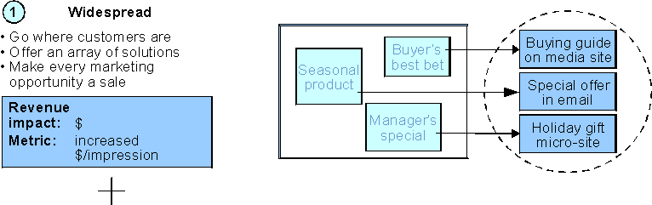
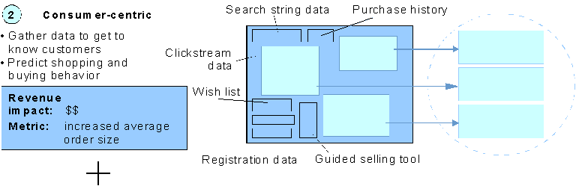
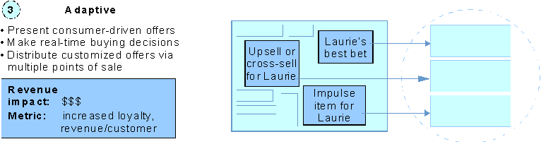
“Communities” are a basic need for successful eCRM
Forrester eMerchandising Overview
T&K Suggested Phasing
Phase 1: Build communities
Build basic site with “guest” (unknown) customer pages
Ask customer for basic information
Use online survey to group customer into appropriate “community”
Phase 2: React in real time
Record clickstreams and sample purchasing behavior
Translate data via mining to related products
Investigate real-time adaptation
Source: Forrester, “Making Merchandising Work”, December 1999

Slide 7
T&K positioning model drives development of Communities
Positioning Strategy
Two Groups of Segmentation Variables
35 to 55 years old
Single, married, and family shoppers
Middle to high-income
Customer specific
Core Customers
Gender
Family status (e.g., single, married no kids, family)
Buying preference (e.g., value, quality, convenience)
Core Competitors
Low price discounters
Home goods category killers
Online niche competitors
Core Products and Services Offering
Apparel and Accessories
Health and Beauty
Food and Wine
Housewares
Home Office
Profile update based on behavior
Session (trip) specific
Needs/interests answered
  Cook
  Prepare
  Present
  Provide
  Entertain
  Outfit
Makes targeted shopping easy and gives browsers reason to buy
Need being fulfilled (e.g., everyday/basic vs. special occasion)
Goods sought (e.g., functional vs. luxury)
Breadth being purchased (e.g., unrelated vs. complimentary)
Key Appeals

Slide 8
Sizing core customer segments prioritizes Communities
T&K customer profile and behavioral segmentation
Other (7%)
3%
3%
Driven by price promotions and coupons
(15.5%)
1%
10%
5%
.5%
.5%
Shops full selection for quality products (53.5%)
40%
13%
3%
Buys high-end merchandise in select categories (24.0%)
9%
12%
Female shopping for others and self (65%)
Female shopping for self (30%)
Male shopper
(5%)
Females represent the most important “community”
  concentrate on 4 shaded groups first
Non-core customer groups should be manually identified (e.g., gift registry shoppers)

Slide 9
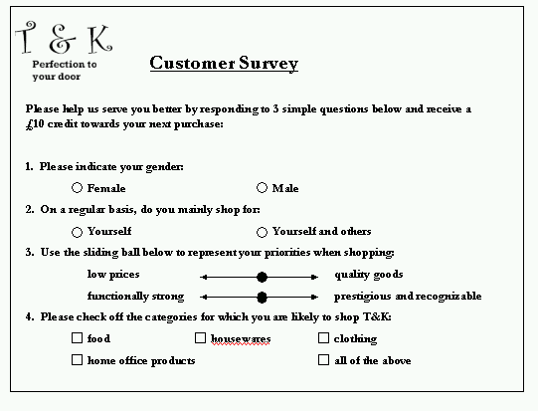
eCRM Phase 1: Gather customer profiles with questionnaire

Slide 10
Knowledge requirements for successful segmentation
Knowledge of the customer:
One-click self-identification through BVSN
  gender
  product category preferences
  price vs. quality sensitivity
Information matching and correlation
  Name/gender lookup
  Mailing list origins (e.g., mothers of newborns)
  Zip code, income, shopping price sensitivity correlation
Past purchasing history
  Internal customer shopping databases
Knowledge of the product:
Identity assigned by merchant to each item that matches customer needs
  position in the product line (i.e., low, mid, high end)
  functional vs. luxury
  everyday vs. special occasion usage
Identify relationships between items using merchant creativity or CRM practices
  “Romance the merchandise” -- products that go in sets or compliment each other (i.e., printers and cartridges, tank tops and shorts)
  Use mining techniques to show likely items that will be purchased with any given item
  Use advanced mining techniques to correlate purchasing of an item with customer profiles to identify surprises (e.g., women who buy brown belts will buy pillowcases -- Net perceptions example)

Slide 11
Web Page Templates / Functions

Slide 12
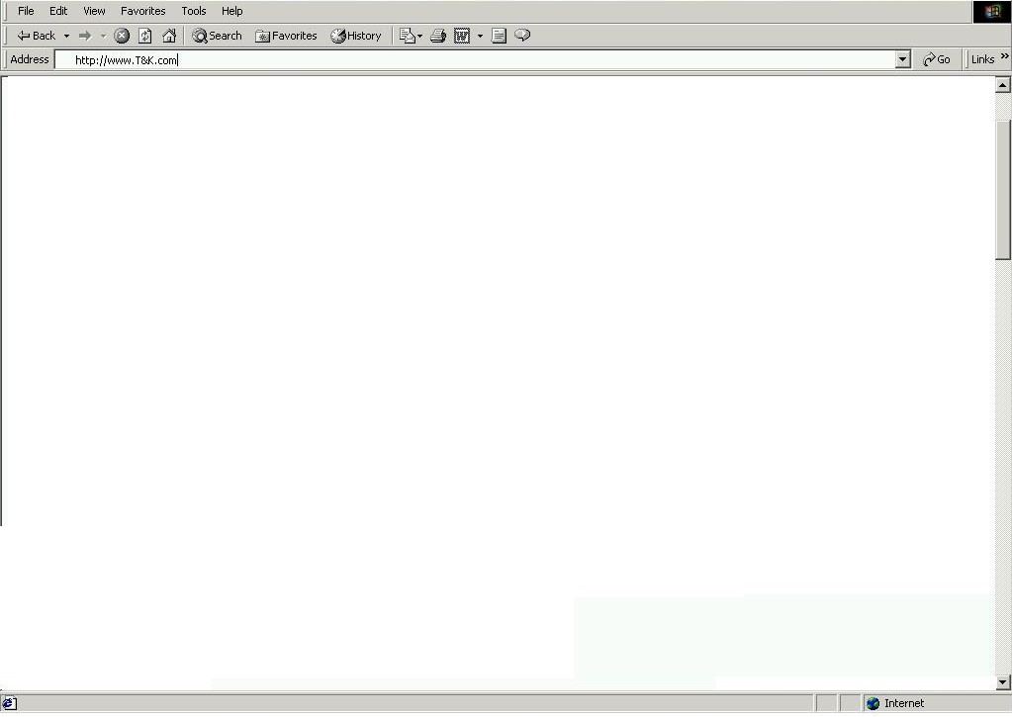
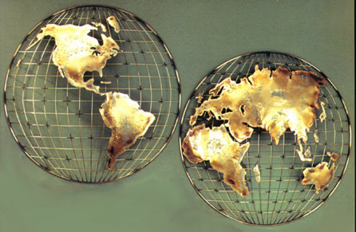
T&K Splash Page
Select the country your are shopping from:
Splash Page Functionality
Customer clicks into a regional community from the splash page. (Selects language and currency in which they are shopping )
Customer can register as a new user
Customer can identify themselves as a current value card member who has never been to the site
Data Requirement / App Functionality
Related attributes must be established for each product to store multiple descriptions and prices
Back office link that supports regional pricing strategies in multiple currencies.
New Customer Registration
Value Card Member

Slide 13
T&K Customer Registration
Use of the BroadVision Standard Customer Record (name, address, gender, income, etc.) to accomplish Phase 1 customer profiling and community development. Modifications of the standard profile to include customer preferences, interests and needs help to further define community and development of sophisticated matching techniques

Slide 14
T&K Home Page
Search
Basic entire site search capability (Keyword)
Link to Advanced (Product Attribute)
Page Banner
Advertisement
Incentive
Etc.
Featured Merchandising Space
Navigation Bar
Customer Service
Corporate Info
Products
My Account
Registry / Wish list
Search
Targeted Content
Advertisement, Incentive or Editorial targeted at the community of the user or the standard promos if the user is unknown
Menu
Services
Specialty Shops
Categories
Personalized Content

Slide 15
T&K Category Page
Search
Basic Search within Category (Keyword)
Link to Advanced (Product Attribute)
Page Banner
Personalized message to customer
Featured Merchandising Space
Featured products and current promotions that are either categorically or customer driven. BroadVision rules are setup to determine whether specific content matched to user should be applied of if the user does not meet criteria and the standard promo should be displayed
Targeted Category Content
Advertisements and Incentives matched to the user using BroadVision delivery methods (Rules, Incentive matching, Taxonomy Matching, etc.)
Editorials / Special interest content (Recommendations, Reviews)
Top 5 items in Category
Menu
Displays T&K specialty shops and service offerings
Category menu drills down to shows sub-categories

Slide 16
T&K Product Page
Search
Link to Shopping Bot
Navigation Bar
Featured Product Space
Enlarged product graphic, extended description and additional characteristic matrix
(i.e. wine.com tasting chart)
Targeted Category Content
Customer who purchased X also bought Y
Suggested complimentary Items (Cross-sell, Coordinate selling)
Product Review
Menu
Category menu
Email to a friend
Giftwrap
Auction functions
Configuration function
Product Reviews
Discussion group functionality to store and display customer reviews, offer expert advice, etc.

Slide 17
T&K Category Page
Search
Basic Search within Category (Keyword)
Link to Advanced (Product Attribute)
Page Banner
Personalized message to customer
Featured Merchandising Space
Featured products and current promotions that are either categorically or customer driven. BroadVision rules are set-up to determine whether specific content matched to user should be applied of if the user does not meet criteria and the standard promo should be displayed
Targeted Category Content
Advertisements and Incentives matched to the user using BroadVision delivery methods (Rules, Incentive matching, Taxonomy Matching, etc.)
Editorials / Special interest content (Recommendations, Reviews)
Top 5 items in Category
Personalized Content
Menu
Displays T&K specialty shops and service offerings
Category menu drills down to shows sub-categories

Slide 18
T&K Product Page
Search
Link to Shopping Bot
Navigation Bar
Featured Product Space
Enlarged product graphic, extended description and additional characteristic matrix
(i.e. wine.com tasting chart)
Targeted Category Content
Customer who purchased X also bought Y
Suggested complimentary Items (Cross-sell, Coordinate selling)
Product Review
Personalized Content
Product Reviews
Discussion group functionality to store and display customer reviews, offer expert advice, etc.
Menu
Category menu
Email to a friend
Gift wrap
Name your price

Slide 19
T&K Product Characteristics Matrix
Define sets of related attributes to be defined for every product offered on the web. Products in related categories with defined attributes can be placed into the delivered BroadVision comparison matrix.
Product Characteristics Matrix
Matrix displays product feature comparison giving customers the ability to view products in the same category side by side and make an informed purchase based on price and functionality.

Slide 20
T&K Shopping Cart
Use standard BroadVision Shopping cart functionality including storage of shopping cart for return visit. Add some personalized content to cross-sell.
Cross Sell Opportunity
Display complimentary items, items also purchased, and other related items during the checkout process
Personalized Content

Slide 21
Website Functions
Matching Techniques
  Rule based matching
  Taxonomy Matching
  Related attribute matching
  Session Matching
Discussion Groups
  Define further to support customer product reviews
E-mail Delivery
  Use of BroadVision SMTP server to deliver targeted e-mail to community groups
Reverse Auction Functionality / Shopping Bot
  Custom development of JAVA enable search engine that can search the web and return
Site Search

Slide 22
Retail Storyboard: Scenario 1

Slide 23
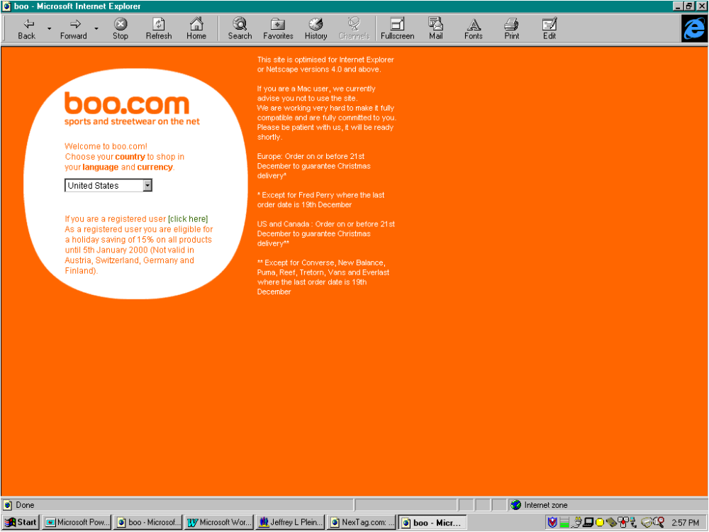
Entry into the Site
Storyline
Carmen is net savvy and spends a fair amount of time shopping on the net. She uses the net to buy products to supply her wine and cheese catering business. During her first visit to the T&K site, Carmen indicated that she is shopping from the U.S. site.
BroadVision feature
Examines cookies, recognizes user, redirects to appropriate page
Greets customer with welcome message
Custom/enhancement
None necessary

Slide 24
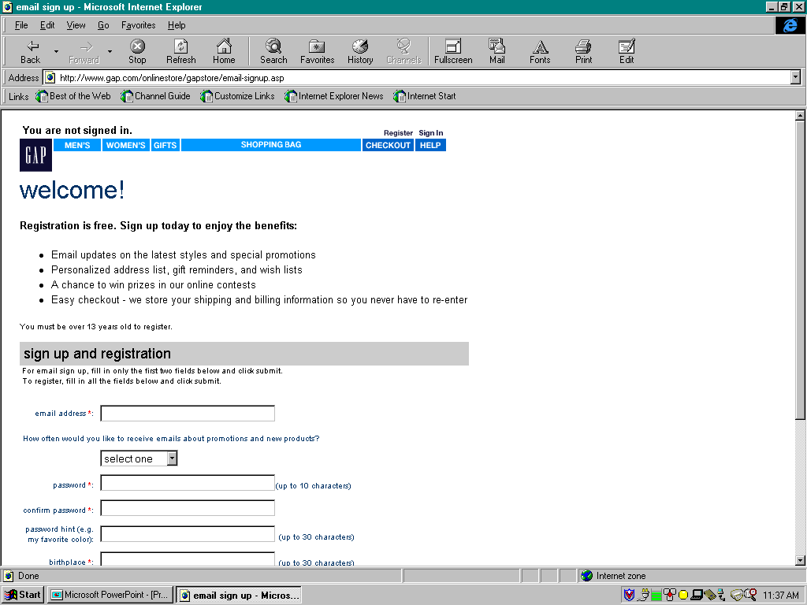
User Registration
Storyline
While logging into the home site during this visit, Carmen provides a little information about herself. She provides her name, gender, birthday, and email address.
BroadVision feature
Built-in customer profile features
Extensible attributes
Custom/enhancement
Understanding of customer groups to expand basic survey

Slide 25
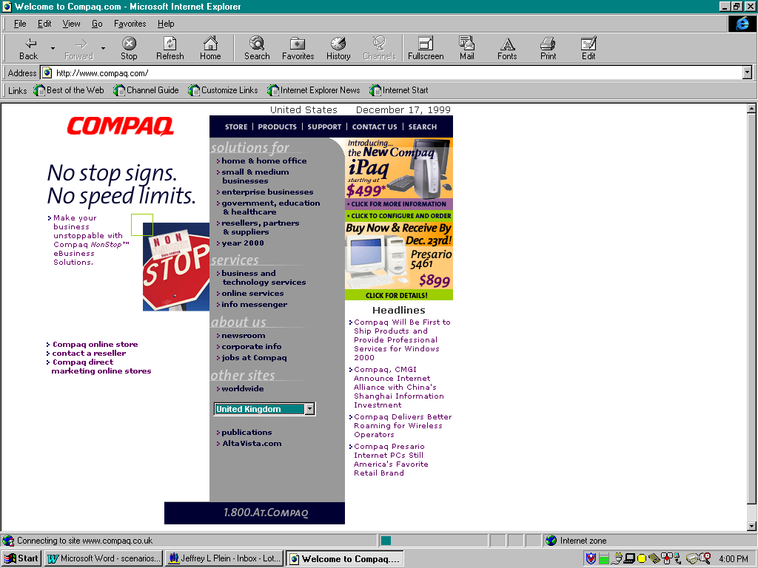
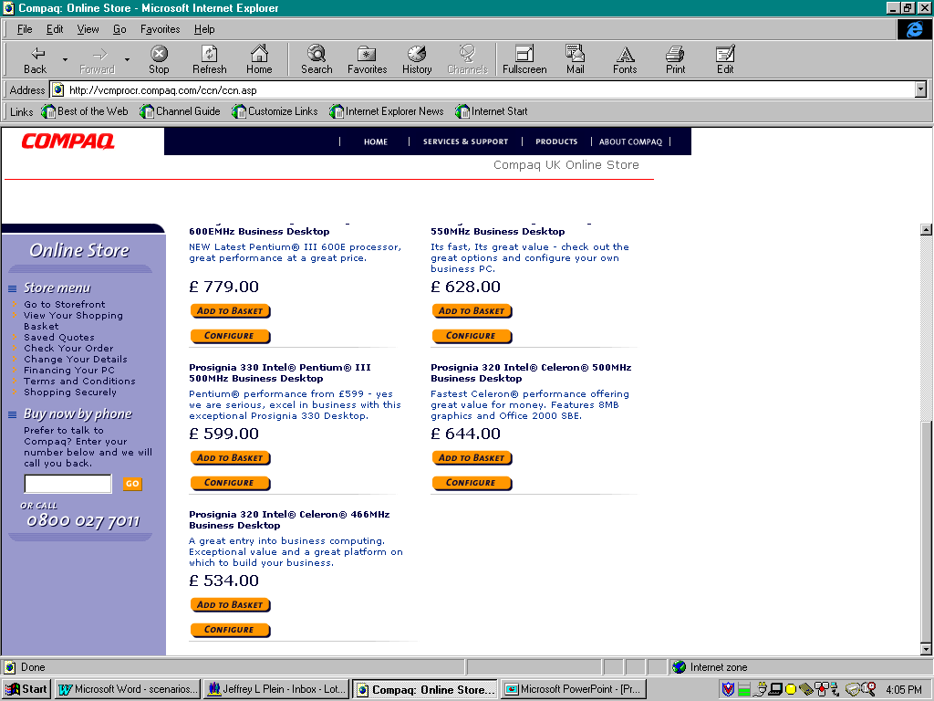
Homepage
Storyline
Carmen proceeds to the homepage for her country and finds that content is already geared to her basic profile.
BroadVision feature
Built-in customer profile features can be tied to rule for content delivery
Custom/enhancement
Back office functionality to handle multi-language and currency, country specific pricing strategies and price conversion capability

Slide 26
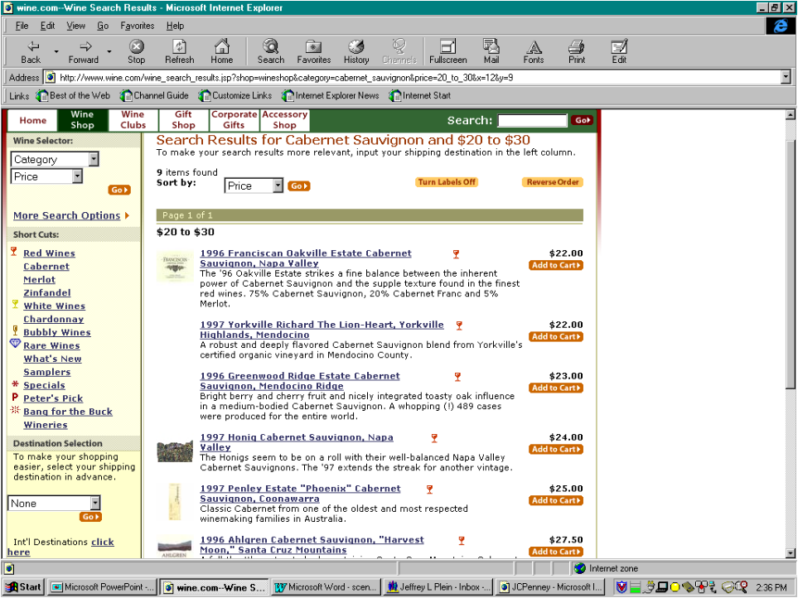
Category Browsing and Site Interaction
Storyline
Carmen’s main objective of this visit is to purchase a printer for her home office. She is not sure which printer to buy, and proceeds to the printer category to browse for a printer. Although Carmen has not specifically indicated so in her profile, T&K knows from the products that Carmen has browsed but not purchased, that Carmen might be a home office consumer. The site begins to target her with home office products by pushing related ads, and incentives to her. She proceeds to the printer section of the home office category and begins to browse the printers available.
BroadVision feature
Rule and Event based matching for content.
Targets homepage promotions based on profile
Coupon incentive is automatically applied during checkout
Custom/enhancement
Clickstream adaptive marketing out-of-scope for phase 1, needs to be investigated

Slide 27
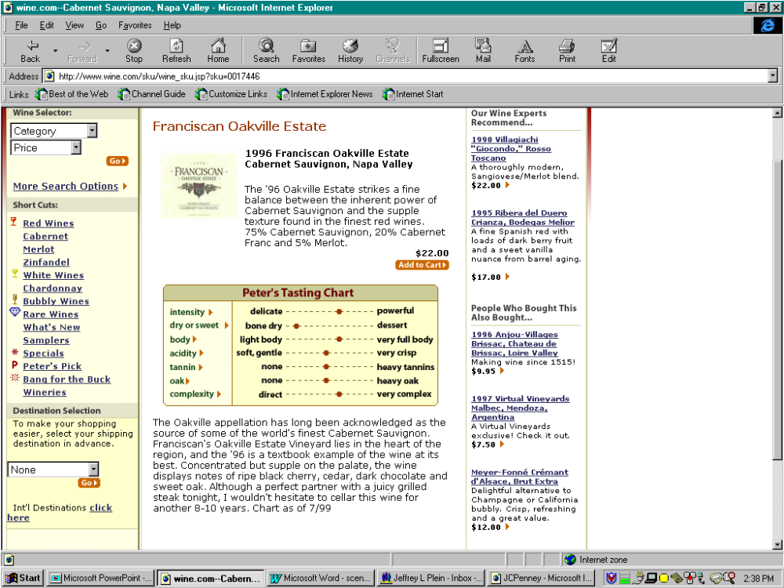
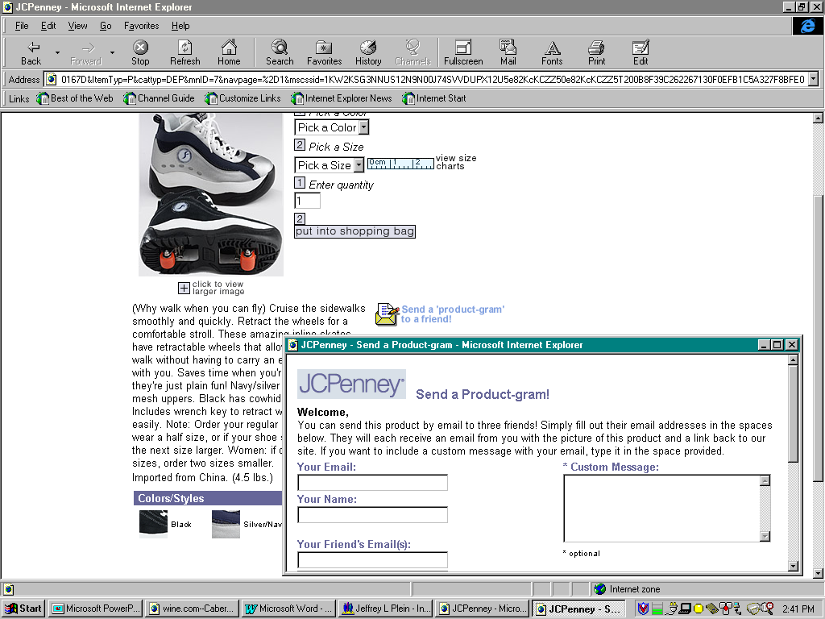
Product Information Page
Storyline
From the printer detail page, she begins to read about the features of the printer she selected. She notices that she can send the product information to her friends or business associates, and remembers someone to whom she emails the page. Carmen also notices that the store has plenty of product available, with over 2,000 units in stock.
BroadVision feature
Full content management
Custom/enhancement
Email button for sending page
Tie-in to inventory systems in real time

Slide 28
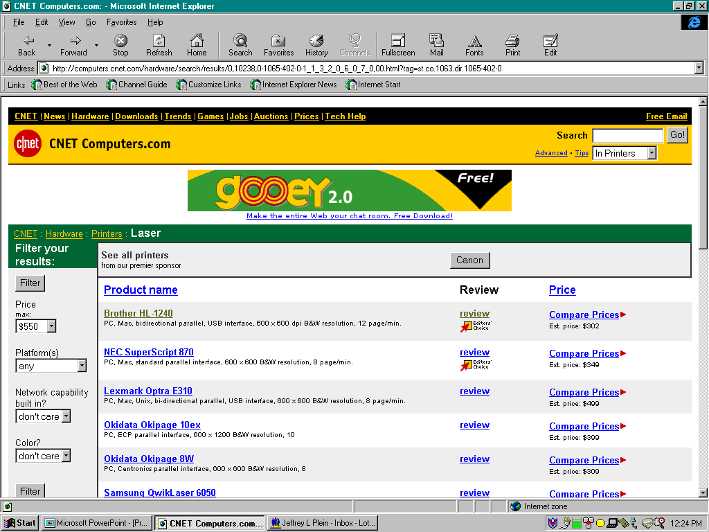
Product Comparison Page
Storyline
Carmen also notices that T&K offers a feature / price comparison service to help her compare products and make a more informed decision. She follows the link and is taken to the printer comparison matrix. From the comparison matrix, Carmen is able to see that the printer she was looking at can not print on the card stock she uses to create the gift cards included in her wine and cheese gift baskets. She uses the basic keyword search engine to find printers that can print on card stock. The site suggests products sold by T&K and even finds other printers sold by other etailers on the Web.
BroadVision feature
Strong search engine functionality within the site itself
Custom/enhancement
Product comparison feature would need to be built
Each product in product file would need attributes relevant for comparison
All-Web shopping bot functionality would need to be developed and integrated into search engine to filter non-T&K products

Slide 29
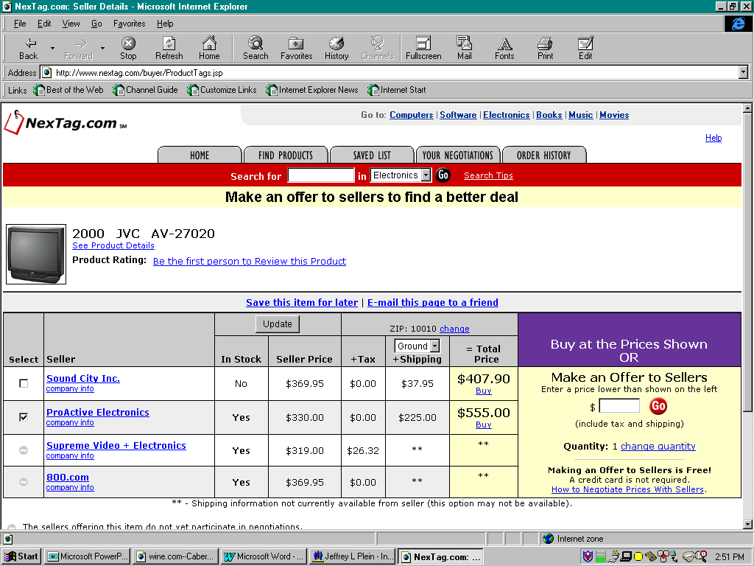
Reverse Auction Functionality
Storyline
Carmen finds a printer that can print on card stock that is just slightly slower than she wanted (6 ppm vs 8 ppm). However, T&K will allow Carmen to name her price for this printer and will tell her within 30 seconds whether they can meet it. To her surprise, Carmen finds that she can buy the printer for much less than she expected.
BroadVision feature
Allows for Java-based popup windows
Custom/enhancement
Name-your-price Java popup that shows MSRP and accepts customer input for price
Match-back with merchant-determined pricing schedule to accept/reject prices
Java window update to communicate status

Slide 30
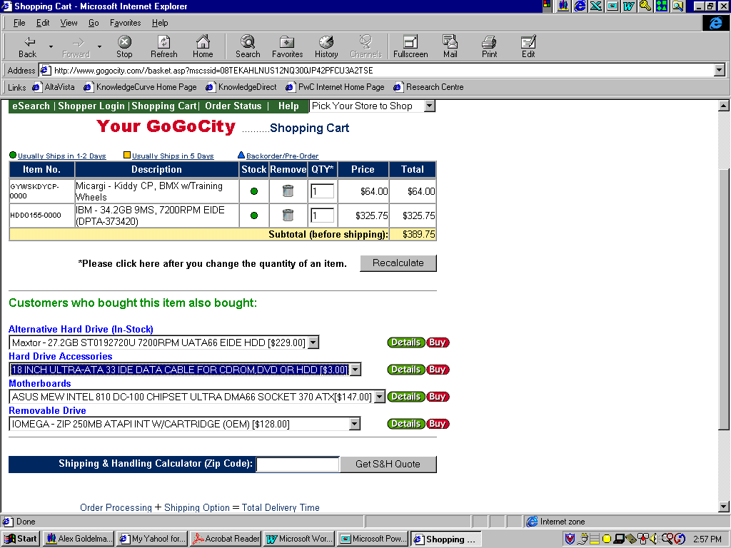
Shopping Cart and Cross-Selling
Storyline
Carmen puts the printer into her shopping basket and is taken to the order processing screen where the T&K shopping assistant offers her some printer accessories such as a printer cable, toner, and special paper to go along with her purchase. Other content from related categories such as fax, shredder, and phone equipment is displayed during the order review process as well. Carmen needs to pick up a few more things and follows the ‘continue shopping’ link to return to the product area.
BroadVision feature
Well-developed shopping cart feature
Custom/enhancement
Identify related products for cross-selling for each item using data mining eCRM techniques

Slide 31
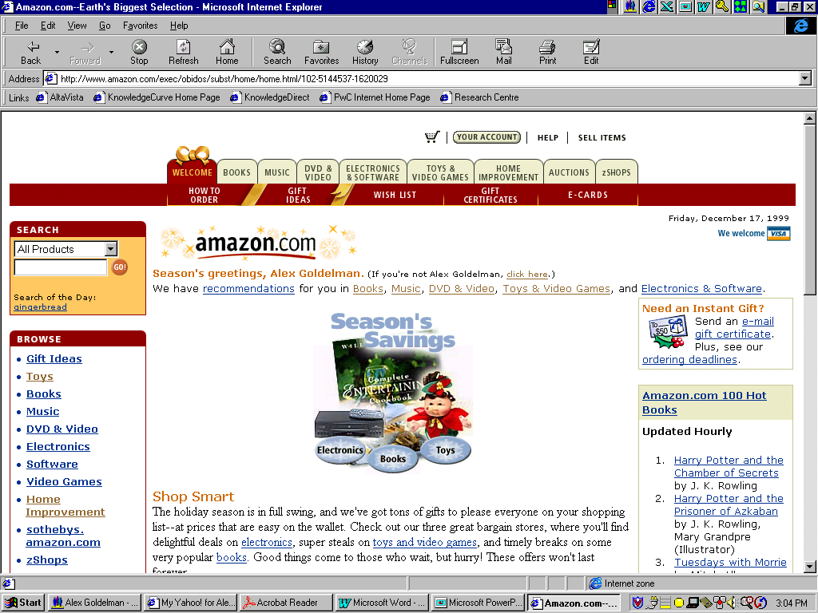
Adaptive Marketing Techniques
Storyline
Carmen’s business requires her to frequently visit and purchase from the T&K site. She has used the T&K site extensively during the past 12 months to purchase Californian wines for her catering business. Although Carmen is a busy person and never took the time to provide an extensive profile of herself or of her specific interests, T&K is developing an extensive database on her preferences. Each of Carmen’s visits to the website are characterized by increasingly sophisticated marketing by T&K. Each purchase defines Carmen’s buying habits further and helps T&K to determine how best to target Carmen as a valued customer. For example, after a few purchases of wine, T&K realized that Carmen had not purchased a single bottle of the more expensive French or Spanish wines. T&K then provided advertising and product information on these wines to see if Carmen may have an interest in upgrading her selections to more expensive wines.
BroadVision feature
Observation / tracking characteristics can be used to target customers via rules
Custom/enhancement
Develop enhancement to write observations to the customer profile database, or integrate net perceptions at this point

Slide 32
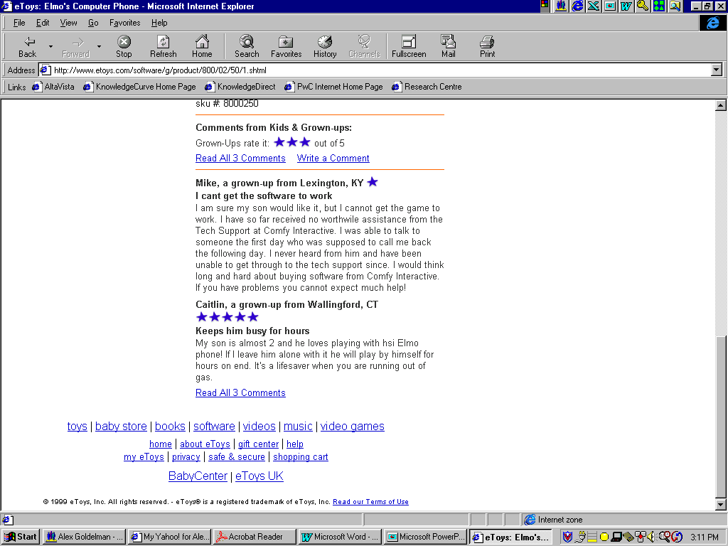
Community and User Reviews
Storyline
Carmen was not sure about purchasing more expensive wines, but began to take advantage of the customer reviews section of the website to read what other T&K customers thought about the wines that were available. She began to broaden her selections based on the advice of the T&K shopping community.
BroadVision feature
BroadVision Discussion group functionality used to create and maintain / monitor the customer reviews
Custom/enhancement
None required

Slide 33
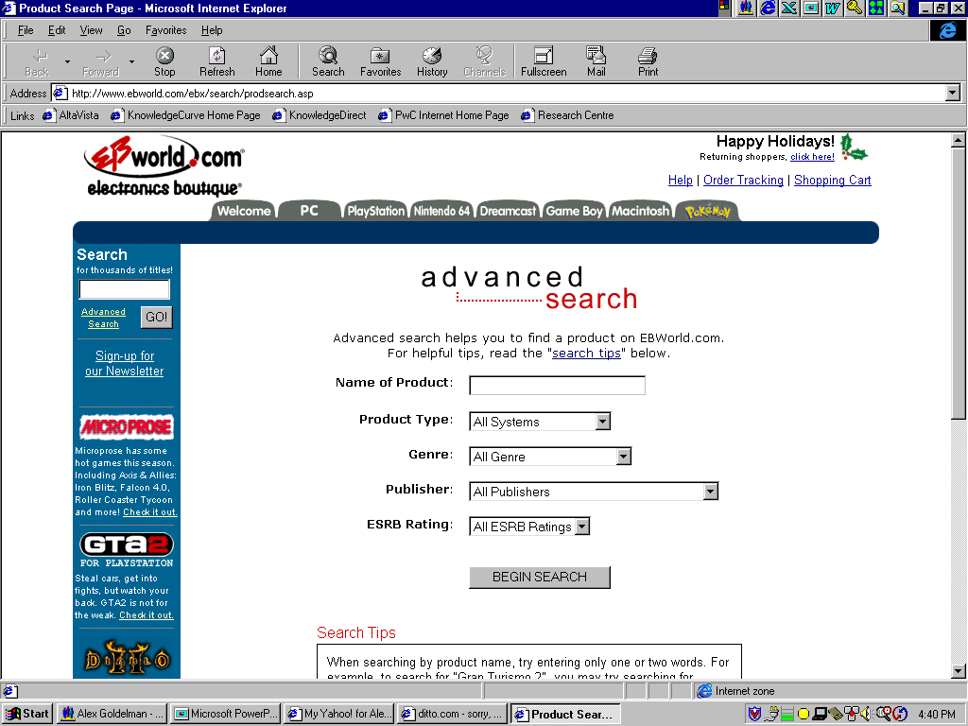
Product Search
Storyline
Carmen notices that her customers are becoming more demanding and competition has cut into her sales. She develops a plan, which will help diversify her offerings and differentiate herself amongst the competition. Carmen decides to start offering deserts to her customers. However, she is new at deserts and needs some guidance. She logs on to T&K’s site and searches for a Martha Stewart cookbook.
BroadVision feature
BV Keyword search functionality, and use of extended product attributes to indicate brand / vendor
Custom/enhancement
Possible development of Shopping Bot to aid in product search and low price determination

Slide 34
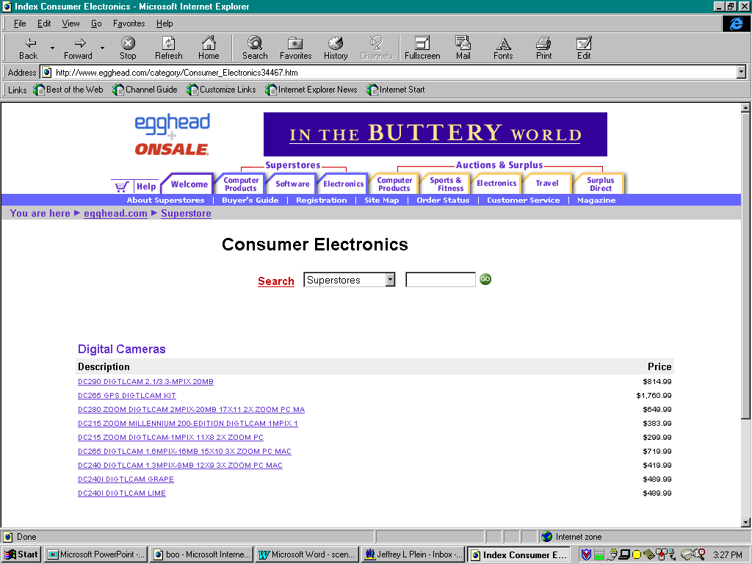
Merchant Shops
Storyline
By now T&K knows from Carmen’s past purchasing habits that she is a home office businessperson who frequently buys wine, cheese, fruit and other related items. The T&K site offers a Martha Stewart cookbook complete with desert recipes. T&K also tries to upsell other Martha Stewart (MS) goods such as MS decorating guides, MS linens and table coverings, MS stationary and business related items, MS holiday gift giving ideas, etc. Carmen is also greeted with numerous other brands offering similar products to those of Martha Stewart in an effort to make Carmen’s shopping experience complete.
BroadVision feature
Rule-based content delivery
Custom/enhancement
When search engine or other rules have hit a predefined criteria, pull up merchant shops

Slide 35
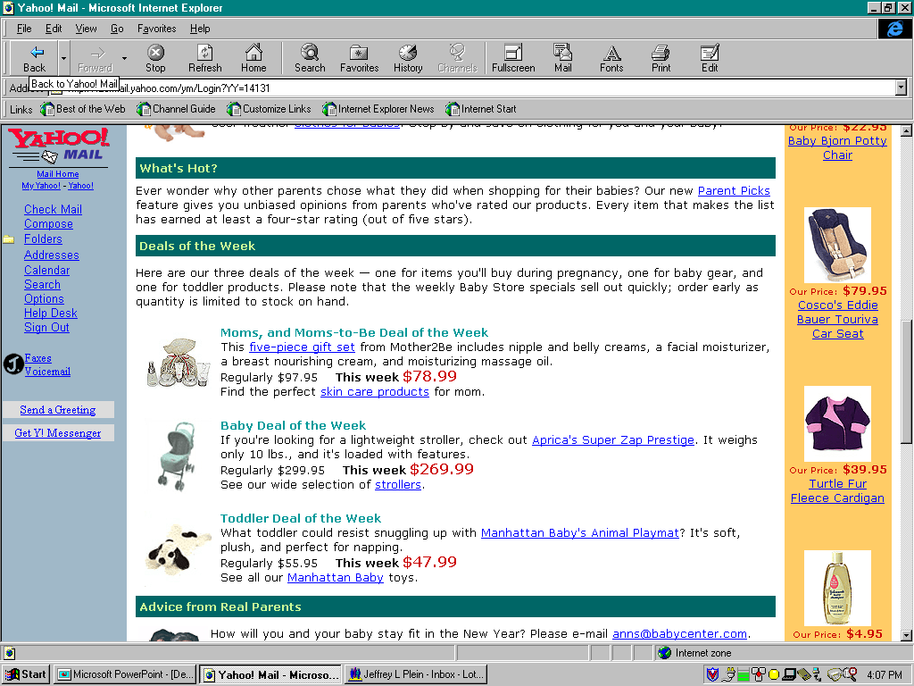
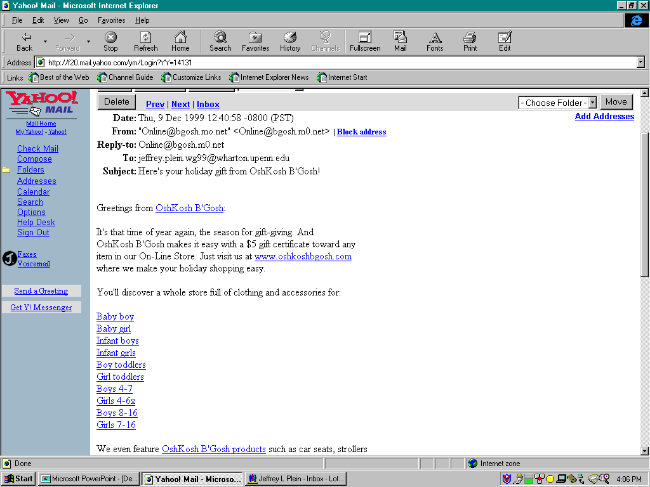
ePromotion
Storyline
Running a catering business is time consuming and because of this Carmen has had little time to keep current on sales or new products that might compliment or add value to her business. T&K provides value by emailing to Carmen once a week a list of upcoming sales on food and party supplies covering both products that she has purchased in the past, as well as products in which she may be interested based on her growing profile.
BroadVision feature
Logging of promotional activity and responses
Email server can be used to target various “communities”
Custom/enhancement
Campaign management software for email, online, direct mail activities and analysis

Slide 36
Next Steps
  Complete Storyboard Demo’s with examples
  Define Customer Profile attributes
  Define BroadVision communities
  Define the T&K Website Merchandise Hierarchy
  Define Product Attributes
  Identify BroadVision content elements needed for demo
    Advertisements
    Incentives
    Editorials
    Observation Queries
  Write sample BroadVision Rules for matching scenarios
  Develop the T&K site map

