Slide 1

DRAFT
FOR DISCUSSION ONLY
BroadVision B2C Demonstration Project
Retail Storyboard Review Session
December 20, 1999
© 1999, PricewaterhouseCoopers L.L.P.

Slide 2
Agenda 12/20/99
  Project Approach
  T&K.com Overview
  T&K Customer Segmentation and Community Development
  Web page Templates and Functionality
  Retail Storyboard: Scenario 1
  Next Steps
  Questions and Concerns

Slide 3
We have developed a three-phased approach to completing the retail demonstration
A: July-September
B: October-December
A:January-February
B: March-June
Phase 3
Provide BroadVision/
PwC perspective on a “complete solution”
December-January
Phase 2
Phase 1
Connect BroadVision and other key applications for demo
Develop a BroadVision demo with a Point-of-View
B2C Focus
Multi-Channel
Personalization
Globalization(eventually)
Retail e-Business Discussion Document
System Functionality
Storyboards, Content, Rules, Attributes
Conceptual and technical integration points
Strategic functionality
Potential Application Footprints
Enhanced Storyboards
Integration with Net Perceptions and other packages
Enhanced Discussion Document
B2B, ROI
White papers, project accelerators
Supply / Value Chain Integration
Financial Systems
Store Operations
Storyboards
Enhanced Discussion Doc

Slide 4
T & K.com Overview
T & K is an international mass merchandiser with stores and warehouses based in North America, the United Kingdom, and Europe . The company has decided to develop new distribution channels and will pursue the development of a web-site offering customers around the world the opportunity to enjoy the same personalized shopping experience they find in T&K stores no matter they are. They have created T&K.com as a separate division to pursue this strategy. The T&K.com Web-site will be based on the following product offering and features:
Product Offering
T&K.com has determined that the following broad array of product categories will be offered on its web-site.
  Apparel and Accessories
  Food & Wine
  Housewares
  Home Office / Consumer Electronics
Personalization & CRM
T&K.com wishes to offer its internet customers comparable high quality customer service that is available to its store customers.
  Support Regional Home Pages for an International retailer
  Support customer sign-up, customer profiling, and profile updates
  Provide customers with a personalized shopping experience (appropriate language, currency, shopping/ fulfillment style, proactively provide information about appropriate lifestyle/interest promotions etc.) through the analysis of customer profiles and web-site usage tacking
  Provide T&K customers access to products regardless of customers’ geographic location
  Obtain customer feedback or conduct customer polls

Slide 5
T & K.com Overview
Shopping Experience
  Allow extensive buying-on-website capability (shopping cart; save shopping cart; replenishment orders; different ship to /bill to; multiple ship to; gifts; personalized/customized products; product sample configuration; shop with a friend function; email product information to a friend; buy something for someone off their wish list; create wish lists)
  Supply customer with various means of obtaining help(chat-style help; self service help; phone help while online, etc. )
  Provide extensive gift purchasing assistance: registry/wish list; ability to identify people who may have access to their lists?; reminders about time-to-make gift purchases, etc.
  Support shopping-related activities: check on order status; pay a credit card balance (or customer wants to get a credit card); more details provide information about a product (reviews, recalls, special product-related events)
  Support online inventory checking of local stores. Allow a customer to shop on-line and pick up merchandise locally.
Corporate Information
  Provide company financial / performance related information such as shareholder information, annual reports, etc.
  Provide alternative channel information including store locations and hours; special store promotions/events; item availability at store locations; pick up product at store locations; store layouts (if accessing from a store kiosk)
  Press Releases
  Employment Opportunities and various contact information

Slide 6
Highlighted Website Features
BroadVision Features
  Customer Profiling
  Content Management
  Matching Techniques
    Rules based
    Taxonomy
    Session
  Session Tracking / Logging
  Product Comparison
  Discussion Groups
  SMTP e-mail server
  Search
  Shopping Cart
  Order Tracking
  Product Pricing
  Regional Content (Multi language and currency)
  Add-on services (Gift wrap, engraving, monogramming)
Other Features
  Shopping assistance (Chat, Configurator, shop with a friend, Browser Control)
  Replenishment Items
  Advanced e-mail functionality (e-promotions, date reminders, e-mail page to a friend)
  Registry / Wish List functionality
  Local inventory checking
  Natural language Search

Slide 7
T&K Customer Segmentation and Community Development

Slide 8
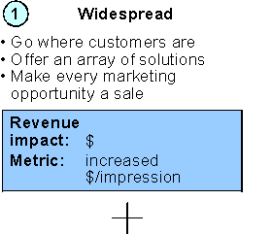
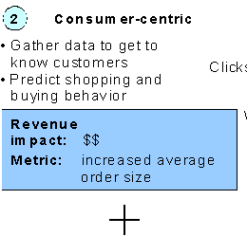
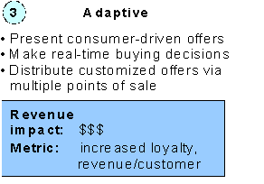
“Communities” are a basic need for successful eCRM
Evolution of communities/ segments
Our demonstration requirements
Build basic site with “guest” (unknown) customer pages and functionality
Obtain basic customer information
Assign customer into appropriate segment
Monitor and record clickstreams for adaptive real-time marketing
Integrate with Net Perceptions (if possible)
Increasing personalization and
Utilization of Broadvision capabilities
Source: Forrester, “Making Merchandising Work”, December 1999

Slide 9
We used hypothetical data to size the customer segments
T&K customer profile and behavioral segmentation
Other (7%)
3%
3%
Driven by price promotions and coupons
(15.5%)
1%
10%
5%
.5%
Full-range, quality-focused family shopper
40%
Full-range, quality-focused single shopper
13%
.5%
Shops full selection for quality products (53.5%)
3%
Targeted upscale single shoppers
9%
Buys high-end merchandise in select categories (24.0%)
Targeted upscale family shopper
12%
Female shopping for others and self (65%)
Female shopping for self (30%)
Male shopper
(5%)
Communities segment themselves along gender, preference, and behavior lines
Females represent the most important “community”
  concentrate on 4 shaded groups first
Non-core customer groups should be manually identified (e.g., gift registry shoppers)

Slide 10

Gather customer profiles with questionnaire for segmentation
Customer Survey
Please help us serve you better by responding to 4 simple questions below and receive a $10
credit towards your next purchase:
1. Please indicate your gender:
Female
Male
2. On a regular basis, do you mainly shop for:
Yourself
Yourself and others
3. Use the sliding balls below to represent your priorities when shopping:
low prices
high quality
generic products
recognizable brands
everyday items
luxury items
self-service
personal shopper
4. Please check off the categories for which you are likely to shop T&K:
food & wine
apparel & accessories
electronics & home office products
housewares

Slide 11
Web Page Templates and Functionality

Slide 12
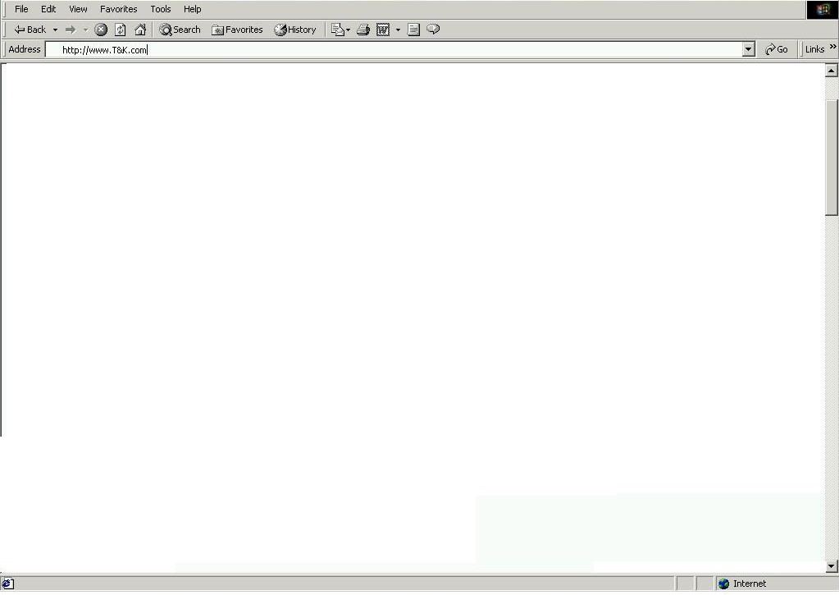

T&K Splash Page
Select the country your are shopping from:
Splash Page Functionality
Customer clicks into a regional community from the splash page. (Selects language and currency in which they are shopping )
Customer can register as a new user and automatically become a value card member when they register
Customer can identify themselves as a current value card member who has never been to the site
United States
Sign In
New Customer Registration
Value Card Member
Data Requirement / App Functionality
Related attributes must be established for each product’s multiple descriptions and prices
Back office link that supports regional pricing strategies in multiple currencies.
Link to existing Customer Database

Slide 13
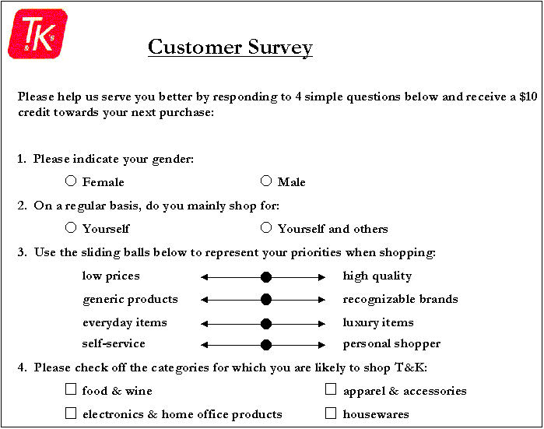
T&K Customer Registration / Personalization
Customer Profile
Use the standard BroadVision customer record (name, address, gender, income, etc.) to establish the basic customer profile.
Modifications of the standard profile will include identification of customer preferences, interests and needs.
Development of Communities based on profile attributes.
Product / Content Attributes
Define products, Incentives, Editorials, Advertisements, etc. to be used as targeted content.
Define attributes that create product “identity” and are the basis for matching content with customers.
BroadVision Rules
Assign rules to template content areas based on the some of the following techniques:
  Rule based matching
  Taxonomy Matching
  Related attribute matching
  Session Matching

Slide 14
T&K Home Page
Search
Basic entire site search capability (Keyword)
Link to Advanced (Product Attribute)
Natural Language Search
Page Banner
Advertisement
Incentive
Etc.
Featured Merchandising Space
Navigation Bar
Customer Service
Corporate Info
Products
My Account
Registry / Wish list
Advanced Search
Shopping Cart
Targeted Content
Advertisement, Incentive or Editorial targeted at the community of the user or the standard promos if the user is unknown
Menu
Services
Specialty Shops
Categories
Personalized Content

Slide 15
T&K Category Page
Search
Basic Search within Category (Keyword)
Link to Advanced (Product Attribute)
Page Banner
Personalized message to customer
Featured Merchandising Space
Featured products and current promotions that are either categorically or customer driven. BroadVision rules are setup to determine whether specific content can be matched to user based on profile or should the standard promotional content be displayed for the category
Targeted Category Content
Advertisements and Incentives matched to the user using BroadVision delivery methods (Rules, Incentive matching, Taxonomy Matching, etc.)
Editorials / Special interest content (Recommendations, Reviews)
Top 5 items in Category
Menu
Displays T&K specialty shops and service offerings
Category menu drills down to shows sub-categories

Slide 16
T&K Product Page
Search
Link to Shopping Bot
Navigation Bar
Featured Product Space
Enlarged product graphic, extended description and editorials (i.e. wine.com tasting chart)
  Add to shopping Cart
  Add to Wish List / Registry
  Product comparison matrix
Targeted Category Content
Customer who purchased X also bought Y
Suggested complementary Items (Cross-sell, Coordinate selling)
Product Review
Menu
Category menu
Email to a friend
Giftwrap
Auction functions
Configuration function
Product Reviews
Discussion group functionality to store and display customer reviews, offer expert advice, etc.

Slide 17
T&K Product Characteristics Matrix
Define sets of related attributes to be defined for every product offered on the web. Products in related categories with defined attributes can be placed into the delivered BroadVision comparison matrix. Customers are able to view products side by side and make more informed purchasing decisions.
Product Characteristics Matrix
Matrix displays product feature comparison giving customers the ability to view products in the same category side by side and make an informed purchase based on price and functionality.

Slide 18
T&K Shopping Cart
Use standard BroadVision Shopping cart functionality including storage of shopping cart for return visit. Add some personalized content to cross-sell.
Cross Sell Opportunity
Display complementary items, items also purchased, and other related items during the checkout process
Back Office integration to enable order tracking by the customer and to display interaction with the existing order fulfillment and purchasing systems
Personalized Content

Slide 19
Retail Storyboard: Scenario 1

Slide 20
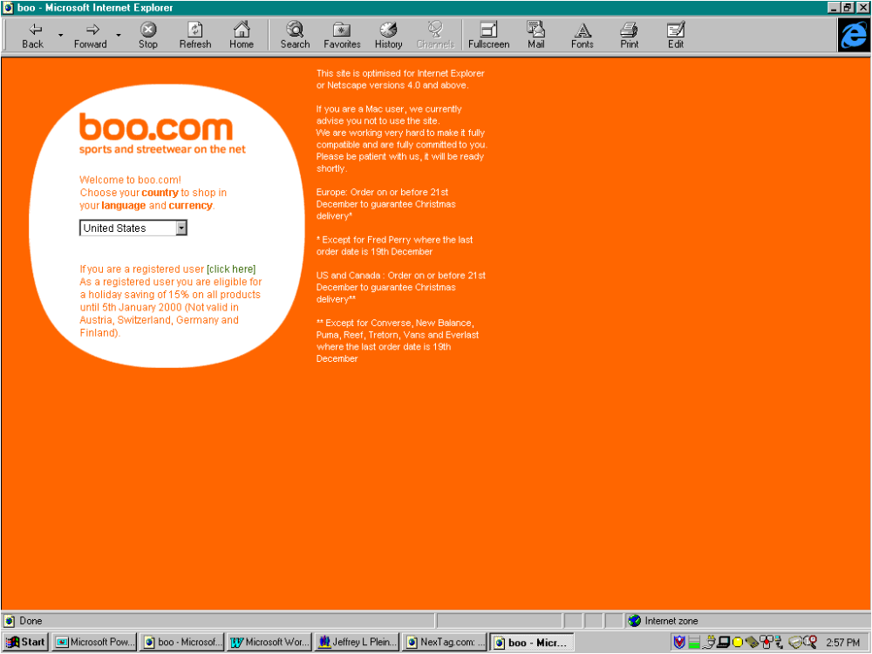
Entry into the Site
Storyline
Carmen is net savvy and spends a fair amount of time shopping on the net. She uses the net to buy products to supply her wine and cheese catering business. During her first visit to the T&K site, Carmen indicated that she is shopping from the U.S. site.
BroadVision feature
Examines cookies, recognizes user, redirects to appropriate page
Greets customer with welcome message
Custom/enhancement
None necessary

Slide 21
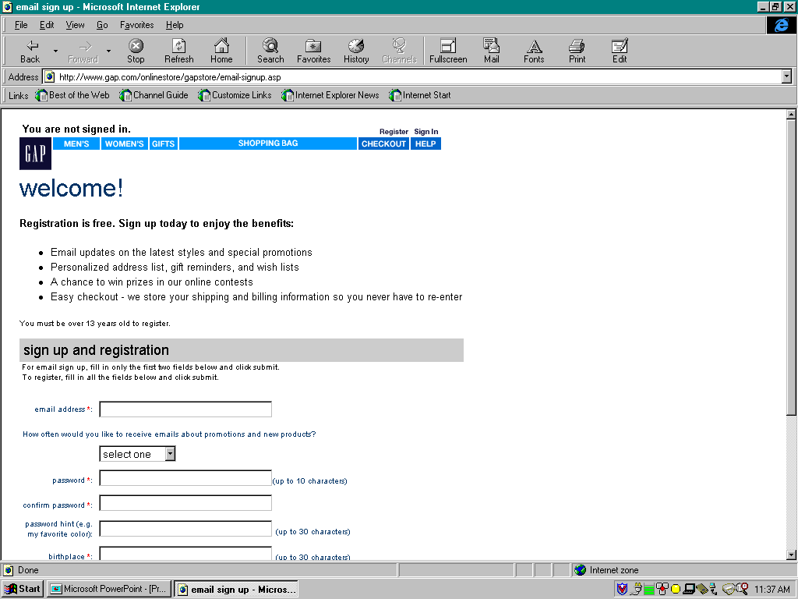
User Registration
Storyline
While logging into the home site during this visit, Carmen provides a little information about herself. She fills out standard information about herself (i.e., name, gender, birthday, and email address), and then provides more personalized information about her shopping preferences.
BroadVision feature
Built-in customer profile features
Extensible attributes
Custom/enhancement
Understanding of customer groups to expand basic survey

Slide 22
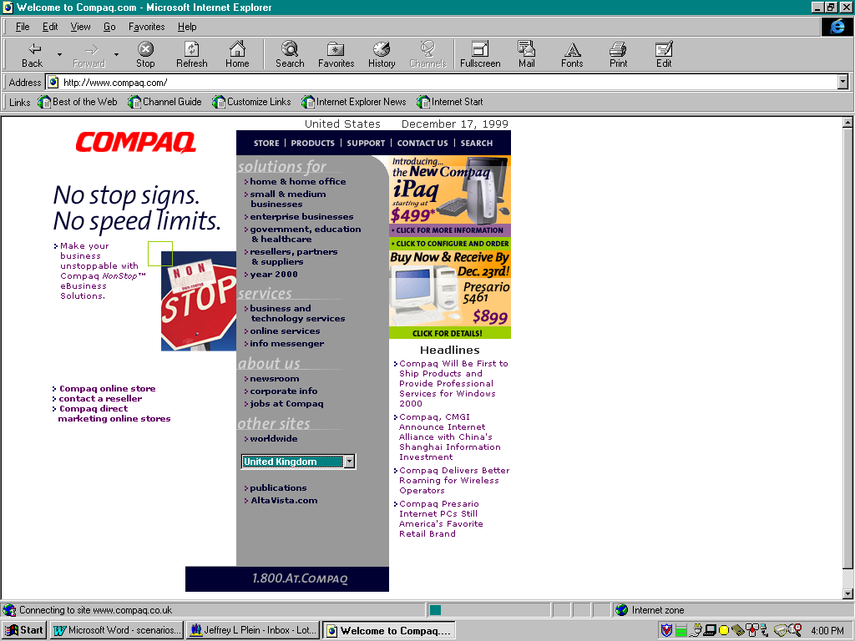
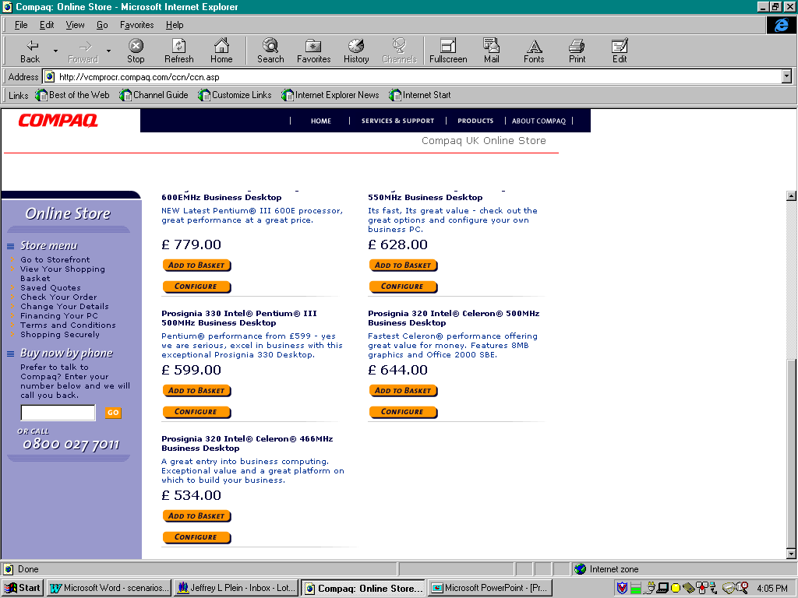
Homepage
Storyline
Carmen is brought to the homepage for her country and finds that content is already geared to her basic profile.
BroadVision feature
Built-in customer profile features can be tied to rule for content delivery
Custom/enhancement
Back office functionality to handle multi-language and currency, country specific pricing strategies and price conversion capability

Slide 23
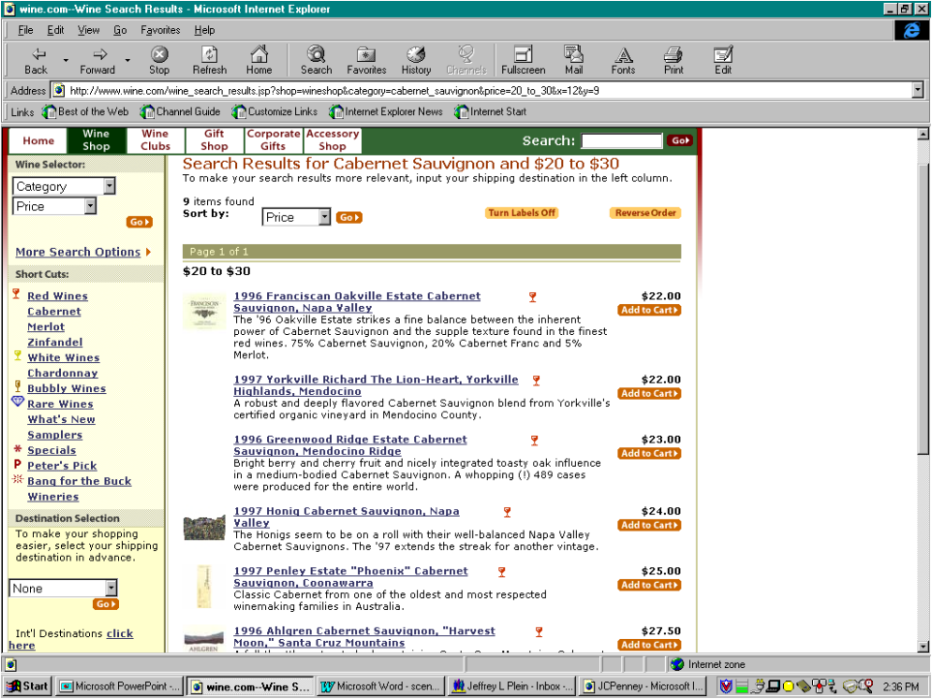
Category Browsing and Site Interaction
Storyline
Carmen’s main objective of this visit is to purchase a printer for her home office. She is not sure which printer to buy, and proceeds to the printer category to browse for a printer. Although Carmen has not specifically indicated so in her profile, T&K knows from the products that Carmen has browsed but not purchased, that Carmen might be a home office consumer. The site begins to target her with home office products by pushing related ads, and incentives to her. She proceeds to the printer section of the home office category and begins to browse the printers available.
BroadVision feature
Rule and Event based matching for content.
Targets homepage promotions based on profile
Coupon incentive is automatically applied during checkout
Custom/enhancement
Possibly include clickstream adaptive marketing

Slide 24
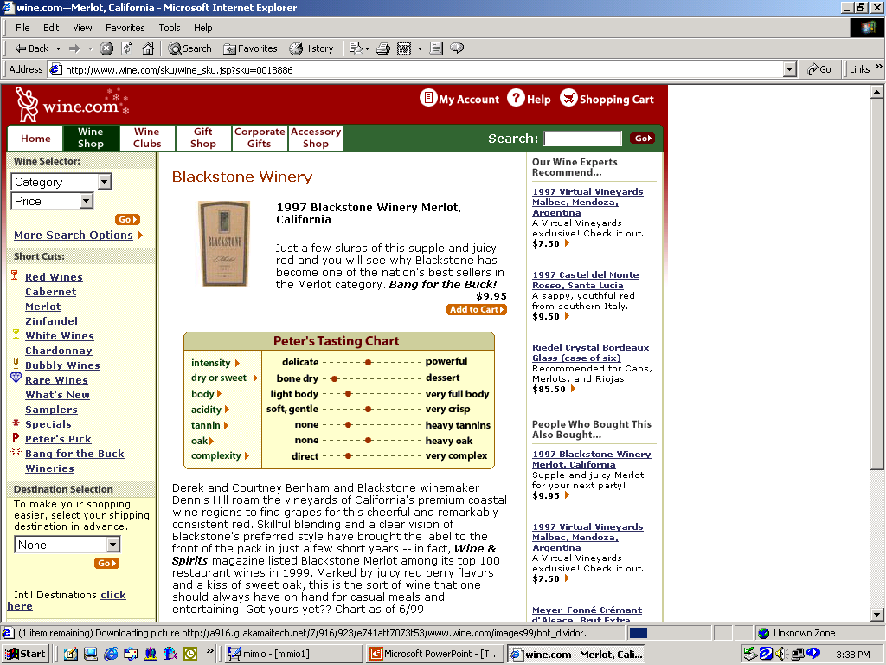
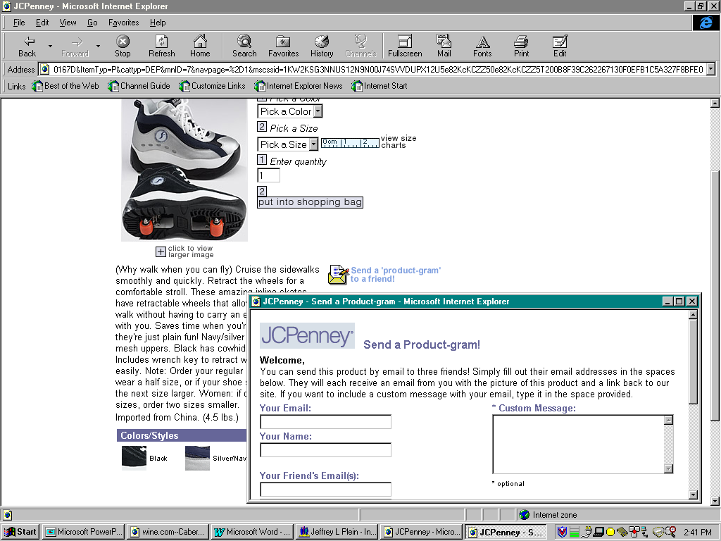
Product Information Page
Storyline
From the printer detail page, she begins to read about the features of the printer she selected. She notices that she can send the product information to her friends or business associates, and remembers someone to whom she emails the page. Carmen also notices that the store has plenty of product available, with over 2,000 units in stock.
BroadVision feature
Full content management
Custom/enhancement
Email button for sending page
Tie-in to inventory systems in real time

Slide 25
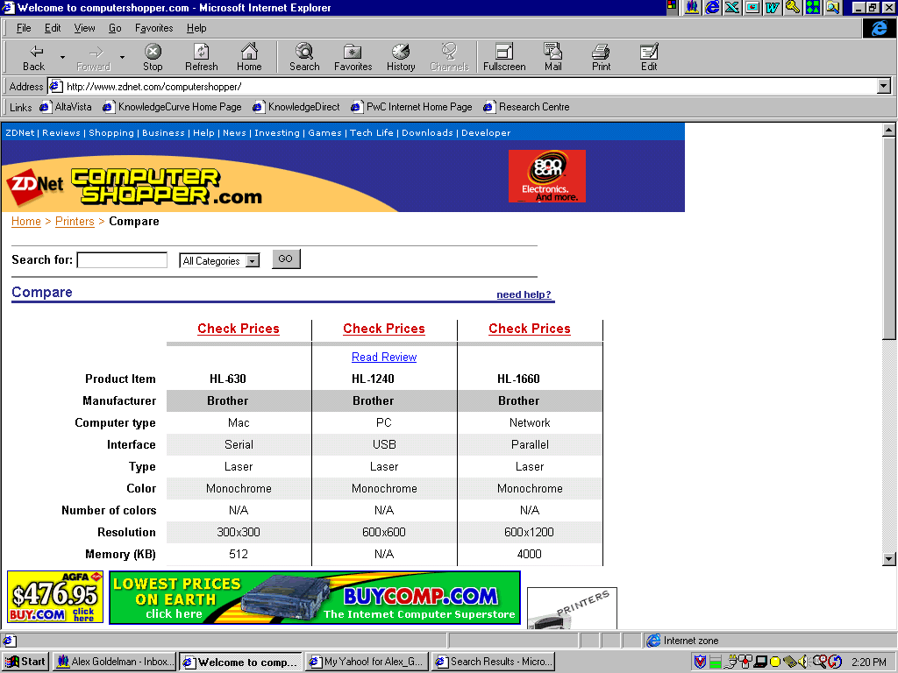
Product Comparison Page
Storyline
Carmen also notices that T&K offers a feature / price comparison service to help her compare products and make a more informed decision. She follows the link and is taken to the printer comparison matrix. From the comparison matrix, Carmen is able to see that the printer she was looking at can not print on the card stock she uses to create the gift cards included in her wine and cheese gift baskets. She uses the basic keyword search engine to find printers that can print on card stock. The site suggests products sold by T&K and even finds other printers sold by other etailers on the Web.
BroadVision feature
Strong search engine functionality within the site itself
BroadVision Product comparison matrix
Custom/enhancement
Each product in product file would need attributes relevant for comparison
All-Web shopping bot functionality would need to be developed and integrated into search engine to filter non-T&K products

Slide 26
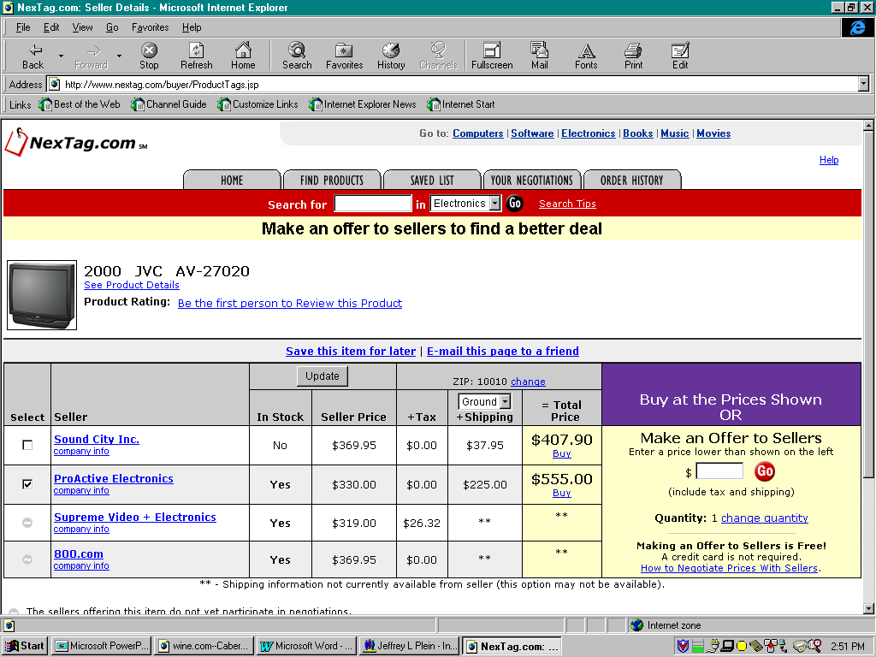
Reverse Auction Functionality
Storyline
Carmen finds a printer that can print on card stock that is just slightly slower than she wanted (6 ppm vs 8 ppm). However, T&K will allow Carmen to name her price for this printer and will tell her within 30 seconds whether they can meet it. To her surprise, Carmen finds that she can buy the printer for much less than she expected.
BroadVision feature
Allows for Java-based popup windows
Custom/enhancement
Name-your-price Java popup that shows MSRP and accepts customer input for price
Match-back with merchant-determined pricing schedule to accept/reject prices
Java window update to communicate status
Note: Reverse Auction functionality addresses sensitive in-store vs. web policy, culture and training issues that would need to be resolved prior to implementing this feature

Slide 27
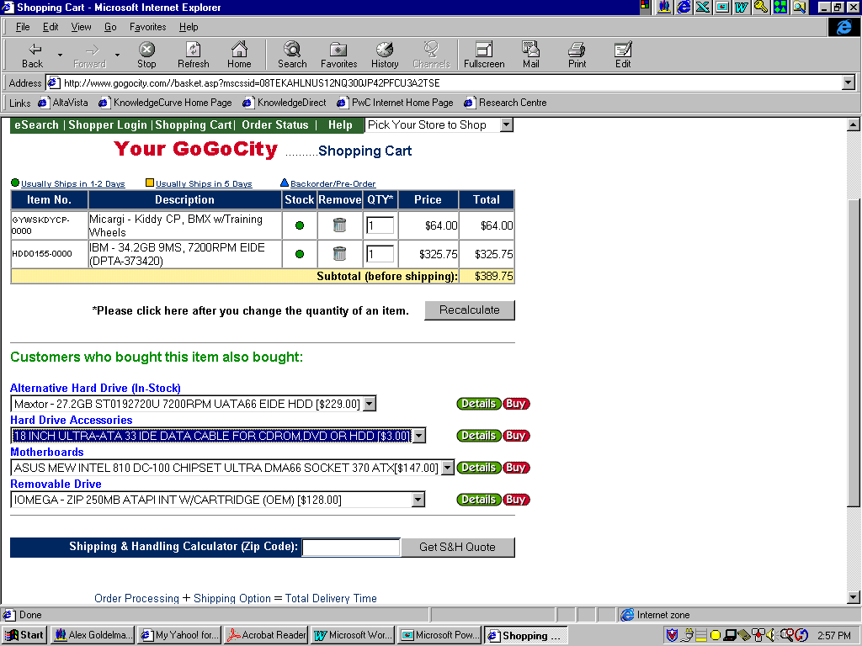
Shopping Cart and Cross-Selling
Storyline
Carmen puts the printer into her shopping basket and is taken to the order processing screen where the T&K shopping assistant offers her some printer accessories such as a printer cable, toner, and special paper to go along with her purchase. Other content from related categories such as fax, shredder, and phone equipment is displayed during the order review process as well. Carmen needs to pick up a few more things and follows the ‘continue shopping’ link to return to the product area.
BroadVision feature
Well-developed shopping cart feature
Identify related products for cross-selling for each item using data mining eCRM techniques
Advanced BroadVision configuration necessary to effectively identify and promote the correct merchandise
Custom/enhancement
Progressive Discounting

Slide 28
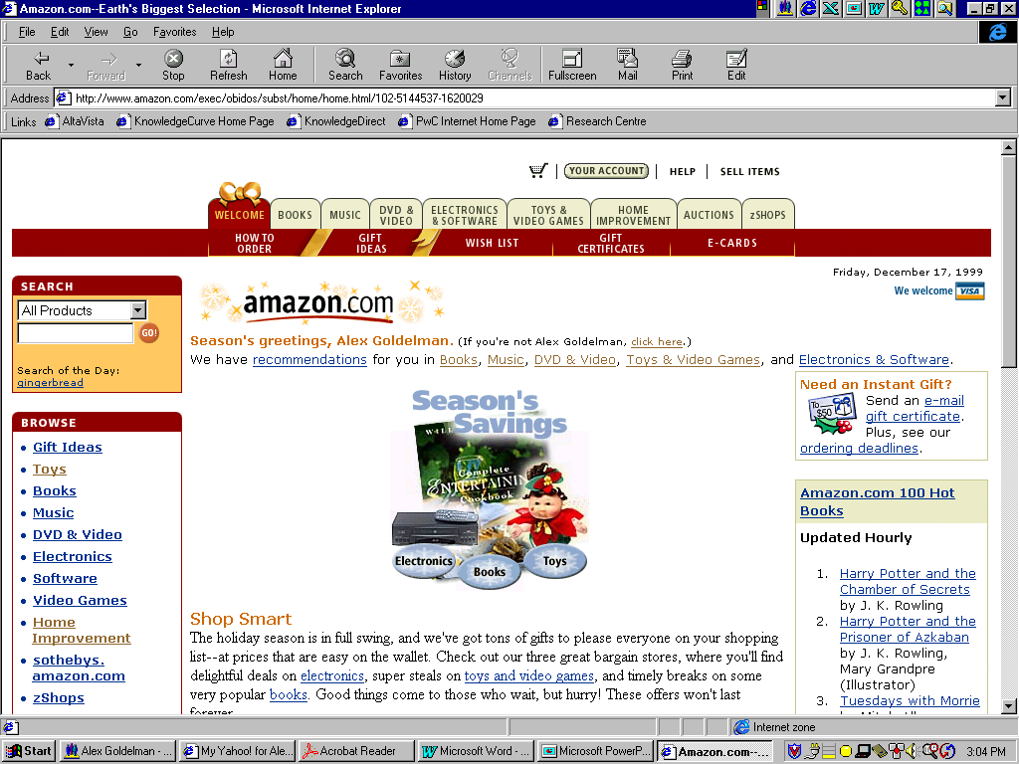
Adaptive Marketing Techniques
Storyline
Carmen’s business requires her to frequently visit and purchase from the T&K site. She has used the T&K site extensively during the past 12 months to purchase Californian wines for her catering business. Although Carmen is a busy person and never took the time to provide an extensive profile of herself or of her specific interests, T&K is developing an extensive database on her preferences. Each purchase defines Carmen’s buying habits further and helps T&K to determine how best to cater to her preferences, and recognize her as a valued customer. For example, after a few purchases of wine, T&K realized that Carmen had not purchased a single bottle of the more profitable French or Spanish wines. T&K then provided advertising and product information on these wines to see if Carmen may have an interest in including or replacing her traditional choices with these options.
BroadVision feature
Observation / tracking characteristics can be used to target customers via rules
Custom/enhancement
Develop enhancement to write observations to the customer profile database, or integrate net perceptions at this point

Slide 29
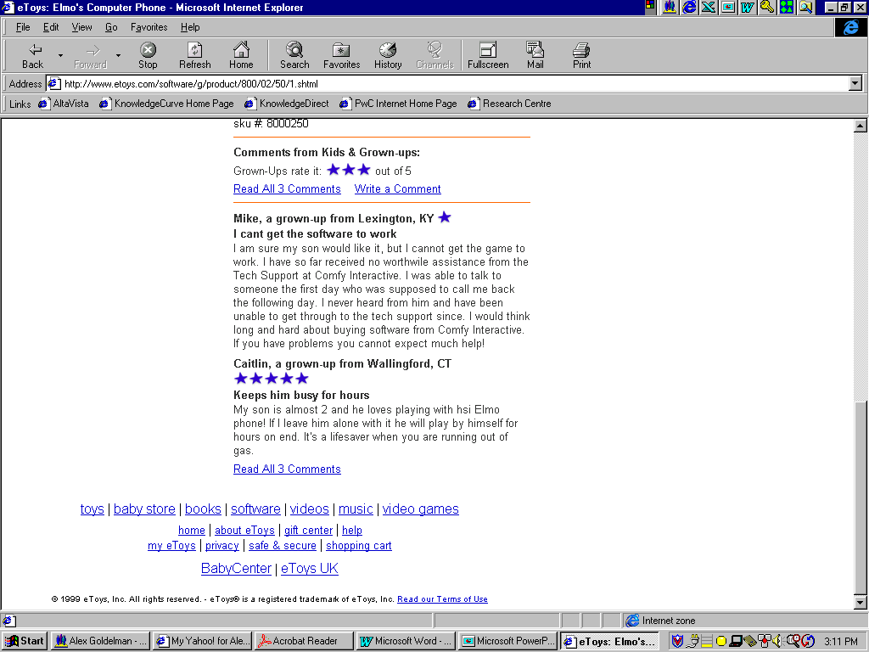
Community and User Reviews
Storyline
Carmen was not sure about purchasing French or Spanish wines, but began to take advantage of the customer reviews section of the website to read what other T&K customers thought about the wines that were available. She began to broaden her selections based on the advice of the T&K shopping community.
BroadVision feature
BroadVision Discussion group functionality used to create and maintain / monitor the customer reviews
Custom/enhancement
None required

Slide 30
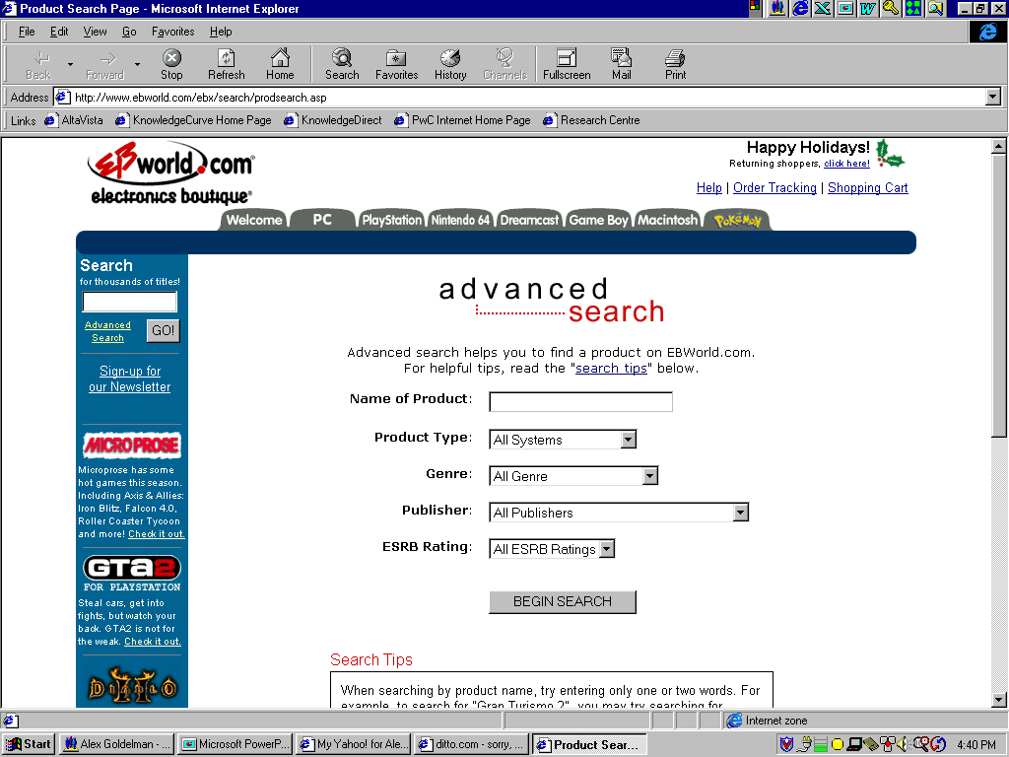
Product Search
Storyline
Carmen notices that her customers are becoming more demanding and competition has cut into her sales. She develops a plan, which will help diversify her offerings and differentiate herself amongst the competition. Carmen decides to start offering homemade deserts to her customers. However, she is new at deserts and needs some guidance. She logs on to T&K’s site and searches for a Martha Stewart cookbook.
BroadVision feature
BV Keyword search functionality, and use of extended product attributes to indicate brand / vendor
Custom/enhancement
Possible development of Shopping Bot to aid in product search and low price determination

Slide 31
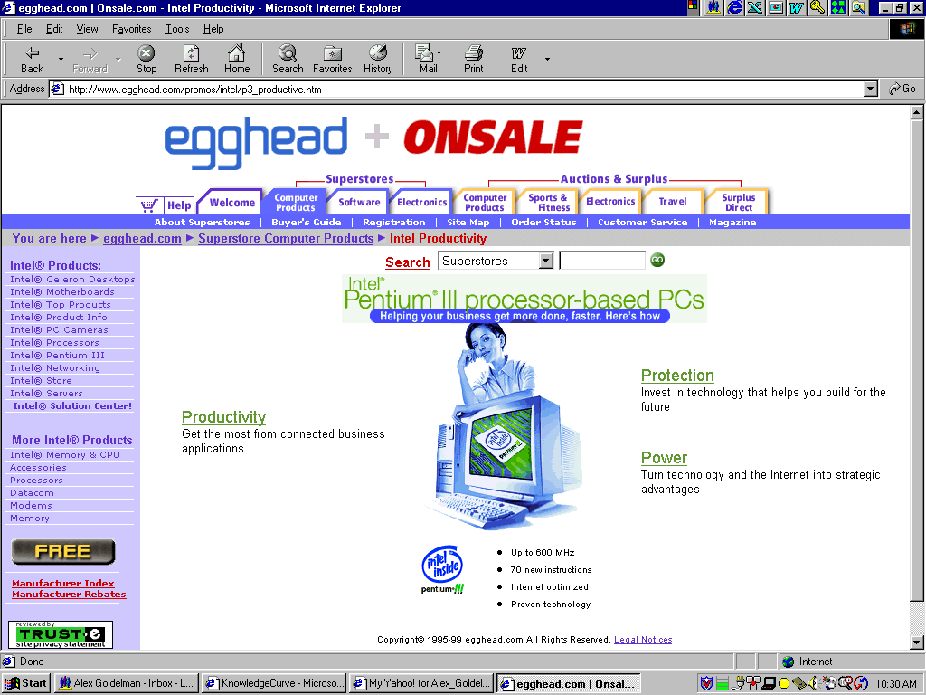
Merchant Shops
Storyline
By now T&K knows from Carmen’s past purchasing habits that she is a home office businessperson who frequently buys wine, cheese, fruit and other related items. The T&K site offers a Martha Stewart cookbook complete with desert recipes. T&K also tries to upsell other Martha Stewart (MS) goods such as MS decorating guides, MS linens and table coverings, MS stationary and business related items, MS holiday gift giving ideas, etc. Carmen is also greeted with numerous other brands offering similar products to those of Martha Stewart in an effort to make Carmen’s shopping experience complete.
BroadVision feature
Rule-based content delivery
Custom/enhancement
None required

Slide 32
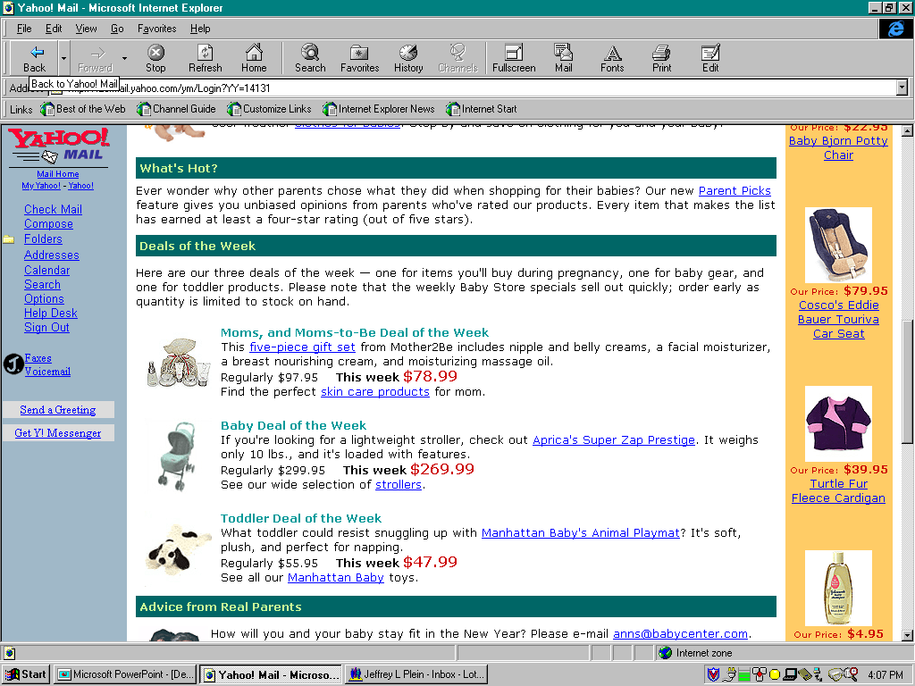
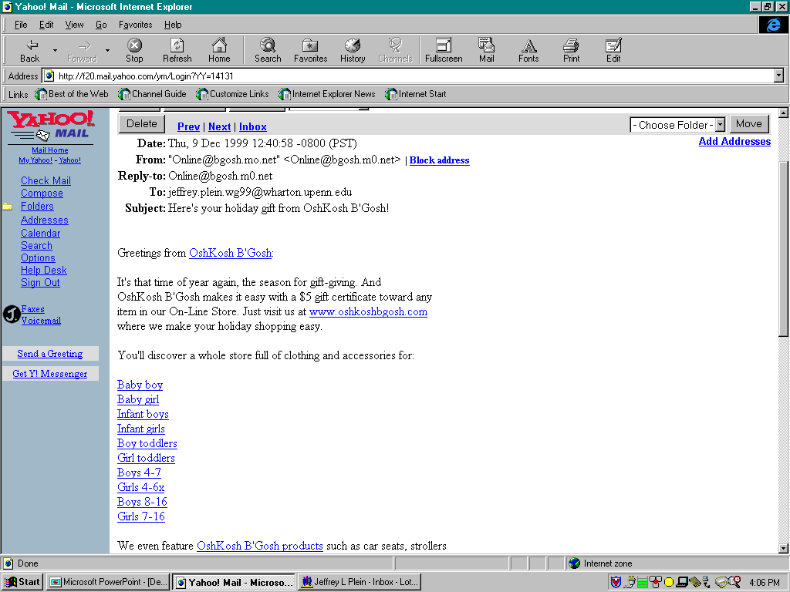
ePromotion
Storyline
Running a catering business is time consuming and because of this Carmen has had little time to keep current on sales or new products that might complement or add value to her business. T&K provides value by offering a weekly promotions newsletter free of charge. After Carmen accepts, she receives emails weekly listing upcoming sales on food and party supplies covering both products that she has purchased in the past, as well as products in which she may be interested based on her growing profile.
BroadVision feature
Logging of promotional activity and responses
Email server can be used to target various “communities”
Custom/enhancement
Campaign management software for email, online, direct mail activities and analysis

Slide 33
Next Steps – This Month
  TEAM TASKS
  Define Customer Profile attributes
  Define BroadVision communities
  Define the T&K Website Merchandise Hierarchy
  Define Product Attributes
  Identify BroadVision content elements needed for demo
    Products
    Advertisements
    Incentives
    Editorials
    Observation Queries
  Define BroadVision Rules for personalized content matching scenarios
  Develop the T&K site map
  OTHER TASKS
  Validate activities with Project Leadership, Swindon Team, and BroadVision
  Determine support requirements going forward
  Prepare project tasks for upcoming phases
  Determine requirements for January 20th meeting

Slide 34
Questions and Concerns
  Basic B2C BroadVision website functionality will be completed by 2/15
  What about added richness:
    Net Perceptions
    Modifications / Enhancements to make the demo more robust (e.g. Chat, Configurator, reverse auctions, browser control, e-mail a friend, shopping bot)
  Materials to accelerate implementations and retail thought leadership to be developed as a second priority

Slide 35
Questions and Concerns

