Slide 1
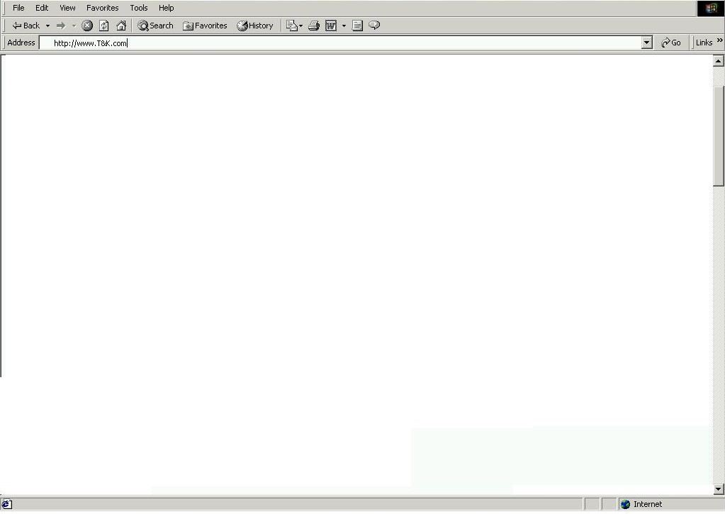
Splash Page
Logo.gif
Select the country your are shopping from:
United States
T&K Map Logo with 2 active regional hyperlinks
T&K Member Sign In
User ID
Region 1 (US)
Region 2 (UK)
Password
New Customer
Registration
Value Card Member

Slide 2

My Account
Navigation Bar – Standard Bar to be displayed on all pages (see script for tabs / links)
BA7 – Replenishment Program
FM1 – User ID / Password / E-mail Address
Continue
Home
FM2 – Customer Name / Billing Address / Shipping Address
FM3 – Personal Information (Interests / Preferences / Needs)
Continue
Home
Text and Hyperlinks to mirror Navigation Bar functions (Copyright / Sponsor Logos)

Slide 3
Home Page
Navigation Bar – Standard Bar to be displayed on all pages (see script for tabs / links)
BA1 – T&K Branded Visa Card Signup
Search
(See Script)
FP1 – Food & Wine
Bottle of image
and text
FP2 – App & Acc
20% off Women’s
Sweaters
AD1 – CK Merchant Shop
Services
(See Script)
AD2 – Top 5 Items
FP3 – Housewares
New Martha Stewart
Stoneware
FP4 – Home Office
Palm V Image
and text
AD3 – Deal of the Day
Product Categories
(Mirrors Mdse Hierarchy / drills down thru cats)
IN1 -BOGO
Text and Hyperlinks to mirror Navigation Bar functions (Copyright / Sponsor Logos)

Slide 4
Category / Sub-Category Page
Navigation Bar – Standard Bar to be displayed on all pages (see script for tabs / links)
BA2 – 20 % off Printer Accessories
Search
(See Script)
FP4 – Home Office
Palm V Image
and text
FP5 – Home Office
HP Printer Image
and text
AD4 – Product Compare
Services
(See Script)
AD5 – Top 5 Movies
FP6 – Electronics
DVD Player Image
and text
FP7 – Electronics
TV Image
and text
AD6 – Buy TV get DVD Free
Product Categories
(Mirrors Mdse Hierarchy / drills down thru cats)
IN2 – Free Mugs with Coffee pur.
Text and Hyperlinks to mirror Navigation Bar functions (Copyright / Sponsor Logos)

Slide 5
2.6 – Product Detail Page
Navigation Bar – Standard Bar to be displayed on all pages (see script for tabs / links)
BA3 – Subscribe to PC Magazine
Search
(See Script)
PD1 – Product Detail for HP Printer 1
(Enlarged Graphic / Extended Text, Inv Level, Price)
AD10 – Customer who bought X also bought Y & Z
Services
(See Script)
AD11 – Extended Warranty Service
Product Categories
(Mirrors Mdse Hierarchy / drills down thru cats)
DG1 – Expert Printer Review from PC Magazine
Text and Hyperlinks to mirror Navigation Bar functions (Copyright / Sponsor Logos)

Slide 6
Product Comparison Matrix
Navigation Bar – Standard Bar to be displayed on all pages (see script for tabs / links)
BA4 – Contact a Personal Shopper for Assistance
Search
(See Script)
CM1 – Printer Comparison Matrix
 | Printer 1 | Printer 2 | Printer 3 | Printer 4
Feature 1 | X |  | X | x
Feature 2 | X | X |  | X
Feature 3 | X | X |  | X
Feature 4 |  | X |  | X
Feature 5 |  | X |  | X
Feature 6 |  |  | X | X
Price | $100 | $120 | $95 | $150
Services
(See Script)
Product Categories
(Mirrors Mdse Hierarchy / drills down thru cats)
Text and Hyperlinks to mirror Navigation Bar functions (Copyright / Sponsor Logos)

Slide 7
Shopping Cart
Navigation Bar – Standard Bar to be displayed on all pages (see script for tabs / links)
BA5 – Secure Web Pages thru Better Web
Search
(See Script)
QTY | DESCRIPTION | $
Remove
Details
Services
(See Script)
CS1 – Two complimentary products
CS2 – Two also bought items not listed above
Product Categories
(Mirrors Mdse Hierarchy / drills down thru cats)
IN4 – Progressive Discount
(Buy X $ get X% off)
Shipping
Handling
Total
Continue Shopping
Checkout
Text and Hyperlinks to mirror Navigation Bar functions (Copyright / Sponsor Logos)

Slide 8
2.9 – Check Out
Navigation Bar – Standard Bar to be displayed on all pages (see script for tabs / links)
BA1 – T&K Branded Visa Card Signup
Search
(See Script)
FM2 – Customer Name / Billing Address / Shipping Address
FM4 – Payment Information
Services
(See Script)
ORDER CONFIRMATION / RECAP
QTY | DESCRIPTION | $
Product Categories
(Mirrors Mdse Hierarchy / drills down thru cats)
Shipping
Handling
Total
Continue Shopping
Confirm Order
Adjust Order
Text and Hyperlinks to mirror Navigation Bar functions (Copyright / Sponsor Logos)

Slide 9
2.10 – Customer Invoice
Navigation Bar – Standard Bar to be displayed on all pages (see script for tabs / links)
BA10 – Food and Accessories Ad
MS1 – Thank you for your order, an e-mail has been sent. Please print this page for your records
ORDER CONFIRMATION / RECAP
QTY | DESCRIPTION | $
Shipping
Handling
Total | $
Home
Text and Hyperlinks to mirror Navigation Bar functions (Copyright / Sponsor Logos)

Slide 10
Order Tracking Page
Navigation Bar – Standard Bar to be displayed on all pages (see script for tabs / links)
BA6 – Welcome Back, Please confirm your account info My Account
Search
(See Script)
FM5 – Order Tracking Form
User ID
Password
Timeframe
Order #
AD1 – CK Merchant Shop
Services
(See Script)
AD2 – Top 5 Items
Form Results – List valid orders in Order Database
Order 1 - Tracking Number link to shipping company
Order 2 - Tracking Number link to shipping company
Order 3 - Tracking Number link to shipping company
Order 4 - Tracking Number link to shipping company
AD3 – Deal of the Day
Product Categories
(Mirrors Mdse Hierarchy / drills down thru cats)
IN1 -BOGO
Text and Hyperlinks to mirror Navigation Bar functions (Copyright / Sponsor Logos)

Slide 11
Customer Order Detail Screen
Navigation Bar – Standard Bar to be displayed on all pages (see script for tabs / links)
BA6 – Welcome Back, Please confirm your account info My Account
MS2 – Order Status “Your order has been Shipped” Tracking Number link to shipping company
ORDER CONFIRMATION / RECAP
QTY | DESCRIPTION | $
Shipping
Handling
Total | $
Return
Home
Text and Hyperlinks to mirror Navigation Bar functions (Copyright / Sponsor Logos)

Slide 12
Reviews
Navigation Bar – Standard Bar to be displayed on all pages (see script for tabs / links)
BA10 – Food and Accessories Ad
Search
(See Script)
FP12
Graphic
DG2 – California Wine Expert Review
Buy Now
Details
Services
(See Script)
FP13
Graphic
DG3 – French Wine Expert Review
Buy Now
Details
FP14
Graphic
DG4 – Spanish Wine Expert Review
Buy Now
Product Categories
(Mirrors Mdse Hierarchy / drills down thru cats)
Details
FP15
Graphic
DG5 – Australian Wine Expert Review
Buy Now
Details
Text and Hyperlinks to mirror Navigation Bar functions (Copyright / Sponsor Logos)

Slide 13
Search Results Page
Navigation Bar – Standard Bar to be displayed on all pages (see script for tabs / links)
BA10 – Food and Accessories Ad
Search
(See Script)
Search Results
Match 1
Match 2
Match 3
Services
(See Script)
Product Categories
(Mirrors Mdse Hierarchy / drills down thru cats)
Text and Hyperlinks to mirror Navigation Bar functions (Copyright / Sponsor Logos)

Slide 14
Registry Search
Navigation Bar – Standard Bar to be displayed on all pages (see script for tabs / links)
BA13 – Check out our gift picks
Search
(See Script)
FM6 – Registry Search
First name
Last Name
Event
Date
ED1 – Registry / Wish List instructions and info
Services
(See Script)
Product Categories
(Mirrors Mdse Hierarchy / drills down thru cats)
Purchase
Modify
Text and Hyperlinks to mirror Navigation Bar functions (Copyright / Sponsor Logos)

Slide 15
Registry Search Results
Navigation Bar – Standard Bar to be displayed on all pages (see script for tabs / links)
BA13 – Check out our gift picks
Search
(See Script)
FM6 – Registry Search
First name
Last Name
Event
Date
Search Results
Match 1
Match 2
Match 3
Services
(See Script)
Product Categories
(Mirrors Mdse Hierarchy / drills down thru cats)
Purchase
Modify
Text and Hyperlinks to mirror Navigation Bar functions (Copyright / Sponsor Logos)

Slide 16
Registry Listing Page
Navigation Bar – Standard Bar to be displayed on all pages (see script for tabs / links)
MS3 – Announcement (Bob & Cindy’s Registry / Date, etc.)
AD21 – Shopping Assistant for registry Purchases
FM7 – Registry Listing
Product ID | Description | Wants | Needs | Price | Inv | Buy
1 | Hyperlink to Detail Page
2
3
4
5
Continue Shopping
Clear Order
Shopping Cart
Text and Hyperlinks to mirror Navigation Bar functions (Copyright / Sponsor Logos)

Slide 17
Shopping Assistant
Navigation Bar – Standard Bar to be displayed on all pages (see script for tabs / links)
BA17 – Shopping Assistant Banner
Search
(See Script)
AD21 – Shopping Assistant for registry Purchases
FM8 – Gift Card / Personalized Message
Would you like to send a personalized message with your purchase?
Type the note as you would like it to appear:
Would you like to e-mail a voice message to the gift recipient?
Services
(See Script)
Product Categories
(Mirrors Mdse Hierarchy / drills down thru cats)
Continue Shopping
Checkout
Text and Hyperlinks to mirror Navigation Bar functions (Copyright / Sponsor Logos)

