Slide 1


Working Together
© 1999, PricewaterhouseCoopers L.L.P.
Notes:
Hello. The PricewaterhouseCoopers Retail E-Business practice is happy that you’re interested in our efforts to build a partnership with BroadVision. In this brief presentation, you’ll learn a little about our organization and the direct-to-consumer demonstrations that we’re currently working on.
Working together, BroadVision software and PwC professional services will help our clients to achieve their operational, financial, and strategic goals.

Slide 2
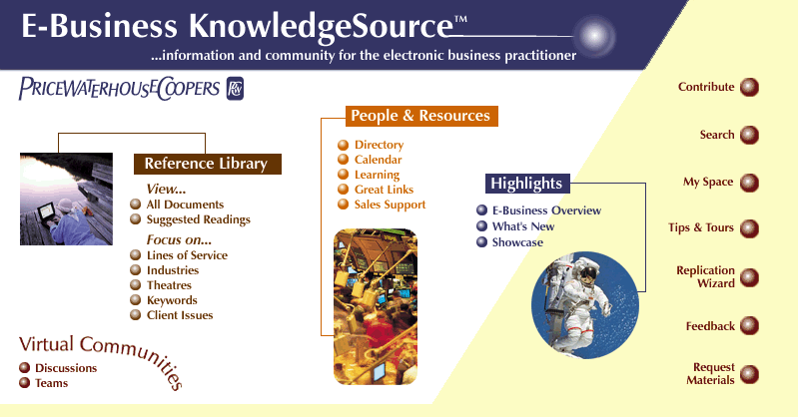

PwC - World Class E-Business and Retail Resources
We have a world class organization that is ready, willing, and able to partner with BroadVision
People
  World’s largest professional services firm; consulting practice 30,000+
  2,500 E-Business professionals across all major industries and services
  2,000 Retail Professionals worldwide
  Total solution provider - Strategy, Creative, Implementation, and Ongoing Support
  Deep consumer goods industry experience with dedicated E-Business professionals
Thought Leadership
  E-Business Technology Forecast
  Retail Intelligence System including E-Retail and Global Services
  E-Business Best Practices Forum
  E-Business KnowledgeSource
  PwC E-Business website
Strategic Alliances
  Creative Agencies - methodfive, Studio Interactive
  Hardware / Software Vendors
  Industry Associations (GMA, FMI, Direct Marketing Association, National Retail Federation)
  Research Organizations (Forrester Research, Gartner Group, Goldman Sachs, commerce.net)
Notes:
PwC’s 2500 e-business and 2000 retail practitioners possess capabilities covering strategy, process, and technology. We work with our clients from strategy through implementation. In particular, our capabilities as system integrators, combined with in depth retail knowledgw will allow us to help BroadVision prospects and customers understand how to maximize the value obtained from investing in BroadVision software.

Slide 3
PwC strategic capabilities help clients to define “core customer” segments
Psychographic and socio-demographic characteristics as the basis for defining BroadVision communities
Sales Lovers (15%)
Splurgers (15%)
Prefer sales and coupon items
Buy branded goods when on sale, generics otherwise
Rarely buy luxury items
Families in middle and down markets
Buy on EDFP basis, rarely use coupons
Prefer brands over generics
Tend to splurge on luxury items in each category
Young couples and singles in middle and up markets
Trusting Folk (35%)
Pragmatists (20%)
Will use coupons as available, less than average
Prefer brands, never buy generics
Purchase basic goods, rarely splurge
Families and households in middle and up markets
Use coupons and buy sales items with average frequency
Mostly purchase generics
Purchase basic goods, rarely splurge
Younger parents in middle and down markets and older households in all markets
Other/Unknown (15%)
All other combinations
Notes:
Our demonstration is built around 3 scenarios concerning customers of T&K.com, the internet commerce arm of T&K. Highlighting some of PwC’s strategic capabilities in customer segmentation, we have defined 5 BroadVision communities for T&K.com by using traditional socio-demographic and psychographic customer information:
Sales Lovers – attracted to coupons and promotions, buy brands only when on sale, avoid luxury, commonly families in middle and down markets
Trusting Folk – sometimes use coupons, always buy brands, avoid luxury, commonly families in middle and up markets
Splurgers – avoid coupon usage, always buy brands, frequently purchase luxury items, commonly young couples and singles in middle and up markets
Pragmatists – sometimes use coupons, usually buy generic, avoid luxury, commonly older households or young parents in middle and down markets
Other – to include unregistered customers and any registered customers who don’t fit into any of the above four categories

Slide 4


Introducing our T&K wine customers
Anne is a Splurger, her profile indicates that she is a married up-market consumer who prefers luxury branded items at every day fair prices.
Product prices
Product brands
Product functions
Product Category
Love sales
Prefer
Recognized
Generic
and
everyday
brands
products
Basic
Luxury
SPLURGER
coupons
fair pricing
Food & Wine
Anne
David is a Pragmatist, his profile indicates that he is a middle market consumer, young and married with children. Through observation and surveys, T&K has also determined that he responds to coupons, prefers generic brands and purchases functional items.
Product prices
Product brands
Product functions
Product Category
Love sales
Prefer
Recognized
Generic
PRAGMATIST
and
everyday
brands
products
Basic
Luxury
coupons
fair pricing
Food & Wine
David
Notes:
Anne and David are two of the T&K customers presented in the demonstration storyline.
Anne is a Splurger, her profile indicates that she is a married up-market consumer who prefers luxury branded items at every day fair prices.
David is a Pragmatist, his profile indicates that he is a middle market consumer, young and married with children. Through observation and surveys, T&K has also determined that he responds to coupons, prefers generic brands and purchases functional items.

Slide 5
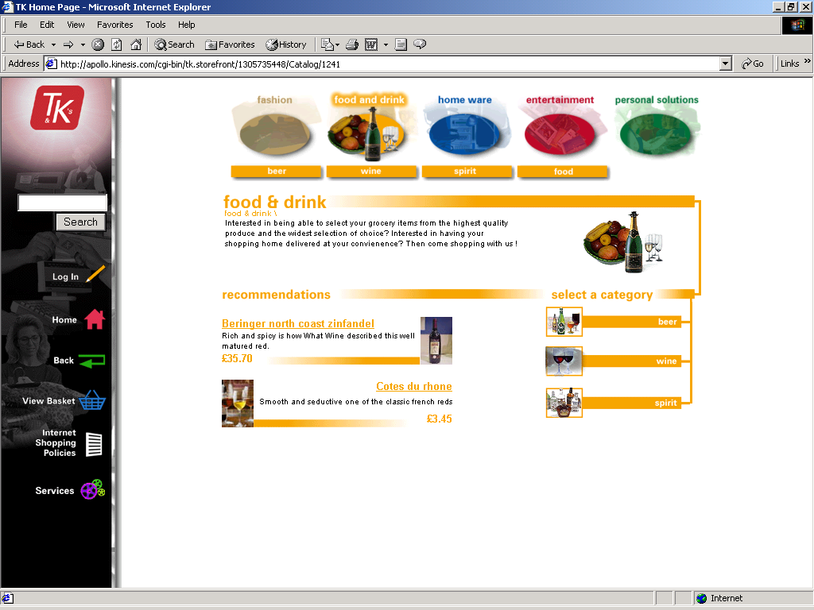


BroadVision Rules based matching selects products in the wine category that match Anne’s brand sensitive up-market profile
Cross-sell indicators on the wine bottles drive suggested complimentary purchases
Notes:
When Anne procedes to the wine section of the T&K website, the personalized content areas are populated with products that are appropriate for a Splurger. Cross-sell items related to the luxury wine selections appropriate for her profile are also displayed.

Slide 6


David is shown a different selection of product when he visits the same wine category page
Cross-sell items are related to the product, not the community
Notes:
When Bob looks at wine, he sees lower priced genric content defined for the Pragmatist community.
In both cases, some of the initial content on the wine category page is driven the user’s community. However, cross-sell items are linked to the products themselves.
This aspect of the demonstration allows clients to see how BroadVision uses rules based matching to personalize web content. In addition, PwC is prepared to talk with clients about content preparation, ongoing maintenance, and to discuss the organizational and process requirements to support these activities.

Slide 7
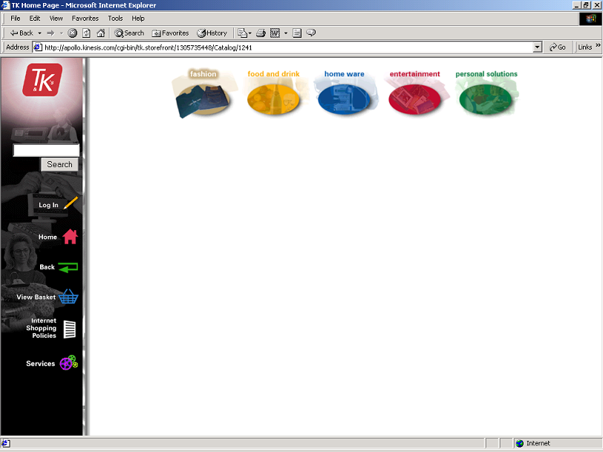
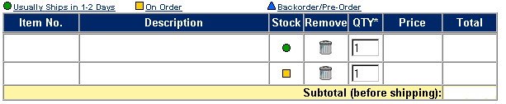

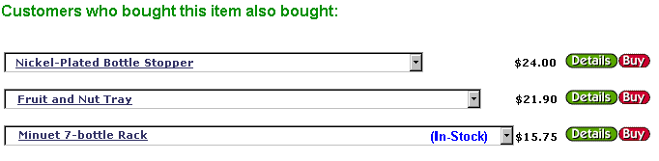



Real time integration with SAP Retail provides stock availability during check out
The Net Perception Collaborative Filtering engine provides suggested cross-sell by analyzing customer purchasing behaviors
Notes:
At checkout, other features of our demonstration include…
Net Perceptions. PwC will integrate Net Perceptions collaborative filtering capabilities within BV e-commerce capabilities. The Net Perception Collaborative Filtering engine provides suggested cross sell opportunities by analyzing customer purchasing behavior.
Inventory Check - Real time integration with SAP Retail provides stock availability during check out

Slide 8
Our demonstration site will highlight both BroadVision and PwC capabilities
Today’s Demonstration focuses on key personalization features:
Communities/Customer segmentation
Customer and product database custom attributes
Personalization based on rules-based matching and collaborative filtering
cross-sell & up-sell indicators
Shopping basket
Stock status
The completed demo will combine personalization with additional B2C functionality and back office integration:
User registration
Household & family user accounts
Persistent shopping basket
Multiple shopping lists
Tax calculation
Shipping & Handling charges
Specific Delivery time
Credit authorization & settlement
Multiple payment options including multiple payments per order
Multi-currency handling
Discussion groups & community development (e.g., Food & Wine Club)
Product comparison matrix
On-line gift registry (wedding)
Loyalty card program - points wallet, account review page, and earning logic
Custom merchandise configurator
Incentives & Discounts
e-mail order confirmations
e-mail community-specific promotions
Calendaring / date reminder service
Observation tracking & logging
Aggregation & analysis of observation data
Sales order creation and tracking
In store pick up of web purchases
In-store and on-line returns
Store and Internet purchasing history
Real time inventory check
WAP - wireless phone content delivery & order/sales transactions
Notes:
Today’s demonstration only highlights a few of the features we will be including in the completed BroadVision Demo. In addition to the key personalization features of the BroadVision software, we will offer a fully developed business to consumer web solution including back office systems integration and cross channel CRM.

Slide 9
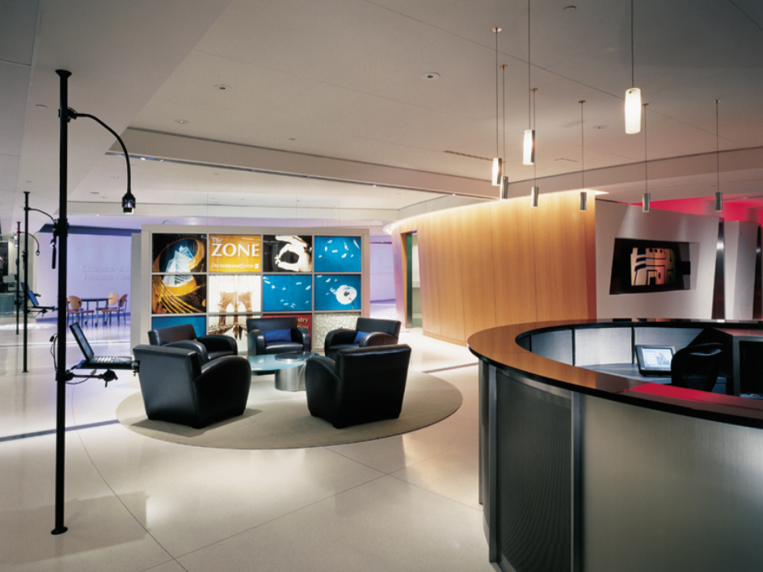
As partners, BroadVision can leverage the capabilities of The Zone (Philadelphia, PA)…
The Zone
Full-service, industry focused solution delivery center featuring state-of-the art demonstration, development, and training capabilities
Demonstrates the impact of technology on business before making significant investments
Divided into three sections: industry rooms, demonstration/ presentation centers, and development/training centers
Notes:
We invite you to use our demonstration facilities at the Zone in Philadelphia.

Slide 10
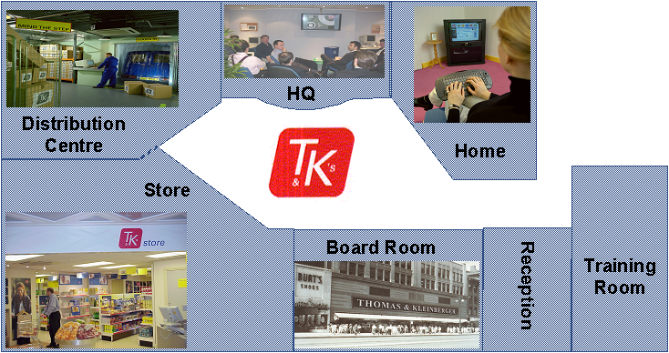
…and the Retail Solution Centre (Swindon, UK)
A “full stage” set including store, warehouse, head office and a consumer’s living room, presented as a real case study
Notes:
and At The Retail Solution Center in Swindon, a suburb of London.

Slide 11





























E-Business Client Roster
Our Clients include many top tier names - through partnership with BroadVision, we expect to strengthen our relationships with these clients and develope many new together
Notes:
WE HOPE You’ve enjoyed this brief introduction to our practice and to our demonstration. We look forward to working together to develop opportunities, expand this list, and continue to deepen our relationships with these clients.

