Slide 1
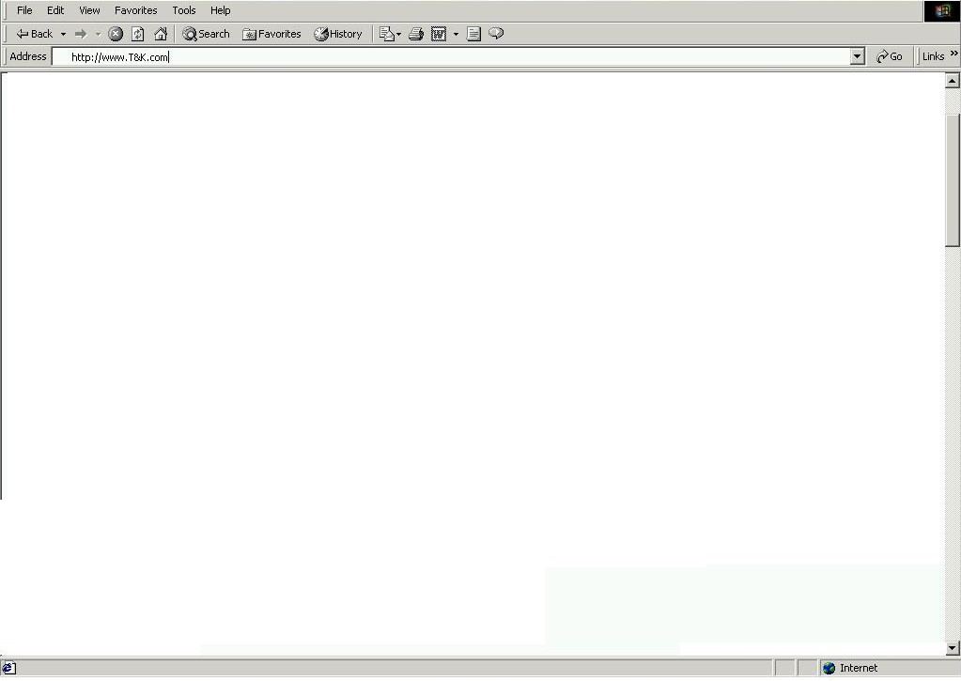
T&K Splash Page
Select the country your are shopping from:
United States
Sign In
New Customer Registration
Value Card Member

Slide 2
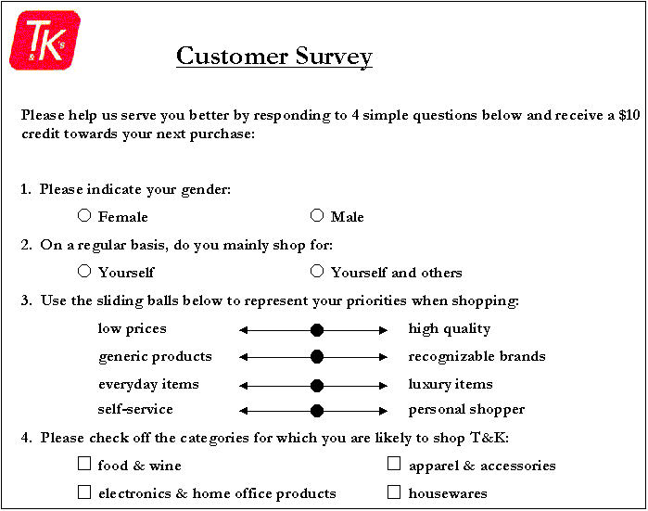
T&K Customer Registration / Personalization

