Slide 1
INTRODUCTION TO RETAILING

Slide 2

DEFINITION OF RETAILING
In order to understand who are clients are, we must understand what our clients do.
  Retailing: a set of business activities that adds value to the products and services sold to consumers for their personal and family use. These activities can occur in a store or non-store format such as catalog or Internet.
  Retailer: a business that sells products and services to consumers for their personal or family use. A retailer is the final business in a distribution channel that links manufacturers with consumers.
SUPPLIER
MANUFACTURER
DISTRIBUTOR
RETAILER
CUSTOMER
You may have known the above, but I bet you didn’t know that the word retail is derived from the French word retaillier, meaning to cut a piece off or to break bulk. This fun-fact will certainly impress your date.

Slide 3
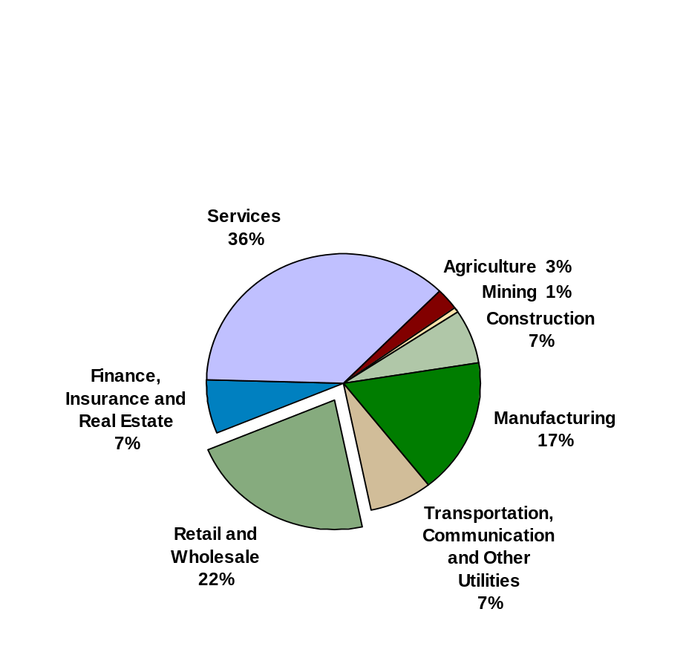
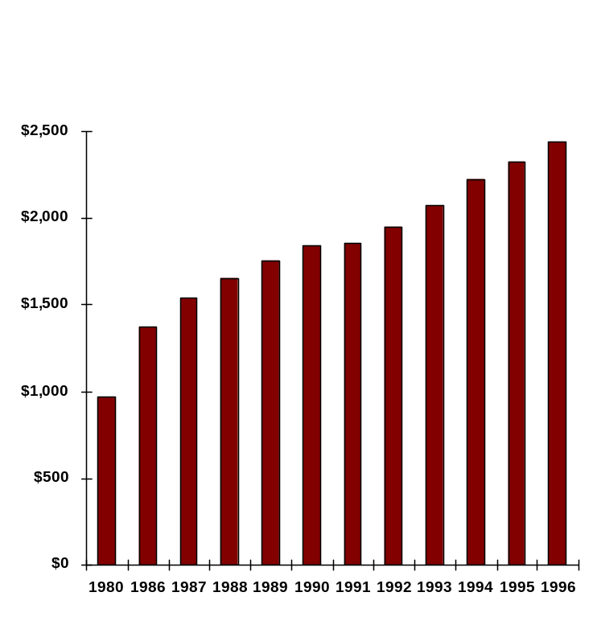
RETAIL IS BIG BUSINESS
Employment by Industry, 1996
Retail Trade Sales in the U.S.
1980 - 1996 ($ billions)*
* Retail Trade sales include durable and nondurable goods sales totals
Source: U.S. Bureau of Census, Current Business Reports, Annual Benchmark Report of Retail Trade
Source: U.S. Bureau of Labor Statistics, Employment and Earnings

Slide 4
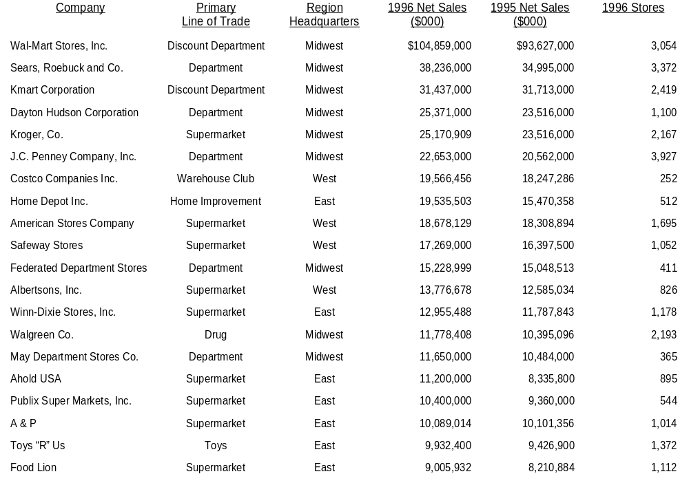
OUR TARGET MARKET - TOP 20 NATIONAL RETAILERS
Source: Stores and Price Waterhouse LLP.

Slide 5
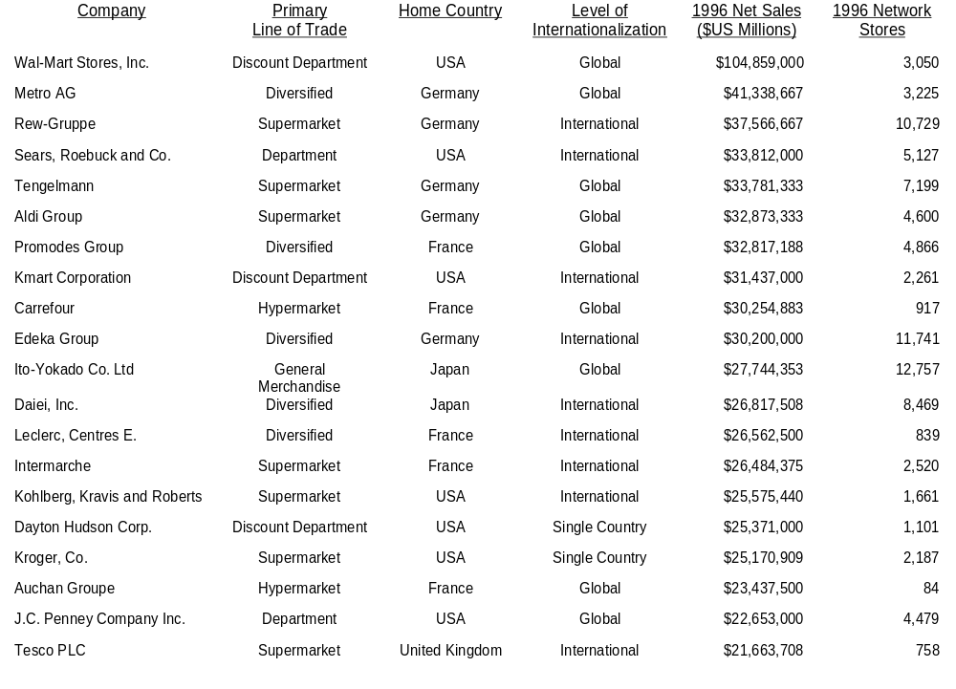
OUR TARGET MARKET - TOP 20 GLOBAL RETAILERS
Source: Management Horizons, A Consulting Division of Price Waterhouse LLP.

Slide 6
INDUSTRY STRUCTURE -
LINE OF TRADE CLASSIFICATIONS
The U.S. Department of Commerce classifies the retail trade by Standard Industrial Classification (SIC) code. SIC codes are assigned based on a business’s retail industry segment or line of trade. These industry segments are distinguished by their product offer, store size or format, pricing and service strategies.
  SIC 52 Building Materials and Garden Supply Stores
  SIC 53 General Merchandise Stores (including: conventional department stores, discount department stores, national mass merchandise chain stores, variety stores, warehouse clubs and catalog showrooms)
  SIC 54 Food Stores (including: grocery stores and convenience stores)
  SIC 55 Automotive Stores (including: auto dealers, auto supply stores and service stations)
  This is not a focus of the Retail Merchandising COE.
  SIC 56 Apparel and Accessory Stores (including: men’s & boys’, women’s, family and shoe stores)
  SIC 57 Furniture and Home Furnishings Stores (including: furniture stores, home furnishings stores, household appliance stores, consumer electronics stores, music stores and computer stores)
  SIC 58 Eating and Drinking Establishments (including: restaurants. lunchrooms and cafeterias)
  This is not a focus of the Retail Merchandising COE.
  SIC 591 Drug Stores and Proprietary Stores
  SIC 592 Liquor Stores
  This is not a focus of the Retail Merchandising COE.
  SIC 594 Sporting Goods and Bicycle Stores, Book Stores and Jewelry Stores
  SIC 596 Non-store Retailers (including: catalog and mail order companies)

Slide 7
INDUSTRY STRUCTURE -
HOME IMPROVEMENT STORES
The home improvement industry experienced significant consolidation over the last five years. The top ten players have increased their share of industry sales by more than 50% -- from 22.9% in 1991 to 35.6% in 1996. This consolidation has been primarily driven by industry leaders Home Depot and Lowe’s. Together, they accounted for 22.0% of industry sales in 1996, up from less than 10% in 1991. In fact, Home Depot alone accounted for almost one-sixth of industry sales in 1996.
Economic Concentration of Top 10 Home Improvement Stores, 1996
Sales
($ Million)
Share
of Total
Estimated
Stores
1.
2.
3.
4.
5.
6.
7.
8.
9.
10
The Home Depot
Lowe’s Companies, Inc.
Meynard, Inc.
Payless Cashways, Inc.
Builders Square (Kmart)
The Sherwin-Williams Co.
Hechinger Company
84 Lumber Co.
Homebase (Waban, Inc.)
Sears Hardware
$18,786
8,600
3,100
2,643
2,550
2,410
2,199
1,500
1,453
1,190
$44,430
$124,739
15.1%
6.9
2.5
2.1
2.0
1.9
1.8
1.2
1.2
1.0
35.6%
100.0%
488
402
128
192
164
2,156
117
386
84
229
4,346
n/a
Top 10
Total Industry
Source: Company annual reports,, National Home Center News, U.S. Department of Commerce, and Management Horizons, A Consulting Division of Price Waterhouse LLC

Slide 8
INDUSTRY STRUCTURE -
HOME IMPROVEMENT STORES, CONT.
Key Trends and Issues
  Home improvement retailers are at the maturity stage of their retail life cycle. The industry has experienced significant consolidation over the past few years, including numerous mergers and acquisitions and store closings. In addition, all major U.S. markets are saturated with multiple players creating pockets of intense competition, hence, causing most retailers to generate negative comp store sales.
  For home improvement centers, the distinction between the winners and the “also-rans” is becoming more apparent on both a national and market-by-market basis. Several players are exiting individual markets, while others are scurrying for Chapter 11 protection or going out of business. Recent casualties include Ernst, Grossman’s, Handy Andy, Payless Cashways, Builder’s Emporium and Rickel. On the other had, Home Depot and Lowe’s have solidified themselves as the industry’s top two players.
  In an attempt to differentiate themselves from Home Depot and Lowe’s, several players that historically focused on the DIY customer are testing or rolling-out stores that target women. These stores feature more products that appeal to women (e.g., a larger selection of home decor products), a more friendly store design (e.g., larger aisles and more subdued colors), and special services (e.g., interior design consultants). Examples include Hechinger, HomeBase and Scotty’s. Stores are targeting women because they are more often the primary shopper of have more influence on home improvement purchases today.
  Sears is attempting to fill the gap between big-box home improvement centers and mom and pop hardware stores by opening conveniently located 20-25,000 sq. ft. hardware stores. Sears plans to operate 500 stores by the year 2000, a goal that was accelerated by its acquisition of Orchard Supply Hardware in 1996. Hechinger is taking this idea one step further and is testing two 60,000 sq. ft. super hardware stores.
  Some home improvement retailers are looking outside of the United States for growth opportunities. Home Depot helped open the first “big box” home improvement store in China, named Home Way, in December 1996. The company also plans to open its first store outside North America in Chile in 1998 with two more stores slated for 1999. In addition, Home Depot opened five Canadian stores in 1996 bringing its total to 24. Ace Hardware opened its first distribution center in Mexico in July 1997 with plans to open a paint franchise store program in 1998.

Slide 9
INDUSTRY STRUCTURE -
DEPARTMENT STORES
The $97 billion department store industry is a mature, slow growth retail sector. Despite the strength of the economy, improved consumer confidence and a rebound in apparel spending, 1996 saw department store sales growth slow considerably. Between 1995 and 1996, nominal sales at department stores grew by just 1.3%. Real sales also slowed, increasing just 1.9%.
Economic Concentration of Top 10 Department Stores, 1996
Sales
($ Million)
Share
of Total
Estimated
Stores
1.
2.
3.
4.
5.
6.
7.
8.
9.
10
Sears, Roebuck and Co.
J.C. Penney Company , Inc.
Federated Department Stores, Inc.
The May Department Stores Co.
Dayton Hudson Department Stores
Dillard Department Stores, Inc.
Montgomery Ward Holding Corp.
Nordstrom, Inc.
Mercantile Stores Company, Inc.
Kohl’s Corporation
$21,657
18,694
14,925
11,650
7,518
6,228
5,879
4,453
2,946
2,388
$96,337
$97,300
22.3%
19.2
15.3
12.0
7.7
6.4
6.0
4.6
3.0
2.5
98.6%
100.0%
821
1,228
411
365
365
250
341
83
102
150
4,116
n/a
Top 10
Total Industry
Source: Company annual reports, Stores Magazine, U.S. Department of Commerce, and Management Horizons, A Consulting Division of Price Waterhouse LLC

Slide 10
INDUSTRY STRUCTURE -
DEPARTMENT STORES, CONT.
Key Trends and Issues
  As competition continues to intensify within the department store sector, so does the pace of consolidation and bankruptcy. Increasingly only the largest, most efficient and formidable players are capable of surviving in today’s market. 1996 was yet another year of industry consolidation as up and coming as well as established players solidified their position by strategic mergers and acquisitions. Leading the field was Proffitt’s through its acquisition of G.R. Herberger’s and its proposed merger with Carson Pirie Scott.
  Having rationalized their businesses, closed underperforming units and exited poor performing markets, the industry’s leading players appear to be once again focusing on expanding their portfolio of stores. Rather than expanding in a speculative fashion, retailers are carefully targeting high potential markets. Saks Fifth Avenue’s new store in Houston’s Galleria is a lavish example of the retailer’s growth strategy. Saks plans to open 20 additional new stores over the next two years. Other retailers with aggressive growth plans include Kohl’s, Dillards and Federated.
  In an effort to fully cater to their customers and expand their reach, a number of retailers are experimenting with non-store formats such as catalogs and the Internet:
    In the fall of 1997, Federated Department Stores launched a catalog for its Macy’s division. Macy’s By Mail is modeled after the retailer’s Bloomingdale’s By Mail catalog. The catalog features many of the same brands of apparel and homegoods sold at Macy’s stores.
    In June 1997, J.C. Penney launched a new Internet store that features over 2,000 items, an electronic order form, and the company’s 19 print catalogs.
  Private brands continue to receive star treatment at major department store chains. Federated Department Stores, J.C. Penney and Sears have led the field by developing and expanding key labels that span multiple departments and are perceived by consumers as “national” brands. These proprietary brands now have their own design and marketing teams charged with elevating the profile and quality of the brand with higher design standards and intensified marketing. As a rule, private brands are now supported by in-store shops and prominent advertising. The latest in an ever increasing list of retailers revealing that they will focus heavily on their own brands in Mercantile Stores.
  With consumers’ quest for value and affordability dominating the industry, retailers continue to converge on the middle market broadening their moderate assortment and giving an increasing amount of space to moderate and lower-priced lines. Leading the charge is Federated’s Macy’s division, whose moderate focus has resulted in the elimination of the majority of its women’s bridge lines.

Slide 11
INDUSTRY STRUCTURE -
DISCOUNT DEPARTMENT STORES
Discount department store industry sales, including food sales from supercenters, exceeded $151 billion in 1996. Nominal sales have grown at a compound annual rate of 10.5% annually over the past five years. However, nominal growth has been slowing down a bit in recent years from 11.9% in 1994 to 9.5% in 1995 to a still healthy 7.7% in 1996. Due to low inflation in the channel, real sales growth has also been strong in the period, averaging 10.2% per year.
Economic Concentration of Top 10 Discount Department Stores, 1996
Sales
($ Million)
Share
of Total
Estimated
Stores
1.
2.
3.
4.
5.
6.
7.
8.
9.
10
Wal-Mart
Kmart
Target (Dayton Hudson)
Meijer Inc.
Fred Meyer, Inc.
The Caldor Corporation
Ames Department Stores, Inc.
ShopKo Stores, Inc.
Hills Stores Company
Bradlees, Inc.
$80,007
30,378
17,853
7,210
3,628
2,602
2,256
2,006
1,878
1,562
$149,380
$151,487
52.8%
20.1
11.8
4.8
2.4
1.7
1.5
1.3
1.2
1.0
98.6%
100.0%
2,304
2,134
736
108
109
157
303
130
165
109
6,255
6,974
Top 10
Total Industry
Source: Company annual reports, Discount Merchandiser, Discount Store News, U.S. Department of Commerce, and Management Horizons, A Consulting Division of Price Waterhouse LLC

Slide 12
INDUSTRY STRUCTURE -
DISCOUNT DEPARTMENT STORES, CONT.
Key Trends and Issues
  The discount department store industry is in the midst of a major transformation as conventional discount department stores grapple with the challenges of a mature industry sector, while the supercenter segment of the industry is on the ascent.
  Driven primarily by Wal-Mart’s aggressive expansion plans, supercenters will be the growth engine of the discount department store industry through the end of the decade. Nationally, there is little room for conventional discount department store expansion. Wal-Mart and Target are the only players with significant expansion plans for conventional units. Even so, Wal-Mart plans to open nearly twice as many supercenters as conventional units in 1998.
  In terms of international expansion, Wal-Mart continue to expand while Kmart is focusing on domestic operations. As of November 1997, Wal-Mart operated over 560 international units (including warehouse clubs). Expansion plans include eight to ten units in Canada, ten to twenty in Mexico, six to ten in both Argentina and Brazil, two or three in Puerto Rico, and an undisclosed number in China and Indonesia. Kmart virtually exited the international market in 1997 by dissolving its joint venture partnership that operated supercenters in Mexico and disposing of the majority of its interest in Kmart Canada.
  Discounters have been building their private label and captive brand rosters in an attempt to differentiate themselves from the competition. Significant new exclusive labels that debuted in the past year include Martha Stewart Everyday domestics and related products and Sesame Street infants’ and toddlers’ apparel at Kmart; the Home to Home label for basic and moderate home textiles, furniture, housewares, and home accessories and the Stone Mesa denim line at Venture; and Cherokee women’s apparel at Target. The Greatland men’s brand at Target is slated to be converted to the Cherokee brand in Spring 1998.
  Several industry players are looking to food sales as a source of growth in conventional units. Caldor debuted its new food department, dubbed The Market, in August 1997. Caldor’s Market features cereal, cookies, candy, snacks, juice, and soda. Target is opening stores with a scaled down version of its Market (which includes frozen food), while Kmart continues to convert stores to its Big K format which includes its Pantry department. Several new Target locations feature Taco Bell Express and Pizza Hut Express. Time pressed Wal-Mart shoppers at 35 locations can place their in-house McDonald’s orders at the checkout. Kmart offers Little Caesar’s Pizza at its in-store Kcafes.

Slide 13
INDUSTRY STRUCTURE -
SUPERMARKETS
The grocery store industry rang up over $400 billion in nominal sales in 1996, posting a 3.2% increase over 1995 and a 2.5% compound annual increase over the last five years. However, grocery store prices rose 3.1% from 1995 to 1996, essentially negating any real sales growth. Real sales growth was also flat in 1995 and averaged just 0.4% over the last five years. Grocery stores are facing mounting pressures largely from inroads made by alternative formats, like supercenters, and from changing consumer shopping and eating patterns.
Economic Concentration of Top 10 Supermarket Companies, 1996
Sales
($ Million)
Share
of Total
Stores
1.
2.
3.
4.
5.
6.
7.
8.
9.
10
Kroger
Kohlberg Kravis Roberts
Albertson’s
American Stores
Winn-Dixie
Ahold USA
Yucaipa
Publix
Delhaize
Tengelmann
$23,508
22,104
13,777
13,420
13,219
11,232
10,918
10,431
9,281
8,282
$136,172
$400,454
5.9%
5.6
3.4
3.4
3.3
2.8
2.7
2.6
2.3
2.1
34.0%
100.0%
1,356
1,590
826
813
1,174
817
655
534
1,125
784
9,674
71,195
Top 10
Total Industry
Source: Company annual reports, Supermarket News, U.S. Department of Commerce, and Management Horizons, A Consulting Division of Price Waterhouse LLC

Slide 14
INDUSTRY STRUCTURE -
SUPERMARKETS, CONT.
Key Trends and Issues
  Grocery stores are under attack by several competitive formats. Highly efficient supercenters, discount department stores with in-store concept shops such as Kmart’s Pantry and the Target Markets, convenience stores co-branded with quick serve restaurants, and home meal replacement (HMR) specialists are giving grocery stores a run for their money.
  Leading grocery stores are deploying a variety of strategies to remain competitive. These strategies include leveraging economies of scale through internal expansion and acquisitions; driving productivity through investments in systems technology and processes; driving supply chain efficiencies through the adoption and expansion of Efficient Consumer Response (ECR) and other cost containment efforts; and continuing to ramp-up private-label programs.
  Grocery stores are adding store-within-a-store destinations shops to prevent the continued loss of market share to category killers. Examples include; Wegman’s, Kroger’s, and American Stores’ Acme division have added in-store pet shops; Hannaford Bros., A&P, and Kroger have natural/organic food store-within-a-store concepts; Albertson’s offers an expanded selection of baby and toddler products in its Parents Magazine Complete Baby Care Centers and is testing ABC (Albertson’s Better Care) Centers in Phoenix, AZ; and A&P expected to have Kitchen Shops in 35 stores by the ends of 1997.
  More and more grocery stores are implementing customer loyalty programs to increase shopper frequency and transaction size. According to the Food Marketing Institute, 45%of grocery retailers offer loyalty programs and 35% of U.S. households have memberships. American Stores’ Lucky Stores Southern California Division and Harris Tetter are among the grocery stores to launch frequent shipper programs in 1997.
  Consumers are altering their shopping and eating behavior. They are spending more on food away from home. The weekly stock-up trip to the local grocery store is no longer routine for many households. In 1990, over three quarters of households shopped grocery stores on a weekly basis, according to the Management Horizons consumer database. In 1996, only 56% if households made the weekly grocery store trip.
  Efforts to increase sales include a focus on freshness and HMR offers; the addition of ancillary services such as in-store banks and ATMs, packaging and mail service, dry cleaning, and gasoline pumps; exploring the uncharted territories represented by on-line grocery shopping alternatives; and opening stores in new geographic markets, both domestic and abroad.

Slide 15
INDUSTRY STRUCTURE -
CONVENIENCE STORES
The convenience store industry has experienced several years of strong growth, reaching sales of almost $152 billion in 1996. Over the past five years, nominal sales have grown at a compound annual rate of 7.5% annually, or 5.9% after adjusting for inflation. However, sales growth has begun to moderate. In 1996, nominal sales growth slowed to 5.4%, while real sales increased just 0.2%.
Economic Concentration of Top 10 Convenience Store Companies, 1996
Sales
($ Million)
Share
of Total
Estimated
Stores
1.
2.
3.
4.
5.
6.
7.
8.
9.
10
Texaco, Inc.
The Southland Corporation
Mobil Oil Corporation
Amoco Corporation
Atlantic Richfield Company
Marathon Oil Company(USX)
Chevron Corporation
Tosco Corporation
BP America Inc.
Shell Oil Company
$6,303
6,293
6,056
5,026
4,835
4,176
4,126
3,645
3,232
2,861
$46,553
$151,900
4.1%
4.1
4.0
3.3
3.2
2.7
2.7
2.4
2.1
1.9
30.6%
100.0%
2,713
4,967
3,900
1,950
1,254
1,592
2,560
2,400
1,214
1,590
24,140
n/a
Top 10
Total Industry
Source: Company annual reports, Convenience Store News, National Petroleum News, U.S. Department of Commerce, and Management Horizons, A Consulting Division of Price Waterhouse LLC

Slide 16
INDUSTRY STRUCTURE -
CONVENIENCE STORES, CONT.
Key Trends and Issues
  For the convenience store industry, the 1990s have been a period of renewal and revitalization. An expanding gas store sector, re-merchandised and remodeled stores, and a growing customer base have combined to drive strong sales growth. As a group, the publicly held convenience stores have been able to improve their sales growth rate over the past five years.
  Food service is an important component of the convenience store industry’s revitalization. There is little doubt that prepared foods will continue to grow in importance to the industry. Alliance between quick service restaurants (QSRs) and convenience stores have continued to proliferate, particularly with the leading g-store operators. Other convenience store operators-- Southland, Casey’s General Store, and Wawa, among others --have developed proprietary food programs internally.
  After steadily declining from its 1990 peak of over 100,000 units, the industry added net new stores in 1996. Industry store count is on the increase now that many players have finished pruning unproductive stores.
  Recent developments in gasoline fueling technology provide consumers with quicker, more convenient service. The Mobil Speedpass system uses radio frequency transmissions from a device located on a customer’s key chain or on the rear windshield of the car to get bank approval to activate the pump. Fuel purchases are automatically charged to the customer’s credit card. Shell’s version of this system is called Easy Pay. Shell is also reportedly readying a test of an automatic fueling system, Shell Smart Pump. The pump identifies the make and model of the car from a transmitter mounted on the front windshield, and a robotic arm dispenses fuel.

Slide 17
INDUSTRY STRUCTURE -
APPAREL SPECIALTY STORES
Sales growth in the apparel and accessory store industry improved significantly in 1996. Nominal sales grew 3.1%, a marked improvement over 1995’s 0.5%. In addition to the apparent rebound in consumer demand for apparel, nominal sales growth was aided by a stabilization in apparel prices -- prices fell 0.4% in 1996, compared to -1.9% in 1995. Despite the recent sales improvement, both nominal and real compound annual growth rates for the industry were modest at 3.4% and 3.5%, respectively, from 1991 to 1996.
Economic Concentration of Top 10 Apparel Stores, 1996
Sales
($ Million)
Share
of Total
Estimated
Stores
1.
2.
3.
4.
5.
6.
7.
8.
9.
10
The Limited, Inc.
The TJX Companies, Inc.
The Gap, Inc.
Burlington Coat Factory Warehouse
Ross Stores, Inc.
American Retail Group
Eddie Bauer (Spiegel Inc.)
Charming Shoppes, Inc.
The Talbots, Inc.
Goody’s Family Clothing Inc.
$7,208
6,350
5,284
1,758
1,690
1,300
1,098
1,016
839
819
$27,363
$94,483
7.8%
6.7
5.6
1.9
1.8
1.4
1.2
1.1
0.9
0.9
29.0%
100.0%
4,883
1,050
1,645
243
309
1,350
411
1,134
510
203
11,738
n/a
Top 10
Total Industry
Source: Company annual reports, U.S. Department of Commerce, and Management Horizons, A Consulting Division of Price Waterhouse LLC

Slide 18
INDUSTRY STRUCTURE -
APPAREL SPECIALTY STORES, CONT.
Key Trends and Issues
  Having weathered several difficult years, apparel and accessory store companies have emerged as a considerably leaner and meaner group of retailers. 1996 saw some industry consolidation as larger companies continued to grow and weaker players disappeared. The fact that the channel’s leading retailers now operate fewer stores than has historically been the case is of particular interest. Leading specialty apparel store retailers are pursuing more selective location strategies, typically operating fewer, larger stores in a wide variety of both traditional and non-traditional locations.
  Throughout 1997, retailers catering to the vast middle market, including specialty store chains, continued to lose market share to value oriented channels. With discounters and off-pricers continuing to win over lower and middle income consumers, many apparel and accessory store companies were left holding the bag. Several specialty retailers began testing lower introductory prices on their fall 1997 merchandise in an attempt to bolster sales and margins. If this strategy proves successful, and correspondingly becomes more widespread, it is likely to reduce the cycle of promotional activity so common across the channel.
  One of the brightest spots has been the resurgence in the teen market. In total, teens were estimated to have spent approximately $103 billion in 1996, approximately one-third on apparel, according to Packaged Facts. As one of the largest, fastest growing and most lucrative demographic segments, it is hardly surprising that retailers catering to them are performing well. Retailers that have success in capturing teen dollars have several common traits -- a strong trend intelligence capability, short lead times, extensive assortments, and a cutting edge in-store environment. Leading the field in terms of sales and overall profitability were Abercrombie & Fitch, The Buckle, Gadzooks, Hot Topic, Pacific Sunwear, and Wet Seal.
  In 1997, consumers’ price sensitivity continue to squeeze apparel and accessory store companies. Retailers are also finding that consumers are increasingly demanding. Despite their strong value orientation, they are also less likely to trade convenience and service for price. As a result, concepts that marry value, style and imagination are proving increasingly popular. Leading the field in this category are The Gap’s Old Navy division and Ann Taylor’s Loft concept.
  In order to reach time pressed consumers, 1997 saw an increasing number of retailers experimenting with catalogs, including a number of conventional retailers with little or no experience in cataloging. Companies who revealed plans for a catalog over the course of the year included Abercrombie & Fitch, Banana Republic, Esprit, and Wet Seal.

Slide 19
INDUSTRY STRUCTURE -
FURNITURE & HOME FURNISHINGS STORES
The home furniture and furnishings store industry continued to grow in 1996, albeit not as fast as in previous years. Nominal sales increased 4.5% in 1996 to $66.7 billion, after increasing 4.8% in 1995 and 9.5% in 1994. Overall, the industry grew at a compound annual growth rate of 6.1% from 1991 to 1996. The furniture and home furnishings store industry is comprised of furniture, window coverings, and home furnishings stores. During the last five years, industry growth for home furnishings/window and floor coverings stores has been stronger than home furniture stores. Annual sales growth averaged 7.7% for home furnishings stores, compared to 5.1% for furniture stores.
Economic Concentration of Top 10 Furniture & Home Furnishings Stores, 1996
Sales
($ Million)
Share
of Total
Estimated
Stores
1.
2.
3.
4.
5.
6.
7.
8.
9.
10
Heilig-Meyers Company
Levitz Furniture Incorporated
Pier 1 Imports, Inc.
Bed Bath & Beyond Inc.
Linens ‘n Things, Inc.
Sears HomeLife
IKEA
Williams-Sonoma, Inc.
Haverty Furniture Companies, Inc.
W.S. Badcock
$1,342
967
947
823
696
657
531
514
457
455
$7,389
$66,663
2.0%
1.5
1.4
1.2
1.0
1.0
0.8
0.8
0.7
0.7
11.1%
100.0%
944
129
661
108
169
146
13
256
95
369
2,890
n/a
Top 10
Total Industry
Source: Company annual reports, Furniture Today, U.S. Department of Commerce, and Management Horizons, A Consulting Division of Price Waterhouse LLC

Slide 20
INDUSTRY STRUCTURE -
FURNITURE & HOME FURNISHINGS STORES, CONT.
Key Trends and Issues
  The home furnishings store industry continues to feel increased competition from other retail channels. Apparel, department, and discount department store retailers are increasing and/or expanding their home furnishings offer through both private label and national brand extensions. Kmart’s Martha Stewart Everyday line has expanded to include multiple home furnishings categories. Banana Republic has opened its first store featuring a separate room for home products. J.C. Penney has added a high-end selection of textiles under the Laura Ashley brand name while Saks is re-introducing home accents to its stores. In addition, a number of designer brands are either entering the home arena or expanding their existing product offerings, including Guess, Tommy Hilfiger and Ralph Lauren.
  Home furnishings superstores continue to gain strength and expand nationally, even though they still account for a very small percent of industry sales. Two of the three major superstore players appeared in the 1996 top ten list -- Bed Bath & Beyond and Linens ‘n Things. The top three players will continue to grow market share by opening new stores -- 21 for Bed Bath & Beyond; 20 to 25 for Linens ‘n Things; and 40 for HomePlace during 1997. In addition, Strouds has developed its own version of the superstore, Home Compass, to compete more effectively with the leading players.
  Some traditional furniture retailers are responding to increased competition by developing their own version of a hot retail concept -- the room package specialty store. This concept centers around value-priced furniture packages, including lamps and accessories. Heilig-Meyers entered this arena in February through the acquisition of The Room Store and has expanded the concept by converting some existing Rhodes stores. Kittle’s has also developed a room package prototype, Kittle’s Rooms Express. Plans for the room package leader, Rooms To Go, include building an additional distribution center to support store expansion.
  In the face of increasing competitive pressures, some furniture and home furnishings retailers are attempting to reach new customers with dedicated products, shops and stores for children. Eddie Bauer Home has added products for infants under the Eddie Bauer Baby label. HomePlace has added juvenile trend shops and a Kid’s Place shop to its new prototype. IKEA added Children’s IKEA, a store-within-a-store concept that combined all children’s merchandise in one area at all stores. Rooms To Go has developed a new furniture store dedicated exclusively to children that operates under the name Rooms To Go Kids. Dayton Hudson department stores are also adding juvenile merchandise to their domestic departments and, if successful, will develop a private label children’s line.

Slide 21
INDUSTRY STRUCTURE -
CONSUMER ELECTRONICS & APPLIANCE STORES
The consumer electronics store industry, consisting of electronics, computer, appliance, CD/tape and software stores, has experienced a slowdown in sales during the last few years. Nominal sales increased 5.9% in 1996 to $56.1 billion after increasing 11.0% in 1995 and 17.7% in 1994. Overall nominal sales have grown at a compound annual rate of 10.8% since 1991. In real terms, the industry has experienced growth rates of 20+% during the last five years, except for 14.3% in 1992. The significant difference between real and nominal growth rates represents the price deflation that is occurring in this industry.
Economic Concentration of Top 10 Consumer Electronics, Computers & Appliance Stores, 1996
Sales
($ Million)
Share
of Total
Estimated
Stores
1.
2.
3.
4.
5.
6.
7.
8.
9.
10
Best Buy Co., Inc.
Circuit City Stores Inc.
Tandy Corporation
Comp USA Inc.
Musicland Stores Corporation
Nobody Beats the Wiz
Micro Center
The Good Guys, Inc.
Sun Television & Appliances, Inc.
Lechmere (Montgomery Ward)
$7,771
7,154
6,210
4,407
1,822
1,300
1,085
926
683
666
$32,023
$56,100
13.9%
12.8
11.1
7.9
3.2
2.3
1.9
1.7
1.2
1.2
57.1%
100.0%
272
493
6,999
129
1,466
60
12
75
41
33
9,580
n/a
Top 10
Total Industry
Source: Company annual reports, Twice, Dealerscope, Dsicount Store News, U.S. Department of Commerce, and Management Horizons, A Consulting Division of Price Waterhouse LLC

Slide 22
INDUSTRY STRUCTURE -
CONSUMER ELECTRONICS & APPLIANCE STORES CONT.
Key Trends and Issues
  Consumer electronics superstore chains, Best Buy and Circuit City, continue their march into markets already occupied by other regional and national specialty stores, creating over saturation of most major markets. However, Best Buy’s expansion has slowed during the last few years -- a net addition of 13 stores in 1997 and 22 in 1996 (after 53 in 1995 and 47 in 1994). Circuit City continue to open a large number of superstores with plans for more than 60 in fiscal 1997 (ending 2/27/98).
  The consumer electronics segment remains highly competitive. Discount stores continue to upgrade their merchandise mix and offer products at lower price points than traditional electronics retailers. Wal-Mart has added the Acer America Aspire line of computer hardware to its mix, while Kmart and Target are emphasizing peripherals. By the end of 1997, Virginia-based Fresh Picks planned to outfit more than 300 supermarkets across the nation with racks of compact discs and listening stations. Music labels such as Capitol Records are selling their products directly over the Internet, and computer manufacturers/marketers such as Dell and Gateway 2000 are selling direct via catalogs, magazines, and the Internet. Gateway has also pulled its Destination products from stores such as Nobody Beats The Wiz and CompUSA. Gateway 2000 is also opening its own retail showrooms, the Gateway 2000 Country Store, where customers can place orders for PCs.
  In response to competition from non-store retail channels, traditional consumer electronics retailers are taking their products to the Internet and bringing the Internet into their stores. In November 1996, Computer City placed Internet demo stations inside all its stores. The demo stations have a customized Computer City web browser that allows customers to learn more about the Internet, obtain coupons and special offers, and download trial versions of Microsoft software products. Waves Music has developed a new store prototype that is designed around intranet-based kiosks that allow customers to call up hundreds of music-related web pages. Musicland is using the Internet to drive customers into its stores. The company has teamed up with NetRadio, an Internet radio station, to offer instant digital coupons good only at Musicland stores. CompUSA is testing direct purchasing of hardware and software over the Internet and in November 1996, Egghead became the first software retailer to deliver programs over the Internet directly to customers’ computers.
  Several music retailers are reacting to competitive pressures by adding customer loyalty programs. New Jersey-based Compact Disc World has developed Club CD, a program that offers discounts and other benefits to members at a low annual cost. Membership allows customers to preview any CD in the store before purchasing it and also gives members special
  return benefits. Spec’s has also adopted a customer loyalty program called Payback. The program awards members
  Spec’s Bucks for every dollar spent that can be redeemed for products, including prerecorded music and autographed memorabilia. Members also receive benefits including preferred concert seating and drawings for Caribbean cruises
  with rock stars.

Slide 23
INDUSTRY STRUCTURE -
DRUG STORES
Sales growth for the drug store industry increased a healthy 6.0% in 1996. After removing the effects of inflation, this translates into growth of 3.6%, the highest growth rate experienced in the 1990s. Over the last five years, nominal sales grew at a compound annual rate of 3.7%, or 1.0% after adjusting for inflation. The large chains in the industry are mostly responsible for the recent growth due to new store sales, which are being driven by prescription sales.
Economic Concentration of Top 10 Drug Store Companies, 1996
Sales
($ Million)
Share
of Total
Estimated
Stores
1.
2.
3.
4.
5.
6.
7.
8.
9.
10
Walgreens
Rite Aid
Revco
CVS
Eckerd
American Drug Stores
Thrifty Payless
JCPenney Drug Stores
Longs Drug Stores
Phar-Mor
$11,778
6,970
5,575
5,528
5,376
5,227
4,799
3,147
2,828
1,075
$52,303
$90,682
13.0%
7.7
6.1
6.1
5.9
5.8
5.3
3.5
3.1
1.2
57.5%
100.0%
2,193
2,574
2,552
1,408
1,756
882
1,049
943
337
103
13,797
44,993
Top 10
Total Industry
Source: Company annual reports, Drug Store News, U.S. Department of Commerce, and Management Horizons, A Consulting Division of Price Waterhouse LLC

Slide 24
INDUSTRY STRUCTURE -
DRUG STORES, CONT.
Key Trends and Issues
  Merger and acquisition activity among drug store industry leaders is increasing market concentration. Recent mega-mergers involved several top-tier players joining forces, including Rite Aid/Thrifty Payless, J.C. Penney’s Thrift Drug/Eckerd, and CVS/Revco. Critical mass is becoming a key to leveraging operating costs, increasing buying power, improving efficiencies, and driving traffic in a managed care environment.
  Drug stores continue to emphasize convenience. Several leading players are rolling out freestanding units in high traffic intersections, expanding convenience food selections, including chilled and frozen products, and adding drive-through pharmacy.
  Prescription drugs are driving industry sales. Pharmacy represents the largest and fastest growing category for chain drug stores. In 1996, prescription drugs represented 39% of chain drug store sales, up from 27% in 1991. Drug stores are also winning back prescription drug customers from competing formats. In 1996, 59% of primary household shoppers chose drug stores as their preferred format for prescription drugs, compared to 52% in 1992, according to Management Horizons’ consumer database.
  Several leading players are increasing their status in mail order pharmacy operation. For example, Eckerd recently tripled the size of its mail order facility. Rite Aid has partnered with Diversified Prescription Delivery, a mail order subsidiary of drug manufacturer Smithkline Beecham.
  Drug stores are exploring new marketing approaches in an attempt to retain and attract customers and bolster sales, particularly in non-prescription categories. Several leading players, including CVS and Rite Aid, are testing loyalty cards. Several companies are also launching web sites that provide information to consumers.
  Some drug store industry leaders are expanding their scope in the health care field -- helping patients manage and monitor specific diseases, moving toward patient counseling, disease state management programs, and fulfilling the special health and dietary needs of consumers.

Slide 25
INDUSTRY STRUCTURE -
NON-STORE RETAILING
The $48 billion non-store retailing industry is comprised of firms that sell directly to consumers primarily through catalogs, but also via television, personal computers or other electronic means. This industry experienced double digit growth from 1991 to 1994. However, nominal sales growth slowed to 5.9% in 1995 and 4.0% in 1996. The primary reasons for this slowdown have been price deflation in key merchandise categories, like consumer electronics and apparel, and the inability of catalog companies to increase shopper frequency. Over the past five years, nominal sales grew at a compound annual rate of 9.9% while real sales increased 10.5% per year. The difference between the growth rates represents the price deflation that has occurred in this industry.
Economic Concentration of Top 10 Non-Store Retailing, 1996
Sales
($ Million)
Share
of Total
1.
2.
3.
4.
5.
6.
7.
8.
9.
10
Gateway 2000, Inc.
J.C. Penney Catalog
QVC Network, Inc.
Spiegel, Inc.
Fingerhut Companies, Inc.
Lands’ End, Inc.
HSN, Inc.
CDW Computer Centers, Inc.
L.L. Bean
Brylane Inc.
$5,035
3,772
1,800
1,681
1,653
1,119
1,015
928
908
705
$18,616
$48,012
10.5%
7.9
3.7
3.5
3.4
2.3
2.1
1.9
1.9
1.5
38.8%
100.0%
Top 10
Total Industry
Source: Company annual reports, Catalog Age, U.S. Department of Commerce, and Management Horizons, A Consulting Division of Price Waterhouse LLC

Slide 26
INDUSTRY STRUCTURE -
NON-STORE RETAILING, CONT.
Key Trends and Issues
  In 1996, higher paper and postal costs increased the costs of catalog product. As a result, catalogers cut back on their mailings. Toward the end of the year, paper prices started to fall enabling companies to increase mailing sizes.
  In an attempt to increase shopability and sales, catalogers are moving toward less cluttered presentations of their merchandise. The order and arrangement of products on a page is becoming simpler as catalogers focus on running fewer products per page. Examples of catalogers that have simplified their presentations include L.L. Bean, J.C. Penney, Spiegel, and Williams-Sonoma.
  Due to the maturity of the catalog industry, catalogers are expanding into alternative venues, namely store-based formats and on-line shopping web sites. Companies that already operate a significant number of stores have aggressive growth plans in place, including Eddie Bauer, J. Crew, Talbots, and Victoria’s Secret.
  Like many retail channels, the non-store sector is expanding overseas. Many catalog retailers are testing the waters by distributing trail catalogs. Lillian Vernon sent out its Favorites catalog this spring in Japan, Fingerhut tested in the UK in the fall, and The Popcorn Factory is testing in Canada. Disney also plans to launch a catalog in the UK and Ireland. TV home shopping retailers are also looking for customers overseas. Over the past year, Home Shopping Network started transmitting its programming in Japan and World Shopping Network launched a network in Hungary.
  Due to slowing U.S. sales and increased competition from on-line retailing, TV home shopping is attempting to obtain a larger audience via the Internet. While sales for QVC grew 12.5% in 1996, sales growth for the Home Shopping Network remained flat. QVC operated an on-line division called iQVC through the Microsoft Network, and HSN acquired the Internet Shopping Service in 1995.
  On-line retailing, although still in its infancy, has attracted all types of companies eager to market their goods and services. In fact, retail growth over the next decade will likely occur more in cyberspace than the mall. More and more retailers and manufacturers are creating web sites that sell their products. For the most part, these companies are less concerned with short-term profits and more focused on long-term prospects via the Web.

Slide 27
INDUSTRY STRUCTURE -
OTHER HARDGOODS SPECIALTY STORES
  Sporting Goods Stores: The $22 billion sporting goods industry has experienced several years of solid growth. Nominal sales increased 9.2% in 1996 and 8.0% on a compound annual basis over the 1991-1996 period. Real sales have grown at a 7.6% rate over the same period reflecting a low level of inflation for sporting goods.
  Book Stores: Following several years of strong growth in the first half of the decade, book store sales growth slowed to 5.5% in 1996 bringing the total of the industry to $11 billion. Real sales increased only 2.1% in 1996. For the past five years industry sales increased at a relatively robust compound annual rate of 8.4% in nominal terms, or 5.4% in real terms. Never-the-less, book store sales have not kept pace with rapid roll-out of superstore retail space.
  Jewelry Stores: In 1996, the jewelry store industry generated over $20 billion in nominal sales, an increase of 8.4% over 1995. Real sales increased 10.1% in 1996 due to a 1.9% drop in prices. Over the 1991-1996 period, compound annual growth rates in both nominal and retail terms were lower than the 1996 increases, due mostly to slower growth in 1992 and 1995. Nominal sales grew at a compound annual rate of 6.5% from 1991 to 1996. Sales grew 4.7% annually after adjusting for inflation.

Slide 28
RETAIL STRATEGY

Slide 29
RETAIL POSITIONING MODEL
The key issues addressed during a strategic and operational analysis emanate from the components of Management Horizons' Retail Positioning Model. This systematic approach to analyzing these issues improves the likelihood of developing a profitable market position and roll-out strategy.
POSITIONING VARIABLES
RETAIL MIX VARIABLES
CORE CUSTOMERS
FINANCIAL
PERFORMANCE GOALS
THE RETAIL CONCEPT
CORE COMPETITION
MERCHANDISING
CORE MERCHANDISE
POSITIONING
STRATEGY
MERCHANDISE MIX
KEY APPEALS
PRICING
ADVERTISING/ PROMOTION
BUYING/SOURCING
OPERATIONAL
STRATEGY
CUSTOMER SERVICE
DISTRIBUTION/
LOGISTICS
INFORMATION SYSTEMS
ORGANIZATION PERSONNEL

Slide 30
RETAIL POSITIONING MODEL -
POSITIONING VARIABLES
The positioning variables on the left side of our Retail Positioning Model allow our clients to determine current and desired market positions.
Who are our core customers?
What consumers do we want to attract (focus versus broad target
market)? For what occasion? What day part?
What demographic/psychographic segments should we target?
CORE CUSTOMERS
Who is our competition?
How should we differentiate ourselves?
How do we stay competitive?
How can we align ourselves to reduce competitive threats?
CORE COMPETITION
What will our category mix be?
What merchandise/service offering will we stand for in the
consumer's mind?
What will be the quality/price relationship of our merchandise?
What role should brands play in our mix?
POSITIONING
STRATEGY
CORE MERCHANDISE
Why will consumers choose to shop at our store?
- selection - brands
- speed of service - reputation
- quality - price
What will we stand for in the consumer's mind?
What ambiance will we create within our store?
KEY APPEALS

Slide 31
RETAIL POSITIONING MODEL -
RETAIL MIX VARIABLES
The retail mix variables on the right side of the model impact strategic and tactical areas of the business. Management has full control over these elements and they are critical in differentiating a concept. All these elements must be synchronized with the store's positioning.
What should the store's physical facilities look like (e.g., store design, size, floorplan, parking)?
Where should we locate stores?
Should the operation be stand-alone or integrated with another operation?
What is the most effective roll-out approach?
RETAIL
CONCEPT
MERCHANDISING
What will be the store layout/adjacencies?
What fixtures and display techniques will we use?
What signage/graphics will we use?
What role will vendors have?
MERCHANDISE MIX
What categories of merchandise/services will we carry?
What items/brands will be traffic builders vs. profit balancers?
How will we determine category assortments?
POSITIONING
STRATEGY
PRICING
What will be the price point strategies?
What markdown strategies will we use?
What will be our transaction size targets?
How competitive should we be?
ADVERTISING/
PROMOTION
What message and image do we want to portray?
How should we advertise?
What is the appropriate promotion strategy?
How can we build long term loyalty?
CUSTOMER SERVICE
What is the ideal level of sales support?
How else can we deliver customer service (signs, product demonstrations/taste tests,
being in-stock, home delivery, delivery to pump, etc.)?
What are the HR/organization/system implications?

Slide 32
CONSUMER DATABASE
Management Horizon’s Consumer Database is a unique source of information about consumer shopping behavior today and over time. It is consistently cited by American Demographics as one of the country’s “100 Best Sources of Marketing Information.”
The database contains results of national consumer shopping behavior surveys that Management Horizons has conducted every two years since 1986, and on an annual basis beginning 1994. Topics addressed in the survey include shopping frequency, store preferences for specific merchandise categories, factors influencing store choice, and a myriad of other issues. Starting in 1995, the survey was redesigned to gain additional information on food and drug shopping.
The database is created through a mail survey administered to a sample of U.S. households through the National Family Opinion’s (NFO) nationally representative household panel. The 1996 survey was based upon data collection from over 6,300 households. Survey respondents are self-designated “primary shoppers” in their households. The sample is balanced based upon the distribution of households across the Management Horizons’ Consumer Market Matrix. The following pages outline the components of the Consumer Market Matrix and provide an example deliverable.
Data Collection is funded by the Retail Intelligence System (RIS) and is used extensively in RIS publications (See Section VII - Retail Knowledge Management).

Slide 33
CONSUMER DATABASE -
CONSUMER MARKET MATRIX
CONSUMER MARKET MATRIX SEGMENT DEFINITIONS
Younger Singles—The head of the household is single and under the age 45 with no children present (this includes both single-person households and non-family households headed by a single person under the age of 45).
Younger Couples—A married couple with the head of the household under the age of 45 and with no children present.
Younger Parents—The head of the household is under the age of 45 and child(ren) are present (this includes married couples with children and single parent households).
Mid-Life Families—The head of the household is between the ages of 45 and 64 with child(ren) either present in the household or financially supported by the household.
Older Households—The head of the household is 65 years old or older, or retired.
CONSUMER MARKET MATRIX INCOME DEFINITIONS
Down Market—The lower quartile of household income for specific lifestage.
Middle Market—The two middle quartiles of household income for a specific lifestage.
Up Market—The upper quartile of household income for a specific lifestage.
Younger Singles Under $17,500 (down)
$17,500 to $44,999 (middle)
$45,000 and over (up)
Younger Couples Under $30,000 (down)
$30,000 to $59,999 (middle)
$60,000 and over (up)
Younger Parents Under $20,000 (down)
$20,000 to $49,999 (middle)
$50,000 and over (up)
Mid-Life Families Under $30,000 (down)
$30,000 to $74,999 (middle)
$75,000 and over (up)
Mid-Life Households Under $22,500 (down)
$22,500 to $59,999 (middle)
$60,000 and over (up)
Older Households Under $10,000 (down)
$10,000 to $32,499 (middle)
$32,500 and over (up)

Slide 34
CONSUMER DATABASE -
CONSUMER MARKET MATRIX, CONT.
ILLUSTRATIVE
WOMEN'S CASUAL APPAREL PURCHASERS VS. DOMESTICS PURCHASERS
Women's Casual Apparel Purchasers
Domestic Purchasers*
Down Market
Middle Market
Up Market
Down Market
Middle Market
Up Market
Younger
2.6%
1.4%
6.3%
3.1%
3.4%
4.0%
20.8%
4.8%
2.9%
14.9%
8.1%
6.7%
12.4%
49.8%
1.9%
2.0%
10.1%
3.5%
4.1%
7.6%
29.2%
9.3%
6.3%
31.3%
14.7%
14.2%
24.0%
2.7%
1.2%
5.4%
3.1%
3.3%
3.5%
19.2%
6.3%
2.4%
14.2%
8.3%
7.0%
11.1%
49.3%
3.2%
1.8%
10.2%
4.2%
4.6%
7.5%
31.5%
12.2%
5.3%
29.8%
15.6%
14.9%
22.2%
Singles
76
108
100
100
89
70
68
121
115
117
103
90
63
118
123
121
108
104
79
92
86
100
87
61
89
100
110
120
108
80
107
106
124
145
121
103
Younger
Couples
Younger
Parents
Mid-Life
Families
Mid-Life
Households
Older
Households
*Includes linens, sheets, towels and tablecloths.

Slide 35
RETAIL BUSINESS PROCESS

Slide 36
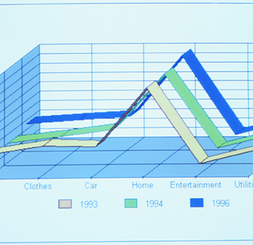
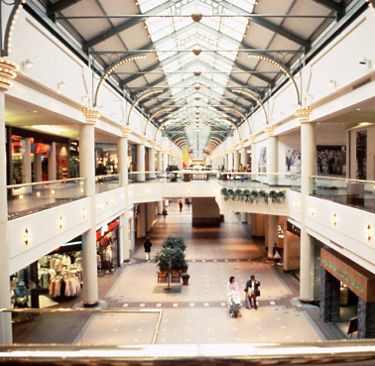
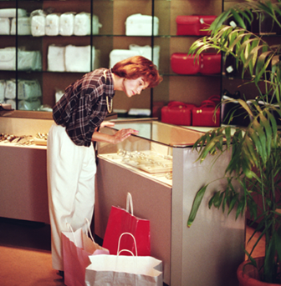

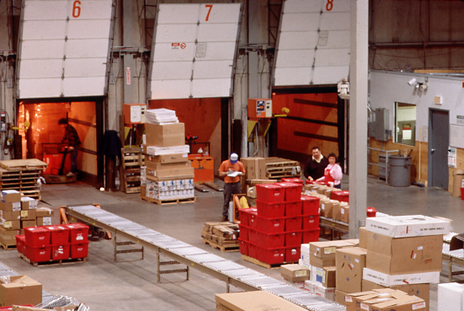



RETAIL SUPPLY CHAIN
As an organization driven by demand for merchandise and related services, a retailer is dependent on its ‘supply chain’ to survive and profit. Its competitive advantage is achieved by improving performance on multiple dimensions, within each component as well as across functional boundaries, to achieve strategic objectives.
Forecasting/
Planning
Product
Development
Buying/
Sourcing
Logistics
Allocation/
Distribution
Inventory Management
Store
Operations
Consumer
Financial/Cost Management
Integrated Supply Chain Management Process and Information Systems
DIMENSIONS OF IMPROVEMENT
Cycle Time (Speed)
Inventory
Risk
Costs
Customer
Satisfaction
Profit
Quality

Slide 37
RETAIL SUPPLY CHAIN - FORECASTING/PLANNING
Forecasting/
Planning
Product
Development
Buying/
Sourcing
Logistics
Allocation/
Distribution
Inventory Management
Store
Operations
Consumer
Financial/Cost Management
Integrated Supply Chain Management Process and Information Systems
Major Activities
  Develop Demand/Sales Forecast
  Develop Merchandise/Category Plans
    Develop Division/Zone Plans
    Develop Store/Department Plans
  Develop Merchandise Assortment
  Develop Markdown Plans
  Develop Open-To-Buy (OTB)
  Develop Planograms
Objectives/Better Practices
  Increase market share
  Improve profitability
  Increase profit per customer
  Increase effectiveness/accuracy of the forecasts
  Streamline the forecasting/planning processes
  Integrate planning processes across functional areas
  Integrate with vendors’/suppliers’ forecasting and
  planning process

Slide 38
RETAIL SUPPLY CHAIN - PRODUCT DEVELOPMENT
Forecasting/
Planning
Product
Development
Buying/
Sourcing
Logistics
Allocation/
Distribution
Inventory Management
Store
Operations
Consumer
Financial/Cost Management
Integrated Supply Chain Management Process and Information Systems
Major Activities
  Product Design
  Research and Development
  Product Specifications
  Product Costing
  Sample / Pattern Making
  Marking / Grading
  Product Testing
Objectives/Better Practices
  Reduce product development cycle time
  Accurately cost product
  Enhance market research capabilities/expertise
  Refine product/category/market strategy
  Increase product specification quality/accuracy
  Facilitate cross-functional communication (e.g. design and production)
  Develop/refine product testing strategy
  Implement automated design tools (e.g. CAD technology)

Slide 39
RETAIL SUPPLY CHAIN - BUYING/SOURCING
Forecasting/
Planning
Product
Development
Buying/
Sourcing
Logistics
Allocation/
Distribution
Inventory Management
Store
Operations
Consumer
Financial/Cost Management
Integrated Supply Chain Management Process and Information Systems
Major Activities
  Item Set-up
  Vendor Set-up
  Merchandise Procurement
  Order Processing
  Respond to OTB Plan
  Vendor Relations
  Trade Funds Management
  Space Planning
Objectives/Better Practices
  Increase margin potential
  Improve utilization of resources
  Leverage purchasing power
  Drive partnership initiatives
  Develop and manage profitable supplier/vendor agreements
  Implement effective supplier/vendor rationalization process
  Select and implement effective decision support systems
  Establish EDI linkages

Slide 40
RETAIL SUPPLY CHAIN - LOGISTICS
Forecasting/
Planning
Product
Development
Buying/
Sourcing
Logistics
Allocation/
Distribution
Inventory Management
Store
Operations
Consumer
Financial/Cost Management
Integrated Supply Chain Management Process and Information Systems
Major Activities
  Materials Traffic Management
  Inbound Logistics
  Import/Export Administration
  Traffic
  Receiving
  Ticketing/‘Floor Ready’ Processing
Objectives/Better Practices
  Reduce processing time
  Reduce handling costs
  Increase allocation/order fulfillment accuracy and quality
  Improve thru-put
  Enhance tracking ability/information visibility
  Develop efficient global logistics network
  Expand “floor-ready” processing capability

Slide 41
RETAIL SUPPLY CHAIN - ALLOCATION/DISTRIBUTION
Forecasting/
Planning
Product
Development
Buying/
Sourcing
Logistics
Allocation/
Distribution
Inventory Management
Store
Operations
Consumer
Financial/Cost Management
Integrated Supply Chain Management Process and Information Systems
Major Activities
  Assortment Management
  Merchandise Allocation
  Order Fulfillment
  Open-to-Ship Management
  Flow-Through Processing
  Shipment Management
  Delivery Scheduling
Objectives/Better Practices
  Reduce processing time
  Track progress throughout the process
  Implement support for ‘post-receipt’ allocation
  Allocate product based upon productivity potential
  Manage assortment as product is received
  (vs. ordered)
  Enhance support for Flow Through processing
  Adopt ‘pack-by-store’ strategies where appropriate

Slide 42
RETAIL SUPPLY CHAIN - INVENTORY MANAGEMENT
Forecasting/
Planning
Product
Development
Buying/
Sourcing
Logistics
Allocation/
Distribution
Inventory Management
Store
Operations
Consumer
Financial/Cost Management
Integrated Supply Chain Management Process and Information Systems
Major Activities
  Inventory Tracking
  Replenishment Management
  Reordering
  Price Management
  Promotion/Event Management
  Physical Inventory Management
Objectives/Better Practices
  Increase inventory productivity (reduce invest./increase turnover)
  Minimize hand-offs/paperwork throughout the process
  Improve information quality across functional areas
  Enhance production scheduling to meet consumer demands
  Incorporate ‘Just-in-Time’ production strategies
  Support local market pricing and promotional initiatives
  Integrate replenishment process with vendors’ process
  Increase support for Vendor Managed Inventory (VMI)

Slide 43
RETAIL SUPPLY CHAIN - STORE OPERATIONS
Forecasting/
Planning
Product
Development
Buying/
Sourcing
Logistics
Allocation/
Distribution
Inventory Management
Store
Operations
Consumer
Financial/Cost Management
Integrated Supply Chain Management Process and Information Systems
Major Activities
  Customer Service
  Store Receiving
  Stock Transfers
  Time and Attendance
  Couponing
  Schedule Management
  Traffic Counter Management
  Visual Merchandising
Objectives/Better Practices
  Define customer service targets
  Reduce non-sales generating activities
  Implement wireless technology (supports receiving, transfers, returns, physical inventories)
  Streamline back office activities
  Focus on sales floor productivity
  Schedule sales associates based upon customer traffic patterns
  Implement electronic timekeeping
Staff Development
Opening/Closing
Loss Prevention
Cash Management
Inventory Management
Physical Inventory
Special Orders
Direct Store Delivery

Slide 44
RETAIL SUPPLY CHAIN - CONSUMER
Forecasting/
Planning
Product
Development
Buying/
Sourcing
Logistics
Allocation/
Distribution
Inventory Management
Store
Operations
Consumer
Financial/Cost Management
Integrated Supply Chain Management Process and Information Systems
Major Activities
  Performance Analysis
  Customer Research
  Customer Relations
  Brand Management
  Consumer Relationship Marketing
  Promotion/Event Management
  Advertising
  Direct Mail
Objectives/Better Practices
  Identify retail trends and business opportunities
  Develop product positioning strategies
  Enhance brand management
  Provide benchmarking capabilities
  Increase consumer value
  Align direct mail, advertising, and in-store initiatives
  Focus on developing long-term customer relationships
  Track consumer purchases

Slide 45
RETAIL MERCHANDISING COE -
TARGET INDUSTRIES AND BUSINESS PROCESSES
Retail
Merchandise Planning
Assortment Planning
Buying/Sourcing
Allocation/Distribution
Category Management
Vendor Management
Consumer Products
Merchandising/Licensing
Vendor Management
  Direct to Retail Distribution
  Direct to Consumer Distribution
Category Management
Space Management/Planning
Merchandising
Processes
Entertainment, Media & Comm.
Merchandising/Licensing
Vendor Management
  Direct to Retail Distribution
  Direct to Consumer Distribution
Category Management
Space Management/Planning
High Tech
Vendor Management
  Direct to Retail Distribution
  Direct to Consumer Distribution
Category Management
Space Management/Planning

Slide 46
RETAIL INFORMATION TECHNOLOGY

Slide 47
RETAIL TECHNOLOGY OVERVIEW
Major Technology Trends in the Retail Industry
1960’s
1970’s
1980’s
1990’s
The Kimball Ticket
  track team movement
Non integrated systems
  units and $s maintained separately
Early Credit Authorization
Accounting machines
Cash registers
Point of Sale terminals
  detailed capture of sales data
  first in-store systems
  redesign wrapdesk tasks
Integrated systems
Expansion of Credit Authorization
Mainframe computers/ proprietary software
Packaged retail software introduced
  mainframes and minis
  integrated systems
  automation for small to medium sized retailers
  proprietary software
Big custom development projects
Introduction of the PC
New generation POS - scanning/PLU
Store level automation
Hand held terminals/radio frequency
Complete Credit Authorization
Client Server/PC networks
WANs
GUI
Open systems
  shared data
  non proprietary
  complete integration
Special function software
EDI
Satellite communications
Check authorization
Smart Cards/debit cards

Slide 48
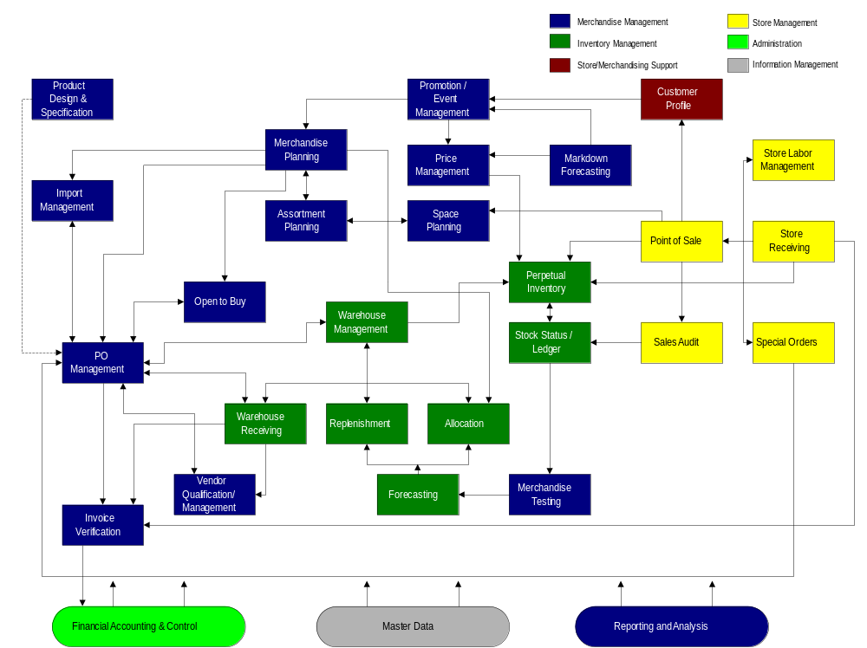
RETAIL APPLICATION ARCHITECTURE
During the analysis of a retailer’s systems environment, we find it helpful to define the retail application architecture. The retail application architecture pictorially suggests how a company’s information flows from one system area to another. The boxes highlighted below look very similar to the process areas discussed in the previous section, but they also represent the software components that a make up a retailer’s systems environment.

Slide 49
RETAIL PERFORMANCE METRICS

Slide 50
RETAIL PROFIT MODEL
Originally named Management Horizons’ Total Profitability Model, the Retail Profit Model was introduced during a Management Horizons conference series. Historically, retail industry managers operated solely on profit margin management. The Retail Profit Model re-focused managers to return on investment (ROI). This model demonstrates how relatively modest improvements on any number of variables can significantly and favorably impact corporate return.
Net Sales
Gross
Margin
Cost of Goods Sold
Gross Profits from Operations
Total Operating Expenses
Net Profit Before Taxes
Net Other Expenses
Net Profit $
Income Taxes
Net Profit Margin %
÷
Inv
Net Sales
Return on Assets
x
Financial Leverage
=
Return on Investment
Current Assets
Annual Turnover
÷
Other Current Assets
Total Assets
÷
Fixed Assets
Net Worth (Investment)
Total Liabilities
Source: Management Horizons, A Consulting Division of Price Waterhouse LLC.

Slide 51
KEY RETAIL FINANCIAL MEASUREMENTS
Base Values
  Sales
  Inventory
  Markdowns
Sample Financial Measurements
  Gross margin %
  Cumulative Mark Up%
  PO Mark Up%
  Maintained Mark Up%
  GMROI
  Freight to Sales
  Cost of Goods Sold
Sample Productivity Indicators
  Sales per Outlet
  Sales per Square Foot
  Average Store Size
  Stock to Sales
  Inventory Turnover
  Shrink
  Days of Supply
  Service Levels
  Market Share %
  Category Share %

Slide 52
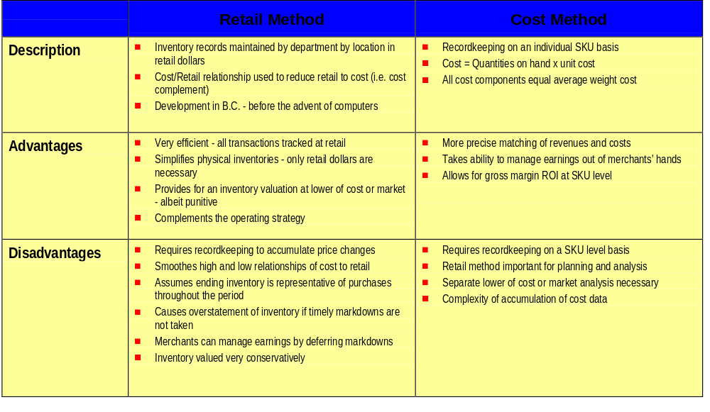
ACCOUNTING METHODS -
COST VS. RETAIL ACCOUNTING

