Slide 1
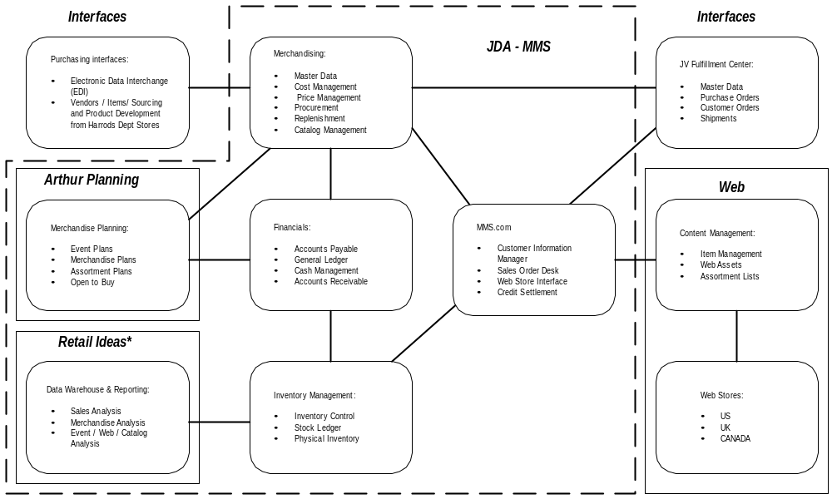
System Overview Diagram

Slide 2
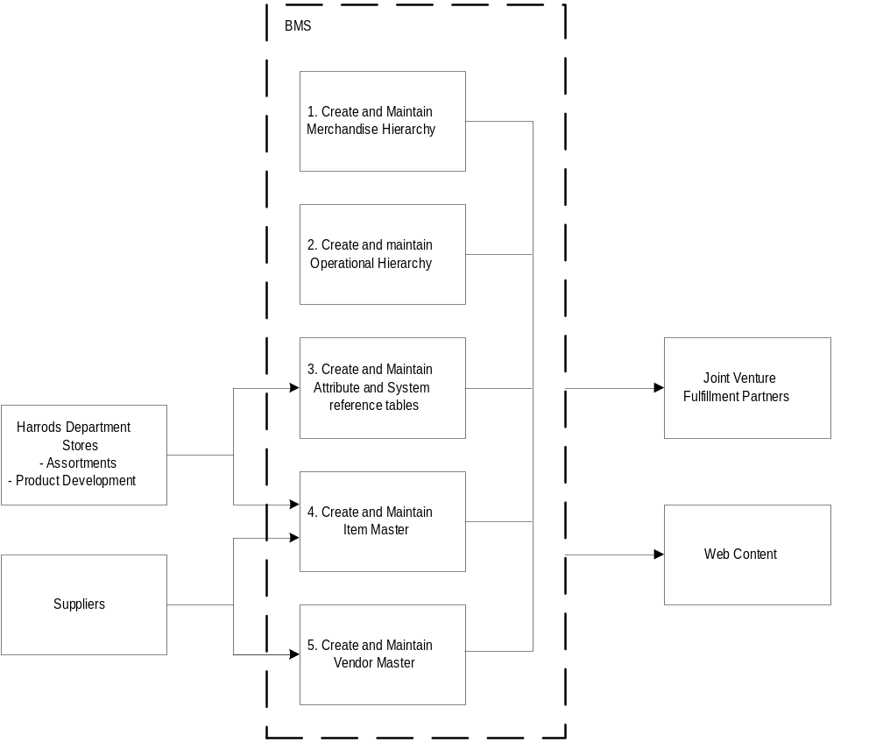
1.0 Master Data
Process chart: Set-up Master Data

Slide 3
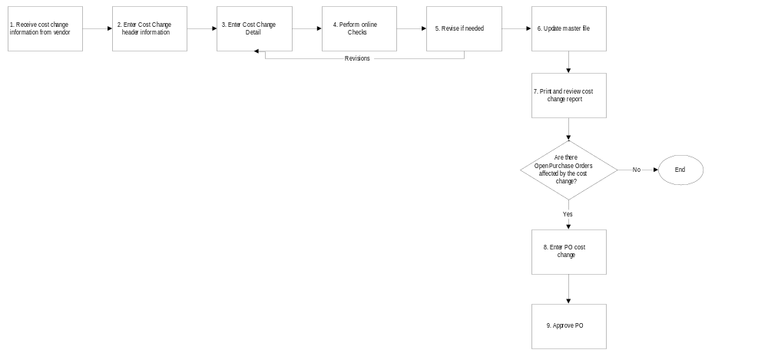
2.0 Cost Management
Process chart: Execute Cost Change

Slide 4
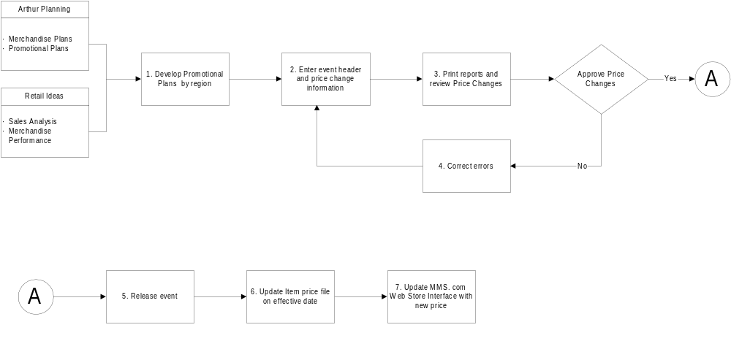
3.0 Price Management
Process chart: Price Event Management (permanent and promotional changes)

Slide 5
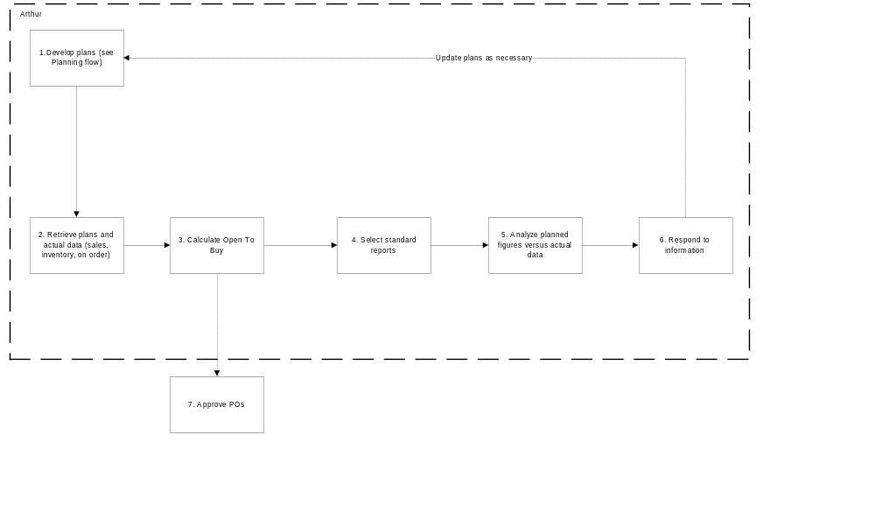
4.0 Open to Buy
Process chart: Open to Buy

Slide 6
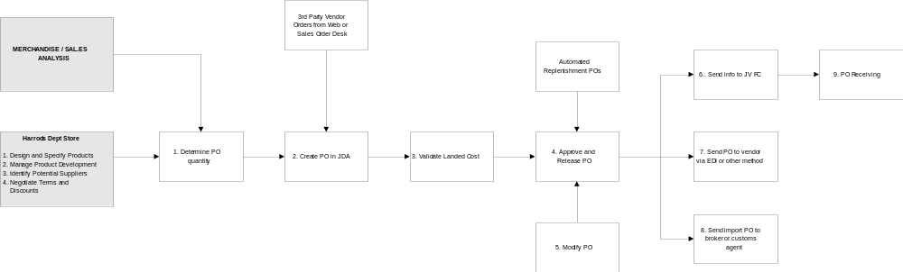
5.0 Procurement
Process chart: Create / Modify PO

Slide 7
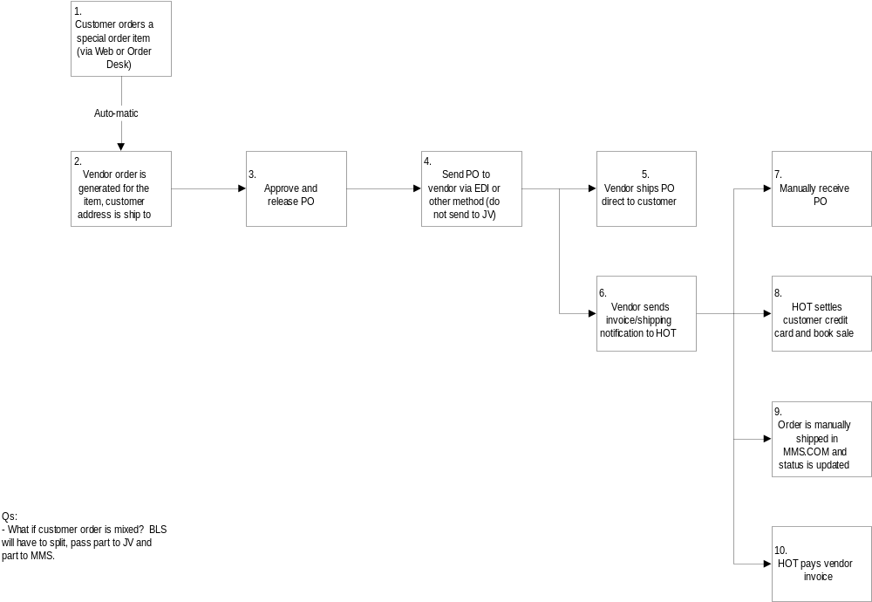
5.0 Procurement
Process Chart: Special Customer Order

Slide 8
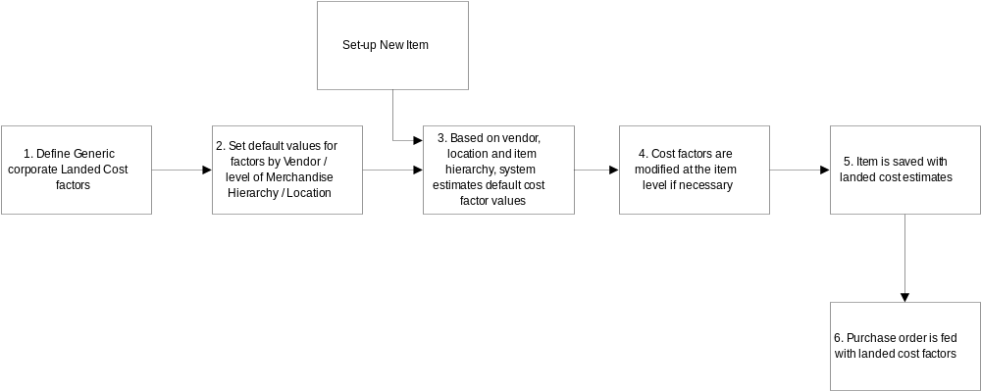
5.0 Procurement
Process chart: Set-up Landed Cost models

Slide 9
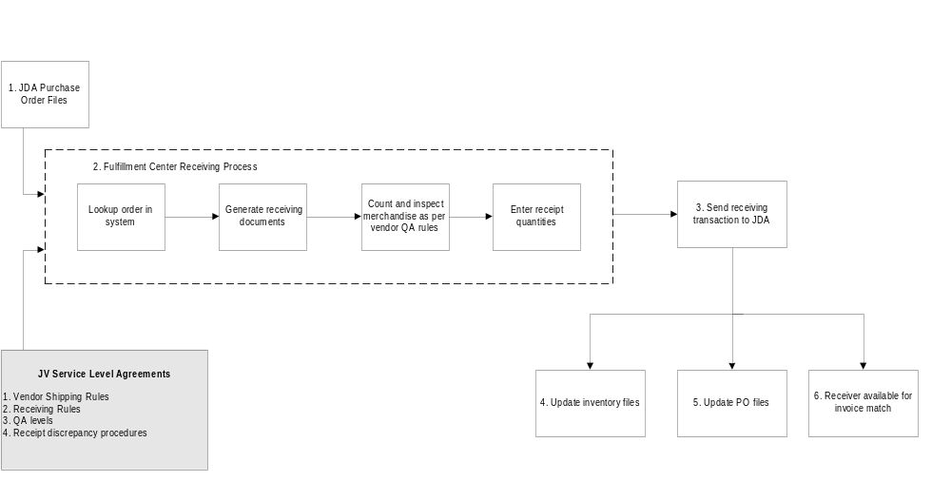
5.0 Procurement
Process chart: PO Receiving

Slide 10
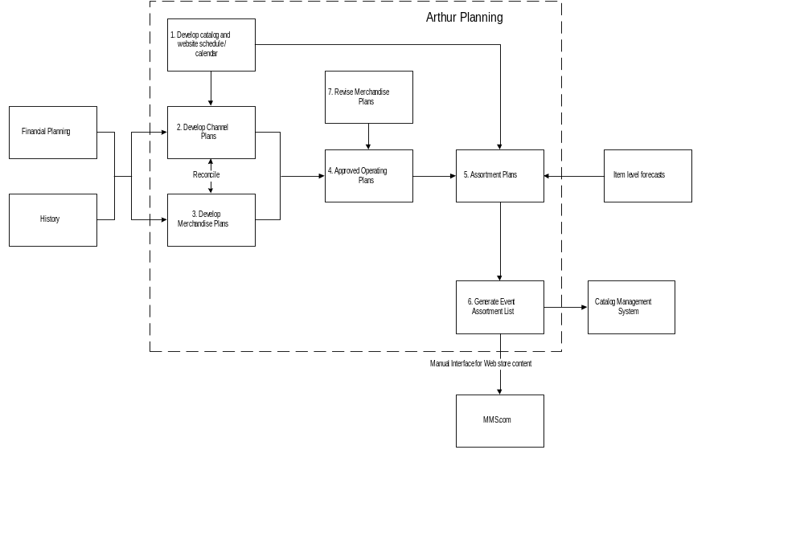
6.0 Merchandise Planning
Process chart: Merchandise planning

Slide 11
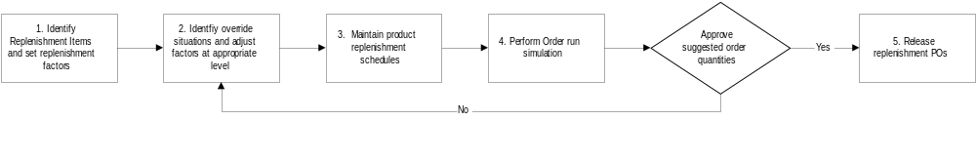
7.0 Replenishment
Process chart: Replenishment

Slide 12
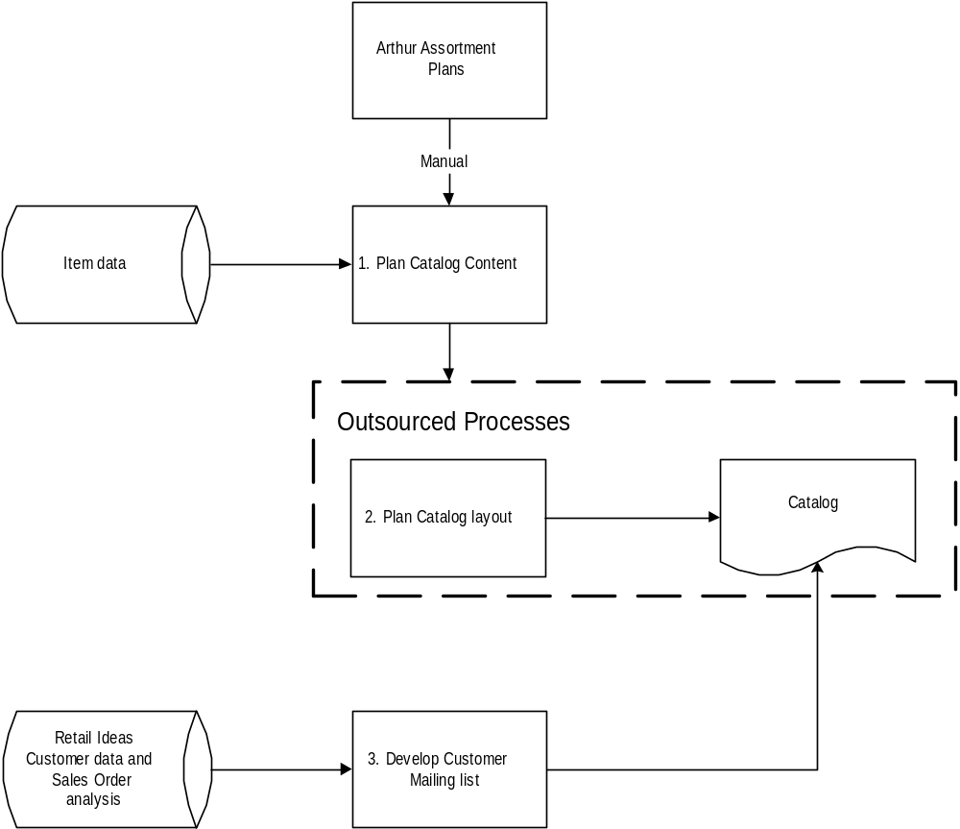
8.0 Catalog Management
Process Chart:

Slide 13
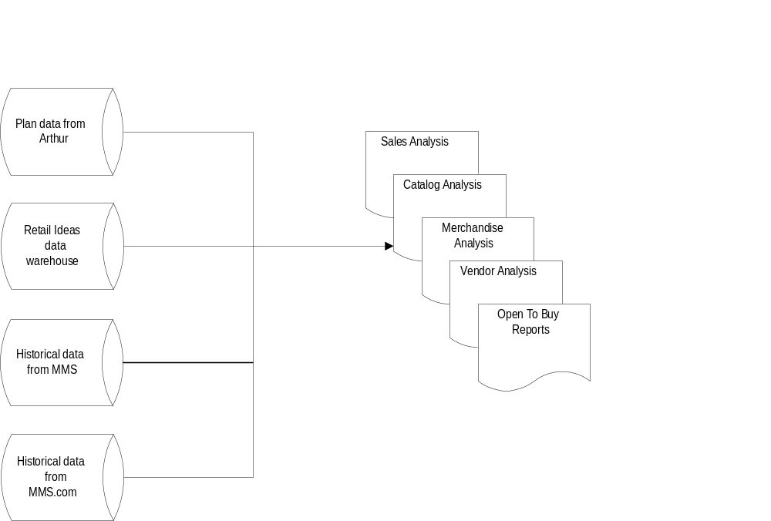
9.0 Merchandise Reporting and Analysis
Process Chart:

Slide 14
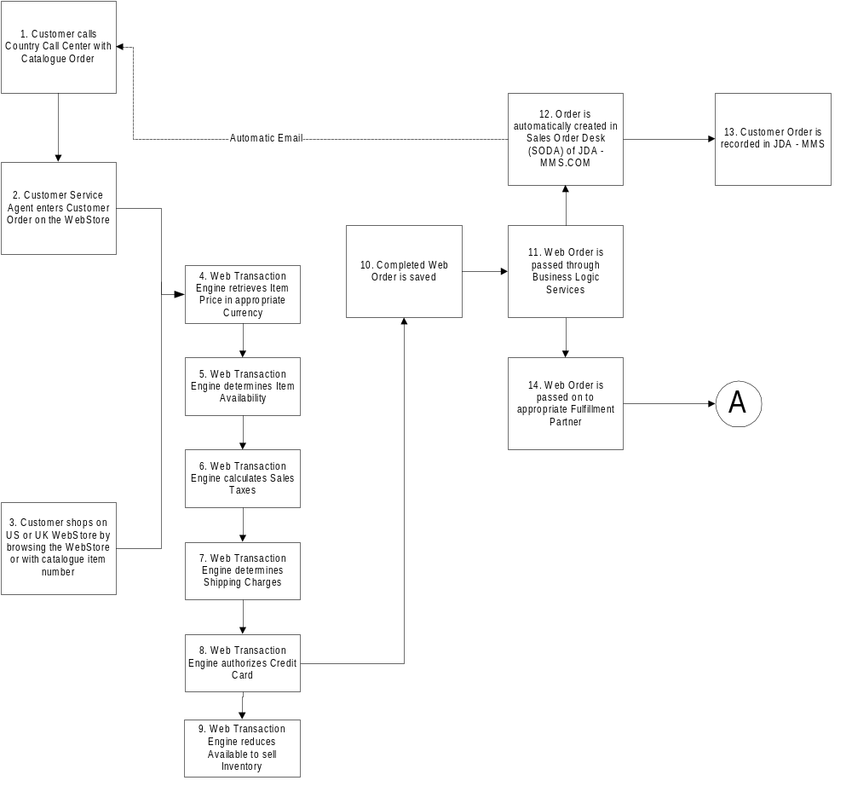
11.0 Order Management
Process Chart: Customer Order

Slide 15
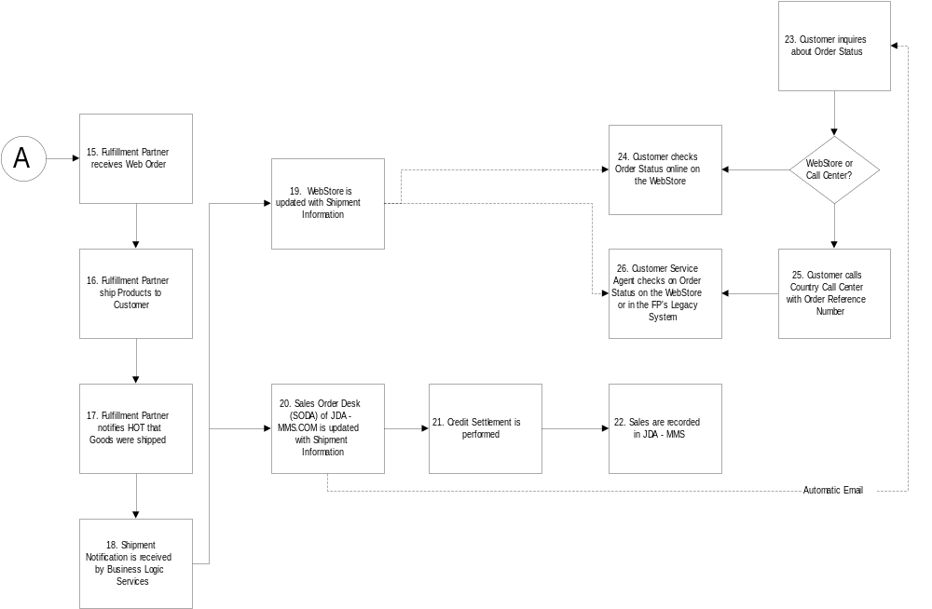
11.0 Order Management
Process Chart: Customer Order (cont)

Slide 16
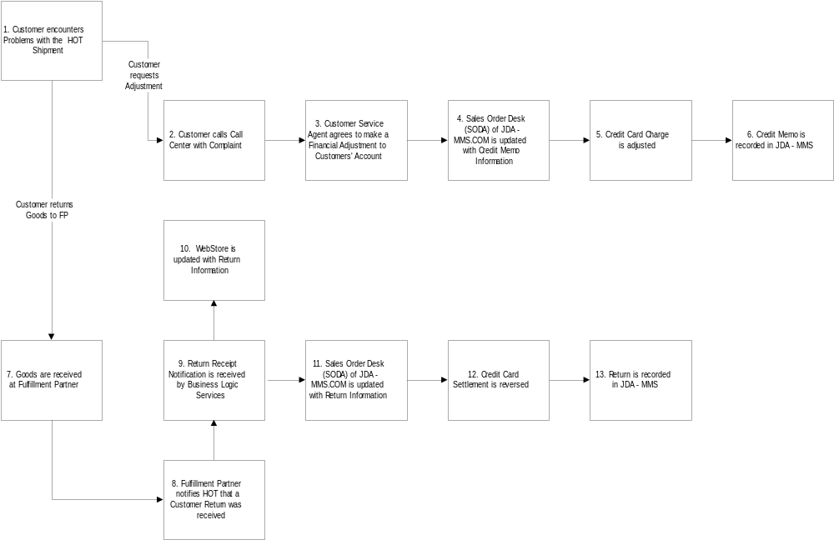
11.0 Order Management
Process Chart: Customer Return / Customer Credit

Slide 17
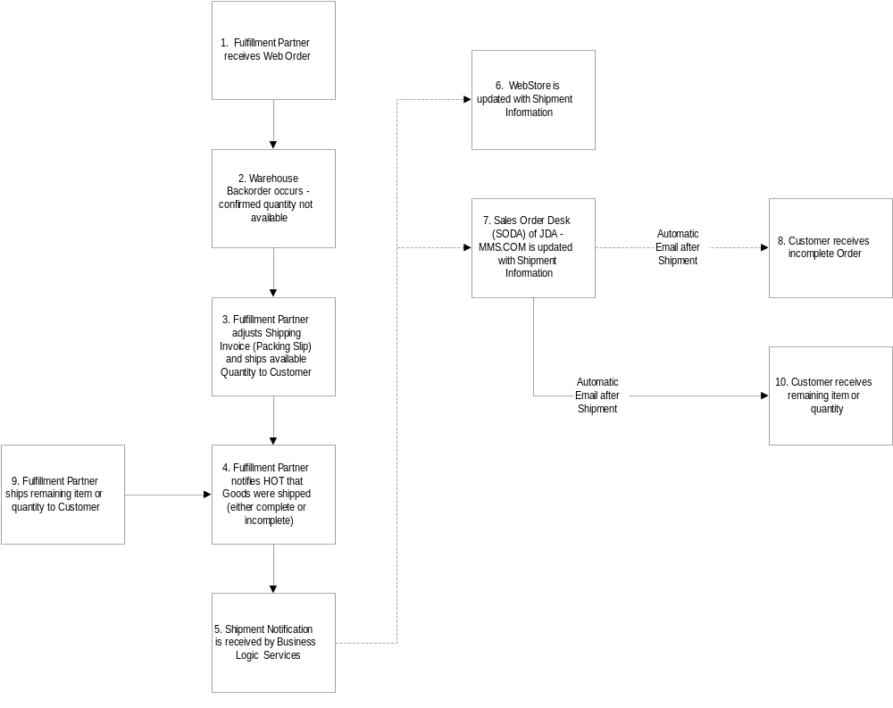
11.0 Order Management
Process Chart: Warehouse Backorder

