Slide 1


Welcomes
to
Progress Report
29 September 1999

Slide 2

Agenda
Project Organization
Gantt Chart for Phase 2 Scheduling
Communications Plan
Team Progress Reports:
  Business Management Systems (BMS)
    Interfaces
  Global Web Sites
  Content Management
  IT Architecture
Next Steps

Slide 3
Harrods Online Trading Team
Harrods Online
Executive Sponsors
Don Norman - HOT
Herb Kleinberger - PwC
Program Office
PwC Program Advisors
John Carey - HOT
Amy Wright
Jack Pomarole - PwC
Colin Windsor
Tom Kinsella - PwC
Sachin Shah / Dow Smith
IT Architecture
Global Web Site
Content Management
Business Mgmt Systems Team
Interfaces
Dave Layton - Lead
Bob Sellers - Lead
Joe Ruske - Lead
Larry Bagwell - Lead
Edward Ng Pack- Lead
Ramana Alladi
Leigh Joines
Carlos B. Castillo
*Barbara Brillhart
Bill Taylor
Tracy Blackburn
*Joanne McArthur
Application Systems
Interfaces
TBA (2)
Catherine Ziegler
Geoff Lyle
Sumana Krishnareddy
Mike Lenz
Marialyce Tobin
Klaus Schwarz
*Start date October 4, 1999

Slide 4
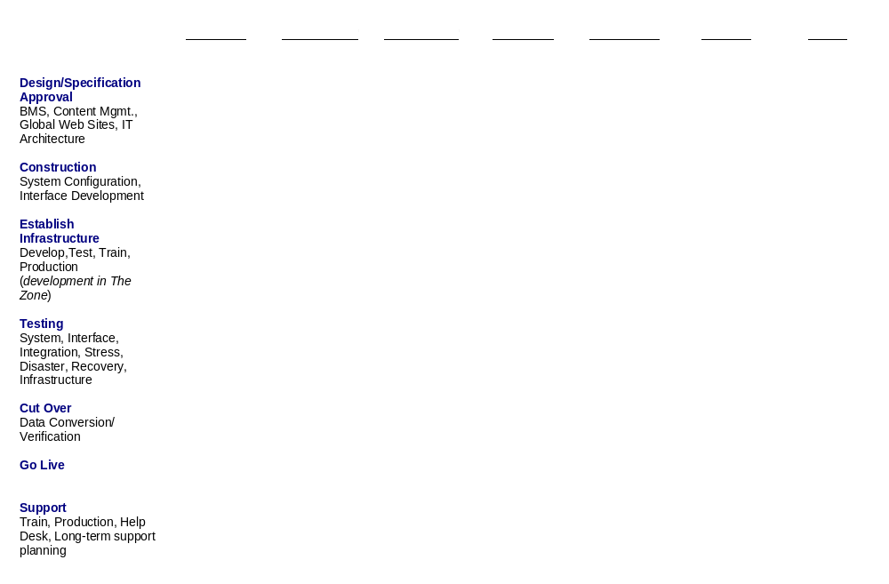
Gantt View Schedule: Phase II
10 / 22
01 / 17
02 / 14
03 / 13
03 / 31
ongoing

Slide 5
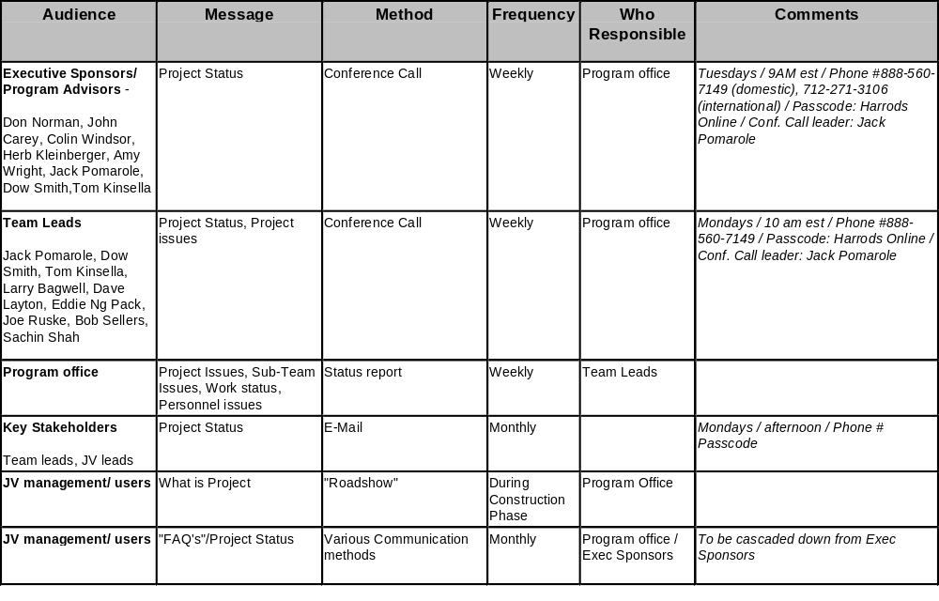
Communications Plan

Slide 6









Business Infrastructure
Harrods
PRODUCTS
IT Architecture
BMS
Hosting
Global Web
MARKETING
Content Mgmt
JV Fulfillment Partners
Spiegel
Grattan
Germany
Business Process Outsourcing
Japan
Content Sources

Slide 7
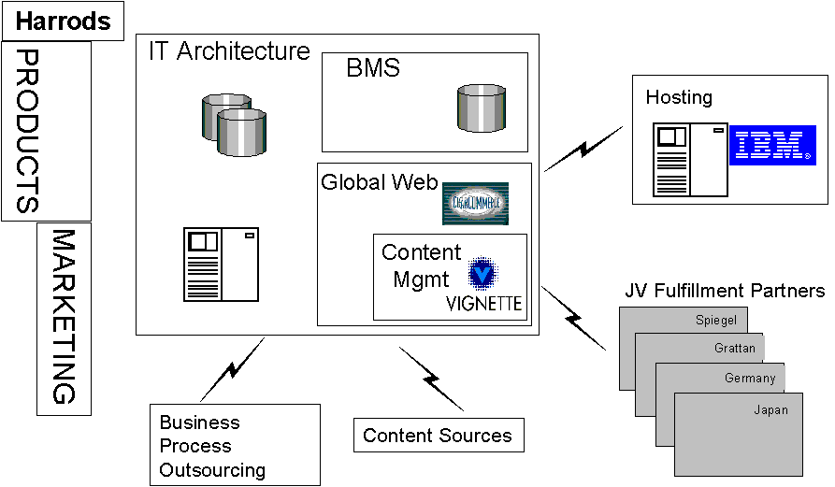
Business Management System

Slide 8
BMS Status Update
The Business Management Systems team is progressing with the following items:
  High level functional systems overview and flow
  Ranking various vendors against critical high level Functional Requirements
  Assumptions used to delineate Functional Requirements
  Interfaces necessary between Joint Venture and Fulfillment Partners

Slide 9
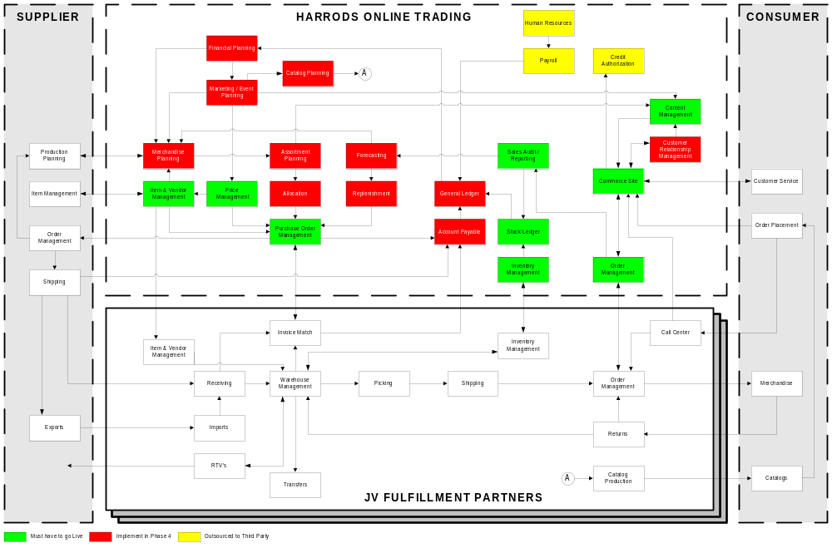
BMS Overview

Slide 10
Interfaces: Proposed Environment
Warehouse Management (CWS)
  Receipts
  Order Fulfillment
  Delivery
  Returns
  Inventory Count
Call Centre (CSS)
Merchandising
Item (CID)
Vendor
DataTrade (Import)
General Finance & 3way match
JV - Spiegel
Merchandise
Management
Procurement
Management
Customer
Management
Inventory
Management
Interface
Clearing house for shared business information
  data processing controls
  repository for interface rules and calculations
  map source file format to target file format
HOT - Business
Systems
HARRODS ONLINE TRADING
ITEM,
CATALOGUE,
CONTENT,
VENDOR
PURCHASING,
MERCHANDISING
SALES,
INVENTORY
A/P,
FINANCE
CUSTOMER/ORDER,
MARKETING
COMMERCE
TRANSACTION
PROCESSING
CONTENT
MANAGEMENT
PRESENTATION
Internet/
Extranet
CONTENT STORAGE MANAGER
HARRODS
SUPPLIERS

Slide 11
Global Web Sites

Slide 12
Global Web Sites Progress Update
The Global Web Sites team is progressing with the following items:
Participated in several Phase I / November launch with Harrods
Meeting with Business Management Systems team to understand existing
ERP interfacing requirements
Meeting with IT Architecture team to understand Phase I constraints and
environment
Preliminary logical overview for proposed personalization, transaction and
web integration

Slide 13
Global Web Sites System Function Model
Users
dB Layer
Content Acquisition
Content Presentation
dB Layer
dB Layer
Call Center
dB Layer
HarrodsOnline.com
Registration/ User Profile
Search
About
E-catalogue
dB Layer
Feedback
Information Push
Collaborative Filtering
Profiling
E-commerce
Concept Matching
User Information
Content Information
dB Layer

Slide 14
Content Management

Slide 15
Content Management Progress Update
The Content Management team is progressing with the following items:
Participated in several Phase I / November launch with Harrods
Developed plan for content submission, content review and promotion
to production, content registration with Vignette Story Server’s file
system mode
Researched requirements for the content collection within repositories

Slide 16

Content Management Overview
Vignette Logical Model
Security
Web Browser
Ask
Graphic Files
E-Mail
Web
Server
Workflow
Transaction
Engine
Answer
Programs
Integrated
Documents Management
Databases
Personalization

Slide 17
IT Architecture

Slide 18
IT Architecture Progress Update
The IT team is progressing with the following items:
Integrating with BMS team to understand existing assumptions
Participated in architectural assessment with Spiegel
Meeting with Global Web Site team to understand Phase I constraints and environment
Preliminary Network Topology for proposed system

Slide 19
Business Infrastructure
Harrods
PRODUCTS
IT Architecture
BMS
Hosting
Global Web
MARKETING
Content Mgmt
JV Fulfillment Partners
Spiegel
Grattan
Germany
Business Process Outsourcing
Japan
Content Sources

Slide 20
Deliverables
Specifications
BMS
  Package Selection
    Merchandise System
    Financial Systems
    Order Management
  Business Process
    High Level Definition
Content Management
  Systems & Applications
  Personalisation
  Data Model
Global Web Sites
  Architecture
  Systems & Applications
  Transaction Process
IT Architecture
  Global Configuration
  HW / SW / Tools
  Network
Interfaces
  JV Fulfilment Partners
  BMS
  Applicable Web & Content Engines
Workplan
HOT Phase 2 Integrated Workplan
  Infrastructure
  Oper Sys & Software Development
  Data & Content Loading
  Testing
  Conversion (November site)
  Training
  Launch
  Support

Slide 21
Next Steps
Synchronize Calendar with Communications Plan
  Confirmation
  Next update, Tuesday October 5th
Synchronize Deliverables Meeting
  October 22nd

Slide 22
Appendices

Slide 23
Harrods Online Trading Team
Business Management Systems
Larry Bagwell
Manage the identification of functional specifications through implementation including package evaluation and selection. Conduct business process design for all business systems necessary to run a retail enterprise
Geoff Lyle and Catherine Ziegler
Identification of Merchandising system functional requirements, package evaluation and detailed business process design for the following systems: Purchase Order Management, Replenishment, Pricing, Allocation, Assortment Planning, Event Management.
Michael Lenz
Identification of Financial system functional requirements, package evaluation and detailed business process design for the following systems: General Ledger, Accounts Payable, Budgeting, Inventory Management, Sales Analysis and Reporting, Accounts Receivable.
Klaus Schwarz
Identification of Order and Customer Management system functional requirements, package evaluation and/or custom development requirements for Order Management, Customer Management,
Identification and design of package enhancements, test plan creation, and configuration of Order and Customer Management system functionality
Edward Ng Pack and Sumana Krishnareddy
Identify and define requirements for interfaces needed between Fulfillment Partner systems and HOT including Purchase Orders, Customer Orders, Inventory Management, Items and Vendor information
Marialyce Tobin
Produce written design specifications and system requirement documents, application user guides, and training deliverables. Responsible for adding Technical Writing team resources as needed

Slide 24
Harrods Online Trading Team
Global Web Sites and Content Management
Bob Sellers
Manage the Global Web Site design specifications for the web infrastructure commerce engine and plug-in applications necessary for the functional global web capabilities -- this includes web navigation and graphics presentation specifications and development
Joe Ruske
Manage the Content Management design and functional requirements to create a global content management model using Vignette and supporting applications and data architectures
Leigh Joines and Barbara Brillhart*
Manage project communication, develop tool selection matrix, validate business requirements, identify data schemas and data structure, assist in the definition of ERP interfaces, and detail personalization strategy & recommendation
Carlos B. Castillo
Responsible for code management, plan standardized communications protocols, create workflow process document, create error handling strategy
Bill Taylor and Joanne McArthur*
Define content format and multi-lingual content
Tracy Blackburn
Implement tools, create migration strategy, validate business requirements and logical specifications, identify transaction engines and short list, detail personalization strategy & recommendation
* start date October 4, 1999

Slide 25
Harrods Online Trading Team
IT Architecture
Dave Layton
Manage the identification of technical specifications through implementation including architectural constraints, network topology,hardware topology and network topology to ensure service level requirements are achieved
Ramana Alladi
Platform and Infrastructure - responsibilities include hardware and software selection, repository requirements, development and testing environment, system topology, service level agreements, disaster and recovery procedures
TBA (1)
Middleware tools - responsibilities include network topology, hardware and software configuration data distribution architecture, middleware requirements, application distribution architecture, security infrastructure
TBA (2)
Systems Integration - responsibilities include architecture assessment, constraints, existing development environment, existing hardware and software assessment, architecture capabilities, performance specifications, user capabilities

Slide 26
Business Management System
Appendix

Slide 27
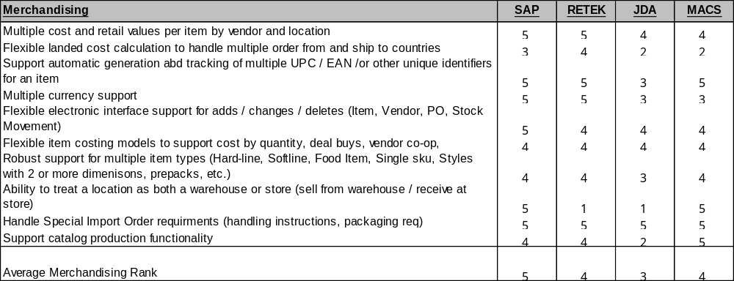
BMS Package Rankings
Legend
5 Fully meets
432 Partially meets
1 Does not meet

Slide 28
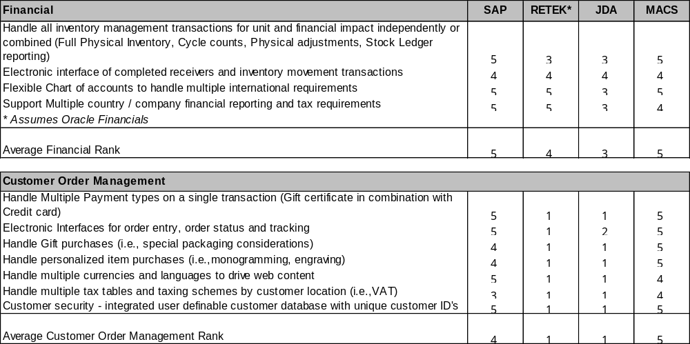
BMS Package Rankings
Legend
5 Fully meets
432 Partially meets
1 Does not meet

Slide 29
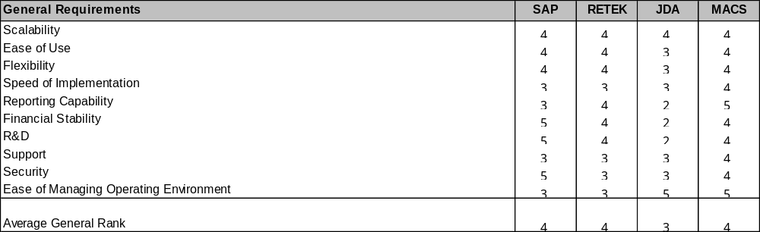
BMS Package Rankings
Legend
5 Fully meets
432 Partially meets
1 Does not meet

Slide 30
BMS Assumptions
Harrods Online Assumptions Captured to Date
To be reviewed by HOT in next conference call (see Communications Plan)
    Harrods Online Trading will use the Cost method of accounting
    Harrods Online Trading will manage inventory through replenishment and
    forecasting tools instead of using Open to Buy
    Harrods Online Trading will need basic pricing functionality as it will not be
    highly promotional
    HR and Payroll will be either manual or outsourced in Phase 2
    Bank settlement process will be outsourced in phases 1-3 (Phase 4 TBD)
    Credit settlement will occur when shipping takes place
    Harrods Department Store credit card will not be supported for
    payment in Phase 2
    Electronic Gift Certificates will not be sold over the Web in Phase 2
    Loyalty program functionality will not be supported in Phase 2
    Catalogue production interface will be manual in Phase 2
    Chart of Accounts will be provided to us by November 15
    Merchandise Hierarchy will be provided to us by November 15

Slide 31
BMS Assumptions
Fulfilment Partner (FP) Assumptions Captured to Date
To be reviewed by HOT in next conference call (see Communications Plan)
A single Purchase Order will be generated for each Fulfilment Partner in Phase 2
Invoice match will be done by the FP financial systems
Quality Control Inspections to be done by the FP
Inventory counting activities (i.e. Physical Inventory, Cycle Counts) will be performed by the FP
Import management will be done by the FP or a third party
Export management to be done by the FP or third party
Personalised items (i.e. monogramming, engraving) will be responsibility of the FP
The FP Call Center will perform all functions through the HOT website
The FP partner will handle catalogue production and accept catalogue data interface
Transfer requests between Fulfilment Partners will be handled manually
Item / Vendor maintenance of the FP reference data will be handled manually in Phase 2
Notes:
Our landscape for e-business evolution:
E-business initially enables selling and buying activities, with firms doing the same type of activities more efficiently (box one and two)
Second stage is equivalent of the railway and telegraph revolution: complete restructuring of value chains, creation of new virtual firms and cybersourcers (box three)
Finally, process specialists take their expertise to new markets - a virtual version of the convergence on attractive markets familiar from the physical world

Slide 32
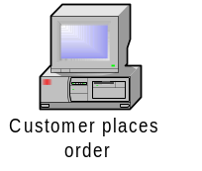
Interfaces: Customer Order Event
Example of systems interaction diagram.
Web
Interface
HOT Systems
Spiegel Systems
Requirements and Workflows
Translate customer order information for tracking
Customer and order Data
HOT Sales Module
Interface Specifications
Workplans
Items ordered and quantity entered
Translate order to inventory transaction to affect on-hand values
HOT Inventory Module
Customer name, address, and profile
Translate customer information for profiling
HOT Marketing Module
Order value payment method
Translate order for payment processing
HOT Financial Module
Items ordered,QTY ordered,customer name, ship location
Translate order for fulfilment processing
Spiegel CWS/ DFS Modules
HOT Order Management

Slide 33
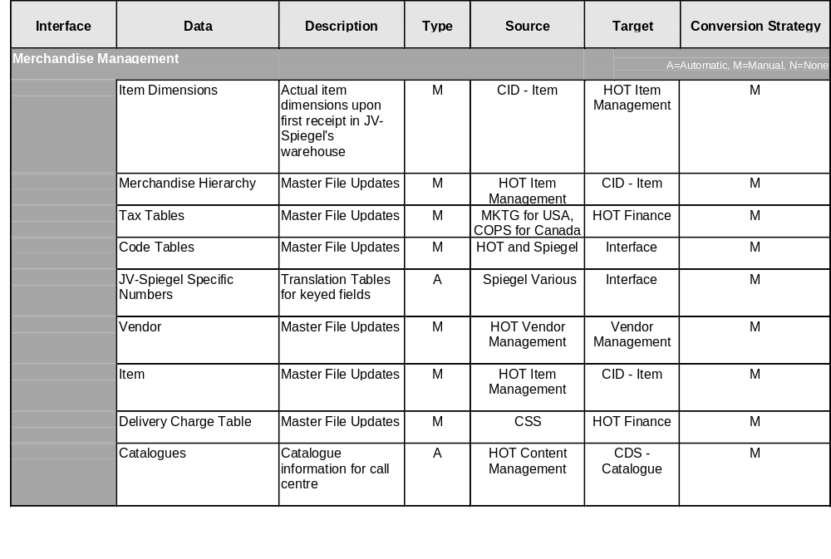
Interfaces: Proposed Environment

Slide 34
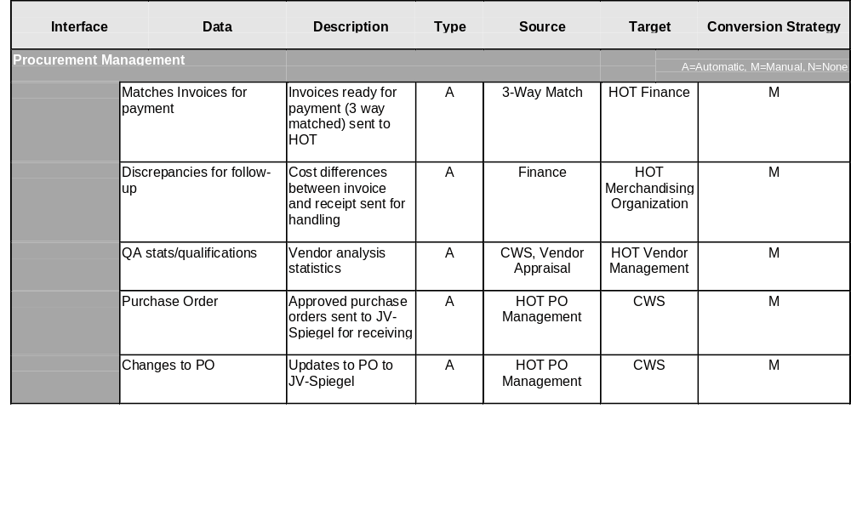
Interfaces: Proposed Environment

Slide 35
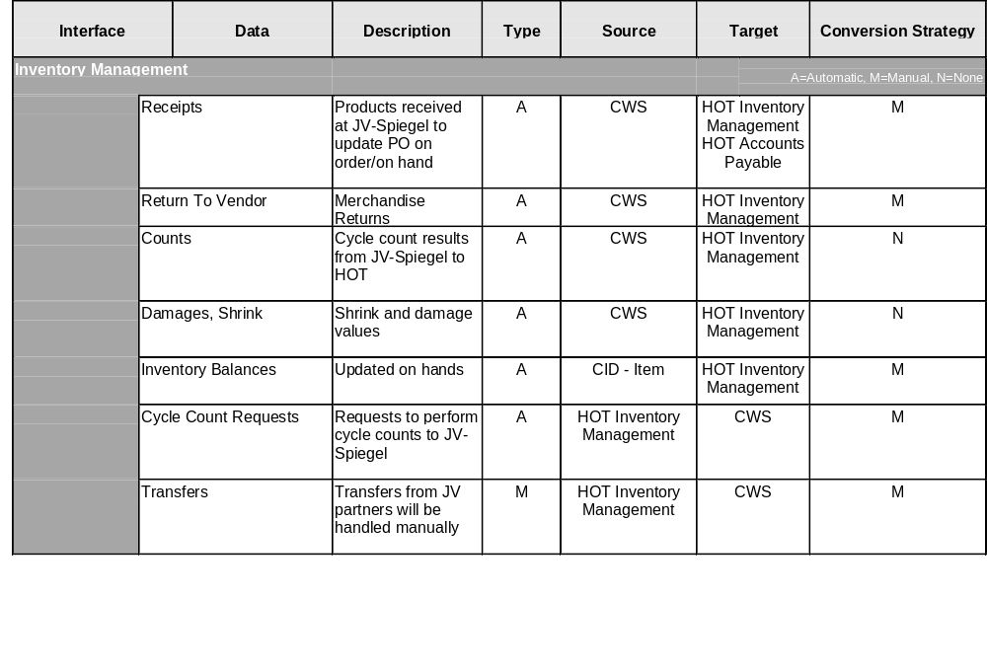
Interfaces: Proposed Environment

Slide 36
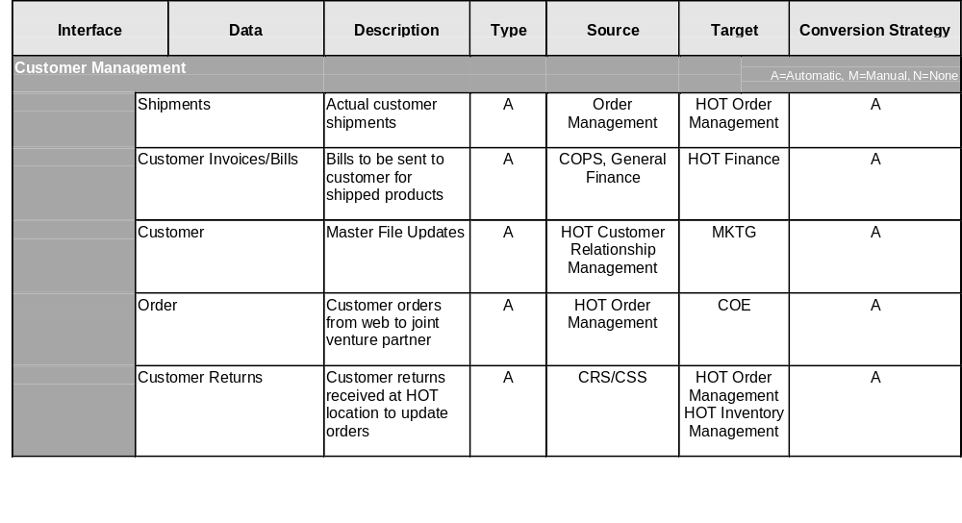
Interfaces: Proposed Environment

Slide 37
Global Web Sites
Appendix

Slide 38


Web Transaction Flow Diagram
Valid
Credit Card ?
Web Transaction
Submitted
Field Level
Validation
Flow diagram showing the credit card processing and verification of a live web transaction
A
Formatted Transaction
Data
Valid Format?
Display
Error
Credit Card Verification
Cache Transaction
Valid Transaction?
Transaction
Data
NO
Display Error
Page
Error Handling
Sequence
Oracle dB
Update Cache
Yes
A
Display Transaction
Confirmation Screen
Verification
Data
Credit Card
Fraud Check
Oracle dB
Finish

Slide 39
Item Transaction Screen Flow Diagram
Purchase
Order Confirmation
Details
Order Verification
1.1.1
1.1.0
Screen Flow Diagram show the form elements on the Order Verification and the Order Confirmation web pages
Order Number
Customer Name
Total Price
Billing Address
Customer Service Info
Billing State
Customer Name
Billing Country
Phone Number
Post/Zip Code
Phone Number
Home
Credit Card Number
Exp. Date
Issuing Bank
Item Array
Unit Cost Array
KEY
Tax
= Page
Shipping
= Go To Page
Total Cost
=Page Input Field
=Page Output Field
Currency
=Page Action
Tracking ID
=Application Decision
= Same Page Action
Change
=From Page Link
=Information Grouped on Page
Accept
Cancel

Slide 40
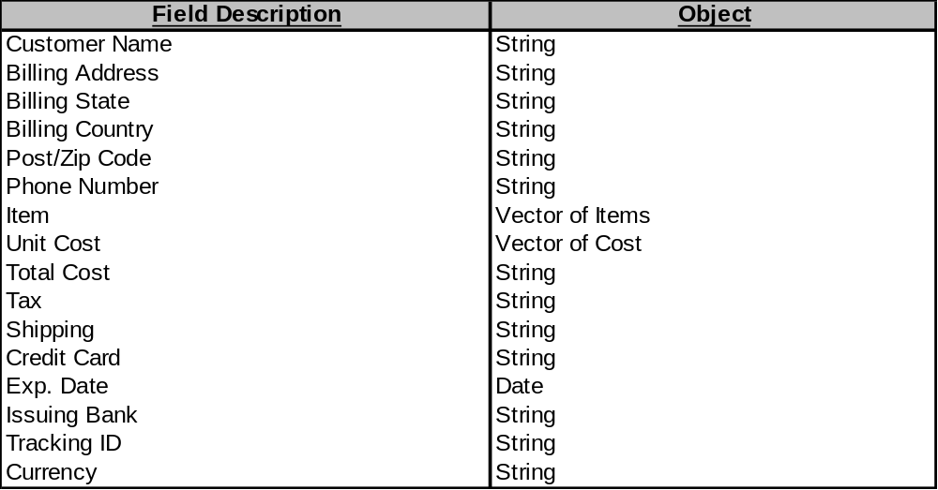
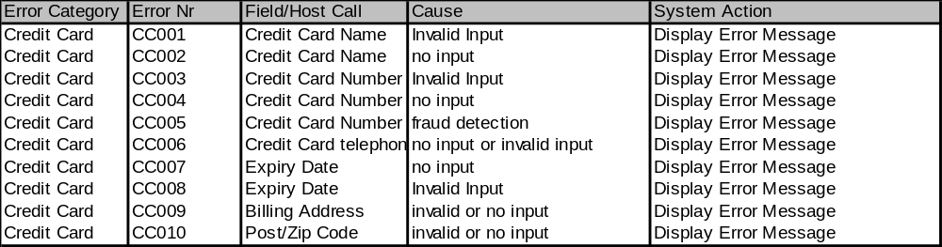
Transaction Element Summary
Transaction Element Summary of Order Verification
These logic tables provide further definition to the Order Verification Page
Order Verification Error Codes Definition

Slide 41
Global Web Site Assumptions
Transaction Engine Assumptions Captured to Date
To be reviewed by HOT in next conference call (see Communications Plan)
Transaction Engine will be supported and integral to the Business Management Systems
Transaction Engine will provide real-time credit card verification for web purchases
Transaction Engine will facilitate transaction matching for fulfilment.
Transaction Engine must provide or facilitate a standard shopping cart metaphor
Transaction Engine must support three-part payment
Transaction Engine must support multiple process house connections
Transaction Engine must be certifiable by process house

Slide 42
Global Web Site Assumptions
Web Systems Assumptions Captured to Date
To be reviewed by HOT in next conference call (see Communications Plan)
Web side products and tools will be functional within a cluster environment
All web tools will be compatible and functional with Vignette and Netscape Enterprise Server
Oracle 8.x will utilised for the web side repository
The Web Server Farm will be located at an ISP – TBD
All web tools and products must be compatible with overall security framework
Performance is a major consideration in our design criteria
Load and web metrics for Harrods on-line are considered unknown at this point they will computed by extrapolation of know volume from existing site

Slide 43
Content Management
Appendix

Slide 44
Content Management Architecture
Extranet Users
Harrods Online Intranet
Harrods Online Internet
Harrods’ Merchandising
Secure Authentication
Vignette Development Server
Secured Staging Layer
Development Teams
Graphics Server
Web Server Pool
Graphics Production Teams
Catalog Asset Server
Brand Specific Teams
XML Repository
Extranet users will provide content for presentation on the Harrods Online web site. Graphics Houses provide images for both catalogue and site pages. Merchandisers provide catalogue items with text, graphics, and other elements. Development teams provide encoded HTML and scripted pages to present content and provide web functionality.
All submitted content is stored in appropriate systems. Following review, content promoted to production is presented on the site.

Slide 45
Content Management Flow Diagram
Graphics
Secured Login to Extranet
Merchandise
Validate User
Good User?
Select Type of Content for Submission
Secured User Authentication is followed with system determination of available roles/groups.
Roles and Groups determine type of content that can be submitted.
NO
Exit
Yes
Associate User with Group & Roles
Development
Display Submission Page
Brand Subsite

Slide 46
Content Management Flow: Graphics
Graphics
Graphics Houses submit items for catalogue content and site pages. For catalogue graphics gathered to link graphics to skills. For site pages information is necessary to define reference pages using the images. This information is stored in an XML repository.
For Catalogue?
For Page?
Yes
Yes
User Interface Page
User Interface Page
User Indicates
-SKU -Image Type
User Indicates
-Site Map Page -Image Type
User Indicates
-Upload graphic
-Attach graphic to SKU (and element within XML Doc)
User Indicates
-Upload graphic
-Attach graphic to page (and element within XML Doc)
Retrieve XML Repository Record
Retrieve XML Repository Record for Site Map Page
Record Exists?
Yes
XML Repository Record Updated
Record Exists?
Yes
XML Repository Record Updated
Audit Trail logged
Audit Trail logged
NO
Submission Approval Workflow initiated
NO
Submission Approval Workflow initiated
User Indicates
-Catalogue Item Type (XML Document Format selection)
User Indicates
-New Page in Site Map (XML Document Format selection)

Slide 47
Content Management Flow: Merchandise
Merchandise
For Catalogue?
Feature?
Yes
Yes
User Interface Page
User Interface Page
User Indicates
-Fulfillment Center -SKU
User Indicates
-Title -Detail -SKU
- (Elements within XML Doc)
Harrods.COM Feature Process
Retrieve XML Repository Record
XML Repository Record Updated
Record Exists?
Yes
Audit Trail logged
Submission Approval Workflow initiated
NO
Merchandise groups enter catalogue entries. These entries include graphical and textual content. All this information is stored in the XML repository.
User Indicates
-Catalogue Item Type (XML Document Format selection)
-Fulfillment Channel (XML Document Format selection)

Slide 48
Content Management Assumptions
Content Management Assumptions Captured to Date
To be reviewed by HOT in next conference call (see Communications Plan)
Personalization for phase 2 will contain search, ratings and recommendations automation
Harrods.com and Harrods-online.com will not share customer data and tracking information
Personalization engine will be Orbix and CORBA compliant
Cookies will be utilised on this site
Users will be categorised will be identified in three ways
  Anonymous
  Cookie Based
  Logged in
E-Mail push and promotions will be supported at the Business Management Level
Personalization models will be clearly defined by Harrods-online prior to coding
Personalization engine will support or be adaptable to Harrods on-line identified marketing strategies and stated directions

Slide 49
Content Management Assumptions
Coding Assumptions Captured to Date
To be reviewed by HOT in next conference call (see Communications Plan)
HTML will be provided with graphics by third party production houses
HTML will require development QA and modification prior to promotion
HTML tags and code will be standardised
HTML encoding will support IE version 3 and higher as well as Netscape version 3 and higher
HTML will be submitted without any functionality scripting (TCL, JavaScript, External calls)
A user interface will be provided for third parties and internal parties to submit HTML, validate
HTML, modify HTML, and authorise promotion of HTML to production
An XML repository will be established to house and relate HTML pages and graphics
Following authorisation for promotion, HTML will be copied from the XML repository to the Vignette file system or copied into the Vignette Story Server content database
A workflow process will be defined to handle submission of HTML, validation of HTML, modification HTML, and authorisation and promotion of HTML to production
HTML pages will not be encoded into ASPs for the phase two implementation (March 2000 launch)
The following are outside of scope:
  DHTML or other HTML variants that are browser specific
  ASP re-usability
  Navigation integration to the site map

Slide 50
IT Architecture
Appendix

Slide 51
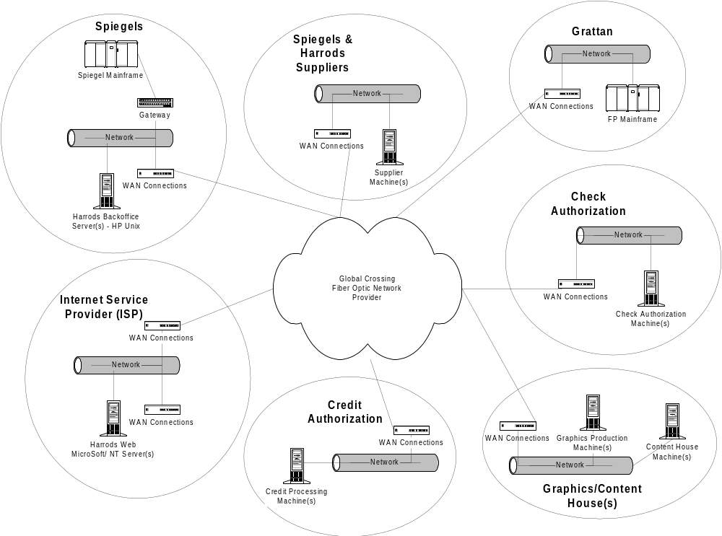
IT Architecture Network Topology

Slide 52
IT Architecture Assumptions
Global Crossing Fiber Optic Network will be used for International
network communication
Harrods Online Trading HOT is co-located with
Joint Venture (JV)
BackOffice software will run on HP/UNIX
Web Server software will run on Windows NT
Fiber Optic backbone will be used for all network connectivity
Internet Service Provider (ISP) will be logically and
physically separated from HOT
System landscape will consist of separated development, testing and
production environments
HP MC Service Guard will be used to implement failover strategy

Slide 53
IT Architecture Network Requirements
Integrated global fiber optic network.
Robust infrastructure to provide connectivity to top metropolitan
cities in North America, Europe, Asia, and other countries.
Highly reliable network to support service level requirements
Support for data, voice, and video.
Example(s): AT&T and Global Crossing

