Slide 1



Intel
Retail
Consumer Package Goods
Marketing

Slide 2
Intel
Retail-CPG
Marketing
Best-in-class solutions.
Developed with proven partners.
According to industry. Piloted. Tested.
Open standards. Phased migration.
Rapid implementation. Available now.
Today’s demands. Tomorrow’s vision.
Brought to you by PwC and Intel.
Extended POS
Sell More. Spend Less.

Slide 3
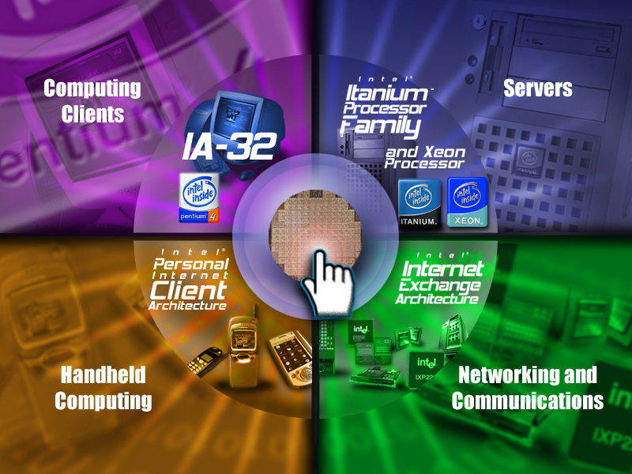
Building Blocks
Notes:
the speaker can use this slide to speak to the Intel corporate strategy of being the preeminent building block supplier to the worldwide internet economy. end to end solutions and where the enterprise solutions fit in. Then the second slide can be used to describe Intel’s end to end solution and to lead into how COIN fits into Intel’s enterprise strategy.

Slide 4







Intel e-Business Solutions
Architecture translated to business value
Intel
Retail-CPG
Marketing
Solutions Channels
Retail-CPG Mkting
Solutions Enabling
Architecture / Standards
Products
*All names and brands are property of their respective owners

Slide 5

Worldwide Solution Centers
Intel
Dev Labs
OEM Satellite Labs
EBSP Satellite Lab
Participate in standards bodies
Drive industry collaboration + initiatives
Develop/Demonstrate solutions
*All names and brands are property of their respective owners
Notes:
Example engagements
Stockholm: Working with Tella, MS, CPQ, SignalSoft, and PacketVideo to stream localized video on iPaq (signalsoft and packetvideo are intel investments)
Japan: Working with Hitachi, NTT, and Cybird for iMode billing demo (cybird is an intel investment)
China: Working with MS and Chanwang Telco for Chinese wireless tablet

Slide 6
Profit –abilities.
Assessing Total Project Value . . . With Intel
App Business Impact
RETAIL-ABILITY
White Board to Business
AGILITY
Optimize Legacy
REUSE-ABILITY
New Stores & Apps
FLEXIBILITY
Power and Reliability
SCALABILITY
Life Cycle TCO
COST EFFICIENCY
Sources: www.microsoft.com/value,
as validated by The Gartner Group;
http://www.intel.com/ebusiness/affiliates/
tpc.org, 19 Dec 2000; Gartner Group and
Contingency Planning Research
Notes:
OPTIMIZING THE RETURN ON YOUR IT INVESTMENT.
AGAIN – IT IS STRATEGY. CRITICAL CHOICES.
(BUILD UP FROM THE BOTTOM)

Slide 7
MARKET ENVIRONMENT
North American-EMEA Retail Point of Sale:
A Rapid Move to the Benefits of
Open, Flexible Architectures
Industry shifting from limited function, proprietary systems
  to PC-based POS that moves into the enterprise
real-time POS data feeds key to sales promotion,
  price optimization, collab supply chain
Need for database integration, real-time mining
SW shift to modular, W2K or Linux-based apps
Windows to gain 55% MSS in POS OS by ’03
55% of US retailers plan wireless comm or POS by ‘03
EID TTx Platform promises de facto P4P POS standard
Intel-PwC: expanding the scope of POS
Sources: RetailTech and PwC: The State of
Retail Technology, survey of 350 USA-
Canadian-European Retail IT Mgrs, July 2001.
Brian Hume, Martec, August 2001.

Slide 8
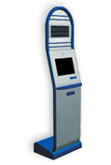
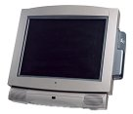
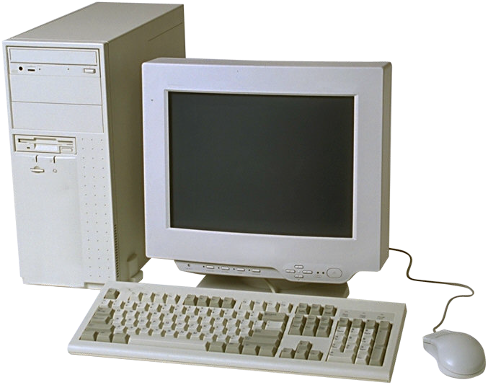
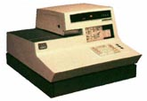
POS Market & Technology Trends
INTEL
EXTENDED
POS
P4P, IA-64
Web Services
4 Architectures
Non-Intelligent
Dedicated Use
Limited
Functionality
2002-3-4
Custom Mthbd
802.11
All-in-one des.
High Perform.
Integrated POS
Functionality
Mega-Data
Mining
Multimedia
Streaming Video
802.11a/g
Gbe
Dual mon.
Remote mgmt
1990’s
Grey Box PC
Limited POS
Functionality
Bulky
DOS based
1980’s
The Full Function
POS-to-Enterprise
Retail Future

Slide 9
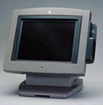
Intel
Retail-CPG
Marketing
Full Function.
Full Function Plus.
Transaction-authorization, of course.
Wireless & online for B2C-B-E
Terminal or kiosk.
Open standards.
New PC-based POS. Easy migration.
Maximum Productivity.
PRIPHRLS
P4P-ETx
POS
FIT
CLIENT
SlsPr
STORES
CATALOG
B2C .COM

Slide 10
Intel
Retail-CPG
Marketing
Real-time Retail.
Know sooner. React faster. Decide smarter.
CTData online to the mid-tier and database.
Retailer and vendors and sources.
The core of
collaboration.
PRIPHRLS
P4P-ETx
POS
FIT
CLIENT
SlsPr
WEB
SVCS
STORES
CATALOG
B2C .COM

Slide 11
FULL FUNCTION - REAL-TIME RETAIL
At the core:
Web-connected Point of Sale . . .
The new Full Function Client . . .
The new PC POS Standard.
BUSINESS VALUE
Tomorrow’s Infrastructure Now
The cornerstone of rapid response,
Multi-channel business analysis
Fullest Function Point of Sale
Increased Speed and Service
Terminals, Kiosk, Wireless
Value-adding Web Access:
Planograms, Vendor Availability,
Online Onfloor, Rich Media
In-store perpetual Inventory Control
Loyalty Rewards Mgmt
Performance Reporting
Employee Management
Voucher-Gift-Payment Authorization
The New PC POS Standard
Long-term HW migration strategy
Distributed Architecture
PC POS
EMB OS
POS SW
WEB
SVCS
KIOSKS
EMB OS
POS SW
APPLICATION BY SUB-VERTICAL
Software
MICROSOFT eXP
Op System
INTEL eATX – NCR, COMPAQ, WINCOR
Hardware
SYMBOL, COMPAQ, FUJITSU
Wireless
MICROSOFT .NET
Web Svcs

Slide 12
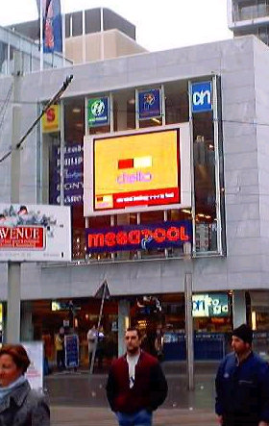
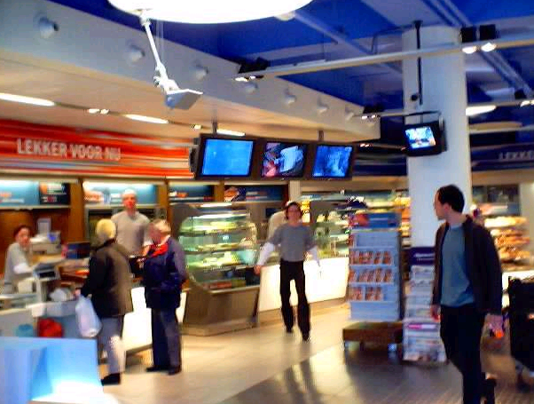
Intel
Retail-CPG
Marketing
Rich Experience.
Real-
Time
Streaming
Media
Intel Networking, Enterprise Technology.
Albert Heijn, Netherlands, December 2001.
300 store roll-out thru 2003.

Slide 13
KIOSK POS-
RICH MEDIA
BUSINESS VALUE
Projected Results
QSR Staff Expenses
cut $150-180K per store.
Maintain current
$ transactions per hour
In-store and drive-thru.
$ per transaction up 3-5%.
Enhanced promo revenues.
Enhanced brand image,
measured by consumer opinion.
Real-time editing of
Menu boards, streaming media
Real-time POS data
Linked to supply chain
Web-Connected Consumer-Facing POS
Streaming Media to POS and Display
In-Store and Drive-Thru
More revenue per transaction
Next-level cross-promotion
RADIANT, INTERSHOP
Software
MICROSOFT EMBEDDED XP
Op System
P4P-BASED NCR-COMPAQ-FUJITSU
Hardware
REZN8
Media
MICROSOFT .NET
Web Svcs

Slide 14




Intel
Retail-CPG
Marketing
Wireless.
The Wireless Store.
Mobile POS and kiosk.
Online inventory scanning.
RF-ID. Line Busting.
Personal Shopping Assistant .
Wireless
Devices
In-Store
Kiosk

Slide 15
Intel
Retail-CPG
Marketing
Smart Portal.
See the numbers that are important to you.
Have problems identified immediately.
In real-time. Via desktop or wireless.
In a single, easy-to-use management tool.

Slide 16
Significant financial benefits
60-180% ROI, quick payback projected
- Illustrative Benefits for a $1B Retailer, based on conservative 3rd party analysis -
Benefits, Low and High Scenarios ($ in millions)
MERCHANDISING
34.1
High
Raise sales per square foot
Improve margins
Decrease stock-outs
Decrease inventory levels
28.8
24.0
19.8
Low
17.8
16.5
SUPPLY CHAIN
13.3
7.9
9.6
Reduce stock-outs
Decrease inventory levels, improve turns
Reduce production costs
Decrease transportation costs
4.5
1
2
3
4
5
Year
STORE LEVEL EXECUTION
Low
High
Benefits, Operating Margin
$6.0M
$13.0M
Process orders more efficiently
Increase revenue by shortening access time to key data
+ Benefits, Operating Expenses
$28.0M
$47.5M
= Total Benefits (Discounted)
$34.0M
$60.5M
ROI
60%
180%
Payback Period
2-3 years
1-2 years
Sources: Scient analysis

Slide 17
SMART PORTAL
BUSINESS VALUE
Faster Decisions.
Better Informed Decisions.
Personalized.
Desktop and Wireless.
Proven Results
Increased Revenues, Margins
via
Faster Response to Trends.
Improved Markdown Mgmt.
Phased Implementation.
18-24 mo. roll-out.
The Data You Need.
Where and When you need it.
Desktop. Wireless. Personalized.
Spend your time making decisions
instead of looking for data.
Portal
SAP, PLUMTREE, CA
MICROSOFT W2K
Op System
Hardware
And Mobile
COMPAQ, DELL, SYMBOL
Smart
Shelf App
MERCARI
MICROSOFT .NET
Web Svcs

Slide 18
Intel
Retail-CPG
Marketing
OOS Reduction.
By 25% or more on basic items.
The future of CPFR.
All the way to source.

Slide 19


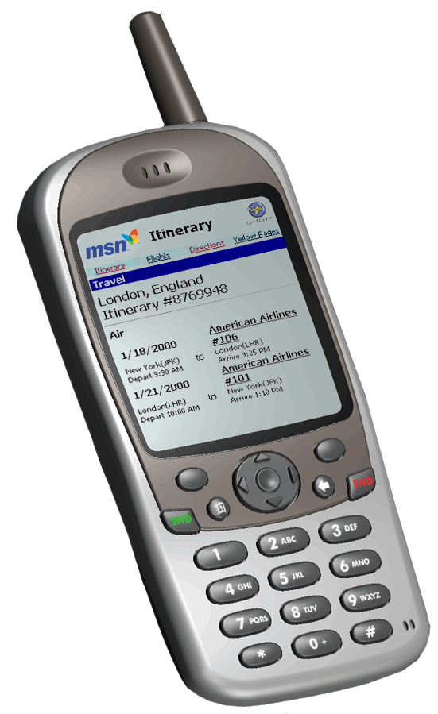

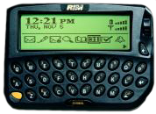
the Microsoft-Intel
Retail Supply Chain Initiative
Suppliers
BizTalk Server
A
P
P
L
I
C
A
T
I
O
N
S
Repl
Plan
E
N
T
E
R
P
R
I
S
E
Alloc
A
D
A
P
T
E
R
S
CRM
P
O
S
Transform
Orchestrate
Route
SA
Merch
LP
Fin
Rpt
DSS
Services
Notification
Devices

Slide 20
OUT OF STOCKS
BUSINESS VALUE
Results from Pilots:
Out of Stocks Reduced by 25%+.
1-2% Per-Door Revenue Increase.
Increase revenues 5-6%
On Top 200 items.
Accurate Prediction of
Key SKU OOS’s
On a per-door basis
Via real-time POS data
Real-time, time-effective
Per-store notification
Also: web-based links
back to vendor supply chain
For replenishment
At the core:
Web-connected Point of Sale . . .
Real-time Predictive OOS Analysis per door
Notification to in-store desktop, PDA’s
POS
WEB
SVCS
D.V.
WEB
SVCS
STORE
DATA VENTURES, SYSTECH
Software
MICROSOFT W2K
Op System
COMPAQ
Hardware
BLACKBERRY PAGERS, COMPAQ
Wireless
MICROSOFT .NET
Web Svcs

Slide 21

Intel
Retail-CPG
Marketing
Lifetime Value
Real-time data feed for Multi-Channel Mgmt.
Promotion, Acquisition, Loyalty Campaigns.
Merchandising-Buying.
Biz Smarts
TRANSACTION DATA
MID-TIER APPS

Slide 22
MULTI-CHANNEL
MDSING ANALYSIS
BUSINESS VALUE
A Single View of
Consumer Behavior
Across Channels
Across Brands
Proven Results
Increased Revenues, Margins
via
Faster Response to Trends.
Improved Markdown Mgmt.
Real-time POS data
From all channels
To SAS Retail Analytics
Geneva ERS data mining
Web-connected POS from all channels
Mega, near real-time data mining
Cross-channel consumer-trend-vendor-
analysis
M-Channel
Analytics
SAS
MICROSOFT W2K
Op System
COMPAQ, DELL
Hardware
GENEVA ERS
DB Mining
MICROSOFT .NET
Web Svcs

Slide 23
MULTI-CHANNEL
PROMO ANALYSIS
BUSINESS VALUE
A Comprehensive View of
Consumer Behavior
Across Channels
Across Brands
Proven Results
via
Increased Effectiveness of
Cross-Channel Promotion,
Customer Loyalty Programs.
Real-time POS data
From all channels
To campaign-promotions analytics
Geneva ERS data mining
Web-connected POS from all channels
Mega, near real-time data mining
Cross-channel promotion-campaign
analysis
M-Channel
Analytics
SAS, MARKETSWITCH, MANUGISTICS
MICROSOFT W2K
Op System
COMPAQ, DELL
Hardware
GENEVA ERS
DB Mining
MICROSOFT .NET
Web Svcs

Slide 24
Intel
Retail-CPG
Marketing
Data that sells.
Real-time loyalty-affinity-promo at POD.
POS data feed to Retail analytics. Cross-up sell.
Fast cross-channel mgmt of inventory, OOS.
Data Value
TRANSACTION DATA
MID-TIER APPS
WEB
SVCS

Slide 25
Intel
Retail-CPG
Marketing
Data Value.
Data that sells.
Pilots:
Heartbeat
Geneva ERS
PRIVACY
ISSUES
AFFINITY - LOYALTY
HIGH DATA VERTICALS
PHARMA – CON ELEC - DIY
TRANSACTION DATA
NON-PERSONAL
CAMPAIGN MANAGEMENT
MERCHADISING MANAGEMENT
MID-TIER APPS

Slide 26
INTEL-BASED EXTENDED POS
HW-SW SOLUTIONS
MID-TIER APPS
A&L
PYO
OOS
In-Store
Kiosk
PRIPHRLS
Wireless
Devices
P4P-ETx
Rich Media
Display
POS
RICH
CLIENT
INTEGRATED DATABASE
SlsPr
WEB
SVCS
STORES
Wireless
Devices
CATALOG
B2C .COM
MCDS
MCCM
SCM
BI-MIP
MID-TIER APPS

Slide 27
Intel
Retail-CPG
Marketing
Serve better. Know sooner.
Act faster. Decide smarter.
Sell more. Spend less.
Extended POS
The Intel Extended Point of Sale Program.

Slide 28
Intel
Retail-CPG
Marketing
Thank you.
Extended POS
The Intel Extended Point of Sale Program.

Slide 30
Intel
Retail-CPG
Marketing
Extended POS
It’ll win because we’re changing
The rules of the game.
  New technology. An end-to-end alternative.
The players at the table.
  The power of teamwork.
The scope of today’s POS.
  Moving beyond terminals.
The added value now required.
  Enterprise impact for ROI

Slide 31
Extended POS
FOOD DRUG
Targeted
Sub-
Verticals
Targeted
Products-
Solutions
OUT OF STOCK
REDUCTION
Full Function
Rich Client
RICH MEDIA,
M-CH MDSE MGMT
M-CH CAMPAIGN
MGMT
PwC
Intel
APPAREL CHAIN
BIG BOX
Intel
eATX
REAL-TIME RETAIL
Web Svcs
KIOSK POS
RICH MEDIA
KIOSK POS
RICH MEDIA
MEDIA-MC CHAINS
QSR

Slide 32

Intelligent Inventory Mgmt
Intel
Retail-CPG
Marketing
Decision
Dashboard
OOS
Reduction
Private E-
Exchanges
The Greatest
Retail Net Profit Return
Extended POS
INTEL RETAIL-CPG PRACTICES
2001-2002
Full Function
POS
Rich Media
Display
Kiosk
Wireless
Best-in-Class
Integration
Software
Hardware
Real-Time Retail
Web Services
Integrated Multi-Channel Analysis
Geneva ERS
datamining
Multi-Chan
Campaign
Multi-Chan
Content
Notes:
IN ORDER TO FACILITATE THAT . . .
WORKING WITH BEST-IN-CLASS SOFTWARE-HARDWARE-INTEGRATION
DEVELOPING FOUR FOCUS AREAS OF EXPERTISE – SPECIFIC INTEL-BASED GO-TO-MARKET PROGRAMS

