Slide 1
The Challenge Remains the Same … But The Approach Must Change
The Retail Challenge
To Win, Retailers Must
Get Real
Right Product
Right Place
Right Time
Right Price
Right Way
Real Focused
Real Efficient
Real Smart
Real Close
All in Real Time
Sustainable growth will come from an increased understanding of consumers needs and a mixture of “Art” and “Science”

Slide 2

Real Time Retail – Driving Growth at the Point of Decision
Real-time connections with:
  Consumers
  Partners
  Stores
Significant impact on:
  Customer Service
  Inventory Management
  Pricing / Promotions
  Purchasing
Technology-enablers include:
  Collaborative Value Chains
    CPFR
    CPC
    SDO
  In-store wireless CRM
  RFID / Auto-ID

Slide 3
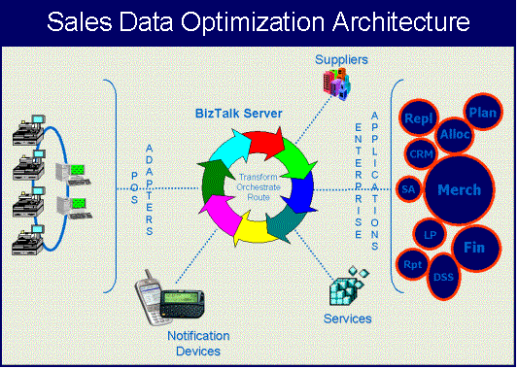
The SDO Architecture lays the foundation of data availability which can be leveraged for supply chain optimization and CRM opportunities
A scalable architecture built on the Microsoft BizTalk platform
Industry standard transaction templates and message queues
Real time data access
Flexible operating environment
  Retailer supported (In-store or Corporate)
  ASP Model
The SDO Architecture acts as a hub providing on demand access to store transactional data; allowing a variety of services to analyze, and respond to the store environment in real time

