Slide 1
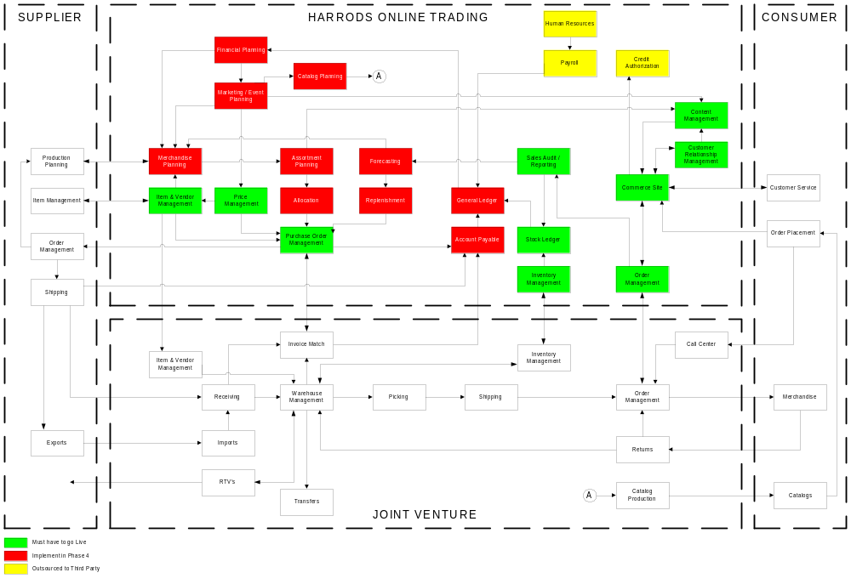
Harrods Online Trading Process Architecture DRAFT

