Slide 1


Intel
Retail
Consumer Package Goods
Marketing

Slide 2
Intel
Retail-CPG
Marketing
Extended POS
The Intel Extended Point of Sale Program.
A presentation to
PricewaterhouseCoopers
20 November 2001
Jon.C.Stine@intel.com
Intel Rationale, Market Opportunity

Slide 3
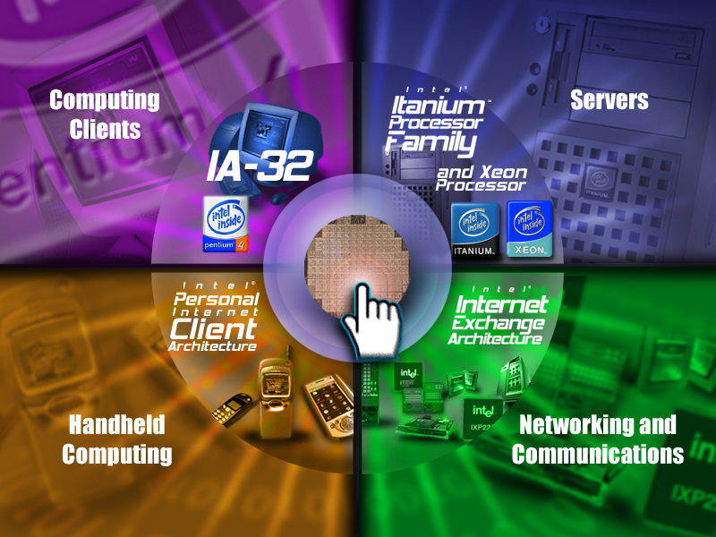
Building Blocks
Notes:
the speaker can use this slide to speak to the Intel corporate strategy of being the preeminent building block supplier to the worldwide internet economy. end to end solutions and where the enterprise solutions fit in. Then the second slide can be used to describe Intel’s end to end solution and to lead into how COIN fits into Intel’s enterprise strategy.

Slide 4



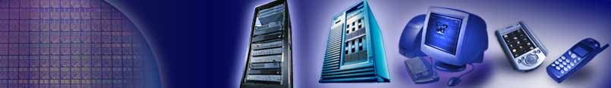



Intel e-Business Solutions
Solutions Channels
Solutions Enabling
Architecture / Standards
Products
*All names and brands are property of their respective owners

Slide 5
MARKET ENVIRONMENT
North American-EMEA Retail Point of Sale:
A $25-30B IT Market Moving Now
To Open, Flexible Architectures
Industry shifting from limited function, proprietary systems
  to PC-based POS that moves into the enterprise
real-time POS data feeds key to sales promotion,
  price optimization, collab supply chain
Need for database integration, real-time mining
SW shift to modular, W2K or Linux-based apps
Windows to gain 55% MSS in POS OS by ’03
55% of US retailers plan wireless comm or POS by ‘03
EID TTx Platform promises de facto P4P POS standard
4-Architecture Market Leadership – If We Act Now
Sources: RetailTech and PwC: The State of
Retail Technology, survey of 350 USA-
Canadian-European Retail IT Mgrs, July 2001.
Brian Hume, Martec, August 2001.

Slide 6
MARKET SIZE
North American-EMEA Retail Point of Sale:
28-35% of industry IT spending
(HW-SW-Svcs) to be POS-related
NA-EMEA Retail IT expenditures increase to 3% of revenues
  by ’02, or more than $100B²
Andersen projects total POS-related spending to be
  28-35% of the industry total³
IDC: total NA-EMEA Retail expenditure for HW-SW-Services:
  $78.7B LY, projected at $111.3B by ’04.¹
“We believe . . . that e-POS systems will be
a large beneficiary of the increased IT spend.” ²
Sources:1. IDC Vertical Market Model
V1.0, May 2001. 2. MB Technologies
Equity Research, E-POS, 2000.
www.mbt.co.za. 3. Robert Corbett, Compaq,
August 2001; Brian Hume, Martec,
August 2001.

Slide 7
PC-Based POS Forecast Growth
WORLDWIDE 2000 DESKTOP SHIPMENTS: 2.3m UNITS
47% N AMERICA
(1079Ku)
28% EMEA
(643Ku)
25% ROW
(578Ku)
FORECAST GROWTH
PC-BASED POS
2001: 2.37m units
0.43m
2002: 2.48m units
FORECAST GROWTH
PC-BASED KIOSK
0.52m
2003: 2.62m units
0.66m
2004: 2.80m units
0.83m
2005: 3.00m units
Source: IHL Consulting Group, ©2000;
Frost and Sullivan
Intel EID, September 2001

Slide 8
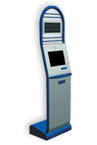
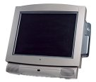
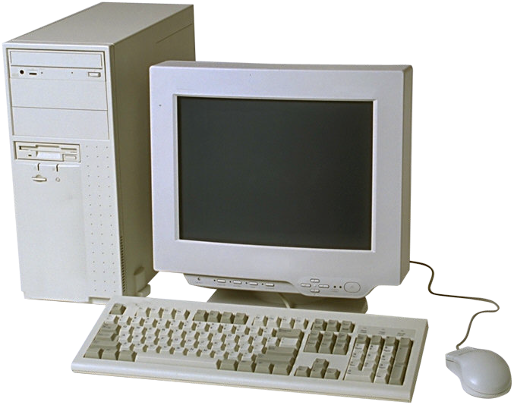
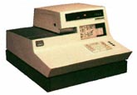
POS Market & Technology Trends
INTEL
EXTENDED
POS
P4P, IA-64
Web Services
4 Architectures
Non-Intelligent
Dedicated Use
Limited
Functionality
2002-3-4
Custom Mthbd
802.11
All-in-one des.
High Perform.
Integrated POS
Functionality
Mega-Data
Mining
Multimedia
Streaming Video
802.11a/g
Gbe
Dual mon.
Remote mgmt
1990’s
Grey Box PC
Limited POS
Functionality
Bulky
DOS based
1980’s
The Full Function
POS-to-Enterprise
Retail Future

Slide 9
What we’re here to do.
Take the lead in building the
POS-to-enterprise vehicle that
will win the industry.
Hand PwC the keys.

Slide 10
What we’re here to do.
Thesis:
Retail IT spending stable-growing in US and the EU
Aging installed base, move to PC-based and open systems,
  competitive demand for end-to-end functionality
POS – and extended POS – the prime Retail IT topic
IBM the prime end-to-end competition.
Response:
Create end-to-end, best-of-breed modular POS solutions.
Team with the best global sales channel and integrator.
Beat IBM in every phase: desktop to mobile to enterprise.
Today:
Agree that we’ll work together. And how.

Slide 11
Why We’re Doing This
Intel
Retail-CPG
Marketing
Intel:
Tilt the “Ecosystem” to sell IA.
Stack, Business Value for Marquee Reference Wins.
Sales-Integration-Service for Replication of ESPs.
Sell more Intel across all four architectures.
Beat IBM and AMD at POS and through the enterprise.

Slide 12
Why You’re Doing This
Intel
Retail-CPG
Marketing
PricewaterhouseCoopers:
Significant jobs. Billable hours.
Beat IBM WW.
Stack, Business Value for Marquee Wins.
Proven Stacks for Rapid Replication.
Billings: Consulting. Integration. Service.
Beat IBM at POS and through the enterprise.

Slide 13
Gives and Gets
Intel
Retail-CPG
Marketing
DEVELOPMENT ASSISTANCE
PARTNER COMMITMENT:
SALES & MARKETING
BI-ANNUAL PARTNER
TRAINING & REVIEW
ANNUAL-QUARTERLY
SALES-DEVELOPMENT METRICS
COMPETITIVE ADVANTAGE
POSITION VS. IBM
REGULAR STREAM NEW SOLUTIONS
CONSULTING-INTEGRATION-
SERVICES REVENUE
NEW REVENUE – CURRENT CLIENTS
NEW CLIENTS
PWC
FT RELATIONSHIPS
ENT. SOLUTION PLATFORMS
PILOTS WHEN-WHERE
MKTING COLLATERAL
EVENT MARKETING
PR/ADVERTISING
SOLUTION SERVICES
BDM TECHNICAL SUPPORT
WORLD-CLASS WORLDWIDE
SALES-REPLICATION CHANNEL
INDUSTRY LEADERSHIP
REGULAR CRITICISM-REVIEW
SOLUTION SVCS REVENUE
INTEL

Slide 14
Recommended Performance Metrics, Progress Indicators
TIMELINE | PWC | INTEL | PWC-INTEL
DEC | Decide | Confirm Key FTs | 12-31-01: LOI, Emphases
JAN | 1-2-02: Sales Development Plan 1-21-02: Training | 1-15-02: Mkting Overview Plan, initial training materals Key FT MOU’s inked | NRF: PR announcements, EmXP booth. Meet with Microsoft.
FEB | Begin development of $XM deal pipeline, filled by 6-30-02 | 4 Initial ESP’s thru DA by 2-28-023-31-02: X leads in pipeline, with Y forecast wins
MAR | Pilot Wins, M100 engagements. Checkpoint: $XM Revenue | ESP Marketing Plans, with full collateral, support By 3-15-02 SCS Support Pack in place | EOM March: 1st Quarterly Review. REZN8 pilot?
2nd QUARTER | M100 engagement. 6-30-02: $XM pipeline $XM revenue | Global Forum, RSS Complete REZN8, Heartbeat, B&N, Systech pilots | Global Retail Technology Foum, Paris Launch EMEA Retail Systems Show
EOY 2002 | $XM Pipeline $XM Deals End User Satisfaction | Add 1 Stack Per Qtr | Intel EID MSS from 25-33% Year-end Review

Slide 15
Intel Solution Marketing Strategy
Executive Summary/Project Description
Market Analysis/Opportunity (what problem are we solving)
Goals/Objectives (ROI, $, segment share)
Target Audience (industry segments, user preferences)
Positioning/Value Proposition (what makes us better/different)
Key Messages (no more than 3-5 compelling statements)
Marketing Strategy
  Product = Solution Offering
  Price Tag
  Channel Strategy (key partners, defined “lead” vs supporting actors)
  Promotions (Events, PR, Collateral, Ads, etc.)
Success Metrics – “measure what you treasure”
Timeline/Milestones
Budget – engineering, sales, marketing

Slide 16
Intel Solution Marketing Toolkit
Area | Tactic
Technical Marketing | Reference architecture diagram Solutions Blueprint, I.e. technical documentation
ESP Demand Creation Marketing | PR: joint press release & pilot announcements ESP white paper with “solution architects” ESP solution summary (2-pages) Pilot case study, I.e. results from Solution Center End-user case studies, I.e. Target, K-Mart, CVS Joint events + PWC participation at Intel events Web: Intel e-Business Center and webcasts – www.intel.com/go/retail with links to other co. sites Advertorials and advertising in business/trade press
Sales Support | Promote solution to field – “yours, ours and theirs” Training Collateral posted on internal web sites

Slide 17
TTX Description and Benefits
Features | Benefits
Low-Profile, Small Form Factor (9.6” x 7.5” x 1.5”) | Use in height constrained applications where ATX family is not appropriate
Option DC Power | Many smaller form factor applications need a small “laptop” style power supply
Low Profile Expansion (LPE) | “PCI like” expansion in a low-profile form factor
Backwards Compatibility with ATX Family | Leverage huge installed base of ATX-family enclosures

Slide 18
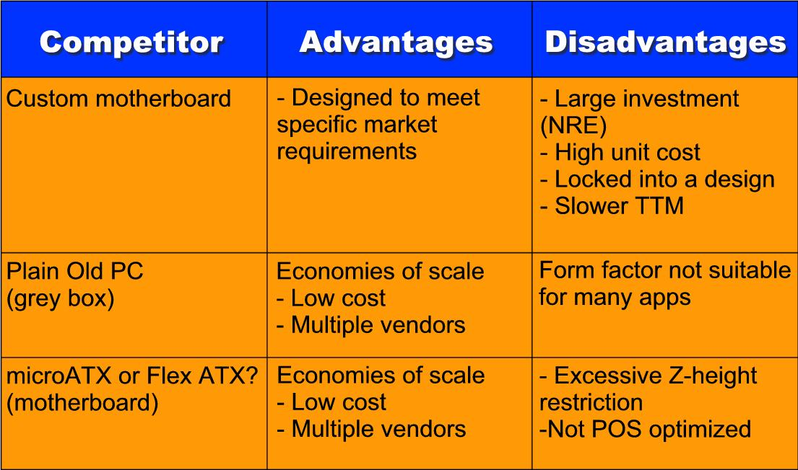
Key TTx Competitors

