Slide 1

Practical Workflows in an Accounting Firm
Eliminate. Automate. Delegate. A simple framework for changing the way your firm works — with a real example, start to finish.

Slide 2
WHAT WE'LL COVER
Your next 60 minutes.
01
02
03
04
Foundations
Our System
A Real Example
Your Turn
Eliminate, Automate, Delegate - the framework we use for every workflow:
Research, Build, Test - how we actually action a change, step by step.
BAS working paper reviews- what we tried, what failed, and what worked.
A 5-minute exercise to apply this to one workflow in your own firm.
INTRODUCTION
01

Slide 3
G'DAY
I'm Beau, from Growthwise.
We're an accounting and advisory firm based in Newcastle, Australia. I look after our internal systems and processes. My job is finding better ways for our team to work.
WANT TO SEE IT IN ACTION?
Today I'm talking through the thinking, not doing live demos.
For AI demos in full, check the chat for links to:
Three principles guide every workflow we touch:
• Our YouTube playlist
Eliminate
Automate
Delegate
• Recent LinkedIn videos (@beaugaudron)
• Skill template (Link Shared Later ;-) )
More on each of these shortly.
INTRODUCTION
02

Slide 4
BEFORE WE DIVE IN
Three workflows we've already changed.
01
02
03
Automated client communication
Review agents
Automated job status movements
Removing manual follow-ups and status chasing from our team's plate entirely.
A first-pass reviewer that flags what to check or tells a story about what's happening in a client's business. This is our deep-dive today.
Jobs move through Karbon based on criteria, not on someone remembering to drag a card.
GOING DEEPER TODAY
INTRODUCTION
03

Slide 5
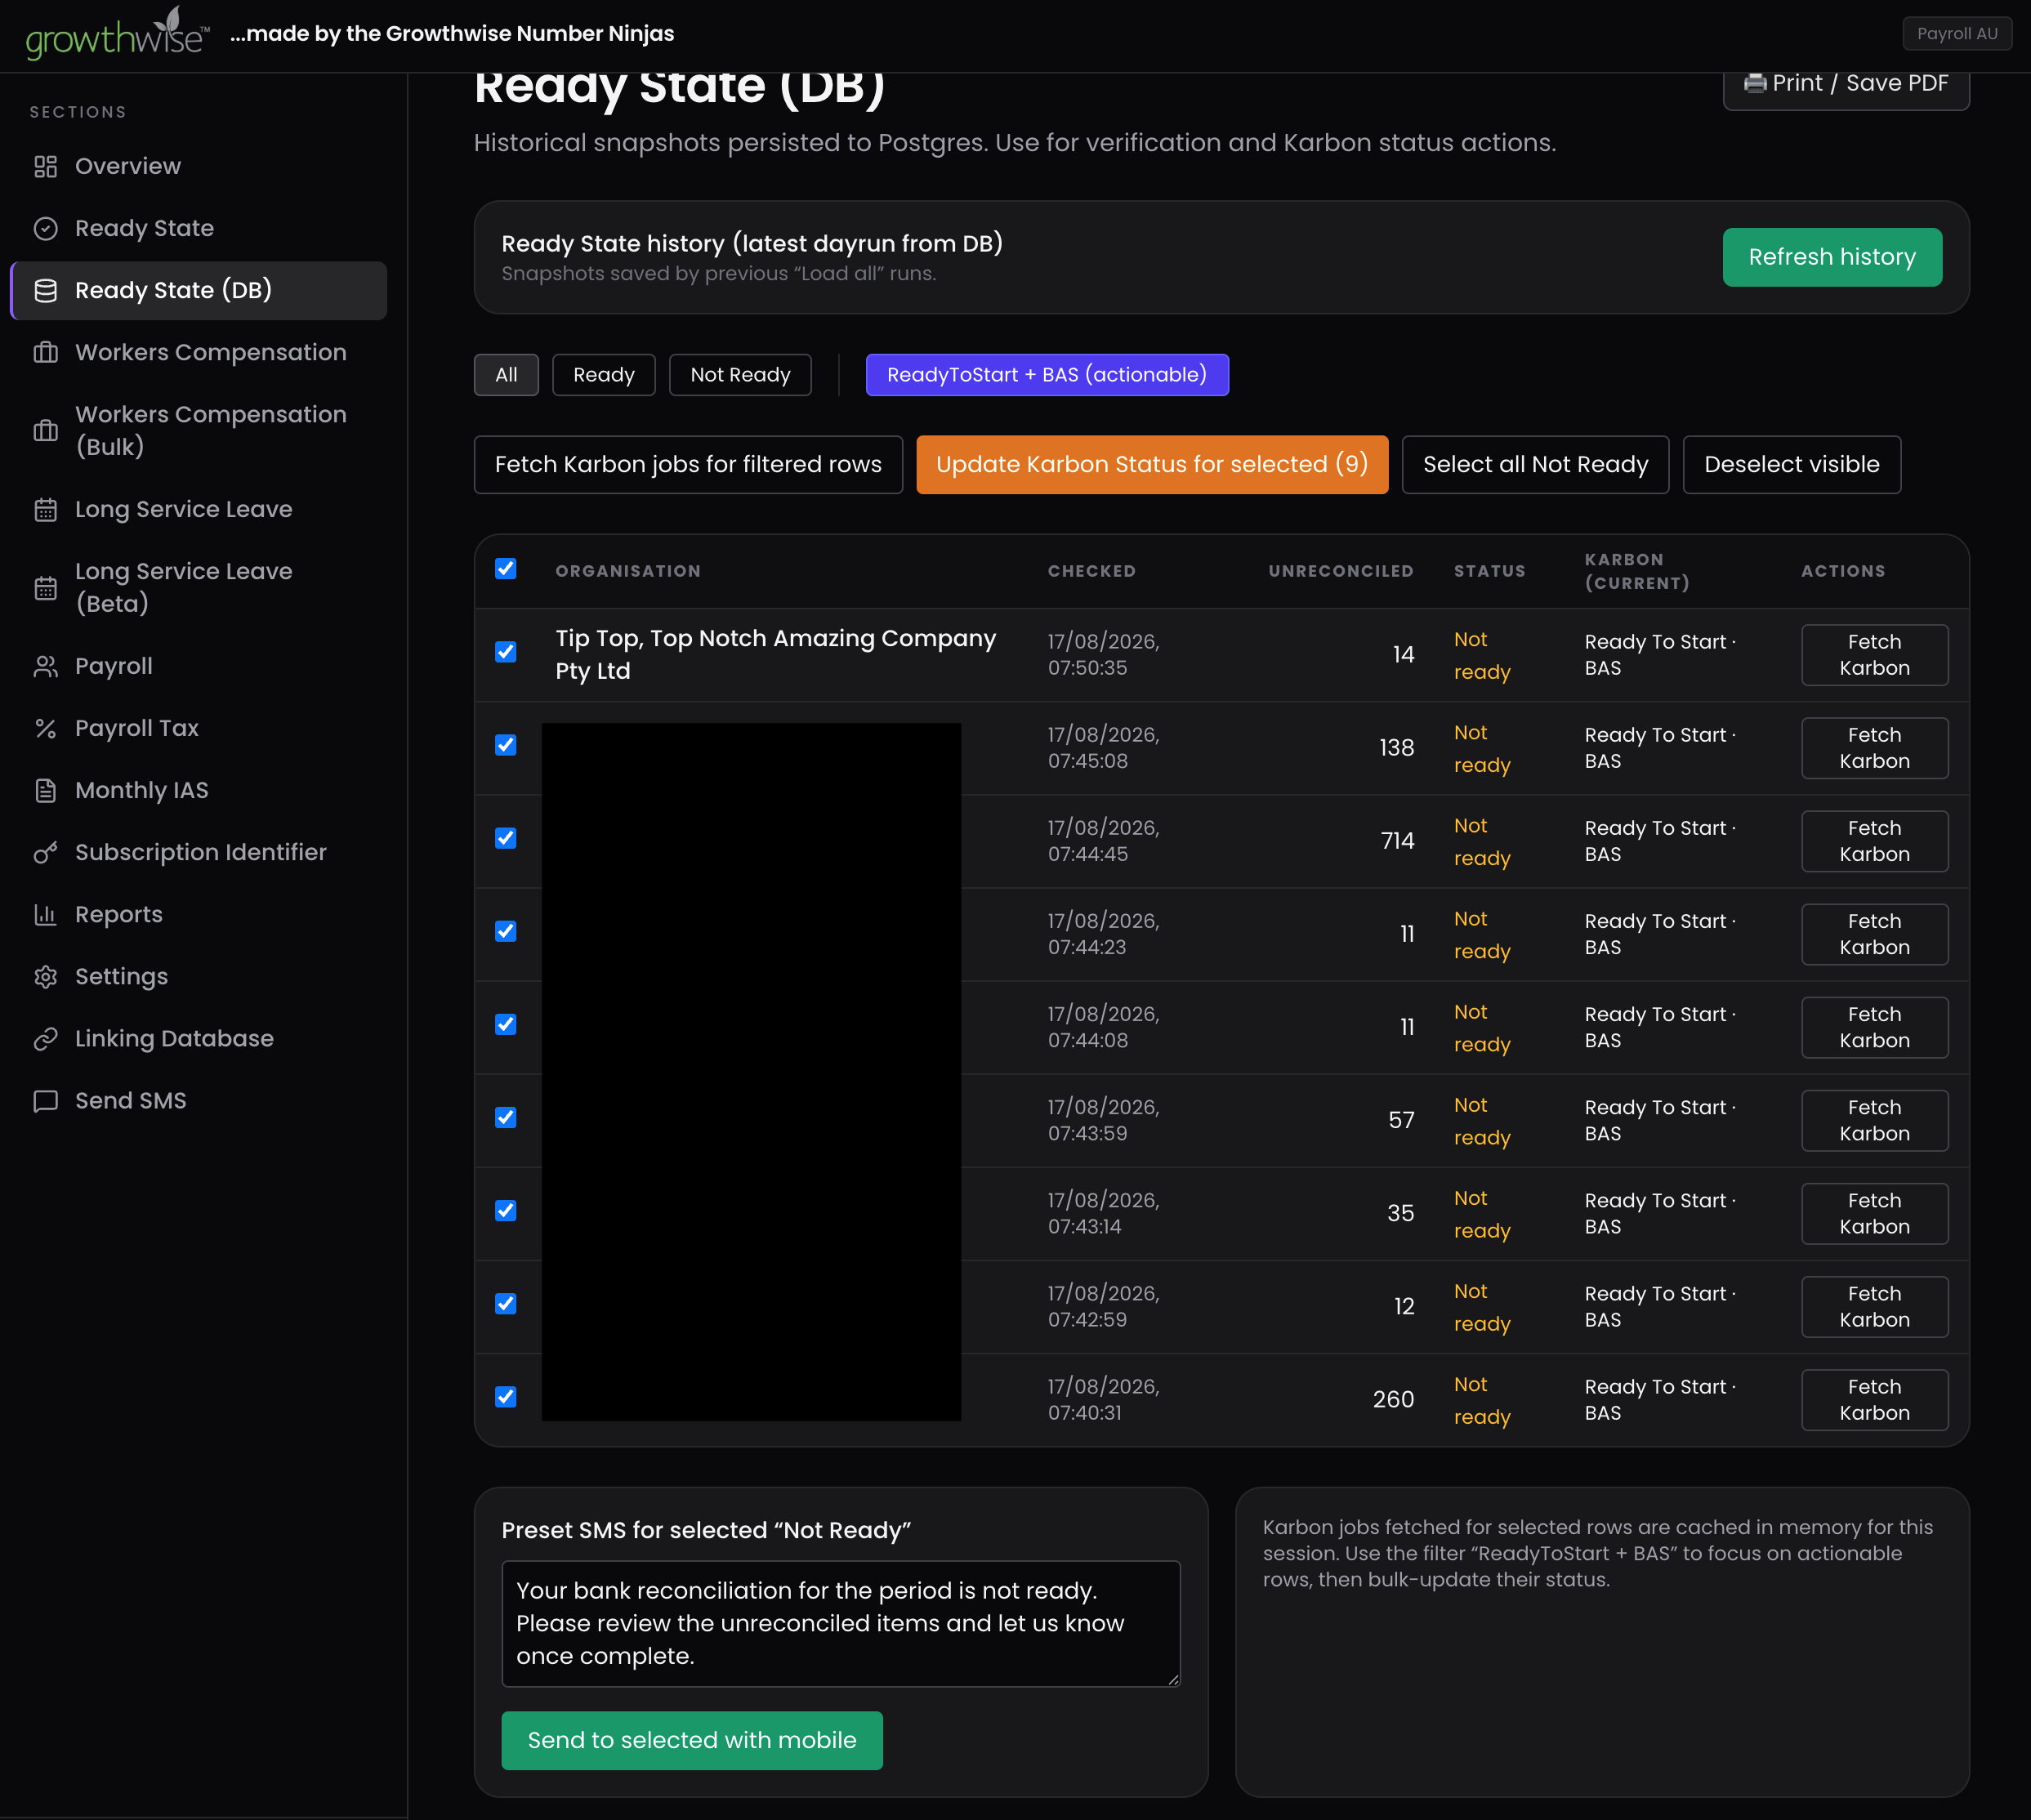
EXAMPLE ONE OF THREE
Automated client communication.
Pulls the ready state straight from Xero
Every client's reconciliation status, checked automatically — no one logging in client by client.
Drafts the chase-up message for you
Anyone marked “Not Ready” gets a preset SMS, ready to send in one click.
Removes the manual chasing entirely
The team isn't remembering who to follow up — the system already knows.
INTRODUCTION
04

Slide 6
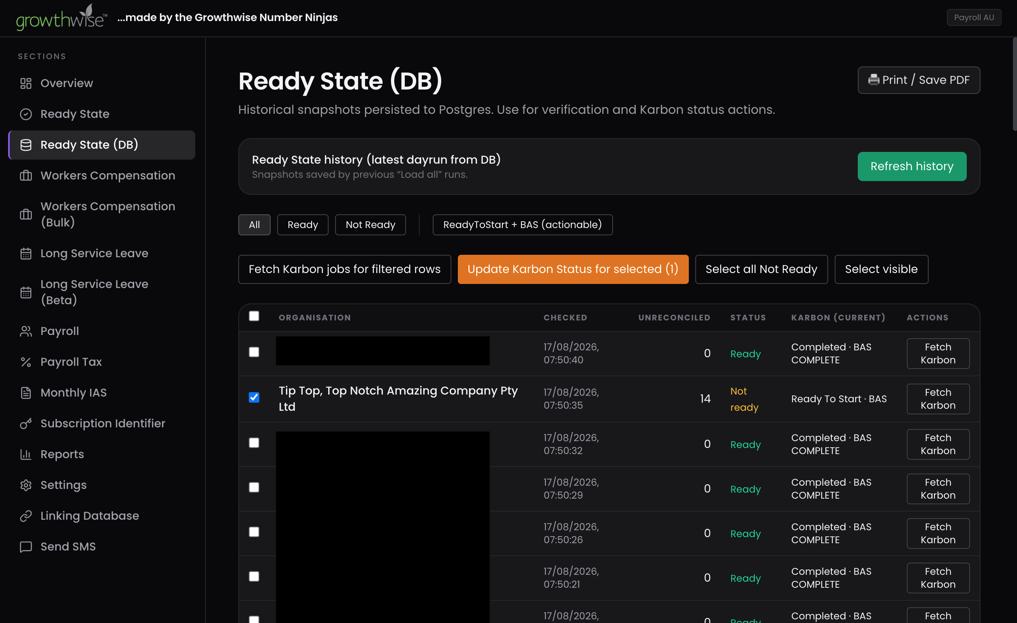
EXAMPLE THREE OF THREE
Automated job status movements.
Same tool, a second job
The reconciliation ready-state check also compares against each client's Karbon job.
Status moves itself when the numbers clear
Once a client is genuinely “Ready,” the matching Karbon job can be bulk-updated automatically.
No one dragging cards on faith
Jobs move because the data says they're ready — not because someone remembered to check.
INTRODUCTION
05

Slide 7
PART 01 OF 03
The framework: Eliminate, Automate, Delegate
The three questions we ask before touching any workflow.
06

Slide 8
STEP ONE
Eliminate.
Do we even need to do that at all?
The step everyone glosses over — but it's often the easiest win in the room.
Before you automate or delegate a task, ask whether the task itself is still earning its place. Plenty of recurring work exists purely out of habit.
TRY THIS
Think of something you have to go back & forth with clients on that you would love to eliminate.
EXAMPLES :
Content Snare for chasing documents Calendly for booking appointments
PART 01 · FRAMEWORK
07

Slide 9
STEP TWO
Automate.
Get the system to do it, with no input.
This isn't new — it's been around long before AI agents. But AI has made a lot more of it possible.
1
2
3
No decisions required
Runs without a person watching
Frees up judgement time
Rule-based, criteria-driven — the same input always gets the same output.
It should keep working whether someone remembers to check it or not.
Automating the repeatable work is what makes room for the advisory work.
PART 01 · FRAMEWORK
08

Slide 10
STEP THREE
Delegate.
Hand off what's left to a person, or a system.
Whatever can't be eliminated or easily automated still needs a home — a person, or a system you trust to own it.
DELEGATE TO A PERSON
DELEGATE TO A SYSTEM
Best when the work needs judgement, relationship context, or accountability that a system can't hold yet.
Best when the task is well-defined and repeatable — this is where AI agents increasingly fit, once Research and Build are done properly.
PART 01 · FRAMEWORK
09

Slide 11
PART 02 OF 03
Our system for success: Research, Build, Test
Things you can actually use on Monday morning — not just admire from the audience.
10

Slide 12
THE CORE LOOP
Five questions, three phases.
01
Identify the problem
Seems obvious — but naming it precisely is where most of the value hides.
02
Outline what works and what doesn't
Separate the parts worth keeping from the parts worth changing.
03
Work out what's needed to improve it
What has to change for the issue to actually go away?
04
Know your systems
How do your systems interact? What's already at your fingertips that you're not using?
05
Explain the change to your team
A change nobody understands is a change nobody follows.
PART 02 · OUR SYSTEM
11

Slide 13
RESEARCH
Know your systems before you touch anything.
We have amazing tools at our fingertips now — but the common mistake is not stopping to ask: don't I already have something that can do this?
What systems do we have?
Draw them out if you have to — most firms have never mapped this.
What are their capabilities?
Software moves fast. You may already own the fix, at no extra cost.
Is it already on a roadmap?
Sometimes the choice isn't build vs. buy — it's build vs. wait.
Has someone already solved this?
Don't reinvent the wheel — plenty of firms are sharing their builds.
PART 02 · OUR SYSTEM
12

Slide 14
BUILD & TEST
Building is the easy part. Testing finds what you missed.
BUILD
TEST
Now that you know your tools and your problem, map out how the solution will actually work.
Once it's built, you have to test it — and testing often sends you straight back to Build.
• Where might it fall down?
• Is there a way around that?
• Then — actually build it.
“What if you made an assumption you didn't catch, but your team did?”
“What if your AI agent told you it could do something it actually couldn't?”
PART 02 · OUR SYSTEM
13

Slide 15
PART 03 OF 03
RBT in action: reviewing BAS working papers
One real workflow, worked all the way through — including where it went wrong.
14

Slide 16
RESEARCH PHASE
What are we actually trying to fix?
Every BAS needs a stack of reports pulled together, checked for anything that stands out, and reconciled — before an accountant even starts preparation.
THE STARTING QUESTION
11
Could we use an agent to do a first-pass review of all this?
separate reports the team had to manually gather from Xero for every single BAS.
That question was the whole of our Research phase — and it started before we'd written a single prompt.
Manual gathering doesn't just cost time — it costs consistency, too.
PART 03 · EXAMPLE
15

Slide 17
A USEFUL DISTINCTION
Minimum Viable Solution vs. Moonshot.
During Research we think in both registers at once — it keeps ambition and momentum in the same room.
MVS
MOONSHOT
Minimum Viable Solution
The crazy, incredible version
The simplest possible change: can I make one part of this work better than it currently does? Small, achievable, ships this week.
What would it look like if this worked perfectly? Unlikely to land soon — but don't exclude it, because the payoff justifies keeping it on the list.
PART 03 · EXAMPLE
16

Slide 18
BUILD PHASE · STEP ONE
Turns out, we already owned the fix.
Xero has practice-level reports. Set up correctly in Xero Partnerhub under Practice → Client Report Templates, they're reusable across every client organisation.
BEFORE
AFTER
ONE CAVEAT
11
1
Payroll reports aren't included — that stays a separate step.
reports, gathered manually, one click at a time
report pack, built once, reused for every client
Even with that gap, this alone was worth doing.
PART 03 · EXAMPLE
17

Slide 19
BUILD PHASE · STEP TWO
Now — could an AI review it all?
ATTEMPT ONE
ATTEMPT TWO
Upload straight to Claude, ask a question.
Build a skill: what to look for, how to reconcile, what output we want.
You can probably guess what happened: the results were inconsistent.
Sounds like the fix. It wasn't quite.
THE CATCH WITH SKILLS
A skill only gets invoked the way the user happens to ask for it. “Tell me what's wrong with this” and “Find the anomalies in this report” can trigger it very differently — and lead to very different results.
PART 03 · EXAMPLE
18

Slide 20
BUILD PHASE · STEP THREE
Back to Eliminate: remove the prompt.
If a skill's weak point is how someone phrases the ask — eliminate the phrasing. We built a system where the team just uploads the Xero reports, no wording required.
01
02
03
04
Team uploads
Xero reports
→
System applies
the review logic
→
Structured output
returned every time
→
Accountant reviews
before preparation
No expectation that the team asks a certain way. If they have the reports, they send them off and get consistent results back.
PART 03 · EXAMPLE
19

Slide 21
TEST PHASE · WHAT'S NEXT
We're not done. Here's where it goes next.
The moonshots we're still working towards for this exact workflow:
1
2
3
Automated report extraction
Automated hand-off to the review agent
Automated preparation aspects
Removing the manual upload step entirely.
Reports flow straight from Xero into review, no human bridge.
Letting the agent's output feed directly into BAS preparation.
This is where coming back to the framework helps: RBT, and Eliminate, Automate, Delegate.
PART 03 · EXAMPLE
20

Slide 22
BEFORE WE WRAP
Your turn: 5 minutes, one workflow
Pick one recurring task in your firm. Which of Eliminate, Automate, or Delegate applies first? Talk it through with the table next to you.
21

Slide 23
KEY TAKEAWAYS
Two frameworks, worth screenshotting.
BEFORE YOU TOUCH A WORKFLOW
HOW WE ACTION A CHANGE
Eliminate
Research
Do we need this at all?
Know the problem and your own systems first.
Automate
Build
Can it run with no input?
Map the solution — MVS and moonshot together.
Delegate
Test
Who — or what system — owns what's left?
Expect to loop back to Build. That's the process working.
WRAP UP
22

Slide 24
TAKE THESE WITH YOU
Resources & links.
1
2
3
YouTube playlist
LinkedIn — @beaugaudron
Skill template (download)
github.com/growthwise/snare_summit
Full AI demos referenced throughout today's talk.
Recent videos and posts on the workflows we've shipped.
The reviewer skill template — try it on your own reports.
All links are in the event chat — no need to scan or type anything out.
WRAP UP
23

Slide 25
THANK YOU
Questions?
Beau Gaudron · Growthwise
LinkedIn: @beaugaudron · growthwise.com.au
24

