Slide 1

Mini project : Challenge Areal Team Sputnik
Members :
VERRIEZ CHASTANG Mathilde
DORDAIN Jean-Camille
HERBERA Mathis
ZENAIDI Lydia
DAHASSE Rayane
HUART Kevin
URL of challenge :
https://codalab.lri.fr/competitions/399
Repo GitHub of project :
https://github.com/grpSputnik/Sputnik

Slide 2

Introduction

Slide 3
Context and description of the problem
* 13 category
* 9100 satellite images
* Size : 128*128
* 700 images by class
* 2 parts : preprocess and row data

Slide 4
Motivations

Slide 5
Fast description of classes

Slide 6

Preprocessing
* Load and transform raw data into understandable data
* 9100 images raw
* Images of validation, training and tests
* Algorithm of feature selection
* RFE
* PCA

Slide 7
Feature selection (before)
0 | 0 | 1
0 | 1 | 1
0 | 0 | 0
0 | 1 | 1
1 | 1 | 0
0 | 1 | 1

Slide 8
Feature selection (after)
0 | 1
1 | 1
0 | 0
1 | 1
1 | 0
1 | 1

Slide 9
Prediction
* Naive Bayes or Gaussian Classifier
* SVM
* Decision Tree
* Random Forest
* Nearest Neighbors

Slide 10
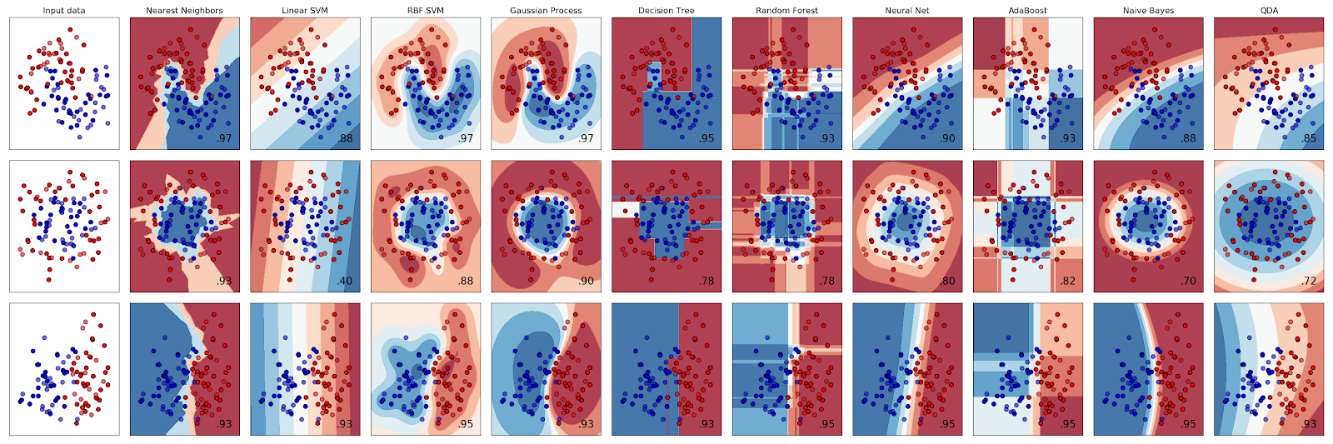
Prediction

Slide 11
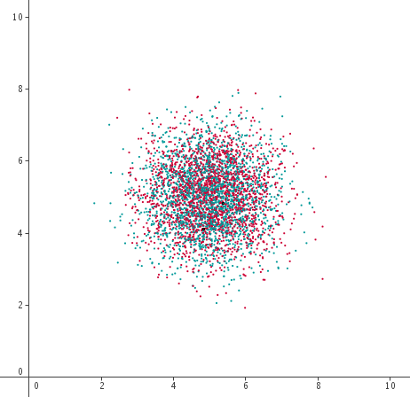
Visualization
Point cloud
Source : http://calque.pagesperso-orange.fr/logiciels/graphisme/nuage.html

Slide 12
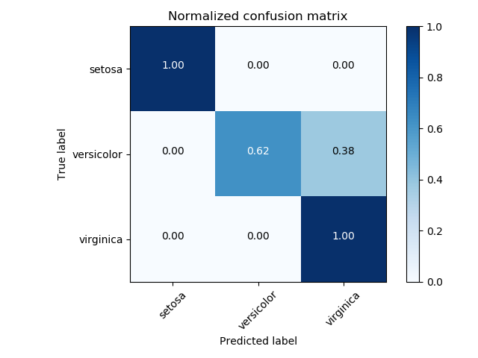
Vizualisation
Confusion matrix
Source : https://scikit-learn.org/stable/auto_examples/model_selection/plot_confusion_matrix.html

Slide 13
Statistics and preliminary results
Dataset | Num. Examples | Num.Variables/features | Has categorical variables ? | Has missing data ? | Num.Example in each class
Training | 5200 | 1024 | no | no | 400 per class
Validation | 1950 | 1024 | no | no | Unknown
Test | 1950 | 1024 | no | no | Unknown
Statistics of the data

Slide 14
Statistics and preliminary results
Method | NaiveBaiyes or Gaussian Classifier | SVM | Decision Tree | Random Forest | Nearest Neighbors
Training | 0,81 | 0,81 | 0,57 | 0,64 | 0,92
CV | 0,80 | 0,79 | 0,67 | 0,63 | 0,83
Validation | 0,80 | 0,80 | 0,56 | 0,65 | 0,85
Preliminary results

Slide 15
Discussion and conclusion

