Slide 1
Distributed Systems Clusters, Grids, Clouds, Future Internet
B534/B490 Spring 2011
Lecture 16
March 23, 2011
Judy Qiu
http://salsahpc.indiana.edu
School of Informatics and Computing
Indiana University

Slide 2
Issues: Distributed Systems
{Security & Fault Tolerance}
Information
Assurance
{Virtualization & Load-Balancing}
Discovery
Data
Distribution
Performance
{Scaling & Latencies}
Shrideep Pallickara

Slide 3
Ergo …
An infrastructure that insulates systems from the vagaries inherent in distributed settings will facilitate easier, richer and more complex application development.
Shrideep Pallickara

Slide 4
The NaradaBrokering Substrate
The NaradaBrokering Substrate
Shrideep Pallickara

Slide 5
Messages & Selectivity
Shrideep Pallickara

Slide 6
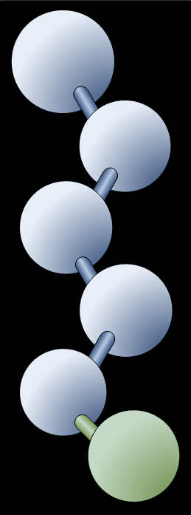
NaradaBrokering: Quick Summary
Data Distribution
Funding Sources
Two grants from the National Science Foundation
Two grants from the United Kingdom’s Open Middleware Infrastructure Institute
Website: http://www.naradabrokering.org/
Code base specifics
1425 classes
157 packages
300,000 lines of code
1000 annual downloads
Security
Fault Tolerance
Discovery
QoS
Web Services
Shrideep Pallickara

Slide 7
Reliable Delivery: Desiderata
Cope with node/link failures & unpredictable links
Links may duplicate, garble and lose messages
Many-to-Many reliable delivery across sessions
Support recovery from failures or disconnects
Support replays
Transport-independent
Support exactly-once delivery
Order, duplicate detection

Slide 8
Reliable delivery: Salient Features
Reliable delivery ONLY for authorized entities
Coexists with entities not interested in reliable delivery
Storage, is not communal, and should be provisioned by the topic owner.
Control Messages are issued over different topics.
Discovery constraints can be imposed e.g. Restrict replays
Different QoS can be associated with control topics.
Require signed acknowledgements (Non-repudiation)
Buffering & Jitter reduction services for replayed messages.
Streams replayed at say 24 fps instead of 500 fps
Easy to track usage patterns
Track client loss rates, NAKs, disconnects & recoveries
Lends itself naturally for greater redundancy
Notes:
How you can profile different entities

Slide 9
Reliable Delivery
One Repository associated with a reliable topic
A Repository can manage multiple reliable topics

Slide 10
Reliable Delivery
P2R-Order
R2S*-Persistent
S2R-ACK
R2P-NAK
R2S-Rectify
P2R-Retransmit
S2R-NAK
R2P-ACK
R2S-Retransmit
R2S-Sync
Regular Exchange
Error Detection
Error Correction

Slide 11
Repository Bundle: Publisher
P2R-Order
Repository
P2R-Retransmit
P2R-Order
P2R-Order
R2P-ACK
Publisher
R2P-ACK
R2P-NAK
R2P-NAK
Repository
P2R-Retransmit
P2R-Retransmit
P2R-Order
Repository
P2R-Retransmit

Slide 12
Repository Bundle: Subscriber
S2R-ACK
Repository
R2S*-Persistent
S2R-ACK
R2S*-Persistent
S2R-ACK
R2S-Rectify
S2R-NAK
Subscriber
R2S-Rectify
Repository
S2R-NAK
R2S-Retransmit
R2S-Retransmit
R2S-Sync
R2S-Sync
S2R-ACK
Repository

Slide 16
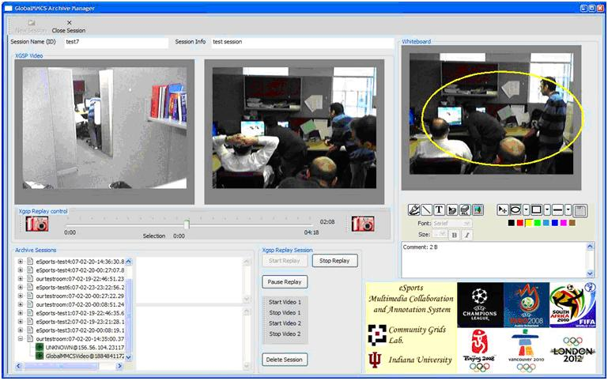
eSports

Slide 17
Some Other Performance
Broker Discovery (WAN) ~500 ms
5000 messages/sec
Concurrent clients
400 video
1200 audio

Slide 18
Project #3: Resource Monitoring System
MVC with pub/sub messaging middleware

Slide 19
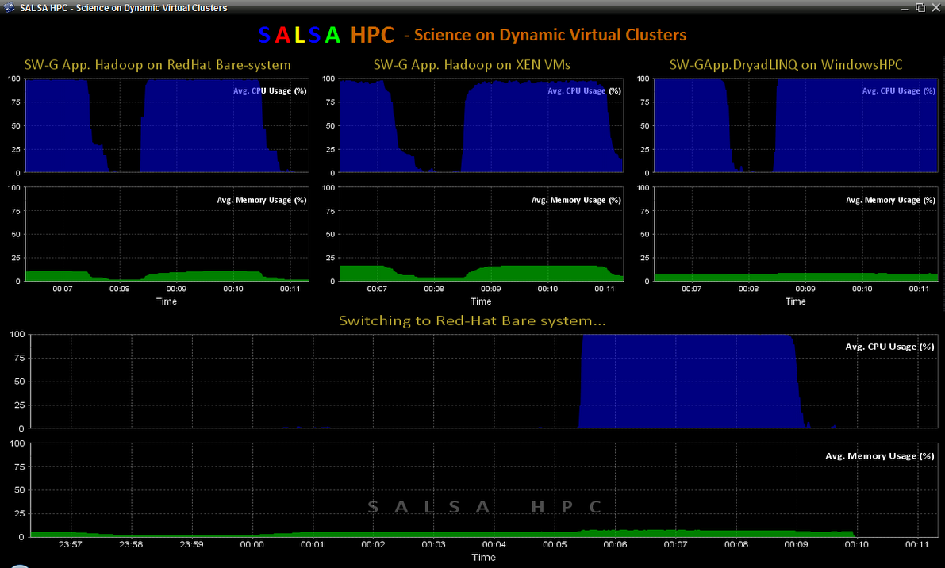

Slide 20
SMMV vs. MMMV as MVC interactive patterns
Model 1
Model 2
Model m-1
Model m
Model
NaradaBroker
View 1
View 2
View n-1
View n
View 1
View 2
View n-1
View n
a) Single Model Multiple View
b) Multiple Model Multiple View
SIMD– A single control unit dispatches instructions to each processing unit.
MIMD– Each processor is capable of executing a different program independent of the other processors. It enables asynchronous processing.
SMMV generalizes the concept of SIMD
MMMV generalizes the concept of MIMD
In practice, SMMV and MMMV patterns can be applied in both asynchronous and synchronous applications, thus form general collaboration paradigms.

Slide 21
Three MVC approaches based on different communication mechanism
and interactive pattern between model and view
Broker
Pub/Sub
View
Control
Model
View
Messages
Model
View
Model
a) classic
(method-based)
b) request/response
(method-based or message-based)
c) publish/subscribe
(message-based)

Slide 22
Monitoring
Message Broker (eg: Narada Brokering)
Resource Utilization (Eg: CPU, Memory)
Application Status
Coordination & Monitoring
Monitoring Daemon
Application
Summarizing & displaying monitoring information
Resource Monitoring Library *
Monitoring Application Progress
Coordinating the provisioning of Clusters based on monitoring info
FutureGrid Interface
Hypervisor (in VM Environment)
Desktop / Laptop
Provisioned Nodes
* Eg: http://www.hyperic.com/products/sigar

Slide 23
Distributed System and Cloud Computing
Monitoring GUI
Kaufmann Publisher 2011
StatClient
GraphUpdater
GenericGraph
Monitor

Slide 24
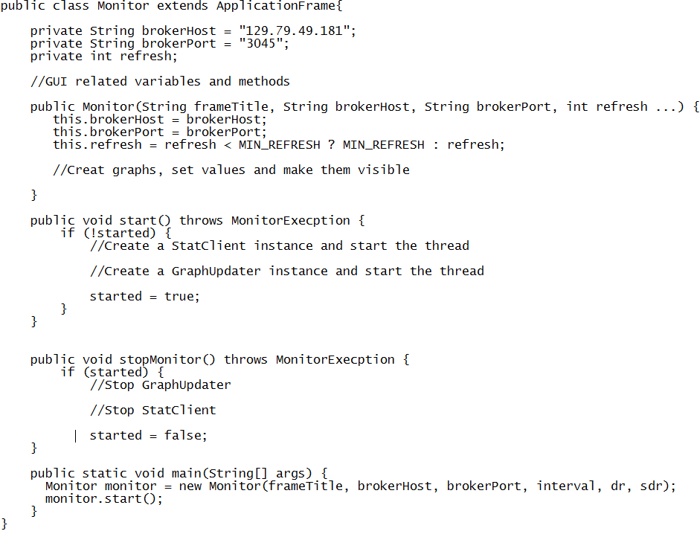
//Pseudo code

Slide 25
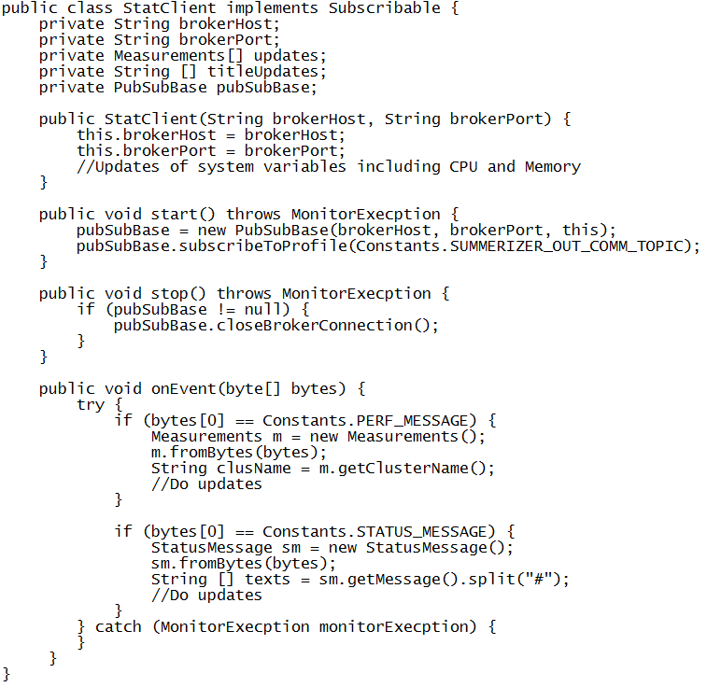
//Main class to set up connection with NaradaBroker server
//To receive messages from NaradaBroker and process them

Slide 26
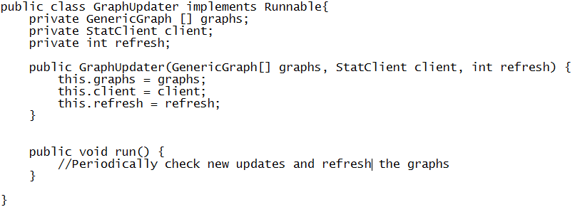

GraphUpdater
// Updating graphs based on new performance values
GUI Design

Slide 27
Performance Daemon
PubSubBase
MonitorDaemon
ServiceListener
MonitorWorker

Slide 28
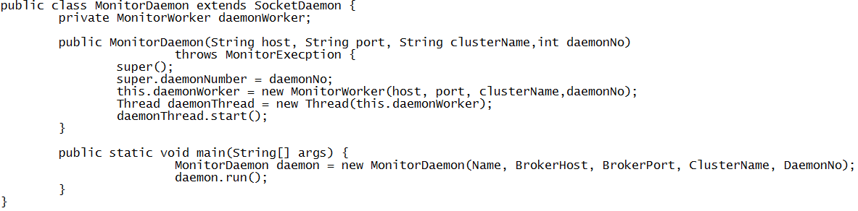
Monitor Daemon
//Each daemon runs on a cluster node

Slide 29
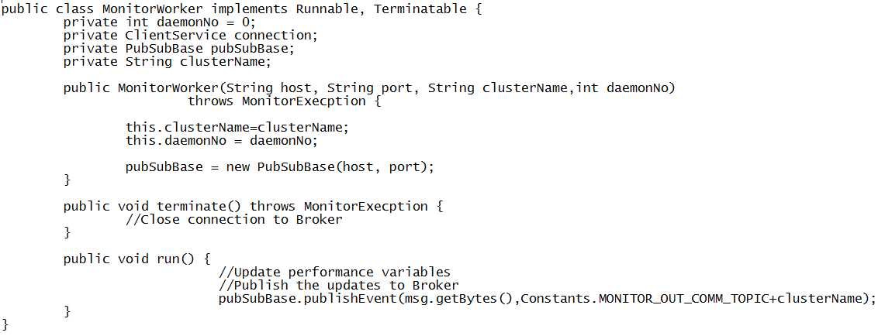
Monitor Worker
//Each MonitorWorker monitors performance and publish
// events to Broker

Slide 30
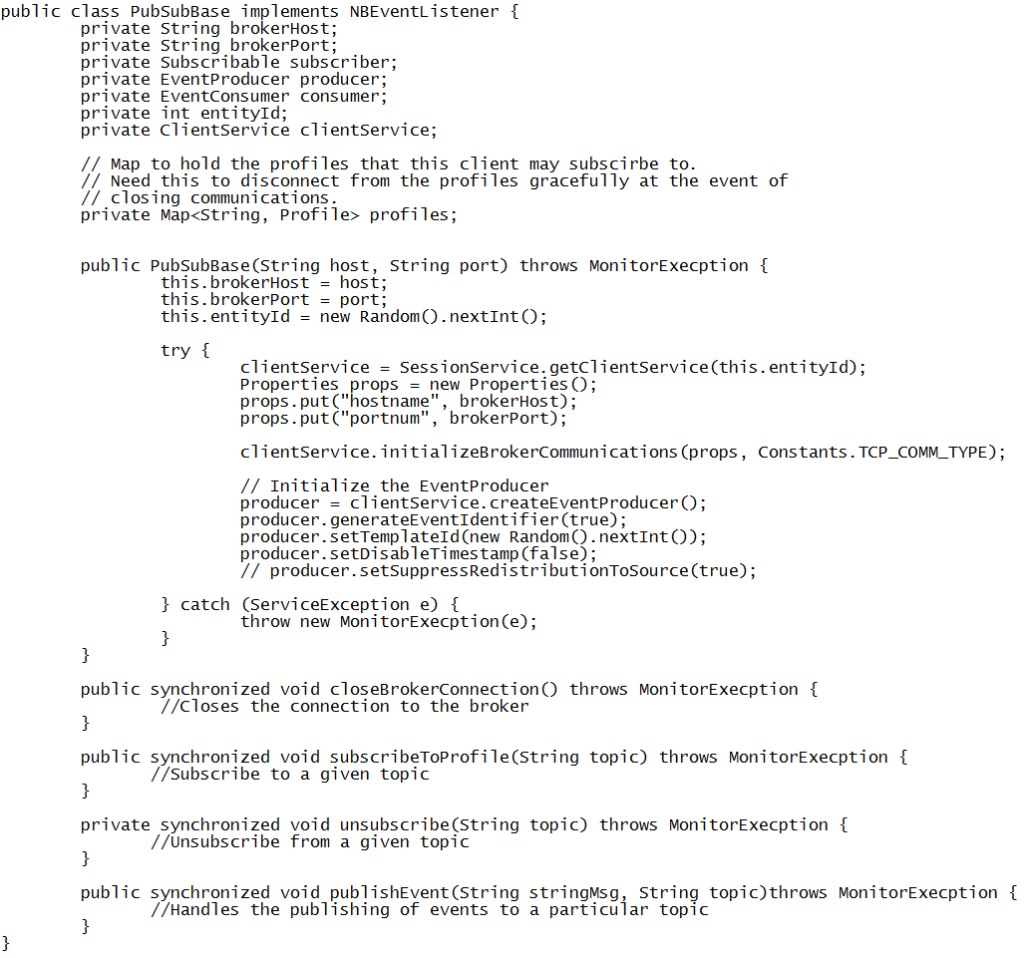
//Main class to set up connection with NaradaBroker server

Slide 31
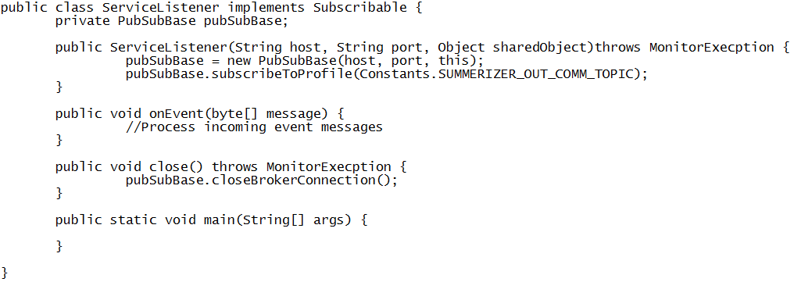
A Simplified Example
//An example to show how to subscribe to NaradaBroker server
// and receive messages under a topic from the broker

Slide 32
A list of topics
Visit to IU Data Center : Time and Place to meet
Diversity Week Activities : Intercultural impact in collaboration
A Discussion session of Survey Papers: State of the art technologies in Distributed Systems
A Guest Talk: Making a Case for Distributed File Systems at Exascales
Raj Jain, The Art of Computer Systems Performance Analysis: Techniques for Experimental Design, Measurement, Simulation, and Modeling, Wiley- Interscience, New York, NY, April 1991, ISBN:0471503361

