Slide 1
Video Steganography
Aaron Gubrud
Jose Trigueros
April 16th, 2012
CSE509

Slide 2
Introduction
Steganography
The art and science of writing hidden messages such that only the sender and receiver know of its existence
Security through obscurity
Uses secrecy of design or implementation to provide security
Terms used throughout the presentation
Carrier: Medium through which the hidden message is embedded
e.g. Servant transporting message
Seed: The message which will be hidden within the carrier
e.g. Message tattooed on his/her head
Common Intermediate Format (CIF) – 352 pixels × 288 pixels
Quarter Common Intermediate Format (QCIF) – 176 pixels × 144 pixels

Slide 3
Introduction
Steganography in imaging
It is possible to hide messages or even entire separate images within a carrier image
LSB method
Store a message in the least significant bit of each pixel
Pros: Simple, intuitive
Cons: Easier to detect tampering in the carrier image
Blocking method
Break image into blocks, take DCT, store message into LSB of DCT coefficients
Pros: More difficult to detect as it is not applied in spatial domain
Cons: More complex to design
If this is possible in imaging it is possible in video

Slide 4
Overview
Related Work
Approach
Preliminary Results and Discussion
Remaining Work

Slide 5
Related Work
Primary paper used as guidance:
Bit Length Replacement Steganography Based on DCT, K B Shiva Kumar et al.
A bit confusing as it lacked information regarding specific way of encoding/decoding
No pun intended
Image Steganography Websites:
Zero Hiding: Bit manipulation
YUV Sequences and CIF/QCIF Standards:
YUV Sequences
CIF and QCIF Standards

Slide 6

Approach 1: Algorithm
Split Y channel of carrier image into blocks of 8 pixels × 8 pixels
Perform 2D DCT on each carrier block
Gives 8×8 matrix of coefficients
Bottom right half is less important to image structure and quality
Split Y channel of seed image into blocks of 8 pixels × 8 pixels
For each pixel value, currpix, find two values:
floor =$\left\lfloor \frac{currpix}{16}\right\rfloor$
remainder = $currpix−\left(floor\text{×}16\right)$
Gives $2\text{×}QCIF_{width}\text{×}QCIF_{height}=2\text{×}176\text{×}144=50,688 values to be stored$

Slide 7

Approach 1: Algorithm
Store the previously defined set of values into the carrier image
50,688 spaces in the carrier image are needed
Ratio of carrier image resolution to seed image resolution is 4:1
Each block in the carrier image can hold a quarter of a block in the seed image
Use bottom right half of each carrier image DCT coefficient matrix
Gives 32 hiding places per block
Can hide $\frac{1}{4}$ of each block of the seed image = $\frac{64}{4}=16 pixels ∗2\frac{values}{pixel}=32 values$
$32\text{×}\left(\frac{352}{8}\right)\text{×}\left(\frac{288}{8}\right)=50,688$ places in carrier to store seed information

Slide 8
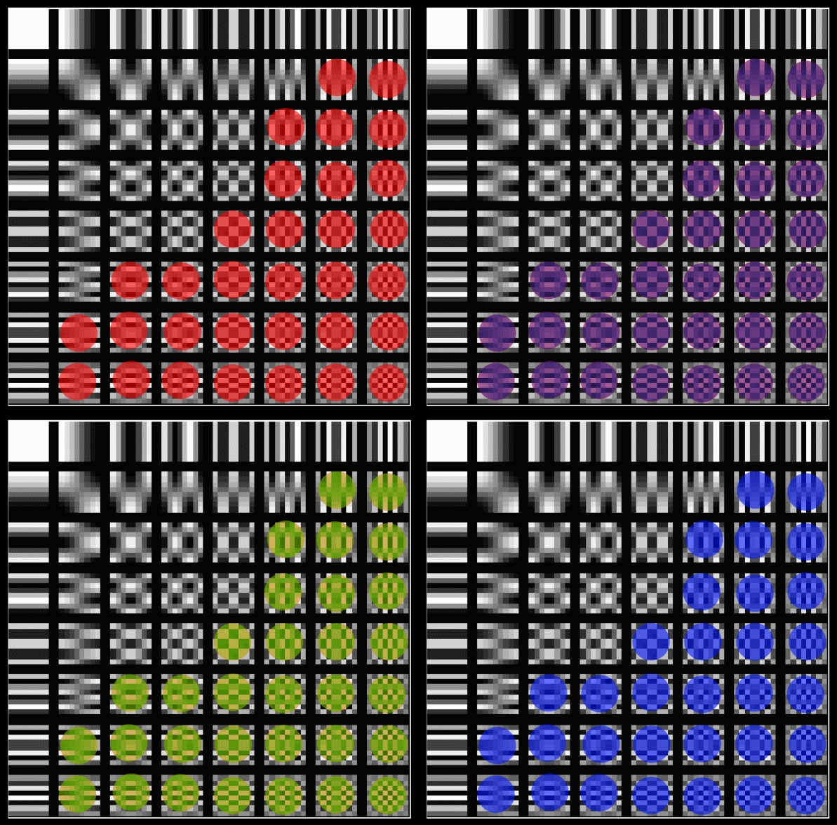
Approach 1:

Slide 9
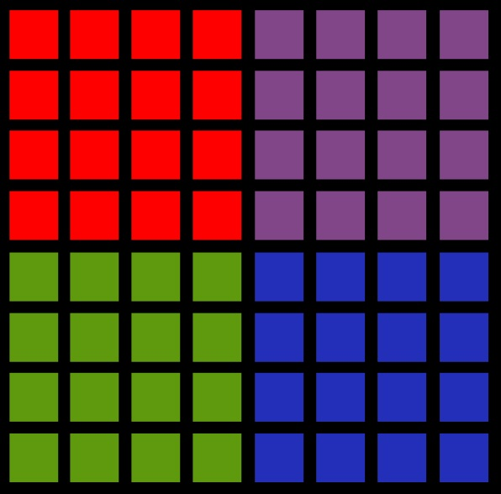
Approach 1:

Slide 10
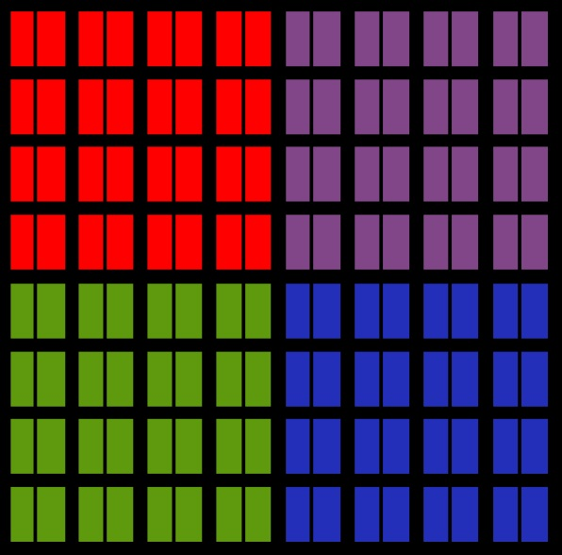
Approach 1:

Slide 11
Approach 2: Embedding
Apply 2D DCT to entire Y channel of the host frame.
This breaks the frame into frequency components.
Specify the number of LSB/MSB bits to use for embedding.
Create random bit mask for later use, or custom bit mask can be specified.
This bit mask will be the same size as a CIF frame.
Iterate through the bit mask, and store an MSB/LSB value in an alternating pattern in the carrier frame if the bit is on.
Apply IDCT and save the YUV channels and results in the embedded carrier.

Slide 12
Approach 2: Embedding

Slide 13
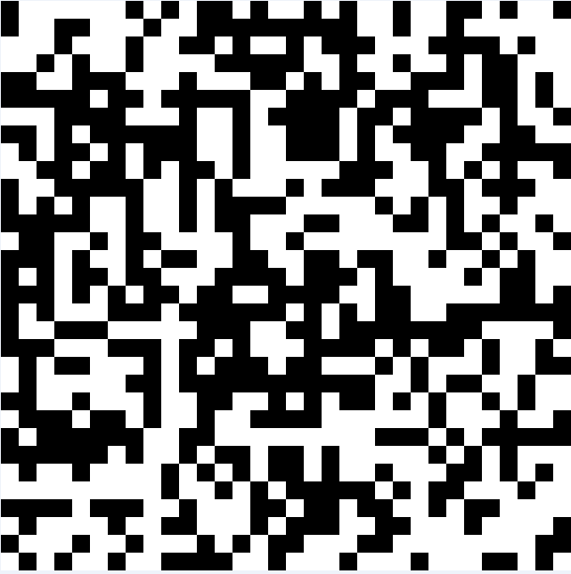
Approach 2: Bit Mask

Slide 14
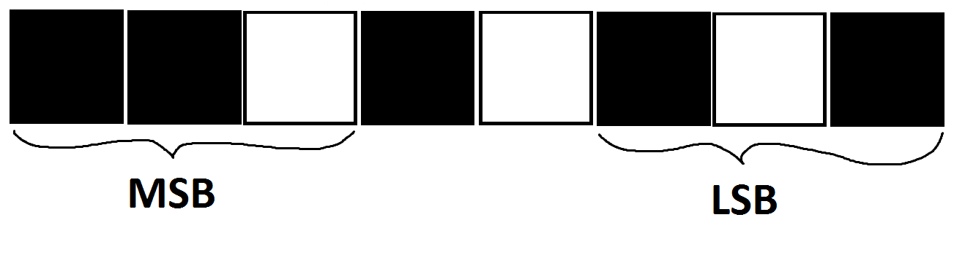
Approach 2: Selection

Slide 15
Approach 2: Retrieval
Same initial process as the embedding section.
Iterate through the Y channel of the carrier frame and extract the last n-bits from the current value.
Every pair that is extracted is joined to form an 8-bit pixel, which will be used to form the seed frame.
Once every pixel is reconstructed a frame has been extracted and can be saved.

Slide 16
Approach 2: Retrieval

Slide 17
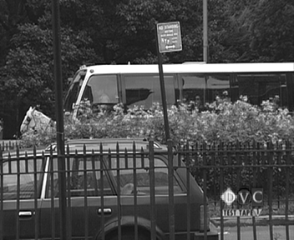

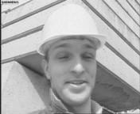
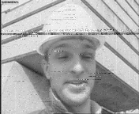
Preliminary Results and Discussion Approach i
Host
Carrier
PSNR: 34.47 dB
SSIM: .8443
Seed
Extracted Seed
PSNR: 34.65 dB
SSIM: .7751

Slide 18

Preliminary Results and Discussion Approach i

Slide 19
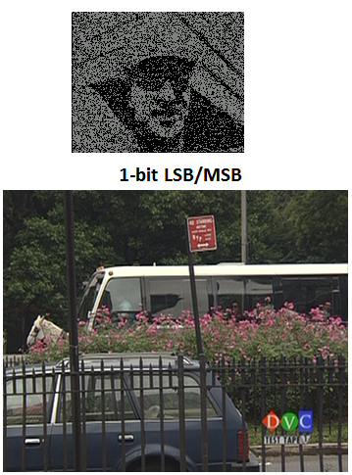
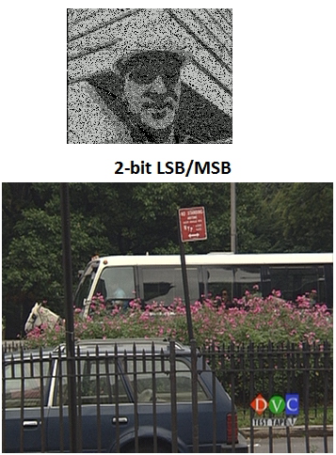
Preliminary Results and Discussion Approach II
SSIM: 0.0576
PSNR: +24.55 dB
SSIM: 0.1563
PSNR: +24.98 dB
SSIM: 0.9987
PSNR: +55.94 dB
SSIM: 0.9938
PSNR: +49.49 dB

Slide 20
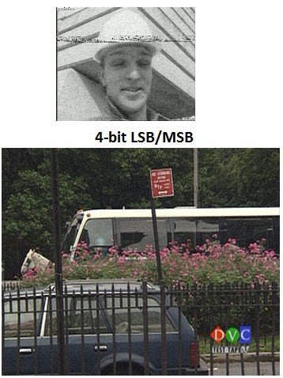
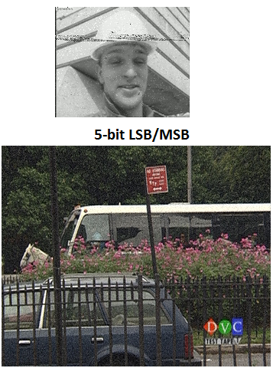
Preliminary Results and Discussion Approach II
SSIM: 0.6631
PSNR: +30.10 dB
SSIM: 0.7557
PSNR: +35.93 dB
SSIM: 0.9048
PSNR: +36.64 dB
SSIM: 0.7460
PSNR: +31.51 dB

Slide 21
Remaining Work
Refactor and Clean-up MATLAB Code
Consistent variable names and proper comments
Create functions of re-usable components
Try different combinations of carrier and seed sequences and observe effects on the carrier and extracted seed
Compile report
If time allows, encode one seed frame across many carrier frames for better output quality

Slide 22
Concluding Statement
Ambitious initial requirements
Quality of either the carrier or the extracted seed must be sacrificed.
Space constraints
There are only so many bits that can be hijacked before it becomes obvious that the image has been tampered with.
Transformation side effects
Unexpected results caused by rounding errors during conversion from the frequency domain to the spatial domain and vice versa.
QCIF and CIF
A fixed ratio between the carrier and seed resolutions made this project easier to conceptualize.
Embedding in U and V channels
Our chroma subsampling of choice (4:2:0) made this impossible because data was lost when converting back and forth between YUV and RGB.

Slide 23
References
http://www.mathworks.com/matlabcentral/fileexchange/6318-convert-yuv-cif-420-video-file-to-image-files
YUV sequence reading and writing in MATLAB by Da Yu
http://www.mathworks.com/matlabcentral/fileexchange/135-psnr/content/PSNR.m
PSNR implementation in MATLAB by John T. McCarthy
http://www.cns.nyu.edu/~lcv/ssim/
SSIM implementation in MATLAB by Zhou Wang

