Slide 1
Data Science Framework Report
CreditOne New Credit Limit Model
-Josh Martin

Slide 2
Goals
Reliably predict if a customer is at risk of defaulting of a loan before the customer is offered credit
In addition, if a customer is not a default risk, then reliably predict how much credit to offer that customer

Slide 3
Data Science Framework
We will use a goal-oriented data science framework (as presented in Zumel and Mount, Practical Data Science with R)
Main advantage of this framework:
The business goal – accurately predicting credit limits – drives every step of the process
Other advantages
Building, testing, and deploying a successful model are built in to the procedure

Slide 4
Data Management and Security
Data will be retrieved from CreditOne’s MySQL database
Data will be kept on a single secure machine and shared with no one without direct consent from CreditOne
Data will be permanently removed when project is completed

Slide 5
Data Complications
Extra headers embedded in the data
Categorical variables need to be assigned numerical representations

Slide 6
Data Science Framework - Explained
Goal
Collect Data
Model
Evaluate Model
Present Results
Use Model
Reliably predict a new customer’s credit limit
Securely connect to and retrieve historic data from CreditOne’s database
Explore the data through visualizations and descriptive statistics to find pattern
Data may have anomalies - clean as necessary
Based on results, decide of classification and regression models to use
Train and test models to find accurate prediction rubrics
Create technical report explaining accuracy and intricacies of mode
Explore more possible models if necessary
Employ model to create a new business rule for assigning credit
Hand off model for production and monitor model by CreditOne
Executive summary and big picture take-aways to be presented to relevant stakeholders

Slide 7
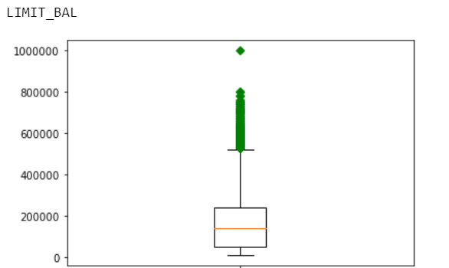
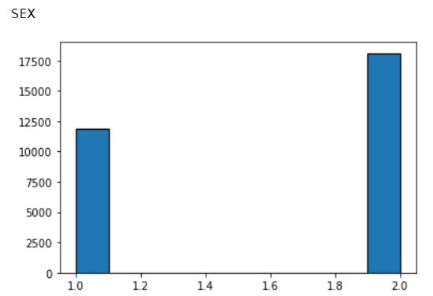
Preliminary Insights
Much of the debt incurred by customers can be attributed to outliers
There are several inequities in the demographics (almost 50% more females than males, for example), perhaps making patterns easier to find.
1=male,
2=female

