Slide 1
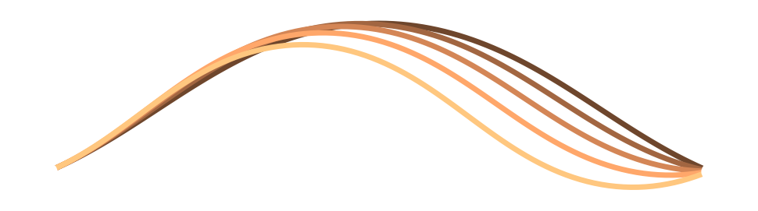
Mapping the clamped elastica across its snap surface
Continuation with buckling-mode branch tracking in FEniCSx / PETSc
Notes:
Today: how we map every stable equilibrium of a clamped rod as we change its end distance and its two clamp angles.
The hard part is the snap: at some settings the rod jumps to a different shape, and the solver has to notice.
Plan: the math, the snap surface, how the continuation handles it, and the full production map.

Slide 2
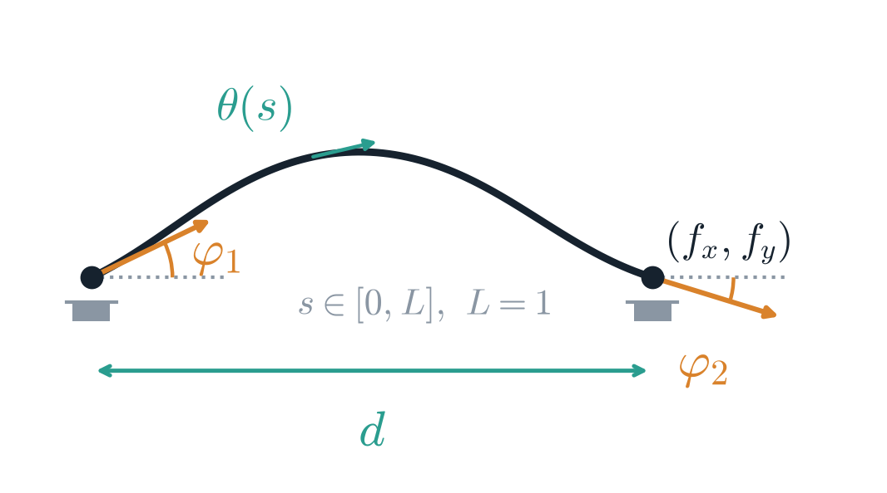
One rod, three parameters, a map of equilibria
d
End-to-end distance (L = 1)
0.70 – 0.99; Δd = 0.01
φ₁
Clamp angle at s = 0
−π/2 to π/2; Δφ = π/314 ≈ 0.01
φ₂
Clamp angle at s = L
For every point (d, φ₁, φ₂) solve for the tangent angle θ(s) and the end forces f_{x}, f_{y}; record both clamp moments and the bending energy U.
Same range as φ₁; grid 30 × 315 × 315
Notes:
A thin rod of unit length, clamped at both ends; EI = 1.
Three controls: the clamp distance d and the two clamp angles φ₁ and φ₂.
At every grid point we solve for the shape and the end forces, then record the clamp moments and the bending energy.
The production grid has 30 d layers of 315 × 315 angle pairs: just under three million equilibria.

Slide 3
Equilibria are stationary points of the bending energy
Bending energy
$$Π\left[θ\right]=\frac{1}{2}\int_{0}^{L}{θ}′{\left(s\right)}^{2} ds$$
Inextensible Euler–Bernoulli rod, EI = 1
Constraints
$$\int_{0}^{L}{\cos{θ}} ds=d, \int_{0}^{L}{\sin{θ}} ds=0, θ\left(0\right)=φ_{1}, θ\left(L\right)=φ_{2}$$
End position fixed, both ends clamped
Lagrangian
$$ℒ\left[θ,f_{x},f_{y}\right]=\frac{1}{2}\int_{0}^{L}{θ}′^{2} ds+f_{x}\left(\int_{0}^{L}{\cos{θ}} ds−d\right)+f_{y}\int_{0}^{L}{\sin{θ}} ds$$
f_{x}, f_{y} enforce the two end-position integrals
f_{x} and f_{y} are the Lagrange multipliers of the end-position constraints — physically, the reaction forces at the right clamp. The study maps every stable stationary point of ℒ the continuation reaches over the (d, φ₁, φ₂) box.
Notes:
The rod settles where its bending energy is stationary, with its ends held where we put them.
θ along the arc keeps the length fixed automatically.
The end position enters through two Lagrange multipliers, fx and fy: the reaction forces at the clamp.
Only stable stationary points are kept; the stability test comes later.

Slide 4

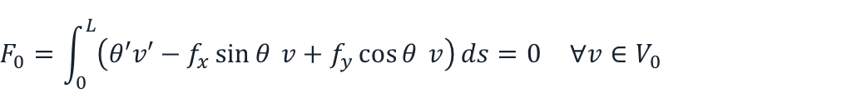
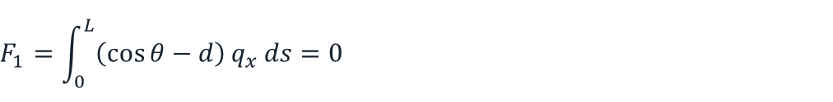
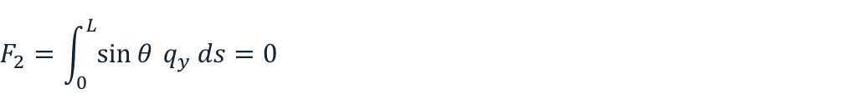
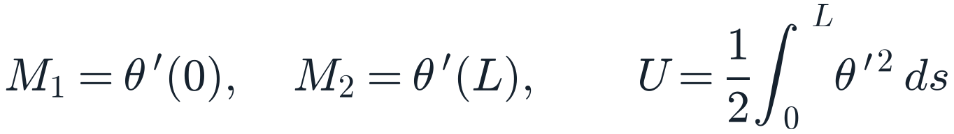
Stationarity gives the elastica equation and a mixed weak form
Euler–Lagrange equation
Residuals assembled by FEniCSx (solver.py)
$$θ′′+f_{x}\sin{θ}−f_{y}\cos{θ}=0$$
$$F_{0}=\int_{0}^{L}{\left(θ′v′−f_{x}\sin{θ} v+f_{y}\cos{θ} v\right)}ds=0 ∀v∈V_{0}$$
θ(0) = φ₁, θ(L) = φ₂
$$F_{1}=\int_{0}^{L}{\left(\cos{θ}−d\right)}q_{x} ds=0$$
1
θ ∈ P1 Lagrange on 200 elements, graded towards both clamps
f_{x}, f_{y} ∈ “Real” space: one global DOF each
$$F_{2}=\int_{0}^{L}{\sin{θ}} q_{y} ds=0$$
2
3
Clamp angles imposed as Dirichlet BCs on θ
$$M_{1}=θ^{′}(0), M_{2}=θ^{′}(L), U=\frac{1}{2}\int_{0}^{L}{θ^{′}}​^{2} ds$$
Post-processed per point
Moments: end-element slope plus a half-element Taylor correction (second order)
Notes:
Setting the variation of the Lagrangian to zero gives the classic elastica equation.
In FEniCSx we solve the weak form: θ on 200 linear elements, refined towards the clamps, plus one global unknown each for fx and fy.
The grading matters near d = 1 with large clamp angles: the tension is huge and the rod turns inside thin boundary layers at the clamps.
Per point we store both clamp moments and the bending energy.

Slide 5

Each parameter point is one Newton solve on 203 unknowns
$$J\left(u^{k}\right) δu=−F\left(u^{k}\right), u^{k+1}=u^{k}+α_{k} δu$$
u = (θ₀ … θ₂₀₀, f_{x}, f_{y}); (0 < α_{k} < 1) from cubic backtracking line search
203
LU
10⁻¹⁰
50
unknowns per point
MUMPS direct solve
relative tolerance
max Newton its
201 nodal angles + 2 multipliers
KSP preonly: exact linear steps
absolute 10⁻¹²
per warm start; more counts as a failure
At a fold of the solution branch, the Jacobian becomes singular, so the snap surface is exactly where the Newton solver fails, and where the continuation logic has to take over.
Notes:
Each point of the map is a single Newton solve on 203 unknowns, so one solve is cheap: about 11 ms.
Direct LU solve, cubic backtracking line search, tight tolerances.
A warm start from a neighbour normally converges in a few iterations; 50 is the cap before we call it a failure.
The catch is the fold: the Jacobian goes singular exactly where the snap happens.

Slide 6
The snap surface
Where the equilibrium jumps from one branch to another
Notes:
Now, what the snap looks like in the data.
This is the feature that makes the problem interesting, and hard.

Slide 7
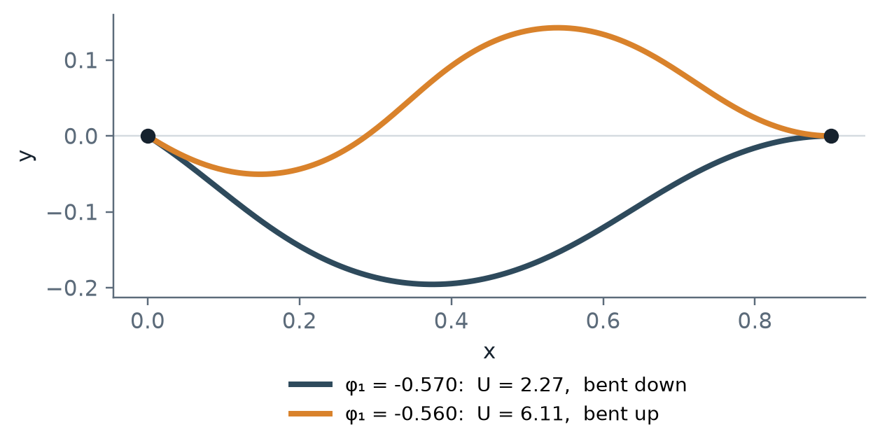
Two equilibria 0.01 rad apart: the rod has snapped
Why Newton struggles here
1
Fold
The branch ends; the Jacobian goes singular and Newton steps blow up.
2
Silent branch switch
A warm start from one side converges, but to the other branch.
3
Residual can't tell
Both sides meet 10⁻¹⁰, so convergence alone says nothing about which branch you are on.
d = 0.90, φ₂ = 0, production run. Converged solutions on either side of the jump.
Notes:
Two converged shapes only a hundredth of a radian apart in clamp angle, yet completely different.
On the left the rod is bent down with U = 2.27; one step on it is bent up with U = 6.11.
The branch the rod was on ends, so it jumps to another one.
Both solutions meet the tolerance, so convergence alone can't tell you a jump happened. We need a shape test.

Slide 8
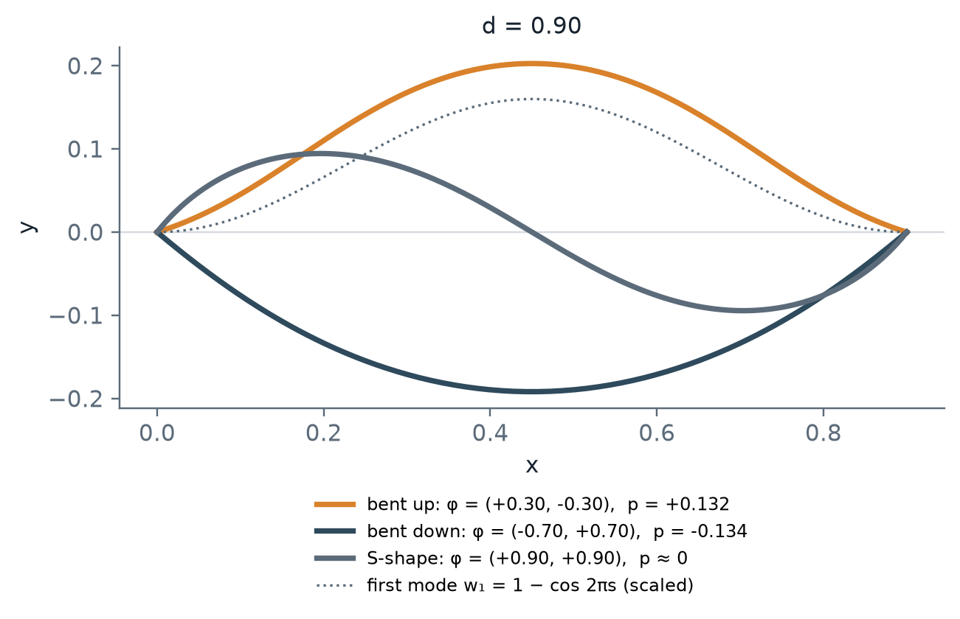
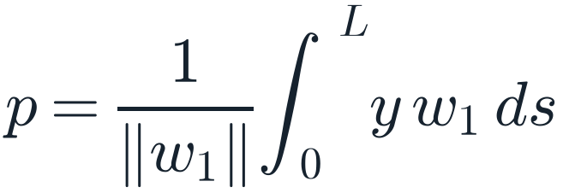
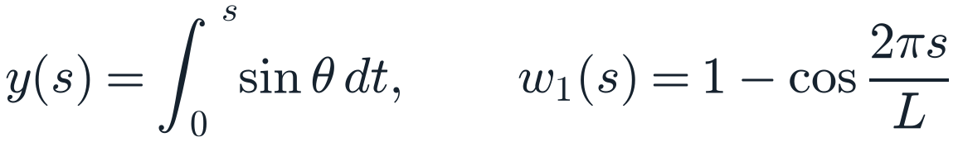
Bent up or bent down: the first buckling mode decides
$$p=\frac{1}{‖w_{1}‖}\int_{0}^{L}{y} w_{1} ds$$
$$y(s)=\int_{0}^{s}{sin}θ dt, w_{1}(s)=1−cos\frac{2πs}{L}$$
1
First clamped buckling mode
w₁ is the symmetric hump; the second mode is antisymmetric and carries no up/down information.
2
Sign = branch
p > 0: bent up. p < 0: bent down. The S-shape has p ≈ 0.
3
Built-in symmetry
p is unchanged by the mirror (φ₁, φ₂) → (−φ₂, −φ₁) and flips under (φ₁, φ₂) → (−φ₁, −φ₂).
Notes:
To tell which branch a solution is on, we project its transverse shape onto the first clamped buckling mode.
y(s) is the deflection, w₁ = 1 − cos 2πs is the first mode; p is their normalised inner product.
Positive p means the rod bows up, negative means it bows down. The S-shape sits at p ≈ 0.
The second mode is antisymmetric, so it says nothing about up versus down; the first mode alone is enough.

Slide 9
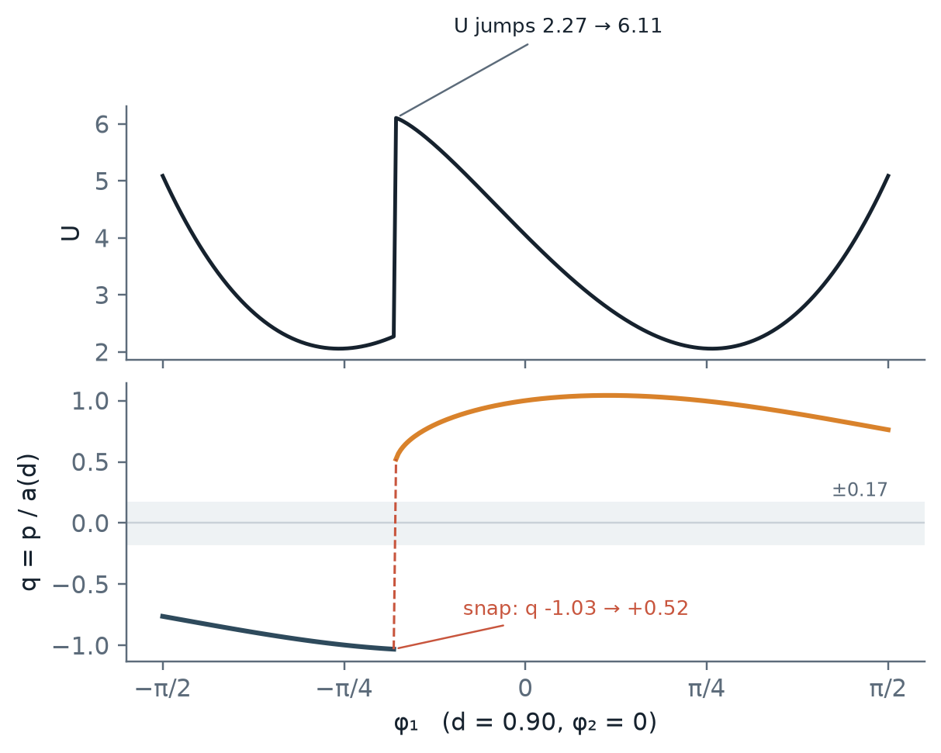
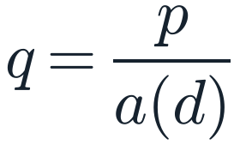
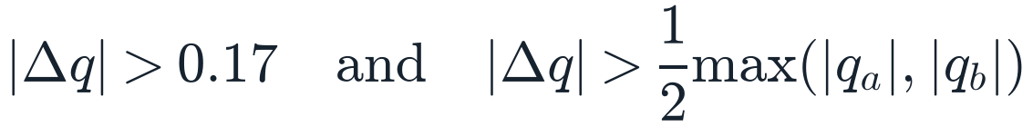
A snap is a sign change of p with a jump
$$q=\frac{p}{a(d)}$$
$$|Δq|>0.17 and |Δq|>\frac{1}{2}max(|q_{a}|,|q_{b}|)$$
1
Scale out d
p shrinks like √(1 − d); a(d) is |p| of the exact first mode at (d, 0, 0), so q = ±1 there at every d.
2
Snap
Sign change with a jump: q goes −1.03 → +0.52 in one 0.01 step. Smooth neighbours differ by about 0.003.
3
Smooth crossing
Sign change without a jump, through the S-shape near φ₁ = φ₂. Not a snap.
Notes:
p itself shrinks as the rod straightens, so we compare q = p over a(d), the amplitude of the exact first mode at that d.
Between two neighbours, q jumps when it changes by more than 0.17 and by more than half its size.
Along this line at d = 0.90, q goes from −1.03 to +0.52 in one step: that is the snap. Normal neighbours differ by 0.003.
q can also pass through zero smoothly, through an S-shape near the diagonal. That is a crossing, not a snap.
The same rule also catches a jump onto the unstable S-shaped family without a sign change; the solver rejects those too.

Slide 10
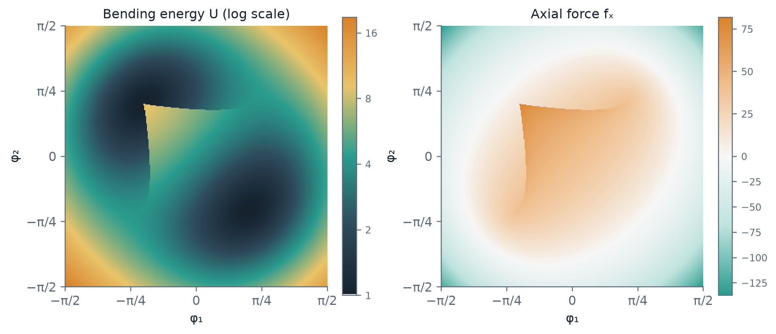
Smooth fields, then a jump across an L-shaped surface
Smooth interior
Grid neighbours differ by |Δq| ≈ 0.003
Sharp edge
Jump at φ₁ ≈ −0.57 and, by symmetry, φ₂ ≈ +0.57
Large jump
U 2.27 → 6.11 and f_{x} 28 → 59 in a single 0.01 step
Production run, d = 0.90 layer: φ₁, φ₂ ∈ [−π/2, π/2], Δφ ≈ 0.01, 99,225 points.
Notes:
These are the fields on one layer, d = 0.90, over the full range of clamp angles.
Everything is smooth, except along an L-shaped edge where all the fields jump together.
The energy nearly triples and the axial force doubles in a single grid step.

Slide 11
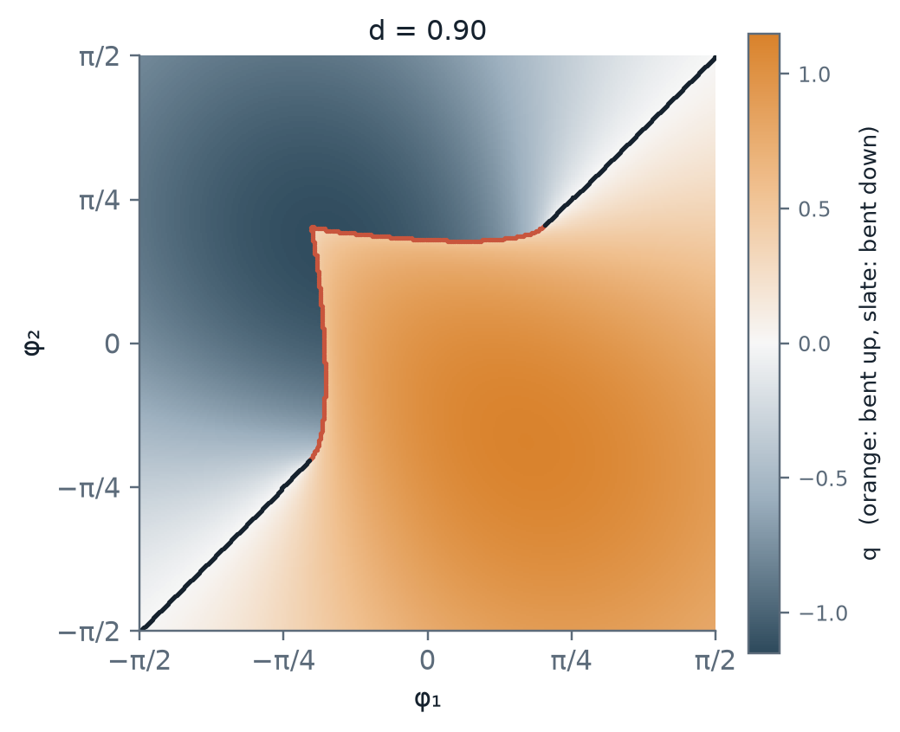
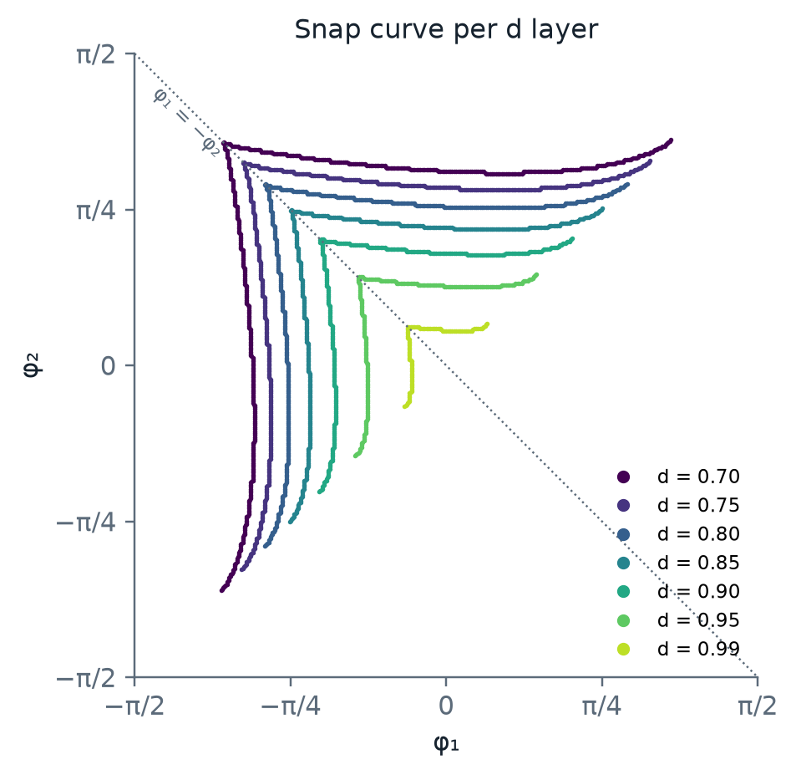
The sign of p traces the snap surface
Red: snap edges, where p changes sign with a jump. Black: smooth crossings through the S-shape.
As d → 1 the L closes in: at φ₂ = 0 the snap sits at φ₁ ≈ −0.98 (d = 0.70), −0.57 (0.90) and −0.18 (0.99).
Notes:
Colour is q: orange bent up, slate bent down. The jump rule on neighbouring grid points draws the snap in red.
The black lines along the diagonal are smooth zero crossings, where the rod passes through an S-shape.
Stacking the snap curves of several layers: the L-shape shrinks towards the origin as the rod straightens.
Its corner sits on the anti-diagonal φ₁ = −φ₂ and its ends on the diagonal.

Slide 12
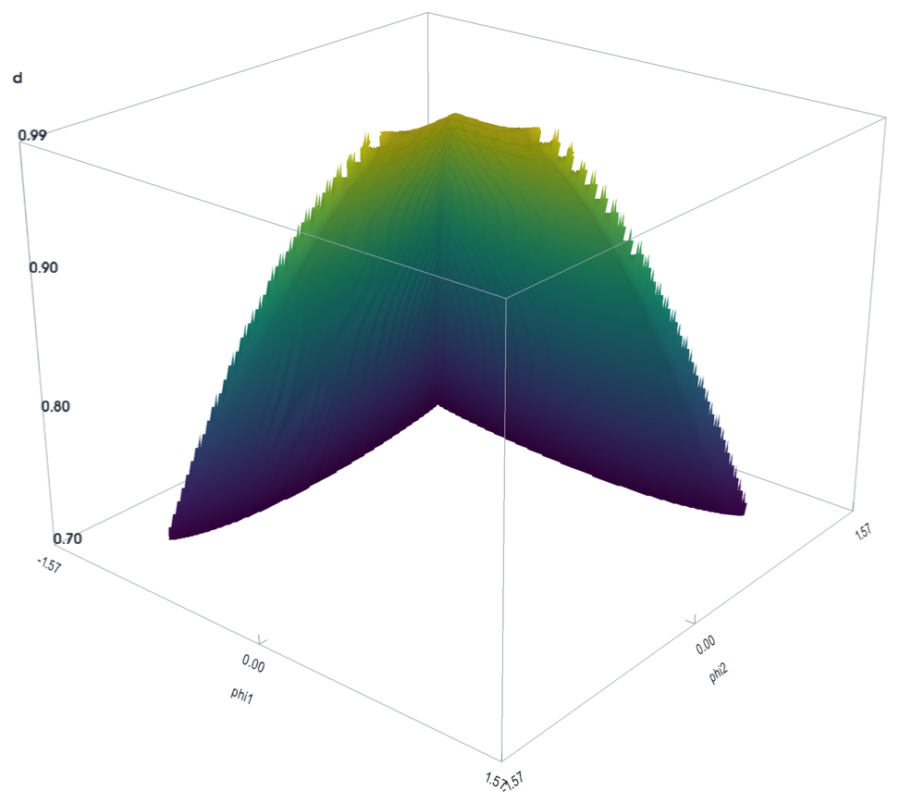
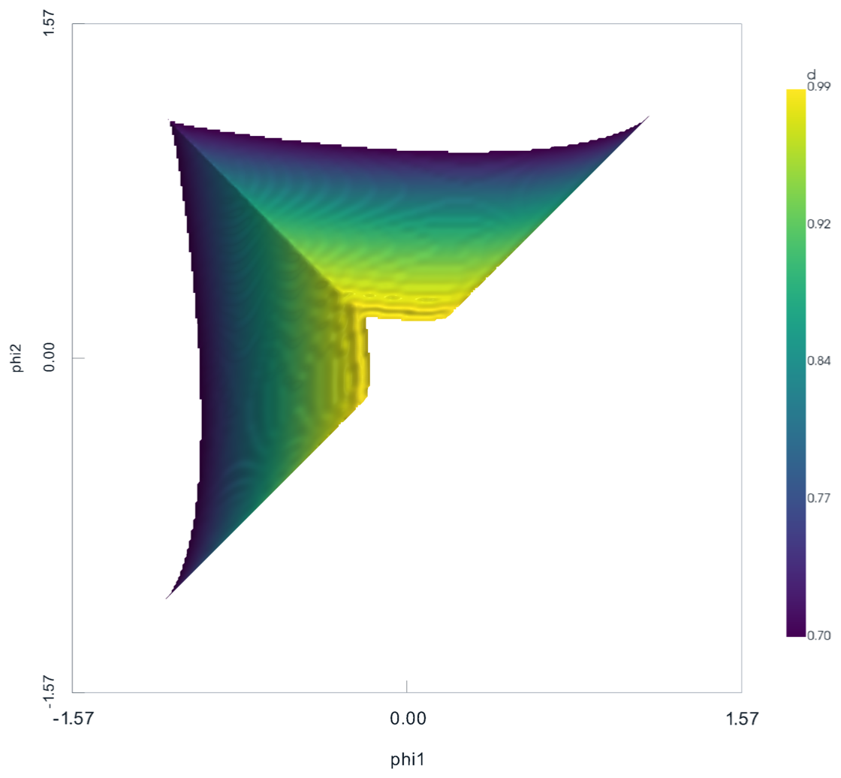
The snap surface in 3D
Oblique view, d stretched ×8. The p = 0 contour of the 17.2 M-tetrahedron grid, kept where p jumps: 30,081 snap edges, area 2.64.
Down the d axis: every layer is the L-shape, and the sheet closes in on the origin as d → 1. Colour: d.
Notes:
Stacking every layer gives the snap surface over the whole box.
It is the p = 0 contour of the tetrahedral grid, keeping only the part where p jumps, so smooth S-shape crossings are left out.
Seen down the d axis, each layer is the same L, and the sheet tilts in towards the origin as d approaches 1.

Slide 13
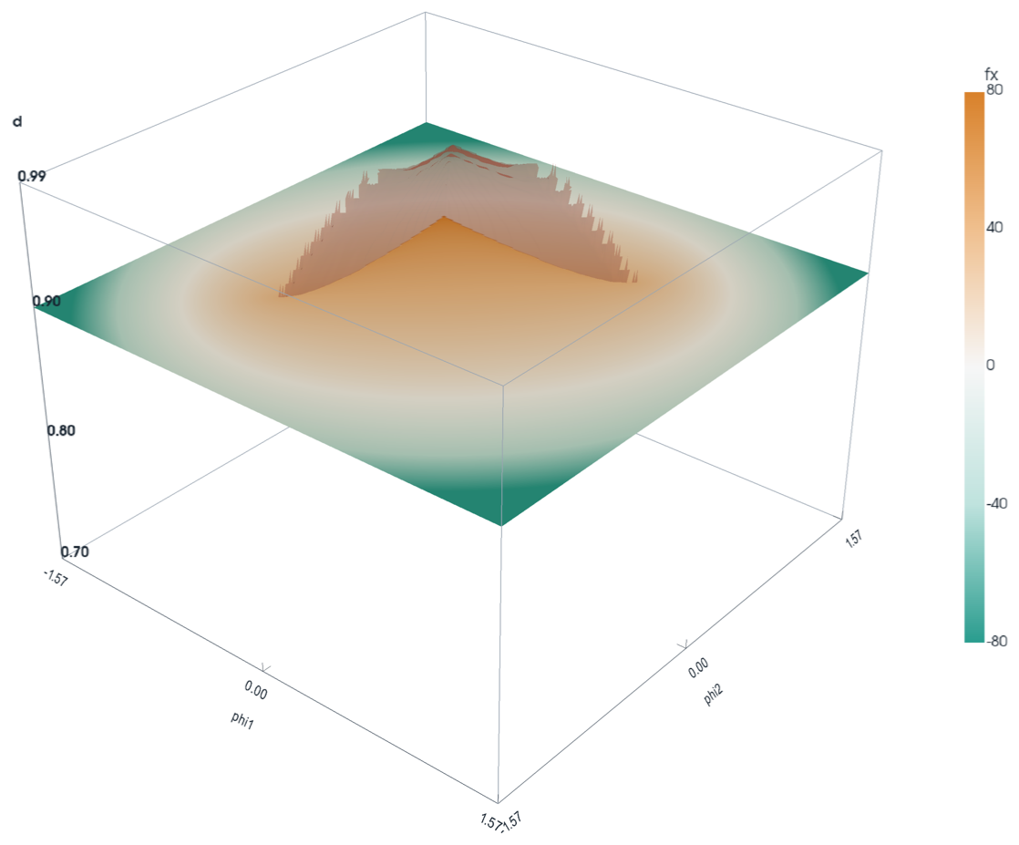
The sheet rises from the step in axial force
Across the snap at φ₂ = 0, f_{x} roughly doubles at every d:
30.1 → 61.5
d = 0.80, jump at φ₁ ≈ −0.80
28.3 → 58.7
d = 0.90, jump at φ₁ ≈ −0.57
27.4 → 55.4
d = 0.97, jump at φ₁ ≈ −0.31
The surface is built from the shape alone, through the sign of p, yet it lands exactly on the step the forces see.
Layer d = 0.90 coloured by f_{x} (clipped at ±80); the snap sheet above it is translucent.
Notes:
Here the d = 0.90 layer is coloured by the axial force, and the snap sheet rises from it.
Across the sheet the compressive force roughly doubles, at every d.
The sheet comes from the shape alone, through p, and it sits exactly on that force step.

Slide 14
The bistable region
Two stable rods for the same clamps, and which snap the rod can meet
Notes:
So far every map came from one bent-up cold start.
Starting bent down gives a second map. Where the two disagree, the rod has two stable shapes for the same clamps.
That region decides which snap a rod meets when the clamps are turned.

Slide 15
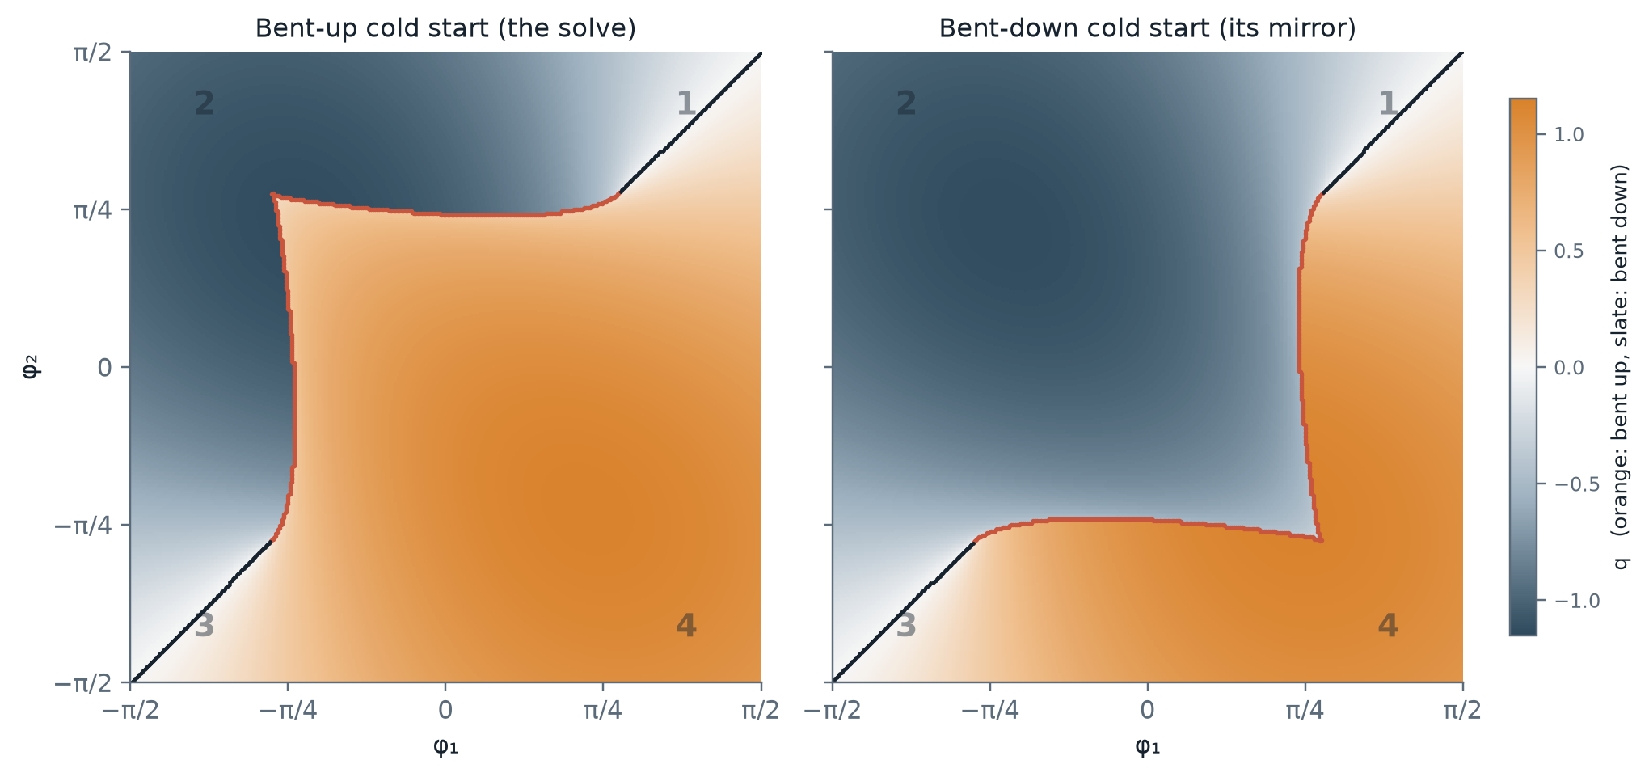
A bent-down cold start mirrors the map across φ₁ = φ₂
d = 0.82. θ → −θ takes the solve to the bent-down cold start: (φ₁, φ₂) → (−φ₁, −φ₂) with p negated. With the mirror (φ₁, φ₂) → (−φ₂, −φ₁) that is a reflection in φ₁ = φ₂ with orange and slate swapped. Red: each map's snap curve, in quadrants 1, 2, 3 and 1, 3, 4.
Notes:
Left is the production solve, grown from the bent-up cold start. Its snap curve, where the bent-up branch ends, runs through quadrants 1, 2 and 3.
Turning every rod upside down gives the solve from a bent-down cold start. No new solves are needed: node (φ₁, φ₂) takes the rod at (−φ₁, −φ₂), upside down.
Combined with the mirror symmetry this is a reflection in the diagonal with the colours swapped, so its snap curve runs through quadrants 1, 3 and 4.

Slide 16
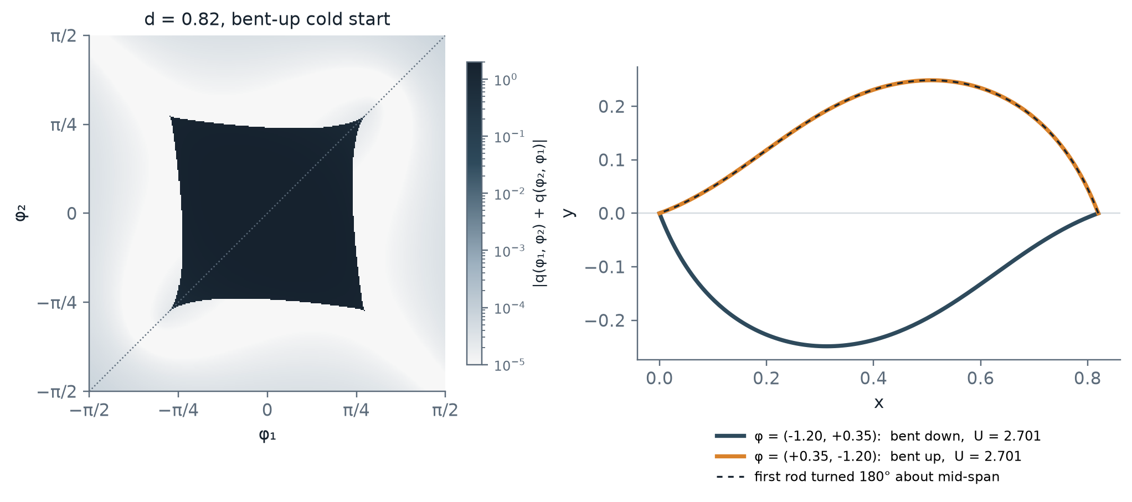
Outside the region, swapping the clamps turns the rod over
$$(d,φ_{1},φ_{2})↦(d,φ_{2},φ_{1}): \tilde{θ}(s)=θ(L−s), \tilde{p}=−p, \tilde{U}=U, {\tilde{f}}_{x}=f_{x}, {\tilde{f}}_{y}=f_{y}, {\tilde{M}}_{1}=−M_{2}$$
Left: |q(φ₁, φ₂) + q(φ₂, φ₁)| at d = 0.82 is about 1e-4 everywhere except a square, the bistable region. Over all layers 2.35 M of the 2.98 M nodes pass, with q within 6.6e-4 and U within 1.5e-8. Right: the rod at (−1.20, +0.35) turned 180° lies on the rod at (+0.35, −1.20).
Notes:
Swapping the two clamp angles is the same as walking the rod from the other end: θ(s) becomes θ(L − s), the rod turned 180° about its midpoint.
That flips p, so bent up becomes bent down, and keeps the energy and both forces. The two clamp moments swap with a sign change.
Where there is only one equilibrium the data obey this to round-off. Inside a square around the origin they do not: there the solve is bent up on both sides of the diagonal. That square is the bistable region.

Slide 17
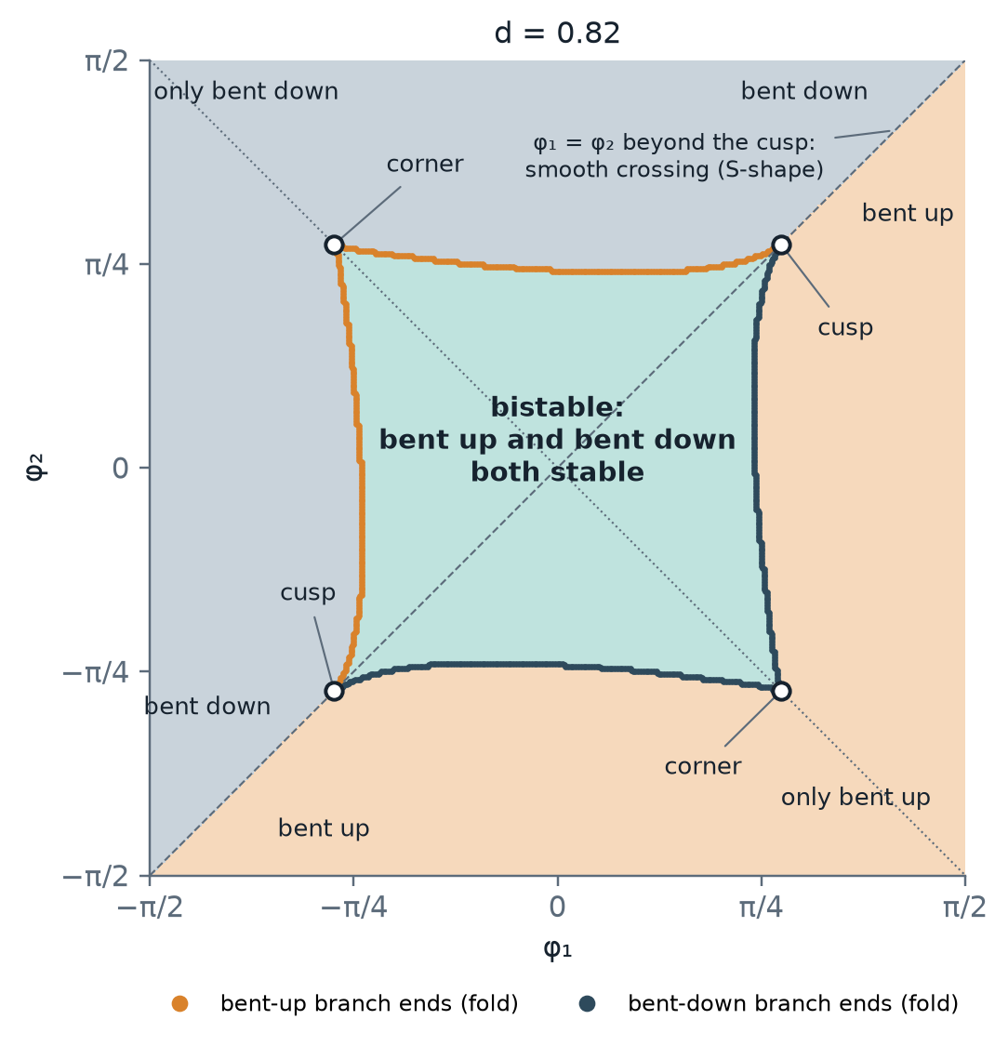
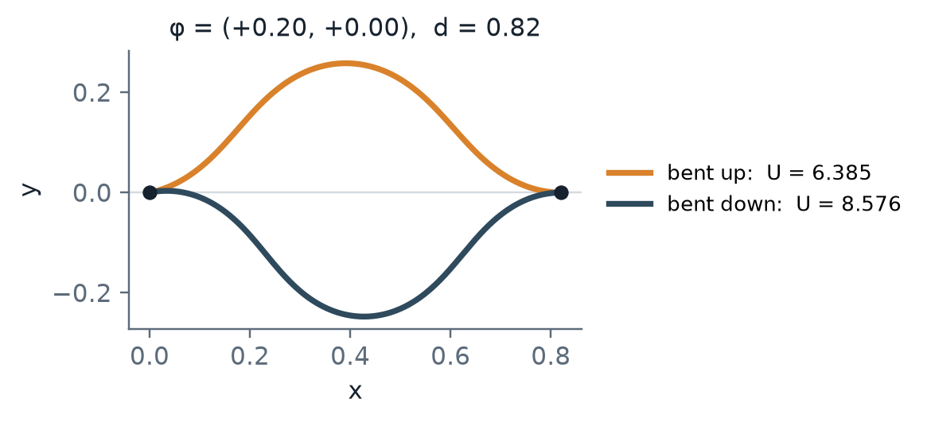
The bistable region: two stable rods for the same clamps
$$Bistable where the bent-up solve is bent up at a point and at its mirror: q(φ_{1},φ_{2})>0 and q(φ_{2},φ_{1})>0$$
1
Left and top: the bent-up branch ends (fold). Leave this way bent up and the rod snaps down.
2
Bottom and right: the bent-down branch ends, the mirror image. Leave this way bent down and the rod snaps up.
3
On the diagonal the curves meet at cusps. Beyond them φ₁ = φ₂ is a smooth S-crossing and nothing snaps.
Notes:
Definition: at a given d, the bistable region is where the rod has two distinct stable equilibria, one bent up and one bent down.
In the data the two cold starts then hold different rods. Their q differs by at least 0.034 there, and agrees to 7e-4 everywhere else.
In each layer it is a square around the origin with inward-bowing sides. Each side is a fold where one branch disappears, so the snap you meet depends on which side you leave by and on the branch you are on.
At φ = (0.20, 0) the two rods have U = 6.39 and 8.58, and both pass the stability test.

Slide 18
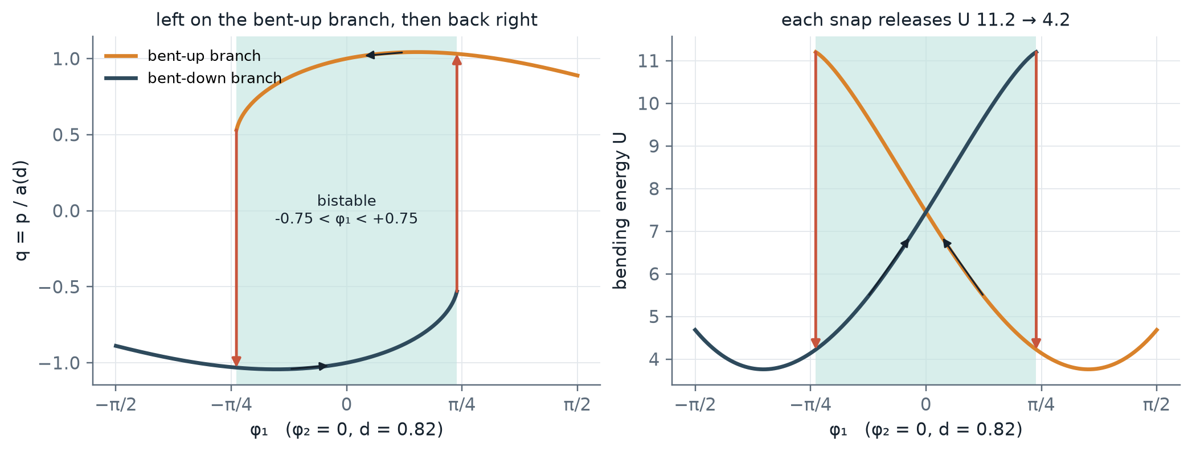
Which snap the rod meets depends on the branch it is on
d = 0.82, φ₂ = 0. Bent up (orange), the rod crosses the whole bistable band (teal) and snaps down only at φ₁ ≈ −0.76. Bent down (slate), it snaps up only at +0.76. The loop between the two snaps is the hysteresis; each snap releases U 11.2 → 4.2.
Notes:
Walk the left clamp along φ₂ = 0. Starting bent up at the origin and turning φ₁ negative, the rod stays bent up through the whole band and snaps only where the bent-up branch ends, at −0.76.
Turn it back: the rod is now bent down and stays so until +0.76, the far edge, where the bent-down branch ends.
So the same clamp angles give different rods depending on the history. By the symmetry both snaps release the same energy.

Slide 19
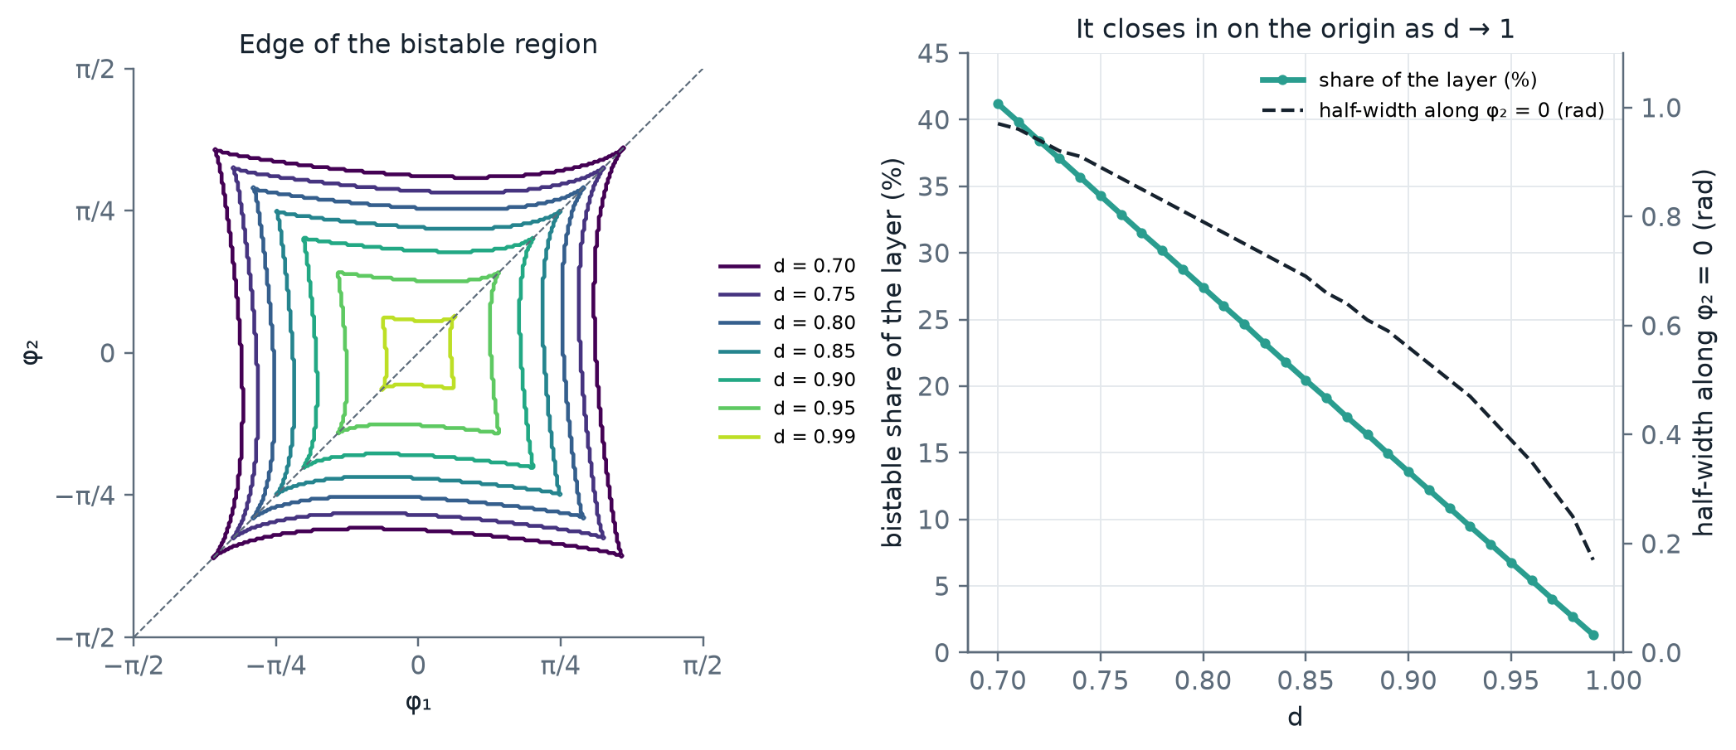
The bistable region closes in as d → 1
Share of the layer: 41 % at d = 0.70, 25 % at 0.82, 14 % at 0.90, 1.3 % at 0.99. Along φ₂ = 0 it spans |φ₁| < 0.97, 0.75, 0.56 and 0.17. The largest energy gap between the two rods falls from 25.6 to 0.8.
Notes:
The square shrinks steadily towards the origin as the rod straightens: a straighter rod has less room for two buckled states.
Its corners follow the corners of the L-shaped snap curve on the earlier slides.

Slide 20
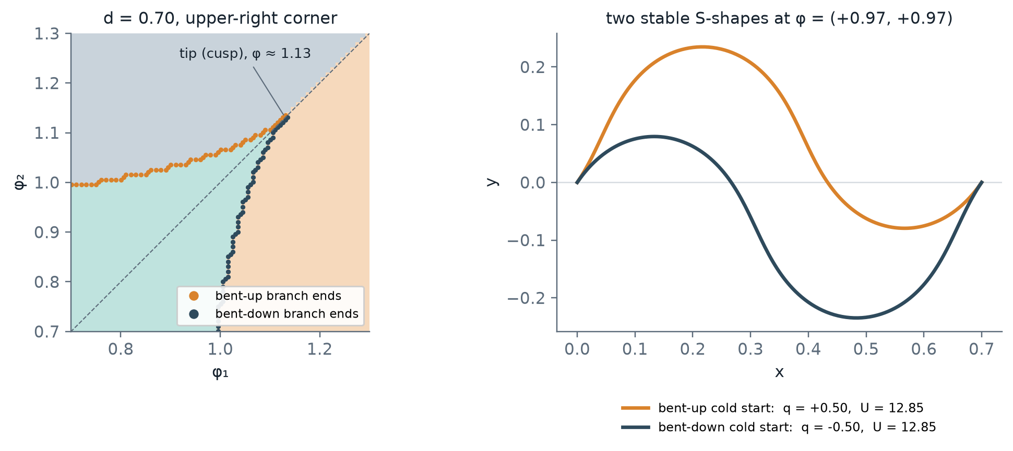
The region ends in a cusp on the diagonal
d = 0.70. Towards the diagonal the two fold curves close in and meet at a cusp at φ ≈ 1.13. Near it both stable rods are S-shapes, mirror images with q ≈ ±0.5 and equal energy on the diagonal; at the cusp q falls to 0. The cusp moves in with d: φ ≈ 0.86 at d = 0.82, 0.20 at 0.99.
Notes:
At small d the region does not stop at the corner of the square. The bent-up snap curve continues just below the diagonal, the bent-down one just above, and they close at a cusp further out.
Inside that thin tip the two stable rods are both S-shaped, one the mirror of the other.

Slide 21
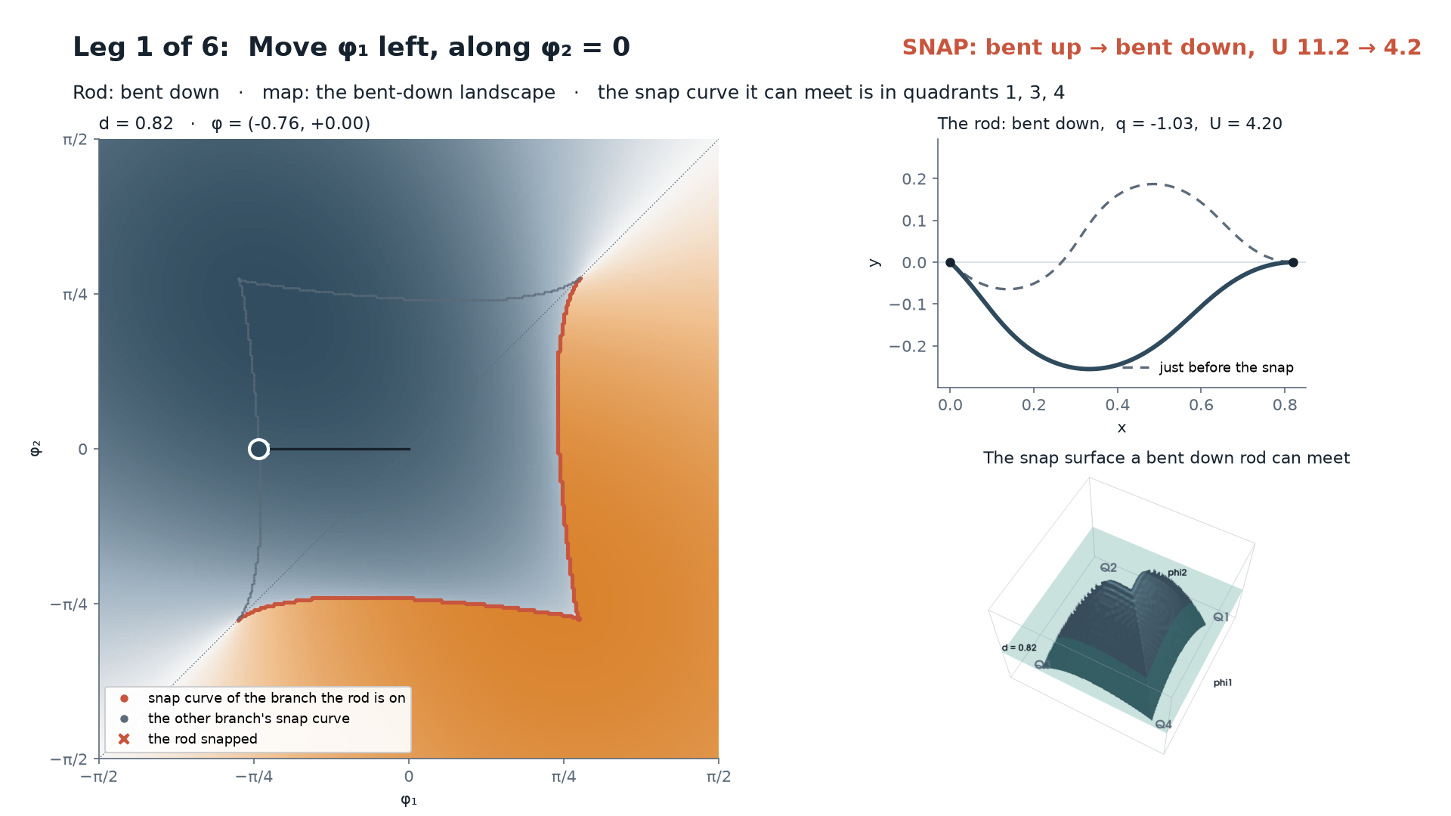
Following one rod around the snap surface
1
Across. Bent up, the rod snaps down at φ₁ = −0.76, and the map and snap surface switch to the bent-down ones. Coming back it snaps up only at +0.76.
2
Around. Raising φ₂ at φ₁ = 1.25 passes the end of the snap curve: a smooth S-crossing turns the rod bent down, no snap.
3
Back at the start, now bent down. Repeating the first move, nothing snaps: its snap curve is in quadrants 1, 3, 4.
Click to play (29 s). d = 0.82. Left: the map of the branch the rod is on; red, the snap curve it can meet; grey, the other branch's. Right: the rod, and the snap surface in (φ₁, φ₂, d) for its branch.
Notes:
One rod at d = 0.82, moved quasi-statically one grid step at a time. Each step it keeps the equilibrium continuous with the one it is on, and snaps only where that branch ends.
Legs 1 and 2: across the region. The rod snaps at the far edge each way, and every snap changes the branch, and with it the snap curve and surface the rod can meet next.
Leg 3 goes round the end of the snap curve instead. On the diagonal beyond the cusp the rod passes smoothly through an S-shape and comes out bent down.
Legs 4 to 6 bring it back to the start, now bent down. Leg 6 repeats leg 1 and nothing snaps: going round the surface changed the branch without a snap.

Slide 22
Continuation strategy
How the solver walks the parameter space and guards against branch switches
Notes:
Now the solver: how it covers the box without ever jumping across the snap.

Slide 23
Traverse the grid; reject jumps and unstable results
Cold-start once at φ₁ = φ₂ = 0, smallest d; visit nodes by grid distance from it
Warm-start θ, f_{x}, f_{y} from a solved grid neighbour: bent-up ones first, then nearest
Newton solve (SNES, at most 50 iterations)
No jump in q, and stable?
Accept, store, and write the mirror point
yes
no
Rejected or diverged: try the next neighbour. After 3 failures from one branch, wait for the other; a waiting node retries whenever a neighbour is solved.
Grid
Restartable
Half domain
Rectilinear (d, φ₁, φ₂) grid split into 6 tetrahedra per cell; warm starts come from the 26 grid neighbours
Live NPZ checkpoints, also on Ctrl-C; a resume reloads every stored θ as a warm-start source
Only φ₁ + φ₂ ≥ 0 is solved; a precomputed mirror index fills the other half
Notes:
One cold start, at the angular origin and the smallest d. Then the solved region grows as a front, nearest grid distance first.
Each node is warm-started from a solved neighbour: its θ and both forces.
A result is kept only if q does not jump relative to that neighbour, and the equilibrium is stable.
Otherwise we try the next neighbour; after three failures from one branch, the node waits for the other branch.
Only half the box is solved; the mirror fills the rest.

Slide 24
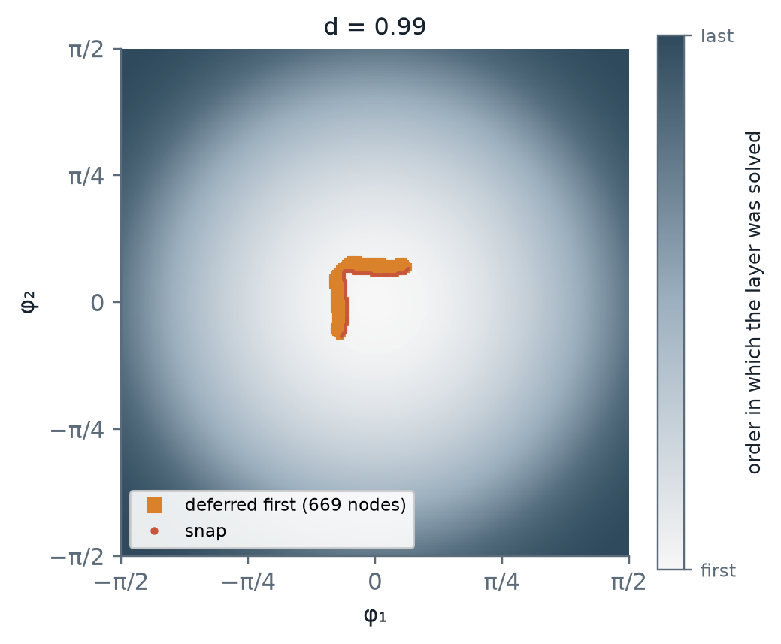
Going around a fold: defer, never jump
1
Defer
A node with no acceptable warm start is set aside, not forced; it is retried each time a new neighbour is solved.
2
Wait for the other branch
After 3 failures from neighbours on one branch it only tries the other, so a node past a fold waits for the far side.
3
The long way round
The front reaches the cut-off region through the smooth crossings and approaches it from the far side.
4
Last resort
Only if the whole front stalls is the nearest waiting node cold-started.
Production run: 1,155 nodes waited (all at d ≥ 0.97); one extra cold start, at (0.99, 0.20, 0.20). A final promotion pass gave the bent-up rod to 1,571 bistable nodes the front had filled bent down.
d = 0.99 layer: the front grows outward; orange nodes had to wait for a neighbour on the other branch.
Notes:
The key rule: never accept a branch switch. A node that cannot be reached without a jump is deferred.
If three neighbours on one branch fail, the node only tries the other branch, so it waits for the front to arrive from the far side of the fold.
The front gets there the long way round, through the smooth crossings near the diagonal.
In the production run this happened only near d = 1; 1,155 nodes waited, and one extra cold start was needed.

Slide 25
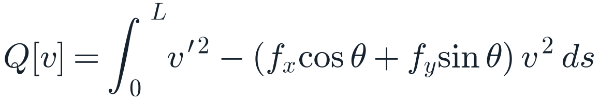
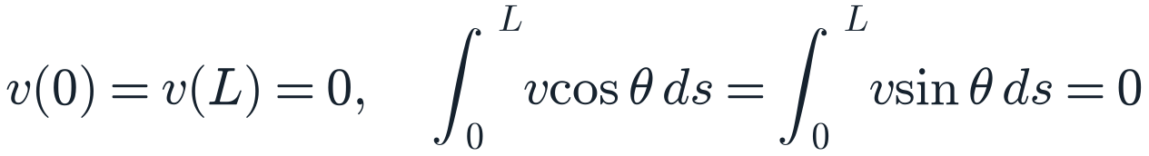
A stability test catches what the jump test misses
Constrained second variation
1
Why the jump test is not enough
On φ₁ = −φ₂ the rod is symmetric (f_{y} = 0); the bent-up branch loses stability at a symmetry-breaking bifurcation, not a fold. Newton follows it smoothly, with no jump in q.
$$Q[v]=\int_{0}^{L}{v^{′}}​^{2}−(f_{x}cosθ+f_{y}sinθ) v^{2} ds$$
$$v(0)=v(L)=0, \int_{0}^{L}{v}cosθ ds=\int_{0}^{L}{v}sinθ ds=0$$
2
Inertia of a bordered matrix
A is the tridiagonal P1 form, C the two constraint vectors (Haynsworth). One LDLᵀ sweep: O(N), about 0.2 ms against an 11 ms solve.
$$n_{−}=neg(A)+pos(C^{T}A^{−1}C)−2$$
Stable when n₋ = 0: no direction lowers the energy.
17
0
3
Every candidate
Warm starts and cold starts alike: an unstable result counts as a failure and the node moves on to the next neighbour.
unstable results rejected
unstable in the final map
during the production run
all 2,976,750 nodes re-tested
Notes:
Newton converges to unstable equilibria as happily as to stable ones.
Usually a jump in q gives that away, but not on the anti-diagonal: there the rod is symmetric and the bent-up branch loses stability at a bifurcation, without a jump.
So every candidate also gets a stability test: the constrained second variation must have no negative direction.
We count negative directions from the inertia of a bordered tridiagonal matrix, which is linear in the number of elements and costs about 0.2 ms.
In production 17 unstable results were rejected, and a re-test of the final map found none.

Slide 26




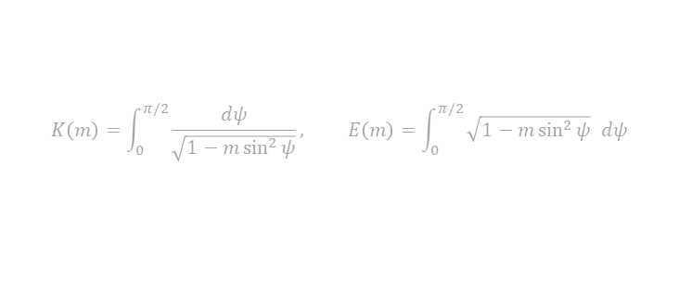

Deriving the exact first mode used for the cold start
1
φ₁ = φ₂ = 0 is mirror-symmetric, so f_{y} = 0 and the elastica is a pendulum
$$θ′′+λ^{2}\sin{θ}=0, λ^{2}=f_{x}, f_{y}=0$$
2
Multiply by θ′ and integrate once; θ′ = 0 at the peak angle α
$$θ^{′}​^{2}=4λ^{2}\left(k^{2}−\sin^{2}\frac{θ}{2}\right), k=sin\frac{α}{2}$$
3
Substituting sin(θ/2) = k sin ψ gives ψ′ = λ√(1 − m sin²ψ), so sin ψ = sn(λs | m)
$$θ\left(s\right)=2\sin^{-1}\left[k sn\left(λs | m\right)\right], m=k^{2}$$
4
θ(L) = 0 and ∫ sin θ ds = 0 need one full period of sn (4K): four quarter-waves
$$λL=4K\left(m\right) ⇒ f_{x}={\left(\frac{4K\left(m\right)}{L}\right)}^{2}$$
5
The end distance fixes m; d/L falls monotonically in m, so a 1-D root-find is safe
$$\frac{d}{L}=\frac{1}{L}\int_{0}^{L}{\cos{θ}} ds=\frac{2E\left(m\right)}{K\left(m\right)}−1$$
6
Small bow, m → 0: the A sin(2πs/L) shape with A = 2√(1 − d/L), and the Euler load
$$θ≈2\sqrt{m} \sin{\frac{2πs}{L}}, m≈1−\frac{d}{L}, f_{x}→\frac{4π^{2}}{L^{2}}$$
$$K\left(m\right)=\int_{0}^{π/2}{\frac{dψ}{\sqrt{1−m\sin^{2}{ψ}}}}, E\left(m\right)=\int_{0}^{π/2}{\sqrt{1−m\sin^{2}{ψ}}} dψ$$
Notes:
The cold start needs a solution we know exactly. At zero clamp angles the problem is symmetric, fy vanishes and the elastica is the pendulum equation.
Integrating once and substituting gives the Jacobi elliptic sn function; the modulus k is the sine of half the peak angle.
The clamp conditions need exactly one period of sn: four quarter-waves, which fixes λL = 4K(m) and the axial force.
The end distance then fixes m through a one-dimensional root-find. For a small bow it reduces to the familiar sine shape and the Euler load.

Slide 27
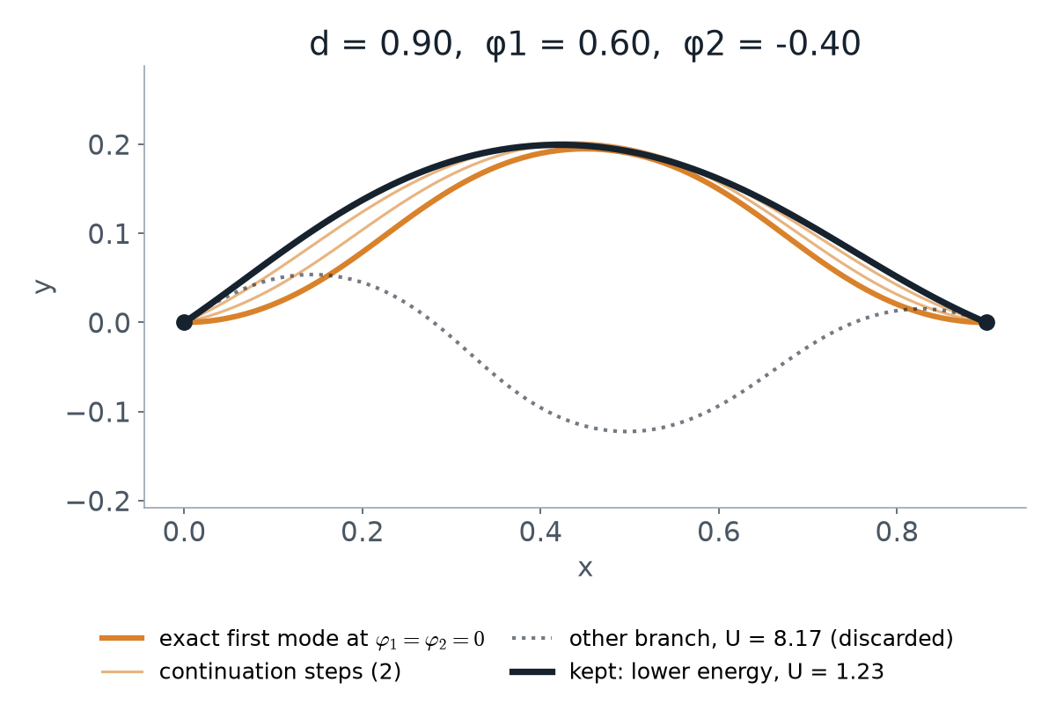

Exact first-mode cold start, then continue the clamp angles
$$θ≈2\sqrt{m} \sin{\frac{2πs}{L}}, m≈1−\frac{d}{L}, f_{x}→\frac{4π^{2}}{L^{2}}$$
Predictor for each continuation step
$$θ_{0}^{\left(k+1\right)}\left(s\right)=θ^{\left(k\right)}\left(s\right)+Δφ_{1}\left(1−\frac{s}{L}\right)+Δφ_{2}\frac{s}{L}$$
1
Exact at φ₁ = φ₂ = 0 for any d, with ∫ sin θ ds = 0: Newton converges in 2 iterations
2
Steps ≤ 0.25 rad, ≤ 15 Newton iterations each; a failed step halves, giving up below 0.02 rad (a fold)
3
Both hump signs are continued and the lower energy kept, so the result does not depend on which branch the ramp follows
Notes:
The exact mode at zero clamp angles converges in two Newton iterations at any d.
From there we ramp the clamp angles to the target, at most a quarter radian per step, halving a step that fails.
Both the hump-up and hump-down modes are continued and the lower energy kept.
This is used once at the start, and otherwise only as a last resort when the front stalls.

Slide 28
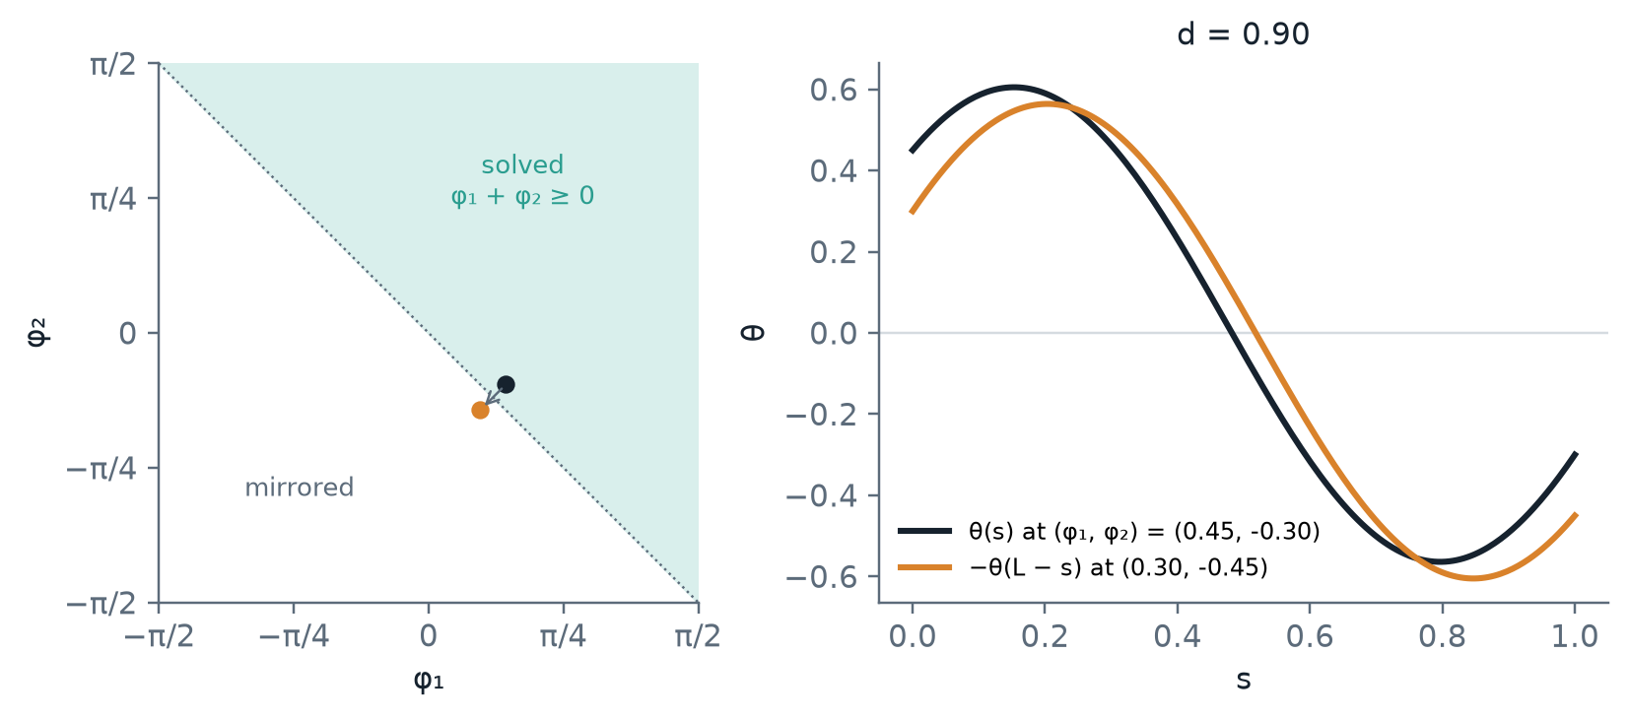
Mirror symmetry halves the number of solves
$$(d,φ_{1},φ_{2})↦(d,−φ_{2},−φ_{1}): \tilde{θ}(s)=−θ(L−s), {\tilde{f}}_{x}=f_{x}, {\tilde{f}}_{y}=−f_{y}, {\tilde{M}}_{1}=M_{2}, \tilde{p}=p$$
1
Reflecting the rod about mid-span maps (φ₁, φ₂) to (−φ₂, −φ₁)
2
Only φ₁ + φ₂ ≥ 0 is solved; points on the anti-diagonal are solved once
3
f_{x}, U and p carry over, f_{y} flips sign, and the left and right moments swap
Notes:
Reflecting the rod about mid-span maps the clamp angles (φ₁, φ₂) to (−φ₂, −φ₁).
So only the half φ₁ + φ₂ ≥ 0 is solved; every accepted solution also fills its mirror node.
The axial force, the energy and p carry over; fy flips sign and the two clamp moments swap.

Slide 29
Final run
d ∈ [0.70, 0.99], φ₁, φ₂ ∈ [−π/2, π/2], Δ = 0.01: 2.98 M equilibria and their level sets
Notes:
Finally, the full production map, and what it says about energy, force and moment.

Slide 30
2.98 M equilibria, every one checked
2,976,750
≈ 4 h
0.27 %
0
equilibria
on one core
max error vs. BVP
unstable equilibria
30 × 315 × 315 grid; 1.49 M Newton solves, the mirror fills the rest
about 11 ms per solve, from one cold start (plus one more near d = 1)
300 random nodes re-solved with scipy solve_bvp; median 0.014 %
stability test on all 2,976,750 nodes
Exact checks pass
Branch share
Ranges
Mirror pairs agree to 3 × 10⁻⁸. At φ₁ = φ₂ = 0 every layer matches the exact first mode: f_{x} within 1.3 × 10⁻⁴.
Bent up on 70.6 % of the layer at d = 0.70, falling almost linearly to 50.5 % at d = 0.99. Snap surface area 2.64 (30,081 snap edges).
f_{x} from −13,785 (tension, d = 0.99, |φ| = π/2) to +93; |f_{y}| ≤ 340; |M| ≤ 168; U from 0.10 to 142.
ParaView: data/production/post/elastica_solution_space.vtu (every node, all fields).
Notes:
Every one of the almost three million grid points is solved, in about four hours on one core.
Checks independent of the front: the mirror pairs, the exact first mode on every layer, and 300 random points re-solved with scipy's BVP solver, worst error 0.27 %.
A stability re-test of the whole map found no unstable equilibrium.
The bent-up share falls from 70 % to about half as the rod straightens.
Everything is in one VTU for ParaView.

Slide 31
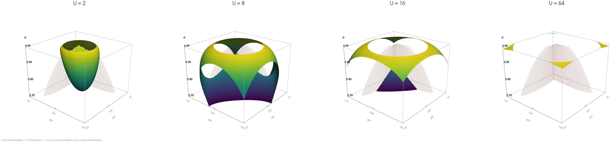
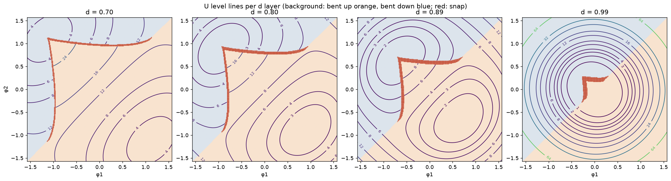
Constant-energy surfaces: shells around the straight rod
U = ½∫θ′² ds
From 0.10 to 142. Lowest for a nearly straight rod (d → 1, φ → 0): U = 2 is a bowl around that corner and higher levels are wider domes. Each ends at the snap (faint red), where U jumps.
Notes:
Surfaces of constant bending energy, coloured by d; the faint red sheet is the snap surface.
Low energy is a bowl around the nearly straight rod; higher levels wrap around it.
The level sets stop at the snap, because the energy jumps there.

Slide 32
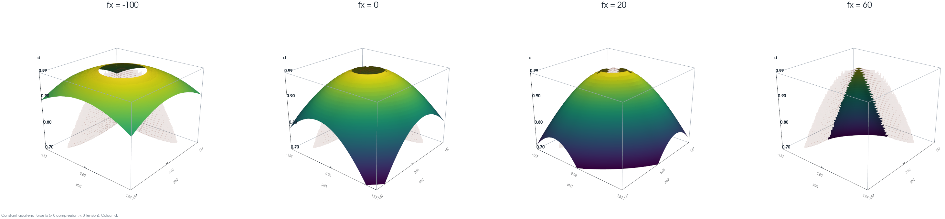
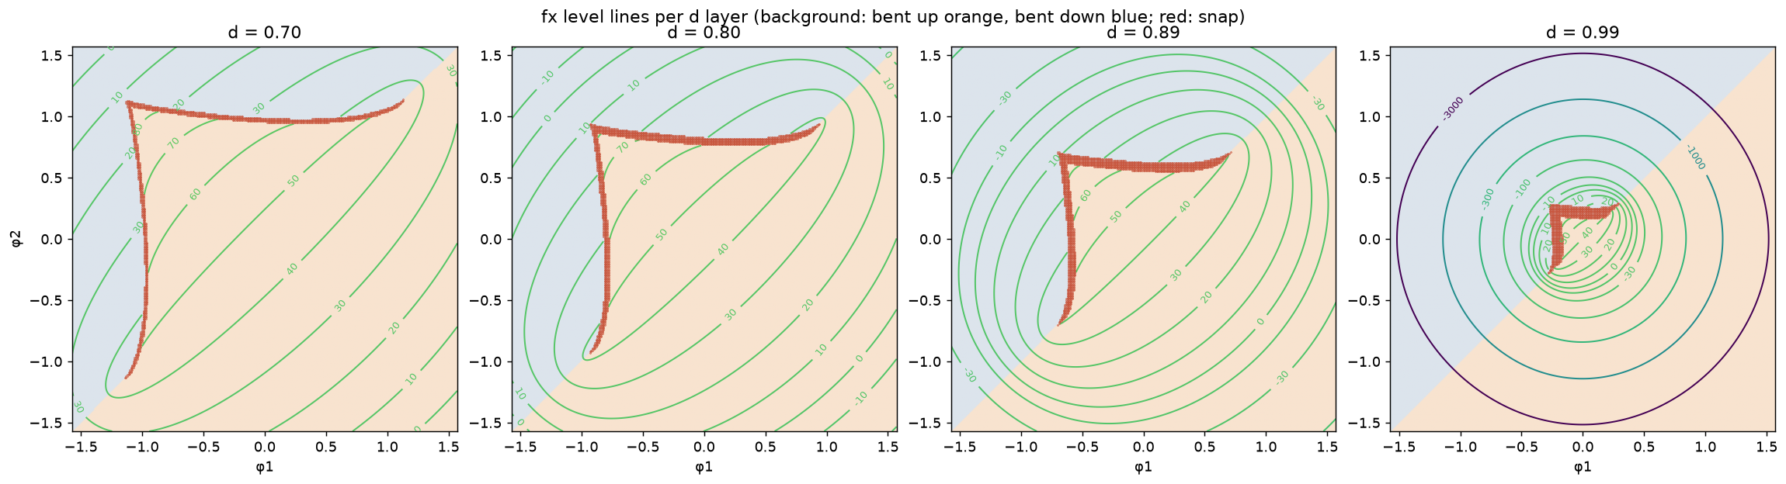
Constant axial force f_{x}: bounded in compression
f_{x} > 0: compression
From −13,785 (tension, d = 0.99, |φ| = π/2) to +93. Compressive levels exist only inside the bent-up region: f_{x} = 60 is a sliver and nothing reaches 100.
Notes:
Surfaces of constant axial force. Positive is compression.
Compression is bounded: it never reaches 100, and the high levels are small slivers inside the bent-up region.
Tension, by contrast, grows without bound as the rod is pulled straight with large clamp angles.

Slide 33
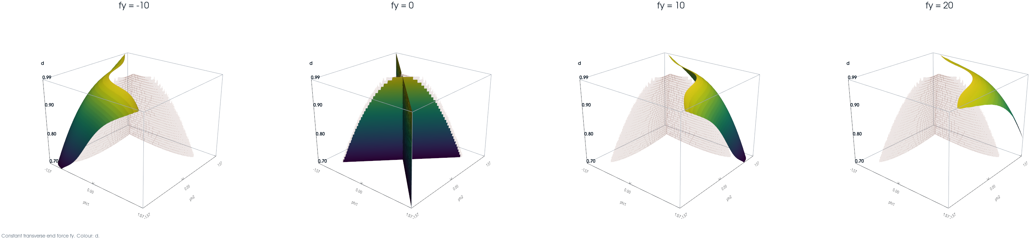
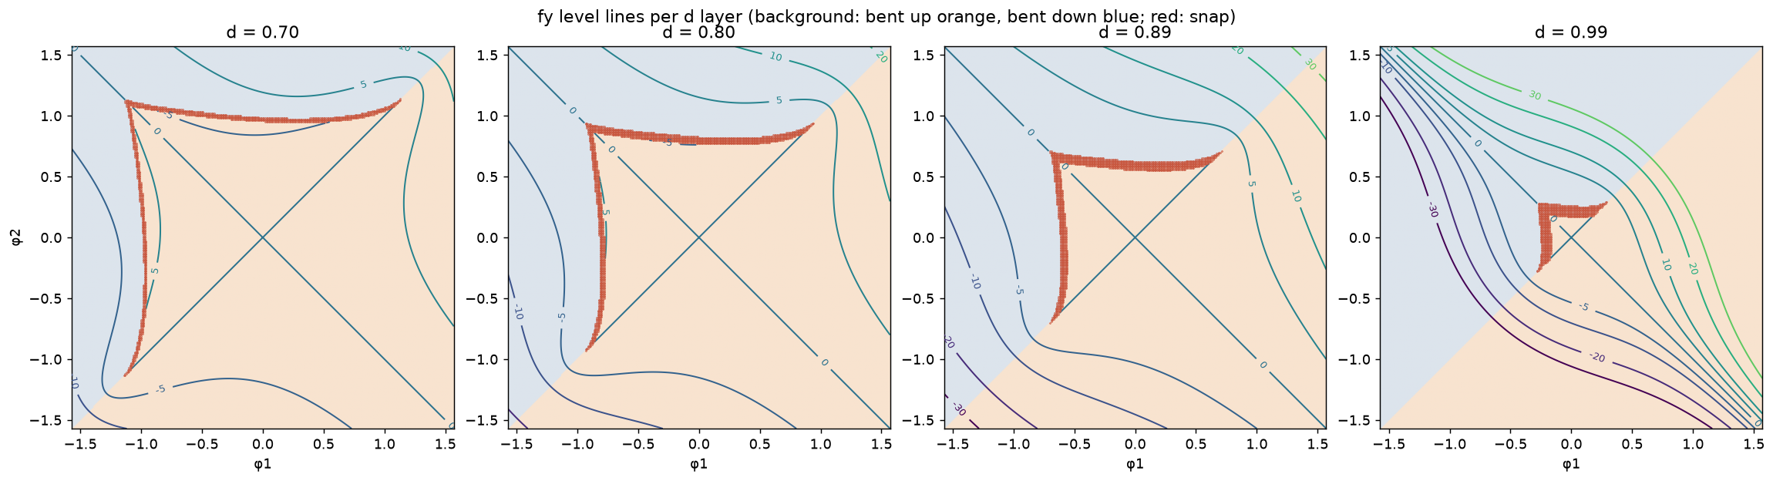
Constant transverse force f_{y}: mirror-image pairs
Odd under the mirror
|f_{y}| ≤ 340. (φ₁, φ₂) → (−φ₂, −φ₁) flips f_{y}, so f_{y} = 0 holds on the whole plane φ₁ = −φ₂ and ± levels come in pairs of equal area.
Notes:
Surfaces of constant transverse force.
The mirror flips fy, so fy = 0 on the whole anti-diagonal plane, and each positive level has a negative twin.

Slide 34
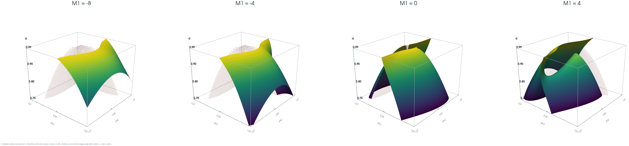
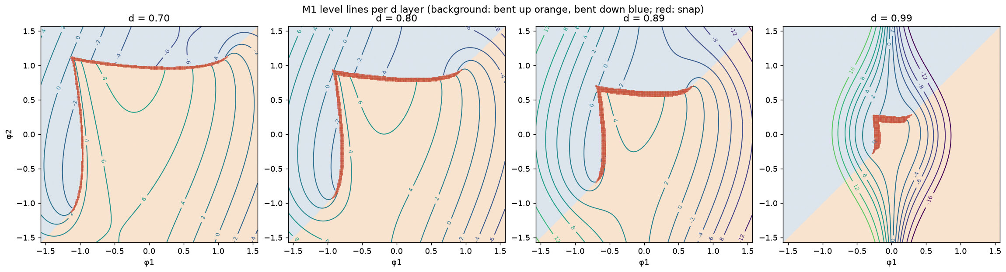
Constant clamp moment M₁; M₂ is its mirror image
M₁ = θ′(0)
Within ±168. M₂ at (φ₁, φ₂) is M₁ at (−φ₂, −φ₁), so its surfaces are mirror images (both in the VTU). Small |M₁| levels split into two sheets.
Notes:
Surfaces of constant left clamp moment.
The right moment needs no separate plot: by the mirror it is the left moment at the reflected angles.
Both are in the VTU for exploration in ParaView.

Slide 35
Refined sampling
Training data: both branches at every node, and more solves where the energy is low: 7.6 M states

Slide 36
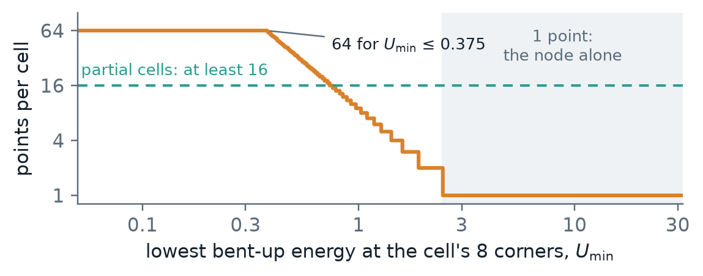
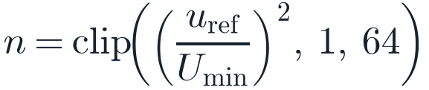
More points per cell where the energy is low
Points per grid cell
1
Density follows the energy
U_{min} is the lowest bent-up energy at the cell's 8 corners and u_{ref} = 3: one point (the node) above U_{min} = 2.45, all 64 below 0.375.
$$n=clip\left({\left(\frac{u_{ref}}{U_{min}}\right)}^{2},1,64\right)$$
2
Partial cells: at least 16
Cells where the bent-up branch holds at some corners only: its fold edges, and along φ₁ = φ₂, where p changes sign smoothly.
3
Spread through the cell
The node, then a scrambled Sobol set with a random shift per cell. Only the bent-up branch on φ₁ + φ₂ ≥ 0 is solved; mirror and reflection give the rest.
1.11 M
7.6 M
4
Production tests, and negatives
Warm start from the corners, nearest first, at most 3 tries: no jump in q, stable. A failure in a partial cell is kept as a negative example (no state).
new points solved
states in the dataset
998 k states, 112 k past a fold; 23 min on 14 workers
28.9 % with U < 1, against 2.4 % in the production run

Slide 37
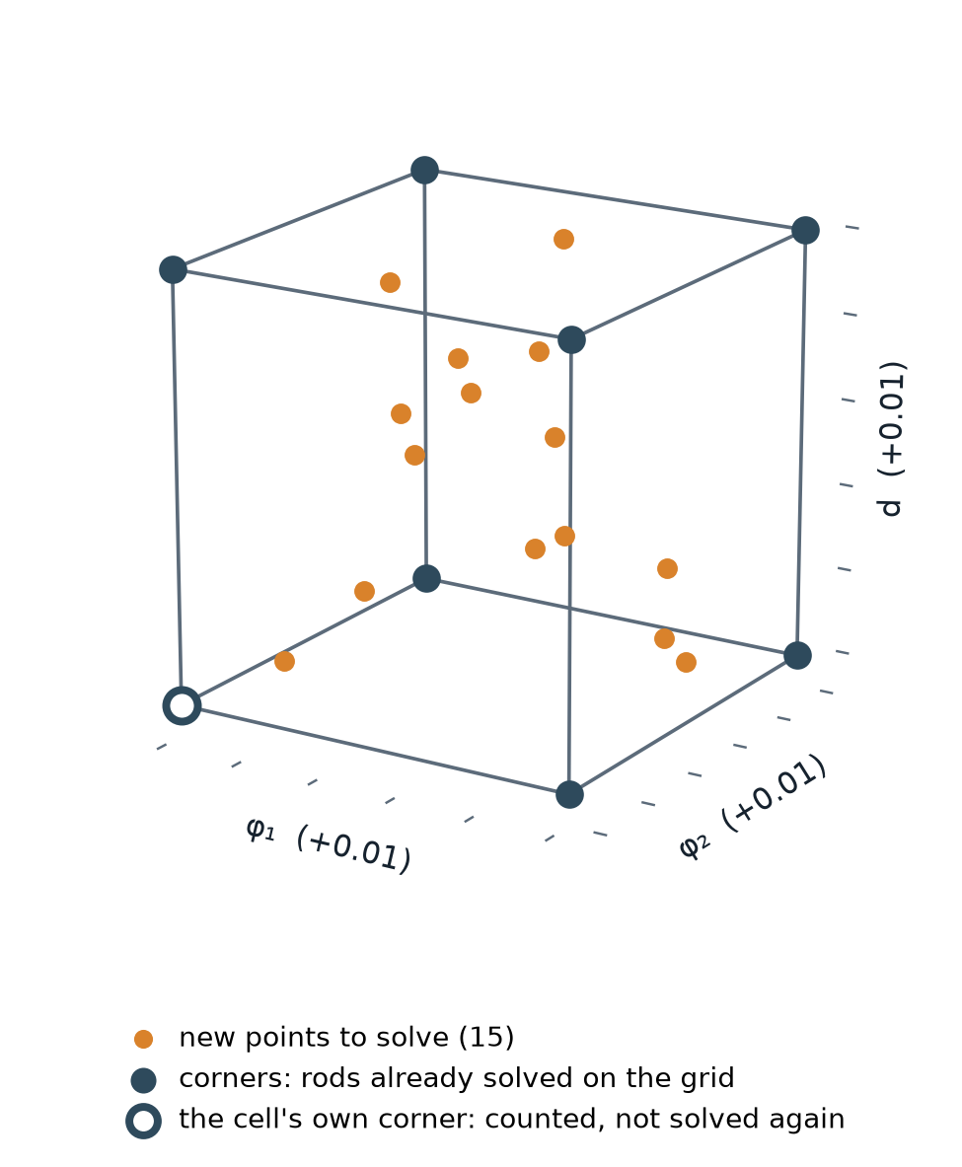
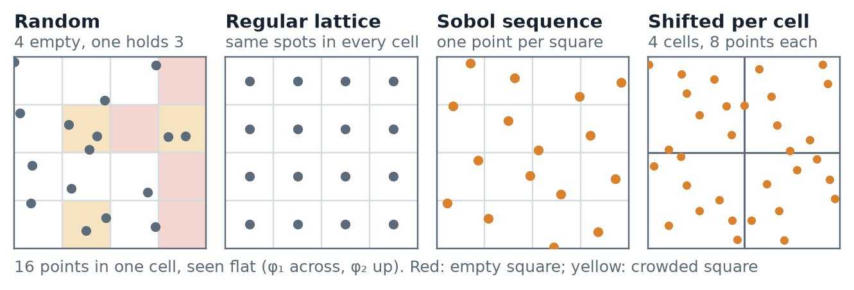
Inside a cell: new points spread evenly
1
What a cell is
The box between 8 neighbouring grid points, 0.01 wide in φ₁, φ₂ and d. Its corners are already solved.
2
Spread evenly: Sobol
A recipe that gives every part of the box its share of points: no clumps, no holes.
3
A new shift in each cell
Each cell slides its pattern by its own random amount, so neighbouring cells never share one pattern.
Example: n = 16, so the cell's own corner plus 15 new points, anywhere inside, d included: the data also covers values between the 30 d layers.

Slide 38
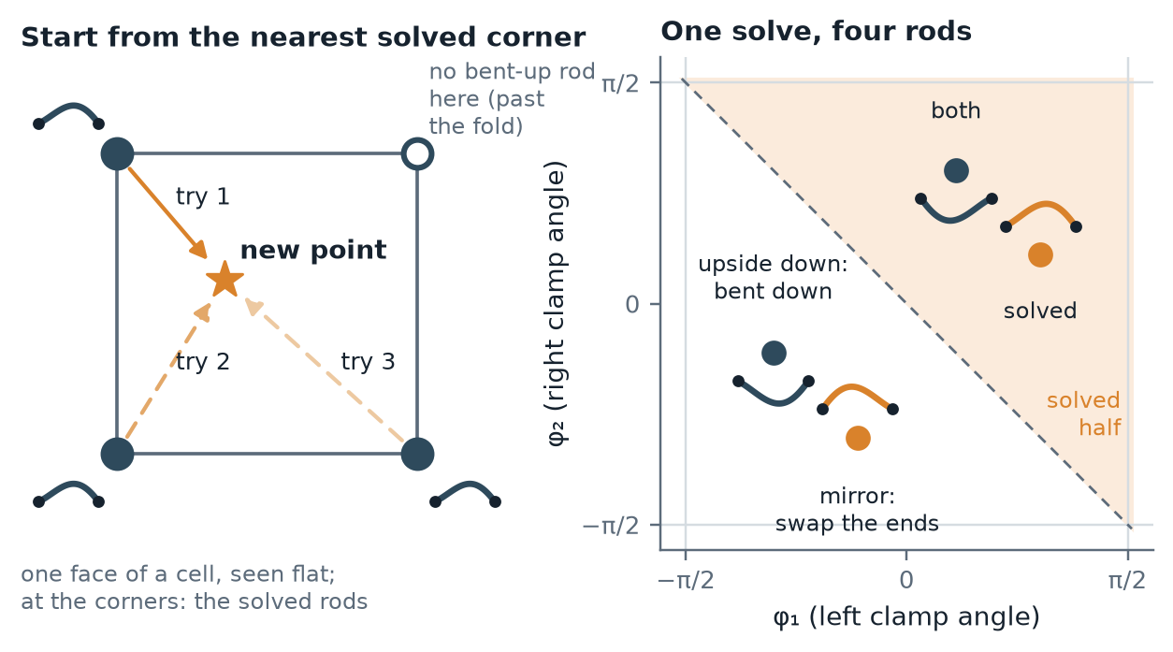
Solving each new point from its neighbours
1
Start from a nearby answer
Each rod is found by Newton's method, which improves a guess step by step. A solved corner rod, at most 0.01 away, is a very good guess.
2
Nearest corner first, up to 3 tries
Only corners holding the bent-up rod are used. The answer is kept if it converged, did not snap to the other shape, and is stable.
3
If every try fails
Near a fold the bent-up rod may not exist at that point: it is kept as a “no rod here” example, which shows where the shape ends. Elsewhere: a fresh solve, or the point is dropped.
998 k
112 k
9
4
One solve gives four rods
A rod seen from behind (ends swapped) or turned upside down is still a valid rod, so only a quarter of the points are solved.
rods accepted
“no rod here”
dropped
from 1.11 M new points
kept: past a fold
3 more: solved afresh

Slide 39
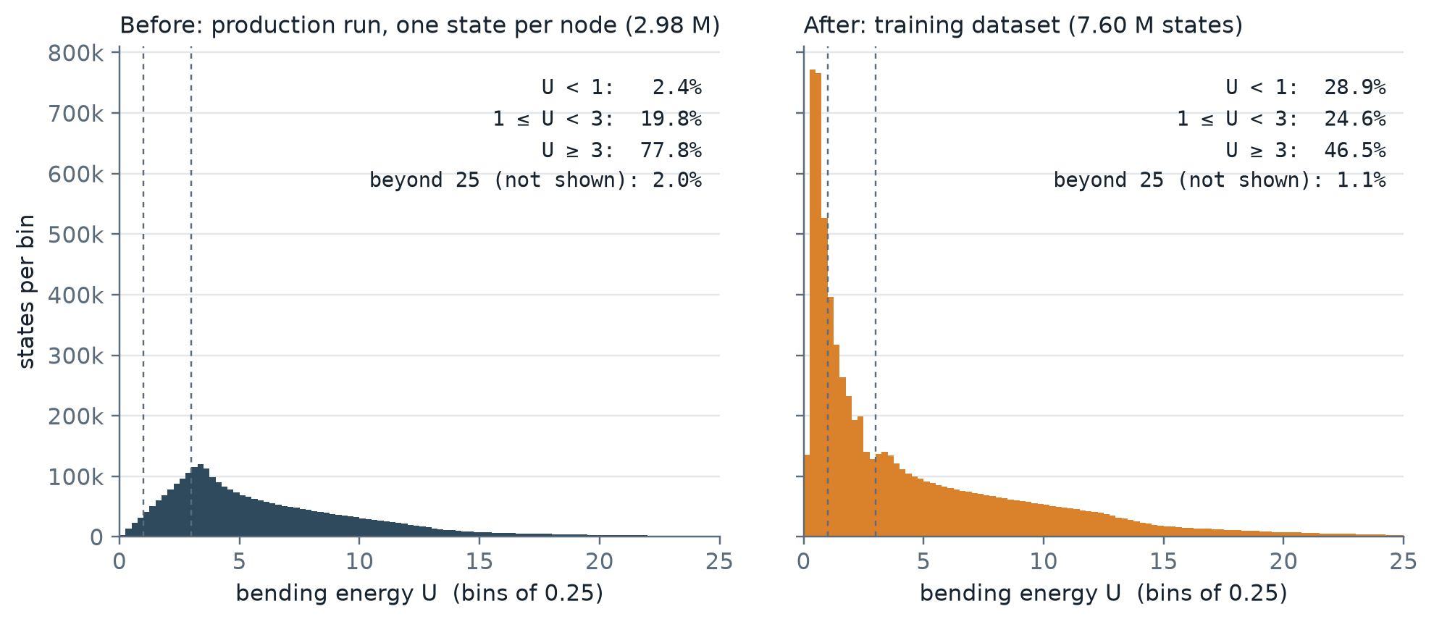
Refinement moves the data to low energy
Same bins and axes. Before: one state per grid node, 2.4 % of them with U < 1. After: both branches at every node plus 4.0 M refined states (998 k solves and their symmetry images); 28.9 % with U < 1 and 24.6 % with 1 ≤ U < 3. The grid's high-energy states are all kept.

Slide 40
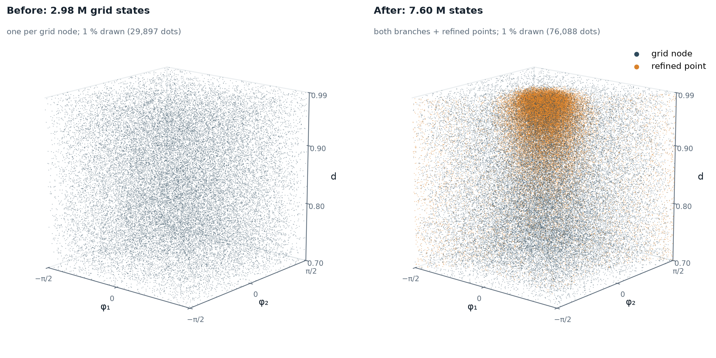
In 3D: the new points gather where the energy is low
Each side draws the same random 1 % of its points, so dot density is data density. Before: one state per grid node, evenly spread. After: refined points (orange) fill the low-energy region at high d near the centre; grid nodes (slate) still cover the rest. Orange away from the centre comes from the minimum of 16 points per partial cell: fold edges, and the diagonal φ₁ = φ₂.

Slide 41
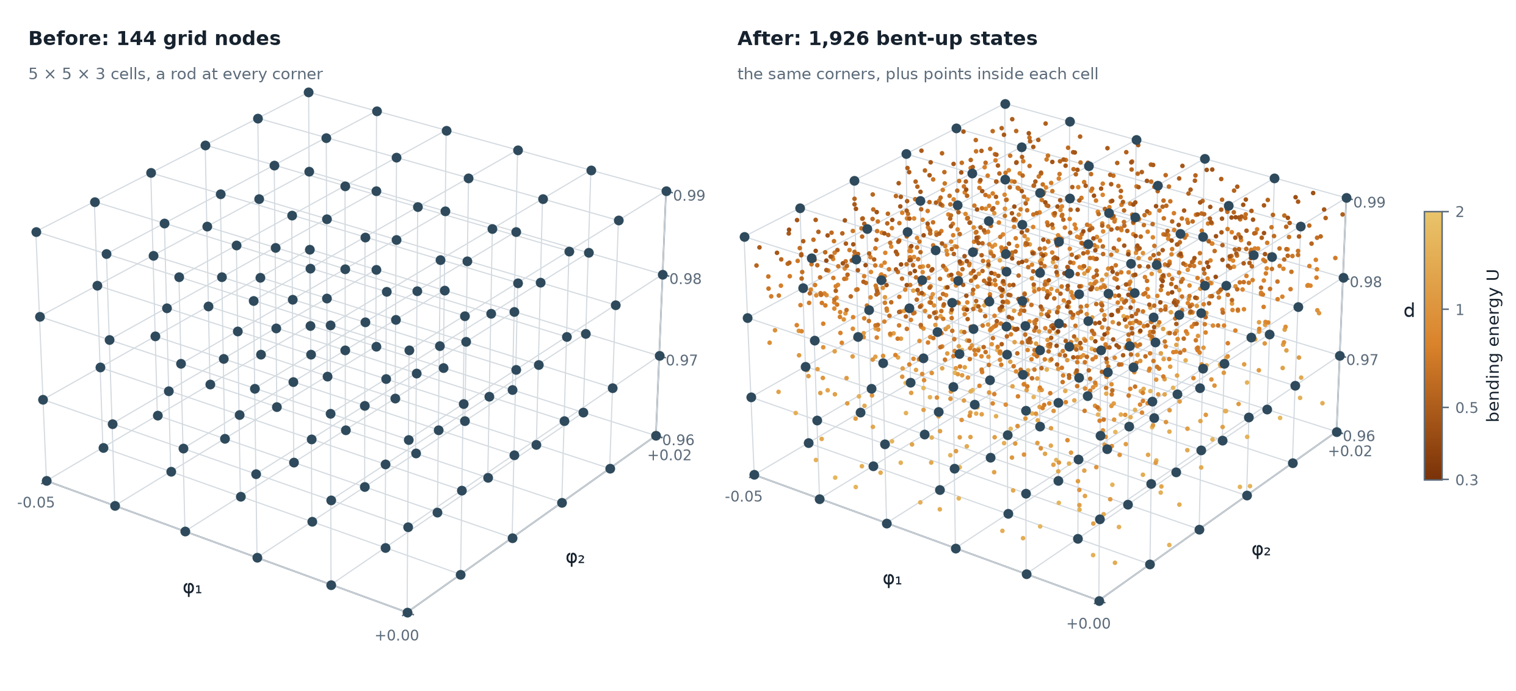
Close up: more points inside the cells where U is low
Every bent-up point in 75 cells at d = 0.96–0.99, φ₁ ∈ [−0.05, 0], φ₂ ∈ [−0.03, 0.02]. The grid nodes stay; each cell adds its own points inside. Towards the top U falls (0.36 at the lowest) and the cells hold up to 64 points; at the bottom, where U reaches 1.8, as few as 5.

Slide 42
Iso-energy sampling
A second scheme: points on level sets of U, as many per level as a 1/U target asks: 8.9 M states, 45 % with U < 1

Slide 43
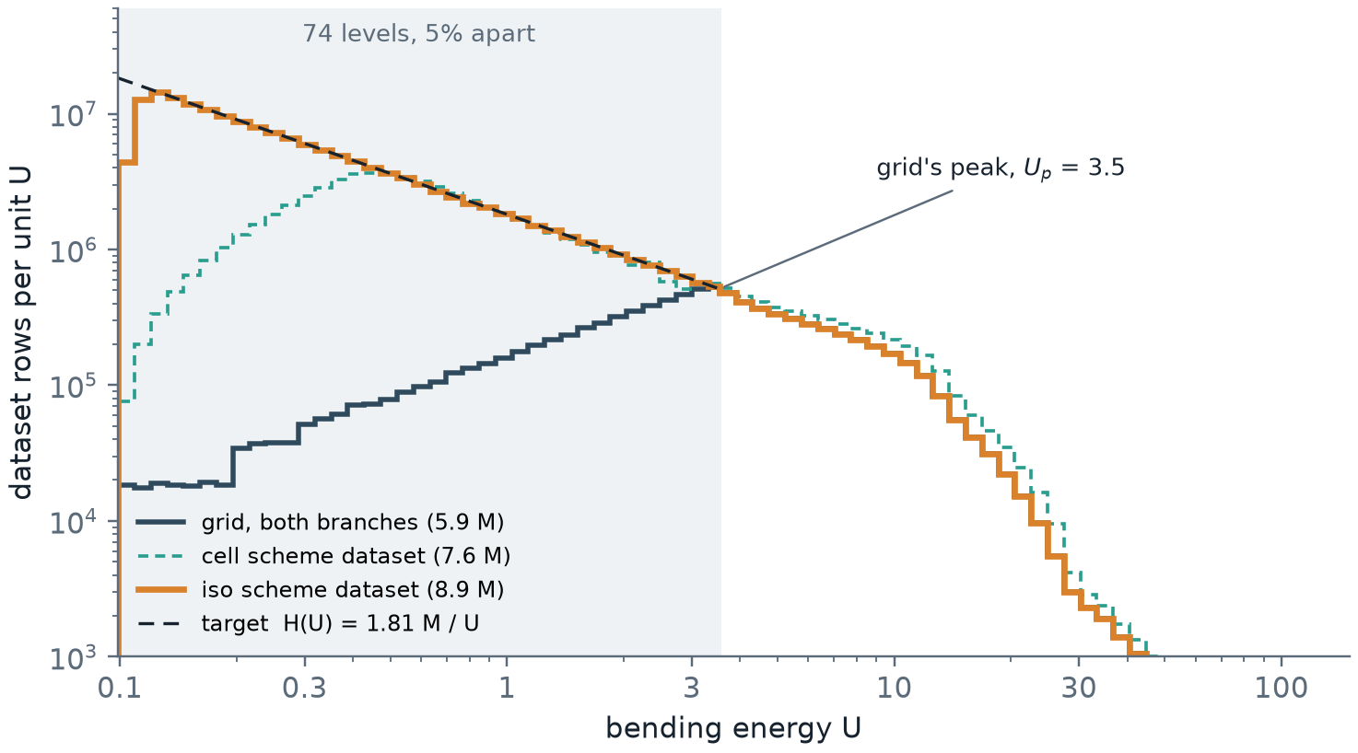
Aim the whole histogram at a target
1
A target for the dataset
Rows per unit energy H(U) = C / U, from the lowest energy, 0.10, up to Uₚ ≈ 3.5, where the grid’s own histogram peaks. Above Uₚ the grid alone.
2
Why 1 / U
Every decade of U gets the same data: what a fit of log U, or of U to a fixed relative error, needs. 1 / U² would take 15.5 M solves, 11 times as many.
3
Levels 5 % apart
74 levels Uₖ from 0.10 to 3.5. Each gets the target’s rows in its interval, less the grid’s rows already there, divided by four: one solve gives four rods.
74
1.33 M
1.81 M / U
4
Planned before any solve
A dry run places every point and predicts the histogram: 2.5 min for all 74 levels.
levels
points solved
rows per unit U
U = 0.10 to 3.5
none dropped
measured, 0.12 ≤ U ≤ 3.5

Slide 44

Points spread evenly over each level surface
1
The level surface
Marching tetrahedra over the 6 tetrahedra of every cell, only those with the bent-up rod at all four corners and no jump in q: the surface ends at the fold.
2
Candidates
The surface’s own vertices, one per crossed grid edge, then a lattice inside every triangle at half the spacing.
3
Poisson-disk selection
Vertices first, then lattice points, in random order: a point is kept unless a kept point lies within r. r is tuned per level to within 3 % of its target.
1.06 r
1.54 r
2.6 k
4
Half the surface
Only φ₁ + φ₂ ≥ 0 is placed; the mirror and the reflection give the other three rods. r never drops below 0.05 grid steps.
median spacing
99.9 % closer
on the lowest level
nearest neighbour, all levels
no wide gaps
target 22 k: a tiny cap at d = 0.99

Slide 45

Solve, then slide each point onto its level
1
Warm start from the corners
As in the cell scheme: corners holding the bent-up rod, nearest first, at most 3 tries; no jump in q, and stable.
2
It lands near the level
The surface came from linear interpolation, so the solve misses Uₖ slightly; near d = 0.99 by a few %.
3
The gradient comes free
Envelope theorem: ∇U = (−fx, −M₁, M₂) in (d, φ₁, φ₂), which the solve already gives. Step by −(U − Uₖ) ∇U / |∇U|² and re-solve from the rod just found.
99.78 %
1.55
28 min
4
Up to 4 steps
Until |U / Uₖ − 1| < 10⁻⁴. A step that would leave the box slides along its face.
within 10⁻⁴
projection steps
on 14 workers
the rest: valid rods, 2.8 × 10⁻⁴ off
mean per solve
1.33 M solves

Slide 46

Iso-energy sampling puts 45 % of the data below U = 1
Same bins and axes as the cell scheme. The iso scheme adds 5.3 M states (1.33 M solves and their images), 74 % of them with U < 1; the grid’s states are all kept. The lowest four levels, within 20 % of the lowest energy, are tiny caps on the d = 0.99 face and hold 2.6 k–21 k points instead of 22 k.

Slide 47
Energy-shell sampling
A third scheme: the same target, with the points spread through the shells between the levels instead of on them: 9.0 M states, 46 % with U < 1

Slide 48

Points on the levels leave the energies between them empty
Left: energies of the new states from U = 0.9 to 1.2, on 0.24 % bins. The iso scheme’s sit on its levels (dotted), 5 % apart: all of them within 0.5 % of a level. The shells’ fill the range: 18 % within 0.5 % of a level, about what evenly spread energies give. Right: in space the two look alike at this scale; a slab of d a third of a grid step thick holds 4.4 k and 4.0 k points. The gap is in the energies.

Slide 49

Fill the shell between two levels
1
Same target, levels as bin edges
H(U) = 1.81 M / U up to Uₚ ≈ 3.5, in 74 bins 5 % wide; each gets the target’s rows less the grid’s, divided by four.
2
The shell
Where the energy interpolant over the jump-free bent-up tetrahedra lies in the bin: it ends at the fold and at the box.
3
Uniform candidates, Poisson disk in 3D
The same number of random points in every tetrahedron the bin crosses, kept inside the shell, 12 per point wanted; a greedy 3D Poisson-disk pass keeps the target, r tuned per bin.
1.36 M
99.64 %
29 min
4
Solve, then project onto the plan
Warm start from the corners, then along ∇U = (−fx, −M₁, M₂) to the point’s planned energy, within 10⁻⁴. Stopping at the bin edge instead piles states up there.
points solved
within 10⁻⁴ of plan
on 14 workers
planned in 69 s, none dropped
99.95 % in their bin
1.62 projection steps on average

Slide 50

Three schemes on the same bins
The shells add 5.4 M states (1.36 M solves and their images) and match the iso scheme bin for bin at this scale: 46 % of the data below U = 1, against 29 % per cell. In the smallest bins, caps at d = 0.99, a 3D shell holds more points than a surface: 5.4 k, 11 k and 17 k in the lowest three, against 2.6 k, 8.4 k and 15 k; the target is 22 k.

Slide 51
A neural-network surrogate
A fast formula, fitted to 9 million solver results, that gives U, M₁, M₂, fx, fy and which shapes exist at any clamp setting; and how far it can be trusted

Slide 52

Why replace the solver with a network?
A solve takes 18 ms and must start from a solved neighbour; the network answers any clamp setting in microseconds, with exact derivatives.
1
The solver
Newton iterations on 203 unknowns at every point, each started from an already-solved neighbour: 17.9 ms of one CPU core, 5 hours per million states.
2
The surrogate
One formula, evaluated at any (d, φ₁, φ₂) and either shape, with no neighbour needed: 0.46 µs per state on a GPU, 7.6 µs on a CPU.
3
What that is for
Sweeps over millions of clamp settings, and optimisation or control loops that need many evaluations and their derivatives.
4
The price
It is a fit, so it carries an error. The slides that follow measure that error, and where it is largest.

Slide 53

What is a neural network?
A flexible formula built from many simple units. Fitting sets its 662 thousand numbers so that it reproduces the solver’s results.
1
One unit
Takes a weighted sum of its inputs, adds a constant, and bends the result with a smooth curve (bottom left).
2
Layers of units
Each layer feeds the next: 6 layers of 256 units. Stacking simple bends lets the formula follow curved, steep surfaces such as U(d, φ₁, φ₂).
3
Fitting
Start from random weights; again and again, compare with the solver on a batch of states and nudge every weight to reduce the mismatch (gradient descent).
4
Why a smooth bend
The formula can then be differentiated exactly everywhere, which the forces need (slide 55).

Slide 54

What goes in, and what comes out?
In: the clamp setting and the shape, bent up or bent down. Out: U, M₁, M₂ and whether that shape exists. The forces follow from U.
1
The shape is an input
Where both shapes exist, one clamp setting has two answers: b = +1 or −1 says which one is wanted.
2
The energy network
Gives U, M₁ and M₂ of that shape. It works with ln U and asinh M rather than U and M (slides 57 and 58).
3
The existence network
Gives the probability that the shape exists there: past a fold the rod has snapped, and there is no such state.
4
The forces
Not separate outputs: fx and fy are slopes of the network’s U, computed exactly (next slide).

Slide 55

Why can the forces come from the energy?
Because the end loads are the slopes of U: fx = −∂U/∂d, M₁ = −∂U/∂φ₁, M₂ = ∂U/∂φ₂, and fy follows from a rotation.
1
Work done at the ends
Moving the clamps changes the stored energy by the work of the end loads: dU = −fx dd − M₁ dφ₁ + M₂ dφ₂ (the envelope theorem).
2
fy from a rotation
Turning the whole rod by α changes nothing but moves its end sideways by d α, so fy = (∂U/∂φ₁ + ∂U/∂φ₂) / d.
3
Checked on the solver
Slopes of the solver’s own U between grid points match its fx, M₁ and M₂ to 1 part in 10⁴. Left: the tangents, at one clamp setting.
4
What it buys
Forces consistent with the energy by construction, from exact derivatives of the formula, not from differences between nearby points.

Slide 56

Which data is it fitted to, and how is it tested?
11.4 million solver results. One grid cell in five is held back, whole, and used only to measure the error.
1
The states
9.04 million solved states of both shapes, denser where the energy is low (the refinement schemes earlier in the deck).
2
The no-state points
2.34 million grid points past a fold, where the chosen shape does not exist: the examples for the existence network.
3
Held back
20 % of the grid cells, drawn at random in each energy band, are never shown to the fit. Every error on the following slides is measured on them.
4
Mirror images together
A state and its mirror images always fall on the same side, so no held-back state is the mirror of a fitted one.

Slide 57



Why fit ln U instead of U?
U spans 0.1 to 142. Fitted directly, the large energies would dominate the fit; fitted as ln U, every state counts by its relative error.
$$ln(U+δU)−lnU≈\frac{δU}{U}$$
A miss in ln U is a relative miss in U: 0.001 in ln U is 0.1 % of U, at U = 0.1 and at U = 100 alike.
$$(δU)^{2}=(0.01 U)^{2} against (δlnU)^{2}={0.01}^{2}$$
For the same 1 % miss, the plain squared error weighs a state at U = 142 two million times one at U = 0.1 (middle); ln U weighs them equally.
$$U=e^{z}>0 for every z$$
The network’s output z can be any number, and U = eᶻ is still a positive energy (right).

Slide 58


Why asinh for the moments and forces?
They change sign, so ln is ruled out. asinh is linear near zero and logarithmic far from it: absolute accuracy near 0, relative when large.
$$asinhM=ln\left(M+\sqrt{M^{2}+1}\right)$$
Defined for every M, positive or negative. Used for M₁ and M₂, and for fx / 10 when the force is fitted.
$$asinhM≈M (|M|≪1), asinhM≈±ln2|M| (|M|≫1)$$
Its two limits (left): it follows M near zero, and the logarithm of |M| far from it.
$$δM≈\sqrt{1+M^{2}} δ(asinhM), asinh(−M)=−asinhM$$
So a fixed miss is an absolute error below |M| = 1 and a relative one above (right). And it is odd: bent down, which mirrors M to −M, stays a mirror.

Slide 59





What exactly does the fit minimise?
One number, the loss: the average squared mismatch with the solver, summed over five terms. Fitting lowers it, batch after batch.
Energy: ln U of the network against ln U* of the solver. ⟨ ⟩ is the average over the states in a batch; * marks the solver’s value.
$$L_{U}=\left\langle (lnU−lnU^{*})^{2}\right\rangle$$
LM=i=1,2​(asinhMi−asinhMi*)2
Moments, on the asinh scale of slide 58.
$$L_{∂}=\left\langle {\left(asinh\frac{−∂U}{∂φ_{1}}−asinhM_{1}^{*}\right)}^{2}+{\left(asinh\frac{∂U}{∂φ_{2}}−asinhM_{2}^{*}\right)}^{2}\right\rangle$$
The network’s slopes of U against the solver’s moments: makes the energy and the moments agree (slide 55).
$$L_{f}=\left\langle {\left(asinh\frac{−∂U/∂d}{f_{0}}−asinh\frac{f_{x}^{*}}{f_{0}}\right)}^{2}\right\rangle , f_{0}=10$$
The network’s slope along d against the solver’s force (slide 65). f₀ = 10 sets where asinh turns from linear to logarithmic.
Existence: e = 1 where the shape exists, else 0. The penalty grows without bound for a confident wrong answer.
$$L_{∃}=−\left\langle elnP+(1−e)ln(1−P)\right\rangle$$
Each term weighted 1. The energy network sees only states that exist; the existence network sees every point.
$$L=L_{U}+L_{M}+L_{∂}+L_{f}+L_{∃}$$

Slide 60

Does the fit converge without memorising?
Over 200 passes through the data every term falls by 2½ to 6 decades, and states the fit never saw come out as well as the ones it did.
1
A pass
Every training state used once, in batches of 8192; each batch gives one small correction to all the weights: 1,113 corrections per pass.
2
Measured on held-back rows
The curves are the loss terms on rows the fit never uses, every 5 passes. The early jumps come from large steps, which shrink towards the end.
3
No memorising
Median errors on fitted and on held-back states agree to two digits in every energy band (slide 66): the fit has not just stored its data.
4
Cost
86 minutes on one RTX A6000 graphics card, for 662 thousand weights and 11.4 million rows.

Slide 61

How close is it on states it never saw?
Half of the held-back states are within 0.0012 % in U and 0.04 % in the moments and forces.
Relative error = |network − solver| / |solver|, with a floor of 1 % of the typical size where a quantity passes through zero (the moments, fy); 1.8 million held-back states of both shapes, in 35 bins of energy. fy’s 99th percentile is high only where fy itself is close to zero.
0.0012 %
0.036 %
0.013 %
0.027 %
energy U
moment M₁
force fx
force fy
median; 99 % within 0.011 %
median; 99 % within 0.61 %
median; 99 % within 0.16 %
median; 99 % within 2 %

Slide 62

How big are the errors in the problem’s units?
They grow with U about as fast as the quantities themselves, and stay a median 3½ to 5 decades below them.
EI = L = 1. Dotted: the typical size of the quantity at that energy; shaded: the error from its median to its 99th percentile, on the held-back states. U is off by 3 × 10⁻⁶ below U = 1 and by 2.6 × 10⁻⁴ above U = 10; the moments and fy by 1.5 × 10⁻⁴ to 5 × 10⁻³; fx by 1.4 × 10⁻³ to 1.2 × 10⁻². Above U = 30, where |fx| reaches 1.4 × 10⁴, fx is off by a median of 1.8.

Slide 63

Where are the errors largest?
Along the fold, where a shape is about to snap: there the errors are 5 to 11 times those inside. The corners of the box come next.
Median |network − solver| per hexagon, over the 15,773 held-back bent-up states with |d − 0.90| < 0.0025; grey line: where the bent-up shape ends. Within 0.06 of the fold the median error is 1.5 × 10⁻⁴ in U against 2.3 × 10⁻⁵ inside, 6.5 × 10⁻³ against 6.0 × 10⁻⁴ in M₁, 1.3 × 10⁻² against 2.4 × 10⁻³ in fx. The relative error is also 2 to 4 times higher there for M₁ and fx: near a fold the state changes fastest with the clamps.

Slide 64

Does it know where each shape exists?
Yes: 99.994 % of the held-back points are classified right, and the mistakes sit on the edges, within a grid step of where a shape ends.
d = 0.90, on the solver’s grid. The edges are the folds, where a shape ends and the rod snaps, and the line φ₁ = φ₂, where the one state there turns from bent up to bent down.
99.994 %
99.3 %
0.004 %
0.014 %
held-back points right
right in fold cells
shapes missed
false shapes
2.27 M points, both shapes
16,572 points at an edge
exists, predicted absent
absent, predicted to exist

Slide 65

Why does the fit use the solver’s forces too?
Fitted on U and the moments alone, ∂U/∂d is off by up to 2 % at high tension; fitting the force too holds fx to 0.01–0.1 %.
1
The tension grows steeply
Above U ≈ 20, near d = 0.99 with large clamp angles, |fx| rises to 10⁴ (top): there U changes very fast with d.
2
A small slope error, a large force error
A tiny error in the shape of U along d then becomes a large error in its slope, fx = −∂U/∂d (bottom, grey).
3
Not a lack of data
That fit is as wrong on the states it was fitted to as on new ones: the fit itself falls short, not the number of states.
4
Fitting the force too
The force term (slide 59) makes the slope match the solver’s force: fx within 0.01–0.1 % at every energy, and U improves as well.

Slide 66

Is it good enough, and where does it stop?
Its errors are about the size of the solver’s own, 1.2 × 10⁻⁴ against an independent solver: to do better, the solver has to improve first.
1
As accurate as its data
The solver agrees with an independent boundary-value solver to 1.2 × 10⁻⁴ (median); the network’s moment and force errors are of that size (shaded band).
2
More data would not help
The errors on fitted states (rings) and on held-back ones (dots) are the same: the network is not short of data.
3
Where it holds
d from 0.70 to 0.99, φ₁ and φ₂ within ±π/2, and only where the existence probability is above 0.5; least accurate along the folds.
4
To go further
A finer beam mesh near the clamps at high tension, then a larger network; more points near the folds for the existence network.

