Slide 1

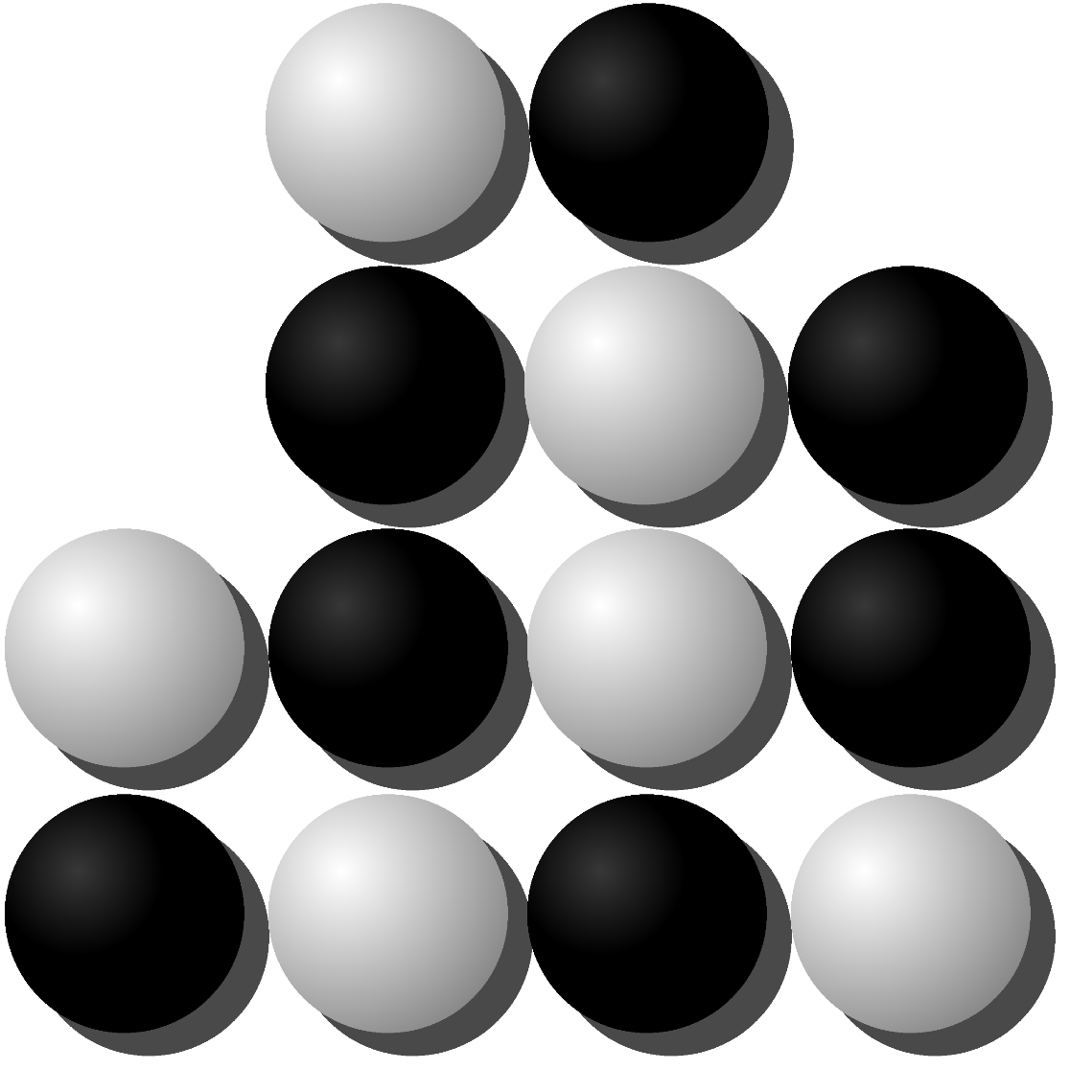
Abschlussarbeit CAS HTML5
Nguyen Khoa Thien
Tyedmers Gérard
Jenzer Ulrich

Slide 2
Reversi Web App
Umsetzung des Spiels Reversi als HTML5 WebApp
3 Spielmodi:
Lokal 2 Spieler
Lokal Spieler vs. Computer
Online
Statistiken / Rangliste
Div. Einstellungen (Darstellung, Avatars, …)

Slide 4
Online Modus
Server-Lösung realisiert mit node.js / socket.io
Lokaler Server (node.js / localhost )
Externer Server (OpenShift by Redhat)

Slide 5
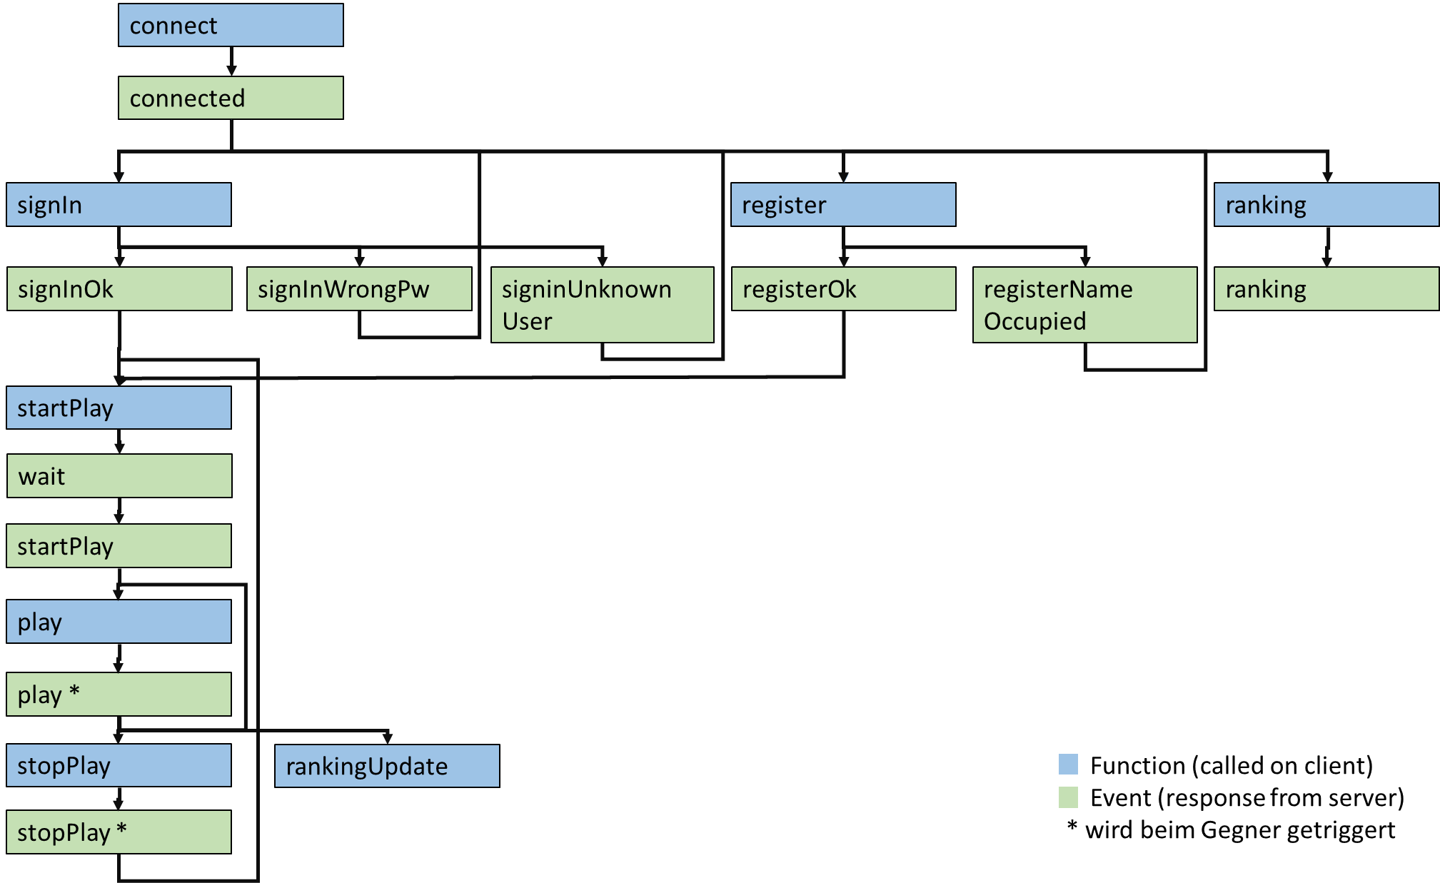
Oline Kommunikation

Slide 6
Verbindungsaufbau
<script src="js/vendor/socket.io.js"></script>
connect = function () { socket = io.connect('http://localhost:3000', {'forceNew': true});

Slide 7
Server Side Script
io.on('connection', function(socket){ // create a new user var user = { id: socket.id, name: null, opponent: null }; io.to(socket.id).emit("connected", user);

Slide 8
Client Event
socket.on('connected', function (data) { console.info("successfully connected "); });

Slide 9
Online Spielzug
play = function (row, col) { socket.emit('play', {to: user.opponent, row: row, col: col}); };
socket.on("play", function (data) { io.to(data.to).emit("play", data); });
self.socket.on('play', function (data) { console.info("opponent played in row " + data.row); }

Slide 10
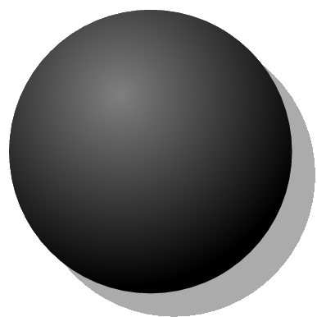
.svg-Grafiken
<svg width="206" height="206" viewBox="0 0 206 206" xmlns="http://www.w3.org/2000/svg"> <defs> <radialGradient fy="0.3" fx="0.4" r="0.7" cy="0.3" cx="0.4" id="black"> <stop stop-color="#7f7f7f" offset="0"/> <stop stop-color="#000000" offset="1"/> </radialGradient> </defs> <g> <ellipse id="shadow" opacity="0.33" ry="90" rx="90" cy="115" cx="115" stroke-linecap="null" stroke-linejoin="null" stroke-width="0" stroke="#000000" fill="#000000"/> <ellipse id="stone_black" ry="90" rx="90" cy="100" cx="100" stroke-linecap="null" stroke-linejoin="null" stroke-width="0" stroke="#000000" fill="url(#black)"/> </g> </svg>
http://svg-edit.googlecode.com

Slide 12

let’s play!
http://grrd01.github.io/Reversi/

