Slide 1

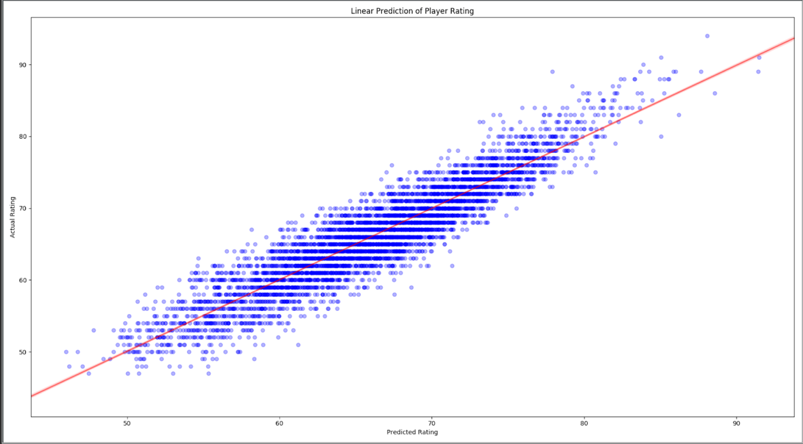
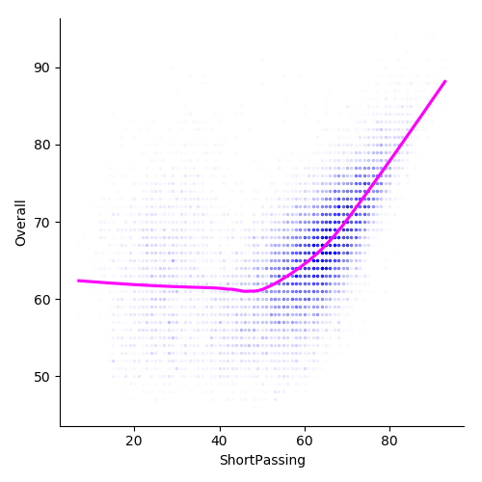
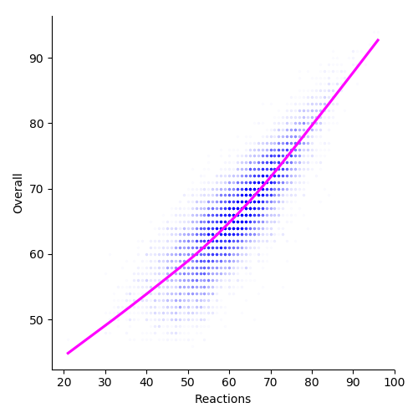
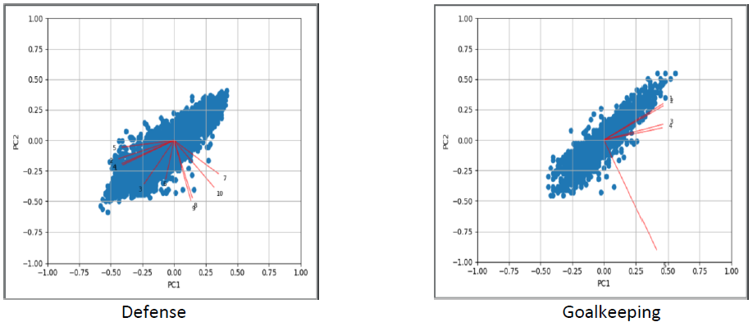
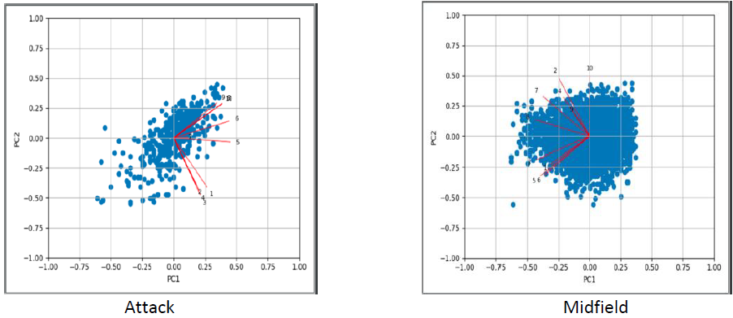
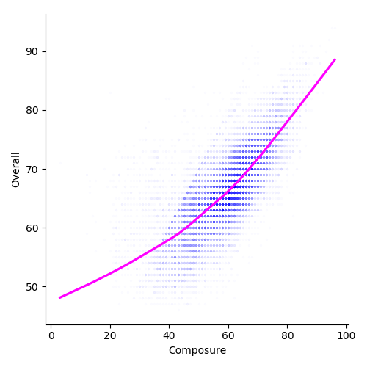
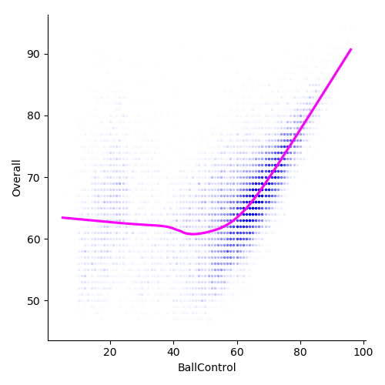
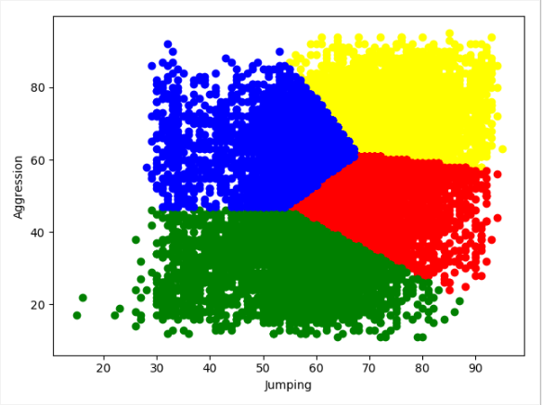
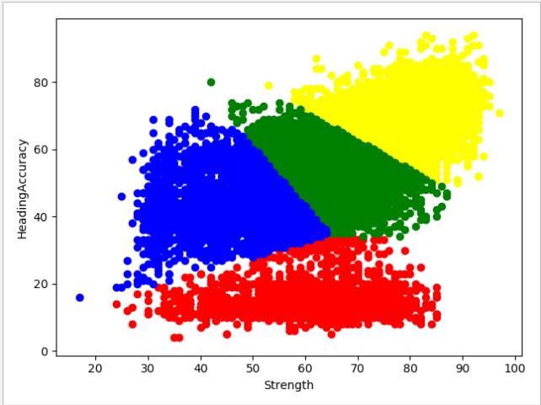
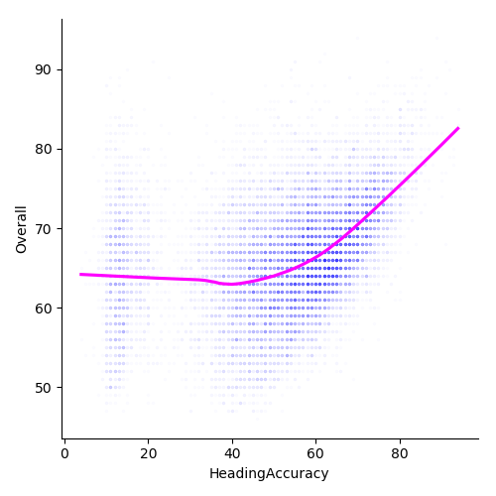
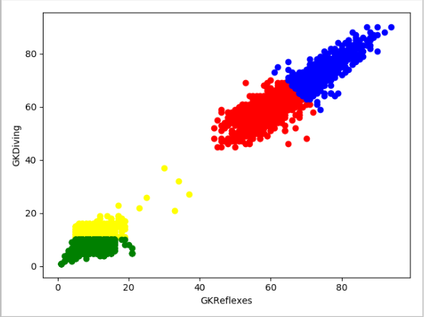
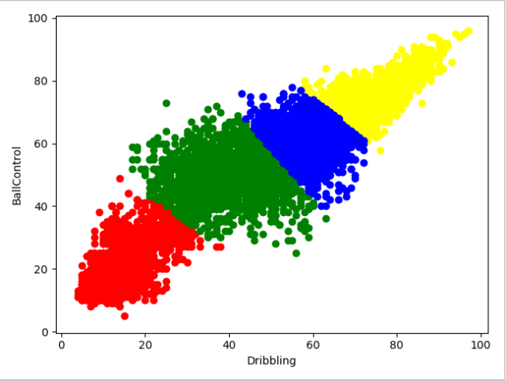
FIFA 19 PLAYER RATING AND WAGE ANALYSIS
Group 44: Lakshmi Narayanan Ramasamy, Mahima Regunathan, Srivathsan Gomadamramesh
Methods
Regression
Read Fifa19 data
Problem & Motivation
The key idea behind this project is to find the factors that influence the ratings/wage of a player by applying techniques like Principal Component Analysis (PCA), K-means ++ clustering and Linear Regression.
Data Preprocessing
FIFA 19 is a soccer-based video game which features around 18,000 domestic and international players
Players depicted in the game possess skillsets that are exactly similar to their real-life counterparts
The game has an intuitive rating system that weighs each player’s skillset according to the position they play
Our motive is to identify the player attributes that contribute majorly to his rating in the game
PCA to find top 2 features
Regression to find top 5 features
Clustering based on the 2 features
Relationship between these features and Overall rating
Accuracy of prediction: 86%
Results
Dimensionality Reduction - PCA
Data
Attack:
Dribbling, BallControl
Midfield: Jumping, Aggression
Defense: - Strength, HeadingAccuracy
Goalkeeping: GKReflexes, GKDiving
The dataset chosen for this project is the FIFA 19 complete player dataset from https://www.kaggle.com/karangadiya/fifa19
The dataset consists of 18,200 rows and 89 columns where each row represents a player and each column represents their attributes/skills
Data Preprocessing
Columns like Wage, Height and Weight had to be normalized to a scale of 100.
Missing values filled with mean of the entire column.
Columns irrelevant to our analysis were removed.
We mined the dataset with 34 features and 27 positions and found the top 10 relevant features needed for each position.
We then mapped the 27 positions to 4 broad categories like ‘Attack’, ‘Defense’, ‘Midfield’, ‘Goalkeeping’.
Clustering – K Means++
Midfield
Defense
Attackers: Yellow
Midfielders: Green
Defenders: Red
Goal Keepers: Blue
As the values of the features go above 60, the overall rating also increases linearly.
This results in a higher rating for the player with higher values for these features.
Thus, we can see that these features influence the rating the most.
Goal Keeping
Attack

