Slide 1
Chinook: Data Analysis
Guruprasad Kandgal • 24.07.2024

Slide 2
About Chinook
Chinook is a digital music platform that offers a vast library of music tracks, albums, and playlists for streaming and purchase. It caters to a diverse audience with a wide range of genres and artists, providing a comprehensive experience similar to leading music apps like iTunes or Spotify.
“Not just a music app, but a revolution for your ears.”

Slide 3
What’s so special about chinook ?
Chinook offers a vast library of over 100 million tracks across diverse genres like Rock, Metal, Jazz, and Classical.
Chinook stands out with innovative features like cross-genre exploration and exclusive content, catering to global tastes while respecting regional preferences.

Slide 4
Agenda
1. Chinook’s data
2. Functions and Tools Used
3. Key insights from objective and subjective questions
4. Conclusions
5. Recommedtions

Slide 5
Chinook’s Data
Data Overview
Chinook has total 59 customers from different countries.
It has 25 different genres and 3503 tracks.
Chinook has 275 different artists spread across 25 different genres.
Database has information about the purchase dates and quantity of tracks purchased.
It helps in understanding customers behaviour and buying habits of the customers.
Preprocessing and Data cleaning
There are NULL values in the customer, invoice and employee table.
All the NULL values are categorical and that’s why no mathematical operations can be applied to replace them.
And it neither can be retrieved from any other table by joining.

Slide 6
Functions and Tools used
Date cleaning : There NULL values are in the categorical column so it cannot be replaced by any aggregation operation or any other mathematical operations.
Data Enrichment: Enriched the dataset with additional insights using JOINs to combine multiple tables.
Descriptive Analysis: Conducted analysis using GROUP BY and aggregate functions like SUM(), AVG(), and COUNT() to derive key performance metrics across different genres.
Customer Segmentation: Utilized CASE statements for classifying customers based on purchasing frequency and average spending, tailoring marketing approaches accordingly.
Created dynamic charts in Google Sheets to visually represent insights, facilitating data exploration and decision-making.

Slide 7
Customer Base
Analysis :
A large part of chinook’s are from USA and Canada.
Followed by other countries Brazil and France. There are many other countries using chinook as there music platform.
Recommendations :
As chinook has strong foot hold in USA and Canada music market they should start give personalized recommendations to its users.
As it also has penitrated other countries music industry they should increase marketing and focus on the countries like india where there is diverse taste of music and since india is most populated it high potential to generate revenue.

Slide 8
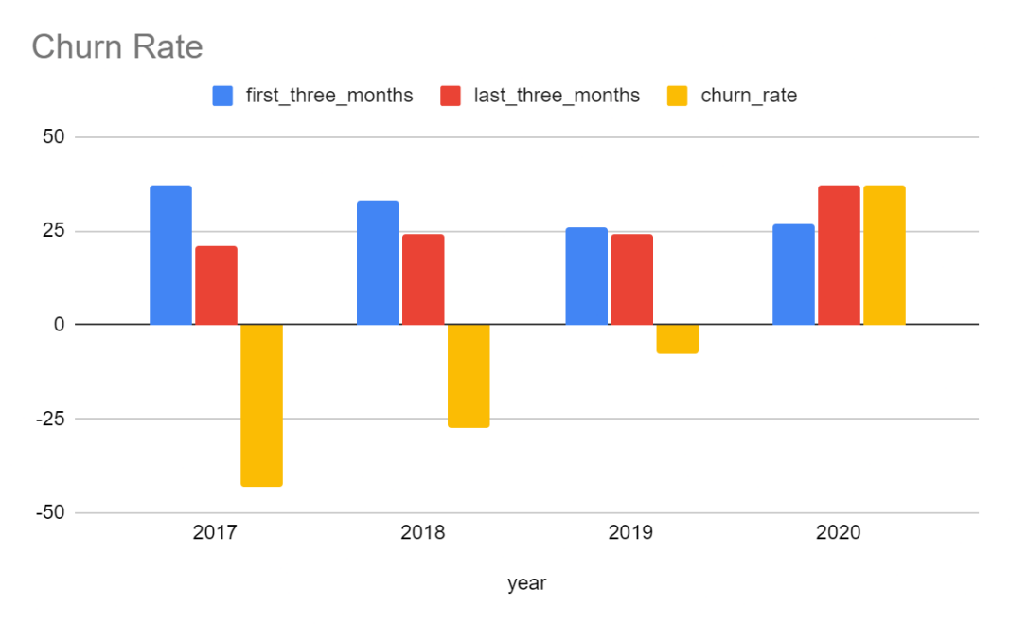
Churn Rate
Analysis:
Customers churn started from year 2017. And it kept decreasing till year 2019.
The year 2020 chinook successfully accquired new customers.
Recommendations:
We can use the marketing stratgies used in 2020 with tailored version to get new consumers.
Same marketing strategy can be applied in the countires where the customer behaviour and economic condtions are alike.

Slide 9
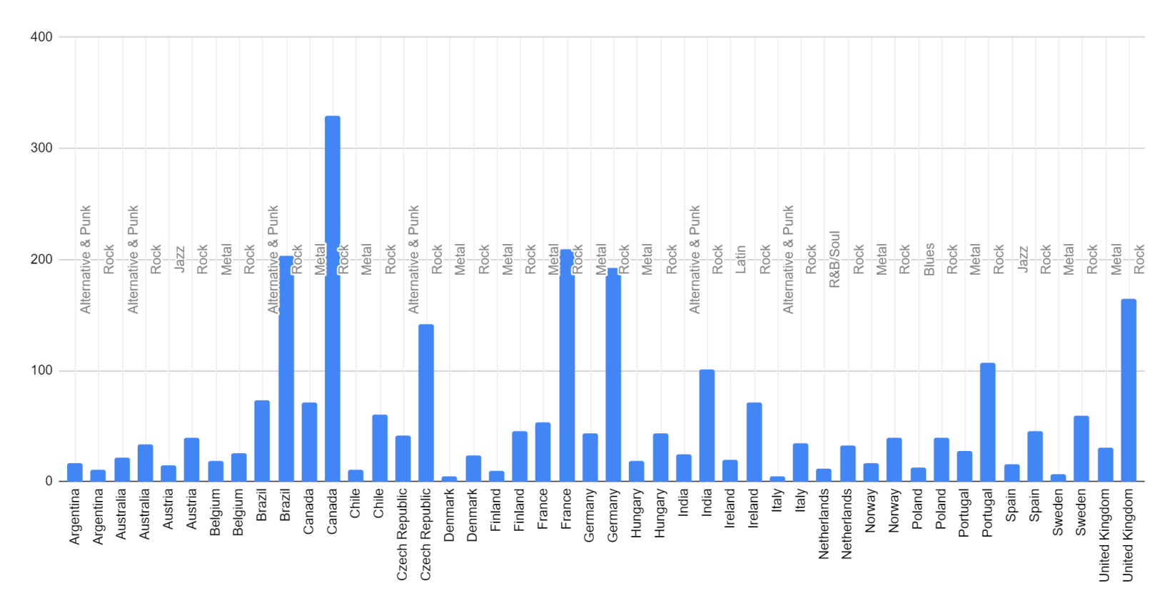
Liked Genre
Analysis:
Every country has Rock in the top genres with other genres.
This makes the rock genre the most liked among users.
Recommedations:
Introducing more rock artists on the platfrom could help get more engagment from new customers globally.

Slide 10
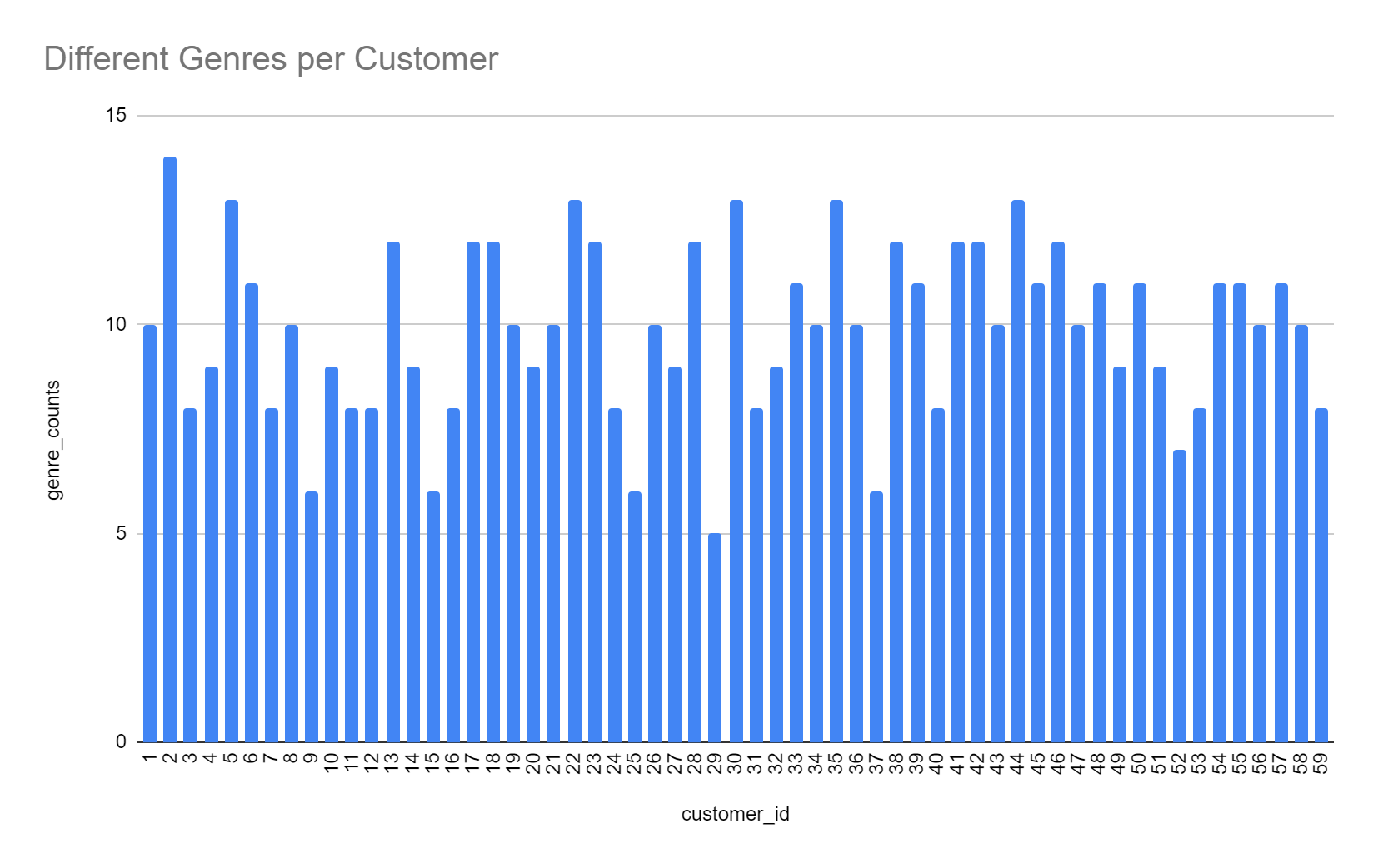
Diverse Taste
Analysis:
Even though the genre is the most like genre. The chart shows that every customer has aleast tracks from 5 different genres.
This shows that customers have diverse taste of music (or trying out songs).
Recommendations:
As customers have diverse taste of music, it gives a chance to market other well performing genres other than rock.

Slide 11
Conclusion
Rock's Dominance:
Rock music commands over 12% of sales and attracts 47% of the customer base, making it the dominant genre.
Geographical Market Presence:
The USA is the strongest market, with the highest number of customers and sales. Other key markets include Canada, Brazil, France, and Germany.
Customer Spending Patterns:
94% of customers spend no more than one dollar on tracks, showing price sensitivity.
Improved Customer Retention:
The churn rate improved significantly from 47% in 2017 to 7% in 2019, showing effective customer retention strategies.
City-Specific Performance:
Cities like Prague demonstrate exceptional performance, with high revenue and invoice counts, suggesting a loyal customer base.

Slide 12
Recommendations
Capitalize on Rock’s Popularity:
Focus Marketing Efforts: Use targeted promotions and collaborations with popular Rock artists to attract more listeners and boost sales.
Expand in Emerging Markets:
Localized Marketing: Develop marketing campaigns tailored to emerging markets like India, the Czech Republic, and Portugal, focusing on local preferences and artists.
Enhance Customer Retention:
Loyalty Programs: Implement rewards programs to incentivize repeat purchases and long-term customer loyalty, offering exclusive content or discounts.
Optimize Pricing Strategies:
Flexible Pricing Models: Introduce pricing models such as bundles or tiered subscriptions to cater to both price-sensitive customers and those willing to spend more.

