Slide 1
Pathogen & resistance identification
EMD 531
Lecture 13
nathan grubaugh, phd

Slide 2
Learning objectives
Students will be able to:
Understand levels of pathogen detection and how genomics compares to traditional approaches.
Understand how drug resistance is determined and when genomics is a helpful approach.
Discuss strategies for closing the “surveillance gap” (activity)
Open Q&A on exercises

Slide 3
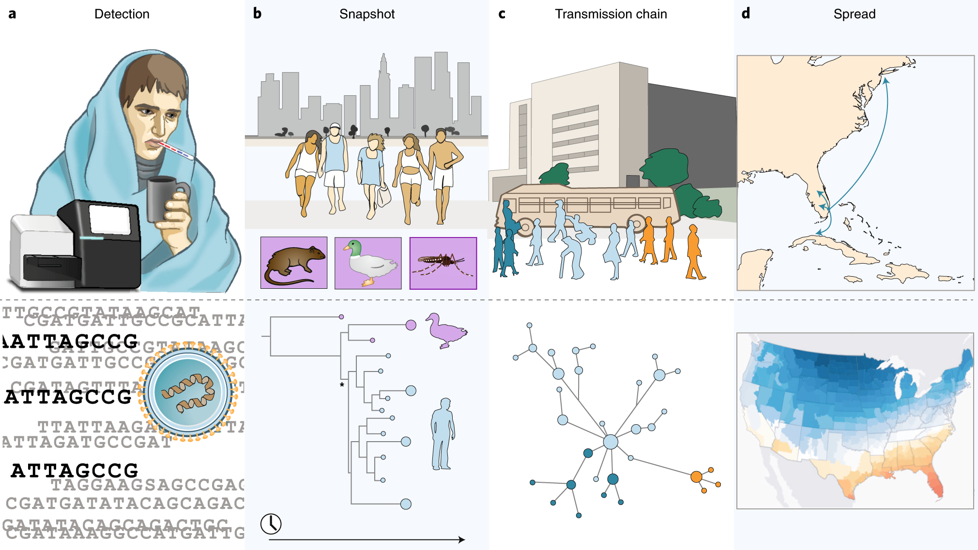
Pathogen genomic applications
Grubaugh et al., 2019. Tracking virus outbreaks in the twenty-first century. Nature Microbiology

Slide 4
When is sequencing the answer? When is it not?

Slide 5
Strategies for detection

Slide 6
Levels of detection
Infection
Virus/bacteria/parasite
Species
Strain
Phenotype

Slide 7
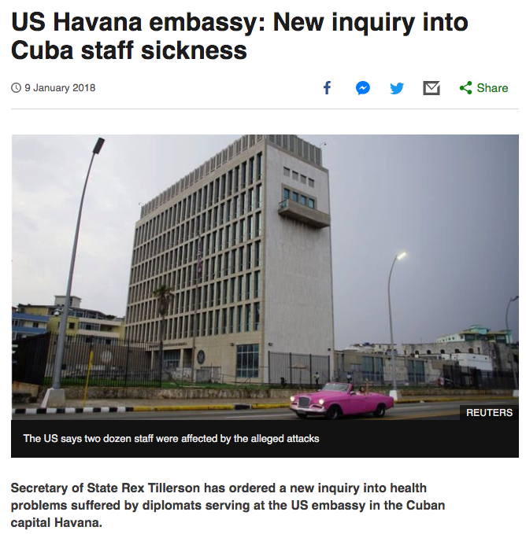
Levels of detection
Infection
Virus/bacteria/parasite
Species
Strain
Phenotype

Slide 8
Levels of detection
Traditional approaches
Infection
Virus/bacteria/parasite
Species
Strain
Phenotype
Symptomology
Culture/microscopy
Antibody tests
PCR
Functional assays

Slide 9
Levels of detection
Traditional approaches
Infection
Virus/bacteria/parasite
Species
Strain
Phenotype
Symptomology
Culture/microscopy
Antibody tests
PCR
Functional assays
Pros?

Slide 10
Levels of detection
Traditional approaches
Infection
Virus/bacteria/parasite
Species
Strain
Phenotype
Symptomology
Culture/microscopy
Antibody tests
PCR
Functional assays
Cons?

Slide 11
Roles of sequencing for detection
Infection
Virus/bacteria/parasite
Species
Strain
Phenotype (allele)
Metagenomics
Targeted sequencing

Slide 12
Detecting drug resistance

Slide 13
How do microbes develop drug resistance?
Incomplete inhibition.
Overuse, incomplete adherence.
Outcompete susceptible strains.
Selection to live/die is a powerful pressure.
Becomes established in population.
If neutral fitness compared to “wild type” w/o drugs.
Share resistance genes among microbes.
Recombination, plasmids, etc.

Slide 14
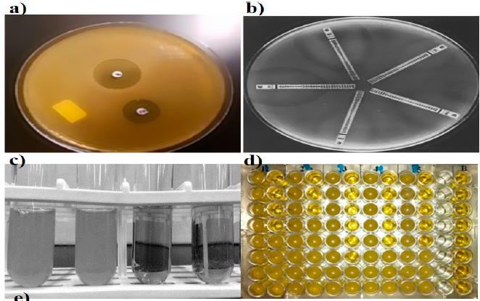
Antibiotic resistance testing – the classics
Khan et al., 2019. Diagnostics. Current and Emerging Methods of Antibiotic Susceptibility Testing

Slide 15
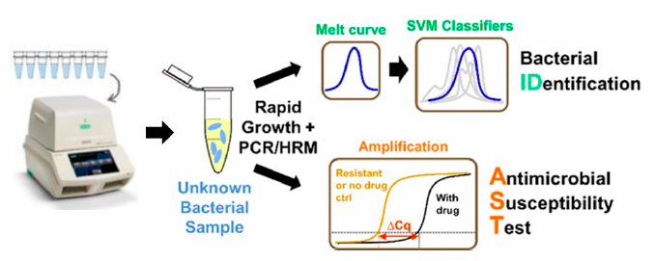
Antibiotic resistance testing – molecular
Khan et al., 2019. Diagnostics. Current and Emerging Methods of Antibiotic Susceptibility Testing

Slide 16
Why not just use sequencing?
Clear research advantages:
Identify resistance allele from known resistance strains
Use ^ to develop standardized targeted sequencing assays
Use ^ to infer how allele emerged and is spreading
But are there clear clinical advantages?
Speed? Sensitivity? Specificity?

Slide 17
Drawbacks to sequencing for antibiotic resistance in the clinic
Specific assay for each microbe/resistance allele
Only for known resistance alleles, misses new alleles, not all have been profiled
Lack of sensitivity towards the patients with latent infections, or when only a few organisms are present in a sample
False-positive results due to contamination
Requires expensive reagents and machinery, and trained personnel

Slide 18
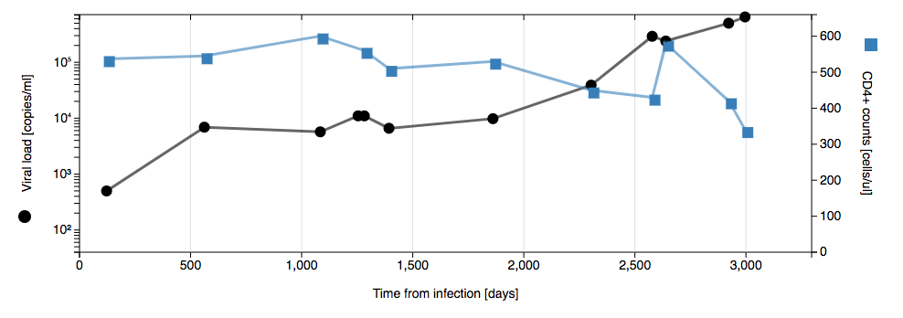
HIV drug resistance: Long-term patient monitoring
https://hiv.biozentrum.unibas.ch/patient/p1/

Slide 19
HIV drug resistance testing
Phenotypic vs genotypic
Cell culture (incubate virus w/ dilutions of drug)
Too slow, not sensitive for mixed populations, variability; mainly for drug discovery
Targeted sequencing (Sanger)
Standardized; High limit of detection (~20%)
Point-mutation assays
Hybridization test (probe to specific allele), only tests one mutation, high false rates; cheap, POC in LMICs
Whole genome next-generation sequencing
Low limit of detection (1-3%), inform all resistance alleles; requires batch sequencing at special facilities

Slide 20
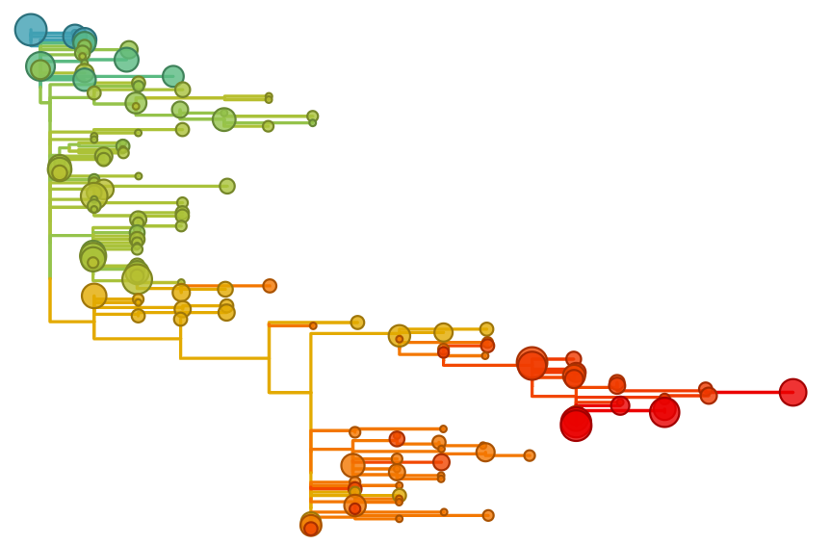
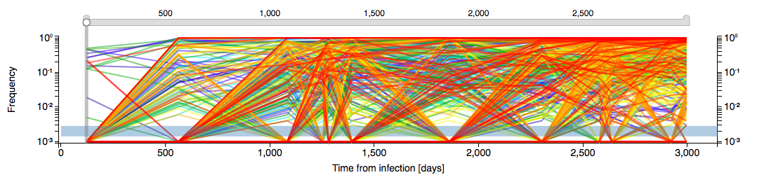
NGS for long-term patient monitoring
Precision medicine: informed decisions for clinical care
https://hiv.biozentrum.unibas.ch/patient/p1/

Slide 21
Surveillance gap

Slide 22
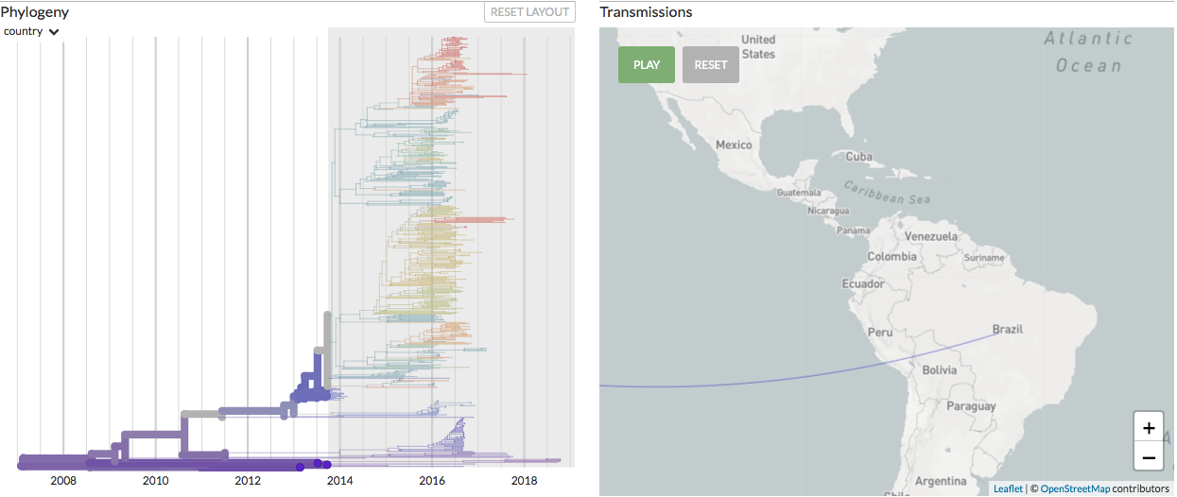
Challenges of detecting the unexpected
Introduction: Late 2013

Slide 23
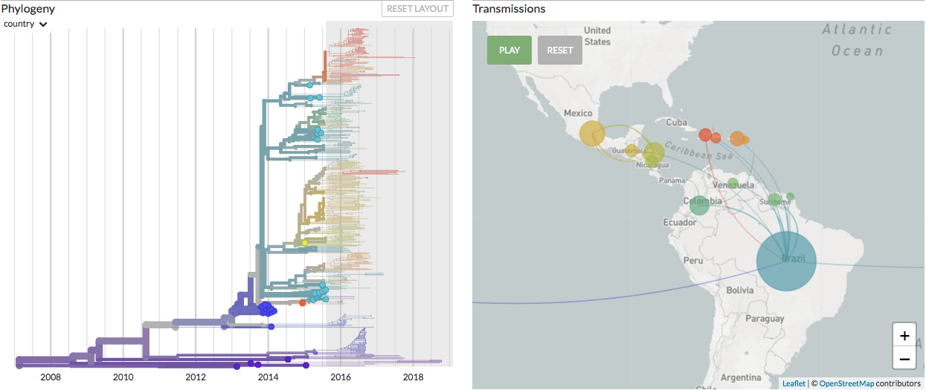
Challenges of detecting the unexpected
First detection: May 2015
Introduction: Late 2013

Slide 24
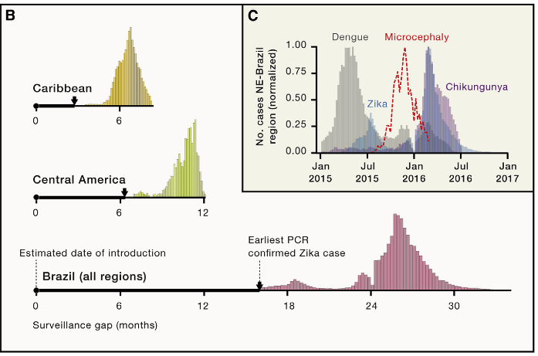
Challenges of detecting the unexpected
Grubaugh et al., 2018. Cell

Slide 25
Shortening the surveillance gap is one of the greatest challenges and opportunities of your generation.

Slide 26
Class activity “Zebra surveillance”

Slide 27
Formulate strategy to (1) detect w/in a structured surveillance program and (2) transition towards targeted diagnostics to track transmission. How does your approach improve on current standards? Consider long-term feasibility, costs, culture, invasiveness, etc.
Emerging causes of respiratory disease near live markets in China.
Emerging causes of acute febrile illness in urban slums in Brazil.
Novel antibiotic resistance in US prisons.
Causes of non-malaria febrile illness in Senegal.
Farm animal disease with zoonotic potential in Europe.

