Slide 1

Grubaugh Lab NGS Sample Prep Protocols
For use in our Yale/CDC-Dengue Branch Collaboration
Joseph Fauver
Grubaugh Lab Meeting
5/3/19

Slide 2
Goals of Yale/CDC-Dengue Branch partnership
Establish protocols to generate complete genomes from archived Zika and Dengue
PrimalSeq (amplicon-based approach)
Metagenomic sequencing
Have students (Aaron & Cheney) train alongside CDC-Dengue researchers
Create a lasting partnership!

Slide 3
Goals
Establish protocols to generate complete genomes from archived Zika and Dengue
PrimalSeq (amplicon-based approach)
Metagenomic sequencing
Have students (Aaron & Cheney) train alongside CDC-Dengue researchers
Create a lasting partnership!

Slide 4
General NGS Workflow (RNA Seq)
RNA extraction
Turn RNA into DNA
Make DNA double stranded
Add bits onto the ends of dsDNA
Put on sequencer

Slide 5
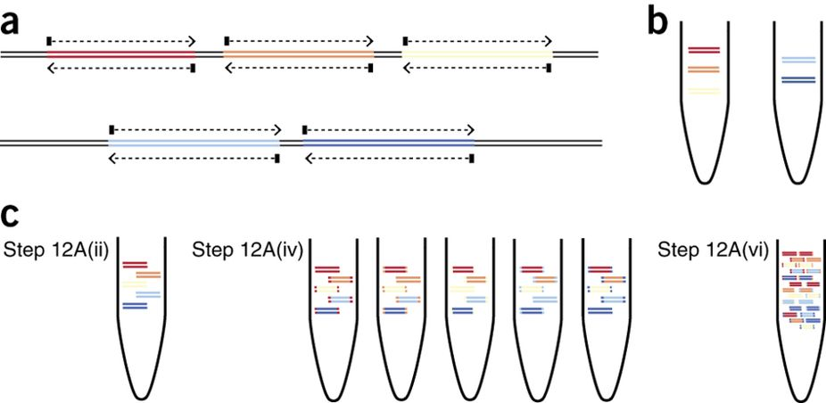
PrimalSeq-workflow
Amplicon approaches are useful for degraded samples, low pathogen titers, complex sample types, known pathogens.
PrimalSeq takes advantage of multiplexing tilled amplicons across the genome to generate complete sequences
Quick et al. Nat Protocols 2017

Slide 6
PrimalSeq-workflow
RNA extraction
cDNA synthesis
PCR amplicon generation
Library preparation
Sequence on MiSeq
Notes:
Going to talk about the molecular biology aspects of what is happening, sprinkled in here is a lot of clean up steps, size selections, determining which index sequences you should be using, fragment length checks, concentration checks, etc..

Slide 7
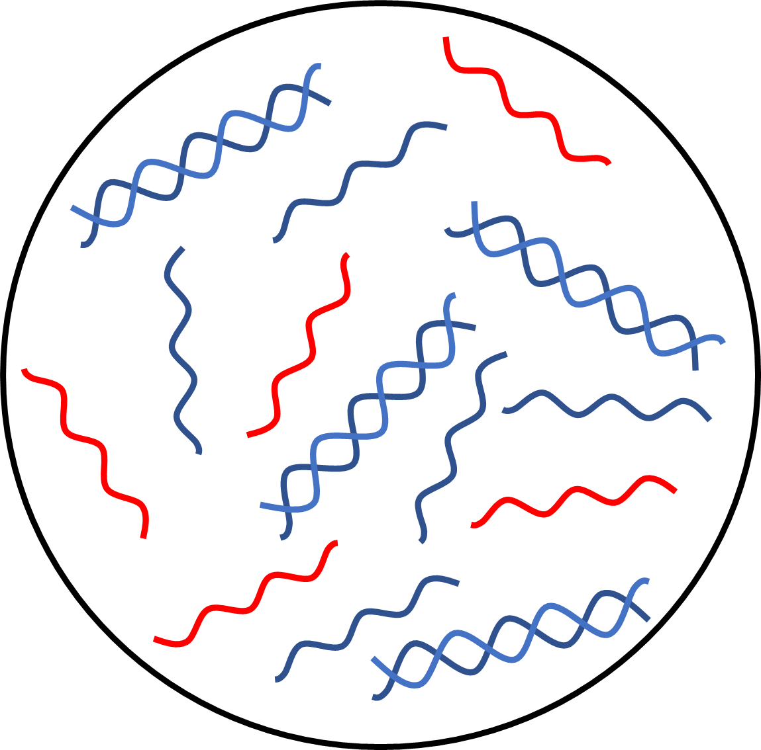

RNA Extraction
Total Nucleic Acid
Reagents
MagNA Pure 96 DNA and Viral RNA LV Kit
Viral RNA
Host RNA
Host DNA

Slide 8
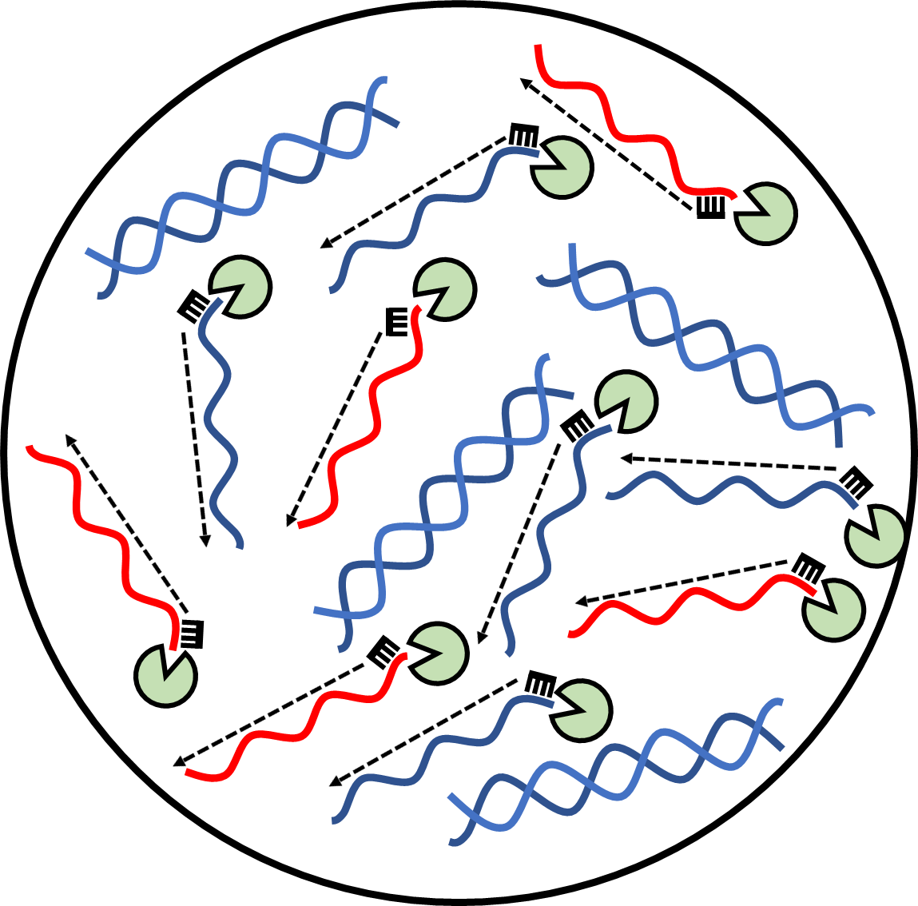
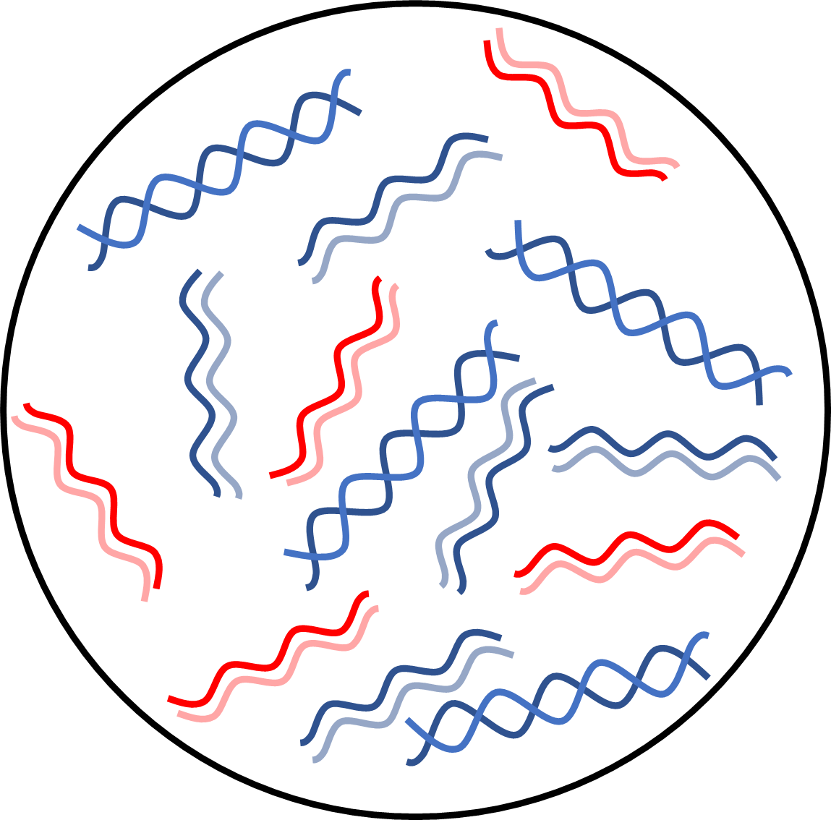
cDNA Synthesis
Reagents
iScript Select cDNA
Synthesis Kit
Reverse Transcription
RNA/cDNA hybrids
Reverse transcriptase
Viral RNA
Host RNA
Random Hexamer
Viral cDNA
Host cDNA
Host DNA

Slide 9
Amplicon Tiling Scheme
Arbovirus Genome cDNA
~400 b.p.
~400 b.p.
Set #1
Set #2
Pooled
+
=
Primer set #1
Primer set #2

Slide 10
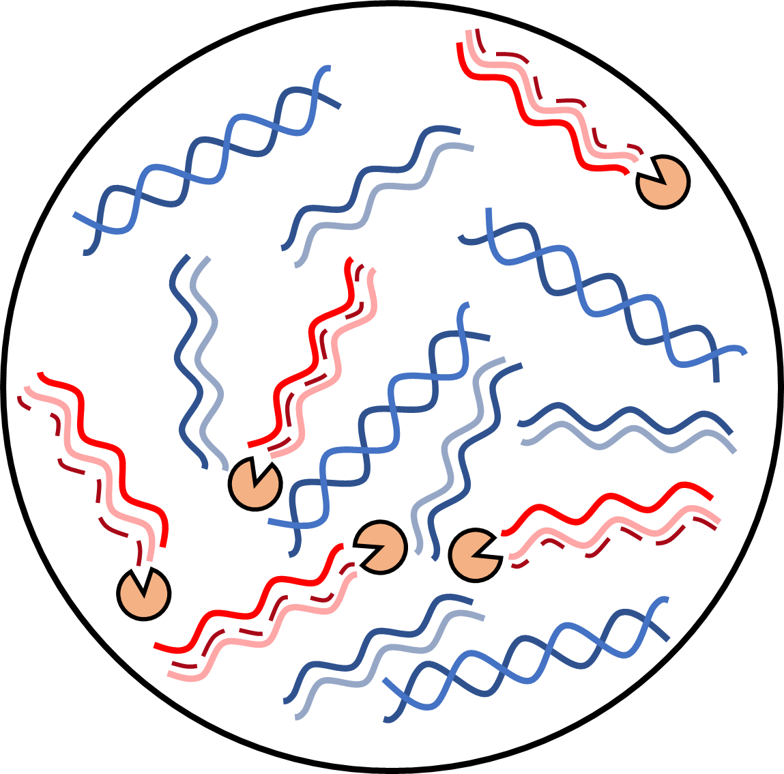
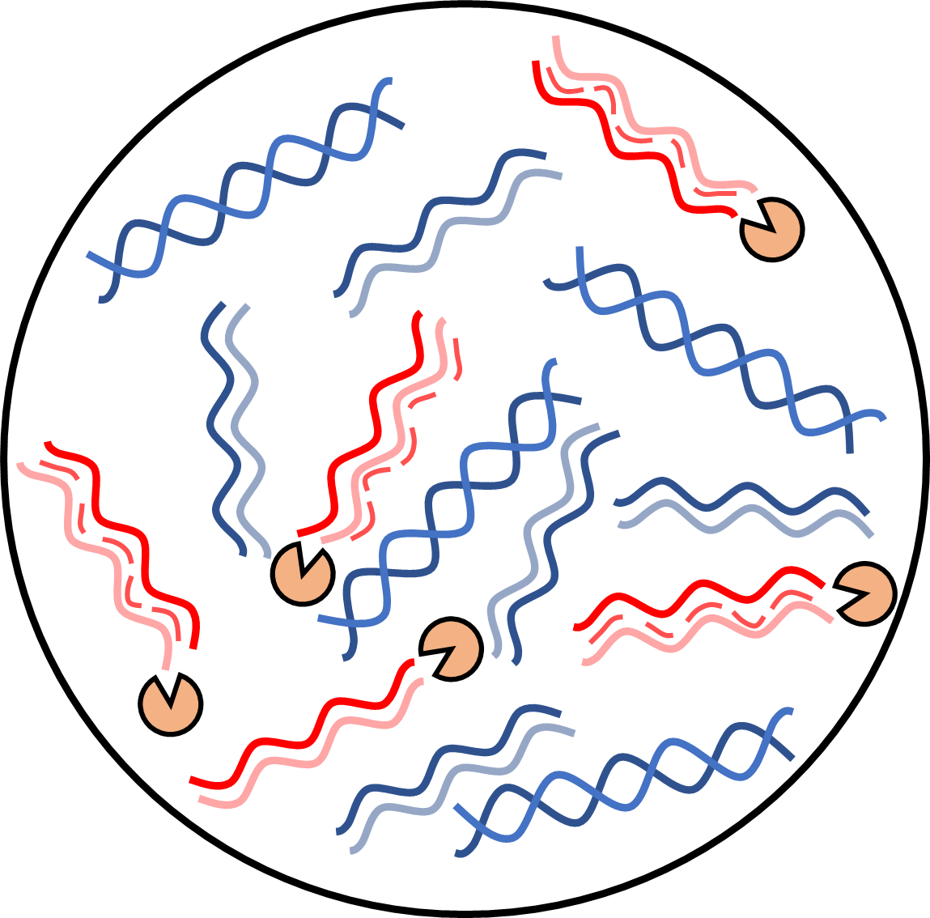
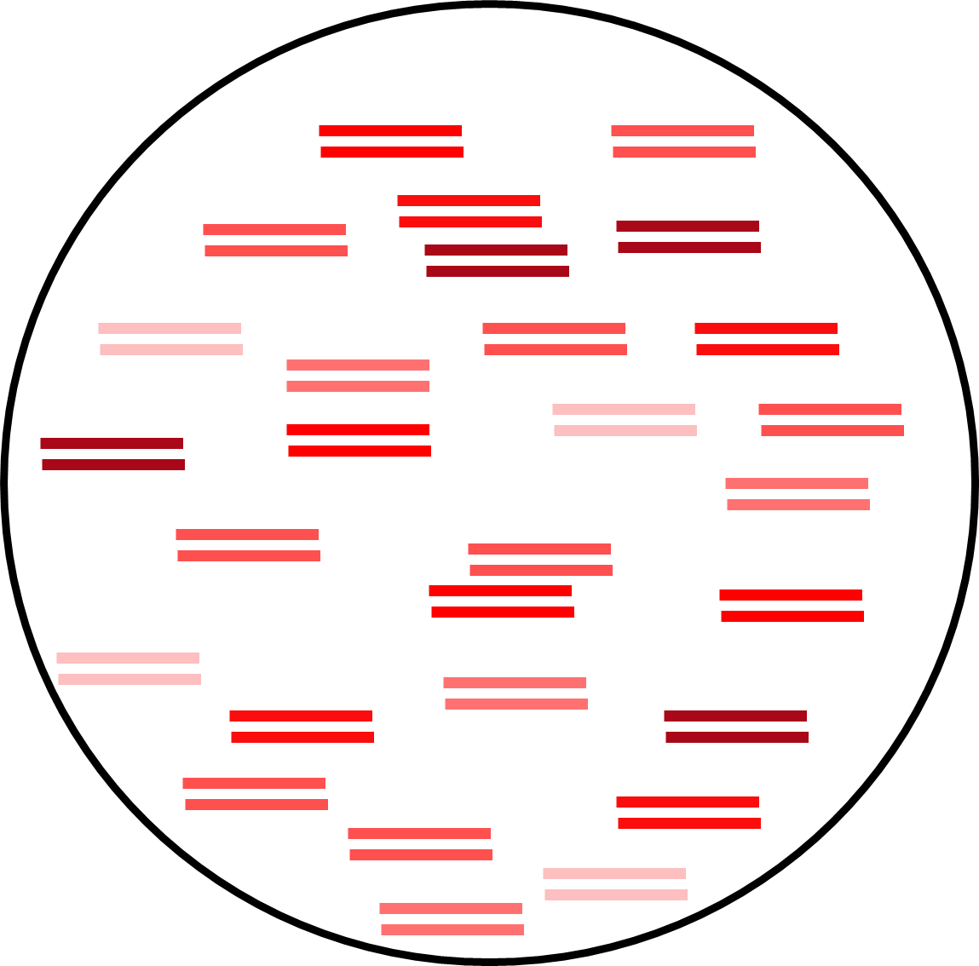
Reagents
NEB Q5 2x Master mix
Custom virus oligos
PCR Amplicon Generation
Post PCR and Pooling
ds-cDNA amplicons
Primer set #1
Primer set #2
35X
PCR
+
Q5 DNA Polymerase
Viral RNA
Host RNA
Pooled Primer set #1
Host DNA
Viral cDNA
Host cDNA
Pooled Primer set #2

Slide 11


Illumina Library Preparation
Reagents
NEBNext Ultra II DNA Library Prep Kit for Illumina
NEBNext Multiplex Oligos for Illumina
dsDNA
amplicons
dA-tailing/
end prep
Prepped
amplicons
+
=
P
A
A
P
Viral Amplicon
Ultra II Ligation Master Mix
NEBNext barbell adaptor
Ultra II End Prep Enzyme Mix
USER Enzyme

Slide 12


Illumina Library Preparation
Reagents
NEBNext Ultra II DNA Library Prep Kit for Illumina
NEBNext Multiplex Oligos for Illumina
dsDNA
amplicons
dA-tailing/
end prep
Prepped
amplicons
+
=
P
A
A
P
Addition of NEBNext adaptors
Amplicon with barbell adaptors
P
A
+
+
=
T
A
A
U
U
A
T
U
P
Viral Amplicon
Ultra II Ligation Master Mix
NEBNext barbell adaptor
Ultra II End Prep Enzyme Mix
USER Enzyme

Slide 13
Illumina Library Preparation
Reagents
NEBNext Ultra II DNA Library Prep Kit for Illumina
NEBNext Multiplex Oligos for Illumina
dsDNA
amplicons
dA-tailing/
end prep
Prepped
amplicons
+
=
P
A
A
P
Addition of NEBNext adaptors
Amplicon with barbell adaptors
P
A
+
+
=
T
A
A
U
U
A
T
U
P
U-clipping to linearize adaptors
Amplicon with linear adaptors
T
A
+
=
U
A
T
U
Viral Amplicon
Ultra II Ligation Master Mix
NEBNext barbell adaptor
Ultra II End Prep Enzyme Mix
USER Enzyme

Slide 14
Illumina Library Preparation
Reagents
NEBNext Ultra II DNA Library Prep Kit for Illumina
NEBNext Multiplex Oligos for Illumina
Q5 High-Fidelity 2X Master Mix
Unique indexes
Amplicon with linear adaptors
BC1
i7
+
+
BC2
i5
BC1
i7
BC1
i7
BC2
i5
BC1
i7
Q5 DNA
Polymerase
i7
BC1
BC2
i5
BC1
i7
BC2
i5
BC1
i7
Unique index #1
i7
BC1
X5 cycle PCR
BC2
i5
=
BC2
i5
Unique index #2
Lots of finished library!

Slide 15
Metagenomic sequencing-workflow
RNA extraction
Metagenomic approaches are useful for unbiased assessments of samples (pathogen discovery, co-infections, unknown etiologies, etc..) and/or the likely target is abundant.
Depletion and/or enrichment approaches are often coupled with metagenomic strategies
rRNA Depletion
cDNA synthesis (1st+2nd strand)
Library preparation
Sequence on MiSeq

Slide 16
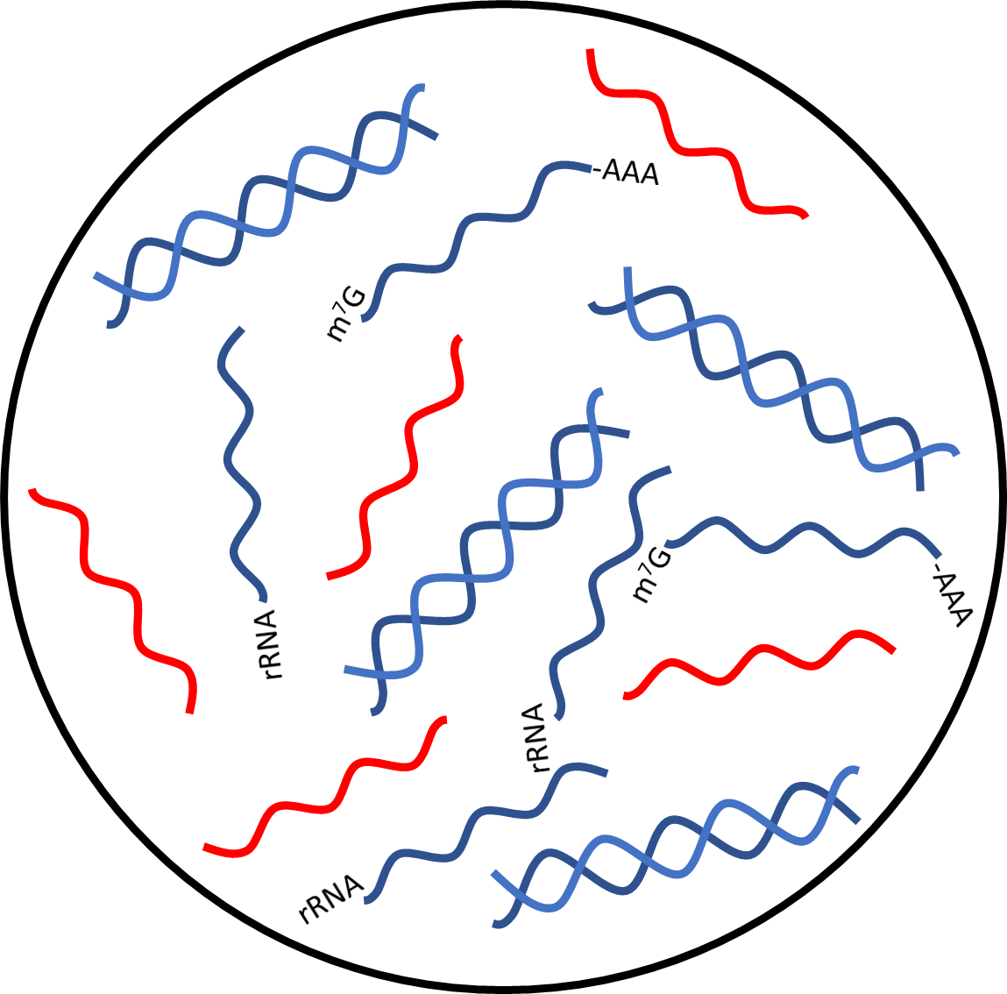
RNA Extraction
Total Nucleic Acid
Reagents
MagNA Pure 96 DNA and Viral RNA LV Kit
Viral RNA
Host RNA
Host DNA

Slide 17
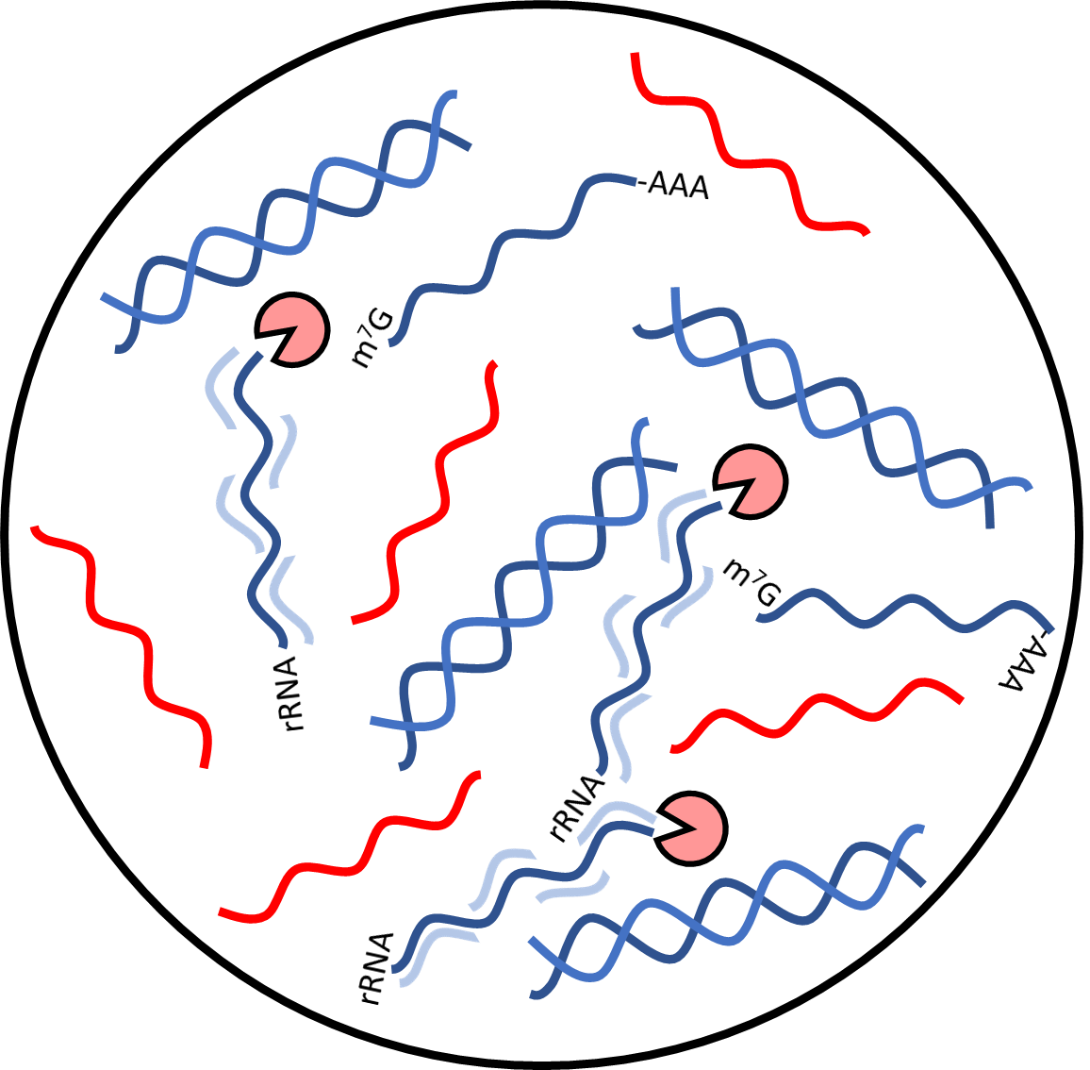
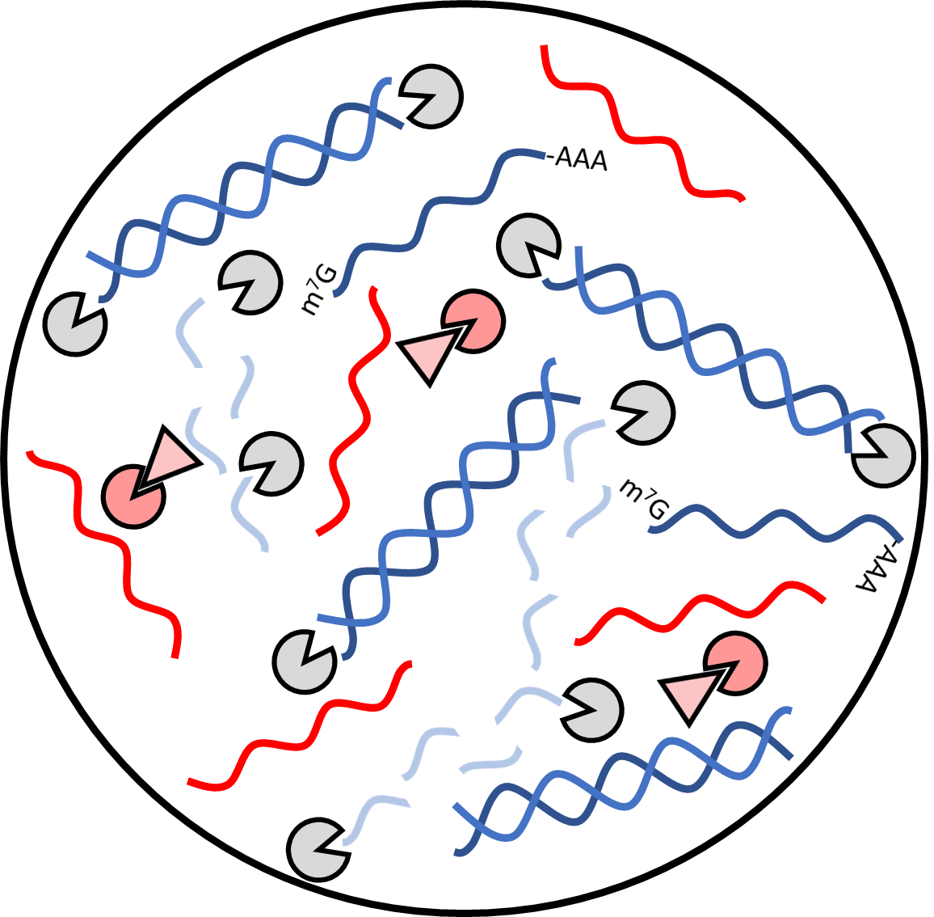
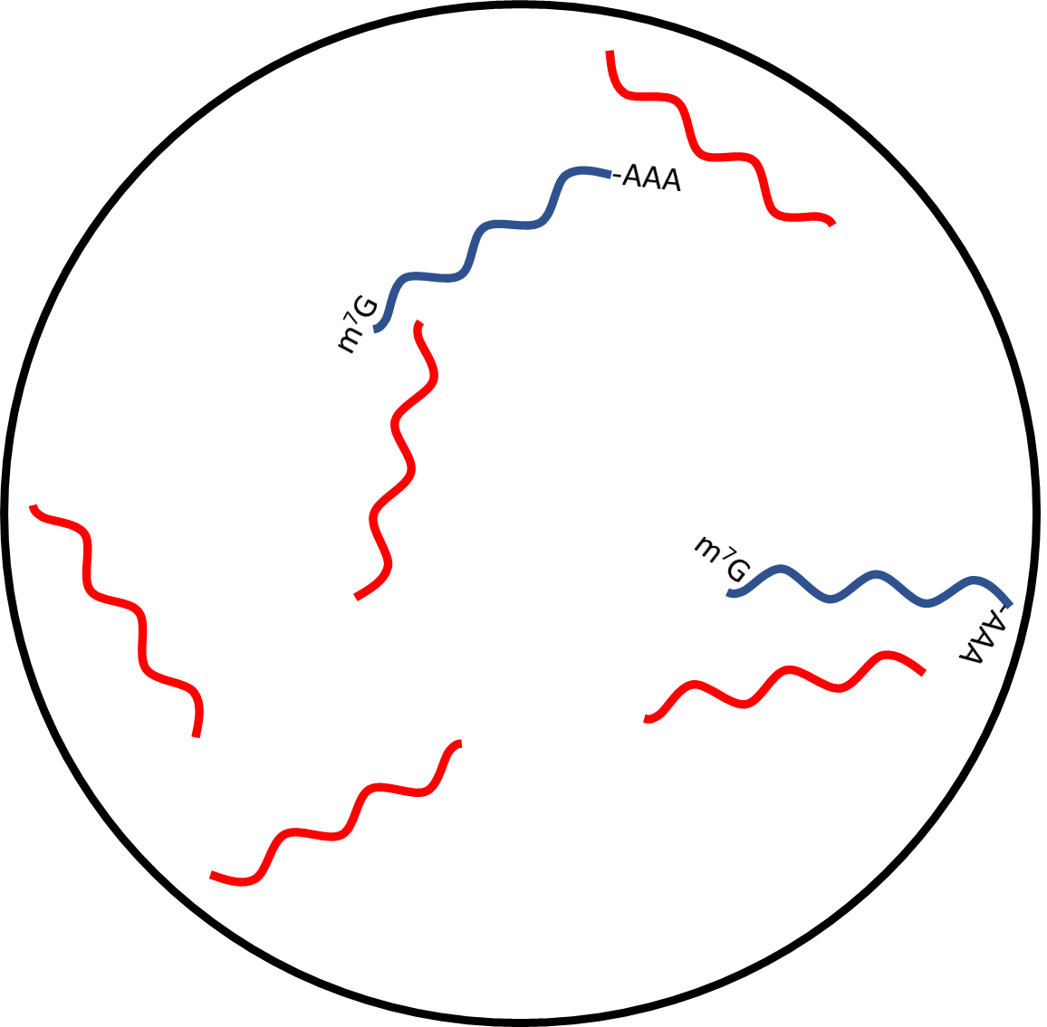


rRNA Depletion
Reagents
rRNA depletion probes
NEB RNase H
SUPERase-In RNase inhibitor
Qiagen Dnase I
rRNA probe hybridization
+
RNaseH treatment
RNase inhibition
+
DNase treatment
Host + viral RNA
RNase H
Viral RNA
rRNA probes
DNase I
Host RNA
RNase inhibitors
Host DNA

Slide 18
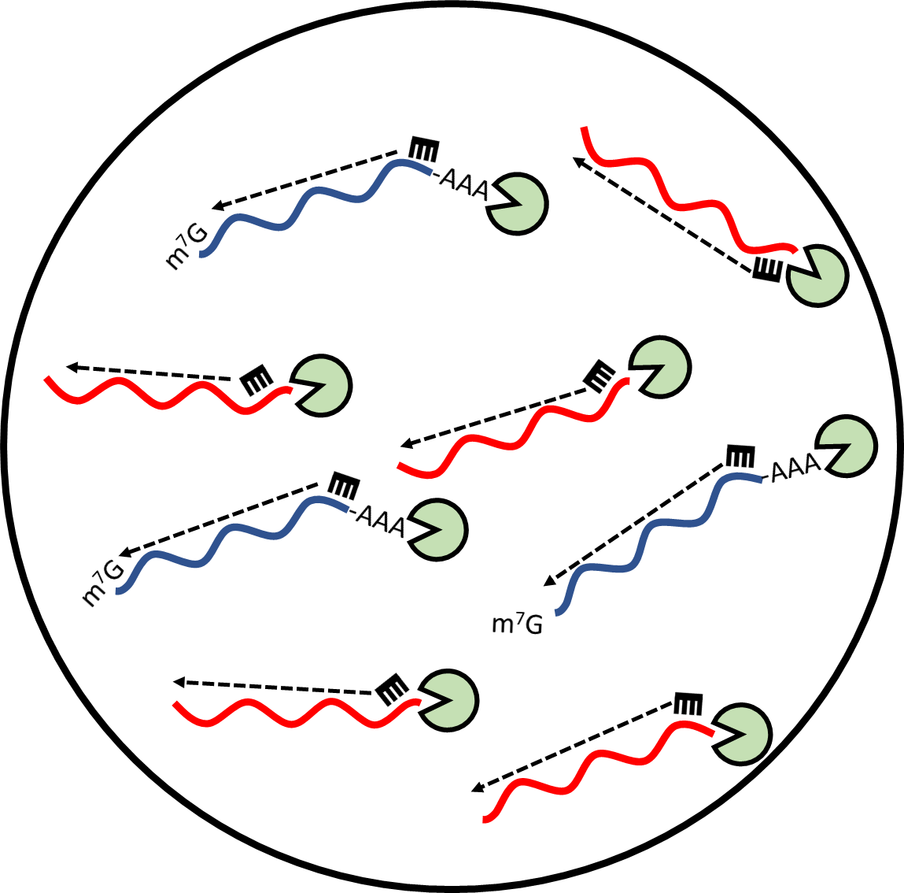
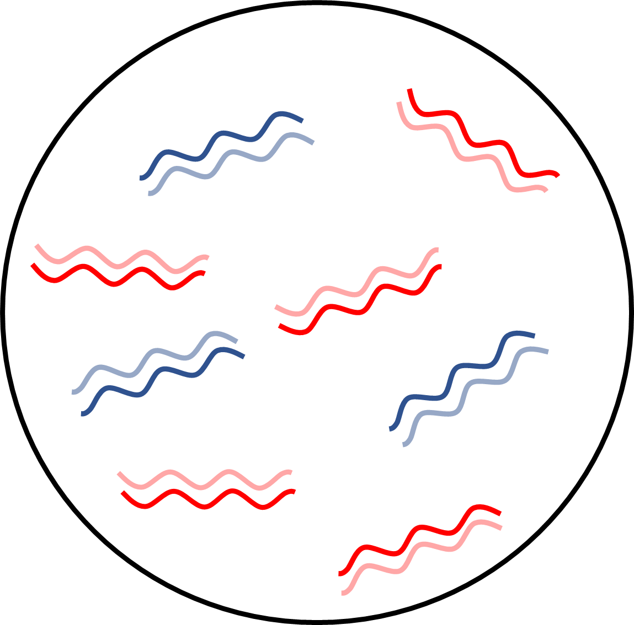
cDNA Synthesis (1st strand)
Reagents
iScript Select cDNA
Synthesis Kit
Reverse Transcription
RNA/cDNA hybrids
Reverse transcriptase
Viral RNA
Host RNA
Random Hexamer
Viral cDNA
Host cDNA

Slide 19
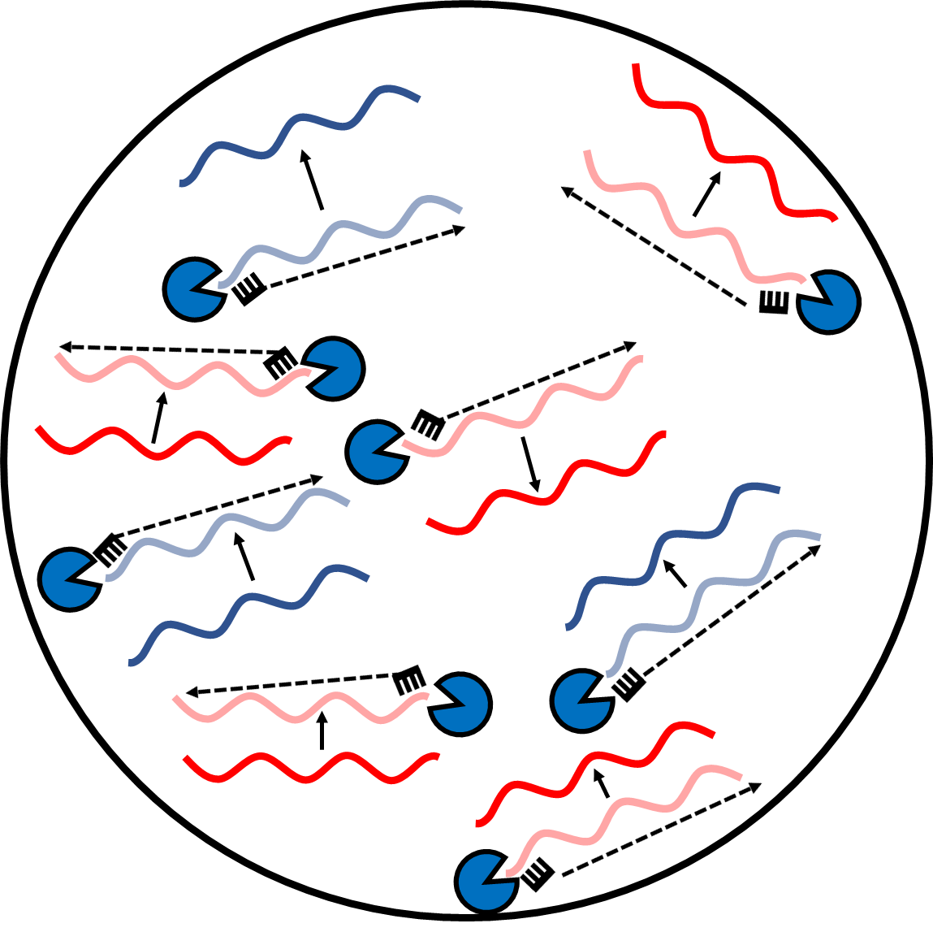
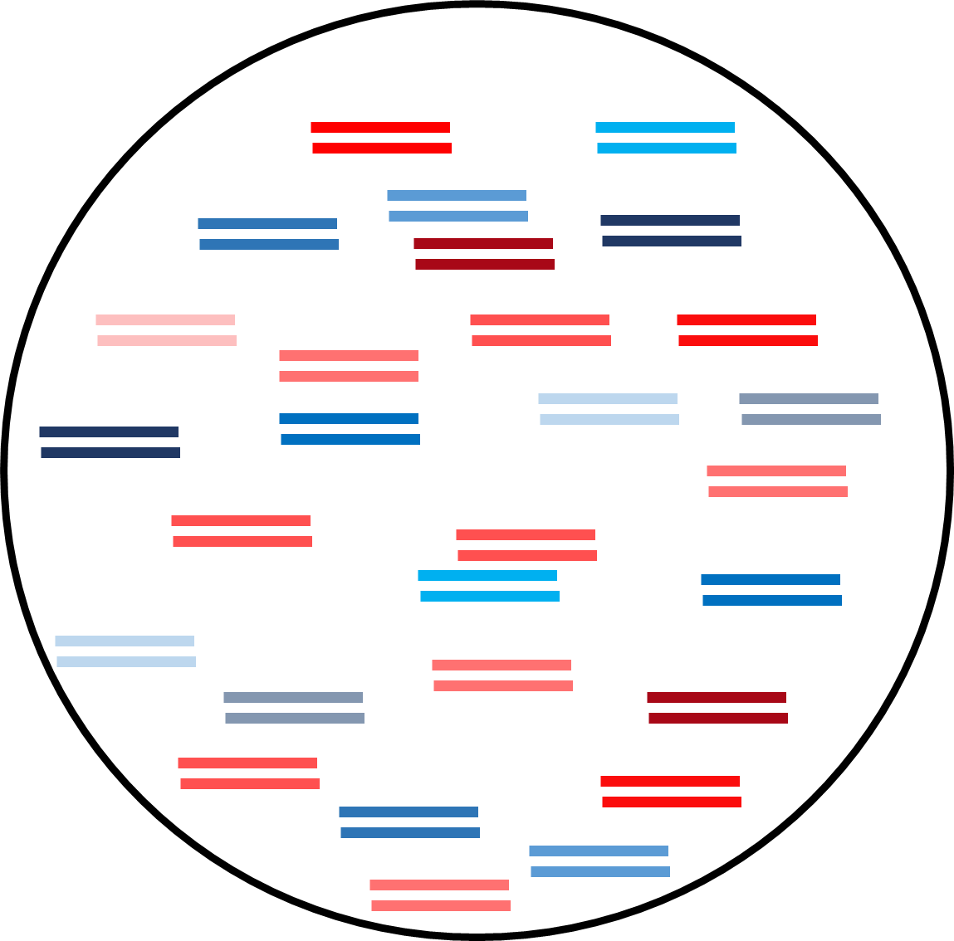
cDNA Synthesis (2nd strand)
Reagents
Sequenase 2.0
Reverse Transcription
ds-cDNA
Sequenase Enzyme
Viral RNA
Host RNA
Random Hexamer
Viral cDNA
Host cDNA

Slide 20
Illumina Library Preparation
Reagents
NEBNext Ultra II FS DNA Library Prep Kit for Illumina
NEBNext Multiplex Oligos for Illumina
ds-cDNA
dA-tailing/
end prep
Prepped
ds-cDNA
P
A
P
A
+
+
A
=
P
P
A
A
P
A
P
Viral Amplicon
Ultra II Ligation Master Mix
NEBNext Ultra II FS Enzyme Mix
Ultra II End Prep Enzyme Mix
USER Enzyme
NEBNext Barbell Adaptor

Slide 21
Illumina Library Preparation
Reagents
NEBNext Ultra II FS DNA Library Prep Kit for Illumina
NEBNext Multiplex Oligos for Illumina
ds-cDNA
dA-tailing/
end prep
Prepped
ds-cDNA
P
A
P
A
+
+
A
=
P
P
A
A
P
A
P
Addition of NEBNext adaptors
Amplicon with barbell adaptors
P
A
+
+
=
T
A
A
U
U
A
T
U
P
Viral Amplicon
Ultra II Ligation Master Mix
NEBNext Ultra II FS Enzyme Mix
Ultra II End Prep Enzyme Mix
USER Enzyme
NEBNext Barbell Adaptor

Slide 22
Illumina Library Preparation
Reagents
NEBNext Ultra II FS DNA Library Prep Kit for Illumina
NEBNext Multiplex Oligos for Illumina
ds-cDNA
dA-tailing/
end prep
Prepped
ds-cDNA
P
A
P
A
+
+
A
=
P
P
A
A
P
A
P
Addition of NEBNext adaptors
Amplicon with barbell adaptors
P
A
+
+
=
T
A
A
U
U
A
T
U
P
U-clipping to linearize adaptors
Amplicon with linear adaptors
T
A
+
=
U
A
T
U
Viral Amplicon
Ultra II Ligation Master Mix
NEBNext Ultra II FS Enzyme Mix
Ultra II End Prep Enzyme Mix
USER Enzyme
NEBNext Barbell Adaptor

Slide 23
Illumina Library Preparation
Reagents
NEBNext Ultra II DNA Library Prep Kit for Illumina
NEBNext Multiplex Oligos for Illumina
Q5 High-Fidelity 2X Master Mix
Unique indexes
ds-cDNA with linear adaptors
BC1
i7
+
+
BC2
i5
BC1
i7
BC1
i7
BC2
i5
BC1
i7
Q5 DNA
Polymerase
i7
BC1
BC2
i5
BC1
i7
BC2
i5
BC1
i7
Unique index #1
i7
BC1
X12 cycle PCR
BC2
i5
=
BC2
i5
Unique index #2
Lots of finished library!

Slide 24
Sequencing on Illumina Platforms (S.B.S)
BC1
i7
+
H
Na+
=
BC2
i5
O
i7
BC1
BC2
i5

Slide 25
Sequencing on Illumina Platforms (S.B.S)
BC1
i7
+
H
Na+
=
BC2
i5
O
i7
BC1
BC2
i5
Illumina Flowcell

Slide 26
Sequencing on Illumina Platforms (S.B.S)
BC1
i7
+
H
Na+
=
BC2
i5
O
i7
BC1
BC2
i5
Illumina Flowcell

Slide 27
Sequencing on Illumina Platforms (S.B.S)
BC1
i7
+
H
Na+
=
BC2
i5
O
i7
BC1
BC2
i5
Illumina Flowcell

Slide 28
Sequencing on Illumina Platforms (S.B.S)
BC1
i7
+
H
Na+
=
BC2
i5
O
i7
BC1
BC2
i5
Illumina Flowcell
“Cluster generation”

Slide 29
Sequencing on Illumina Platforms (S.B.S)
Lasers!
A
ATCGGCTAAGTCCGATCATG
ATCGGCTAAGTCCGATCATG
C
Cameras!
ATCGGCTAAGTCCGATCATG
+
+
=
T
ATCGGCTAAGTCCGATCATG
Proprietary
Enzymes!
ATCGGCTAAGTCCGATCATG
G
ATCGGCTAAGTCCGATCATG
Illumina Flowcell

Slide 30
Common problems to be aware of
1. Low yield- Most enzymatic reactions are optimized for specific input amounts of nucleic acid. A less than optimal quantity will affect efficiency.
Yield throughout is determined by quantification via a qubit
Low yields are remedied by improving extraction efficiencies or more likely increasing cycles during PCR steps
PCR duplicates will be removed first thing in analysis. More PCR=Less reads.

Slide 31

Common problems to be aware of
1. Low yield- Most enzymatic reactions are optimized for specific input amounts of nucleic acid. A less than optimal quantity will affect efficiency.
Yield throughout is determined by quantification via a qubit
Low yields are remedied by improving extraction efficiencies or more likely increasing cycles during PCR steps
PCR duplicates will be removed first thing in analysis. More PCR=Less reads.
2. Adaptor Dimers
Good
Bad
Remedied through size selection (adaptor dimers are shorter) and
U

Slide 32
Common problems to be aware of
1. Low yield- Most enzymatic reactions are optimized for specific input amounts of nucleic acid. A less than optimal quantity will affect efficiency.
Yield throughout is determined by quantification via a qubit
Low yields are remedied by improving extraction efficiencies or more likely increasing cycles during PCR steps
PCR duplicates will be removed first thing in analysis. More PCR=Less reads.
2. Adaptor Dimers
Good
Bad
Remedied through size selection (adaptor dimers are shorter) and
3. Index jumping- When indexes from one sample make it to another
This is remedied through very, very careful pipetting during index steps, good laboratory practice (e.g. cleaning workstations), and no template controls
U

Slide 33
Common problems to be aware of
1. Low yield- Most enzymatic reactions are optimized for specific input amounts of nucleic acid. A less than optimal quantity will affect efficiency.
Yield throughout is determined by quantification via a qubit
Low yields are remedied by improving extraction efficiencies or more likely increasing cycles during PCR steps
PCR duplicates will be removed first thing in analysis. More PCR=Less reads.
2. Adaptor Dimers
Good
Bad
Remedied through size selection (adaptor dimers are shorter) and
3. Index jumping- When indexes from one sample make it to another
This is remedied through very, very careful pipetting during index steps, good laboratory practice (e.g. cleaning workstations), and not template controls
4. Molarity miscalculations- Loading too much or too little library on to flow cell
This is remedied by removing adaptor dimers, generating proper insert sizes for metagenomic protocols, and having accurate quantifications
U

