Slide 1
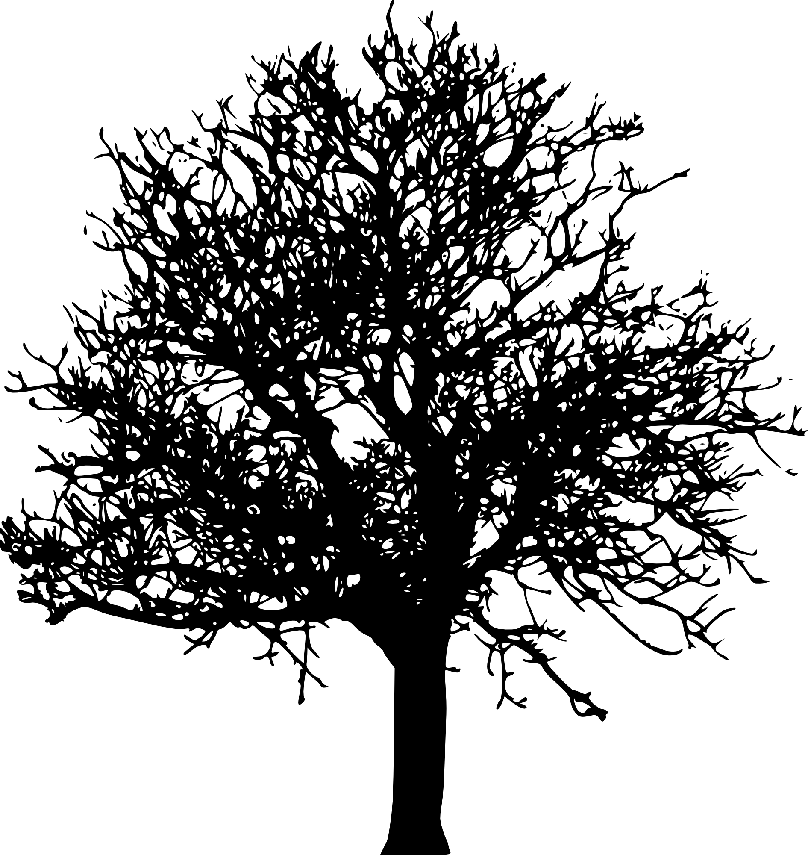
What can you learn by reading a tree?
nathan grubaugh, phd

Slide 2
Outline
Phylogenetic tools during outbreak investigation
Mock scenario: ‘Disease X’

Slide 3
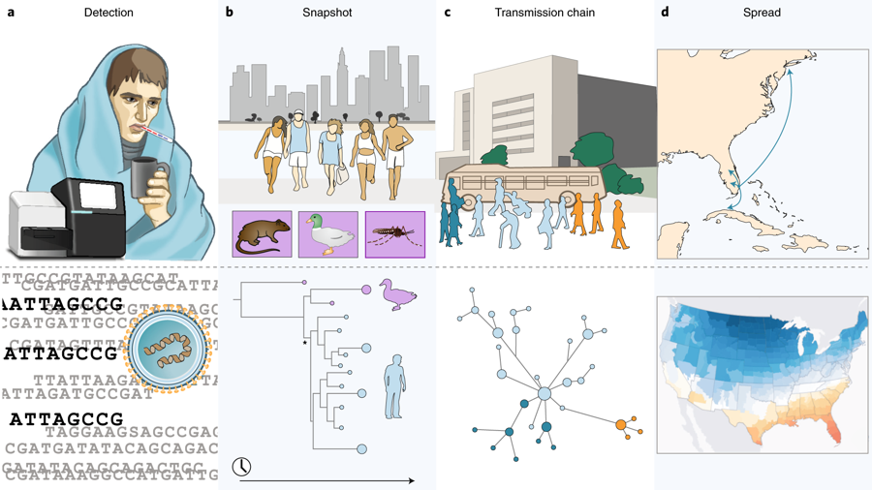
Tools during outbreak investigation

Slide 4
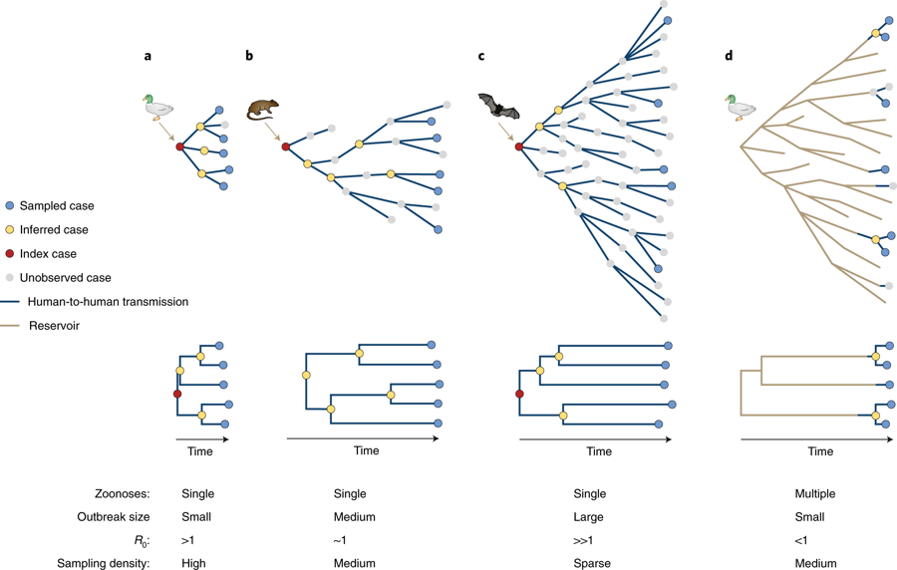
Outbreak scenarios and trees
Fundamental principles
Further back the common ancestor, the larger the outbreak
Transmission intensity proportional to rate at which virus lineages emerge
Sampling density inversely related to branch length
Grubaugh et al. 2019. Nature Microbiology

Slide 5
Outbreak scenarios and trees
Fundamental principles
Further back the common ancestor, the larger the outbreak
Transmission intensity proportional to rate at which virus lineages emerge
Sampling density inversely related to branch length
Grubaugh et al. 2019. Nature Microbiology

Slide 6
Outbreak scenarios and trees
Fundamental principles
Further back the common ancestor, the larger the outbreak
Transmission intensity proportional to rate at which virus lineages emerge
Sampling density inversely related to branch length
Grubaugh et al. 2019. Nature Microbiology

Slide 7
Outbreak scenarios and trees
Fundamental principles
Further back the common ancestor, the larger the outbreak
Transmission intensity proportional to rate at which virus lineages emerge
Sampling density inversely related to branch length
Grubaugh et al. 2019. Nature Microbiology

Slide 8
Outbreak scenarios and trees
Fundamental principles
Further back the common ancestor, the larger the outbreak
Transmission intensity proportional to rate at which virus lineages emerge
Sampling density inversely related to branch length
Grubaugh et al. 2019. Nature Microbiology

Slide 9
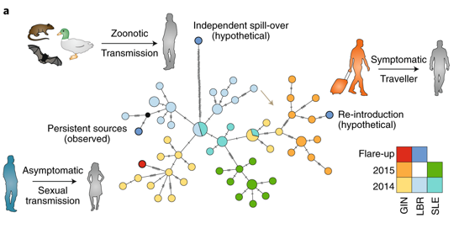
Transmission chain tracking
Grubaugh et al. 2019. Nature Microbiology

Slide 10
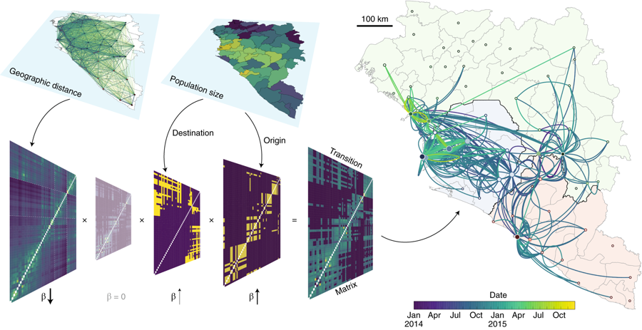
Phylogeographic spread
Grubaugh et al. 2019. Nature Microbiology

Slide 11
Mock scenario
Miami, Florida
Disease X
(idealized situation…)

Slide 12
Mock scenario: week 1
First case
22 yo male, ILI, high fever, labored breathing
ER, died of pneumonia on day 3
Standard diagnostics negative
IgM antibodies slightly cross-reactive to coronaviruses
Reported golfing at nearby resort (wild birds)
Went to work, bars, clubs
5 other young adults presented similar symptoms
Grubaugh et al. 2019. Nature Microbiology

Slide 13
Mock scenario: week 1
Metagenomic sequencing from first patient
Novel coronavirus, related to viruses of ducks
Hypotheses:
Origin (migratory birds)
Transmission route (direct contact; airborne)
Development of virus-specific diagnostics
Grubaugh et al. 2019. Nature Microbiology

Slide 14
Mock scenario: week 4
40 new laboratory confirmed cases
8 healthcare workers (contacted first 6 cases)
32 outside of the hospital
5 total deaths (11% apparent CFR)
Grubaugh et al. 2019. Nature Microbiology

Slide 15
Mock scenario: week 4
Targeted sequencing and phylogenetics
13 patients
Single zoonotic spillover
All subsequent transmission human-to-human
Transmission started >3 months ago
Many missed cases
Grubaugh et al. 2019. Nature Microbiology

Slide 16
Mock scenario: week 8
100’s of cases – rapidly growing outbreak
Diagnostic tests and case descriptions distributed
Extensive contract tracing to identify transmission patterns
Grubaugh et al. 2019. Nature Microbiology

Slide 17
Mock scenario: week 8
Genomics to construct transmission chains
Sequenced 50% of hospital patients
Few individuals infected most cases
Transmission occurred with close proximity
Implementation of patient isolation/containment
Widespread use of facemasks
Grubaugh et al. 2019. Nature Microbiology

Slide 18
Mock scenario: week 52
Outbreak peaked ~2,000 cases
Spread throughout Florida
Several travel cases reported throughout the world
Most did not result in secondary cases
NYC = 2 health care workers
Havana, Cuba = 100 cases
Grubaugh et al. 2019. Nature Microbiology

Slide 19
Mock scenario: week 52
Phylogeography to investigate spread
Sequences from FL (~400), NY (2), Cuba (8)
Outbreaks connected
Metadata layers
Transportation, geographic, climatic, economic, demographic
Dispersal likely to occur to large cities:
Close driving proximity
Direct flights
Outbreak potential:
Low economic status
High population density
Grubaugh et al. 2019. Nature Microbiology

Slide 20
