Slide 1
MIR
A Media Information Retrieval
System
Marco Masetti
grubert65@gmail.com

Slide 2
Who am I ?
Perl programmer since 2000
Working in the R&D department of an Italian SME ( > 200 employees)
Both research and commercial projects
Attended ACT conferences:
  Italian Perl Workshop 2012
  YAPC::Europe 2010
  Italian Perl Workshop 2009
  Italian Perl Workshop 2008
  Italian Perl Workshop 2006
  Italian Perl Workshop 2005
  Italian Perl Workshop 2004
  YAPC::Europe 2003
Notes:
So here I am. Perl coder since year 2000. working for an italian sme, 240 employees, so rather big for an sme, and working in the r&d dptm following both EU funded research projects and commercial ones, actually the goal is to bring research outcomes to the market.
I lead a small team of 3 and since 2006 we have targeted several markets in the IR domain. We started focusing on sponsorship tracking, which means trying to give a relevance to sponsors in a sport events, then we tackled advertisement campaigns and then in 2009 we started collecting and indexing italian regional and local laws and what we have done is now the biggest data store of italian laws, then we addressed news monitoring and automatic clustering and we followed some election campaigns both in usa and in italy, then we addressed social media analysis and recently our platform has been integrated into the nms of a big telco player. What I'm going to present now is the core platform around which most of the applications I've cited are giared.

Slide 3
A gentle introduction to IR
“Information Retrieval (IR) is finding material (usually documents) of an unstructured nature (usually text) that satisfies an information need from within large collections (usually stored on computers)” (cit. C.D.Manning - “An introduction to Information Retrieval” - 2009)
MIR is a platform you can leverage to build distributed IR systems
The MIR core comes as a single distribution
Notes:
Unstructured basically means that you cannot force it to conform to any schema first and that you cannot use the usual techniques (like the sql language) to dig into it.

Slide 4
The MIR system
MIR lets you configure and run acquisition campaigns
A campaign is split into phases:
Several campaigns can run in parallel
MIR is domain-agnostic, highly configurable, can easily scale and is implemented in Perl
Acq
Store
Index
Delivery
Notes:
Mir lets you configure and run what are called acquisition campaigns.
A campaign is usually split into these phases:
- first metadata are extracted from several different sources
- then they get stored somewhere
- then information is extracted and indexed
- lastly the user should be able to query somehow the system and retrieve results back, usually anyhow this is accomplished either designing custom web platforms or interacting with customers ones. More over most often than not indexed data is further crunched before being ready for delivery, for example data is clustered.
Mir lets you configure and run several campaigns concurrently, all phases spread on several nodes
Mir is domain-agnostic in the sense that it can be used to address any use case, basically the core system is fairly stupid and doesn't know anything about what an email is or how to extract features from an invoice. Mir basically helps you grabbing the most out of your sources, but then it is still your effort to bring out the most information out of the collected metadata.
As it starts basically empty, a mir system needs to be heavily configured before being launched.
The only limit to scale is hw availability.
Mir is 100% implemented in modern perl5.

Slide 5
MIR main packages and scripts
Mir::Acq :Acq processors (+ fetchers)
Mir::Store :Metadata store
Mir::IR :Indexing component
Mir::Config :System configuration
Mir::Util :Utility libraries
mir-acq-fetcher.pl :to run a single fetcher
mir-acq-scheduler.pl:to schedule the launch of an acq campaign
mir-acq-processor.pl: to handle the running of campaign fetchers
mir-ir.pl : indexing process (event-based)
mir-ir-polling.pl : indexing process (polls for new docs to index)
Notes:
The distribution also installs some scripts into your executable directory (where your perl interpreter is).
These are a few of them. All start with mir 'dash' the component they are related with, so ok it pollutes your environment bu this should avoid name clashing.

Slide 6
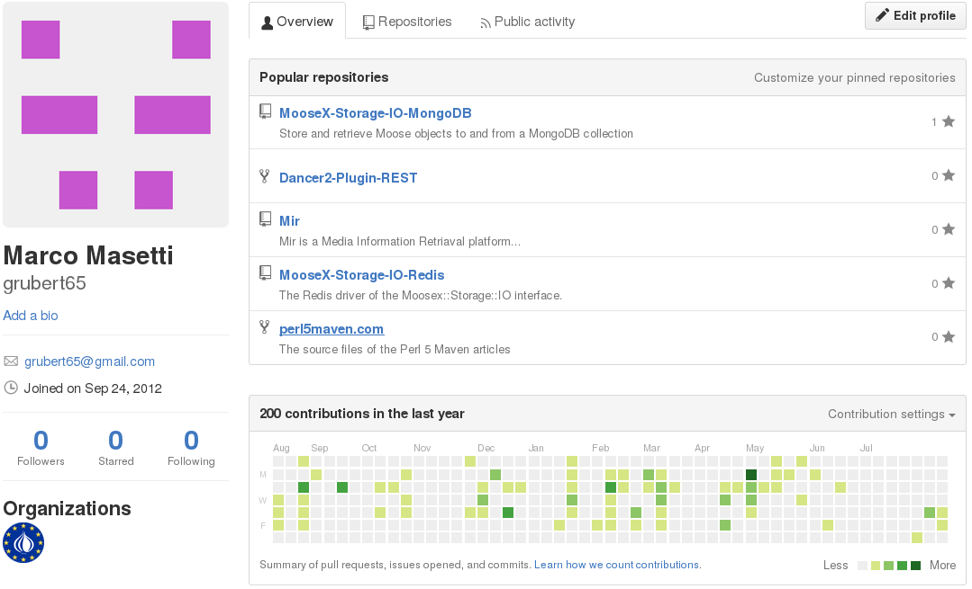
MIR is on Github
Notes:
Mir is currently uploaded on github as it is still heavily developed.
Alongside the mir repository you can find other 2 repositories that contains 2 IO drivers for the MooseX::Storage role, one for Mongo and the other for Redis. They are prerequisites if you what to use these data stores for your metadata.

Slide 7
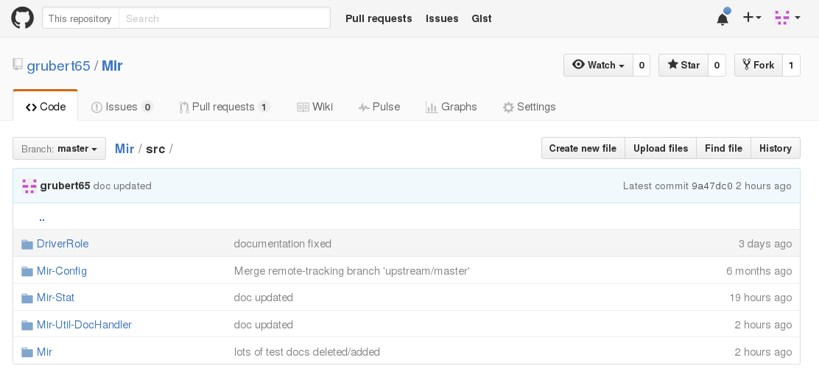
The Mir repository...

Slide 8
MIR system deployments (1)
From simple configurations...
Node 1
Node 2
f
Acq processor
f
metadata
Store
Index
f
Notes:
How you can deploy your system? Basically all processes can be distributed on different nodes, how many to use depends on you use case. Simple systems can be deployed on a single node.

Slide 9
MIR system deployments (2)
...to complex ones...
Acq node 1
Store node 1
Index node 1
Index node 4
f
Acq processor
f
Index
Index
f
Metadata
Store
Acq node 2
Index node 2
Index node 5
f
f
Index
Index
Acq processor
f
Store node 2
f
Metadata
Store
Acq node 3
Index node 3
Index node 6
f
Index
Index
Acq processor
f
f
Notes:
While complex ones need to be split into several nodes. Take into account that both the default data store (mongo) than the default text search engine (elastic) are designed to run as a cluster.
When a system grows system configuration can become an issue. So we will address configuration right now.

Slide 10
Configuring a MIR system (1)
Configuration is split into sections. Sections can be used to configure other sub-systems MIR interacts with.
Configuration sections can be centralized in a single node or distributed
By default a MIR system configuration section is stored in the system collection of the MIR database of the local Mongo server.
Configuration sections can also be stored as distinct JSON files.
MIR lets you configure acquisition campaigns. A campaign can be identified by a process chain from data acquisition, to metadata extraction down to information delivery
Notes:
-
-
- by default all processors look for their configuration connecting to the system collection of the MIR database on the local mongo server
-
-

Slide 11
Configuring a MIR system (2)
The system section usually holds:
  one configuration item for each acquisition campaign
  a configuration item for the ElasticSearch engine (not mandatory).
Notes:
Usually configuring a MIR system means defining a bunch of acquisition campaigns and eventually instruct Elastic on how should treat your data. Now a note: MIR is highly configurable and provided you come with the right driver you can switch from mongo to for example cauchbase without much pain, what is fixed is the use of Elastic as text search engine. This is not because it is the only one, but because search engines are really different one each other, they tackle the same issues from different perspectives, and you cannot switch easily from one to another.
To understand what a campaign configuration looks like better view the system collection directly on mongo...

Slide 12
Metadata handling and storage
A metadata should be a Moose class that should extends the Mir::Doc class or at least consume the Mir::R::Doc role.
The Mir::Doc class consumes the DriverRole and the Mir::R::Doc roles
The DriverRole implements the driver/interface pattern and lets you create a new metadata in this way:
    my $doc = Mir::Doc->create(driver => 'Tweet');
The Mir::R::Doc adds some common attributes (unique id, creation date,...) and consumes the MooseX::Storage role. The MooseX::Storage role provides persistency to Moose objects.
A metadata obj is usually created by an acq fetcher and pass throw all process chain, usually being enriched while processing proceed.

Slide 13
Fetcher design
A fetcher is a tiny bit of logic that gathers data from a given source and creates metadata. Fetchers come as perl distributions. A fetcher class should consume the Mir::R::Acq::Fetch role and belong to the Mir::Acq::Fetcher namespace.
package Mir::Doc::Tweet;
use Moose;
with 'Mir::R::Doc';
has 'lang' => (is => 'rw', isa => 'Str');
has 'place' => (is => 'rw', isa => 'Str');
has 'text' => (is => 'rw', isa => 'Str');
...
1) First define your metadata...
package Mir::Acq::Fetcher::Twitter;
use Moose;
with 'Mir::R::Acq::Fetch';
sub get_docs {
# all the logic to interact with Twitter...
my $tweet = Mir::Doc::Tweet->new(
lang => 'en',
place => 'Cluj-Napoca',
text => 'Following this weird pres...',
...
);
$tweet->store();
}
2) then implement the fetcher...
Notes:
Usually my head is somewhere else...
It drains all my mental resources and the last thing I want to do is to thing now which would be the right data model , the right schema and so on.
I simply what to store and save what I've grabbed.

Slide 14
Fetchers implemented
Implemented by my team @ my company for commercial projects (not freely available...),
the aim is to use CPAN to build a collection of freely available fetchers.
Mir::Acq::Fetcher::FS | Traverse (in many ways) a local or remote file system. Create a metadata for each new file found.
Mir::Acq::Fetcher::Instagram | Retrives published media according to configured criteria (es: lat,lon, radius)
Mir::Acq::Fetcher::Netatmo | Weather data from the Netatmo network of weather stations
Mir::Acq::Fetcher::OpenWeather | Weather data using OpenWeather API
Mir::Acq::Fetcher::WU | Weather data using WeatherUndergroud API
Mir::Acq::Fetcher:RSS | News feeds from an rss channel
Mir::Acq::Fetcher::Twitter | Use Twitter REST API, retrives tweets according to configured criteria
Mir::Acq::Fetcher::TwitterStream | Use Twitter Streaming API to retrieve tweets in stream mode

Slide 15
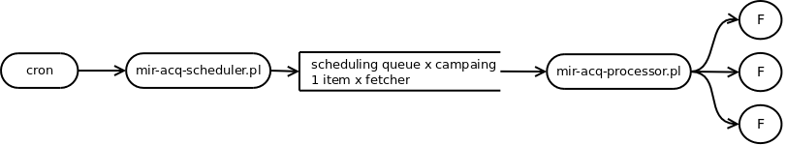
How fetchers are organized...
This is quite complex, but complexity provides you freedom in metadata acquisition
Basically:
  Either run a single fetcher via mir-acq-fetcher.pl
  Or configure an acq campaign using:
    Mir-acq-scheduler.pl to schedule which campaign should start when (using for example the cron daemon)
    Mir-acq-processor.pl to define how many fetchers for each campaign should be launched in parallel
    The scheduler and the processor talk using a network queue

Slide 16
A real example of acquisition handling
# Mir Acq campaigns scheduling on node 1
# m h dom mon dow command
30 19 * * * /home/mir/perl5/perlbrew/perls/perl-5.22.0-threaded/bin/mir-acq-scheduler.pl --campaign DocIndex_commerciale
30 20 * * * /home/mir/perl5/perlbrew/perls/perl-5.22.0-threaded/bin/mir-acq-scheduler.pl --campaign DocIndex_eccairs
0 */6 * * * /home/mir/perl5/perlbrew/perls/perl-5.22.0-threaded/bin/mir-acq-scheduler.pl --campaign DocIndex_progetti
30 4 * * * /home/mir/perl5/perlbrew/perls/perl-5.22.0-threaded/bin/mir-acq-scheduler.pl --campaign DocIndex_cv
30 5 * * * /home/mir/perl5/perlbrew/perls/perl-5.22.0-threaded/bin/mir-acq-scheduler.pl --campaign DocIndex_segreteria_pub
30 6 * * * /home/mir/perl5/perlbrew/perls/perl-5.22.0-threaded/bin/mir-acq-scheduler.pl --campaign DocIndex_segreteria_priv
30 7 * * * /home/mir/perl5/perlbrew/perls/perl-5.22.0-threaded/bin/mir-acq-scheduler.pl --campaign DocIndex_segreteria_ris
30 8 * * * /home/mir/perl5/perlbrew/perls/perl-5.22.0-threaded/bin/mir-acq-scheduler.pl --campaign DocIndex_segreteria_usr
*/20 * * * * /home/mir/perl5/perlbrew/perls/perl-5.22.0-threaded/bin/mir-acq-scheduler.pl --campaign eccairs-SRIS
*/15 * * * * /home/mir/perl5/perlbrew/perls/perl-5.22.0-threaded/bin/mir-acq-scheduler.pl --campaign eccairs-AVIATION
0 * * * * /home/mir/perl5/perlbrew/perls/perl-5.22.0-threaded/bin/mir-acq-scheduler.pl --campaign rss-news
# Mir Acq processing on node 1
mir@mir:~$ ps -ef |grep perl
… perl mir-acq-processor.pl --campaign DocIndex_commerciale --log_config_params mir-acq-processor-log.conf
… perl mir-acq-processor.pl --campaign DocIndex_eccairs --log_config_params mir-acq-processor-log.conf
… perl mir-acq-processor.pl --campaign DocIndex_cv --log_config_params mir-acq-processor-log.conf
… perl mir-acq-processor.pl --campaign DocIndex_segreteria_pub --log_config_params mir-acq-processor-log.conf
… perl mir-acq-processor.pl --campaign DocIndex_segreteria_priv --log_config_params mir-acq-processor-log.conf
… perl mir-acq-processor.pl --campaign DocIndex_segreteria_ris --log_config_params mir-acq-processor-log.conf
… perl mir-acq-processor.pl --campaign DocIndex_segreteria_usr --log_config_params mir-acq-processor-log.conf
… perl mir-acq-processor.pl --campaign DocIndex_progetti --log_config_params mir-acq-processor-log.conf
… perl mir-acq-processor.pl --campaign DocIndex_segreteria_usr --log_config_params mir-acq-processor-log.conf
… perl mir-acq-processor.pl --campaign bilanci --log_config_params mir-acq-processor-log.conf
… perl mir-acq-processor.pl --campaign visure --log_config_params mir-acq-processor-log.conf
… perl mir-acq-processor.pl --campaign eccairs-SRIS --log_config_params mir-acq-processor-log.conf
… perl mir-acq-processor.pl --campaign eccairs-AVIATION --log_config_params mir-acq-processor-log.conf

Slide 17
MIR-IR – text extraction
Metadata can easily refer to files of some format
Mir::Util::DocHandler is a class to extract text from a good range of file types, including: PDF, MS Office, ODF, images,...
Drivers are implemented for each supported file suffix (Office, doc, docx, html, pdf, pdf2, pdf3, rtf, xls, ppt, txt, image), you get a driver for the proper format in the usual way:
my $dh = Mir::Util::DocHandler->create( driver => $suffix );
$dh->open_doc(“/path/to/doc.$suffix”);
my $num_pages = $dh->pages();
my ( $text, $confidence ) = $dh->page_text($_) foreach (1..$num_pages);
LUTs can be configured to use drivers for other suffix (es: 'htm' => 'html' )
The mir-doc-handler.pl script can be used to test how text extraction works on a given doc
Notes:
You get the text and the confidence in the extration for each single document page, the pages method returns 1 by default (for some formats the notion of page is meaningless)

Slide 18
MIR-IR – text indexing
The text indexing process deals with text extraction and indexing into Elastic
A text indexing process active for each campaign
Text indexing can be driven in 2 ways:
  The indexing process gets metadata from an indexing queue (useful for streamlined sources, like TwitterStream API or MPeg7)
  The indexing process polls directly the metadata store for new metadata to process
The mir-ir.pl and mir-ir-polling.pl scripts implement the 2 behaviours
# Mir indexing processes on node 2
mir@mir2:~$ ps -ef |grep perl
perl mir-ir-polling.pl --campaign DocIndex_commerciale --config_driver Mongo --config_params {"host":"192.168.56.21"}
perl mir-ir-polling.pl --campaign DocIndex_eccairs --config_driver Mongo --config_params {"host":"192.168.56.21"}
perl mir-ir-polling.pl --campaign DocIndex_cv --config_driver Mongo --config_params {"host":"192.168.56.21"}
perl mir-ir-polling.pl --campaign DocIndex_progetti --config_driver Mongo --config_params {"host":"192.168.56.21"}
perl mir-ir-polling.pl --campaign DocIndex_segreteria_pub --config_driver Mongo --config_params {"host":"192.168.56.21"}
perl mir-ir-polling.pl --campaign DocIndex_segreteria_priv --config_driver Mongo --config_params {"host":"192.168.56.21"}
perl mir-ir-polling.pl --campaign DocIndex_segreteria_ris --config_driver Mongo --config_params {"host":"192.168.56.21"}
perl mir-ir-polling.pl --campaign DocIndex_segreteria_usr --config_driver Mongo --config_params {"host":"192.168.56.21"}
perl mir-ir-polling.pl --campaign eccairs-SRIS --config_driver Mongo --config_params {"host":"192.168.56.21"}
perl mir-ir-polling.pl --campaign eccairs-AVIATION --config_driver Mongo --config_params {"host":"192.168.56.21"}

Slide 19
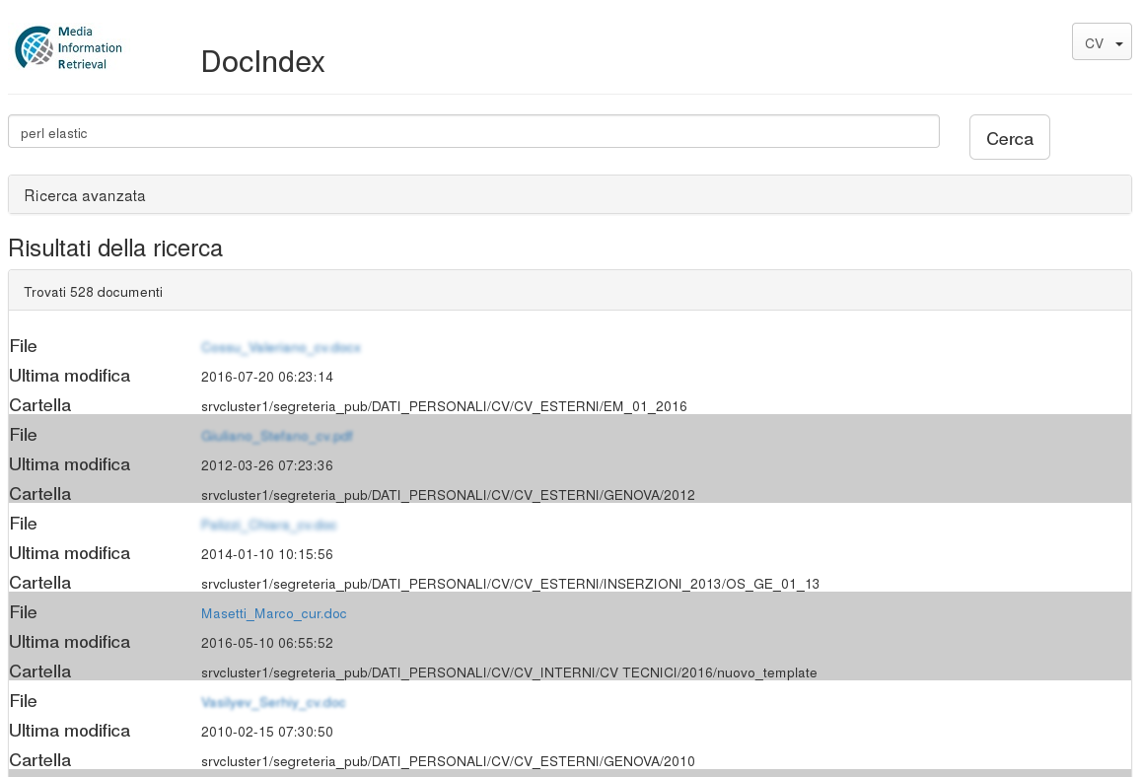
Success stories

Slide 20
Next steps...
Code fixing
Test coverage
Improve documentation (tutorials,...)
MIR system Monitoring GUI
Use Vagrant or similar to ship appliances

Slide 21
Thank YOU!!!
Enjoy your YAPC !!!
Marco Masetti (grubert65@gmail.com)
https://github.com/grubert65/
Notes:
I hope you enjoied my talk, please come to me or drop me an email for any other information you may need.

