Slide 1
MIR
A Media Information Retrieval
System

Slide 2
A gentle introduction to IR
Information Retrieval (IR) is finding material (usually documents) of an unstructured nature (usually text) that satisfies an information need from within large collections (usually stored on computers) (cit. C.D.Manning - “An introduction to Information Retrieval” - 2009)
MIR is a platform to leverage on to build distributed IR systems

Slide 3
The MIR system
MIR lets you configure and run acquisition campaigns
A campaign is split into phases:
Several campaigns can run in parallel
MIR is domain-agnostic, highly configurable, can easily scale and is implemented in Perl
Acq
Store
Index
Delivery

Slide 4
MIR components
Mir::Acq :Acq processors (+ fetchers)
Mir::Store :Metadata store
Mir::IR :Indexing component
Mir::Config:System configuration
[Mir::UI] : Delivery system (still under design)

Slide 5
MIR Roles
Mir::R :namespace for all roles
Mir::R::Acq::Fetch:all fetchers should consume this
Mir::R::Doc :for all document (metadata) classes

Slide 6
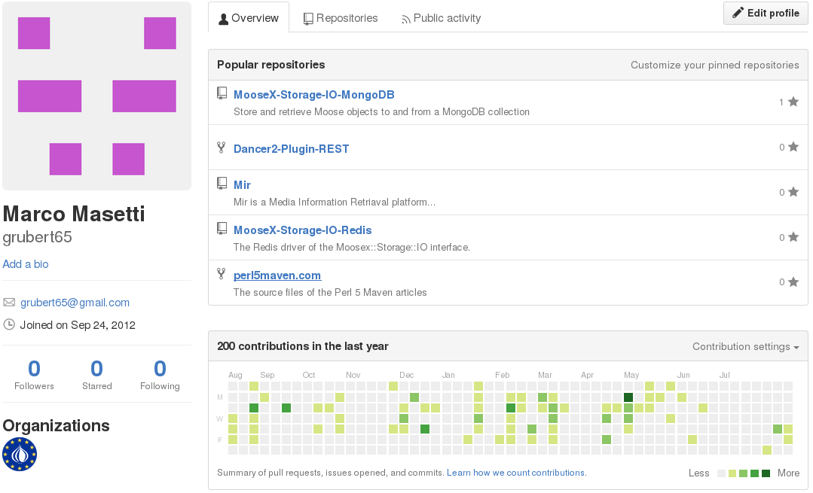
MIR is on Github

Slide 7
MIR system deployments (1)
From simple configurations...
Node 1
Node 2
Delivery
Portal
f
Acq processor
f
metadata
Store
Index
f

Slide 8
MIR system deployments (2)
...to complex ones...
Acq node 1
Store node 1
Index node 1
Index node 4
f
Acq processor
f
Index
Index
f
Metadata
Store
Acq node 2
Index node 2
Index node 5
f
f
Index
Index
Acq processor
f
Store node 2
f
Metadata
Store
Acq node 3
Index node 3
Index node 6
f
Index
Index
Acq processor
f
f
Delivery node 1
Delivery
Portal

