Slide 1
A starter guide to crypto

Slide 2
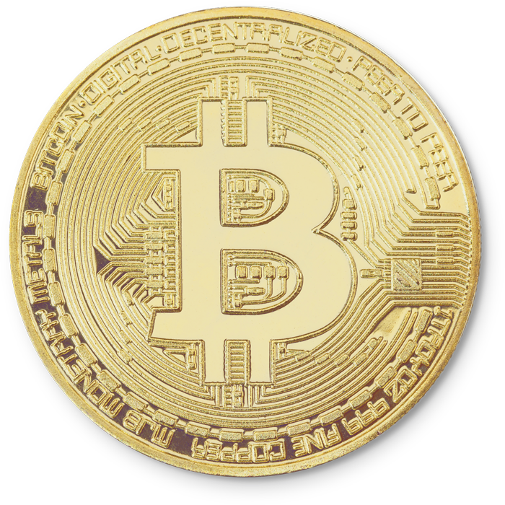
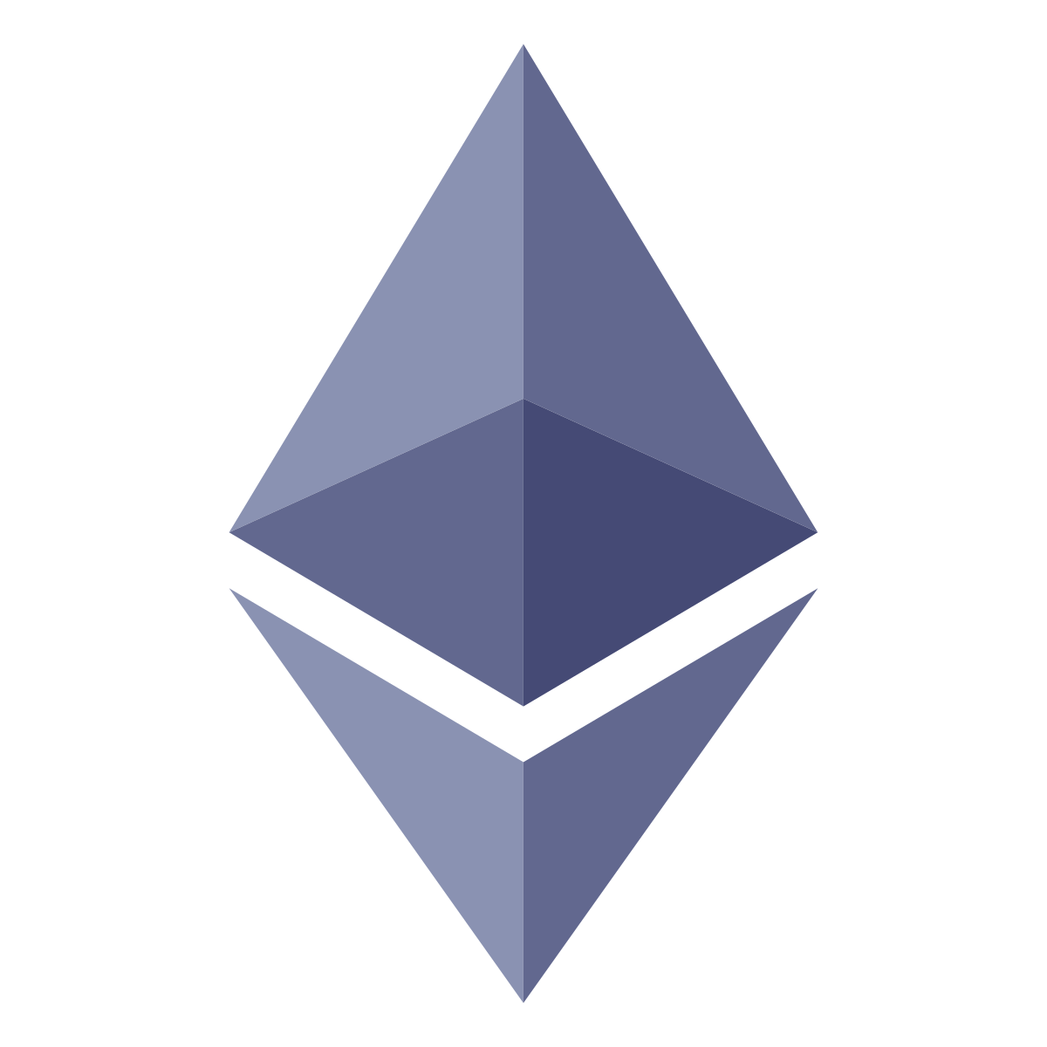

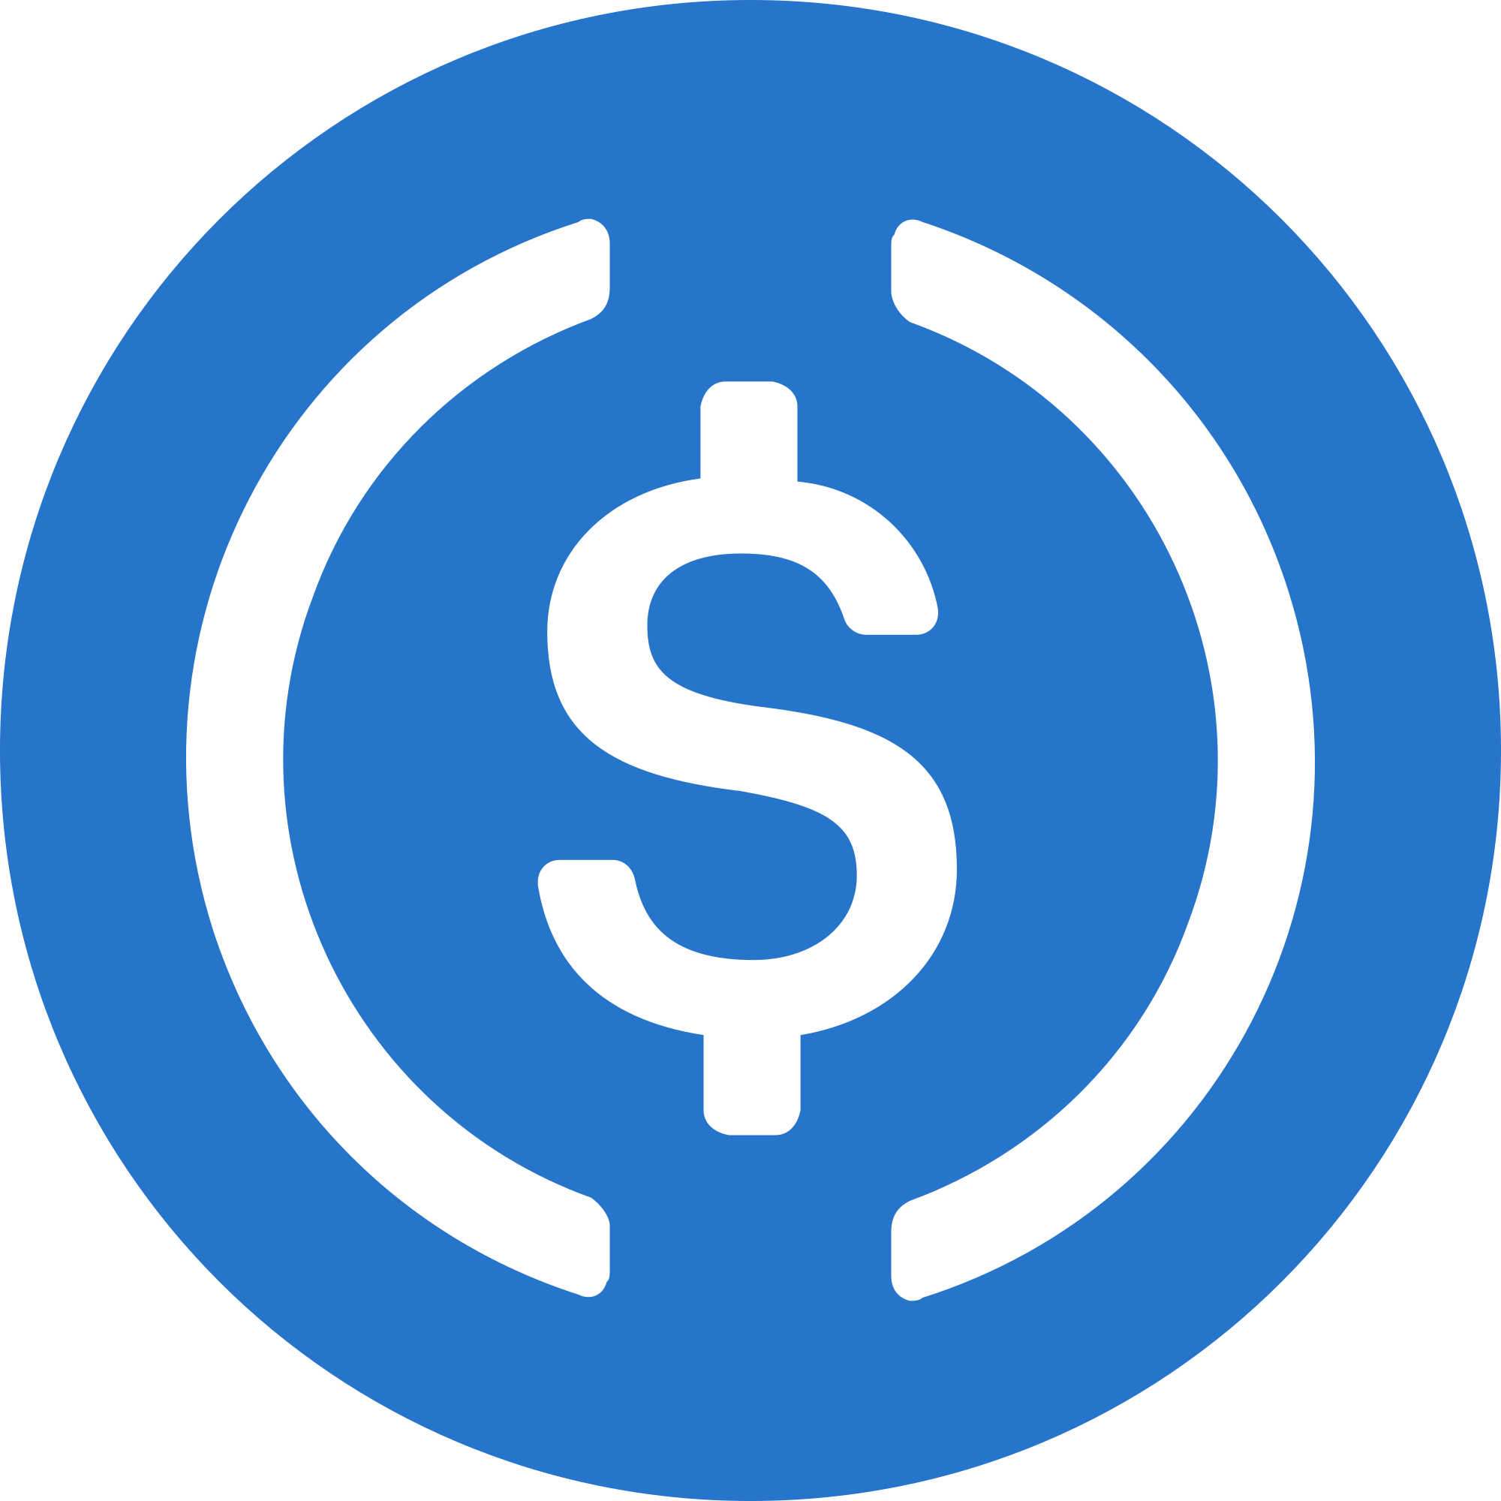

Most popular cryptocurrencies

Slide 3
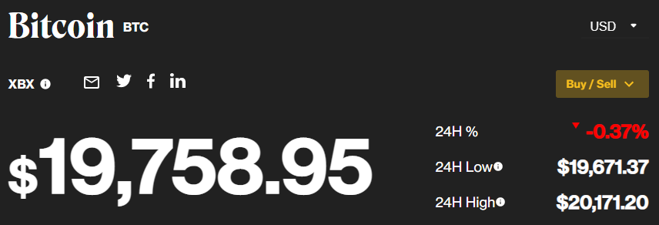
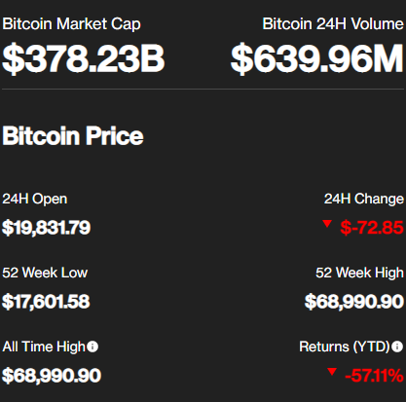
Bitcoin
The most expensive cryptocurrency
Launched in 2009, being the oldest surviving crypto
Invented by an unknown person or group of people using the name Satoshi Nakamoto
Impossible to estimate their net worth
The most mined cryptocurrency, causing the GPU prices to skyrocket
Back

Slide 4
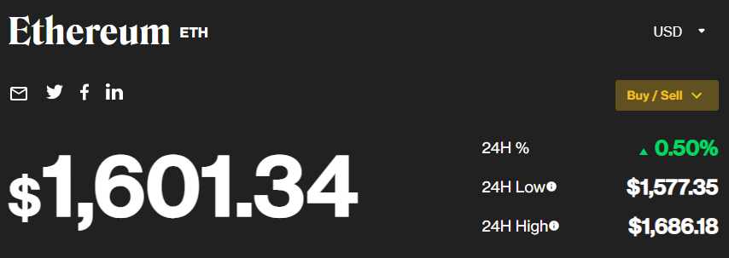
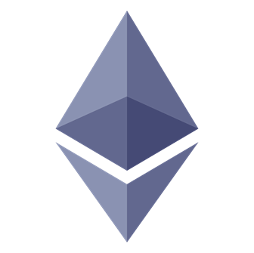
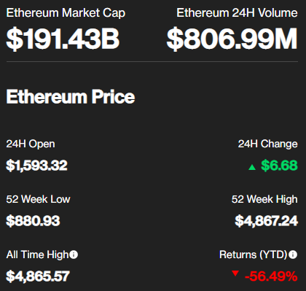
Etherium
A digital currency primarily used for buying such things as NFTs
Founded by Vitalik Buterin and Gavin Wood in 2015
Net worths:
Vitalik Buterin - $1.5 billion
Gavin Wood - $450 million
Numerous games and financial apps are being ran on top of the Ethereum blockchain
Back

Slide 5
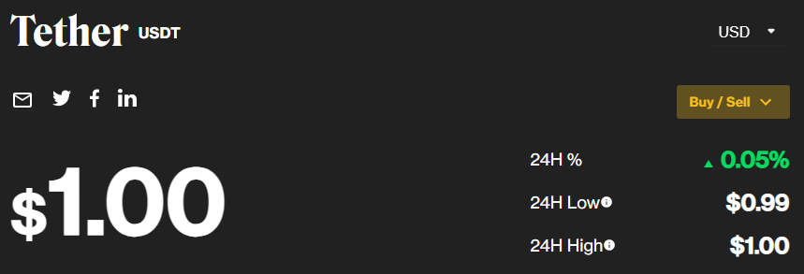
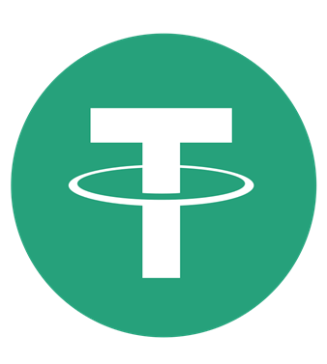
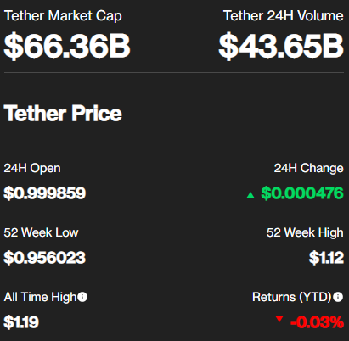
Tether
A stablecoin that crypto enthusiasts have used for years to leverage their cryptocurrency trades.
Invented by the company Tether Limited Inc. in year 2014
Owned by the Hong Kong-based company iFinex Inc.
Unlike Bitcoin, Tether’s value is quite stable
Back

Slide 6
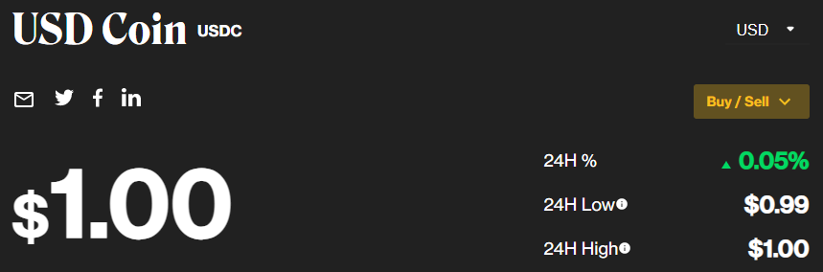
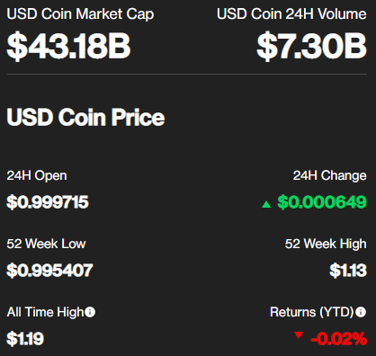
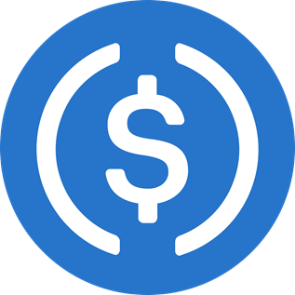
USD Coin
An open source, smart contract-based stablecoin
Pegged to the United States dollar
Launched in September 2018 by Centre
A fast and cost-effective way to transfer value quickly anywhere in the world
Not designed as an investment
Back

Slide 7
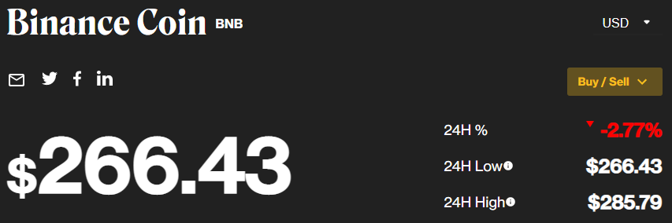
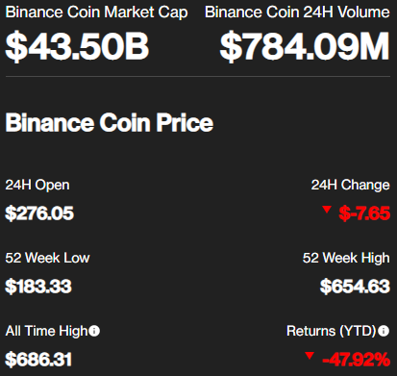

Binance Coin
Can be a great investment in 2022 for all long-term investors
BNB forecast’s predictions by February 2023
Maximum price - $786
Minimum price - $581
Founded by Changpeng Zhao back in 2017 in China
Can be used to trade and pay fees
Back

