Slide 1

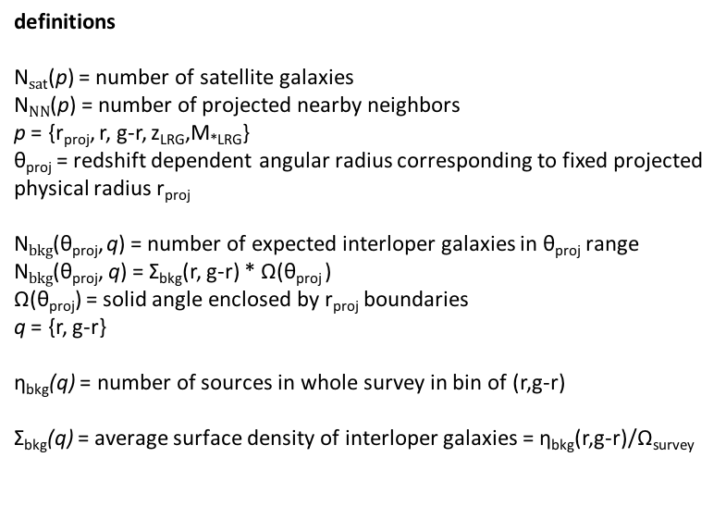




Count number of galaxies over whole survey in cell of (r,g-r).
Over whole survey
Ω(r_{proj})
η_{bkg}(q)
For each LRG
Ω_{survey}
N_{bkg}(θ_{proj}, q)=Σ_{bkg}(q) * Ω(r_{proj})
Σ_{bkg}(q) = η_{bkg}(q)/Ω_{survey}
Around each LRG, count number of galaxies as a function of (r, g-r) with r₁<r_{proj}<r₂
For each LRG
For each LRG
N_{NN}(p)
N$sa$_{t}(p) = N_{NN}(p) - N_{bkg}(q)
definitions
N$sa$_{t}(p) = number of satellite galaxies
N$NN$(p) = number of projected nearby neighbors
p = {r_{proj}, r, g-r, z_{LRG},M_{*LRG}}
θ_{proj} = redshift dependent angular radius corresponding to fixed projected physical radius r_{proj}
N$bkg$(θ_{proj}, q) = number of expected interloper galaxies in θ_{proj} range
N$bkg$(θ_{proj}, q) = Σ_{bkg}(r, g-r) * Ω(θ_{proj} )
Ω(θ_{proj}) = solid angle enclosed by r_{proj} boundaries
q = {r, g-r}
η_{bkg}(q) = number of sources in whole survey in bin of (r,g-r)
Σ_{bkg}(q) = average surface density of interloper galaxies = η_{bkg}(r,g-r)/Ω_{survey}
Over all LRGs
Compute < N$sa$_{t}(p) > in bins of r_{proj}
Compute < N$sa$_{t}(p) > in bins of z_{LRG}
Compute < N$sa$_{t}(p) > in bins of M_{*LRG}
Compute P(N$sa$_{t}(p)| r_{proj,} z_{LRG}, M_{*LRG}) by bininng all LRGs over r_{proj,} z_{LRG}, M_{*LRG} and plotting distribution with respect to each of those parameters

