Slide 1
CSC 3511 Security and Networking
Week 10, Lecture 1: One-Time Pads, Stream Cipher, and Block Cipher

Slide 2
Cryptography Roadmap
 | Symmetric-key | Asymmetric-key
Confidentiality | One-time pads Stream ciphers Block ciphers | RSA encryption
Integrity, Authentication | MACs (e.g., HMAC) | Digital signatures (e.g., RSA signatures)

Slide 3
Roadmap
One-Time Pads
Stream Cipher
Block Cipher

Slide 4
Review: XOR
The XOR operator takes two bits and outputs one bit:
Useful properties of XOR:
0 ⊕ 0 = 0
0 ⊕ 1 = 1
1 ⊕ 0 = 1
1 ⊕ 1 = 0
x ⊕ 0 = x
x ⊕ x = 0
x ⊕ y = y ⊕ x
(x ⊕ y) ⊕ z = x ⊕ (y ⊕ z)
(x ⊕ y) ⊕ x = y

Slide 5
One-Time Pads: Key Generation
The key K is a randomly-chosen bitstring;
The key length is equal to the message length.
Alice
K
0 | 1 | 1 | 0 | 0 | 1 | 0 | 1 | 0 | 1 | 1 | 1
Recall: We are in the symmetric-key setting, so we assume Alice and Bob both know this key

Slide 6
One-Time Pads: Encryption
The plaintext M is the bitstring that Alice wants to encrypt
Alice
K
0 | 1 | 1 | 0 | 0 | 1 | 0 | 1 | 0 | 1 | 1 | 1
⊕ | ⊕ | ⊕ | ⊕ | ⊕ | ⊕ | ⊕ | ⊕ | ⊕ | ⊕ | ⊕ | ⊕
M
1 | 0 | 0 | 1 | 1 | 0 | 0 | 1 | 0 | 1 | 0 | 0
↓ | ↓ | ↓ | ↓ | ↓ | ↓ | ↓ | ↓ | ↓ | ↓ | ↓ | ↓
C
1 | 1 | 1 | 1 | 1 | 1 | 0 | 0 | 0 | 0 | 1 | 1
Encrypt: XOR each bit of K with the matching bit in M
The ciphertext C is the encrypted bitstring that Alice sends to Bob over the insecure channel.

Slide 7
One-Time Pads: Decryption
Bob receives the ciphertext C. Bob knows the key K. How does Bob recover M?
Bob
K
0 | 1 | 1 | 0 | 0 | 1 | 0 | 1 | 0 | 1 | 1 | 1
⊕ | ⊕ | ⊕ | ⊕ | ⊕ | ⊕ | ⊕ | ⊕ | ⊕ | ⊕ | ⊕ | ⊕
C
1 | 1 | 1 | 1 | 1 | 1 | 0 | 0 | 0 | 0 | 1 | 1
↓ | ↓ | ↓ | ↓ | ↓ | ↓ | ↓ | ↓ | ↓ | ↓ | ↓ | ↓
M
1 | 0 | 0 | 1 | 1 | 0 | 0 | 1 | 0 | 1 | 0 | 0
Decrypt: XOR each bit of K with the matching bit in C
For one-time pads, we generate a new key for every message

Slide 8
One-Time Pads: Summary
KeyGen():
Randomly generate an n-bit key, where n is the length of your message
Recall: we assume that Alice and Bob can securely share this key
For one-time pads, we generate a new key for every message
Enc(K, M) = K ⊕ M:
Bitwise XOR M and K to produce C
In other words: XOR the i-th bit of the plaintext with the i-th bit of the key ➔ Ci = Ki ⊕ Mi
Dec(K, C) = K ⊕ C:
Bitwise XOR C and K to produce M ➔ Mi = Ki ⊕ Ci

Slide 9
Two-Time Pads?
Alice
K
Insecure Channel
M0
OTP Enc
C0 = K ⊕ M0
K
Eve sees two ciphertexts over the insecure channel
M1
OTP Enc
C1 = K ⊕ M1
C0 ⊕ C1
What if Alice use the same key K to encrypt two different messages?
What if Alice use the same key K to encrypt the same messages?
Notes:
Eve knows which bits in M0 match bits in M1
If Eve knows M0, she can deduce M1 (and vice-versa)

Slide 10
Impracticality of One-Time Pads
Problem 1: Key generation
Keys must be randomly generated for every message, and never reused
Randomness is expensive
Problem 2: Key distribution
To communicate an n-bit message, we need to securely communicate an n-bit key first
But if we have a way to securely communicate an n-bit key, we could have communicated the message directly!
Communicate keys in advance:
How to establish a shared secret key over an insecure channel? ➔ Diffie-Hellman key exchange (next time)

Slide 11
Roadmap
One-Time Pads
Stream Cipher
Block Cipher

Slide 12
Pseudorandomness and PRGs
What does “pseudorandom” mean?
Informal: cannot be distinguished from uniform (i.e., random)
Informal:
  Fix some distribution D on n-bit strings: x ← D means “sample x according to D”
  D is pseudorandom if it passes all efficient statistical tests
Pseudorandom generators (PRGs)
A PRG is an efficient, deterministic algorithm that expands a short, uniform (random) seed into a longer, pseudorandom output
seed
G
output

Slide 13
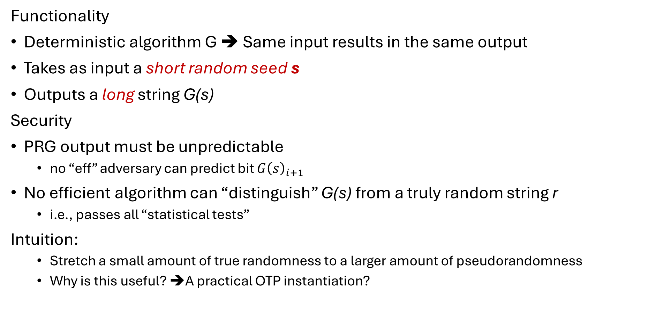
Pseudorandom Generators
Functionality
Deterministic algorithm G ➔ Same input results in the same output
Takes as input a short random seed s
Outputs a long string G(s)
Security
PRG output must be unpredictable
  no “eff” adversary can predict bit ${G\left(s\right)}_{i+1}$
No efficient algorithm can “distinguish” G(s) from a truly random string r
  i.e., passes all “statistical tests”
Intuition:
  Stretch a small amount of true randomness to a larger amount of pseudorandomness
  Why is this useful? ➔A practical OTP instantiation?

Slide 14
PRGs & Stream Ciphers
Gen(1^{n}): output uniform n-bit key k
  Security parameter n ➔ message space {0,1}^{p(n)}
Enc_{k}(m): output G(k) ⊕ m
Dec_{k}(c): output G(k) ⊕ c
Correctness follows as in the OTP…
“Pseudo” One-Time Pad
  Key reuse problem?
n bits
key
p bits
G
“pseudo” key
p bits
p bits
⊕
message
ciphertext

Slide 15
ChaCha20
Designed by Dan Bernstein in 2008
Conceptually, it’s very simple ➔ uses arithmetic operations: integer addition modulo , XOR, and left rotations
Extremely fast (>600 MB/sec) in software and does not require any special hardware
No security weakness have been found
ChaCha20 is widely used in practice, including in TLS

Slide 16
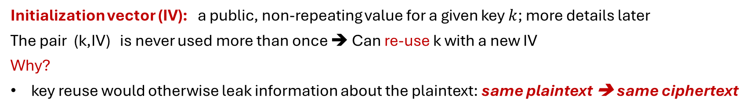
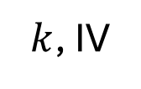
ChaCha20: Workflow
64 bytes
of plaintext stream
ChaCha20
Keystream generator
State
64 bytes
of keystream
$k$, IV
64 bytes
of ciphertext
⊕
update state
Initialization vector (IV): a public, non-repeating value for a given key $k$; more details later
The pair (k,IV) is never used more than once ➔ Can re-use k with a new IV
Why?
key reuse would otherwise leak information about the plaintext: same plaintext ➔ same ciphertext

Slide 17
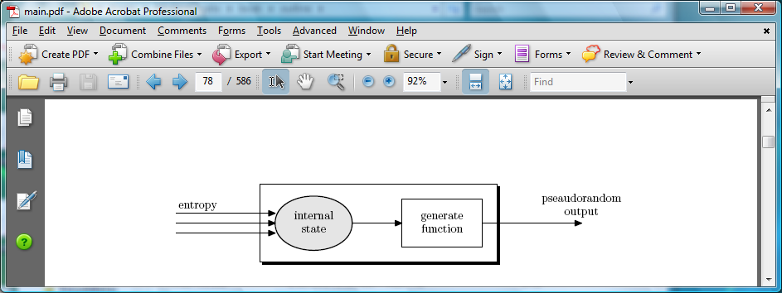
Generating Randomness (e.g. keys, IV)
Pseudorandom generators in practice: (e.g. /dev/random)
  Continuously add entropy (uncertainty) to internal state
  Entropy sources:
    Hardware RNG: Intel RDRAND instruction (Ivy Bridge, 2012). 3Gb/sec.
    Timing: hardware interrupts (keyboard, mouse)
  NIST SP 800-90A: NIST approved generators

Slide 18
Roadmap
One-Time Pads
Stream Cipher
Block Cipher

Slide 19
Block Ciphers
plaintext
Block cipher: A cryptographic scheme consisting of encryption/decryption algorithms for a fixed-sized block of bits
Enc(K, M) → C:
  Inputs: k-bit key K and an n-bit plaintext M
  Output: An n-bit ciphertext C
  Sometimes written as: {0, 1}^{k} × {0, 1}^{n} → {0, 1}^{n}
Dec(K, C) → M:
  Inputs: a k-bit key, and an n-bit ciphertext C
  Output: An n-bit plaintext
  Sometimes written as: {0, 1}^{k} × {0, 1}^{n} → {0, 1}^{n}
  The inverse of the encryption function
n bits
K
k bits
E
n bits
ciphertext
ciphertext
n bits
K
k bits
D
n bits
plaintext

Slide 20
Block Cipher Primitives: Confusion & Diffusion
Claude Shannon: There are two primitive operations with which strong encryption algorithms can be built:
Confusion: An encryption operation where the relationship between key and ciphertext is obscured (or, hidden)
  Today, a common element for achieving confusion is substitution, which is found in both AES and DES. E.g., S-box
Diffusion: An encryption operation where the influence of one plaintext symbol is spread over many ciphertext symbols with the goal of hiding statistical properties of the plaintext.
  A simple diffusion element is the bit permutation, which is frequently used within DES.
Both operations by themselves cannot provide security. The idea is to concatenate confusion and diffusion elements to build so called product ciphers
Notes:
How do we build a block cipher?

Slide 21
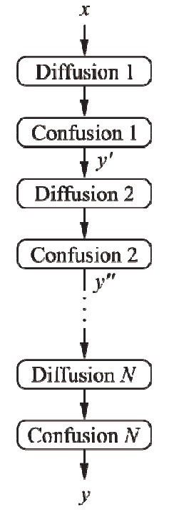
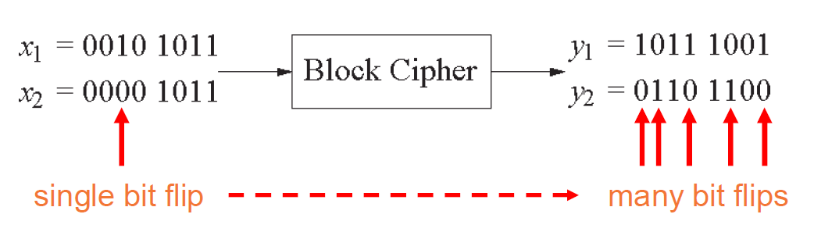
Product Ciphers
Most of today’s block ciphers are product ciphers as they consist of rounds which are applied repeatedly to the data
Can reach excellent diffusion: changing of one bit of plaintext results on average in the change of half the output bits
Example:

Slide 22
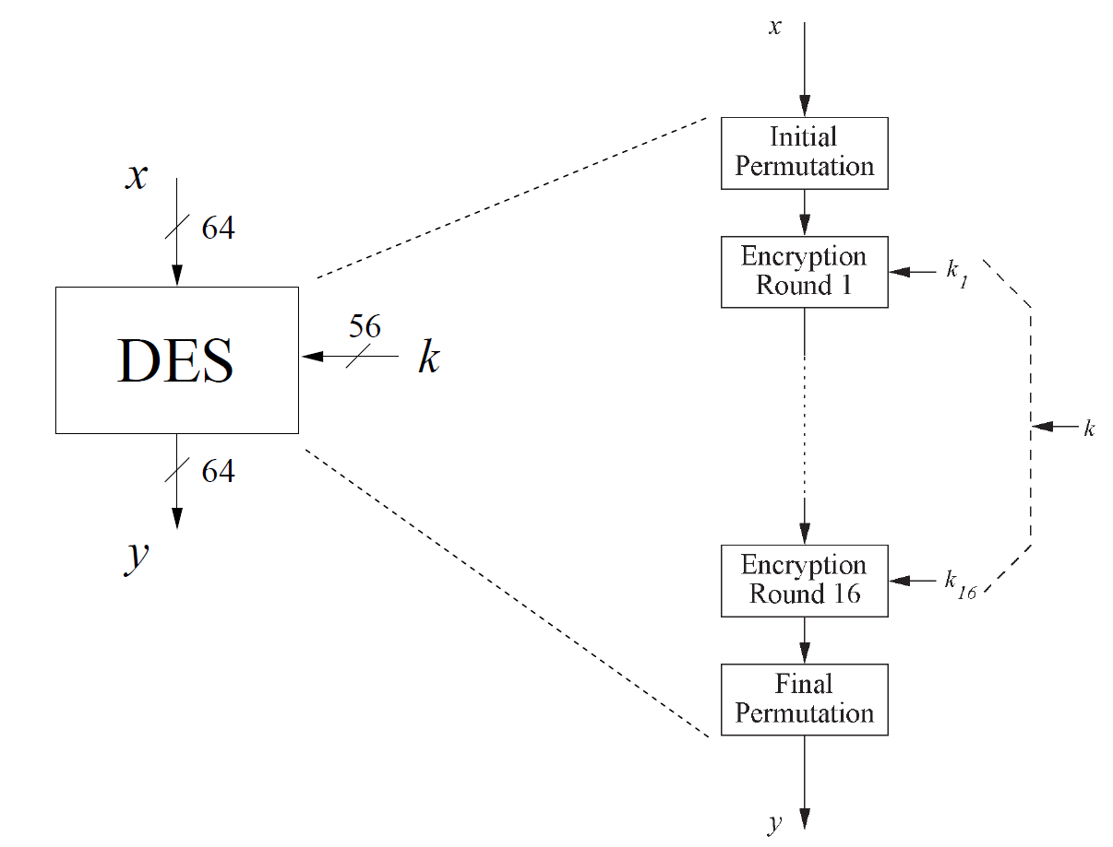
Overview of the DES (Data Encryption Standard)
Developed by IBM and adopted by NBS (now NIST) in 1977
Encrypt blocks of size 64 bits
Use a key of size 56 bits
Use the same key for Enc/Dec
Use 16 rounds which all perform the identical operation
Different subkeys in each round derived from encryption key
DES is insecure; do not use it!
Notes:
NBS: National Bureau of Standards
NIST: National Institute of Standards and Technology
Cryptography courses discuss the Data Encryption Standard (DES because of its historical significance, its role in the development of stronger algorithms like AES

Slide 23
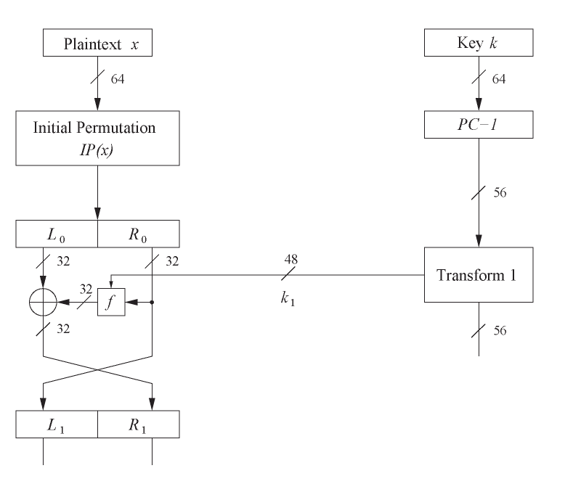
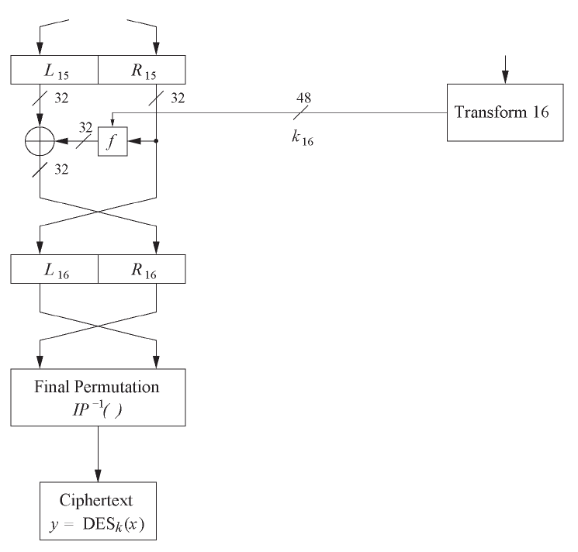
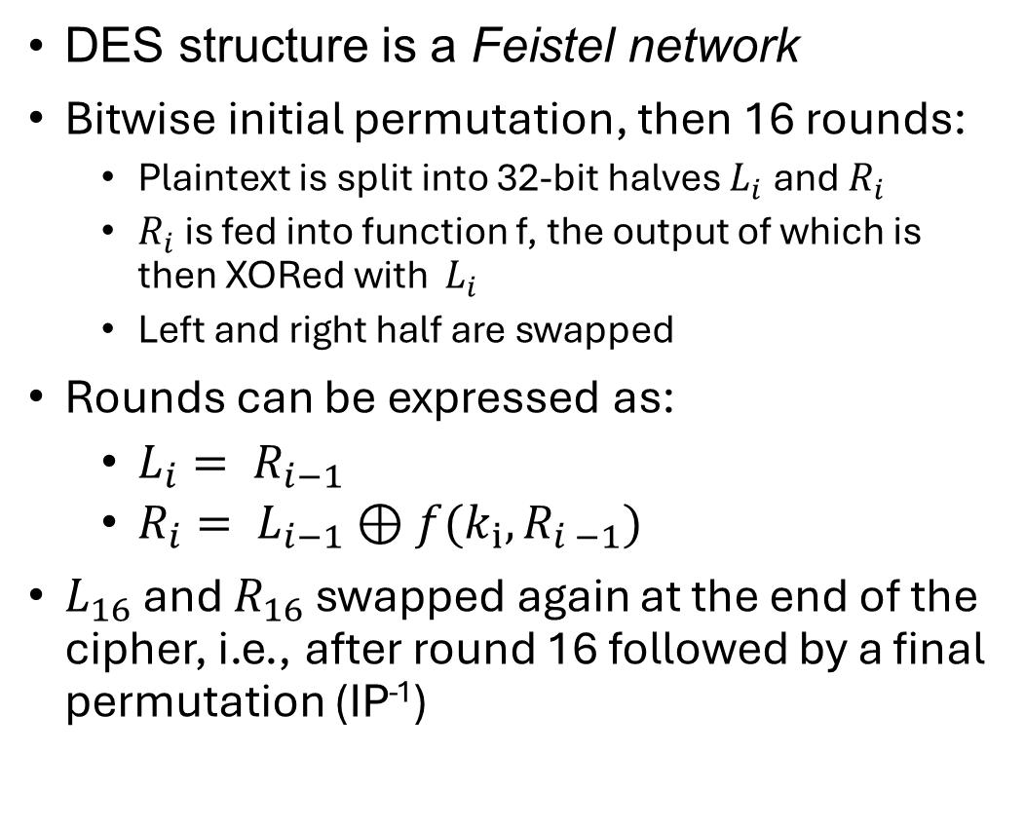
DES internals: Feistel network
DES structure is a Feistel network
Bitwise initial permutation, then 16 rounds:
  Plaintext is split into 32-bit halves $L_{i}$ and $R_{i}$
  $R_{i}$ is fed into function f, the output of which is then XORed with $L_{i}$
  Left and right half are swapped
Rounds can be expressed as:
  $L_{i}= R_{i−1}$
  $R_{i}= L_{i−1}⊕f(k_{i}, R_{i −1})$
$L_{16}$ and $R_{16}$ swapped again at the end of the cipher, i.e., after round 16 followed by a final permutation (IP⁻¹)
Round 1
……
Round 16
Notes:
not required

Slide 24
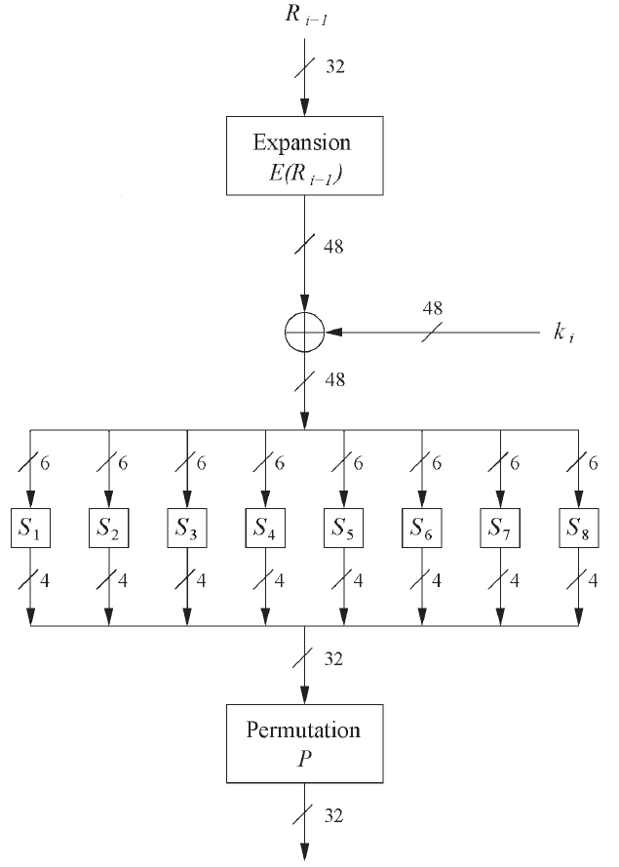

DES internals: the f-Function
Main operation of DES
f-Function inputs: round key $k_{i}$, and $R_{i−1}$
4 steps:
  Expansion E
  XOR with round key
  S-box substitution
  Permutation
Notes:
not required

Slide 25
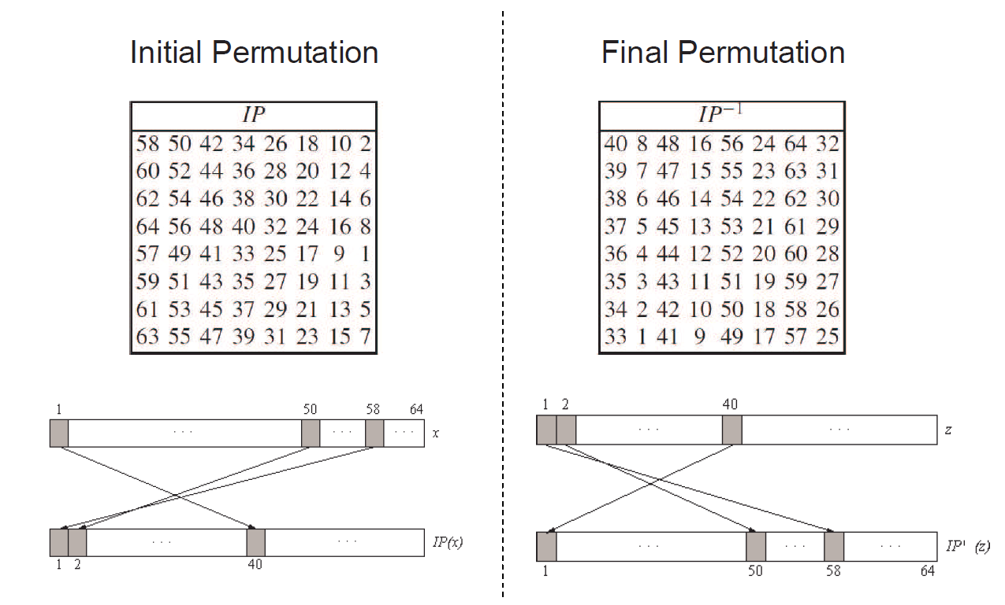
DES internals: IP and IP⁻¹
Bitwise permutations
Described by tables IP and IP⁻¹
Notes:
In DES, why do we need initial permutation?
From a purely mathematical security standpoint, the initial permutation (and its corresponding final permutation IP⁻¹) don't add any cryptographic strength to DES. They don't make the cipher more resistant to cryptanalysis because they don't add any confusion or diffusion - they just rearrange bits in a fixed, known pattern. An attacker who knows the algorithm (which we assume they do, per Kerckhoffs's principle) can simply reverse these permutations.
Main reason: In the 1970s when DES was designed, the permutations helped optimize hardware implementations. They were designed to facilitate the movement of data between 8-bit registers that were common in hardware of that era. The IP helped arrange bits so that the subsequent rounds could be implemented more efficiently in the hardware available at that time.

Slide 26
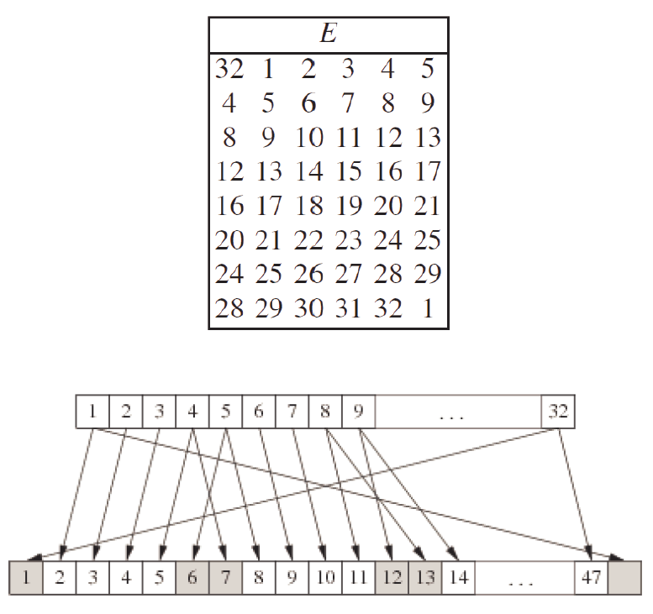
f-Function: 1. the expansion function E
Main purpose: increases diffusion
  Diffusion: the influence of one plaintext symbol is spread over many ciphertext symbols; hide statistical properties of the plaintext

Slide 27
f-Function: 2. add round key
Bitwise XOR of the round key and the output of the expansion function E
Round keys are derived from the main key in the DES keyschedule algorithm (in a few slides)

Slide 28
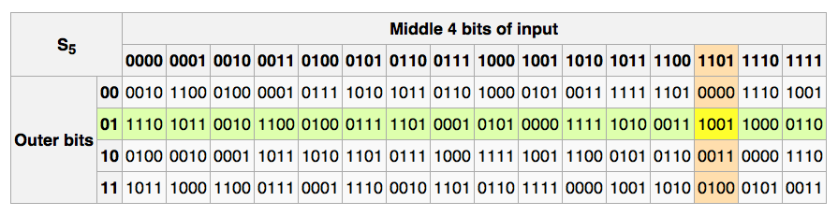
f-Function: 3. S-box
Eight substitution tables
S_{i}: {0,1}⁶ ⟶ {0,1}⁴
Non-linear and resistant to differential cryptanalysis
Crucial element for DES security ➔ heart of DES!
Provide confusion
  Relationship between key and ciphertext is obscured (or, hidden)
Notes:
The key design criteria for DES S-boxes include:
Avalanche Effect: Each S-box was designed so that changing one input bit would change at least two output bits. This property ensures that small changes in the input create significant changes in the output, which is crucial for diffusion. Think of it like dropping a pebble in a pond - you want the ripples to spread widely.
Non-linearity: The relationship between input and output bits is deliberately non-linear. This means you can't express the output as a simple linear function of the input bits (like just XORing them together). This non-linearity is crucial because if the relationship were linear, the entire cipher could be broken using linear algebra.
Resistance to Differential Cryptanalysis: Although not publicly known at the time, IBM designed the S-boxes to be resistant to differential cryptanalysis (a technique that wasn't publicly known until Biham and Shamir discovered it in 1990). This resistance comes from carefully choosing how differences in input pairs relate to differences in output pairs.
Input Size vs Output Size: Each S-box takes 6 bits of input and produces 4 bits of output. This 6-to-4 bit mapping is important because:
It creates compression, making it harder to reverse the operation
The 6-bit input allows the box to consider more context when making substitutions
The 4-bit output helps maintain the overall block size through multiple rounds
No Fixed Points: The S-boxes were designed to avoid fixed points where possible (cases where some input bits passing through unchanged), as these could weaken the cipher's security.

Slide 29
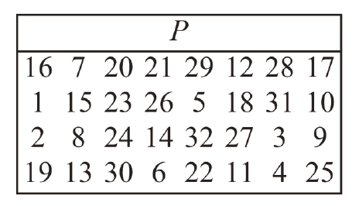
f-Function: 4. permutation P
Bitwise permutation
Introduce diffusion
  Diffusion: the influence of one plaintext symbol is spread over many ciphertext symbols; hide statistical properties of the plaintext
Output bits of one S-Box effect several S-Boxes in next round
E, S-Boxes, and P guarantee that after Round 5 every bit is a function of each key bit and each plaintext bit.

Slide 30
Advanced Encryption Standard (AES)
The need for a new block cipher announced by National Institute of Standards and Technology (NIST) in January 1997
15 candidate schemes accepted in August 1998 ➔ Rijndael was chosen as the AES in October 2000
AES was formally approved as a US federal standard in November 2001 (FIPS 197)
Key lengths: 128, 192, and 256 bits
Block length: 128 bits
2025: No attacks have been found on AES that are (significantly) faster than exhaustive key search
AES is an example of a substitution-permutation network
128 bits
128 bits
 | Key length (bits) | Number of rounds
AES-128 | 128 | 10
AES-192 | 192 | 12
AES-256 | 256 | 14
AES
PT Block
CT Block
Key
128/192/256 bits

Slide 31
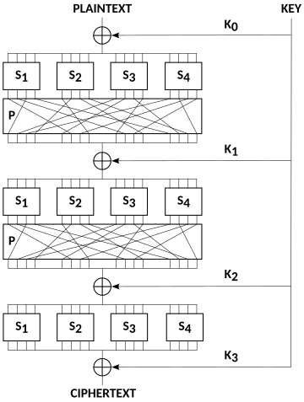
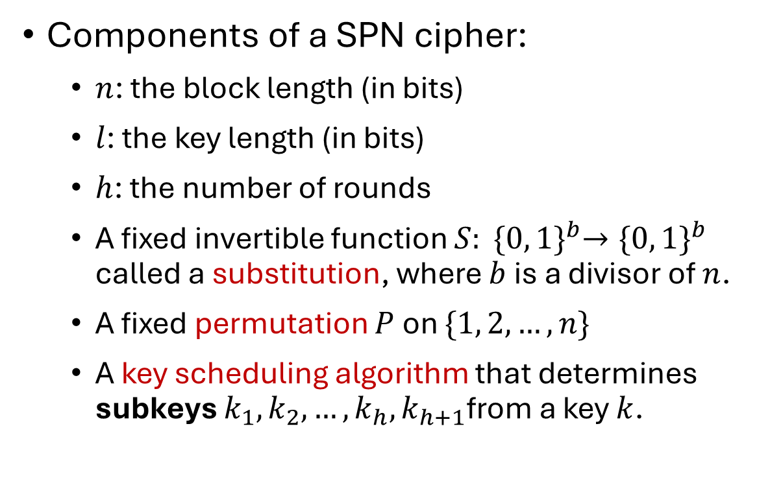
Substitution-permutation Networks (SPN)
A SPN is an iterated block cipher where a round consists of a substitution operation followed by a permutation operation
Components of a SPN cipher:
  $n$: the block length (in bits)
  $l$: the key length (in bits)
  $h$: the number of rounds
  A fixed invertible function $S: {\{0, 1\}}^{b}→{\{0, 1\}}^{b}$ called a substitution, where $b$is a divisor of $n$.
  A fixed permutation $P$on $\{1, 2, …, n\}$
  A key scheduling algorithm that determines subkeys $k_{1},k_{2}, …,k_{h},k_{h+1}$from a key $k$.

Slide 32
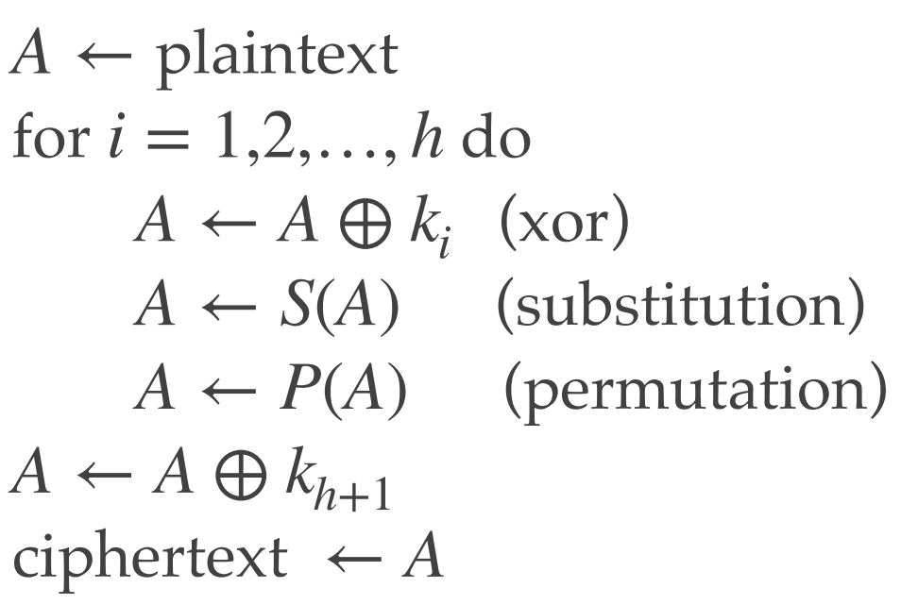
Substitution-permutation Networks (SPN)
Here is a description of encryption
Decryption is the reverse of encryption
AES is an SPN, where the permutation operation is comprised of two invertible linear transformations (ShiftRows & MixColumns )

Slide 33
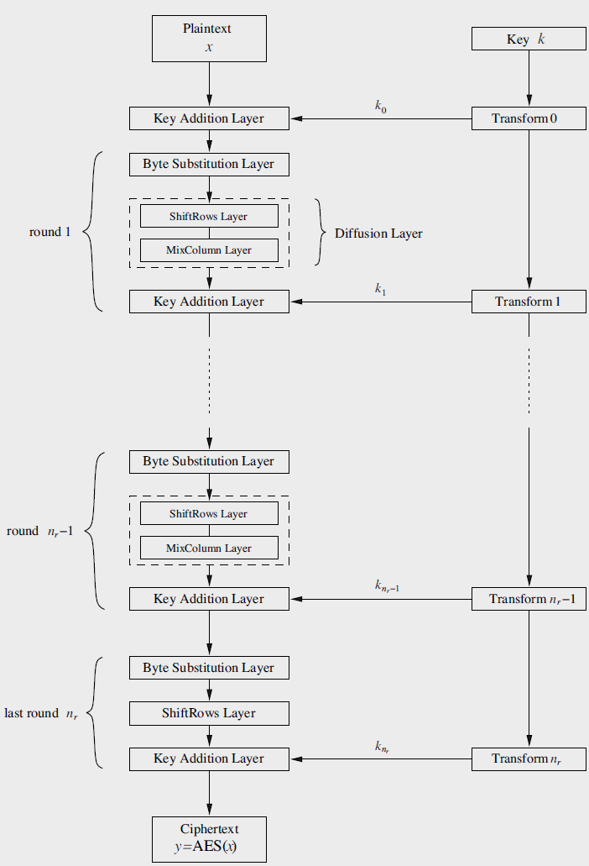
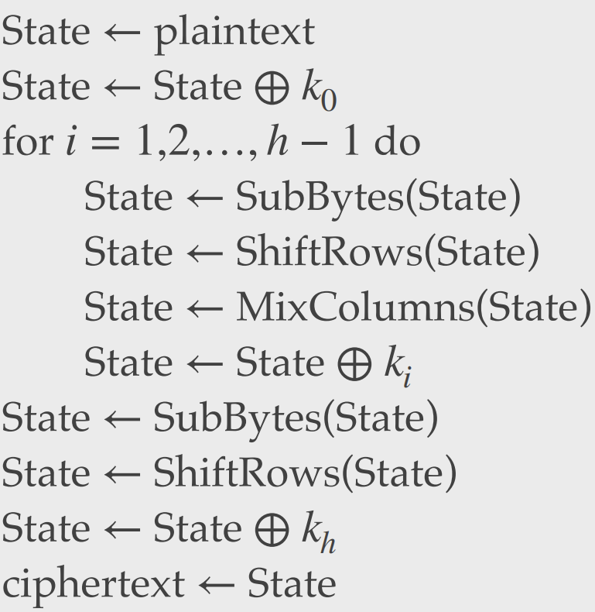
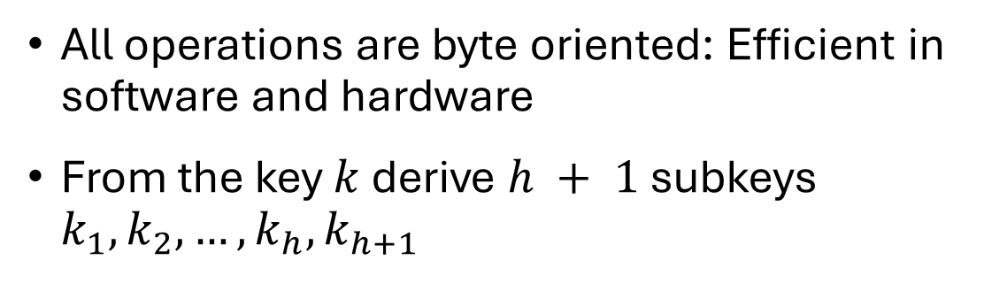
AES: structural information
All operations are byte oriented: Efficient in software and hardware
From the key $k$ derive $h + 1$subkeys $k_{1},k_{2}, …,k_{h},k_{h+1}$

Slide 34
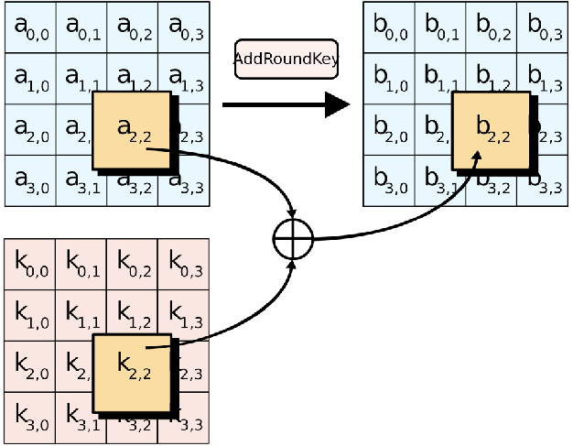
AES Algorithm: AddRoundKey()
XOR the 16-byte block with the 16-byte round key

Slide 35
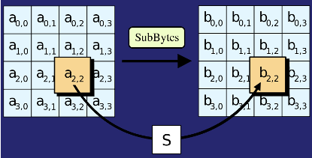
AES Algorithm: SubBytes()
Replace each byte in the block with another byte using an 8-bit substitution box

Slide 36
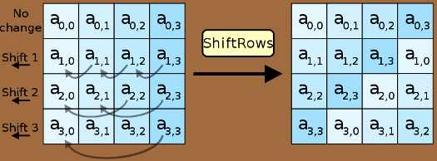
AES Algorithm: ShiftRows()
Cyclically shifts the bytes in each row by a certain offset
The number of places each byte is shifted differs for each row

Slide 37
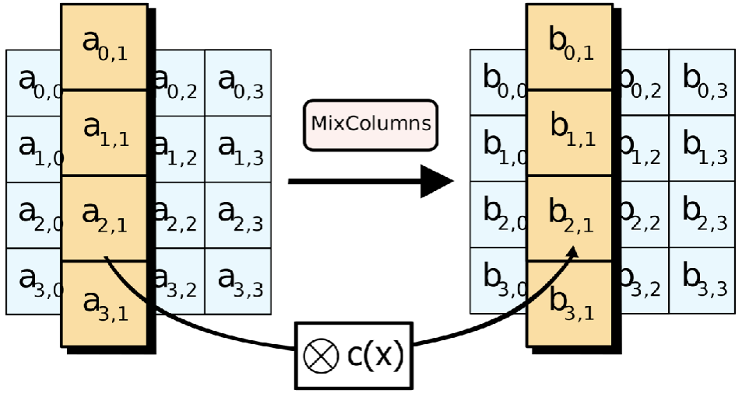
AES Algorithm: MixColumns()
Treats the 16-byte block as a 4 × 4 matrix and multiply it by another matrix

Slide 38


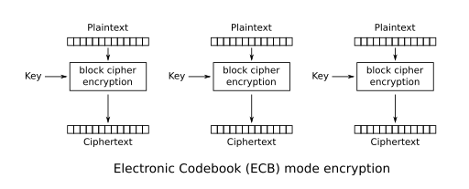
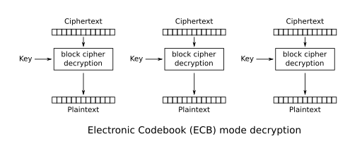
Encryption with Block Ciphers: Modes of Operation
Message is divided into blocks
Each block is encrypted separately
Lack of diffusion
plaintext
ciphertext
n bits
n bits
K
k bits
E
K
k bits
D
n bits
n bits
ciphertext
plaintext

Slide 39
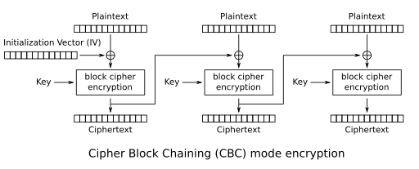
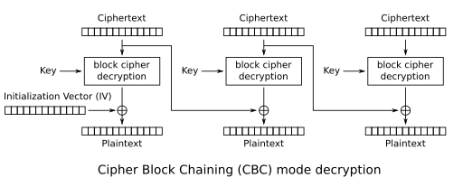
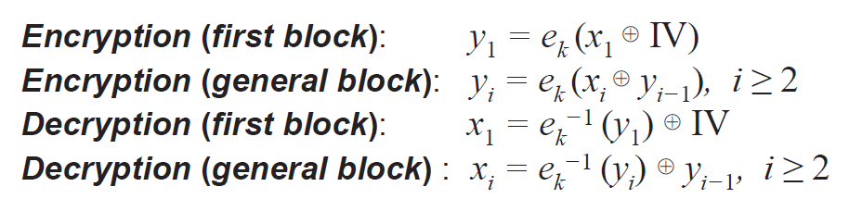
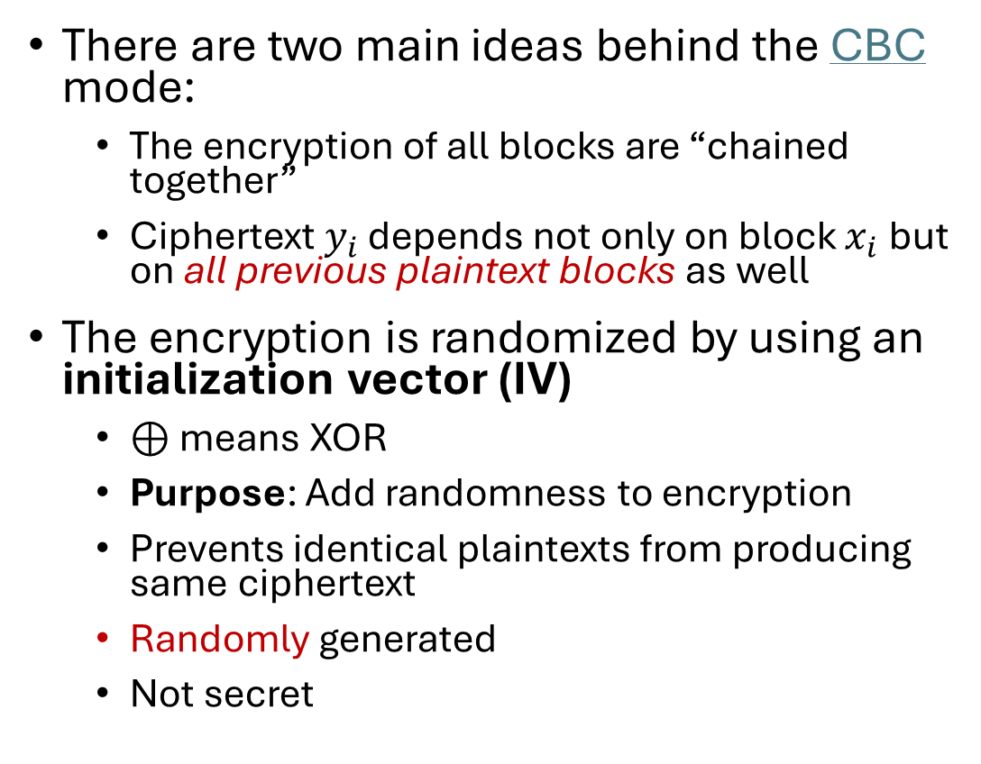
Cipher Block Chaining Mode (CBC)
There are two main ideas behind the CBC mode:
  The encryption of all blocks are “chained together”
  Ciphertext $y_{i}$ depends not only on block $x_{i}$ but on all previous plaintext blocks as well
The encryption is randomized by using an initialization vector (IV)
  ⊕ means XOR
  Purpose: Add randomness to encryption
  Prevents identical plaintexts from producing same ciphertext
  Randomly generated
  Not secret

